Slide 1
Prices of houses
Shuaib Akinyemi

Slide 2
Background
Nigerian property prices are notorious for fluctuating over time. This can be explained by several causes, including the naira's decline in value. However, this investigation aims to determine how property values alter depending on location, number of rooms, and other intrinsic elements. This study will also assist us in determining how a house’s inherent features, such as bedrooms and parking, affect its pricing.

Slide 3
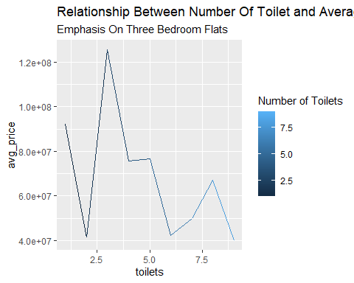
Preparation Of Data and Required Packages
The dataset to be used was extracted from data.world website. We will be loading the tidyverse package which is required for this analysis and also load the data using the read.csv function.
library(tidyverse)
## ── Attaching core tidyverse packages ──────────────────────── tidyverse 2.0.0 ── ## ✔ dplyr 1.1.4 ✔ readr 2.1.5 ## ✔ forcats 1.0.0 ✔ stringr 1.5.1 ## ✔ ggplot2 3.5.1 ✔ tibble 3.2.1 ## ✔ lubridate 1.9.3 ✔ tidyr 1.3.1 ## ✔ purrr 1.0.2 ## ── Conflicts ────────────────────────────────────────── tidyverse_conflicts() ── ## ✖ dplyr::filter() masks stats::filter() ## ✖ dplyr::lag() masks stats::lag() ## ℹ Use the conflicted package (<http://conflicted.r-lib.org/>) to force all conflicts to become errors
nigeria_houses <- read.csv("~/nigeria_houses_data.csv")
#view the data
glimpse(nigeria_houses)
## Rows: 24,326 ## Columns: 8 ## $ bedrooms <dbl> 6, 4, 4, 4, 4, 5, 4, 2, 1, 4, 3, 6, 4, 4, 6, 3, 4, 3, 4,… ## $ bathrooms <dbl> 5, 5, 5, 4, 4, 5, 5, 2, 1, 4, 4, 6, 5, 4, 6, 4, 4, 3, 5,… ## $ toilets <dbl> 5, 5, 5, 5, 5, 6, 5, 3, 1, 5, 5, 6, 6, 5, 7, 4, 5, 4, 5,… ## $ parking_space <dbl> 4, 4, 4, 6, 2, 1, 4, 6, 1, 5, 4, 4, 3, 4, 4, 3, 4, 4, 4,… ## $ title <chr> "Detached Duplex", "Terraced Duplexes", "Detached Duplex… ## $ town <chr> "Mabushi", "Katampe", "Lekki", "Ajah", "Lekki", "Lekki",… ## $ state <chr> "Abuja", "Abuja", "Lagos", "Lagos", "Lagos", "Lagos", "L… ## $ price <dbl> 4.5e+08, 8.0e+08, 1.2e+08, 4.0e+07, 7.5e+07, 4.5e+08, 6.…
head(nigeria_houses)
## bedrooms bathrooms toilets parking_space title town state ## 1 6 5 5 4 Detached Duplex Mabushi Abuja ## 2 4 5 5 4 Terraced Duplexes Katampe Abuja ## 3 4 5 5 4 Detached Duplex Lekki Lagos ## 4 4 4 5 6 Detached Duplex Ajah Lagos ## 5 4 4 5 2 Semi Detached Duplex Lekki Lagos ## 6 5 5 6 1 Detached Duplex Lekki Lagos ## price ## 1 4.5e+08 ## 2 8.0e+08 ## 3 1.2e+08 ## 4 4.0e+07 ## 5 7.5e+07 ## 6 4.5e+08
The data is clean and processed so that means it can be relied on for our analysis.
Analysis Average price for 3 bedroom flats across different states in Nigeria
nigeria_houses %>% drop_na() %>% filter(bedrooms == 3) %>% group_by(state) %>% summarize(avg_price = mean(price)) %>% arrange(-avg_price)
## # A tibble: 19 × 2 ## state avg_price ## <chr> <dbl> ## 1 Lagos 100907396. ## 2 Abia 92500000 ## 3 Abuja 79076492. ## 4 Delta 71681818. ## 5 Anambara 67510811. ## 6 Rivers 63508929. ## 7 Imo 50768293. ## 8 Enugu 42052632. ## 9 Kogi 40000000 ## 10 Edo 35285714. ## 11 Akwa Ibom 35214286. ## 12 Kano 30000000 ## 13 Oyo 28907080. ## 14 Kwara 27500000 ## 15 Ekiti 27333333. ## 16 Kaduna 27333333. ## 17 Nasarawa 21500000 ## 18 Osun 20000000 ## 19 Ogun 16669716.
Towns with the cheapest price for 3 bedroom flats in Lagos
nigeria_houses %>% drop_na() %>% filter(bedrooms == 3 & state == "Lagos") %>% group_by(town) %>% summarize(avg_price = mean(price)) %>% arrange(avg_price)
## # A tibble: 44 × 2 ## town avg_price ## <chr> <dbl> ## 1 Imota 6250000 ## 2 Ijede 12000000 ## 3 Ayobo 12900000 ## 4 Agbara-Igbesa 15000000 ## 5 Badagry 15000000 ## 6 Epe 15000000 ## 7 Ibeju 15000000 ## 8 Ipaja 18375000 ## 9 Agege 20157500 ## 10 Ikorodu 20234146. ## # ℹ 34 more rows
lowest to highest prices for 3 bedroom flats in Abuja
nigeria_houses %>% drop_na() %>% filter(bedrooms == 3 & state == "Abuja") %>% group_by(town) %>% summarize(avg_price = mean(price)) %>% arrange(avg_price)
## # A tibble: 46 × 2 ## town avg_price ## <chr> <dbl> ## 1 Gwagwalada 10500000 ## 2 Kuje 13650000 ## 3 Nyanya 14500000 ## 4 Dei-Dei 17000000 ## 5 Orozo 17000000 ## 6 Kyami 18100000 ## 7 Karshi 21250000 ## 8 Bwari 24000000 ## 9 Dakibiyu 27500000 ## 10 Kurudu 27625000 ## # ℹ 36 more rows
highest to lowest prices for 3 bedroom flats in Abuja
nigeria_houses %>% drop_na() %>% filter(bedrooms == 3 & state == "Abuja") %>% group_by(town) %>% summarize(avg_price = mean(price)) %>% arrange(-avg_price)
## # A tibble: 46 × 2 ## town avg_price ## <chr> <dbl> ## 1 Maitama District 619136475. ## 2 Katampe 441437500 ## 3 Kado 420000000 ## 4 Guzape District 418000000 ## 5 Durumi 395000000 ## 6 Garki 283571429. ## 7 Utako 191857143. ## 8 Asokoro District 179571429. ## 9 Jabi 151500000 ## 10 Wuse 131666667. ## # ℹ 36 more rows
Prices of 3 bedroom flats according to types or title
nigeria_houses %>% drop_na() %>% filter(bedrooms == 3) %>% group_by(title) %>% summarize(avg_price = mean(price)) %>% arrange(-avg_price)
## # A tibble: 7 × 2 ## title avg_price ## <chr> <dbl> ## 1 Semi Detached Duplex 334855769. ## 2 Block of Flats 135848434. ## 3 Detached Duplex 86381780. ## 4 Terraced Duplexes 60999557. ## 5 Detached Bungalow 41099525. ## 6 Terraced Bungalow 30242299. ## 7 Semi Detached Bungalow 24329454.
Visualization We will be using visualizations to show how the price of houses is affected by the different inherent characteristics such as bedroom and parking space.
Relationship Between Number Of Toilet and Average Price Of Houses.
nigeria_houses %>% drop_na() %>% filter(bedrooms == 3) %>% group_by(toilets) %>% summarize(avg_price = mean(price)) %>% ggplot(mapping = aes(x = toilets, y = avg_price, color = toilets)) + geom_line() + labs(title = 'Relationship Between Number Of Toilet and Average Price Of Houses', subtitle = 'Emphasis On Three Bedroom Flats') + scale_color_continuous(name = "Number of Toilets")

Slide 4
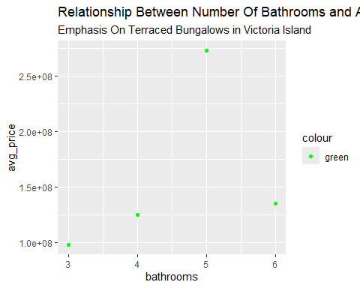
There isn’t much correlation going on there.
Relationship Between Number Of Bathrooms and Average Price Of Houses
nigeria_houses %>% drop_na() %>% filter(state == 'Lagos' & town == 'Victoria Island (VI)' & title == 'Terraced Bungalow') %>% group_by(bathrooms) %>% summarize(avg_price = mean(price)) %>% ggplot(mapping = aes(x = bathrooms, y = avg_price, color = "green")) + geom_point() + labs(title = 'Relationship Between Number Of Bathrooms and Average Price Of Houses', subtitle = 'Emphasis On Terraced Bungalows in Victoria Island') + scale_color_manual(values = "green")

Slide 5
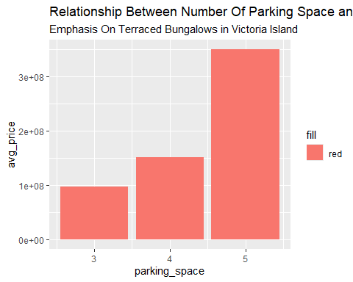
The number of bathrooms also seems not to be a determining factor for the prices of houses.
Relationship Between Number Of Parking Space and Average Price Of Houses
nigeria_houses %>% drop_na() %>% filter(state == 'Lagos' & town == 'Victoria Island (VI)' & title == 'Terraced Bungalow') %>% group_by(parking_space) %>% summarize(avg_price = mean(price)) %>% ggplot(mapping = aes(x = parking_space, y = avg_price, fill = "red")) + geom_bar(stat = "identity") + labs(title = 'Relationship Between Number Of Parking Space and Average Price Of Houses', subtitle = 'Emphasis On Terraced Bungalows in Victoria Island')

Slide 6
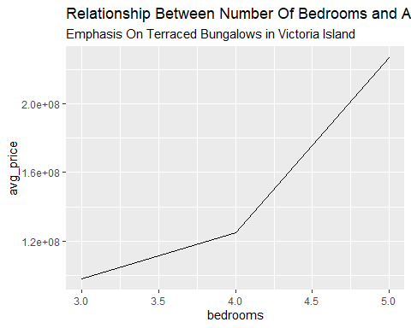
This shows some direct correlation.
Relationship Between Number Of Bedrooms and Average Price Of Houses
nigeria_houses %>% drop_na() %>% filter(state == 'Lagos' & town == 'Victoria Island (VI)' & title == 'Terraced Bungalow') %>% group_by(bedrooms) %>% summarize(avg_price = mean(price)) %>% ggplot(mapping = aes(x = bedrooms, y = avg_price)) + geom_line() + labs(title = 'Relationship Between Number Of Bedrooms and Average Price Of Houses', subtitle = 'Emphasis On Terraced Bungalows in Victoria Island')

Slide 7
Conclusion:
The house prices are not determined by the number of bathrooms or toilets but by the number of bedrooms and parking spaces available. The five most expensive states to buy a house in Nigeria are Lagos, Abia, Abuja, Delta, and Anambra. The most expensive place to buy a house in Lagos is Ikoyi while the cheapest place is Imota. Gwagwalada is the cheapest place to buy a house in Abuja and the most expensive houses are in Maitama. The most expensive houses in Nigeria are semi-detached duplexes while the cheapest are semi-detached bungalows.

