Slide 1
Precious Metals Analysis
Powered by PowerShell

Slide 2
Precious Metals Avg Price Aggregation
metal | min | median | mean | max | std
gold | 35.9502 | 380.8202 | 553.6384 | 1668.9804 | 463.126
palladium | 88.1349 | 352.25 | 502.2671 | 2212.125 | 459.2598
platinum | 359.9643 | 862.2048 | 861.0024 | 1721.8675 | 445.6508
silver | 1.5363 | 5.5398 | 9.4462 | 35.1192 | 7.4787

Slide 3
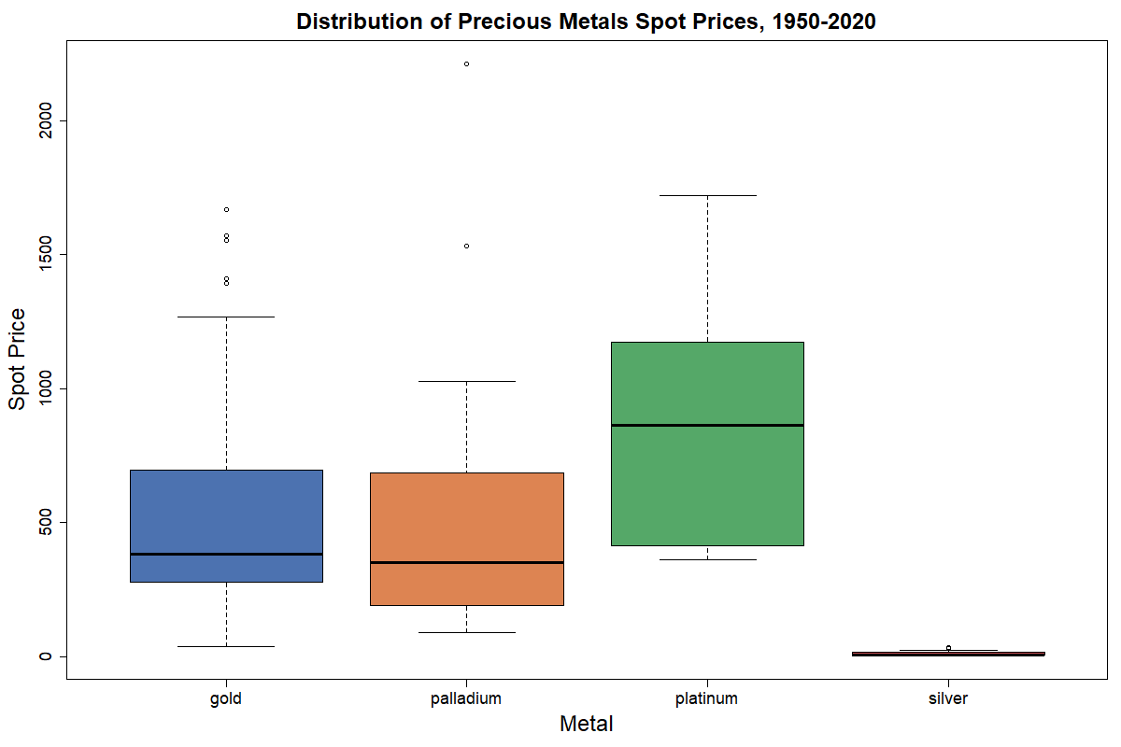
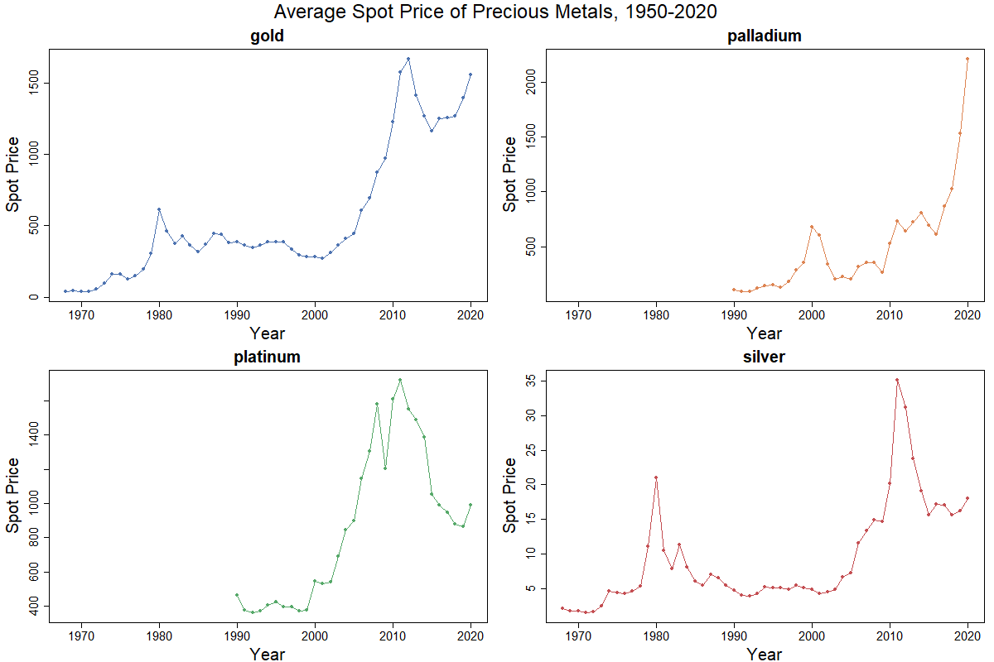
Precious Metals Avg Price Plotting

