Slide 1


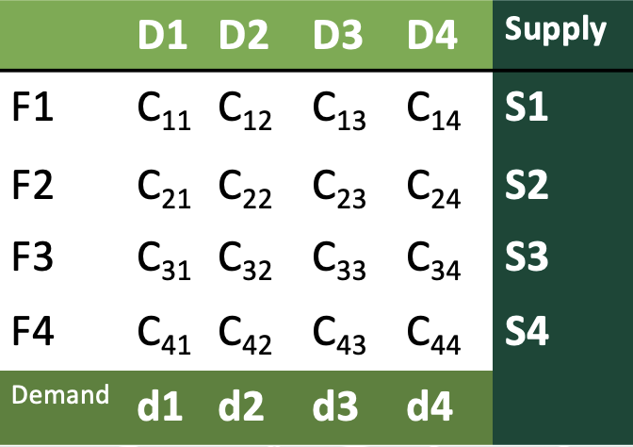
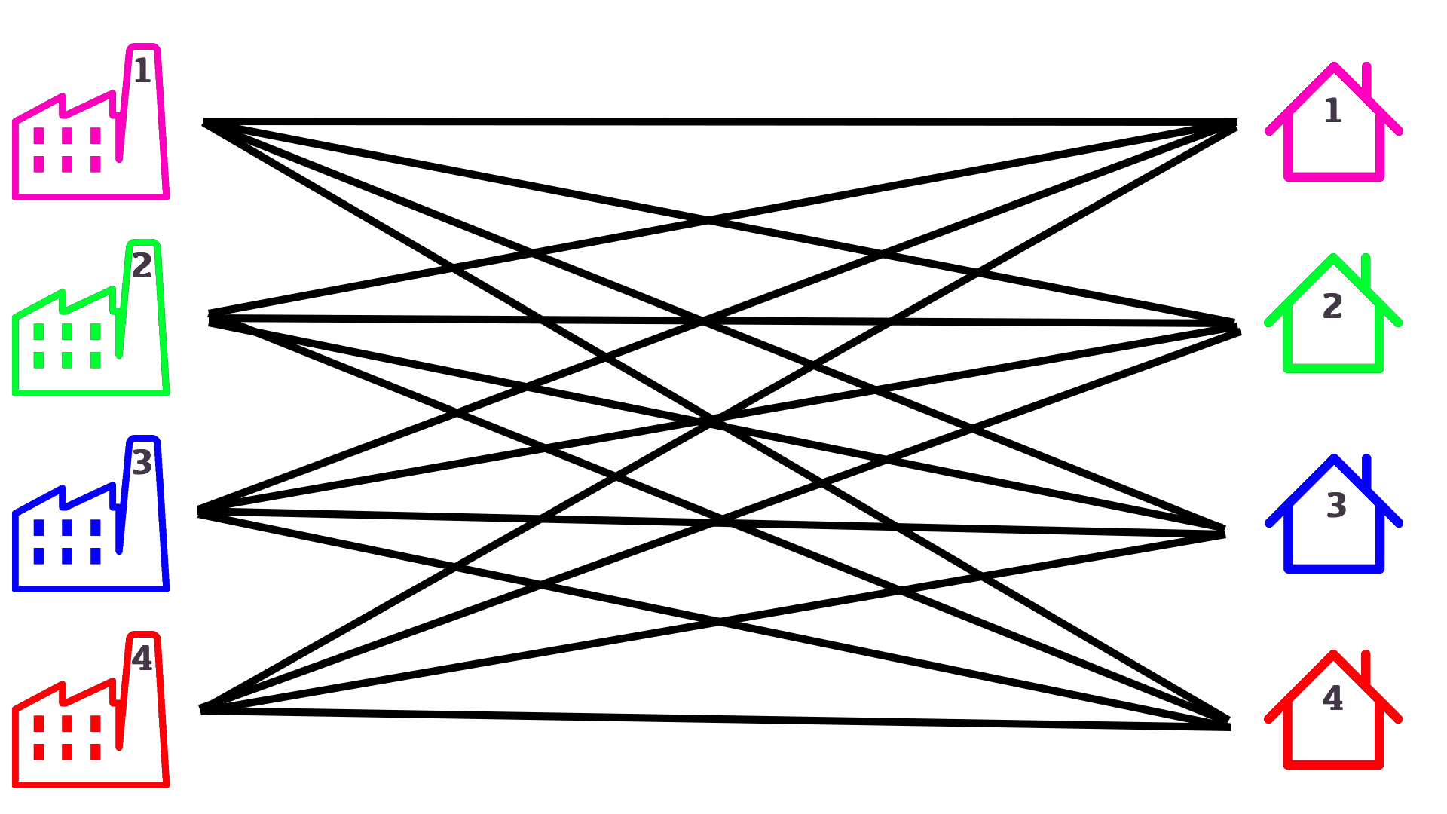

K. J. Somaiya College of Engineering, Mumbai – 400 077
(A Constituent College of Somaiya Vidyavihar University) Dept. of Science and Humanities
F.Y. B. Tech. Semester –I (2021-22)
Applied Mathematics-I
IA-2
Applications of Matrices in Transportation Problem
Name : Pargat Singh
Roll No : 16010121045
Div. : A Batch: A2
Definition
Types of Transportation Problems
Transportation problems are a subset of Linear Programming Problems (LPPs) in which goods are transported from a set of sources to a set of destinations while considering the supply and demand of the sources and destinations, respectively, in order to minimize the total cost of transportation. It is also known as the Hitchcock problem.
Balanced
Unbalanced
When both supplies and demands are equal
When both supplies and demands are unequal
Structure of a Transportation problem
We make use of a Matrixes to represent transportation problems.
In Matrix form
Let's take an Example:
There are 4 Factories (F) from where we must transport supply (S), according to demand (d) to 4 Destinations (D). So, we write the following in a matrix form as shown where C_{ij} is the cost when the product is delivered from Factory Fi to destination Dj.
Matrixes made my work so simple!
Now I can calculate the Total Transportation Cost using
Matrix Minima Method

Slide 2
Matrix Minimum Method
Definition
The Matrix Minimum method, also know as Least Count method, is a method for computing a basic feasible solution to a transportation problem in which the basic variables are selected based on the unit cost of transportation. This method is extremely useful because it reduces the computation and time required to find the best solution.
Factory | Destination |  |  |  | Supply
 | 1 | 2 | 3 | 4
1 | 3 | 5 | 7 | 6 | 50
2 | 2 | 5 | 8 | 2 | 75
3 | 3 | 6 | 9 | 2 | 25
Demand | 20 | 20 | 50 | 60
Let's Take an
Example.
1) We First Look for the minimum transportation cost in the matrix.
3) We now observe that c₂₄=2, is the minimum transportation cost, so x₂₄ = 55. The supply for the respective row is now exhausted.
Factory | Destination |  |  |  | Supply
 | 1 | 2 | 3 | 4
1 | 3 | 5 | 7 | 6 | 50
2 | 2⁽²⁰⁾ | 5 | 8 | 2 | 75 55
3 | 3 | 6 | 9 | 2 | 25
Demand | 20 | 20 | 50 | 60
2) We then fulfill the demand of the respective minimum cost by subtracting the demand from the supply.
Factory | Destination |  |  |  | Supply
 | 1 | 2 | 3 | 4
1 | 3 | 5 | 7 | 6 | 50
2 | 2⁽²⁰⁾ | 5 | 8 | 2⁽⁵⁵⁾ | 75
3 | 3 | 6 | 9 | 2 | 25
Demand | 20 | 20 | 50 | 60 5
4) We continue the above procedure until the demand is fully exhausted and utilized by the given supply.
Damn! Matrixes are so useful, they helped me to minimize the transportation cost for shipping these goods.
Thanks a lot Pargat!
References
Factory | Destination |  |  |  | Supply
 | 1 | 2 | 3 | 4
1 | 3 | 5⁽²⁰⁾ | 7⁽³⁰⁾ | 6 | 50
2 | 2⁽²⁰⁾ | 5 | 8 | 2⁽⁵⁵⁾ | 75
3 | 3 | 6 | 9⁽²⁰⁾ | 2⁽⁵⁾ | 25
Demand | 20 | 20 | 50 | 60
http://arts.brainkart.com/article/initial-basic-feasible-solution---matrix-minima---least-cost-method---transportation-problem-1129/
https://www.acsce.edu.in/acsce/wp-content/uploads/2020/03/1585041316993_Module-4.pdf
https://images.app.goo.gl/PjUq5MgZ6jYd4KWK7
I wonder where else can I utilized the concept of matrixes……
Note:
The formula for the number of variable is:
Factories + Destinations - 1
In this case:
3 + 4 -1 = 6
The Total Transportation Cost is:
= (2x20) + (5x20) + (7x30) + (9x20) + (2x55) + (2x5)
= ₹ 650

