Slide 1

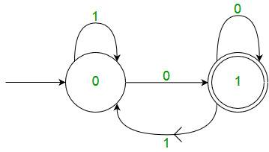


DFA

Slide 2

Example of DFA
Q. Construct DFA with all strings over {a,b} ending with ab
3

Slide 3
Example of DFA
Q. Construct DFA for all Binary numbers divisible by 3
3

Slide 4
Example of DFA
Q. Construct DFA for all possible conditions of 0’s and 1’s which does not have
substring 011
3

Slide 5
Example of DFA
Q. Construct DFA that accepts a string which always ends with 00 over the alphabet {0,1}
3

Slide 6
Example of DFA
Q. Draw a DFA for the language accepting strings containing three consecutive ‘0’ over an input alphabet Σ={0,1}
3

