Slide 1

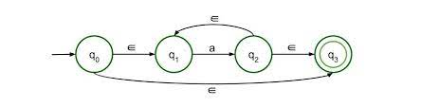


NFA

Slide 2

Non-deterministic Finite Automata
The finite Automata are called non deterministic finite automata if there exist many paths for specific input from current state to next state
It is easy to construct a NFA for a given language
Every NFA is not DFA, but every NFA can be translate into DFA
NFA is defined in the same way as DFA, but with two exceptions:
Multiple next states
It contains ε transitions
3

Slide 3
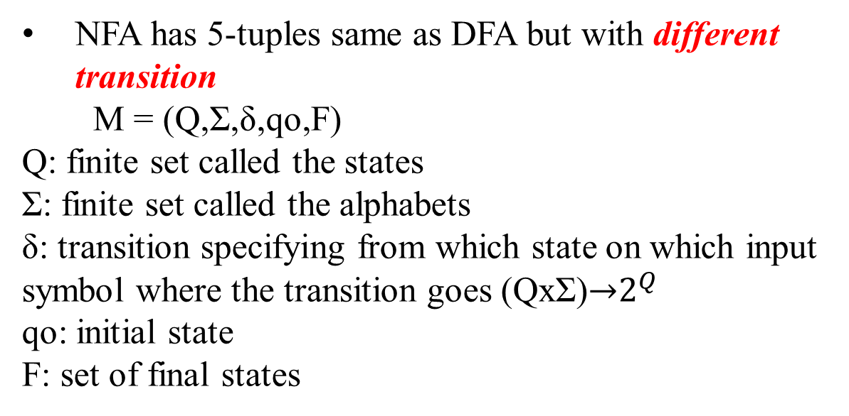
Definition of NFA
NFA has 5-tuples same as DFA but with different transition
M = (Q,Σ,δ,qo,F)
Q: finite set called the states
Σ: finite set called the alphabets
δ: transition specifying from which state on which input symbol where the transition goes (QxΣ)→$2^{Q}$
qo: initial state
F: set of final states
3

Slide 4
Graphical representation of NFA
The state is represented by vertices
The arc labelled with an i/p character show the transition
The initial state is marked with an arrow
The final state is denoted by double circle
3

Slide 5
Example of NFA
Q. Let NFA be Q={qo,q1,q2} q= {qo} Σ={0,1} F={q2}
construct a transition table
3

Slide 6
Example of NFA
Q. Design NFA for the given transition table
State | 0 | 1
qo | q0,q1 | q0, q2
q1 | q3 | ε
q2 | q2 ,q3 | q3
q3 * | q3 | q3
3

Slide 7
Example of NFA
Q. Design NFA with Σ={0,1} accepts the strings in which second last bit is 1
3

Slide 8
Example of NFA
Q. Design DFA with Σ={0,1} accepts the strings in which second last bit is 1
3

Slide 9
Example of NFA
3

