Slide 1




Introduction

Slide 2

About the course
Computation: Solving Problems through mechanical pre-programmed execution of a small series, unambiguous steps
Can be performed using computer
Theory of Computation: comprises the fundamental mathematical properties of computer hardware and software
3

Slide 3
Theoretical computer science
Data Structures and Algorithms
Theory of computation
Semantics of programs
3

Slide 4
Theory of Computation
What can be computed?
What are the limitations of computation?
What are the complexity of computable ones?
To address these aspects, we need certain model of computation:
Finite Automata
Pushdown Automata
Turing Machine
3

Slide 5
Formal Language
The problem that we intend to compute will be described as “Formal Language”
We look forward for an abstract computer which can recognize/accept the language (compute/solve) the problem
Classification:
Easiest to hardest problems and their languages
Unsolvable/Uncomputable problems and their respective languages
3

Slide 6
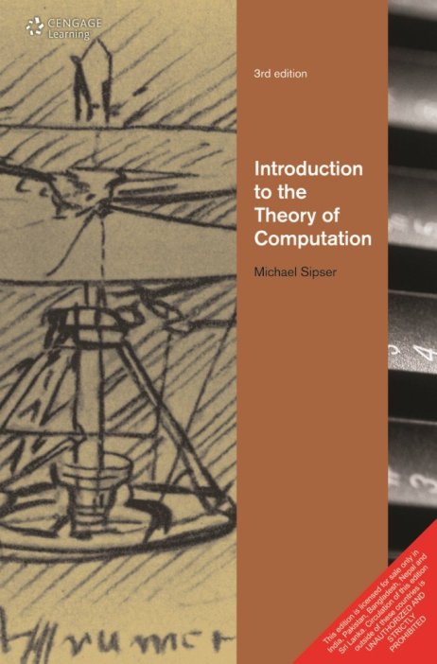
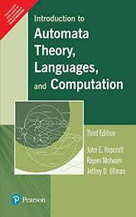
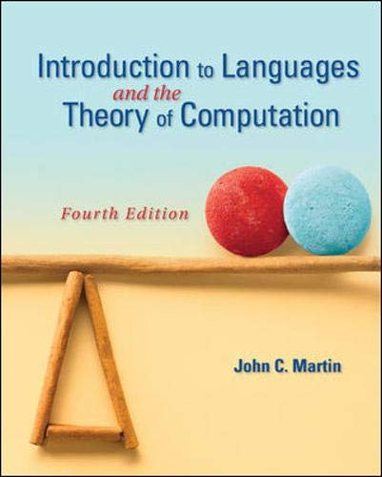
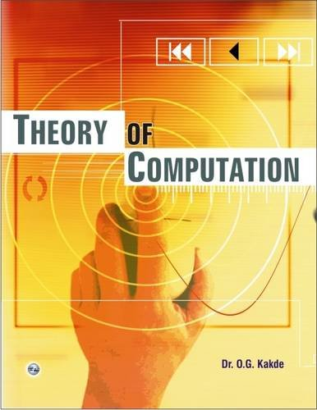
Syllabus and Books
3

Slide 7
Prerequisite
Basic Set Theory
Functions/relators
Mathematical Induction
Graphs/Trees
3

Slide 8
Test Syllabus
Test/ISE
Finite Automata (Module 1)
Regular Languages(Module 2)
Context Free Grammars(Module 3)
ESE
Entire Syllabus
3

Slide 9
Internal Assessment
Internal Assessment (IA) – 20 Marks
Distribution of 20 Marks | The student will be evaluated based on two tasks of 20 marks each. If any of the tasks given is not completed / submitted / shown / evaluated then the marks assigned for that task will be zero.
Sr. No. | Task | Description of task | Schedule
1 | Quiz | Module 1,2,3 | After Test
2 | Study of Recent ( 2019 onwards) Research Paper on TACD | Students will be required to prepare Screencast (Video) of Presentation, Peer grading will be done. | Mid April

