Slide 1
Blockchain is defined as a distributed, replicated peer-to-peer network of databases that allows multiple non-trusting parties to transact without a trusted intermediary and maintains an ever-growing, append-only, tamper-resistant list of time-sequenced records.
Blockchain can be considered as a type of a distributed ledger that sits on the internet for recording transactions and maintaining a permanent and verifiable record-set of information.

Slide 2
Though the terms ‘Bitcoin’ and ‘Blockchain’ are often used to interchangeably, they are not the same. Blockchain is the underpinning technology that the Bitcoin was built on.
“A purely peer-to-peer version of electronic cash would allow online payments to be sent directly from one party to another without going through a financial institution. Digital signatures provide part of the solution, but the main benefits are lost if a trusted third party is still required to prevent double spending. We propose a solution to the double-spending problem using a peer-to-peer network.”
Part of the abstract from the paper “A Peer-to-Peer Electronic Cash System."

Slide 3
Key Concepts of Blockchain
1. Peer-to-peer network
2. Public Key Cryptography
3. Distributed Consensus

Slide 4
Components of Blockchain
1. Node
2. Ledger
3. Wallet
4. Nonce
5. Hash
6. Mining
7. Consensus protocol

Slide 5
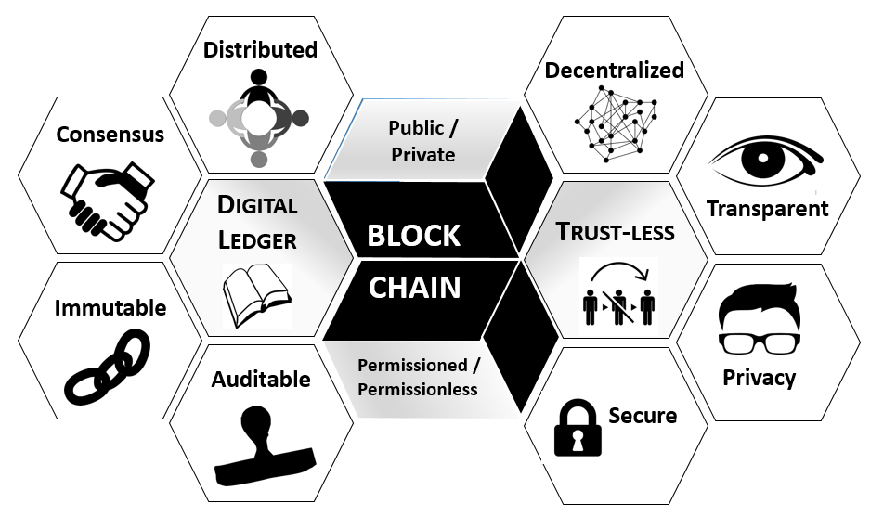
Characteristics of Blockchain

Slide 6
What is a Block?
The block is a record that contains the transaction data details. It comprises of following details:
Hash of the block – Alphanumeric number to identify the block
Hash of the previous block.
Timestamp
Nonce – the random number used to vary the value of the hash
Merkle Root – hash of all the hashes of all the transactions in the block
Transaction data. (Note: This contains details of several transactions)

Slide 7
Double-spending
Double-spending is spending the money more than once.
The double-spend problem is circumvented in blockchain through its consensus mechanism and the basic chronological structure of how the blocks are chained together.
A transaction is verified and added to a block via the consensus mechanism after a considerable amount of computational power and resources are spent.
Once a transaction is confirmed, it is nearly impossible to double-spend it
The more confirmed blocks in the chain, the harder it is to double-spend the crypto.

Slide 8
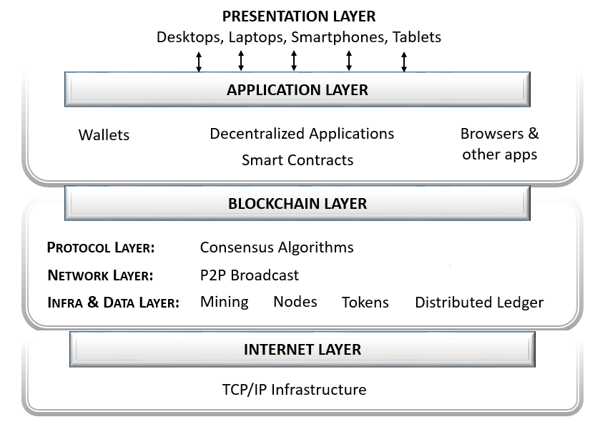
Blockchain Layers

Slide 9
Decentralized and Distributed
Blockchain technology works on the principle of ledger data distributed to all nodes that are non-hierarchical with no single central control.
Pros
Removes any single point of failure by replicating the ledger on every node in the network
Better communication between nodes fosters transparency and faster consensus and synching of data
It allows for more engagement as everyone is involved in the decision-making process and keeping the network honest.
Cons
In some cases, the traditional database may be more suited and do the work a lot faster and cheaper
Specific and trusted third parties exist in some domains that may guarantee more efficient and specialized services using other technologies
If a time-tested and fully functional database and the operational network is already in place, the benefits of replacing or introducing blockchain may not produce the required return-on-investment.
Stronger players (nodes with higher computing power or with pooling) can take control of the network, impacting decentralization.

Slide 10
Trustlessness
In the blockchain, cryptography completely replaces the need for third parties to ensure trust. Also, the complex consensus protocols that are run within the blockchain network to unanimously and securely agree on what should be added and should not be added to the ledger secures it further, thus ensuring its integrity at all times.
Pros
Allows for multiple entities or key players who do not trust each other (i.e., unknown to each other or across borders) to transact directly with one another
Ensures valid and accurate data
Disintermediation (removal of the middleman) reduces the overall cost of transacting.
Cons
The integrity of data is obtained at the expense of time. Every node needs to run the blockchain to verify transactions and maintain consensus. Currently, blockchain can, on an average, process only 5 transactions/sec.
Significant computing power is expended by miners leading to substantial energy consumption and wastage. Hence it is not suitable for organizations that require instant transaction results within milliseconds.
Nodes may prioritize transactions with higher rewards.

Slide 11
Immutability
In blockchain technology, one cannot modify data or transactions once they are recorded in the blockchain database. It becomes a permanent record that is close-to-impossible to undo. Any change required can be addressed only by adding a new block of data to the existing chain of blocks in chronological order ensuring that the database is complete and consistent.
Pros
Contains a verifiable record of all transactions made that is auditable
Consensus algorithms and block propagation mitigate the risk of double-spending, fraud, and manipulation of data.
There is provenance, i.e., ability to track transaction or product movement across accounts.
Cons
Not every node has the capacity to maintain and run a full copy of the blockchain. This can potentially affect consensus and immutability.
In smaller blockchains, there is a risk of a 51% attack. If one or a group of malicious nodes can get 51% of the mining hash rate, they can manipulate the transactions.
Quantum computing can potentially break the cryptographic algorithm to reverse engineer public keys of blockchain networks to obtain the private keys.

