Slide 1


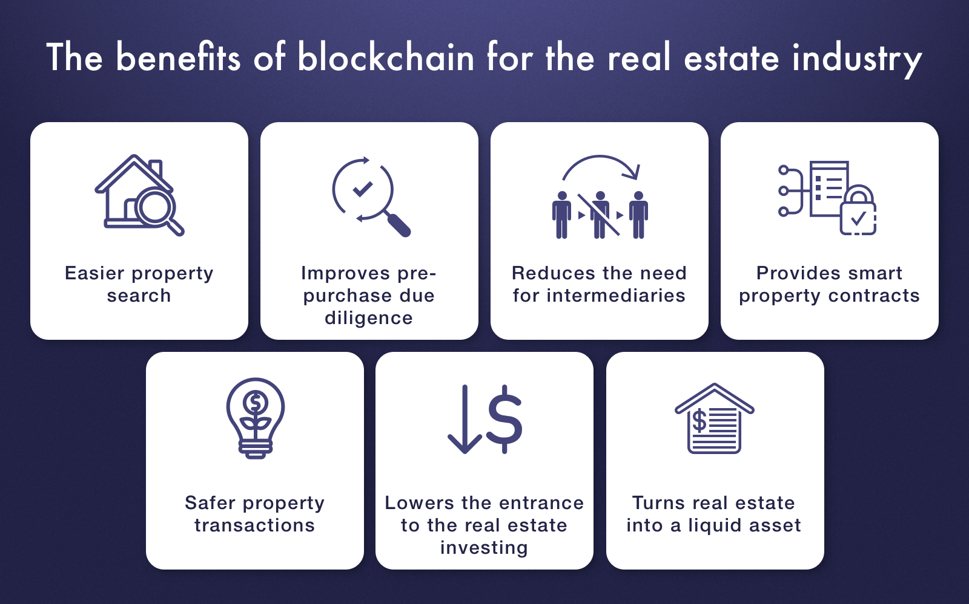
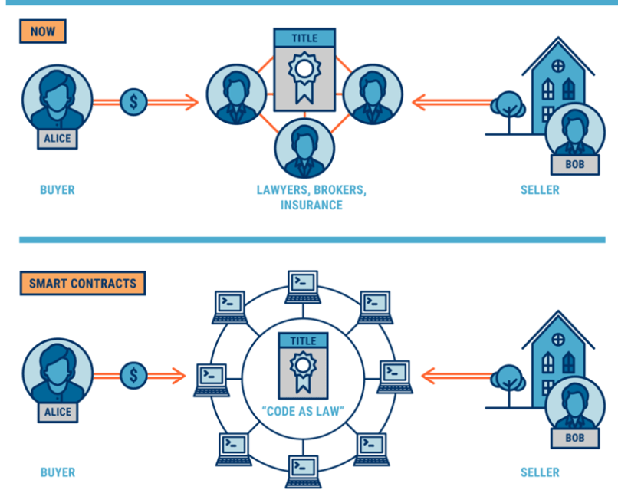
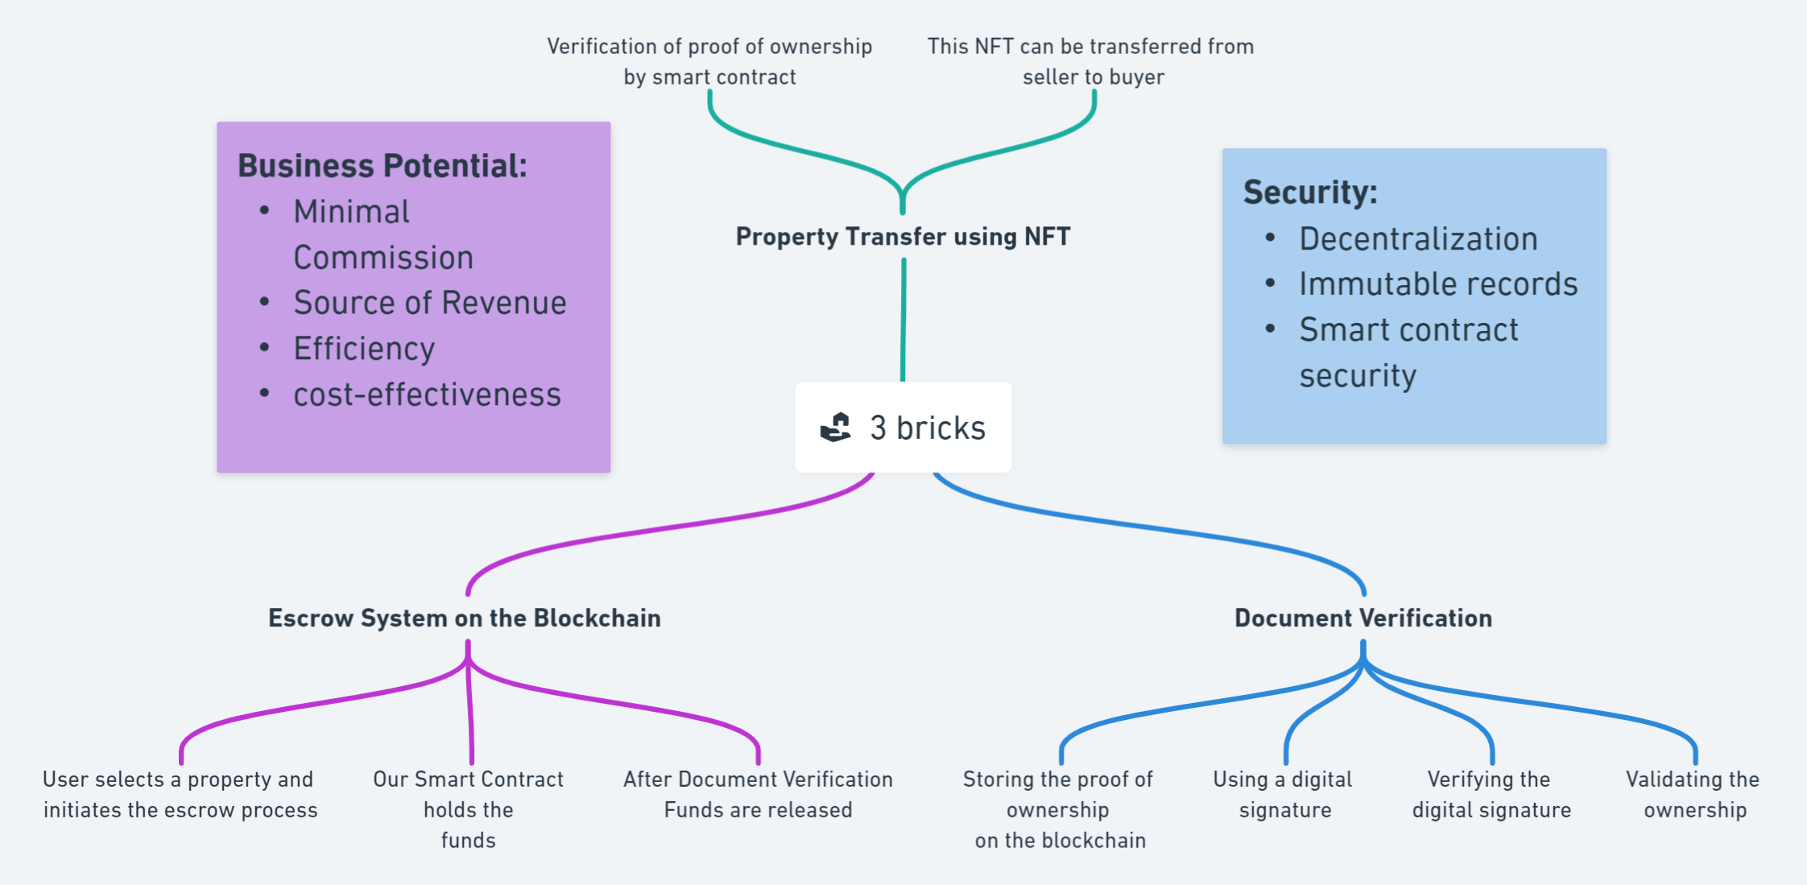
K. J. Somaiya College of Engineering
Department of Computer Engineering
Title: Blockchain in Real estate
Student Name: Pargat Singh Dhanjal
Under the guidance of : Prof. Swapnil Pawar
Course Name: Block Chain Technology
Introduction
Blockchain technology has emerged as a disruptive force with the potential to revolutionize various industries. In this presentation, we will explore how blockchain can transform the real estate sector. Real estate, as one of the oldest and most vital industries, faces numerous challenges, including fraud, lack of transparency, and inefficiencies. Blockchain technology offers innovative solutions to address these issues and revolutionize the way we conduct property transactions.
2. Problem Statement
The real estate industry is riddled with problems such as fraud, lack of transparency, and cumbersome, paper-intensive processes. Property transactions are often slow and prone to errors, leading to disputes and financial losses. The lack of a centralized, trustworthy ledger exacerbates these issues, making the industry ripe for a technological overhaul.
Motivation
The motivation behind applying blockchain technology to the real estate sector is multifaceted. Blockchain promises to bring transparency, security, and efficiency to property transactions.
It can help eliminate fraudulent activities, reduce the need for intermediaries, and create a tamper-proof record of ownership. By doing so, blockchain can significantly enhance the real estate ecosystem.
5. Proposed Approach/Solution :
Property Transfer using NFTs (Non-Fungible Tokens): NFTs are unique digital assets that can represent ownership of physical or digital assets, such as real estate properties. By tokenizing real estate properties as NFTs, we can facilitate the transfer of ownership in a secure and digitally native manner. Each property can have its unique NFT, containing essential information such as property details, legal documents, and ownership history. When a property is sold, the NFT representing that property can be transferred to the new owner, instantly updating the ownership record on the blockchain.
Verification of Purchase by Smart Contracts: In the context of real estate, smart contracts can automate the entire purchase process. When a buyer and seller agree on the terms, a smart contract is created. The contract can hold the buyer's funds in escrow and ensure that all conditions (e.g., property inspection, title verification) are met before the funds are released to the seller and ownership is transferred. This eliminates the need for costly intermediaries and minimizes the risk of fraud or disputes.
Immutable Property Records: Blockchain's decentralized ledger ensures that property records are tamper-proof and permanent. Any changes or transactions related to a property are recorded on the blockchain, creating a transparent and immutable history of ownership and transactions. This significantly reduces the risk of fraudulent activities, title disputes, and errors in property records.
Enhanced Security: Blockchain employs advanced cryptographic techniques to secure data and transactions. Ownership rights are protected through private keys, ensuring that only authorized individuals can access and transfer property. This enhances the security and trustworthiness of real estate transactions.
Reduced Administrative Overhead: By automating many aspects of property transactions through blockchain, administrative overhead and associated costs can be significantly reduced. This includes the elimination of paperwork, manual record-keeping, and the need for intermediaries.
Global Accessibility: Blockchain-based real estate systems can be accessed from anywhere in the world, facilitating international property transactions. This opens up new opportunities for cross-border investment and diversification.
Fractional Ownership and Increased Liquidity: Tokenization of properties allows for fractional ownership, making it easier for individuals to invest in high-value real estate assets. These tokens can also be traded on secondary markets, increasing liquidity in the real estate market.
3. Diagram
Proposed solution
6. Conclusion:
In conclusion, blockchain technology has the potential to transform the real estate industry by addressing its long-standing challenges. By implementing blockchain, we can create a more transparent, secure, and efficient property transaction ecosystem. Collaboration between the real estate and blockchain sectors is crucial to realizing the full potential of this transformative technology.
References/Literature cited
https://www.cbinsights.com/research/blockchain-real-estate-disruption/
https://softengi.com/blog/blockchain-in-real-estate/
https://github.com/team-somehow/3-bricks
https://www.techgropse.com/blog/blockchain-in-real-estate-industry/
https://consensys.net/blockchain-use-cases/real-estate/
https://www.investopedia.com/news/how-blockchain-technology-changing-real-estate/
Notes:
Copyright Colin Purrington (http://colinpurrington.com/tips/academic/posterdesign).

