Slide 1
Chapter 2: Process Concept and scheduling

Slide 2
Chapter 3: Processes
Process Concept
Process Scheduling
Operations on Processes
Interprocess Communication
Examples of IPC Systems
Communication in Client-Server Systems

Slide 3
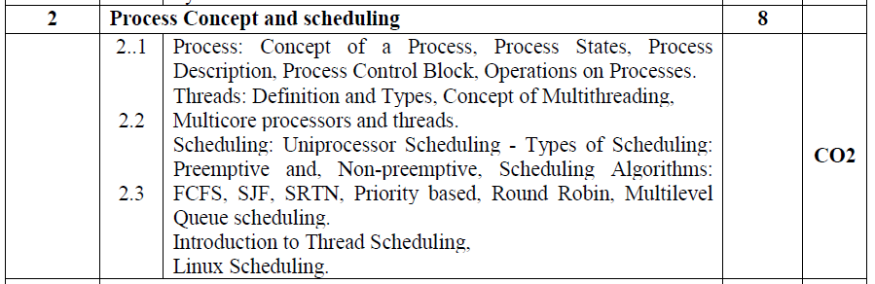
Chapter 3: Processes

Slide 4
Process
What ?
A Program in execution
Unit of work in modern time sharing systems
How?
System consists of a collection of processes:
Operating system processes execute system code
User processes executing user code.
Why?
All these processes can execute concurrently with the CPU(s) multiplexed among them.
By switching between processes, the OS can make computer more productive.

Slide 5
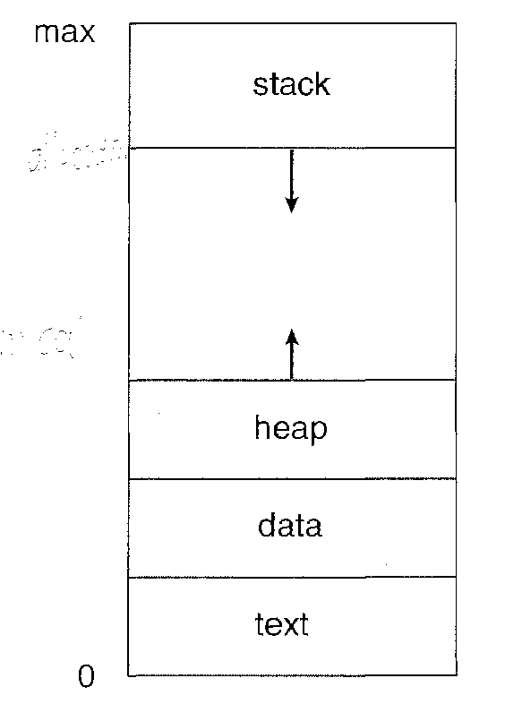
Process Concept
Process
A program in execution
A process is more than the program code.

Slide 6
Process Concept
Multiple parts
The program code, also called text section
Current activity including value of program counter, content of processor registers
Process Stack containing temporary data
Function parameters, return addresses, local variables

Slide 7
Process Concept
Multiple parts
Data section containing global variables
Heap containing memory dynamically allocated during run time

Slide 8
Process Concept
An operating system executes a variety of programs:
Batch system – jobs
Time-shared systems – user programs or tasks
The terms job and process are used almost interchangeably

Slide 9
When does a Program become a process?

Slide 10
Process Concept (Cont.)
A program by itself is not a process.
Program is passive entity stored on disk (executable file), process is active entity
Program becomes process when executable file loaded into memory
Execution of program started via GUI mouse clicks, command line entry of its name, etc

Slide 11
Process Concept (Cont.)
Two processes may be associated with the same program but are separate execution sequences.
One program can have several processes
Consider multiple users executing the same program.
Eg-several users may be running different copies of the mail program.
Same user may invoke many copies of the editor program, Each one of them is a separate process.
The text sections are equivalent, data sections may vary.

Slide 12
Process State
As a process executes, it changes state.
Each process may be in one of the following states:
new: The process is being created
running: Instructions are being executed
Blocked/Waiting: The process is waiting for some event to occur (I/O completion or reception of signal)
ready: The process is waiting to be assigned to a processor
terminated: The process has finished execution
Reference Book-Galvin

Slide 13
Process State
New:
A process that has just been created
Not yet been admitted to the pool of executable processes by the OS.
The new process has not yet been loaded into main memory,
Although its process control block has been created.
Reference Book-William Stallings

Slide 14
New:
For example,
User attempts to log on to a time-sharing system or a new batch job is submitted for execution,
What will Happen next?
Reference Book-William Stallings

Slide 15
New:
The OS can define a new process.
An identifier is associated with the process.
Any tables that will be needed to manage the process are allocated and built.
This means that the OS has performed the necessary actions to create the process
But has not committed itself to the execution of the process.
Reference Book-William Stallings

Slide 16
New:
While a process is in the new state, information concerning the process that is needed by the OS is maintained in control tables in main memory.
However, the process itself is not in main memory.
Where then?
Reference Book-William Stallings

Slide 17
New:
The code of the program to be executed is not in main memory, and
No space has been allocated for the data associated with that program.
While the process is in the New state, the program remains in secondary storage, typically disk storage.
Reference Book-William Stallings

Slide 18
Process State
Ready:
A process that is prepared to execute when given the opportunity.
Reference Book-William Stallings

Slide 19
Process State
Running:
The process that is currently being executed
Reference Book-William Stallings

Slide 20
Process State
Blocked/Waiting:
A process that cannot execute until some event occurs,
Such as the completion of an I/O operation.
I/O completion or reception of signal
Reference Book-William Stallings

Slide 21
Process State
Terminated/Exit:
A process that has been released from the pool of executable processes by the OS,
Either because it halted or because it aborted for some reason.
Reference Book-William Stallings

Slide 22
Process State
Terminated/Exit:
A process is terminated –
When it reaches a natural completion point,
When it aborts due to an unrecoverable error, or
When another process with the appropriate authority causes the process to abort
Reference Book-William Stallings

Slide 23
Process State
Terminated/Exit:
Termination moves the process to the exit state.
At this point, the process is no longer eligible for execution.
The tables and other information associated with the job are temporarily preserved by the OS, which provides time for auxiliary or support programs to extract any needed information.
Reference Book-William Stallings

Slide 24
Process State
Terminated/Exit:
For example,
An accounting program may need to record the processor time and other resources utilized by the process for billing purposes.
A utility program may need to extract information about the history of the process for purposes related to performance or utilization analysis.
Reference Book-William Stallings

Slide 25
Process State
Terminated/Exit:
Once these programs have extracted the needed information,
The OS no longer needs to maintain any data relating to the process and the process is deleted from the system.
Reference Book-William Stallings

Slide 26
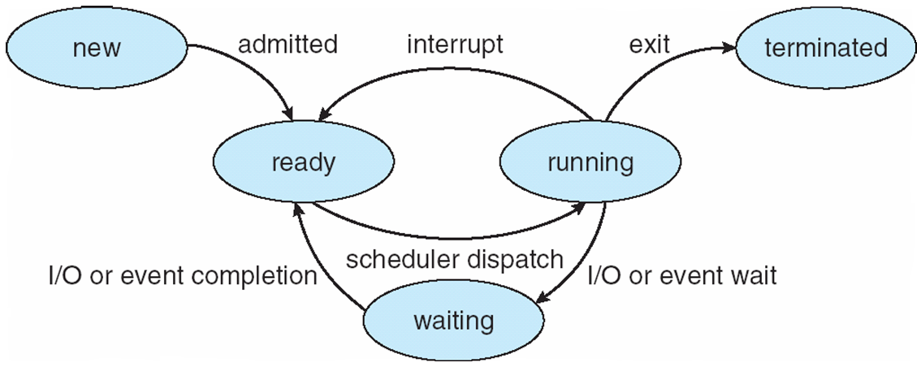
Process State Transition Diagram
Only one process can be running on any processor at any instant, although many processes may be ready and waiting.

Slide 27
Process State Transition
Null to New:
A new process is created to execute a program
Reference Book-William Stallings

Slide 51
Process State Transition
New to Ready:
The OS will move a process from the New state to the Ready state when it is prepared to take on an additional process.
Most systems set some limit based on
The number of existing processes or
The amount of virtual memory committed to existing processes.
This limit assures that there are not so many active processes as to degrade performance.
Reference Book-William Stallings

Slide 52
Process State Transition
Ready to Running:
When it is time to select a process to run, the OS chooses one of the processes in the Ready state.
This is the job of the scheduler or dispatcher.
Reference Book-William Stallings

Slide 53
Process State Transition
Running to Exit:
The currently running process is terminated by the OS if the process indicates that it has completed, or if it aborts.
Reference Book-William Stallings

Slide 54
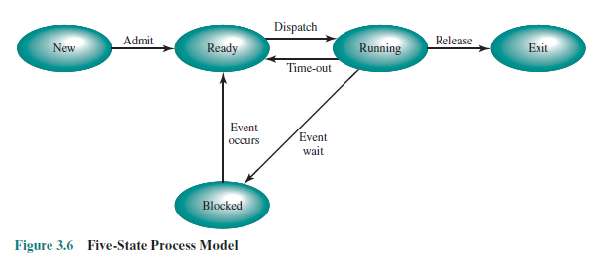
Process State Transition
Running to Ready:
The most common reason for this transition is that
The running process has reached the maximum allowable time for uninterrupted execution.
Reference Book-William Stallings

Slide 55
Process State Transition
Running to Ready:
There are several other alternative causes for this transition-
OS assigns different levels of priority to different processes.
Reference Book-William Stallings

Slide 56
Process State Transition
Running to Ready:
For Example-
Process A is running at a given priority level, and process B, at a higher priority level, is blocked.
If the OS learns that the event upon which process B has been waiting has occurred, moving B to a ready state,
Then it can interrupt process A and dispatch process B.
Thus, the OS has pre-empted process A
Reference Book-William Stallings

Slide 57
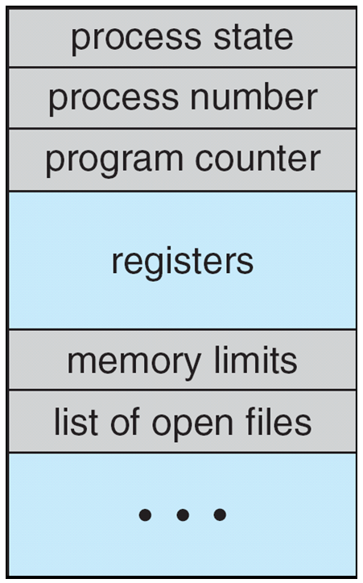
Process Control Block (PCB)
Information associated with each process
(also called task control block)
Repository of any information related to Process

Slide 58
Process Control Block (PCB)
Process state – running, waiting, etc
Program counter – address of the next instruction to be executed for this process

Slide 59
Process Control Block (PCB)
CPU registers –
contents of all process-centric registers,
Registers may vary in number and type depending on system architecture.

Slide 60
Process Control Block (PCB)
CPU registers –
They may include
accumulators,
index registers ,
stack pointers and
general purpose registers
Any condition code information
When interrupt occurs , then this state information along with program counter must be saved to be continued correctly afterward.

Slide 61
Process Control Block (PCB)
CPU scheduling information-
Process priorities,
scheduling queue pointers,
any other scheduling parameters.

Slide 62
Process Control Block (PCB)
Memory-management information –
memory allocated to the process,
value of the Base and limit registers,
the page tables or segment tables.

Slide 63
Process Control Block (PCB)
Accounting information –
CPU used,
clock time elapsed since start,
time limits,
job or process numbers

Slide 64
Process Control Block (PCB)
I/O status information –
list of I/O devices allocated to process,
list of open files

Slide 65
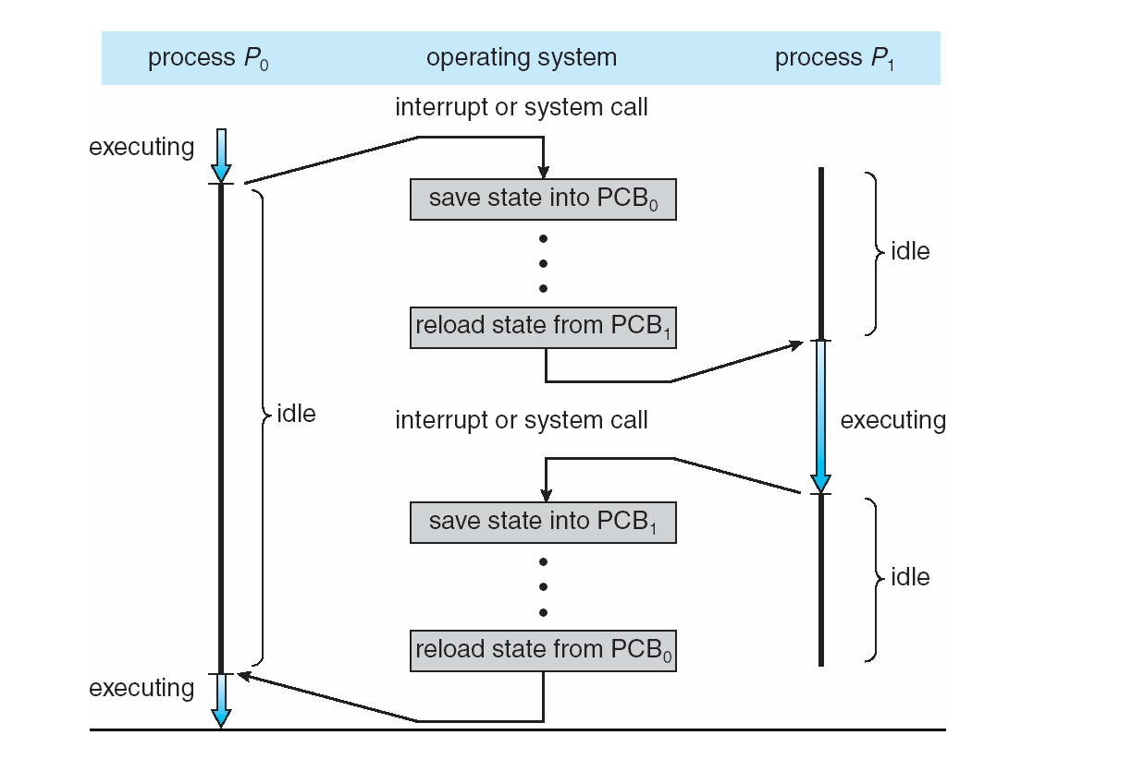
CPU Switch From Process to Process

Slide 66
What is a Thread?
A thread is a path of execution within a process.
A process can contain multiple threads.

Slide 67
Traditional Heavy Weight process
Has a single thread of control.
Process performs a single thread of execution.

Slide 68
Traditional Heavy Weight process
For Example,
If a process is running a word processor program,
A single thread of instructions is being executed.
The user could not simultaneously type in characters and run the spell checker within the same process.

Slide 69
Multithreaded Process
If a process has multiple threads of control,
It can do more than one task at a time.

Slide 70
Why Multithreading?
A thread is also known as lightweight process.
The idea is to achieve parallelism by dividing a process into multiple threads.

Slide 71
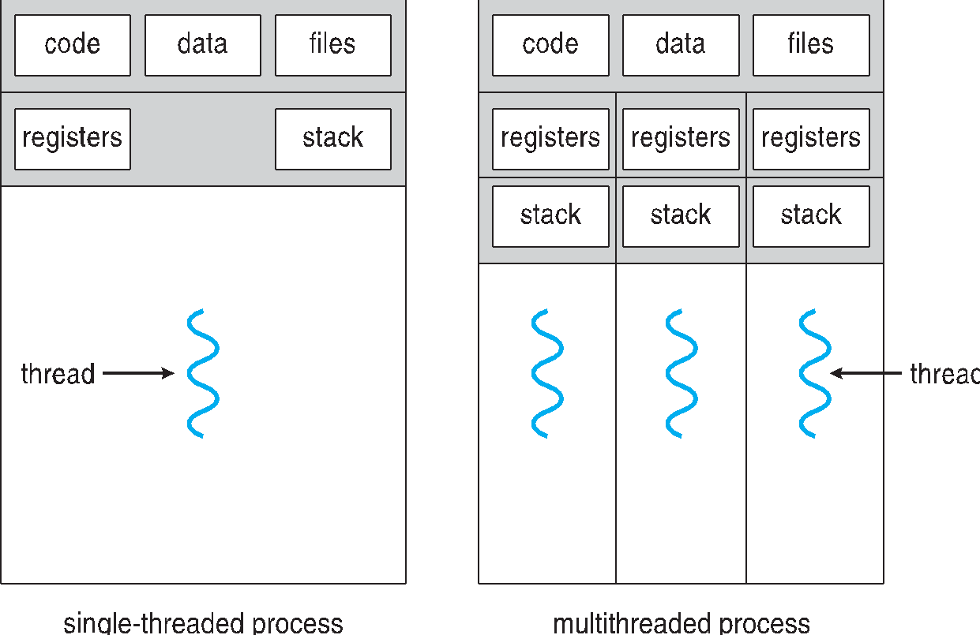
Single and Multithreaded Processes
Program Counter
Program Counter
Program Counter

Slide 72
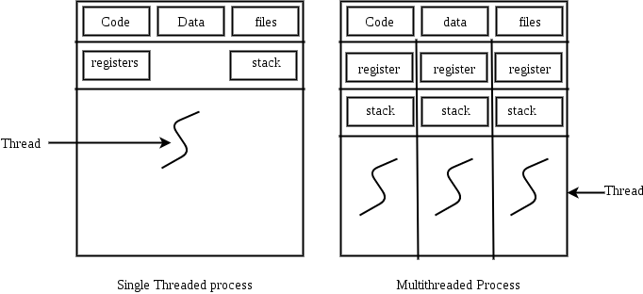
Threads
Threads are not independent of one another like processes
Threads share with other threads their
code section,
data section,
OS resources (like open files and signals).
Program Counter
Program Counter
Program Counter

Slide 73
Threads
But, like process, a thread has its own
program counter (PC),
register set, and
stack space.
Program Counter
Program Counter
Program Counter

Slide 74
Process vs Thread?
Threads within the same process run in a shared memory space, while processes run in separate memory spaces.
Threads are not independent of one another like processes

Slide 75
Advantages of Thread over Process
Responsiveness: If the process is divided into multiple threads, if one thread completes its execution, then its output can be immediately returned.
Faster context switch:
Context switch time between threads is lower compared to process context switch.
Process context switching requires more overhead from the CPU.

Slide 76
Advantages of Thread over Process
3. Resource sharing:
Resources like code, data, and files can be shared among all threads within a process. Note: stack and registers can’t be shared among the threads.
Each thread has its own stack and registers.

Slide 77
Advantages of Thread over Process
Communication:
Communication between multiple threads is easier, as the threads shares common address space,
while in process we have to follow some specific communication technique for communication between two process.

Slide 78
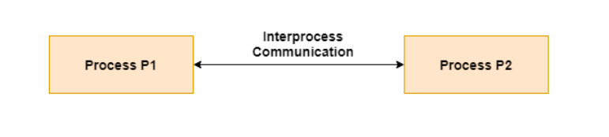
Interprocess Communication
Cooperating processes need interprocess communication (IPC) mechanism to exchange data and information

Slide 79
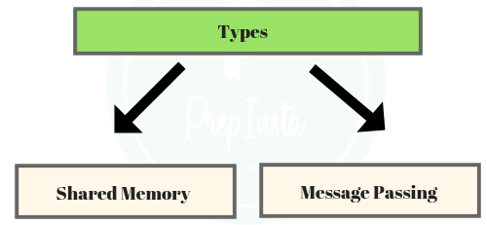
Interprocess Communication
Two models of IPC
Shared memory
Message passing

Slide 80
Advantages of Thread over Process
Effective utilization of multiprocessor system:
If we have multiple threads in a single process,
then we can schedule multiple threads on multiple processor.
This will make have faster execution .

Slide 81
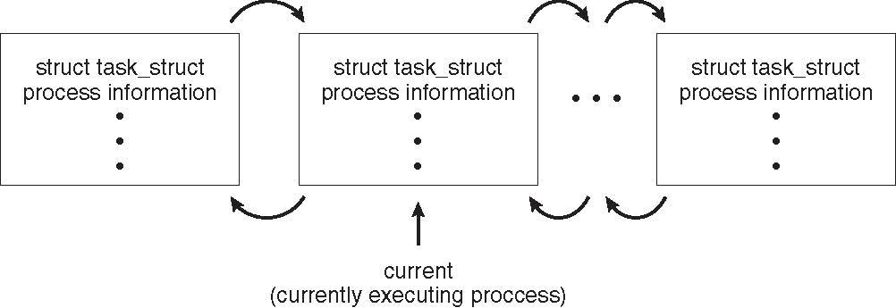
Process Representation in Linux
Represented by the C structure task_struct
pid t_pid; /* process identifier */ long state; /* state of the process */ unsigned int time_slice /* scheduling information */ struct task_struct *parent; /* this process’s parent */ struct list_head children; /* this process’s children */ struct files_struct *files; /* list of open files */ struct mm_struct *mm; /* address space of this process */

Slide 82
Types of Threads
There are two types of threads.
User Level Thread
Kernel Level Thread

Slide 83
User Threads and Kernel Threads
User threads - management done by user-level threads library
Three primary thread libraries:
POSIX Pthreads
Windows threads
Java threads
Kernel threads - Supported by the Kernel
Examples – virtually all general purpose operating systems, including:
Windows
Solaris
Linux
Tru64 UNIX
Mac OS X

Slide 84
User Threads
Implemented by a thread library at the user level
The library provides support for
thread creation,
scheduling and
management in User space
with no support /no intervention from the kernel.
Kernel Threads
Supported Directly by the OS
Kernel performs
thread creation,
scheduling and
management in Kernel space.

Slide 85
User Threads
Generally fast to create
If the Kernel is single threaded,
then any user level thread performing a blocking system call
will cause the entire process to block,
even if other threads are available to run within the application
Kernel Threads
Generally slower to create and manage than user threads
If a thread performs a blocking system call,
the kernel can schedule another thread in the application for execution.

Slide 86
Multithreading Models
Many systems provide support for both user and kernel threads, resulting in different multithreading models
Many-to-One
One-to-One
Many-to-Many

Slide 87
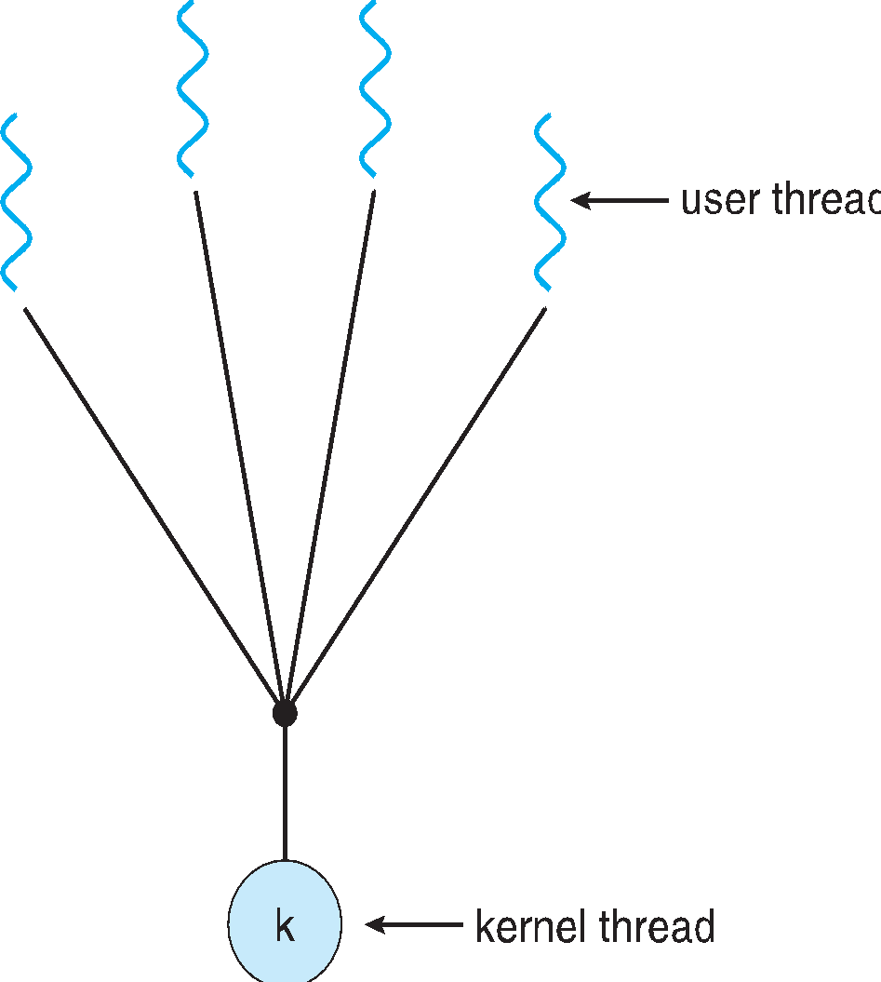
Many-to-One
Many user-level threads mapped to single kernel thread
Only one thread can access the Kernel at a time.
Thread Management done in User space, so is efficient.
If one thread makes a blocking system call, the entire process will block.
One thread blocking causes all to block

Slide 88
Many-to-One
Multiple threads are unable to run in parallel on multicore system because only one may be in kernel at a time
Few systems currently use this model
Examples:
Solaris Green Threads
Green thread, a thread that uses this model
Available for Solaris 2
GNU Portable Threads

Slide 89
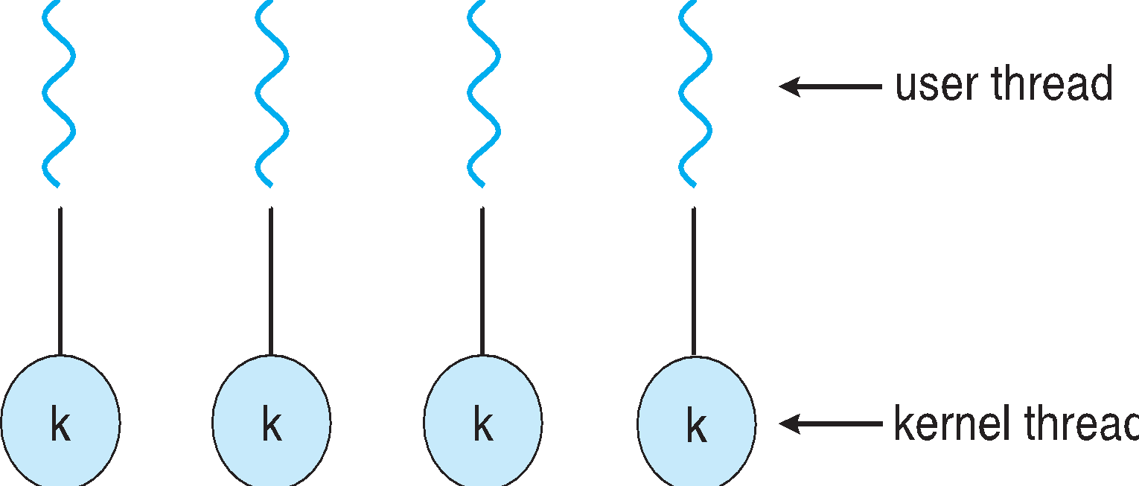
One-to-One
Each user-level thread maps to kernel thread
Creating a user-level thread creates a kernel thread
More concurrency than many-to-one
By allowing another thread to run when a thread makes a blocking system call
Allows multiple threads to run in parallel on multiprocessors

Slide 90
One-to-One
Creating a user thread requires creating the corresponding kernel thread.
Overhead of creating kernel threads can burden the performance of an application
Number of threads per process sometimes restricted due to overhead
Examples
Windows
Linux
Solaris 9 and later

Slide 91
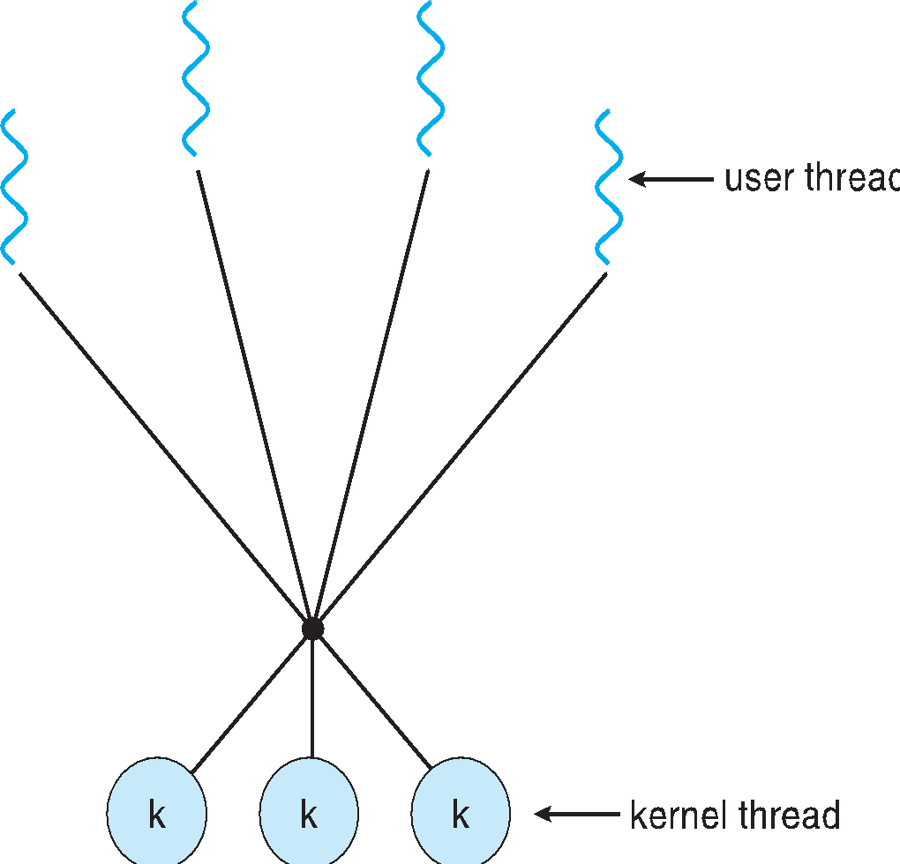
Many-to-Many Model
Allows many user level threads to be mapped to many kernel threads
Allows the operating system to create a sufficient number of kernel threads
The number of kernel threads may be specific to
Either a particular application
Or a particular machine
Solaris prior to version 9
Windows with the ThreadFiber package

Slide 92
Many-to-Many Model
Many to One
Allows developer to create as many user threads as needed
But true concurrency is not gained because kernel can schedule only one thread at a time
One to One
Allows for greater concurrency, but
the developer has to be careful not to create too many threads within an application

Slide 93
Many-to-Many Model
Many to Many
Overcomes these shortcomings
Developers can create as many user threads as necessary
Corresponding Kernel threads can run in parallel on a multiprocessor
When a thread performs a blocking system call, the kernel can schedule another thread for execution

Slide 94
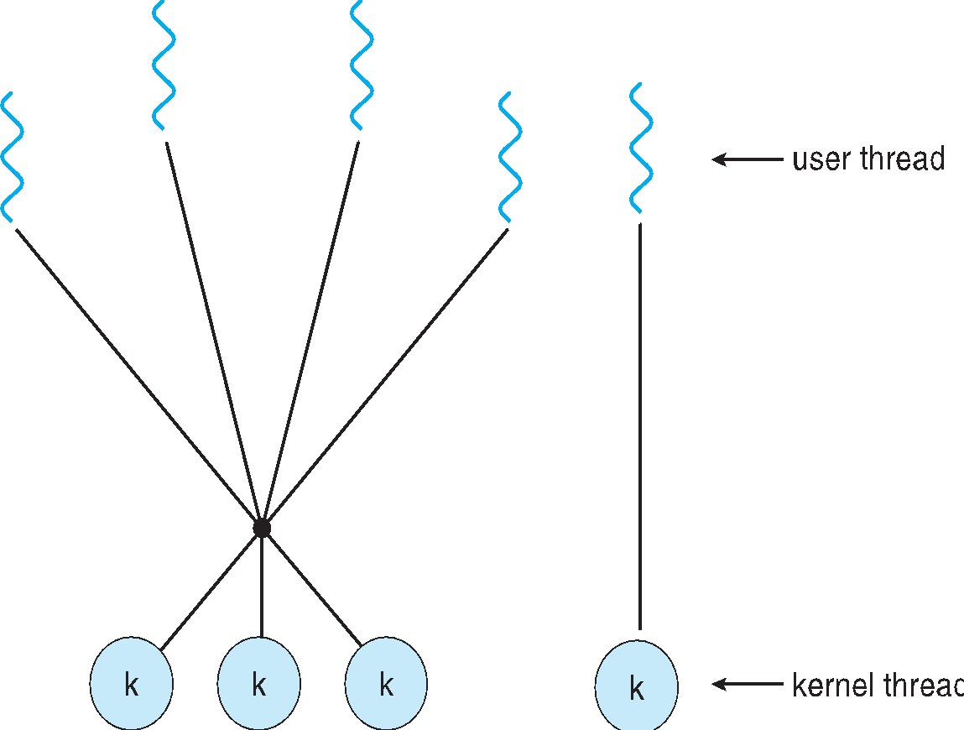
Two-level Model
Similar to M:M, except that it allows a user thread to be bound to kernel thread
Examples
IRIX
HP-UX
Tru64 UNIX
Solaris 8 and earlier

Slide 95
Now, Lets compare User and Kernel Level Threads

Slide 96
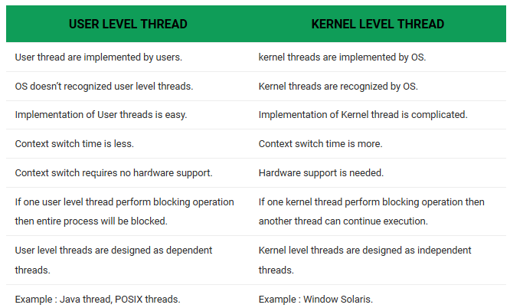
Difference between User Level thread and Kernel Level thread

Slide 97
Done with Process and Threads Now, Lets compare Process and Threads

Slide 98
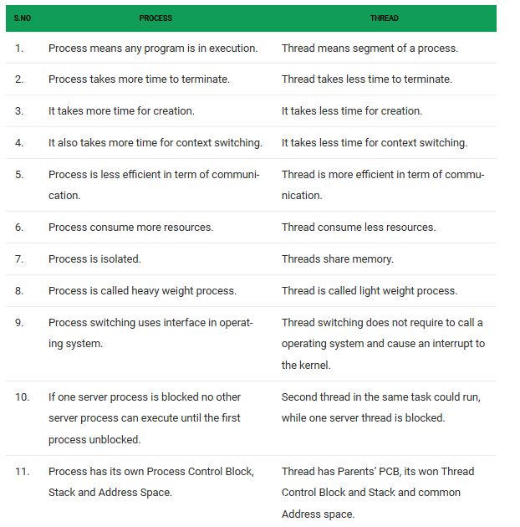

Slide 99
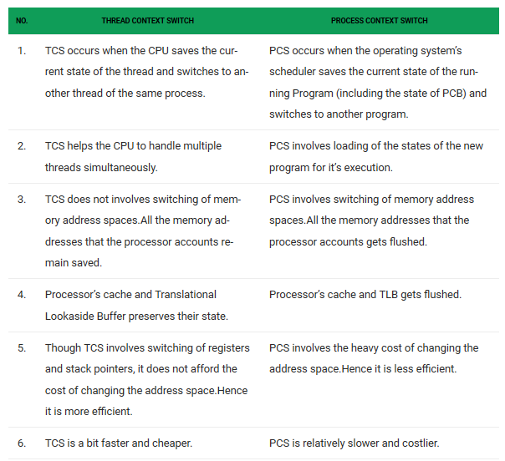

Slide 100
Process Scheduling
Maximize CPU use, quickly switch processes onto CPU for time sharing
Process scheduler selects among available processes for next execution on CPU

Slide 101
Process Scheduling
Maintains scheduling queues of processes
Job queue
Ready queue
Device queues
Processes migrate among the various queues

Slide 102
Process Scheduling
Job queue –
set of all processes in the system,
as a process enters the system,
they are put on job queue..

Slide 103
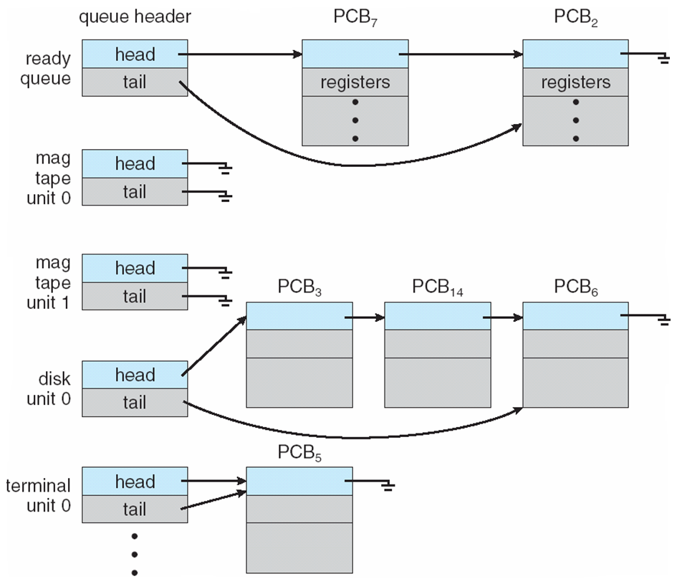
Process Scheduling
Ready queue –
set of all processes residing in main memory, ready and waiting to execute,
generally stored using a linked list.
A ready queue header contains pointers to the first and final PCB in the list.
We extend each PCB to include a pointer field that points to the next PCB in the ready queue.

Slide 104
Process Scheduling
Device queues –
set of processes waiting for an I/O device.
Each device has its own device queue
Processes migrate among the various queues

Slide 105
Summary of Queues
Job Queue:
Each new process goes into the job queue.
Processes in the job queue reside on mass storage and await the allocation of main memory.
Ready Queue:
The set of all processes that are in main memory and are waiting for CPU time is kept in the ready queue.
Waiting (Device) Queues:
The set of processes waiting for allocation of certain I/O devices is kept in the waiting (device) queue.
The short-term scheduler (also known as CPU scheduling) selects a process from the ready queue and yields control of the CPU to the process.
https://cs.stackexchange.com/questions/1106/which-queue-does-the-long-term-scheduler-maintain

Slide 106
Ready Queue And Various I/O Device Queues

Slide 107
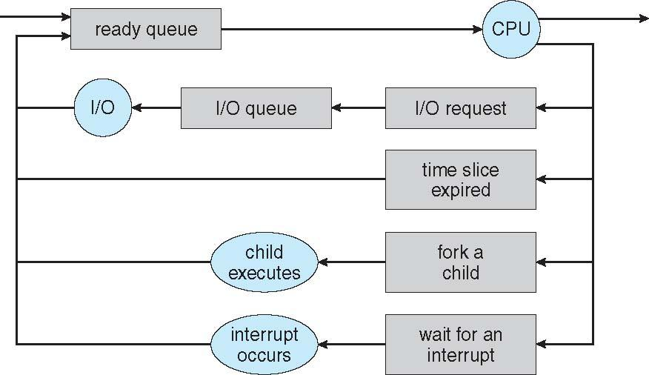
Representation of Process Scheduling
Queueing diagram represents queues, resources, flows

Slide 108
Representation of Process Scheduling
Queueing diagram represents queues, resources, flows
Rectangular box=queue
Circles= resources that serve the queues
Arrows=indicate the flow of processes

Slide 109
Representation of Process Scheduling
A new process is initially put in the ready queue, waits in the ready queue to be dispatched.
Once assigned to the CPU and is executing, one of the several events may occur, the process could:
Issue I/O request and be placed in I/O queue
Create a new sub process and wait for its termination
Be Removed forcibly from CPU due to interrupt and put back in the ready queue
Finally when terminates is removed from all queues, PCBs and resources deallocated.

Slide 110
Schedulers
OS must select processes from these queues in some fashion.
The selection process is carried out by the appropriate scheduler
The schedulers are :
Long-term scheduler (or job scheduler)
Short-term scheduler (or CPU scheduler)
Medium-term scheduler

Slide 111
Long-term scheduler (or job scheduler)
Selects which processes should be brought into the ready queue
invoked infrequently (seconds, minutes) ⇒ (may be slow)

Slide 112
Long-term scheduler (or job scheduler)
The long-term scheduler controls
the degree of multiprogramming
i.e. the number of processes in memory.
If the degree of multiprogramming is stable then:
average rate of process creation= average departure rate of process leaving the system

Slide 113
Long-term scheduler (or job scheduler)
On some systems, the long term scheduler may be absent or minimal
Time sharing systems like UNIX often has no LTS. The stability of such system depends on
physical limitations
such as no of available terminals or
self adjusting nature of human users
If performance declines to unacceptable limits, some users will simply quit .

Slide 114
Long-term scheduler (or job scheduler)
Processes can be described as either:
I/O-bound process –
spends more time doing I/O than computations,
many short CPU bursts
CPU-bound process –
spends more time doing computations;
generates I/O requests infrequently,
few very long CPU bursts

Slide 115
Long-term scheduler (or job scheduler)
Long-term scheduler strives for good process mix of both
If all Processes are I/O bound,
the ready queue will almost always be empty and
STS will have little to do
If all Processes are CPU bound,
I/O waiting queue will almost always be empty,
devices will go unused.

Slide 116
Short-term scheduler (or CPU scheduler)
Selects processes from the ready queue and
allocates the CPU for execution
Selects which process should be executed next
Sometimes the only scheduler in a system
Short-term scheduler is invoked frequently (milliseconds)

Slide 117
Short-term scheduler (or CPU scheduler)
It must be fast,
as a process may execute for only a few milliseconds
before waiting for an I/O request,
so STS needs to select another process from ready queue.
Often STS executes at least once every 100 milliseconds.

Slide 118
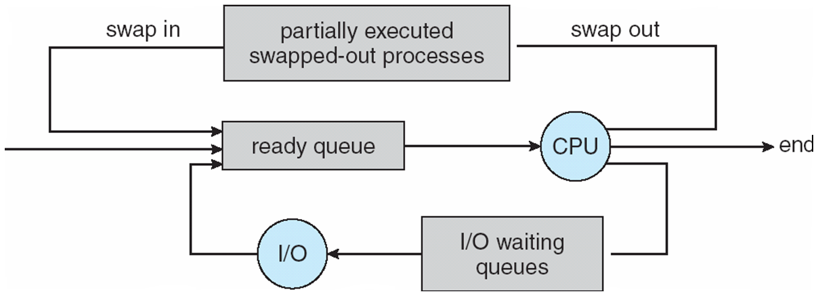
Addition of Medium Term Scheduling
Medium-term scheduler can be added if degree of multiple programming needs to decrease
Remove process from memory, store on disk, bring back in from disk to continue execution: swapping

Slide 119
Addition of Medium Term Scheduling
Why?
To improve the process mix
Memory requirements have overcommitted available memory, Requiring memory to be freed up.

Slide 120
Context Switch
Context of a process represented in the PCB
When CPU switches to another process,
the system must save the state of the old process and
load the saved state for the new process via a context switch
Kernel saves context of old process in its PCB and
loads the saved contents of new process from its PCB to run.

Slide 121
Context Switch
Context-switch time is overhead;
the system does no useful work while switching
Varies from m/c to m/c
The more complex the OS and the PCB 🡺 the longer the context switch
Time dependent on hardware support
Some hardware provides multiple sets of registers per CPU 🡺 multiple contexts loaded at once,
involves changing the pointer to the current register set.

Slide 122
Operations on Processes
System must provide mechanisms for:
process creation,
process termination

Slide 123
Process Creation
Parent process create children processes,
which, in turn create other processes,
forming a tree of processes
Generally, processes are identified and managed via a process identifier (pid)

Slide 124
Process Creation
Resource sharing options(CPU time, memory files, I/O devices)
Parent and children share all resources
Children share subset of parent’s resources
Parent and child share no resources (child obtains resources directly from OS)
Restricting a child process to a subset of parents resources
prevents any process from overloading the system
by creating too many sub processes.

Slide 125
Process Creation
Execution options
Parent and children execute concurrently
Parent waits until children terminate
In terms of Address space
Child duplicate of parent
Child has a program loaded into it

Slide 126
Process Creation-In terms of Address space
fork() creates a new process by duplicating the calling process,
The new process, referred to as child, is an exact duplicate of the calling process, referred to as parent, except for the following :
The child has its own unique process ID, and this PID does not match the ID of any existing process group.
The child’s parent process ID is the same as the parent’s process ID.
The child does not inherit its parent’s memory locks and semaphore adjustments.
The child does not inherit outstanding asynchronous I/O operations from its parent nor does it inherit any asynchronous I/O contexts from its parent.

Slide 127
Process Creation-In terms of Address space
The exec() family of functions
replaces the current process image with a new process image.
It loads the program into the current process space and runs it from the entry point.
The exec() family consists of following functions
int execl(const char *path, const char *arg, ...);
int execlp(const char *file, const char *arg, ...);
int execle(const char *path, const char *arg, ..., char * const envp[]);
int execv(const char *path, char *const argv[]);
int execvp(const char *file, char *const argv[]);
int execvpe(const char *file, char *const argv[], char *const envp[]);

Slide 128
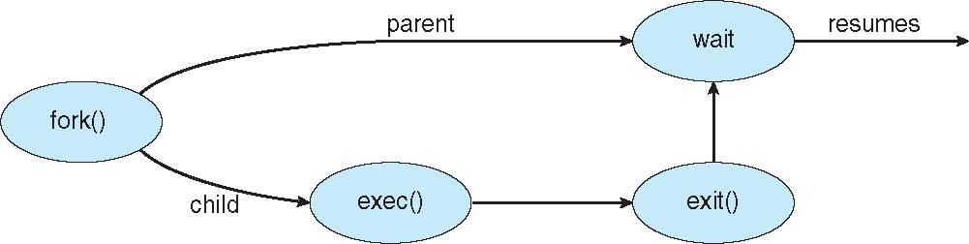
Process Creation (Cont.)
UNIX examples
fork() system call creates new process
exec() system call used after a fork() to replace the process’ memory space with a new program

Slide 129
Fork vs Exec
fork starts a new process which is a copy of the one that calls it, while
exec replaces the current process image with another (different) one.

Slide 130
execlp -- Overlay Calling Process and Run New Program
The execlp function is most commonly used to overlay a process image that has been created by a call to the fork function.
execlp replaces the calling process image with a new process image.
This has the effect of running a new program with the process ID of the calling process.
Note that a new process is not started;
the new process image simply overlays the original process image.

Slide 131
execlp -- Overlay Calling Process and Run New Program
int execlp(const char *path, const char *arg0, ..., NULL);
path
identifies the location of the new process image within the hierarchical file system (HFS).
arg0, ..., NULL
is a variable length list of arguments that are passed to the new process image.
Each argument is specified as a null-terminated string, and the list must end with a NULL pointer.
The first argument, arg0, is required and must contain the name of the executable file for the new process image.

Slide 132
execlp -- Overlay Calling Process and Run New Program
int execlp(const char *path, const char *arg0, ..., NULL);
RETURN VALUE-
A successful call to execlp does not have a return value because the new process image overlays the calling process image.
However, -1 is returned if the call to execlp is unsuccessful.

Slide 133
fork()
Fork system call is used for creating a new process, which is called child process,
which runs concurrently with the process that makes the fork() call (parent process).

Slide 134
fork()
It takes no parameters and returns an integer value. Below are different values returned by fork().
Negative Value: creation of a child process was unsuccessful.
Zero: Returned to the newly created child process.
Positive value: Returned to parent or caller.
The value contains process ID of newly created child process.
i.e. the PID of the child process is returned in the parent

Slide 135
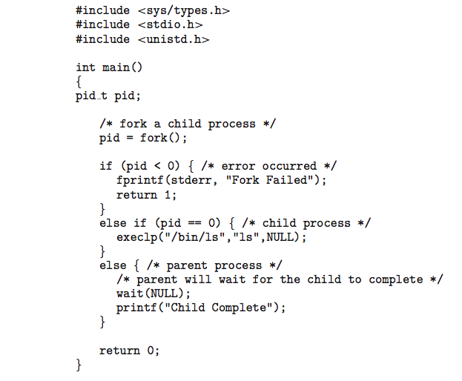
C Program Forking Separate Process

Slide 136
fork()
The parent can create more children or
if it has nothing else to do while the child runs,
it can issue a wait system call to move itself off the ready queue
until the termination of the child.

Slide 137
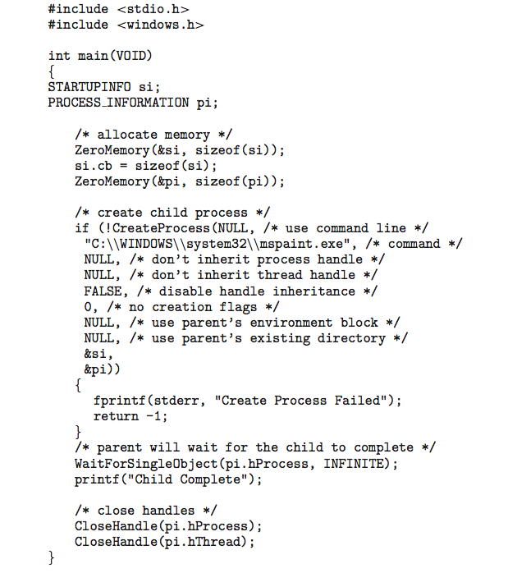
Creating a Separate Process via Windows API

Slide 138
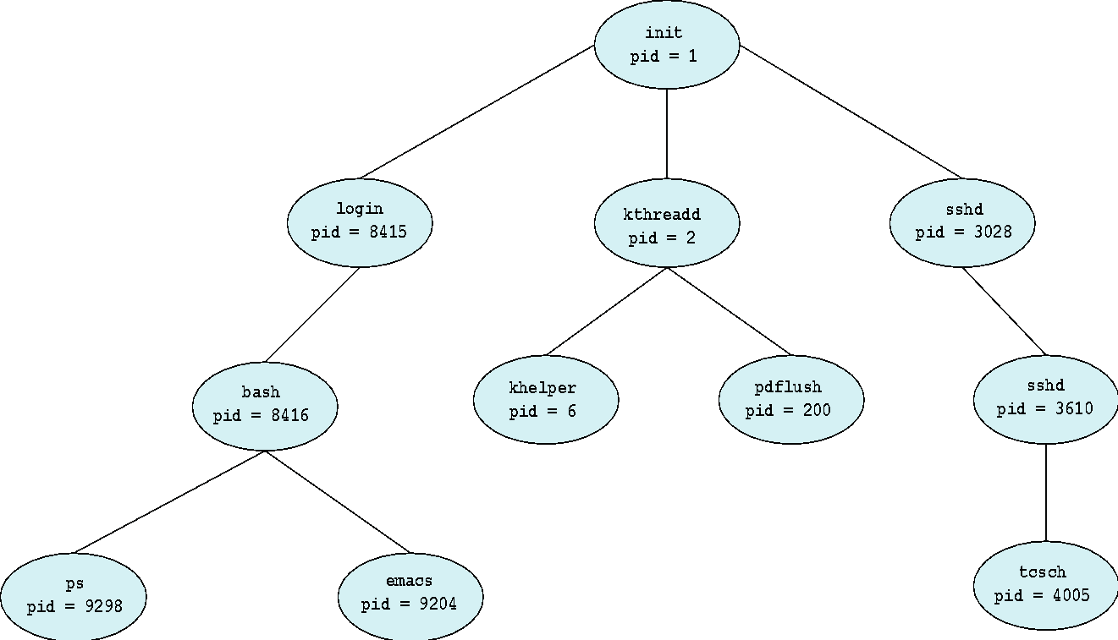
A Tree of Processes in Linux

Slide 139
ISRO | ISRO CS 2018 | Question 63
The following C program
main()
{ fork() ;
fork() ;
printf ("yes");
}
If we execute this core segment, how many times the string yes will be printed ? (A) Only once (B) 2 times (C) 4 times (D) 8 times

Slide 140
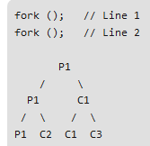
ISRO | ISRO CS 2018 | Question 63
The following C program
main()
{ fork() ; fork() ; printf ("yes"); }
If we execute this core segment, how many times the string yes will be printed ? (A) Only once (B) 2 times (C) 4 times (D) 8 times
Answer: (C) Explanation: Number of times YES printed is equal to number of process created. Total Number of Processes = 2^{n} where n is number of fork system calls. So here n = 2, 2⁴ = 4
So, there are total 4 processes (3 new child processes and one original process).

Slide 141
#include <stdio.h>
#include <sys/types.h>
#include <unistd.h>
int main()
{
// make two process which run same
// program after this instruction
fork();
printf("Hello world!\n");
return 0;
}
Output ?

Slide 142
#include <stdio.h>
#include <sys/types.h>
#include <unistd.h>
int main()
{
// make two process which run same
// program after this instruction
fork();
printf("Hello world!\n");
return 0;
}
Output:
Hello world! Hello world!
After a new child process is created, both processes will execute the next instruction following the fork() system call.

Slide 143
#include <stdio.h>
#include <sys/types.h>
int main()
{
fork();
fork();
fork();
printf("hello\n");
return 0;
}
Output:
hello
hello
hello
hello
hello
hello
hello
hello
The number of times ‘hello’ is printed is equal to number of process created. Total Number of Processes = 2^{n}, where n is number of fork system calls. So here n = 3, 2³ = 8

Slide 144
#include <stdio.h>
#include <sys/types.h>
#include <unistd.h>
void forkexample()
{
// child process because return value zero
if (fork() == 0)
printf("Hello from Child!\n");
// parent process because return value non-zero.
else
printf("Hello from Parent!\n");
}
int main()
{
forkexample();
return 0;
}
Output ?

Slide 145
#include <stdio.h>
#include <sys/types.h>
#include <unistd.h>
void forkexample()
{
// child process because return value zero
if (fork() == 0)
printf("Hello from Child!\n");
// parent process because return value non-zero.
else
printf("Hello from Parent!\n");
}
int main()
{
forkexample();
return 0;
}
Output-
1. Hello from Child!
Hello from Parent!
(or)
2. Hello from Parent!
Hello from Child!
Here, two outputs are possible because the parent process and child process are running concurrently.
So we don’t know whether the OS will first give control to the parent process or the child process.

Slide 146
#include <stdio.h>
#include <sys/types.h>
#include <unistd.h>
void forkexample()
{
int x = 1;
if (fork() == 0)
printf("Child has x = %d\n", ++x);
else
printf("Parent has x = %d\n", --x);
}
int main()
{
forkexample();
return 0;
}
Output?

Slide 147
Point To be Noted….
Parent process and child process are running the same program,
but it does not mean they are identical.
OS allocate
different data and states for these two processes, and
the control flow of these processes can be different.

Slide 148
#include <stdio.h>
#include <sys/types.h>
#include <unistd.h>
void forkexample()
{
int x = 1;
if (fork() == 0)
printf("Child has x = %d\n", ++x);
else
printf("Parent has x = %d\n", --x);
}
int main()
{
forkexample();
return 0;
}
Output:
Parent has x = 0
Child has x = 2
(or)
Child has x = 2
Parent has x = 0
Here, global variable change in one process does not affected two other processes because data/state of two processes are different.
And also parent and child run simultaneously so two outputs are possible.

Slide 149
Process Termination
Process executes last statement and then asks the operating system to delete it using the exit() system call.
Return of data(output) from child to parent (via wait())
Process resources (physical and virtual memory, open files, I/O buffers) are deallocated by operating system

Slide 150
Child Process Termination
Parent may terminate the execution of children processes using the abort() system call.
Some reasons for doing so:
Child has exceeded allocated resources, thus the parent needs a mechanism to inspect the state of its children.
Task assigned to child is no longer required
The parent is exiting and the operating systems does not allow a child to continue if its parent terminates

Slide 151
Child Process Termination
Cascading termination
Some operating systems do not allow child to exists if its parent has terminated.
If a process terminates, then all its children must also be terminated.
All children, grandchildren, etc. are terminated.
The termination is initiated by the operating system.

Slide 152
Process Termination
The parent process may wait for termination of a child process by using the wait()system call.
The wait system call returns status information and the process identifier (pid) of the terminated process
pid = wait(&status);
If no parent waiting (did not invoke wait()) process is a zombie
If parent terminated without invoking wait , process is an orphan

Slide 153
extra

