Slide 1
OSSS_Module2_MCQs

Slide 2
GATE | GATE-CS-2016 (Set 1) | Question 30
Consider an arbitrary set of CPU-bound processes with unequal CPU burst lengths submitted at the same time to a computer system. Which one of the following process scheduling algorithms would minimize the average waiting time in the ready queue?
(A)Shortest remaining time first
(B) Round-robin with time quantum less than the shortest CPU burst
(C) Uniform random
(D) Highest priority first with priority proportional to CPU burst length

Slide 3
GATE | GATE-CS-2016 (Set 1) | Question 30
Consider an arbitrary set of CPU-bound processes with unequal CPU burst lengths submitted at the same time to a computer system. Which one of the following process scheduling algorithms would minimize the average waiting time in the ready queue?
(A)Shortest remaining time first
(B) Round-robin with time quantum less than the shortest CPU burst
(C) Uniform random
(D) Highest priority first with priority proportional to CPU burst length
Answer: (A) As we know, in all CPU Scheduling algorithms, shortest job first is optimal i.ie. it gives minimum turn round time, minimum average waiting time and high throughput and the most important thing is that shortest remaining time first is the pre-emptive version of shortest job first.

Slide 4
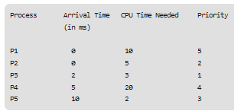
ISRO | ISRO CS 2009 | Question 17
Consider a set of 5 processes whose arrival time, CPU time needed and the priority are given below:
(smaller the number, higher the priority) If the CPU scheduling policy is priority scheduling without preemption, the average waiting time will be
(A) 12.8 ms
(B) 11.8 ms (C) 10.8 ms (D) 9.8 ms

Slide 5
At time=0,Ready Queue={(P2,BT=5,PR=2), (P1,BT=10,PR=5)},
P2 is selected,
Non Pre-emptive so P2 terminates and only then CPU will be free
At time=5,
P2 terminates,
Ready Queue={(P1,BT=10,PR=5), (P3,BT=3,PR=1), (P4, BT=20, PR=4)}
P3 is selected
At time=8,
P3 terminates,
Ready Queue={(P1,BT=10,PR=5), (P4, BT=20, PR=4)}
P4 is selected
At time=28,
P4 terminates,
Ready Queue={(P1,BT=10,PR=5), (P5,BT=2,PR=3)}
P5 is selected
At time=30,
P5 terminates
Ready Queue={(P1,BT=10,PR=5)}
P1 is selected, At time=40, P1 terminates

Slide 6
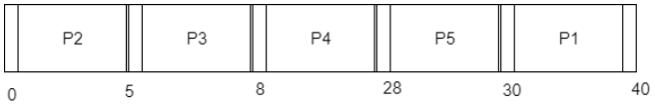
ISRO | ISRO CS 2009 | Question 17
Consider a set of 5 processes whose arrival time, CPU time needed and the priority are given below:
(smaller the number, higher the priority) If the CPU scheduling policy is priority scheduling without preemption, the average waiting time will be
(A) 12.8 ms
(B) 11.8 ms (C) 10.8 ms (D) 9.8 ms Answer: (C) Explanation: Following is the Gantt diagram:
Average Waiting Time = (30 + 3 + 3 + 18)/ 5 = 10.8
So, option (C) is correct.

Slide 7
ISRO | ISRO CS 2017 | Question 60
Consider three CPU intensive processes, which require 10, 20, 30 units and arrive at times 0, 2, 6 respectively. How many context switches are needed if shortest remaining time first is implemented? Context switch at 0 is included but context switch at end is ignored (A) 1 (B) 2 (C) 3 (D) 4

Slide 8
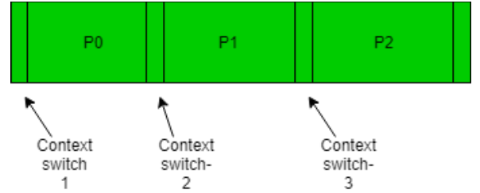
ISRO | ISRO CS 2017 | Question 60
Consider three CPU intensive processes, which require 10, 20, 30 units and arrive at times 0, 2, 6 respectively. How many context switches are needed if shortest remaining time first is implemented? Context switch at 0 is included but context switch at end is ignored (A) 1 (B) 2 (C) 3 (D) 4 Answer: (C) Explanation: Let three process be P0, P1 and P2 with arrival times 0, 2 and 6 respectively and CPU burst times 10, 20 and 30 respectively. At time 0, P0 is the only available process so it runs.
At time 2, P1 arrives, but P0 has the shortest remaining time, so it continues.
At time 6, P2 also arrives, but P0 still has the shortest remaining time, so it continues.
At time 10, P1 is scheduled as it is the shortest remaining time process. At time 30, P2 is scheduled.

Slide 9
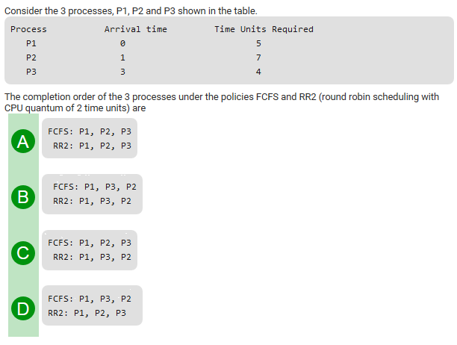
Gate CS 2012

Slide 10
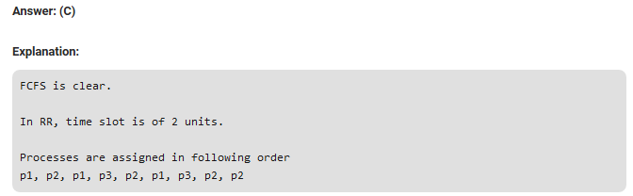
Gate CS 2012
This question involves the concept of ready queue. At t=2, p2 starts and p1 is sent to the ready queue and at t=3 p3 arrives so then the job p3 is queued in ready queue after p1. So at t=4, again p1 is executed then p3 is executed for first time at t=6.

Slide 11
At time =0, Ready Queue={ (P1,5)}, P1 selected
At time =2,Ready Queue={ (P2,7)}, P2 selected, P1 preempted with remaining time=3 and sent back to Queue
At time =3, P3 arrives
At time =4, Ready Queue={ (P1,3) (P3,4)}, P1 selected, P2 preempted with remaining time=5
At time =6, Ready Queue={(P3,4) (P2,5)}, P3 is selected, P1 is prempted with remaining time =1
At time =8, Ready Queue={(P2,5) (P1,1)}, P2 is selected, P3 is preempted with remaining time=2
At time =10, Ready Queue={ (P1,1) (P3,2)}, P1 is selected, P2 is preempted with remaining time=3
At time =11, P1 terminates, Ready Queue={ (P3,2),(P2,3)}, P3 is selected
At time=13, P3 terminates, Ready queue={(P2,3)}, P2 is selected
At time =15, P2 with Remaining time =1 continues as No other process is left
At time =16, P2 terminates

Slide 12
GATE | GATE-CS-2015 (Set 3) | Question 65
The maximum number of processes that can be in Ready state for a computer system with n CPUs is (A) n (B) n² (C) 2n (D) Independent of n

Slide 13
GATE | GATE-CS-2015 (Set 3) | Question 65
The maximum number of processes that can be in Ready state for a computer system with n CPUs is (A) n (B) n² (C) 2n (D) Independent of n Answer: (D) Explanation: The size of ready queue doesn’t depend on number of processes. A single processor system may have a large number of processes waiting in ready queue.

Slide 14
Which module gives control of the CPU to the process selected by the short – term schedular ?
(A) Dispatcher (B) Interrupt (C) Scheduler (D) Threading

Slide 15
Which module gives control of the CPU to the process selected by the short – term schedular ?
(A) Dispatcher (B) Interrupt (C) Scheduler (D) Threading Answer: (A) Explanation: There are three type of scheduler:
Short-term scheduler
Mid-term scheduler
Long-term scheduler
Dispatcher is responsible for handovering the control of CPU to the newly selected process by the Short-term scheduler.

Slide 16
ISRO | ISRO CS 2016 | Question 47
For the real time operating system, which of the following is the most suitable scheduling scheme? (A) Round robin (B) Pre-emptive (C) First come first serve (D) Random scheduling

Slide 17
ISRO | ISRO CS 2016 | Question 47
For the real time operating system, which of the following is the most suitable scheduling scheme? (A) Round robin (B) Pre-emptive (C) First come first serve (D) Random scheduling Answer: (B) Explanation: Pre- emptive scheduling is the most suitable scheduling scheme for real time operating systems as it can always preempt other processes based on priority.
In real time operating systems, we have different tasks to perform simultaneously and also there are a few tasks which need to be performed first at priority basis. Option (B) is correct.

Slide 18
Which of the following process scheduling algorithm may lead to starvation (A) FIFO (B) Round Robin (C) Shortest Job Next (D) None of the above

Slide 19
Which of the following process scheduling algorithm may lead to starvation (A) FIFO (B) Round Robin (C) Shortest Job Next (D) None of the above Answer: (C) Explanation: Shortest job next may lead to process starvation for processes which will require a long time to complete if short processes are continually added.

Slide 20
Operating Systems | CPU Scheduling | Question 5
If the quantum time of round robin algorithm is very large, then it is equivalent to: (A) First in first out (B) Shortest Job Next (C) Lottery scheduling (D) None of the above

Slide 21
Operating Systems | CPU Scheduling | Question 5
If the quantum time of round robin algorithm is very large, then it is equivalent to: (A) First in first out (B) Shortest Job Next (C) Lottery scheduling (D) None of the above Answer: (A) Explanation: If time quantum is very large, then scheduling happens according to FCFS.

Slide 22

GATE | GATE CS 2010 | Question 65
Which of the following statements are true?
(A) I only (B) I and III only (C) II and III only (D) I, II and III

Slide 23
GATE | GATE CS 2010 | Question 65
Which of the following statements are true?
(A) I only (B) I and III only (C) II and III only (D) I, II and III Answer: (D) Explanation: I) Shortest remaining time first scheduling is a pre-emptive version of shortest job scheduling. In SRTF, job with the shortest CPU burst will be scheduled first. Because of this process, It may cause starvation as shorter processes may keep coming and a long CPU burst process never gets CPU.
II) Pre-emptive just means a process before completing its execution is stopped and other process can start execution. The stopped process can later come back and continue from where it was stopped. In pre-emptive scheduling, suppose process P1 is executing in CPU and after some time process P2 with high priority then P1 will arrive in ready queue then p1 is pre-empted and p2 will brought into CPU for execution. In this way if process which is arriving in ready queue is of higher priority then p1, then p1 is always pre-empted and it may possible that it suffer from starvation.
III) round robin will give better response time then FCFS ,in FCFS when process is executing ,it executed up to its complete burst time, but in round robin it will execute up to time quantum. So Round Robin Scheduling improves response time as all processes get CPU after a specified time.
So, I,II,III are true which is option (D). Option (D) is correct answer.

Slide 24
ISRO | ISRO CS 2020 | Question 41
Which of the following algorithms defines time quantum ? (A) shortest job scheduling algorithm (B) round robin scheduling algorithm (C) priority scheduling algorithm (D) multilevel queue scheduling algorithm

Slide 25
ISRO | ISRO CS 2020 | Question 41
Which of the following algorithms defines time quantum ? (A) shortest job scheduling algorithm (B) round robin scheduling algorithm (C) priority scheduling algorithm (D) multilevel queue scheduling algorithm
Answer: (B)

Slide 26
ISRO | ISRO CS 2013 | Question 58
A starvation free job scheduling policy guarantees that no job indefinitely waits for a service. Which of the following job scheduling policies is starvation free? (A) Priority queueing (B) Shortest Job First (C) Youngest Job First (D) Round robin

Slide 27
ISRO | ISRO CS 2013 | Question 58
A starvation free job scheduling policy guarantees that no job indefinitely waits for a service. Which of the following job scheduling policies is starvation free? (A) Priority queueing (B) Shortest Job First (C) Youngest Job First (D) Round robin Answer: (D) Explanation: Round Robin is a starvation free scheduling algorithm as it imposes a strict time bound on the response time of each process i.e. for a system with ‘n’ processes running in a round robin system with time quanta t_{q}, no process will wait for more than (n-1) t_{q} time units to get its CPU turn. Option (D) is correct.

Slide 28
GATE | GATE-CS-2002 | Question 22
Which of the following scheduling algorithms is non-preemptive?
(A) Round Robin (B) First-In First-Out (C) Multilevel Queue Scheduling (D) Multilevel Queue Scheduling with Feedback

Slide 29
GATE | GATE-CS-2002 | Question 22
Which of the following scheduling algorithms is non-preemptive?
(A) Round Robin (B) First-In First-Out (C) Multilevel Queue Scheduling (D) Multilevel Queue Scheduling with Feedback
Answer: (B)
Explanation: Round Robin – Preemption takes place when the time quantum expires
First In First Out – No Preemption, the process once started completes before the other process takes over
Multi Level Queue Scheduling – Preemption takes place when a process of higher priority arrives
Multi Level Queue Scheduling with Feedback – Preemption takes a place when process of higher priority arrives or when the quantum of high priority queue expires and we need to move the process to low priority queue

Slide 30
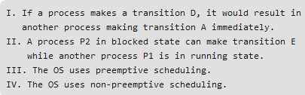
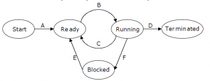
GATE | GATE-CS-2009 | Question 60
In the following process state transition diagram for a uniprocessor system, assume that there are always some processes in the ready state: Now consider the following statements:
Which of the above statements are TRUE?
(A) I and II (B) I and III (C) II and III (D) II and IV

Slide 31
GATE | GATE-CS-2009 | Question 60
In the following process state transition diagram for a uniprocessor system, assume that there are always some processes in the ready state: Now consider the following statements:
Which of the above statements are TRUE?
(A) I and II (B) I and III (C) II and III (D) II and IV
Answer: (C) Explanation: I is false. If a process makes a transition D, it would result in another process making transition B, not A. II is true. A process can move to ready state when I/O completes irrespective of other process being in running state or not. III is true because there is a transition from running to ready state. IV is false as the OS uses preemptive scheduling.

Slide 32
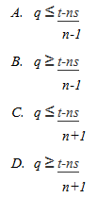
GATE CS 1998 | Question 52
Consider n processes sharing the CPU in a round-robin fashion. Assuming that each process switch takes s seconds,
what must be the quantum size q such that the overhead resulting from process switching is minimized but, at the same time, each process is guaranteed to get its turn at the CPU at least every t seconds ?

Slide 33

GATE CS 1998 | Question 52
Consider n processes sharing the CPU in a round-robin fashion. Assuming that each process switch takes s seconds, what must be the quantum size q such that the overhead resulting from process switching is minimized but, at the same time, each process is guaranteed to get its turn at the CPU at least every t seconds ?
Answer: (A) Explanation: Each process will get CPU for q seconds and each process wants CPU again after t seconds. Thus, there will be (n-1) processes once after current process gets CPU again. Each process takes s seconds for context switch.
It can be seen that since P1 left and arrived again, there have been n context switches and (n-1) processes. Thus, equation will be:

