Slide 1
2.1 MCQs

Slide 2
ISRO | ISRO CS 2013 | Question 59
The state of a process after it encounters an I/O instruction is (A) ready (B) blocked (C) idle (D) running

Slide 3
ISRO | ISRO CS 2013 | Question 59
The state of a process after it encounters an I/O instruction is (A) ready (B) blocked (C) idle (D) running Answer: (B) Explanation: Whenever a process is just created, it is kept in Ready queue. When it starts execution, it is in Running state, as soon as it starts doing input/output operation, it is kept in the blocked state.

Slide 4
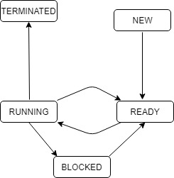
GATE | GATE CS 1996 | Question 18
The process state transition diagram in below figure is representative of
(A) a batch operating system (B) an operating system with a preemptive schedular (C) an operating system with a non-preemptive schedular (D) a uni-programmed operating system

Slide 5
GATE | GATE CS 1996 | Question 18
The process state transition diagram in below figure is representative of
(A) a batch operating system (B) an operating system with a preemptive schedular (C) an operating system with a non-preemptive schedular (D) a uni-programmed operating system Answer: (B)

Slide 6
ISRO | ISRO CS 2009 | Question 66
Process is:
(A) A program in high level language kept on disk (B) Contents of main memory (C) A program in execution (D) A job in secondary memory

Slide 7
ISRO | ISRO CS 2009 | Question 66
Process is:
(A) A program in high level language kept on disk (B) Contents of main memory (C) A program in execution (D) A job in secondary memory Answer: (C) Explanation: A process is termed as a program in execution. Whenever a program needs to be executed, its process image is created inside the main memory and is placed in the ready queue. Later CPU is assigned to the process and it starts its execution.
So, option (C) is correct.

Slide 8
ISRO | ISRO CS 2009 | Question 9
Which is the correct definition of a valid process transition in an operating system? (A) Wake up: ready → running (B) Dispatch: ready → running (C) Block: ready → running (D) Timer runout: ready → running

Slide 9
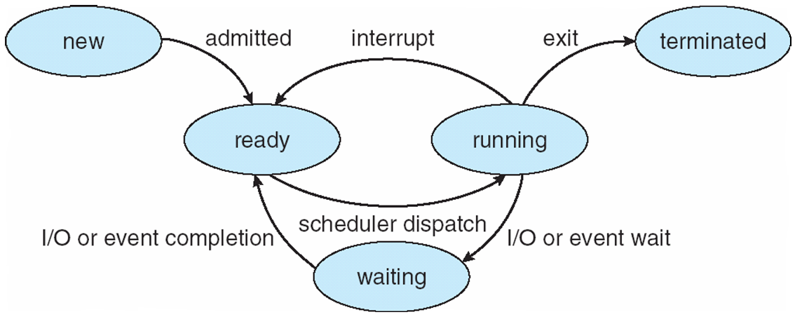
ISRO | ISRO CS 2009 | Question 9
Which is the correct definition of a valid process transition in an operating system? (A) Wake up: ready → running (B) Dispatch: ready → running (C) Block: ready → running (D) Timer runout: ready → running Answer: (B)

Slide 10
ISRO | ISRO CS 2007 | Question 41
A task in a blocked state (A) is executable (B) is running (C) must still be placed in the run queues (D) is waiting for some temporarily unavailable resources

Slide 11
ISRO | ISRO CS 2007 | Question 41
A task in a blocked state (A) is executable (B) is running (C) must still be placed in the run queues (D) is waiting for some temporarily unavailable resources Answer: (D) Explanation: Waiting or Blocked state is when a process has requested some input/output and is waiting for the resource.
So, option (D) is correct.

Slide 12
ISRO | ISRO CS 2008 | Question 44
Which of the following need not necessarily be saved on a context switch between processes? (A) General purpose registers (B) Translation look-aside buffer (C) Program counter (D) All of the above

Slide 13
ISRO | ISRO CS 2008 | Question 61
Which of the following need not necessarily be saved on a Context Switch between processes? (A) General purpose registers (B) Translation look-aside buffer (C) Program counter (D) Stack pointer

Slide 14
ISRO | ISRO CS 2008 | Question 61
Which of the following need not necessarily be saved on a Context Switch between processes? (A) General purpose registers (B) Translation look-aside buffer (C) Program counter (D) Stack pointer Answer: (B) Explanation: The values stored in registers, stack pointers and program counters are saved on context switch between the processes so as to resume the execution of the process. There’s no need for saving the contents of TLB as it is being invalid after each context switch.
So, option (B) is correct

Slide 15
GATE | GATE CS 2011 | Question 16
A thread is usually defined as a “light weight process” because an operating system (OS) maintains smaller data structures for a thread than for a process. In relation to this, which of the following is TRUE?
(A) On per-thread basis, the OS maintains only CPU register state
(B) The OS does not maintain a separate stack for each thread
(C) On per-thread basis, the OS does not maintain virtual memory state
(D) On per-thread basis, the OS maintains only scheduling and accounting information

Slide 16
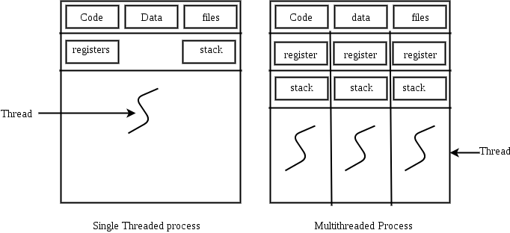
GATE | GATE CS 2011 | Question 16
A thread is usually defined as a “light weight process” because an operating system (OS) maintains smaller data structures for a thread than for a process. In relation to this, which of the following is TRUE?
(A) On per-thread basis, the OS maintains only CPU register state
(B) The OS does not maintain a separate stack for each thread
(C) On per-thread basis, the OS does not maintain virtual memory state
(D) On per-thread basis, the OS maintains only scheduling and accounting information
Answer: (C) Explanation: Threads share address space of Process. Virtually memory is concerned with processes not with Threads.
For multi-threaded -there are multiple threads within a single process, each having their own program counter, stack and set of registers, but sharing common code, data, and certain structures such as open files.

Slide 17
GATE | GATE CS Mock 2018 | Question 20
Which of the following option is False?
(A) An executing instance of a program is called a process while a thread is a subset of the process. (B) Threads have considerable overhead while processes have almost no overhead. (C) Execution of processes are independent while execution of threads are dependent. (D) New processes require duplication of the parent process while new threads are easily created.

Slide 18
GATE | GATE CS Mock 2018 | Question 20
Which of the following option is False?
(A) An executing instance of a program is called a process while a thread is a subset of the process. (B) Threads have considerable overhead while processes have almost no overhead. (C) Execution of processes are independent while execution of threads are dependent. (D) New processes require duplication of the parent process while new threads are easily created. Answer: (B) Explanation: Processes have considerable overhead while threads have almost no overhead. Only option (B) is false.

Slide 19
GATE | GATE-CS-2007 | Question 17
Consider the following statements about user level threads and kernel level threads. Which one of the following statement is FALSE?
(A) Context switch time is longer for kernel level threads than for user level threads.
(B) User level threads do not need any hardware support.
(C) Related kernel level threads can be scheduled on different processors in a multi-processor system.
(D) Blocking one kernel level thread blocks all related threads.

Slide 20
GATE | GATE-CS-2007 | Question 17
Consider the following statements about user level threads and kernel level threads. Which one of the following statement is FALSE?
(A) Context switch time is longer for kernel level threads than for user level threads.
(B) User level threads do not need any hardware support.
(C) Related kernel level threads can be scheduled on different processors in a multi-processor system.
(D) Blocking one kernel level thread blocks all related threads.
Answer: (D)

Slide 21
option (A): Context switch time is longer for kernel level threads than for user level threads. True, As User level threads are managed by user and Kernel level threads are managed by OS. There are many overheads involved in Kernel level thread management, which are not present in User level thread management. So context switch time is longer for kernel level threads than for user level threads.
Option (B): User level threads do not need any hardware support True, as User level threads are managed by user and implemented by Libraries, User level threads do not need any hardware support.
Option (C): Related kernel level threads can be scheduled on different processors in a multi- processor system. This is true.
Option (D): Blocking one kernel level thread blocks all related threads. false, since kernel level threads are managed by operating system, if one thread blocks, it does not cause all threads or entire process to block.

Slide 22
GATE | GATE-CS-2014-(Set-1) | Question 30
Which one of the following is FALSE?
(A) User level threads are not scheduled by the kernel.
(B) When a user level thread is blocked, all other threads of its process are blocked. (C) Context switching between user level threads is faster than context switching between kernel level threads. (D) Kernel level threads cannot share the code segment

Slide 23
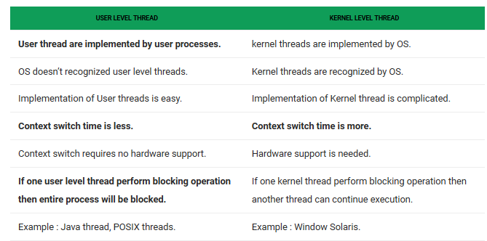
GATE | GATE-CS-2014-(Set-1) | Question 30
Which one of the following is FALSE?
(A) User level threads are not scheduled by the kernel.
(B) When a user level thread is blocked, all other threads of its process are blocked. (C) Context switching between user level threads is faster than context switching between kernel level threads. (D) Kernel level threads cannot share the code segment
Answer: (D)

Slide 24
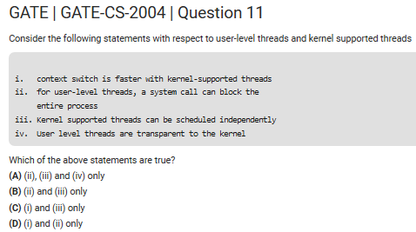

Slide 25
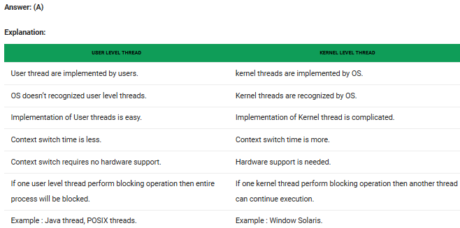

Slide 26
GATE | GATE CS 2011 | Question 6
The time taken to switch between user and kernel modes of execution be t1 while the time taken to switch between two processes be t2.
Which of the following is TRUE? (A) t1 > t2 (B) t1 = t2 (C) t1 < t2 (D) nothing can be said about the relation between t1 and t2

Slide 27
GATE | GATE CS 2011 | Question 6
The time taken to switch between user and kernel modes of execution be t1 while the time taken to switch between two processes be t2.
Which of the following is TRUE? (A) t1 > t2 (B) t1 = t2 (C) t1 < t2 (D) nothing can be said about the relation between t1 and t2 Answer: (C) Explanation: Process switches or Context switches can occur in only kernel mode . So for process switches first we have to move from user to kernel mode . Then we have to save the PCB of the process from which we are taking off CPU and then we have to load PCB of the required process . After that switching from kernel to user mode is done.
But switching from user to kernel mode is a very fast operation(OS has to just change single bit at hardware level)
Thus T1< T2

Slide 28
ISRO CS 2008 |
Which of the following need not necessarily be saved on a Context Switch between processes?
General purpose registers
Translation lookaside buffer
Program counter
Stack pointer

Slide 29
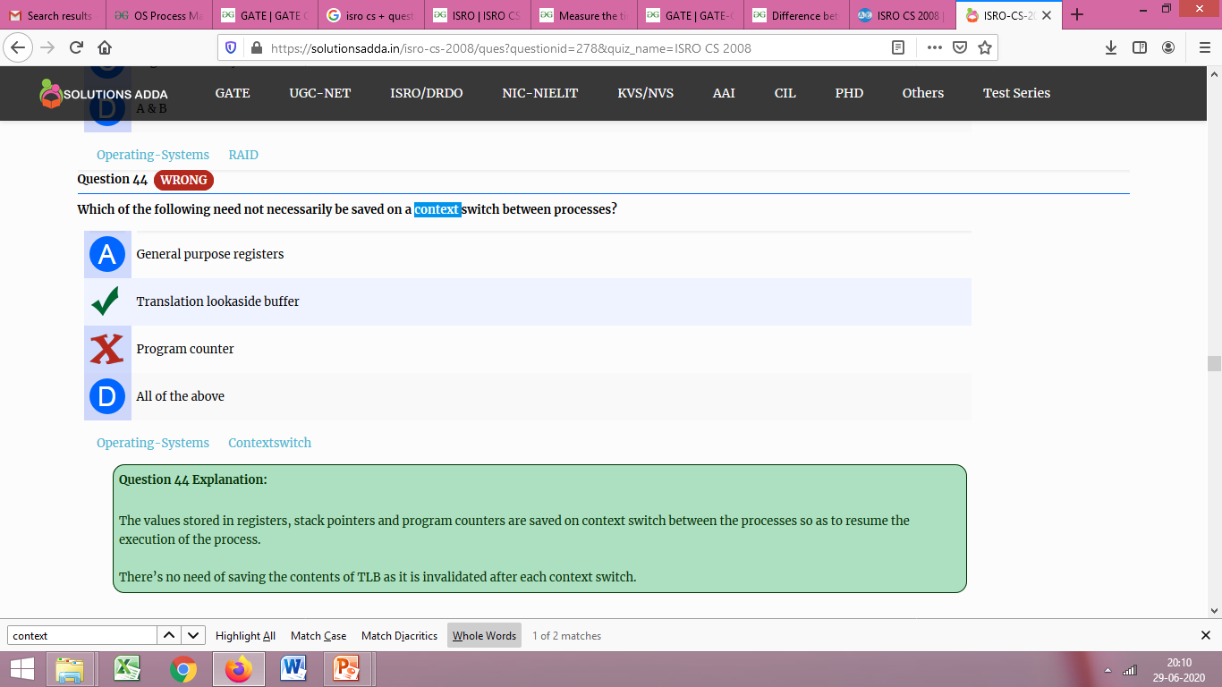
ISRO CS 2008 |
Which of the following need not necessarily be saved on a Context Switch between processes?
General purpose registers
Translation lookaside buffer
Program counter
Stack pointer
Answer : B, Explanation:

Slide 30
ISRO | ISRO CS 2008 | Question 60
Fork is (A) the creation of a new job (B) the dispatching of a task (C) increasing the priority of a task (D) the creation of a new process

Slide 31
ISRO | ISRO CS 2008 | Question 60
Fork is (A) the creation of a new job (B) the dispatching of a task (C) increasing the priority of a task (D) the creation of a new process
Answer: (D) Explanation: fork() creates a new process by duplicating the calling process, The new process, referred to as child, is an exact duplicate of the calling process, referred to as parent, except for the following :
The child has its own unique process ID, and this PID does not match the ID of any existing process group. The child’s parent process ID is the same as the parent’s process ID. The child does not inherit its parent’s memory locks and semaphore adjustments. The child does not inherit outstanding asynchronous I/O operations from its parent nor does it inherit any asynchronous I/O contexts from its parent.
So, option (D) is correct.

Slide 32
ISRO | ISRO CS 2018 | Question 63
The following C program
main()
{ fork() ;
fork() ;
printf ("yes");
}
If we execute this core segment, how many times the string yes will be printed ? (A) Only once (B) 2 times (C) 4 times (D) 8 times

Slide 33
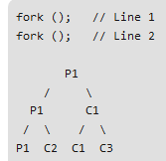
ISRO | ISRO CS 2018 | Question 63
The following C program
main()
{ fork() ; fork() ; printf ("yes"); }
If we execute this core segment, how many times the string yes will be printed ? (A) Only once (B) 2 times (C) 4 times (D) 8 times
Answer: (C) Explanation: Number of times YES printed is equal to number of process created. Total Number of Processes = 2^{n} where n is number of fork system calls. So here n = 2, 2⁴ = 4
So, there are total 4 processes (3 new child processes and one original process).

Slide 34
ISRO | ISRO CS 2017 | Question 61
A process executes the following code
for (i = 0; i < n; i++) fork( );
The total number of child processes created are (A) n² (B) 2^{n+1} -1 (C) 2^{n} (D) 2^{n} -1

Slide 35
ISRO | ISRO CS 2017 | Question 61
A process executes the following code
for (i = 0; i < n; i++) fork( );
The total number of child processes created are (A) n² (B) 2^{n+1} -1 (C) 2^{n} (D) 2^{n} -1 Answer: (D) Explanation: Option (D) is correct.
Total Number of Processes = 2^{n}
Number of Child/New Processes = 2^{n}-1

Slide 36
ISRO | ISRO CS 2017 – May | Question 50
What is the output of the following program?
main( )
{ int a = 10;
if ((fork ( ) == 0))
a++;
printf (“%d\n”, a );
}
(A) 10 and 11 (B) 10 (C) 11 (D) 11 and 11

Slide 37
ISRO | ISRO CS 2017 – May | Question 50
What is the output of the following program?
main( )
{ int a = 10;
if ((fork ( ) == 0))
a++;
printf (“%d\n”, a );
}
(A) 10 and 11 (B) 10 (C) 11 (D) 11 and 11
Answer: (A) 10 for parent and 11 for child

Slide 38
GATE | GATE CS 2012 | Question 8
A process executes the code
fork(); fork(); fork();
The total number of child processes created is (A) 3 (B) 4 (C) 7 (D) 8

Slide 39
GATE | GATE CS 2012 | Question 8
A process executes the code
fork(); fork(); fork();
The total number of child processes created is (A) 3 (B) 4 (C) 7 (D) 8 Answer: (C) Explanation: We can also use direct formula to get the number of child processes. With n fork statements, there are always 2^n – 1 child processes.

