Slide 1
Disk Scheduling

Slide 2
Disk Scheduling
The operating system is responsible for using hardware efficiently —
for the disk drives, this means having a fast access time and disk bandwidth
Minimize seek time
Seek time ≈ seek distance

Slide 3
Disk scheduling
Done by operating systems to schedule I/O requests arriving for the disk.

Slide 4
Hard Disk
A hard disk drive (HDD), hard disk, hard drive, or fixed disk
Is an electro-mechanical data storage device that stores and retrieves digital data using magnetic storage and one or more rigid rapidly rotating platters coated with magnetic material.
The platters are paired with magnetic heads, usually arranged on a moving actuator arm, which read and write data to the platter surfaces.
Data is accessed in a random-access manner, individual blocks of data can be stored and retrieved in any order.

Slide 5
Important?
Important because:
Multiple I/O requests may arrive by different processes and only one I/O request can be served at a time by the disk controller.
Thus other I/O requests need to wait in the waiting queue and need to be scheduled.
Two or more request may be far from each other so can result in greater disk arm movement.
Hard drives are one of the slowest parts of the computer system and thus need to be accessed in an efficient manner.

Slide 6
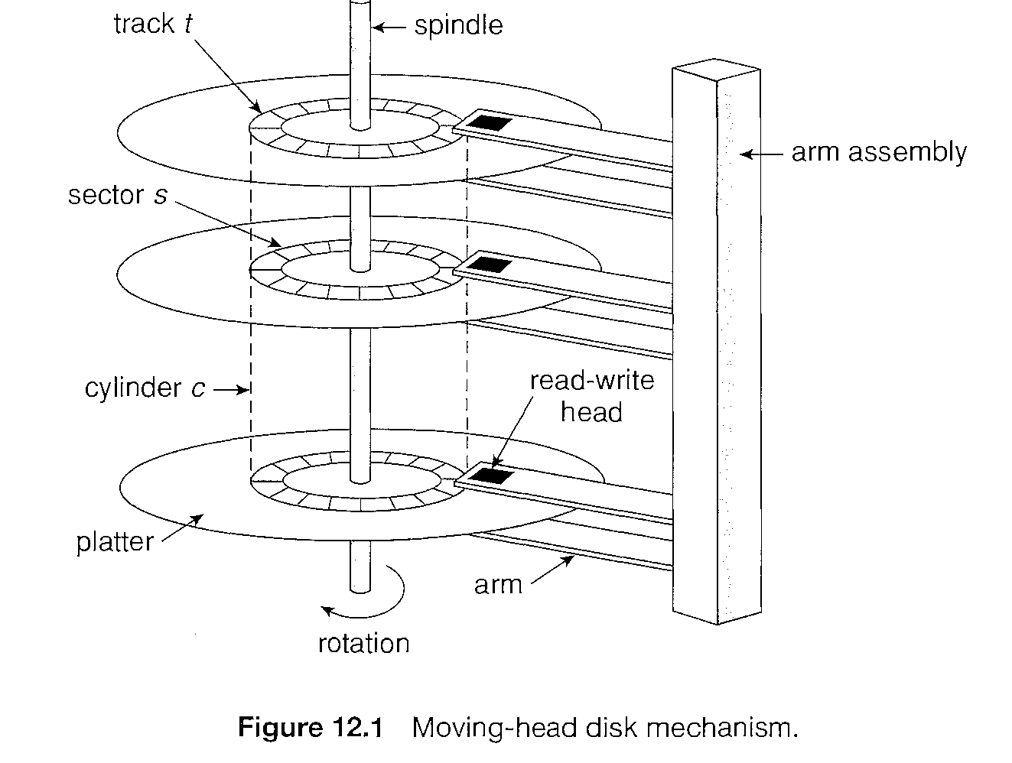
Some important terms:
Seek Time:
Seek time is the time taken to move the disk arm to a specified track containing the desired sector where the data is to be read or written.
So the disk scheduling algorithm that gives minimum average seek time is better.

Slide 7
Some important terms:
Rotational Latency:
Rotational Latency is the time taken by the desired sector of disk to rotate to the disk head, i.e. into a position so that it can access the read/write heads.
So the disk scheduling algorithm that gives minimum rotational latency is better

Slide 8
Some important terms:
Disk bandwidth:
is the total number of bytes transferred, divided by the total time between the first request for service and the completion of the last transfer

Slide 9
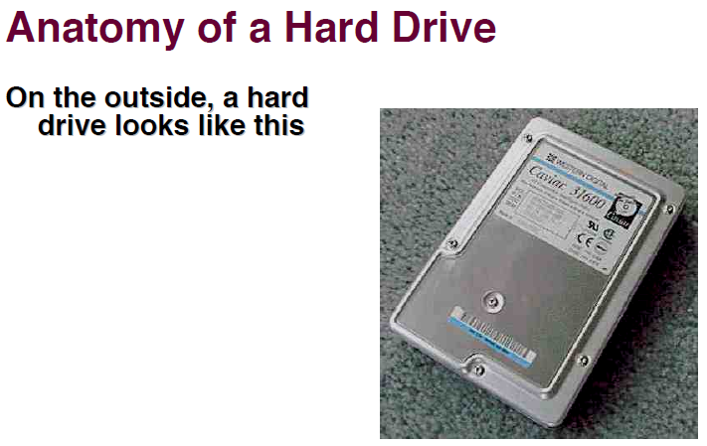

Slide 10
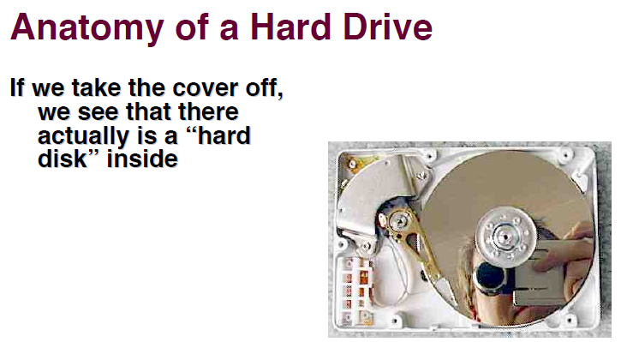

Slide 11
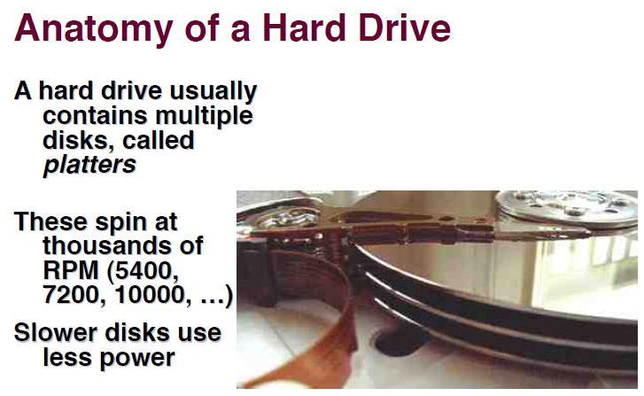

Slide 12
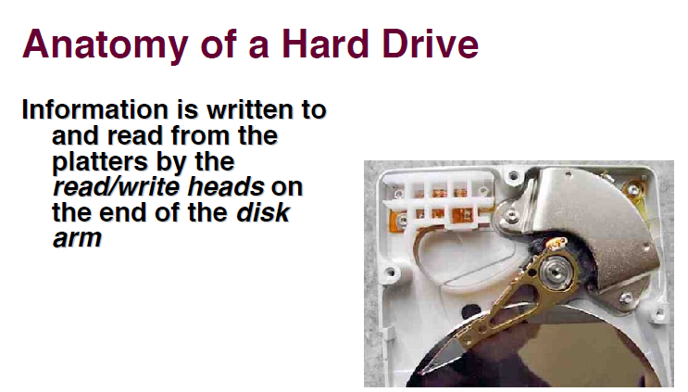

Slide 13
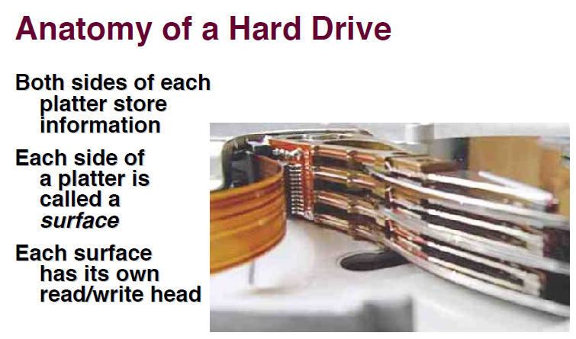

Slide 14
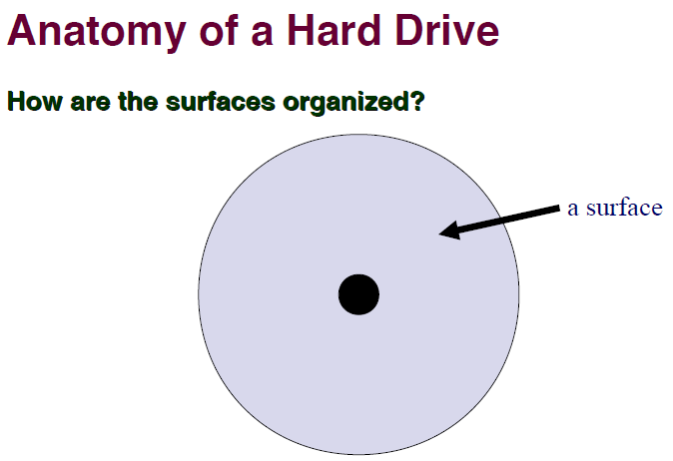
Courtesy-https://www.cs.cmu.edu/~410-s14/lectures/L27_Disks1.pdf

Slide 15
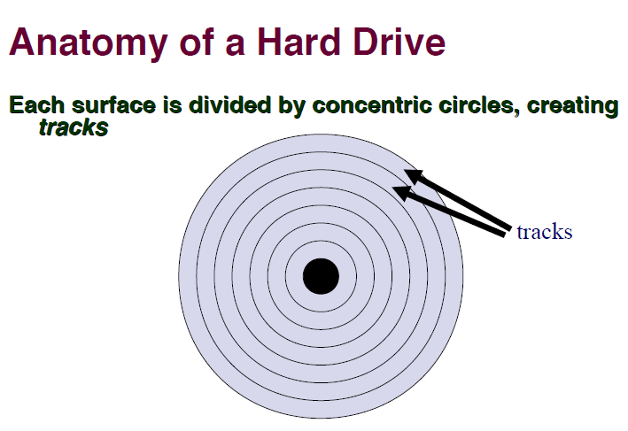

Slide 16
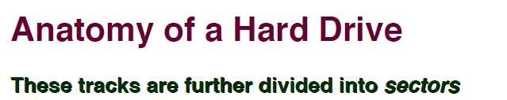

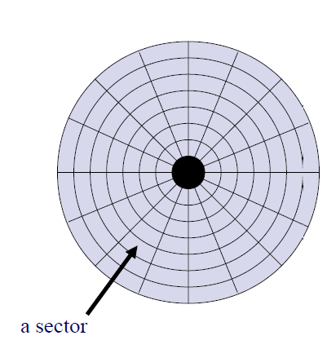

Slide 17
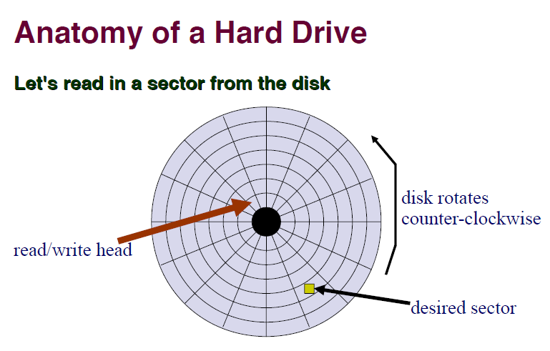

Slide 18
Some important terms:
Transfer Time: Transfer time is the time to transfer the data. It depends on the rotating speed of the disk and number of bytes to be transferred.
Disk Access Time: Disk Access Time is:
Disk Access Time = Seek Time + Rotational Latency + Transfer Time

Slide 19
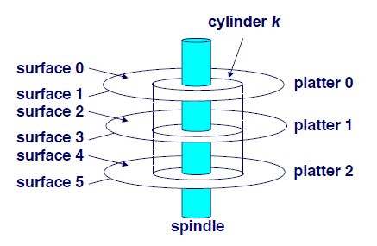

Disk Cylinder
Matching track across surfaces are collectively called cylinder

Slide 20
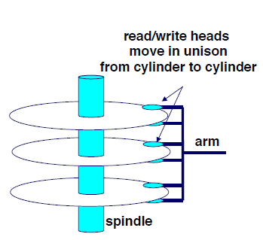
Disk Cylinder
Access within a cylinder is faster
Heads share one arm
All Heads always on same cylinder
Active Head is aligned, others are closed

Slide 21
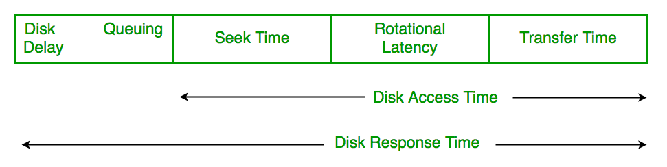
Some important terms:
Disk Response Time:
Response Time is the average of time spent by a request waiting to perform its I/O operation.
Average Response time is the response time of the all requests.
Variance Response Time is measure of how individual request are serviced with respect to average response time. So the disk scheduling algorithm that gives minimum variance response time is better.

Slide 22
Disk Scheduling (Cont.)
There are many sources of disk I/O request
OS
System processes
Users processes

Slide 23
Disk Scheduling (Cont.)
I/O request includes input or output mode, disk address, memory address, number of sectors to transfer
OS maintains queue of requests, per disk or device
Idle disk can immediately work on I/O request, busy disk means work must queue
Optimization algorithms only make sense when a queue exists

Slide 24
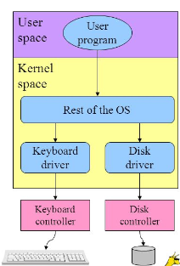
Disk Scheduling (Cont.)
Drive controllers
have small buffers and
can manage a queue of I/O requests (of varying “depth”)

Slide 25
Disk Scheduling (Cont.)
Several algorithms exist to schedule the servicing of disk I/O requests
The analysis is true for one or many platters

Slide 26
Disk Scheduling Algorithms
There are many Disk Scheduling Algorithms-
FCFS
SSTF
SCAN
C-SCAN
LOOK
C-LOOK

Slide 27
Disk Scheduling (Cont.)
We illustrate scheduling algorithms with a request queue (0-199)
Disk Queue with requests for I/O to blocks on cylinders
98, 183, 37, 122, 14, 124, 65, 67
Disk Head is initially at Cylinder 53
Head pointer 53

Slide 28
FCFS
Simplest form of disk scheduling
First-come, first-served (FCFS) algorithm.
Intrinsically fair
Does not provide the fastest service

Slide 29
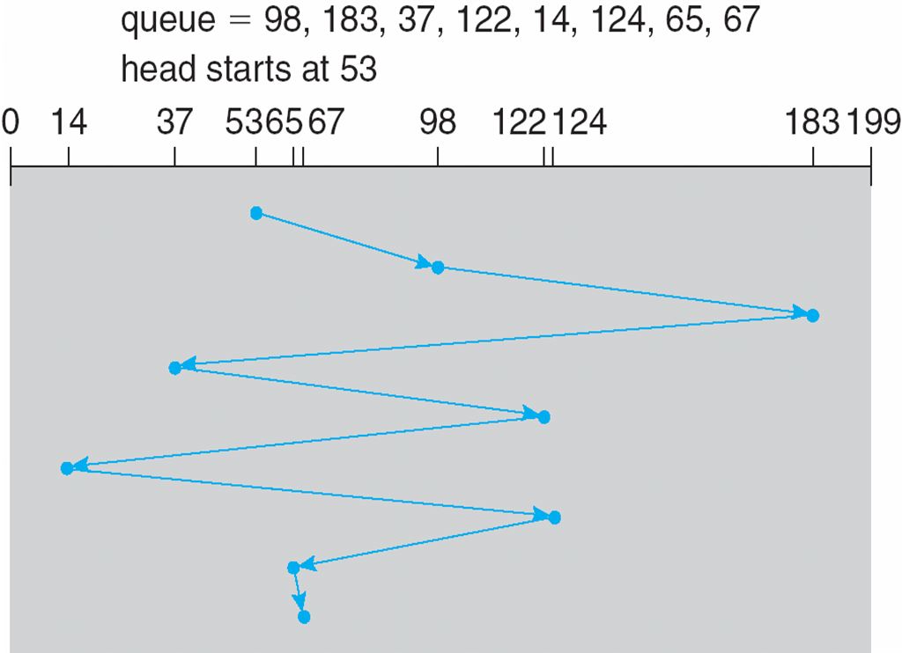
FCFS
Illustration shows total head movement of 640 cylinders

Slide 30
FCFS
The wild swing from 122 to 14 and then back to 124 illustrates the problem with this schedule.
If the requests for cylinders 37 and 14 could be serviced together, before or after the requests for 122 and 124,
the total head movement could be decreased substantially, and performance could be thereby improved.

Slide 31
FCFS
Maintain Queue of Requests
Implemented as FIFO Queue

Slide 32
FCFS
Advantages:
Every request gets a fair chance
No indefinite postponement
Disadvantages:
Does not try to optimize seek time
May not provide the best possible service
Unacceptably High Response time

Slide 33
SSTF
Service all the requests close to the current head position before moving the head far to service other
Shortest Seek Time First selects the request with the minimum seek time from the current head position

Slide 34
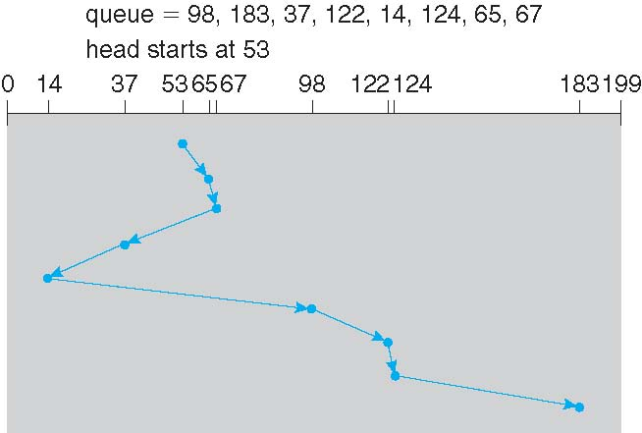
SSTF
Illustration shows total head movement of 236 cylinders

Slide 35
SSTF
The closest request to the initial head position (53) is at cylinder 65.
At cylinder 65, the next closest is cylinder 67.

Slide 36
SSTF
From there, the request at cylinder 37 is closer than the one at 98, so 37 is served next.
67-37=30
98-67=31
Continuing, we service the request at cylinder 14, then 98, 122, 124, and finally 183

Slide 37
SSTF
A total head movement of only 236 cylinders-
In FCFS, 640 cylinders,
SSTF-Little more than one-third of the distance needed for FCFS scheduling
This algorithm gives a substantial improvement in performance.

Slide 38
SSTF
SSTF scheduling is a form of SJF scheduling; may cause starvation of some requests
How??

Slide 39
SSTF
If Requests are for cylinders 14 and 186??
While the request from 14 is being serviced, a new request near 14 arrives.
This new request will be serviced next, making the request at 186 wait.
While this request is being serviced, another request close to 14 could arrive.
A continual stream of requests near one another could cause the request for cylinder 186 to wait indefinitely.

Slide 40
SSTF
Substantial improvement over the FCFS algorithm
Not optimal
We can do better by moving the head
from 53 to 37, even though the latter is not closest, and
then to 14, before turning around to service 65, 67, 98, 122, 124, and 183.
This strategy reduces the total head movement to 208 cylinders.

Slide 41
SSTF
Advantages:
Average Response Time decreases
Very Good Average Response time
Throughput increases
Excellent Throughput (More seeks are short)
Disadvantages:
Overhead to calculate seek time in advance
Can cause Starvation for a request
High variance of response time
Intolerable Response time variance
SSTF favors only some requests

Slide 42
SCAN
The disk arm starts at one end of the disk, and moves toward the other end, servicing requests until it gets to the other end of the disk
At the other end, the direction of head movement is reversed and servicing continues.
The head continuously scans back and forth across the disk.

Slide 43
SCAN
SCAN algorithm Sometimes called the elevator algorithm
Since the disk arm behaves just like an elevator in a building,
First servicing all the requests going up and
then reversing to service requests the other way.

Slide 44
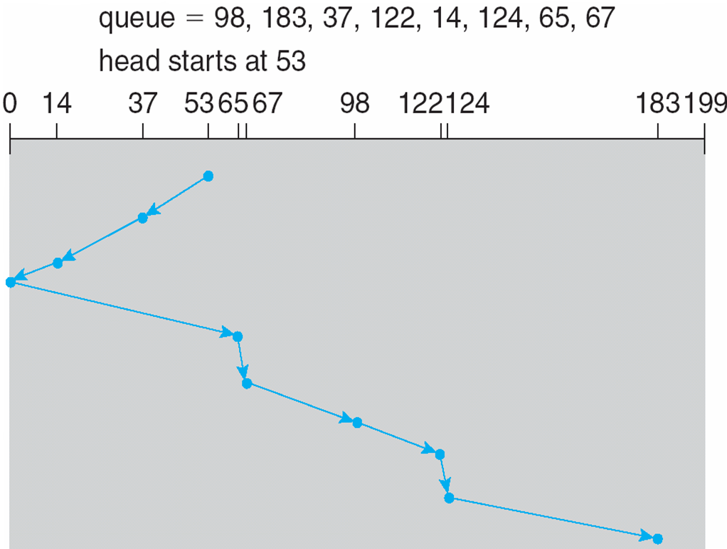
SCAN (Cont.)

Slide 45
SCAN (Cont.)
Need to know the direction of head movement in addition to the head's current position, In Advance

Slide 46
SCAN (Cont.)
Assuming that the disk arm is moving toward 0 and that the initial head position is again 53,
The head will next service 37 and then 14.
At cylinder 0, the arm will reverse and will move toward the other end of the disk, servicing the requests at 65, 67, 98, 122, 124, and 183

Slide 47
SCAN (Cont.)
If a request arrives in the queue just in front of the head,
it will be serviced almost immediately;
A request arriving just behind the head
will have to wait until the arm moves to the end of the disk, reverses direction, and comes back.

Slide 48
SCAN
Illustration shows total head movement of 208 cylinders
SSTF, 236 cylinders-
FCFS, 640 cylinders

Slide 49
SCAN
But note that if requests are uniformly dense, largest density at other end of disk and those wait the longest
??

Slide 50
SCAN
Assuming a uniform distribution of requests for cylinders,
When the head reaches one end and reverses direction.
At this point, relatively few requests are immediately in front of the head, since these cylinders have recently been serviced.
The heaviest density of requests is at the other end of the disk
These requests have also waited the longest so why not go there first?
That is the idea of the next algorithm.

Slide 51
SCAN
Advantages:
High throughput
Low variance of response time
Response time variance better than SSTF
Average response time
Worse than SSTF, better than FCFS
Disadvantages:
Long waiting time for requests for locations just visited by disk arm

Slide 52
C-SCAN
Circular Scan

Slide 53
C-SCAN
The head moves from one end of the disk to the other, servicing requests as it goes
When it reaches the other end, however, it immediately returns to the beginning of the disk, without servicing any requests on the return trip

Slide 54
C-SCAN
Provides a more uniform wait time than SCAN
Treats the cylinders as a circular list that wraps around from the last cylinder to the first one

Slide 55
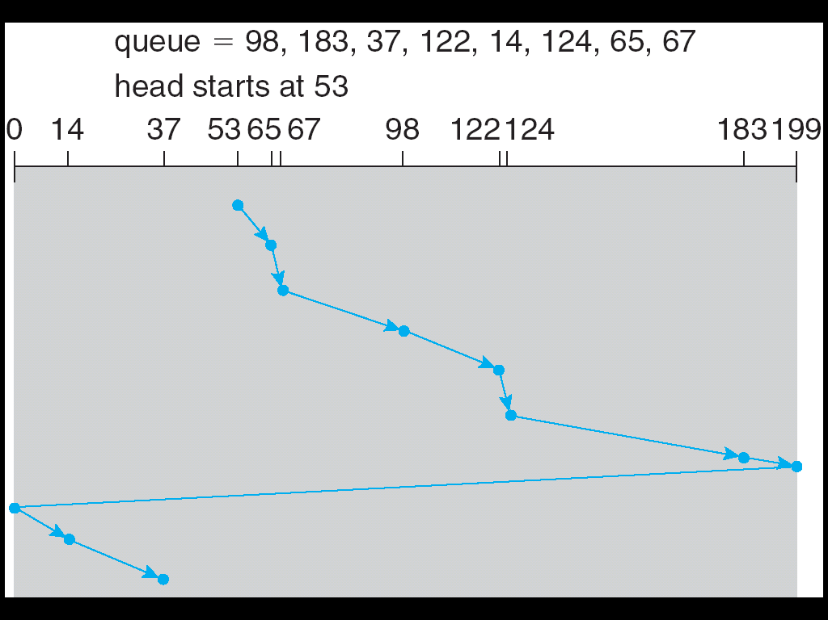
C-SCAN (Cont.)

Slide 56
C-SCAN
Advantages:
Provides more uniform wait time compared to SCAN

Slide 57
SCAN , C-SCAN
Both SCAN and C-SCAN move the disk arm across the full width of the disk.
In practice neither algorithm is often implemented this way.

Slide 58
LOOK, C-LOOK
LOOK a version of SCAN
C-LOOK a version of C-SCAN
They look for a request before continuing to move in a given direction
Arm only goes as far as the last request in each direction, then reverses direction immediately, instead of going all the way to the end of the disk

Slide 59
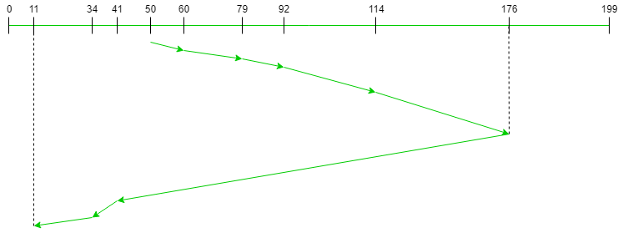
LOOK Algorithm
Request sequence = {176, 79, 34, 60, 92, 11, 41, 114}
Initial head position = 50
Direction = right (We are moving from left to right)
Seek Sequence is 60 79 92 114 176 41 34 11

Slide 60
LOOK Algorithm
Request sequence = {176, 79, 34, 60, 92, 11, 41, 114}
Initial head position = 50
Direction = right (We are moving from left to right)
Seek Sequence is 60 79 92 114 176 41 34 11
Total seek count= (60-50)+(79-60)+(92-79)+(114-92)+(176-114)+(176-41)+(41-34)+(34-11)=291
Total number of seek operations = 291

Slide 61
C-LOOK
Circular Look

Slide 62
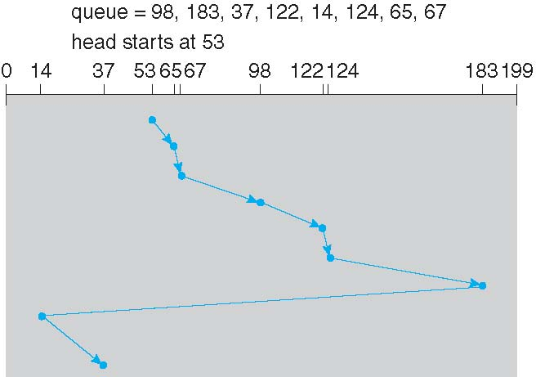
C-LOOK (Cont.)

Slide 63
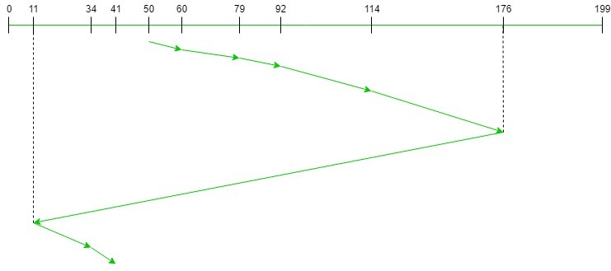
C-LOOK Algorithm
Request sequence = {176, 79, 34, 60, 92, 11, 41, 114}
Initial head position = 50
Direction = right (We are moving from left to right)
Seek Sequence is 60 79 92 114 176 11 34 41
The total seek count = (60 – 50) + (79 – 60) + (92 – 79) + (114 – 92) + (176 – 114) + (176 – 11) + (34 – 11) + (41 – 34) = 321
Total number of seek operations = 321

Slide 64
LOOK,C-LOOK
LOOK-
Improves Mean Response time and Variance
C-LOOK-
Very popular

Slide 65
Selecting a Disk-Scheduling Algorithm
SSTF is common and has a natural appeal
SCAN and C-SCAN perform better for systems that place a heavy load on the disk
Less starvation
Performance depends on the number and types of requests
Requests for disk service can be influenced by the file-allocation method
And metadata layout

Slide 66
Selecting a Disk-Scheduling Algorithm
The disk-scheduling algorithm should be written as a separate module of the operating system, allowing it to be replaced with a different algorithm if necessary
Either SSTF or LOOK is a reasonable choice for the default algorithm
What about rotational latency?
Difficult for OS to calculate
How does disk-based queueing effect OS queue ordering efforts?

Slide 67
For I/O Operations
Unit of transfer:
Data may be transferred as a stream of bytes or characters(e.g., terminal I/O) or in larger blocks (e.g., disk I/O).

Slide 68
Disk Management
The operating system is responsible for several other aspects of disk management like
disk initialization
disk formatting
booting from disk, and
bad-block recovery

Slide 69
Disk Management
Low-level formatting, or physical formatting —
Dividing a disk into sectors that the disk controller can read and write

Slide 70
Disk Management
Low-level formatting, or physical formatting —
Each sector can hold
header information,
plus data,
plus error correction code (ECC)

Slide 71
Disk Management
Low-level formatting, or physical formatting —
Disk controller handles how many bytes of data space to leave between the header and trailer of all sectors.
It is usually possible to choose among a few sizes, such as 256,512, and 1,024 bytes.
Usually 512 bytes of data

Slide 72
Disk Management
Low-level formatting, or physical formatting —
Enables the manufacturer to test the disk
To initialize the mapping from logical block numbers to defect-free sectors on the disk.

Slide 73
Disk Management
Partitioning
To use a disk to hold files, the operating system still needs to record its own data structures on the disk
Partition the disk into one or more groups of cylinders, each treated as a logical disk
The operating system can treat each partition as though it were a separate disk.
One partition can hold a copy of the operating system's executable code
Another holds user files

Slide 74
Disk Management
Logical formatting
“making a file system”
“creation of a file system“
The OS stores the initial file-system data structures onto the disk.
These data structures may include
maps of free and allocated space (a FAT or inodes)
an initial empty directory

Slide 75
Disk Management (Cont.)
Bad Blocks
Methods such as sector sparing used to handle bad blocks

Slide 76
Disk Management (Cont.)
Bad Blocks
Because disks have moving parts and small tolerances
As the disk head flies just above the disk surface,
They are prone to failure
If the failure is complete;
disk needs to be replaced and its contents restored from backup media to the new disk.
More frequently, one or more sectors become defective.

Slide 77
Disk Management (Cont.)
Bad Blocks
On simple disks, such as some disks with IDE controllers, bad blocks are handled manually.
More sophisticated disks, used in high-end PCs are smarter about bad-block recovery.
The controller maintains a list of bad blocks on the disk.
The list is initialized during the low-level formatting at the factory and is updated over the life of the disk.

Slide 78
Disk Management (Cont.)
Bad Blocks
Low-level formatting also sets aside spare sectors not visible to the operating system.
The controller can be told to replace each bad sector logically with one of the spare sectors. This scheme is known as sector sparing or forwarding

Slide 79
ISRO | ISRO CS 2018 | Question 68
Disk requests come to a disk driver for cylinders in the order 10, 22, 20, 2, 40, 6, and 38 at a time when the disk drive is reading from cylinder 20. The seek time is 6 ms/cylinder. The total seek time, if the disk arm scheduling algorithms is first-come-first-served is (A) 360 ms (B) 850 ms (C) 900 ms (D) None of the above

Slide 80
ISRO | ISRO CS 2018 | Question 68
Disk requests come to a disk driver for cylinders in the order 10, 22, 20, 2, 40, 6, and 38 at a time when the disk drive is reading from cylinder 20. The seek time is 6 ms/cylinder. The total seek time, if the disk arm scheduling algorithms is first-come-first-served is (A) 360 ms (B) 850 ms (C) 900 ms (D) None of the above Answer: (D) Explanation: FCFS Total seek time in FCFS Scheduling when the disk drive is reading from cylinder 20 for cylinders in the order 10, 22, 20, 2, 40, 6, and 38 :
= (10 + 12 + 2 + 18 + 38 + 34 + 32)*6 = 146*6 = 876 ms
As no other option matches the answer, option (D) is correct.

Slide 81
GATE | GATE-CS-2014-(Set-1) | Question 65
Suppose a disk has 201 cylinders, numbered from 0 to 200. At some time the disk arm is at cylinder 100, and there is a queue of disk access requests for cylinders 30, 85, 90, 100, 105, 110, 135 and 145. If Shortest-Seek Time First (SSTF) is being used for scheduling the disk access, the request for cylinder 90 is serviced after servicing ____________ number of requests. (A) 1 (B) 2 (C) 3 (D) 4

Slide 82
GATE | GATE-CS-2014-(Set-1) | Question 65
Suppose a disk has 201 cylinders, numbered from 0 to 200. At some time the disk arm is at cylinder 100, and there is a queue of disk access requests for cylinders 30, 85, 90, 100, 105, 110, 135 and 145. If Shortest-Seek Time First (SSTF) is being used for scheduling the disk access, the request for cylinder 90 is serviced after servicing ____________ number of requests. (A) 1 (B) 2 (C) 3 (D) 4 Answer: (C) Explanation: The disk will service that request first whose cylinder number is closest to its arm. Hence 1st serviced request is for cylinder no 100 ( as the arm is itself pointing to it ), then 105, then 110, and then the arm comes to service request for cylinder 90. Hence before servicing request for cylinder 90, the disk would had serviced 3 requests.
Hence option C.

Slide 83
GATE | GATE CS 2008 | Question 31
For a magnetic disk with concentric circular tracks, the seek latency is not linearly proportional to the seek distance due to (A) non-uniform distribution of requests (B) arm starting and stopping inertia (C) higher capacity of tracks on the periphery of the platter (D) use of unfair arm scheduling policies

Slide 84
GATE | GATE CS 2008 | Question 31
For a magnetic disk with concentric circular tracks, the seek latency is not linearly proportional to the seek distance due to (A) non-uniform distribution of requests (B) arm starting and stopping inertia (C) higher capacity of tracks on the periphery of the platter (D) use of unfair arm scheduling policies Answer: (B) Explanation: Whenever head moves from one track to other then its speed and direction changes, which is noting but change in motion or the case of inertia. So answer B

