Slide 1
I/O Management

Slide 2
I/O Management
I/O management is a major component of operating system design and operation
Important aspect of computer operation
I/O devices vary greatly
Various methods to control them
Performance management
New types of devices

Slide 3
I/O Management
Ports, buses, device controllers connect to various devices
Device drivers encapsulate device details
Present uniform device-access interface to I/O subsystem

Slide 4
I/O Hardware
Incredible variety of I/O devices
Storage/Machine readable
Suitable for communicating with electronic equipment
Disks,
Tapes
Sensors
Controllers
USB Keys

Slide 5
I/O Hardware
Incredible variety of I/O devices
Transmission devices/Communication
Suitable for communicating with remote devices
network cards
modems
Human-interface/Human Readable
Suitable for communicating with the user
Terminals i.e. Screen, video display
Keyboard,
Mouse,
Printers

Slide 6
I/O Hardware
Incredible variety of I/O devices
More specialized devices –
Eg- Those involved in the steering of a military fighter jet or a space shuttle.
In these aircraft,
a human gives input to the flight computer via a joystick and foot pedals, and
the computer sends output commands that cause motors to move rudders, flaps, and thrusters.

Slide 7
I/O Hardware
Unit of transfer:
Data may be transferred as a stream of bytes or characters (e.g., terminal I/O) or in larger blocks (e.g., disk I/O).
Data representation:
Different data encoding schemes are used by different devices, including differences in character code and parity conventions.
Error conditions:
The nature of errors, the way in which they are reported, their consequences, and the available range of responses differ widely from one device to another.

Slide 8
I/O Hardware
Types of I/O devices-
Block oriented
Stream oriented

Slide 9
I/O Hardware
Block-oriented device
stores information in blocks that are usually of fixed size, and transfers are made one block at a time.
Generally, it is possible to reference data by its block number.
Disks and USB keys devices.

Slide 10
I/O Hardware
Stream-oriented device
transfers data in and out as a stream of bytes, with no block structure.
Terminals, printers, communications ports, mouse and other pointing devices, and most other devices that are not secondary storage

Slide 11
How the devices are attached and how the software can control the hardware??

Slide 12
I/O Hardware
Common concepts – signals from I/O devices interface with computer
Port – connection point for device
Bus - daisy chain or shared direct access
PCI bus common in PCs and servers, PCI Express (PCIe)
expansion bus connects relatively slow devices
Controller (host adapter) – electronics that operate port, bus, device
Sometimes integrated
Sometimes separate circuit board (host adapter)
Contains processor, microcode, private memory, bus controller, etc
Some talk to per-device controller with bus controller, microcode, memory, etc

Slide 13
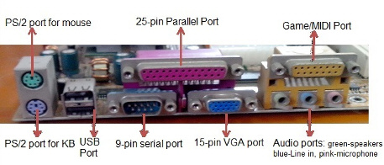
I/O Hardware
A device communicates with a computer system by sending signals over a cable or even through the air.
Port-
A connection point via which the device communicates with the machine. Eg- a serial port.

Slide 14
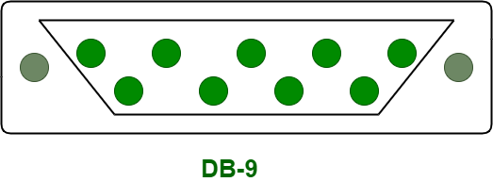
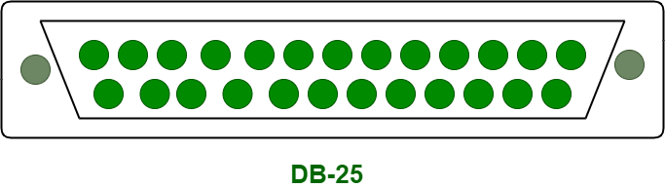
I/O Hardware
Serial Port:
An interface that is used for connecting the serial lines to attain the serial communication.
These ports can dock a 9-pin D-shaped connector that connects to the transmission line, is called DB-9 connectors.
Parallel Port:
Unlike serial port, a parallel port can move a set of 8 bits at a time on eight different wires. That’s why it is faster in comparison to the serial communication.
Unlike serial port, It uses a 25 pin connector that is called DB-25 connector.

Slide 15
I/O Hardware
Check Serial Port and Parallel Port

Slide 16
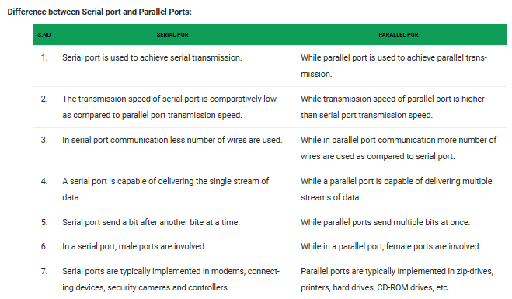

Slide 17
I/O Hardware
Bus-
If devices use a common set of wires, the connection is called a bus.
Set of wires and a rigidly defined protocol that specifies a set of messages that can be sent on the wires.
The messages are conveyed by patterns of electrical voltages applied to the wires with defined timings.

Slide 18
I/O Hardware
Daisy Chain-
When device A has a cable that plugs into device B, and
Device B has a cable that plugs into device C,
Device C plugs into a port on the computer,
Daisy Chain usually operates as a bus.

Slide 19
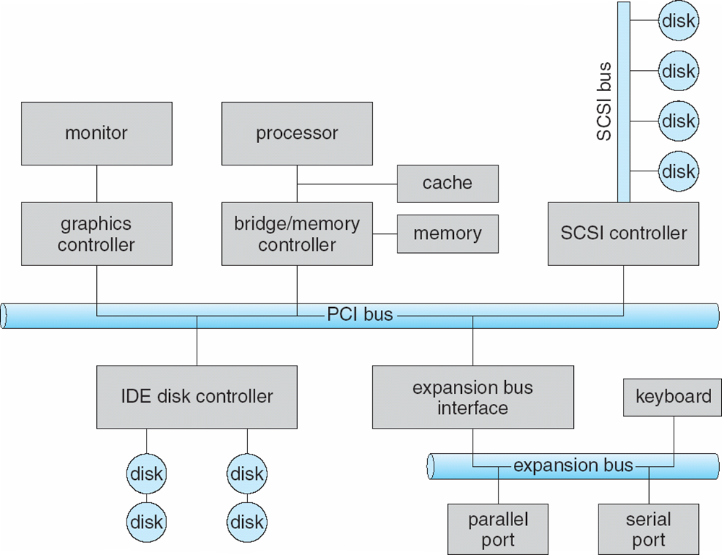
A Typical PC Bus Structure

Slide 20
A Typical PC Bus Structure
"Peripheral Component Interconnect." hardware bus
Common PC system bus
connects the processor-memory subsystem to the fast devices
Expansion Bus
connects relatively slow devices, such as the keyboard and serial and USB ports.

Slide 21
A Typical PC Bus Structure
Top-right portion ,
four disks are connected together
on a SCSI bus plugged into a SCSI controller.
Small Computer System Interface (SCSI)
set of parallel interface standards that allows PCs to communicate with peripheral hardware faster

Slide 22
A Typical PC Bus Structure
Other common buses used to interconnect main parts of a computer
PCI-x with throughput up to 4.3 GB;
PCI Express (PCie), with throughput up to 16 GB
Hypertransport with throughput up to 20 GB.

Slide 23
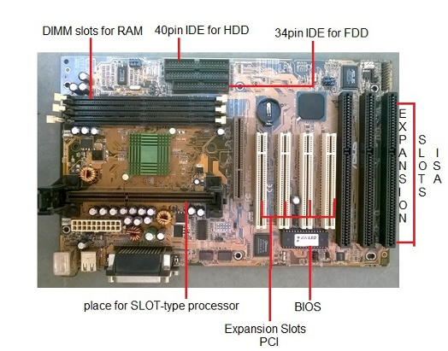
Expansion Slots
ISA slots.
Oldest expansion slots in the history of motherboards.
Used in AT boards and are identified by black color.
Conventional display cards or sound cards were installed in these slots.
The full form of ISA is Industry Standard Architecture and is a 16- bit bus.

Slide 24
Expansion Slots
PCI Slots.
PCI (Peripheral Component Interconnect) Slot: Supports peripherals like sound cards, DVD decoders, and graphic accelerators
There are usually anywhere from 1 to 6 PCI slots available on the motherboard.
The PCI supports 64-bit high-speed bus.

Slide 25
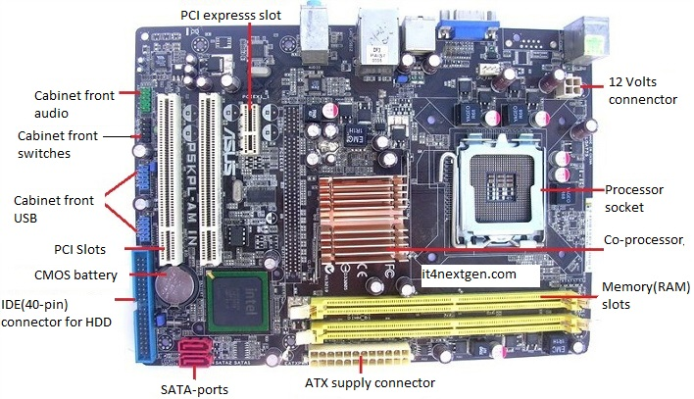
Expansion Slots
PCI express.
Also known as PCIe,
Latest and the fastest component of the motherboard to support add-on cards.
It supports full duplex serial bus.

Slide 26
11.2 ORGANIZATION OF THE I/O FUNCTION
Three techniques for performing I/O:
Programmed I/O
Interrupt-driven I/O
Direct memory access (DMA)

Slide 27
11.2 ORGANIZATION OF THE I/O FUNCTION
Programmed I/O:
The processor issues an I/O command, on behalf of a process, to an I/O module;
that process then busy waits for the operation to be completed before proceeding.

Slide 28
11.2 ORGANIZATION OF THE I/O FUNCTION
Interrupt-driven I/O:
The processor issues an I/O command on behalf of a process.
There are then two possibilities.
If the I/O instruction from the process is non blocking,
the processor continues to execute instructions from the process that issued the I/O command.
If the I/O instruction is blocking,
then the next instruction that the processor executes is from the OS,
which will put the current process in a blocked state Interrupt the current process and schedule another process.

Slide 29
11.2 ORGANIZATION OF THE I/O FUNCTION
Direct memory access (DMA):
The processor sends a request for the transfer of a block of data to the DMA module and is interrupted only after the entire block has been transferred.
A DMA module controls the exchange of data between main memory and an I/O module.
DMA is the dominant form of transfer that must be supported by the operating system.

Slide 30
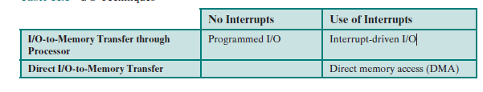
11.2 ORGANIZATION OF THE I/O FUNCTION

Slide 31
11.2 ORGANIZATION OF THE I/O FUNCTION
Direct memory access (DMA):
The DMA unit is capable of mimicking the processor
Taking control of the system bus just like a processor
It needs to do this to transfer data to and from memory over the system bus.

Slide 32
11.2 ORGANIZATION OF THE I/O FUNCTION
Direct memory access (DMA):
The DMA technique works as follows.
When the processor wishes to read or write a block of data, it issues a command to the DMA module by sending to the DMA module some information:

Slide 33
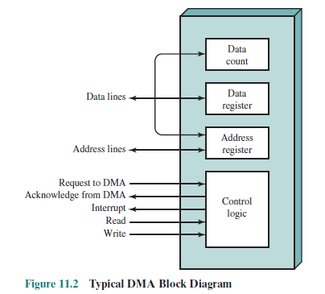
11.2 ORGANIZATION OF THE I/O FUNCTION
Direct memory access (DMA):
The information is:
Whether a read or write is requested,
Using the read or write control line between the processor and the DMA module
The address of the I/O device involved, communicated on the data lines

Slide 34
11.2 ORGANIZATION OF THE I/O FUNCTION
Direct memory access (DMA):
• The starting location in memory to read from or write to, communicated on the data lines and stored by the DMA module in its address register
• The number of words to be read or written, again communicated via the data lines and stored in the data count register

Slide 35
11.2 ORGANIZATION OF THE I/O FUNCTION
Direct memory access (DMA):
The processor then continues with other work.
It has delegated this I/O operation to the DMA module

Slide 36
11.2 ORGANIZATION OF THE I/O FUNCTION
Direct memory access (DMA):
The DMA module transfers the entire block of data,
one word at a time,
directly to or from memory,
without going through the processor

Slide 37
11.2 ORGANIZATION OF THE I/O FUNCTION
Direct memory access (DMA):
When the transfer is complete,
the DMA module sends an interrupt signal to the processor.
The processor is involved only at the beginning and end of the transfer

Slide 38
Direct Memory Access (DMA)
DMA Controller is a hardware device that allows I/O devices to directly access memory with less participation of the processor.
For The data transfer between a storage media such as magnetic disk and memory unit. The peripherals can directly communicate with each other using the memory buses, removing the intervention of the CPU. This type of data transfer technique is known as DMA or direct memory access.

Slide 39
Direct Memory Access (DMA)
During DMA, the CPU is idle and it has no control over the memory buses. The DMA controller takes over the buses to manage the transfer directly between the I/O devices and the memory unit.

Slide 40
Direct Memory Access (DMA)
GATE | GATE-CS-2016 (Set 1) | Question 41
The size of the data count register of a DMA controller is 16 bits. The processor needs to transfer a file of 29,154 kilobytes from disk to main memory. The memory is byte addressable. The minimum number of times the DMA controller needs to get the control of the system bus from the processor to transfer the file from the disk to main memory is _________
(A) 3644 (B) 3645 (C) 456 (D) 1823

Slide 41
Direct Memory Access (DMA)
GATE | GATE-CS-2016 (Set 1) | Question 41
The size of the data count register of a DMA controller is 16 bits. The processor needs to transfer a file of 29,154 kilobytes from disk to main memory. The memory is byte addressable. The minimum number of times the DMA controller needs to get the control of the system bus from the processor to transfer the file from the disk to main memory is _________
(A) 3644 (B) 3645 (C) 456 (D) 1823 Answer: (C) Explanation: Size of data count register of the DMA controller = 16 bits Data that can be transferred in one go = 2¹⁶ bytes = 64 kilobytes File size to be transferred = 29154 kilobytes So, number of times the DMA controller needs to get the control of the system bus from the processor to transfer the file from the disk to main memory = ceil(29154/64) = 456

Slide 42
OPERATING SYSTEM DESIGN ISSUES FOR I/O
Design Objectives
Two objectives are paramount in designing the I/O facility:
Efficiency
Generality

Slide 43
OPERATING SYSTEM DESIGN ISSUES
Efficiency
Most I/O devices are extremely slow compared with main memory and the processor.
Solution??

Slide 44
OPERATING SYSTEM DESIGN ISSUES
Efficiency
Soln=Multiprogramming,
Allow some processes to be waiting on I/O operations while another process is executing.
However, even with the vast size of main memory in today’s machines, it will still often be the case that I/O is not keeping up with the activities of the processor.

Slide 45
OPERATING SYSTEM DESIGN ISSUES
Generality
In the interests of simplicity and freedom from error, it is desirable to handle all devices in a uniform manner.
Uniformity=
The way in which processes view I/O devices
The way in which the OS manages I/O devices and operations.
Due to diversity of device characteristics, it is difficult to achieve true generality

Slide 46
OPERATING SYSTEM DESIGN ISSUES
Generality
Soln=
Use a hierarchical, modular approach to the design of the I/O function.
This approach hides details of device I/O in lower-level routines so that
User processes and Upper levels of the OS see devices in terms of general functions, such as
read,
write,
open,
close,
lock,
unlock

Slide 47
Logical Structure of the I/O Function
Hierarchical Approach-
Leads to an organization of the OS into a series of layers
Each layer performs a related subset of the functions required of the OS
It relies on the next lower layer to perform more primitive functions and to conceal the details of those functions.
It provides services to the next higher layer.

Slide 48
Logical Structure of the I/O Function
Hierarchical Approach-
Ideally, the layers should be defined so that changes in one layer do not require changes in other layers.
Decomposed one problem into a number of more manageable sub problems.

Slide 49
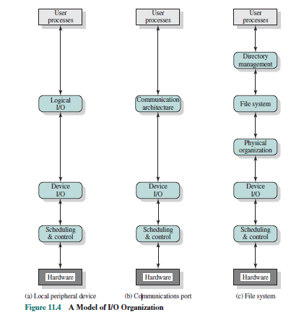
Logical Structure of the I/O Function
The Hierarchy/Logical Structure for I/O
The details of the organization will depend on type of device and the application
Most operating systems approach I/O in approximately this way.

Slide 50
Logical Structure of the I/O Function
Logical I/O:
Deals with the device as a logical resource
Not concerned with the details of actually controlling the device.

Slide 51
Logical Structure of the I/O Function
Logical I/O:
Concerned with managing general I/O functions on behalf of user processes,
allowing them to deal with the device in terms of a device identifier
simple commands such as open, close, read, and write

Slide 52
Logical Structure of the I/O Function
Device I/O:
The requested operations and data (buffered characters, records, etc.) are converted into
appropriate sequences of I/O instructions,
channel commands,
controller orders

Slide 53
Logical Structure of the I/O Function
Device I/O:
Buffering techniques may be used to improve utilization

Slide 54
Logical Structure of the I/O Function
Scheduling and control:
The actual queueing and scheduling of I/O operations occurs at this layer, as well as the control of the operations.
Interrupts are handled

Slide 55
Logical Structure of the I/O Function
Scheduling and control:
I/O status is collected and reported
Layer of software that actually interacts with the I/O module and hence the device hardware

Slide 56
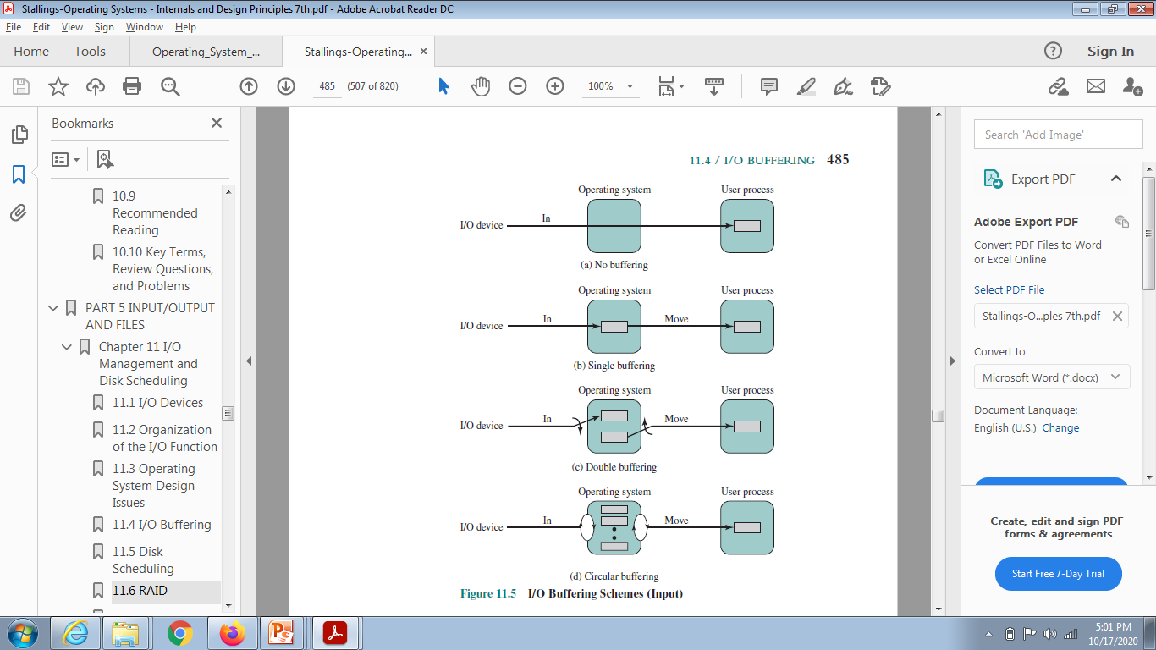
I/O BUFFERING

Slide 57
I/O BUFFERING
Single Buffer
The simplest type of support that the OS can provide
When a user process issues an I/O request,
the OS assigns a buffer in the system portion of main memory to the operation.

Slide 58
I/O BUFFERING
Single Buffer
Input transfers are made to the system buffer.
When the transfer is complete, the process moves the block into user space and immediately requests another block.
It is called reading ahead, or anticipated input;

Slide 59
I/O BUFFERING
Single Buffer
Done in the expectation that the block will eventually be needed.
This approach provides a speedup compared to no buffering.

Slide 60
I/O BUFFERING
Double Buffer
Assigning two system buffers to the operation
A process now transfers data to (or from) one buffer
while the operating system empties (or fills) the other.
Known as buffer swapping .

Slide 61
I/O BUFFERING
Circular Buffer
Double buffering may be inadequate if the process performs rapid bursts of I/O
In this case, the problem can often be alleviated by using more than two buffers.

Slide 62
I/O BUFFERING
Circular Buffer
When more than two buffers are used,
the collection of buffers is referred to as circular buffer,
with each individual buffer being one unit in the circular buffer.
This is simply the bounded-buffer producer/consumer model

Slide 63
I/O BUFFERING
The Utility of Buffering
Buffering is a technique that smoothes out peaks in I/O demand.
No amount of buffering will allow an I/O device to keep pace with a process indefinitely
when the average demand of the process is greater than the I/O device can service
Why??

Slide 64
I/O BUFFERING
Even with multiple buffers,
all of the buffers will eventually fill up
the process will have to wait after processing each chunk of data.
In a multiprogramming environment,
Variety of I/O activity
Variety of process activity to service,
buffering can increase the efficiency of the OS and the performance of individual processes.

