Slide 1



Project Title: PASSWORD WALLET
Team Details:
FY- A2 – Computer Engineering
16010121033 - Nupur Chaudhari
16010121043 - Vishrut Deshmukh
16010121045 - Pargat Singh Dhanjal

Slide 2

Problem Statement
Create a password manager using the module Cryptography that encrypts passwords that are taken as inputs from the user and stores them all at one place. Create a Graphical User Interface (GUI) using Tkinter- Standard Python interface, to handle them.​​
The system can accept new user accounts, login to existing accounts, and is able to add, store and view site name and their passwords entered by the users.
Hence, making it accessible to handle and manage numerous passwords at once without having the fear of forgetting it. The encryption makes it more secure and less vulnerable to hacking which ensures security of the passwords.

Slide 3
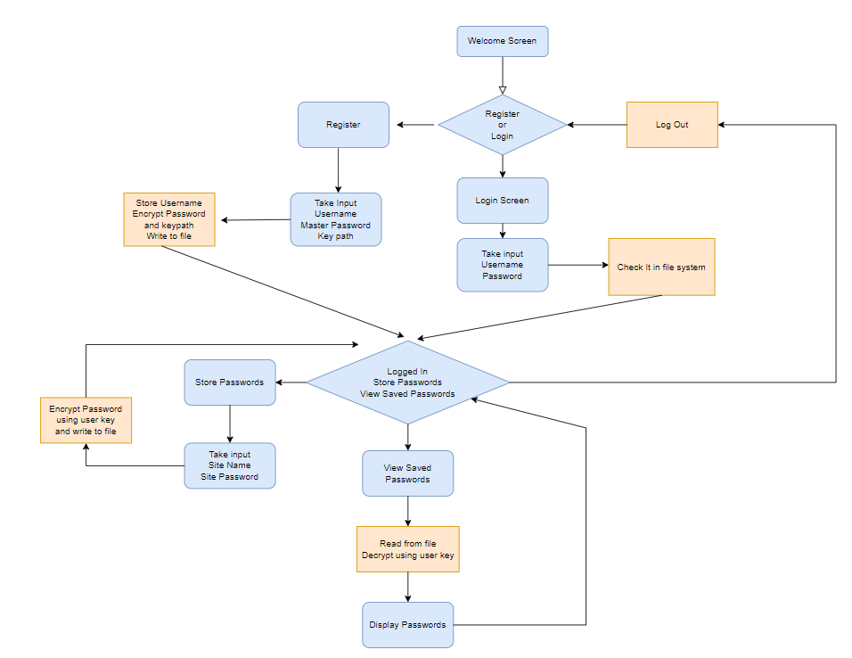
System Architecture

Slide 4

Features of designed system
Easy and Friendly User Interface
Master password encryption
URL-safe base64-encoded 32-byte key for encryption
Runs and stores passwords locally on your machine
Cross platform
Multi-User support
Open Source Project

Slide 5
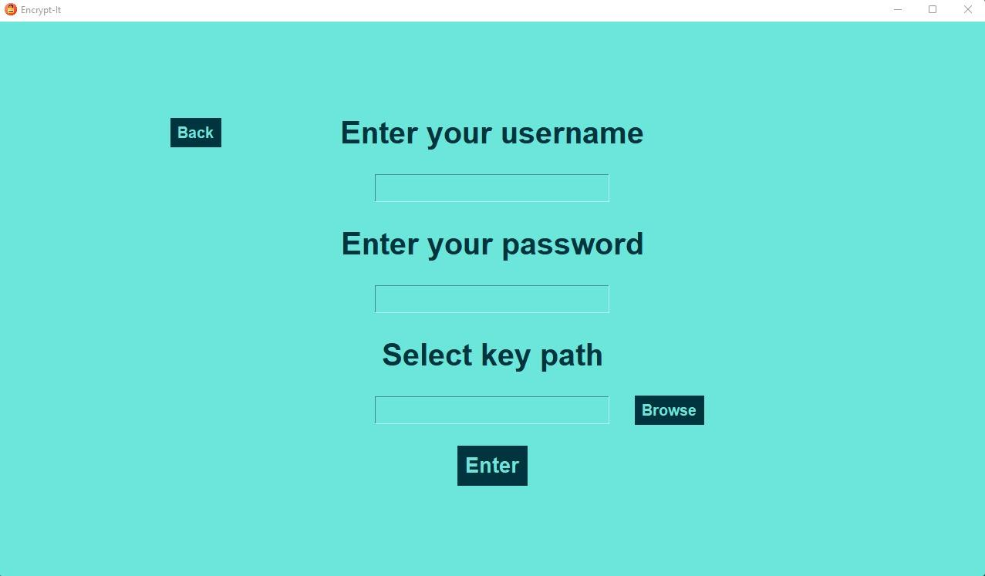
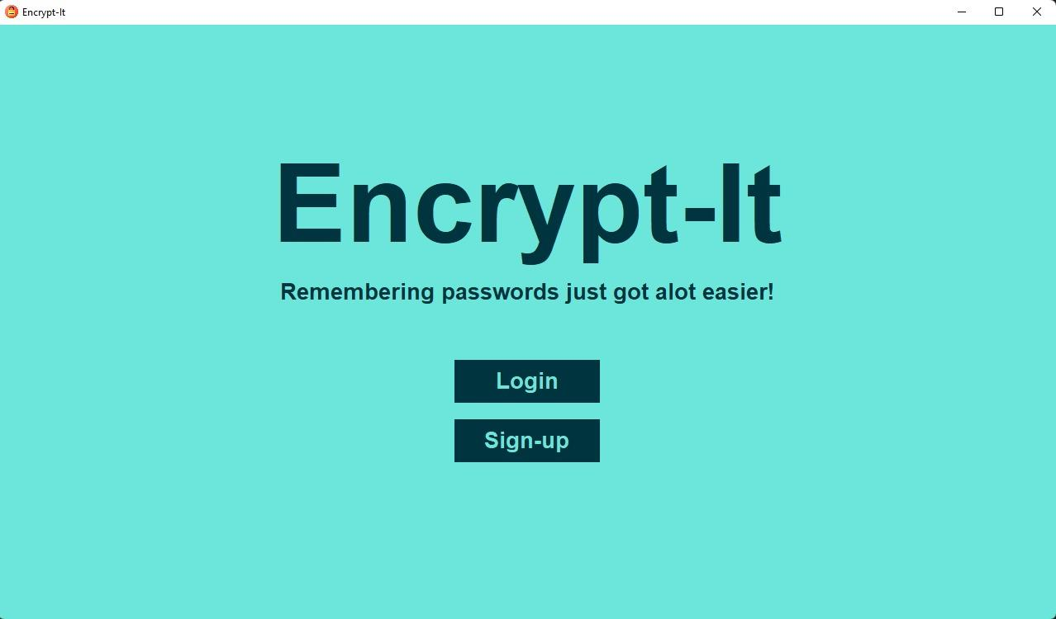
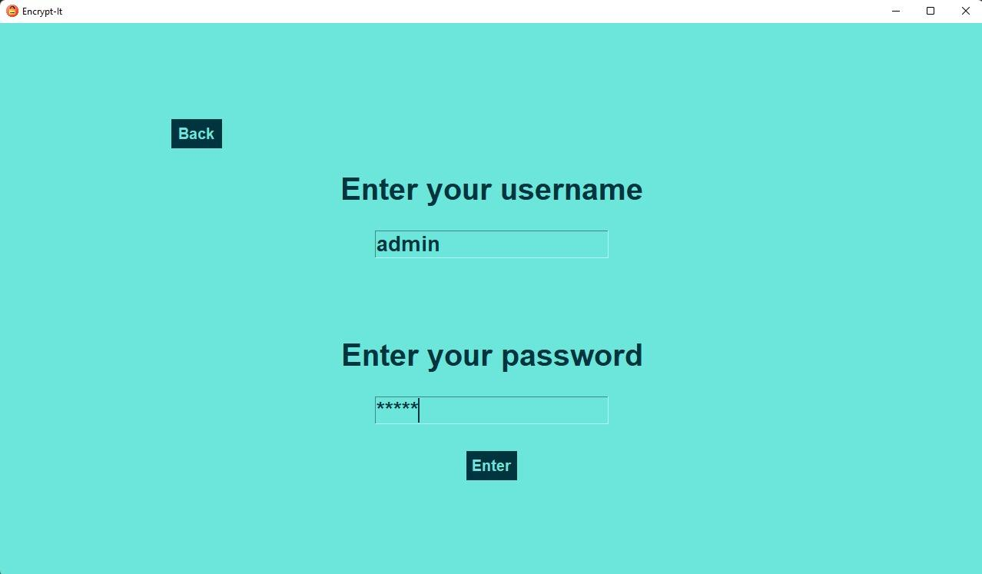

Output
Sign Up
Login

Slide 6
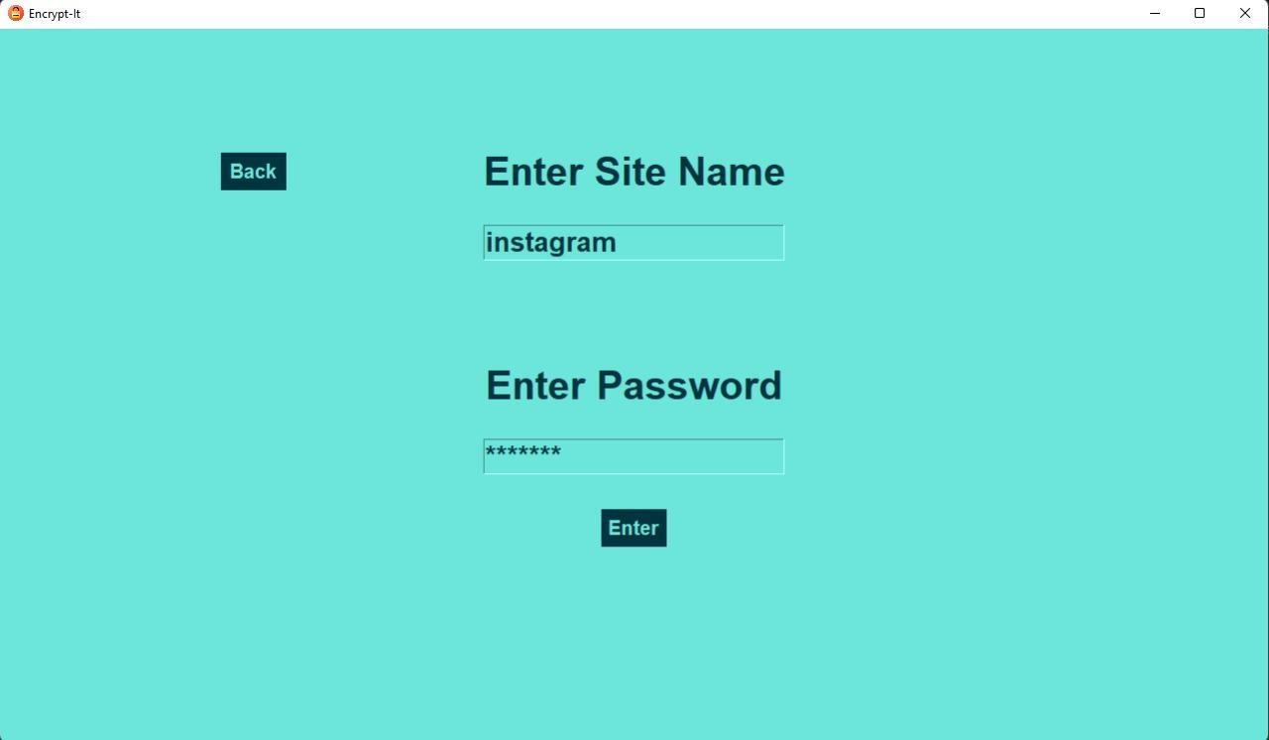
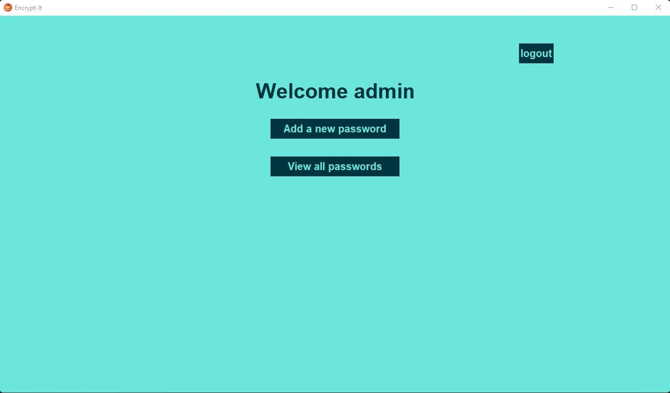
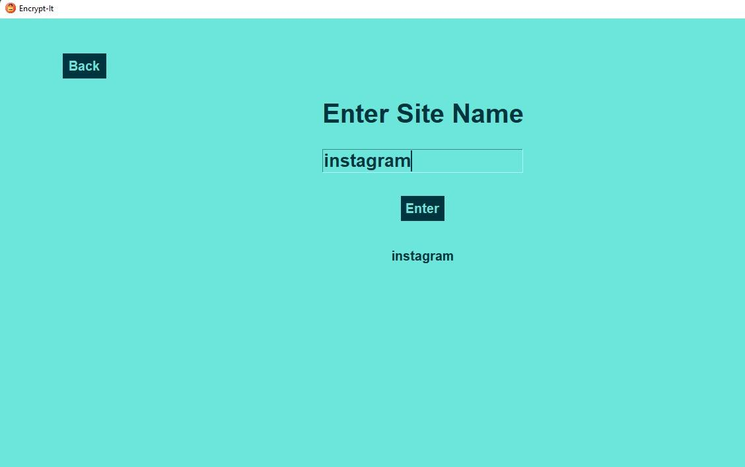
Output
Add
password
View
Password

Slide 7
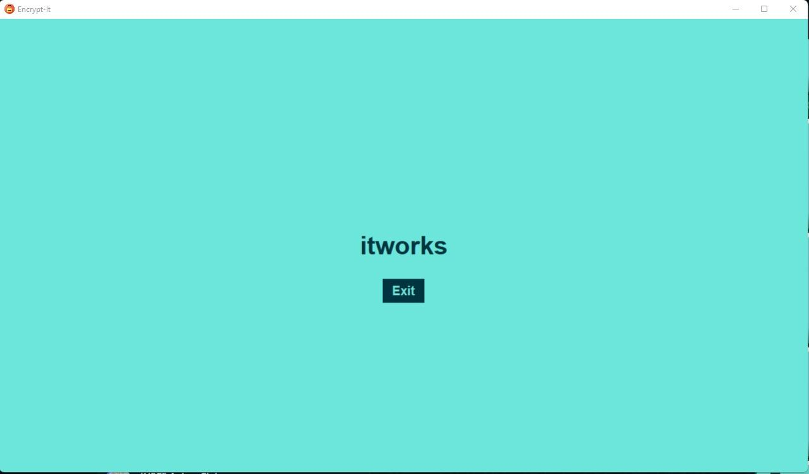
Output

Slide 8
Conclusion
We tried to apply our in-class developed knowledge about python as a language in solving a simple real-life problem faced by many of us.
We learnt how to use Cryptography module in the backend and Tkinter module as GUI in the frontend of the mini-project and many other aspects of programming and program organizing.
The project not only taught us logic building but also team-coordination and time management habits.

Slide 9
References
https://youtu.be/TuLxsvK4svQ
https://www.lastpass.com/get-premium?sdfc_id=7014P000001rVliQAM&sfdc_id=7014P000001rVIiQAM&gclid=Cj0KCQjwn4qWBhCvARIsAFNAMiiYS4Q8Bwy7G9sokFAsV8aEf5HFNGOyYdv0sxv3t1I2MlnWRKfpqy8aAieqEALw_wcB&gclsrc=aw.ds
https://youtu.be/TuLxsvK4svQ
https://pypi.org/project/cryptography/
https://docs.python.org/3/library/tkinter.html

