Slide 1
Algorithms and Environments for Deep RL

Slide 2
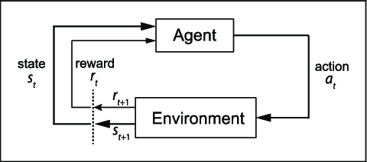

RL Background
Standard reinforcement learning settings
Agent and environment interaction
Agent’s policy
Terminal state or Finite number of time steps
$R_{t}=\sum_{k=0}^{∞}{γ^{k}r_{t+k}}$
$Q^{π}(s, a) = E[G_{t}|st = s; a]$
$Q^{∗}\left(s, a\right)=\max_{π}{Q^{π}(s,a)}$
$V^{π}\left(s\right)= 𝔼[G_{t}|s_{t}=s]$

Slide 3
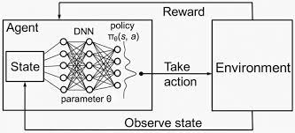

RL Background (Cont.)
Value-based model-free RL:
Function approximator: Q(s,a:𝜃)
Q-learning: $Q^{∗}\left(s,a\right)≈Q\left(s,a;θ\right)$
Learning by iteratively minimizing a sequence of loss functions
The ith loss function: $L_{i}\left(θ_{i}\right)= 𝔼{\left(r+ γ\max_{a^{′}}{Q\left(s^{′},a^{′};θ_{i−1}\right)−Q\left(s,a;θ_{i}\right)}\right)}^{2}$
n-step return: $r_{t}+ γ r_{t+1}+ …+ γ^{n−1}r_{t+n−1}+\max_{a}{γ^{n}Q(s_{t+n},a)}$
Gradient ascent on $𝔼\left[R_{t}\right]$

Slide 4

RL Background (Cont.)
Reinforce algorithm:
Updating 𝜃 in the direction of $∇_{θ}\log{π\left(a_{t} | s_{t}:θ\right)R_{t}}$
Subtracting a learned function of the state $∇_{θ}\log{π\left(a_{t} | s_{t}:θ\right)(R_{t}}−b_{t}(s_{t}))$
A learned estimate of value function $b_{t}\left(s_{t}\right)≈V^{π}(s_{t})$
$R_{t}−b_{t}$ , $A\left(a_{t}, s_{t}\right)=Q\left(a_{t}, s_{t}\right)−V(s_{t})$
Actor-Critic architecture

Slide 5
Basic functions

Slide 6
Basic Classes

Slide 7
Basic Classes (Cont.)

Slide 8
Basic Classes (Cont.)

Slide 9
Basic Classes (Cont.)

Slide 10
Basic Classes (Cont.)

Slide 11
Basic Classes (Cont.)

Slide 12
A2C: Similar Algorithms
Asynchronous RL Framework
Goal of these designs
Hogwild style updates
Using multiple actor-learners is advantages
Asynchronous one-step Q-learning:
Each thread interacts with its own copy of the environment.
Using a shared and slowly changing target network
Asynchronous one-step Sarsa:
Different target value for Q(s,a)
Target value is r + 𝛾 Q(s’,a’;𝜃)

Slide 13

A2C
Asynchronous advantage actor-critic(A3C)
Policy: $π(a_{t}|s_{t};θ)$
Estimate of value function: $V(s_{t};θ_{v})$
$∇_{θ^{′}}logπ\left(a_{t} | s_{t};θ^{′}\right)A(s_{t}, a_{t};θ,θ_{v})$
$A\left(s_{t},a_{t};θ,θ_{v}\right)= \sum_{i=0}^{k−1}{γ^{i}r_{t+i}+γ^{k}V\left(s_{t+k};θ_{v}\right)−V(s_{t};θ_{v})}$
Shared parameters of 𝜃 and 𝜃_{v}
Adding entropy: $β∇_{θ^{′}}H(π(s_{t};θ′))$
$g= αg+\left(1−α\right)Δθ^{2}$
$θ⟵θ−η\left(\frac{Δθ}{\sqrt{g+ε}}\right)$

Slide 14
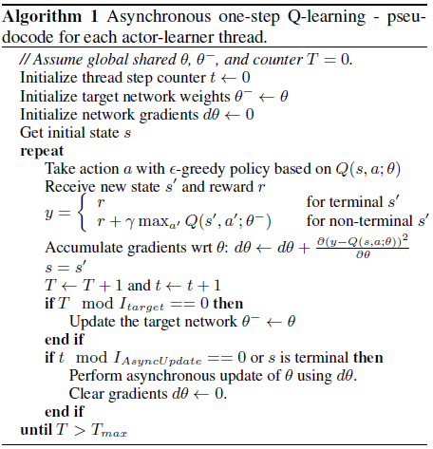
A2C: Algorithm

Slide 15
A2C: Algorithm (Cont.)

Slide 16
A2C: Algorithm Implementation

Slide 17
A2C: Segment
Lambda returns calculation:

Slide 18
A2C: Segment (Cont.)

Slide 19
A2C:Segment (Cont.)

Slide 20

Policy Optimization
Policy Optimization Algorithms:
Policy iteration methods
Policy gradient methods
Derivative-free optimization methods
Expected discounted reward of policy: $η\left(π\right)= 𝔼_{s_{0},a_{0}, …}[\sum_{t=0}^{∞}{γ^{t}r(s_{t})}]$
$Q_{π}\left(s_{t}, a_{t}\right)= 𝔼_{s_{t+1},a_{t+1}, …}[\sum_{l=0}^{∞}{γ^{l}r(s_{t+l})}]$
$V_{π}\left(s_{t}\right)= 𝔼_{s_{t+1},a_{t}, …}[\sum_{l=0}^{∞}{γ^{l}r(s_{t+l})}]$
$A_{π}\left(s,a\right)=Q_{π}\left(s,a\right)−V_{π}(s)$

Slide 21

Policy Optimization: TRPO
Policy Gradient Methods:
$g= 𝔼_{t}[∇_{θ}\log{π_{θ}\left(a_{t} | s_{t}\right)A_{t}}]$
$L\left(θ\right)= 𝔼_{t}[\log{π_{θ}\left(a_{t} | s_{t}\right)A_{t}}]$
Trust Region Methods:
Surrogate objective: $argmax_{θ} 𝔼_{t}[\frac{π_{θ}\left(a_{t} | s_{t}\right)}{π_{θ_{old}}\left(a_{t} | s_{t}\right)}A_{t}]$
s.t $𝔼_{t}\left[KL\left[π_{θ_{old}}\left(. | s_{t}\right), π_{θ}\left(. | s_{t}\right)\right]\right]≤ δ$
Using a penalty instead of a constraint:
$$argmax_{θ} 𝔼_{t}[\frac{π_{θ}\left(a_{t} | s_{t}\right)}{π_{θ_{old}}\left(a_{t} | s_{t}\right)}A_{t} − β KL[π_{θ_{old}}\left(. | s_{t}\right), π_{θ}\left(. | s_{t}\right)]]$$

Slide 22

Policy Optimization(Cont.)
Clipped surrogate objective:
$r_{t}\left(θ\right)= \frac{π_{θ}\left(a_{t} | s_{t}\right)}{π_{θ_{old}}\left(a_{t} | s_{t}\right)}$
$L^{CPI}\left(θ\right)= 𝔼_{t}\left[\frac{π_{θ}\left(a_{t} | s_{t}\right)}{π_{θ_{old}}\left(a_{t} | s_{t}\right)}A_{t}\right]=E_{t}[r_{t}\left(θ\right)A_{t}]$
$L^{CLIP}\left(θ\right)= 𝔼_{t}[min⁡(r_{t}\left(θ\right)A_{t}, clip\left(r_{t}\left(θ\right),1−ε, 1+ε\right)A_{t})]$
Adaptive KL penalty coefficient:
$L^{KLIPEN}\left(θ\right)= 𝔼_{t}\left[\frac{π_{θ}\left(a_{t} | s_{t}\right)}{π_{θ_{old}}\left(a_{t} | s_{t}\right)}A_{t}−β KL[π_{θ_{old}}\left(. | s_{t}\right), π_{θ}(.|s_{t})]\right]$

Slide 23

PPO
$L_{t}^{CLIP+VF+S}\left(θ\right)= 𝔼_{t}[L_{t}^{CLIP}\left(θ\right)−c_{1}L_{t}^{VF}\left(θ\right)+c_{2}S[π_{θ}](s_{t})]$
, where S = entropy bonus and $L_{t}^{VF}={\left(V_{θ}\left(s_{t}\right)−V_{t}^{targ}\right)}^{2}$
$A_{t}=−V\left(s_{t}\right)+r_{t}+γ r_{t+1}+ …+γ^{T−t+1}r_{T−1}+V(s_{T})$
$A_{t}= δ_{t}+(γλ)$ $δ_{t+1}+…+ …+{\left(γλ\right)}^{T−t+1}δ_{T−1}$
,where $δ_{t}=r_{t}+γV\left(s_{t+1}\right)−V(s_{t})$

Slide 24
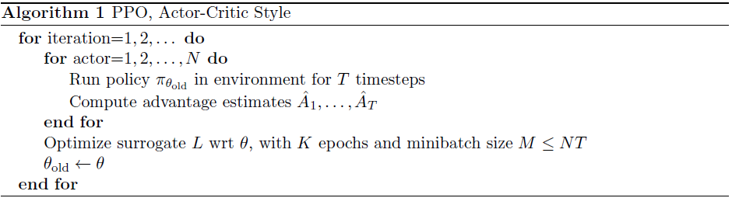
PPO: Algorithm

Slide 25
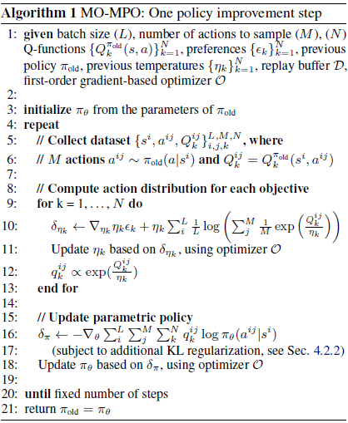
MPO: Algorithm

Slide 26
MPO: Algorithm (Cont.)

Slide 27
MPO: Buffer

Slide 28
MPO: Algorithm Implementation

Slide 29
Training

Slide 30
Training (Cont.)

