Slide 1
ACCOUNT MANAGEMENT SYSTEM
Barclays PostGrad Induction

Slide 2
Application Overview
In Account Management System we have two roles Bank Manager and Customer.
User will see different pages based on their role.
Bank manager can create new account for customer.
Bank manager uses various customer details to create accounts.
Customer can view his account details.
Customer can deposit and withdraw cash from their accounts.
Customer can view their last 5 transactions.

Slide 3
Assumptions
Assumed schema needs to be created separately.
Assumed requirement of two table to handle transaction.

Slide 4
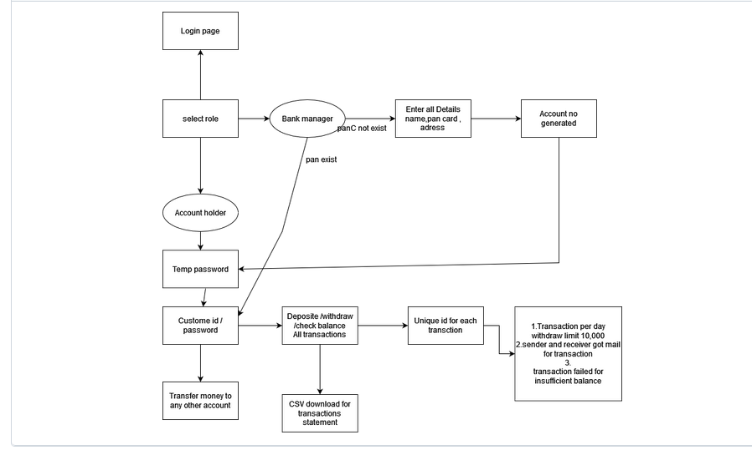
The Architecture of the System
Bank Manger can create account for Customer.
Customer can access their account and use provided features.

Slide 5
The Process
1. Creating the architecture diagram for Account Management System.
2. Creating base structure of project.
3. Creating services using Business logic.
API: Service to add account based on customer Id and password.
API: Service to check role based on RoleId.
API: Service to add customer details.
API: Service to get existing customers by PAN id.
API: Service to view accounts linked to customer ID.
API: Service to view last five transactions for existing account.
API: Cash withdrawal and deposit.

Slide 6
Features - Login
Login as bank manager or customer based on role.

Slide 7
Features - Customer creation
In this feature first we are checking if the customer already exists by entering the Pan Card Number.
If the customer already exists we are going to create a new account for that customer.

Slide 8
Features - Customer withdraw and deposit
Using this feature, customer can withdraw and deposit money from their own account.

Slide 9
Features - Customer can view mini statement
Using this feature, customer can view the last five transaction of their account.

Slide 10
Features - Customer can view his accounts
Customer can view their account details using this feature.

Slide 11
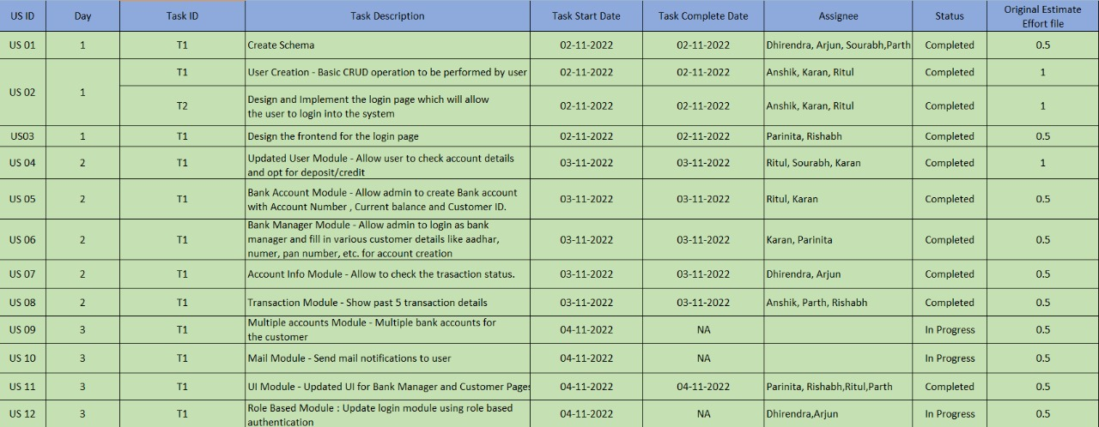
Project Dynamics – Sprint Schedule

Slide 12
Lessons Learned
Lesson 1: We learned how a Spring Boot application works.
Lesson 2: We learned to test API request using postman.
Lesson 3: We learned MYSQL integration with spring boot.
Lesson 4: We learned not to create mysql schema before running the spring boot application.
Lesson 5: We learned how to work in teams and how agile methodology simplifies the process.

Slide 13
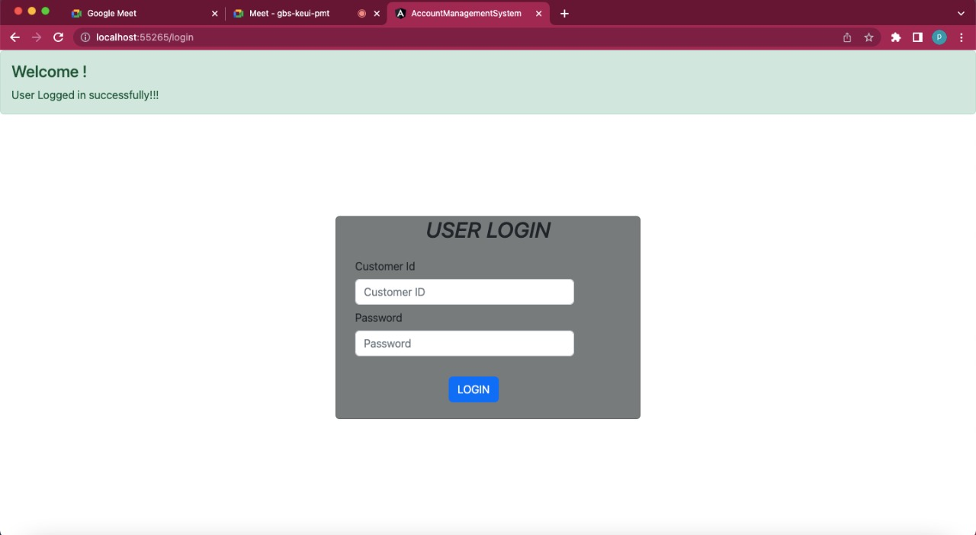
Product Demo Login Page

Slide 14
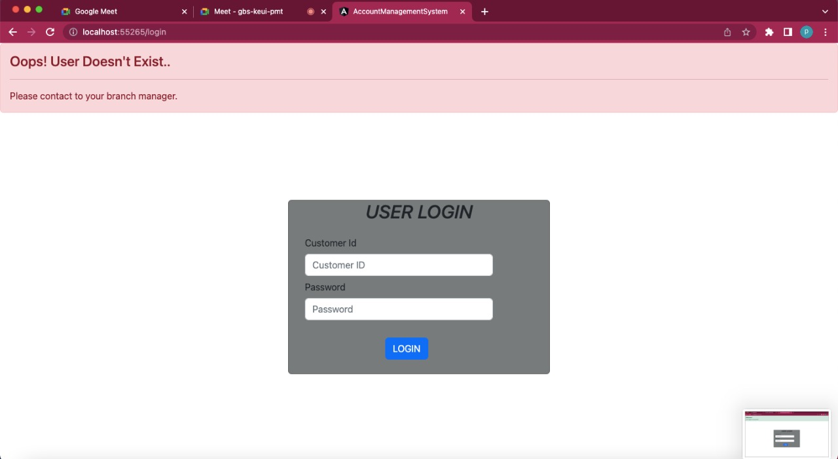
Product Demo Login Failed Page

Slide 15
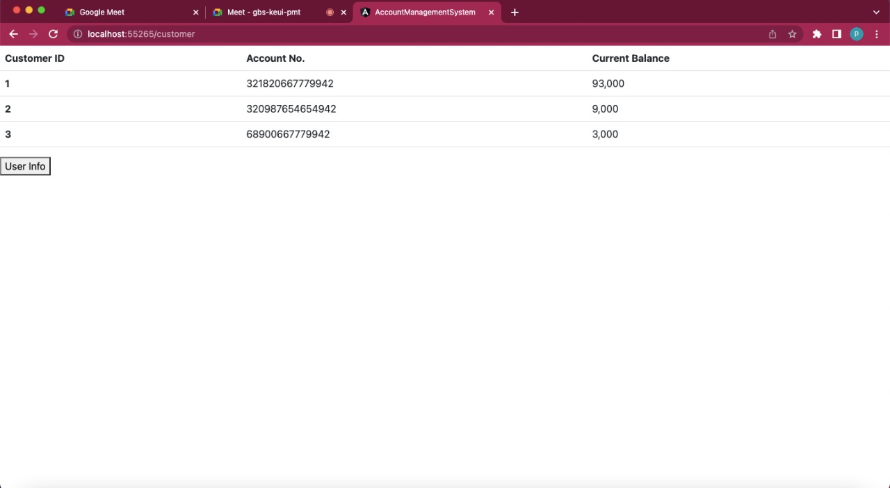
Product Demo Customer Details

Slide 16
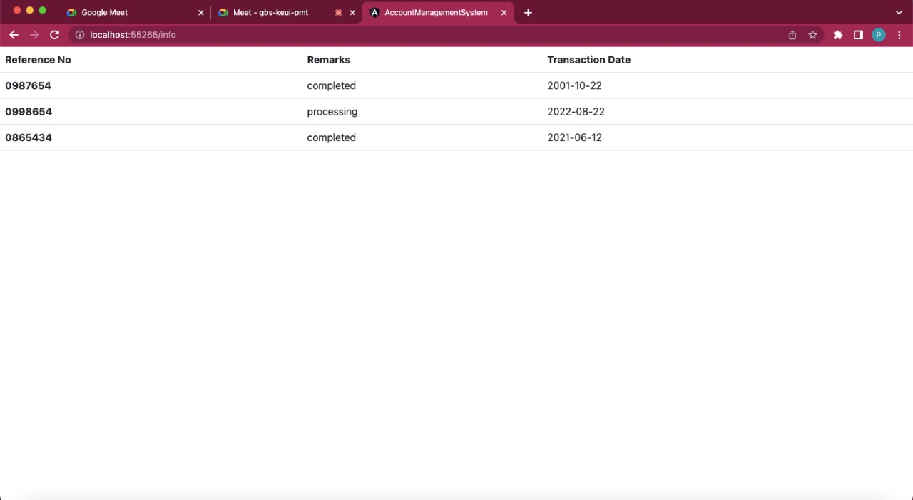
Product Demo Transaction Details

Slide 17
Additional Enhancements
Two factor authentication.
Bank statements to be sent via mail on customer chosen intervals.
Option to track monthly spendings.

Slide 18
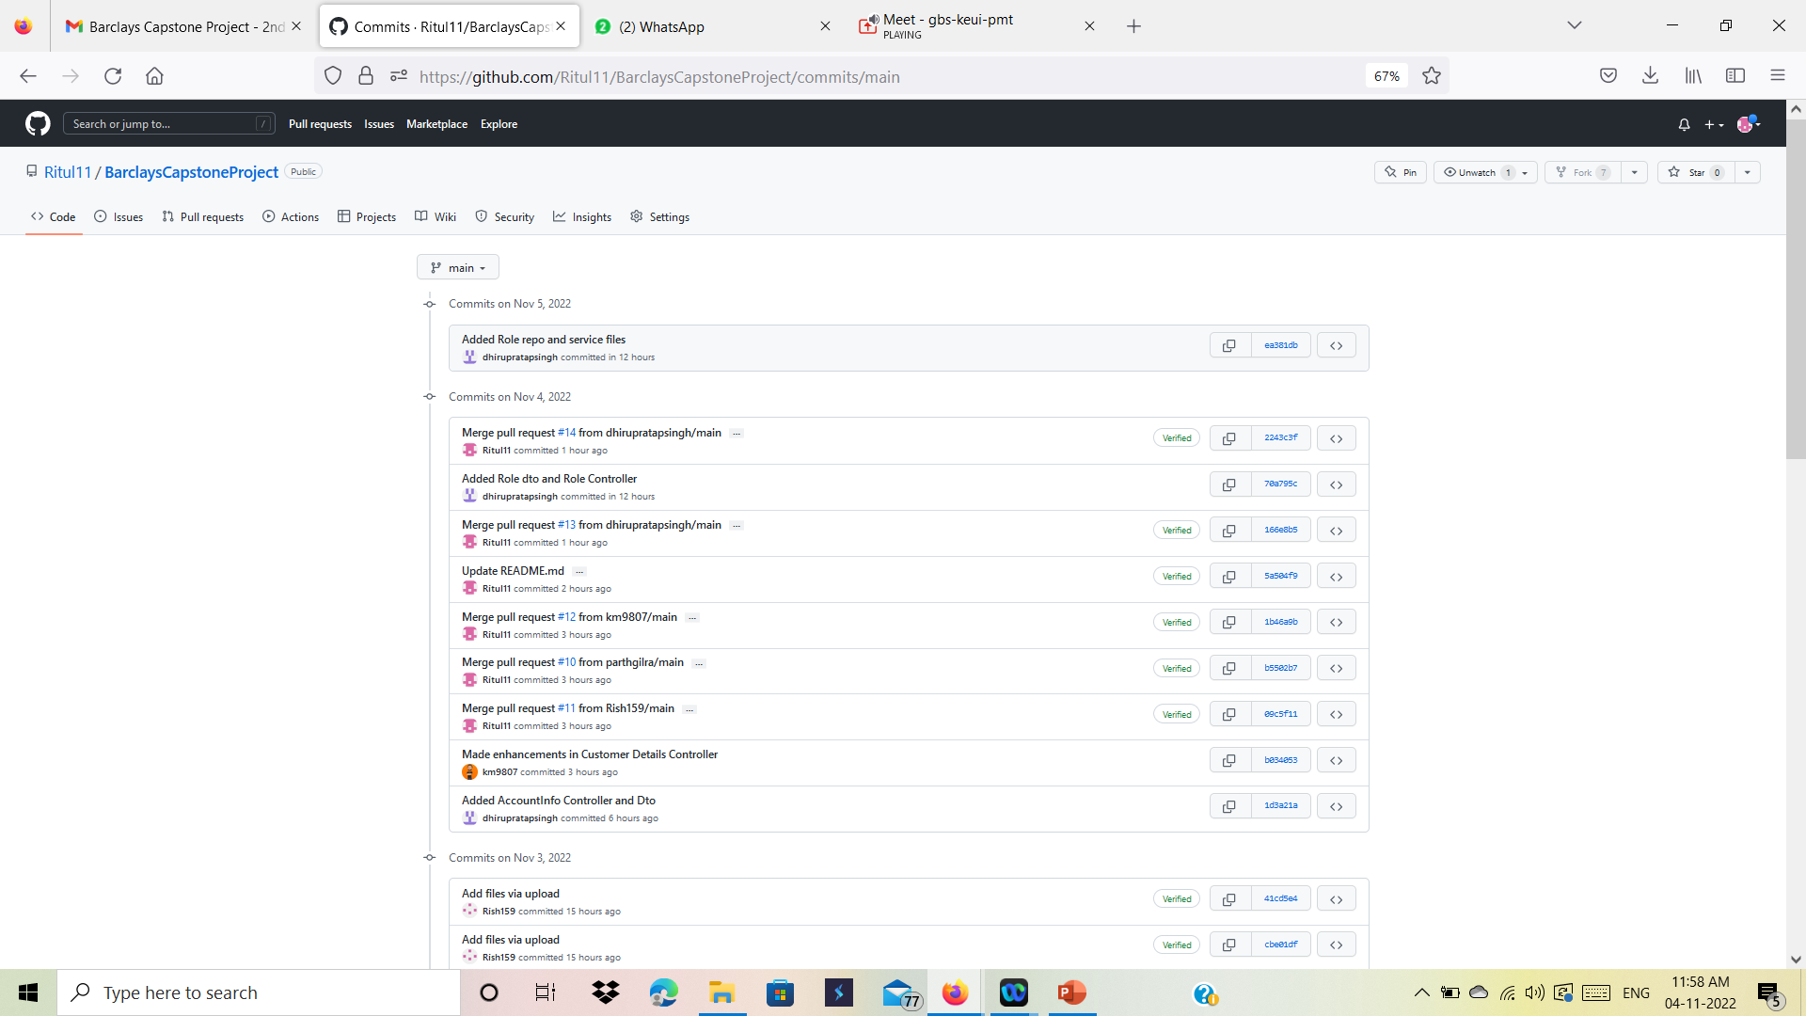
Proof Of Work

Slide 19
Proof Of Work
GitHub Link https://github.com/Ritul11/BarclaysCapstoneProject

Slide 20
Thank You!

