Slide 1
Conflicted Baltimore
Parikshita Tripathi
ptripath@hawk.iit.edu
A20327943

Slide 2
INTRODUCTION
A major social unrest was caused in Baltimore recently due to the death of Freddie Gray under police custody.
There have been cases of police officer shootings in past three years, which led to injury, discharge or in-custody death.
As a result of Freddie Gray’s death, massive protest were organized by the Baltimore public, and by people all over the country on social media sites towards Maryland State Police
According to http://www.forbes.com/pictures/mlj45jggj/7-baltimore/ Baltimore has been rated 7th most dangerous city in US

Slide 3
HYPOTHESIS
Places with high percentage of low income generating families have higher crime rate
Places with high crime rate are more vulnerable to social unrest.
Social media play a major role in aggravating the social unrest happened in a part of a country to throughout the world.

Slide 4
PREDICTORS
Crime
Economic Status
Employment
Education
Police shootings

Slide 5
APPROACH
Collected datasets from data.baltimorecity.gov as well as Twitter API
Used R to perform analysis and visualizations
Collected 2000 tweets on #BaltimoreUprising and did sentiment analysis on that
Created map plots for officer shootings as well as crime incidences reported in past 3-5 years
Aggregated results to draw conclusions

Slide 6
DATASETS
https://data.baltimorecity.gov/Neighborhoods/Neighborhoods-Shape/ysi8-7icr : - Neighborhood Shapefile
https://data.baltimorecity.gov/Crime/Officer-Involved-Shooting-View/mjt5-d7uu : - Officer Shooting
https://data.baltimorecity.gov/Crime/Crime-by-Neighborhood/6ayg-3z5z : - Crime by neighborhoods
https://data.baltimorecity.gov/Public-Safety/BPD-Part-1-Victim-Based-Crime-Data/wsfq-mvij : - Victim based crime
https://apps.twitter.com/ : - Twitter

Slide 7
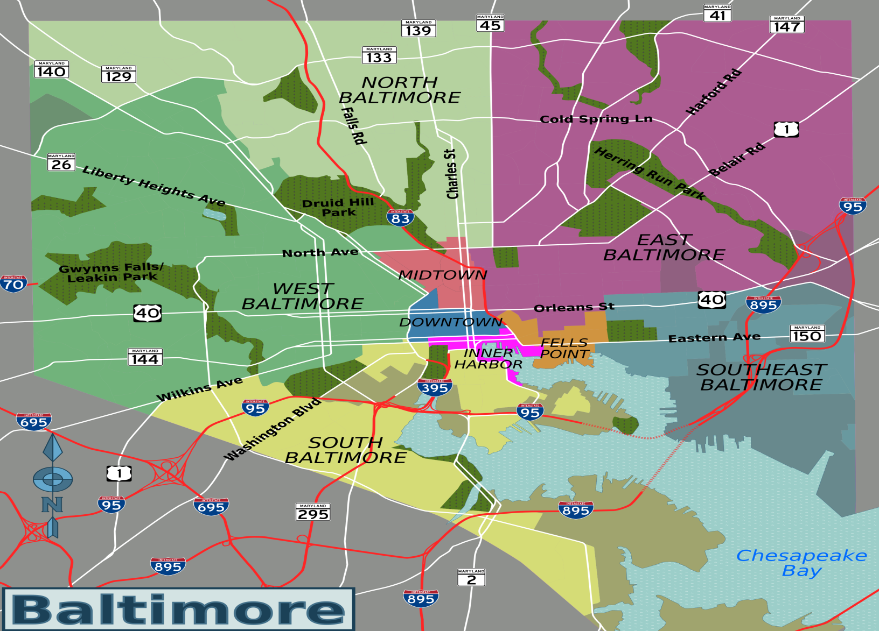
BALTIMORE CITY MAP

Slide 8
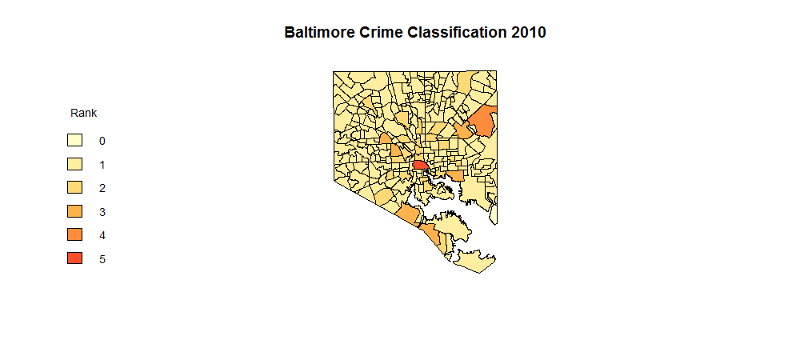
Crime Distribution in 2010

Slide 9

Crime Distribution in 2011

Slide 10
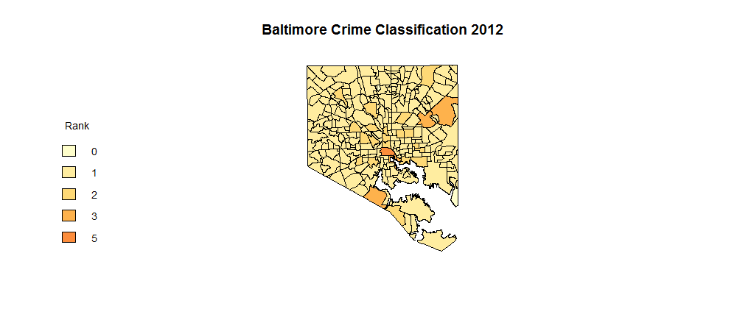
Crime Distribution in 2012

Slide 11

Crime Distribution in 2013

Slide 12
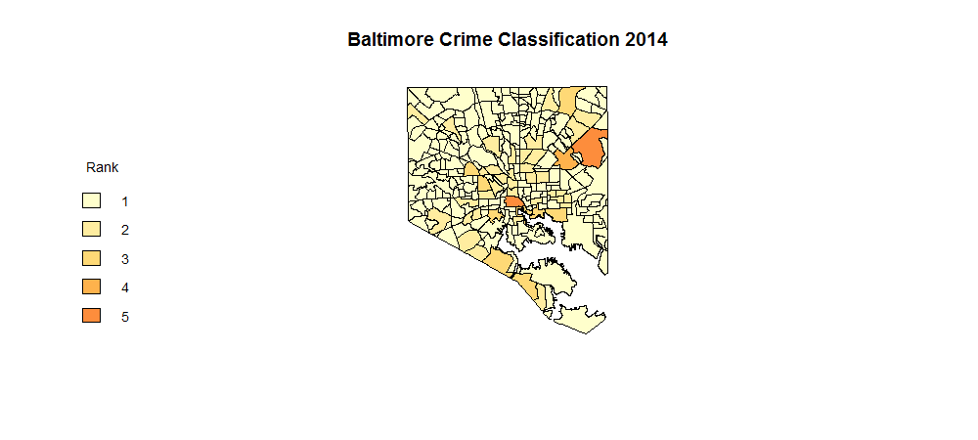
Crime Distribution in 2014

Slide 13
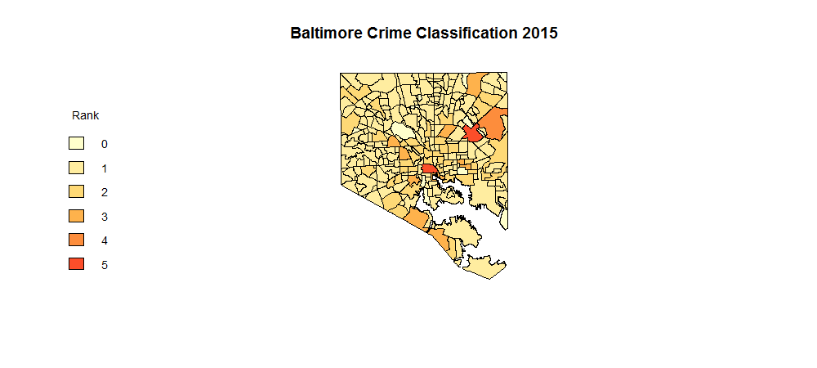
Crime Distribution in 2015

Slide 14
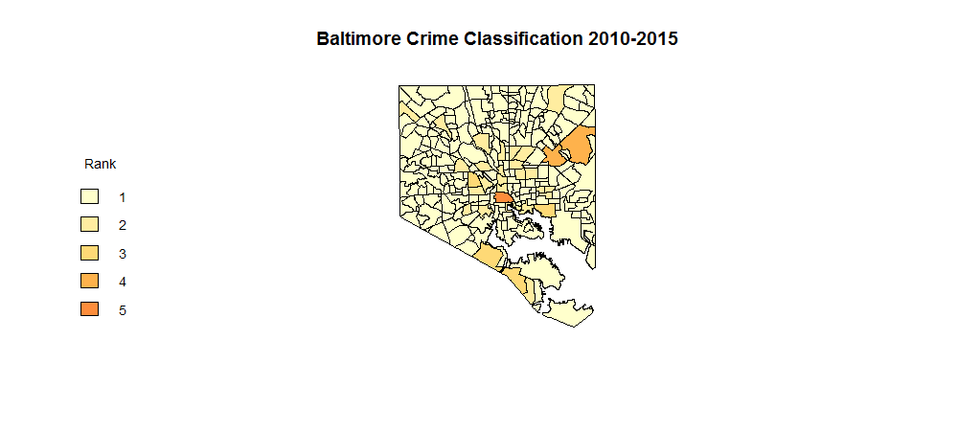
Crime Distribution in 2010-2015

Slide 15
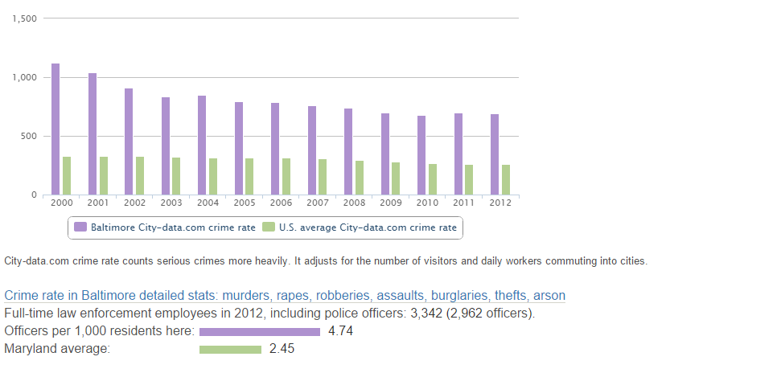
CRIME OF BALTIMORE Vs. US

Slide 16
ANALYSIS OF CRIME
After analyzing the visualizations created for crime data of Baltimore city (using R; where 0/1 indicated the safest areas). We found out that major crime areas are Downtown, Midtown, small part of East Baltimore, areas of West Baltimore touching Downtown, South Baltimore and Fells Point.
The crime in these areas have been consistently higher than the other parts of Baltimore over the years. (based on our observations for 2010-2015)
The average crime rate of Baltimore is higher than US as reported by http://www.city-data.com/city/Baltimore-Maryland.html

Slide 17
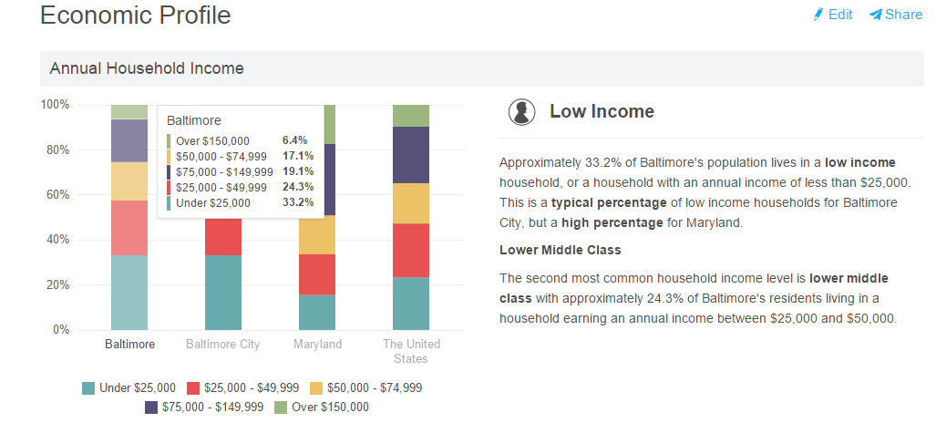
ECONOMIC STATUS
We can clearly see that Baltimore has high percentage of low income families and very few above 75,000. We can relate this to the high rate of crime in the city.

Slide 18
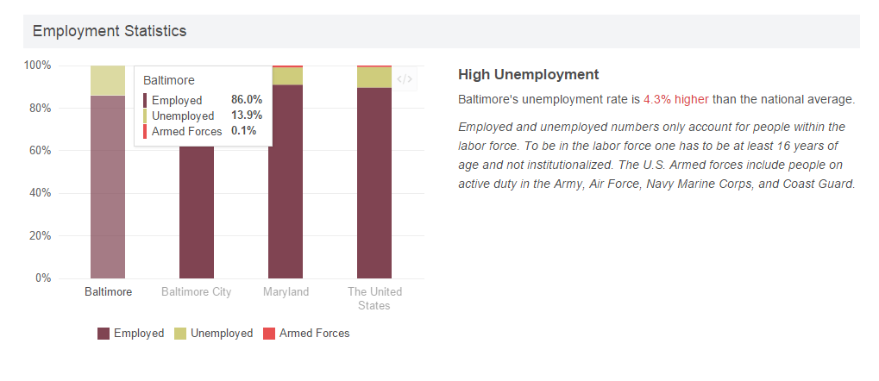
EMPLOYMENT STATUS
Though Baltimore has high employment rate, but it also has high percentage of low income families, which make it more vulnerable to higher violent/ criminal activities.

Slide 19
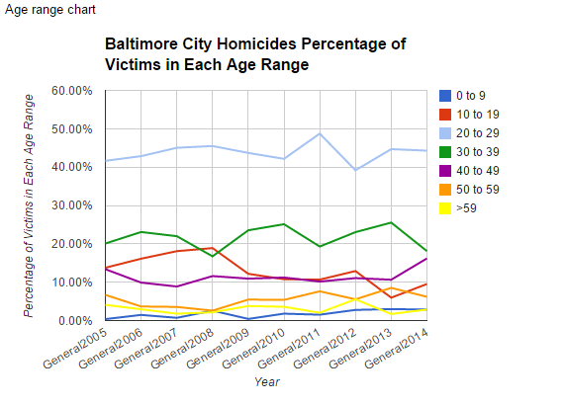
PERCENTAGE OF HOMICIDE BY AGE
Though people of every age range are killed in Baltimore, but there is high percentage of killing for the age range of 20-29 yrs followed by 30-39 yrs.

Slide 20
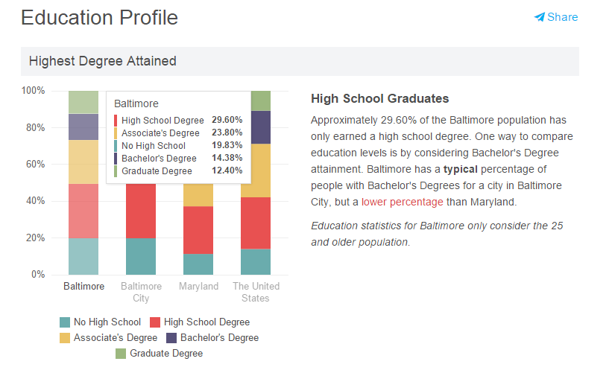
EDUCATION
Though Baltimore has high percentage of high school graduates, which is 29.6. It also has around 19.83 drop outs or no education which is only 10 percent less than high school graduates.

Slide 21
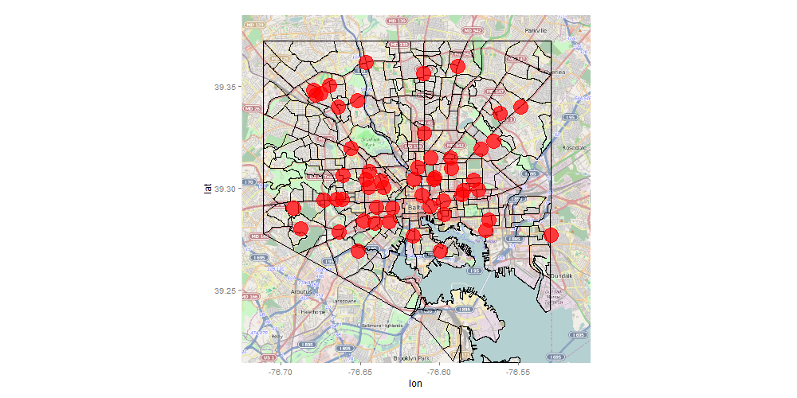
Officer Shooting 2013 - 2015
When we compare the crime data and this map we can see that the shooting reported in areas are Downtown, Midtown, Fells point, parts of East and West Baltimore. These are the areas with high criminal activities as indicated in crime analysis.

Slide 22
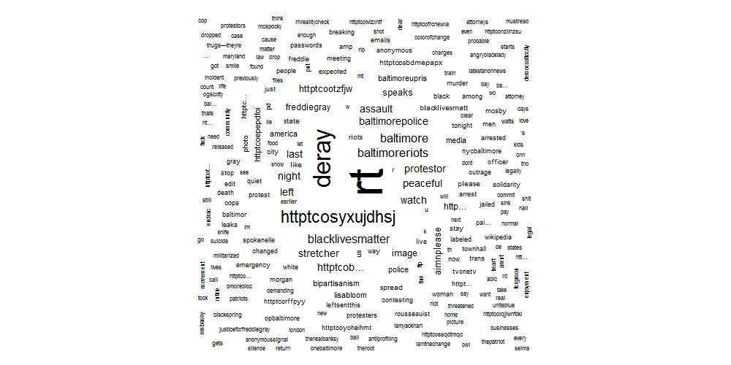
Sentiment Analysis of Twitter data
In the word graph we can see how social media was filled with posts of baltimore uprising, baltimore police, baltimore riots, freddie gray etc. We can see how the unrest caused in Baltimore was spread in the whole country via social media.

Slide 23
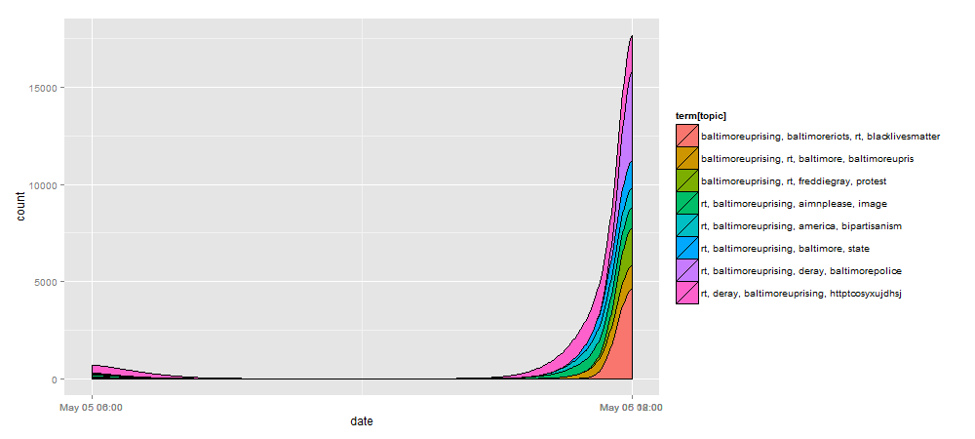
TOPIC MODELLING

Slide 24
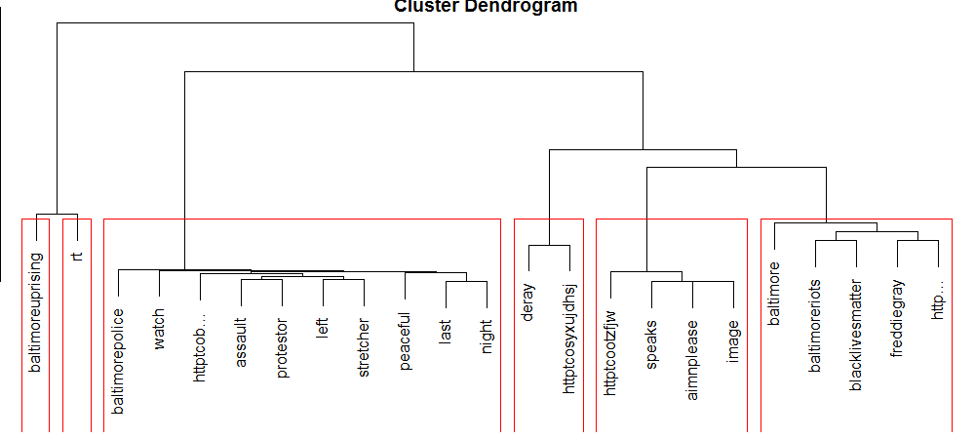
CLUSTER DIAGRAM GENRATED USING TWITTER TWEETS

Slide 25
CONCLUSION
Economic stability of the families in the city keep the criminal activities to minimum
Even though Baltimore had high employment rate but high percentage of low income families made it more vulnerable to criminal activities
The places with high criminal activities has high chances of open police firings
Cities with high criminal activities are more sensitive to the social unrest
Social media activities plays a major role in aggravating the unrest caused in a city and spread it all over the country/world.

Slide 26
References
http://www.slideshare.net/rdatamining/text-mining-with-r-an-analysis-of-twitter-data
http://www.r-bloggers.com/shapefile-polygons-plotted-on-google-maps-using-ggmap-in-r-throw-some-throw-some-stats-on-that-mappart-2/
http://www.r-bloggers.com/throw-some-throw-some-stats-on-that-mappart-1/
http://chamspage.blogspot.com/2014/01/2014-baltimore-city-homicides-list-and.html
http://places.findthehome.com/l/44475/Baltimore-MD
https://sarahleejane.github.io/learning/r/2014/09/21/plotting-data-points-on-maps-with-r.html
http://places.findthehome.com/l/44475/Baltimore-MD

Slide 27
Thank You!

