Slide 1
Cyber Threat Analytics
Platform with Incident
Visualization System
MILESTONE 1
Batch: 4
Year: Third Year Btech in CSE
Team Name: B
Internship Duration: 8 weeks
Mentor Name : NithyaSree, SJ
Submitted By:
1. Pari Patel
2. Sai Sri Venkata Gopi Nukala
3. Hara Prasad S
4. Abisha S
INFOSYS SPRINGBOARD VIRTUAL INTERNSHIP 7.0
PARI PATEL • BATCH 4

Slide 2
Content
01
Project Objective / Description
1
02
Technology Used
3
03
Complete Data Preprocessing Workflow
3
04
Dataset Overview: Six Main Categories
4
05
Validation: Check Before You Analyse
6
06
Feature Engineering: Three Added Columns
7
07
Challenges & Practical Resolutions
9
08
Acknowledgements
10
09
Thank You / Questions & Discussion
11
INFOSYS SPRINGBOARD VIRTUAL INTERNSHIP 7.0
PARI PATEL • BATCH 4

Slide 3
Project Objective / Description
Make it trustworthy
The Cyber Threat Analytics Platform with Incident Visualization System aims to analyse cybersecurity incident data to identify attack patterns, evaluate detection and response efficiency, and understand the financial impact of cyberattacks. Using data preprocessing and interactive Power BI dashboards, the platform will transform raw records into meaningful visual insights, helping security teams monitor incidents, identify trends, and make informed decisions.
01
Make it usable
02
Make it interpretable
03
PARI PATEL • 1

Slide 4
Power BI Workflow Diagram
Cyber Threat Analytics Platform with Incident Visualization System
Problem Understanding
Define the project goal, key cybersecurity questions, and expected analytical outcomes.
Data Collection & Understanding
Collect and inspect the Enterprise Cyber Kill Chain dataset, including its structure, fields, and data quality.
Data Preprocessing
Remove duplicates; clean text; correct data types; review missing values, categories, numerical values, outliers, and date/time fields.
Data Modeling (Model View)
Review the data model and relationships needed for consistent analysis.
DAX Calculations
Create required measures and calculations for meaningful metrics and KPIs.
Data Analysis & Insights
Explore incident patterns, detection and response performance, financial impact, and recovery trends.
Dashboard Creation
Build clear Power BI charts, KPI cards, filters, and interactive report pages.
Report Publishing & Deployment
Publish the report for intended users and review access, usability, and refresh requirements.
Page 2

Slide 5
Technology Used and Milestone 1 Overview
Technology Used
Milestone 1 Overview
Microsoft Power BI Desktop
Milestone 1 focuses on data preparation and validation of the Enterprise Cyber Kill Chain dataset. The goal is to clean and transform the raw incident data so that it can be used for meaningful analysis and visualization in the subsequent milestones.
Used for data preparation, transformation, analysis and visualization
Importing and working with the dataset
Creating calculated columns and measures (DAX)
Building interactive dashboards with charts, tables, filters and KPIs
Key Activities in Milestone 1
Explored and understood the dataset structure (rows, columns, data types)
Removed exact duplicate records
Validated data and handled missing values
Checked and corrected data types
Performed outlier analysis for numerical fields
Created three derived columns: Incident_Time_Period, High_Impact_Incident, Response_Time_Category
Prepared the final cleaned dataset for analysis and visualization
CSV Dataset
Enterprise Cyber Kill Chain dataset
Source file: Enterprise_Cyber_Kill_Chain_Dataset(2).csv
Contains cybersecurity incident records used for analysis and visualization
CSV
PARI PATEL • 3

Slide 6













02 / WORKFLOW
Complete Data Preprocessing Workflow
Data preparation activities performed in Power BI.
Remove duplicates
Text cleaning
(if required)
Data type
correction
Missing-value
handling
01
02
03
04
Category
validation
Numerical data
validation
Outlier
detection
Date and time
formatting
05
06
07
08
Feature
creation
Data consistency
checking
Invalid value
correction
Standardization
of categorical values
09
10
11
12
13
Column renaming
Outcome: a cleaned and structured dataset ready for analysis.
INFOSYS SPRINGBOARD 7.0 / MILESTONE 1
PARI PATEL • 03

Slide 7
03 / DATASET PROFILE
Dataset Overview: Six Main Categories
Enterprise Cyber Kill Chain
Source: Enterprise_Cyber_Kill_Chain_Dataset(2).csv
100,500
Original rows
50
Original columns
500
Exact duplicates removed
100,000
Rows after cleaning
(3 derived columns added)
SIX HIGH-LEVEL COLUMN GROUPS
Dataset Preview (Sample Records)
Incident & attack details
Incident and attack attributes
Detection metrics
Detection_Time_Min and related measures
Incident_ID | Timestamp | Attack_Type | Attack_Vector | Detection_Time_Min | Response_Time_Min | Financial_Loss_USD
INC001 | 2021-03-15 10:24 | Malware | Email | 30 | 120 | 25000
INC002 | 2021-04-02 14:11 | Phishing | Email | 15 | 60 | 10000
INC003 | 2021-05-18 09:45 | Ransomware | Network | 120 | 240 | 50000
INC004 | 2021-06-30 16:20 | DDoS | Network | 10 | 45 | 8000
INC005 | 2021-07-12 11:06 | Insider Threat | Internal | 60 | 180 | 15000
INC006 | 2021-08-21 08:13 | Phishing | Web | 25 | 90 | 12000
INC007 | 2021-09-09 13:50 | Malware | USB | 40 | 110 | 20000
INC008 | 2021-10-14 17:32 | Data Breach | Web | 90 | 300 | 75000
Response metrics
Response_Time_Min and response categories
Financial impact
Financial_Loss_USD and impact indicators
Recovery & remediation
Recovery_Cost_USD and recovery fields
Time & incident context
Timestamp and Incident_Time_Period
Final structure: 100,000 rows × 53 columns*
*50 original columns + 4 new derived columns.
INFOSYS SPRINGBOARD 7.0 / MILESTONE 1
PARI PATEL • 04

Slide 8
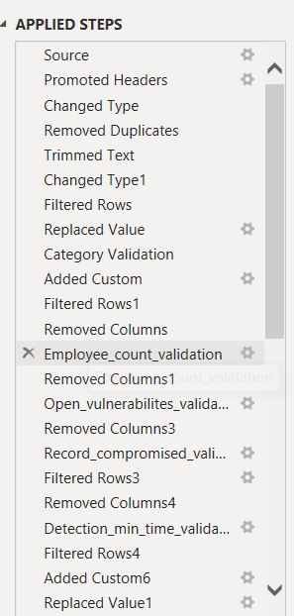


Validation: Check Before You Analyse
VALIDATION CHECKLIST
APPLIED STEPS
Numerical values
Review numerical values and invalid entries.
01
Missing information
Keep unknown values distinct from genuine zero values.
02
Date and time
Check timestamps and related fields for consistency.
03
Data types
Review suitable types for relevant columns.
04
Outliers
Assess unusual values in context; do not remove automatically.
05
INFOSYS SPRINGBOARD 7.0 / MILESTONE 1
PARI PATEL • 06

Slide 9
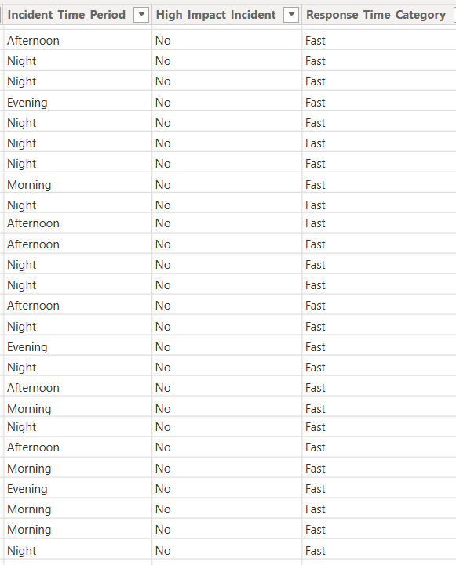
Feature Engineering: Three Added Columns
Three new columns make incident time, impact and response speed easier to interpret.
Incident_Time_Period
Groups timestamps into time-of-day periods, e.g. Morning, Afternoon, Evening or Night.
Example of derived columns (Sample records)
01
High_Impact_Incident
Flags whether an incident is classified as high impact (Yes / No).
02
Response_Time_Category
Groups response time into categories such as Fast, Moderate or Slow.
03
Note: These are sample records to illustrate the derived columns.
PARI PATEL • 07

Slide 10
08 / LESSONS LEARNED
Challenges & Practical Resolutions
CHALLENGE | RESOLUTION
Duplicate records | Removed 500 exact duplicate rows across all columns.
Missing values | Reviewed missing values without replacing unknown values with zero.
Inconsistent categories | Reviewed categorical consistency and cleaned selected text fields.
Types / invalid values | Validated suitable data types and checked numerical and categorical values.
Interpreting raw fields | Created Incident_Time_Period, High_Impact_Incident and Response_Time_Category.
Plausible numerical outliers were retained; validation focused on consistency and readiness.
INFOSYS SPRINGBOARD 7.0 / MILESTONE 1
PARI PATEL • 09

Slide 11
Conclusion
Milestone 1 successfully established the foundation for the Cyber Threat Analytics Platform with Incident Visualization System. The collected datasets were cleaned, validated, standardized, and prepared using Power Query in Power BI. This phase improved data quality, consistency, and reliability for further analysis. The prepared dataset will support interactive visualizations, threat trend analysis, hotspot identification, and data-driven decision-making in the upcoming milestones.
PARI PATEL • 10

Slide 12
Acknowledgements
We would like to express our heartfelt gratitude to the Infosys Springboard Team for organizing this valuable internship opportunity and providing a structured platform for learning and professional development. We are sincerely thankful to our mentor for her continuous guidance, constructive feedback, and encouragement throughout the project. Her valuable suggestions helped us improve our analytical approach and execute the project effectively. We extend our appreciation to our teammates for their collaboration, mutual support, idea sharing, and dedicated teamwork during every phase of the project. We are also grateful for the opportunity to work with a real-world dataset, which enabled us to apply theoretical analytical concepts in a practical environment. Working with Power BI, data preprocessing, data modeling, and interactive dashboard development significantly enhanced our technical knowledge and problem-solving abilities. Furthermore, the collaborative environment, regular reviews, and milestone-based execution helped us develop essential professional skills, including communication, accountability, time management, and coordination. This internship has been a valuable learning experience and an important milestone in our professional growth, strengthening our technical expertise and preparing us for future challenges in data analytics.
PARI PATEL • 10

Slide 13

INFOSYS SPRINGBOARD VIRTUAL INTERNSHIP 7.0
Thank you.
Questions & Discussion
Cyber Threat Analytics Platform with Incident Visualization System
Presented by Pari Patel • Batch 4
MILESTONE 1 / DATA PREPARATION & VALIDATION

