Slide 1

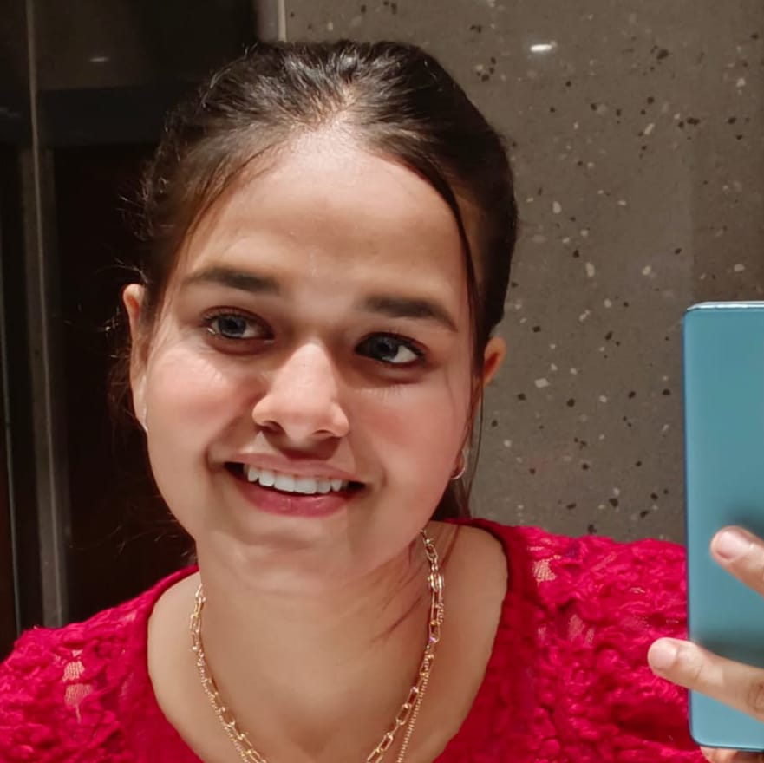
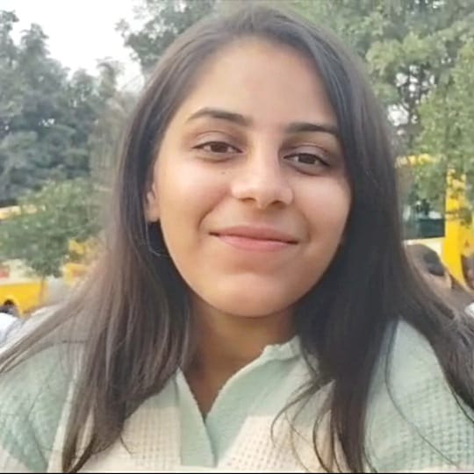
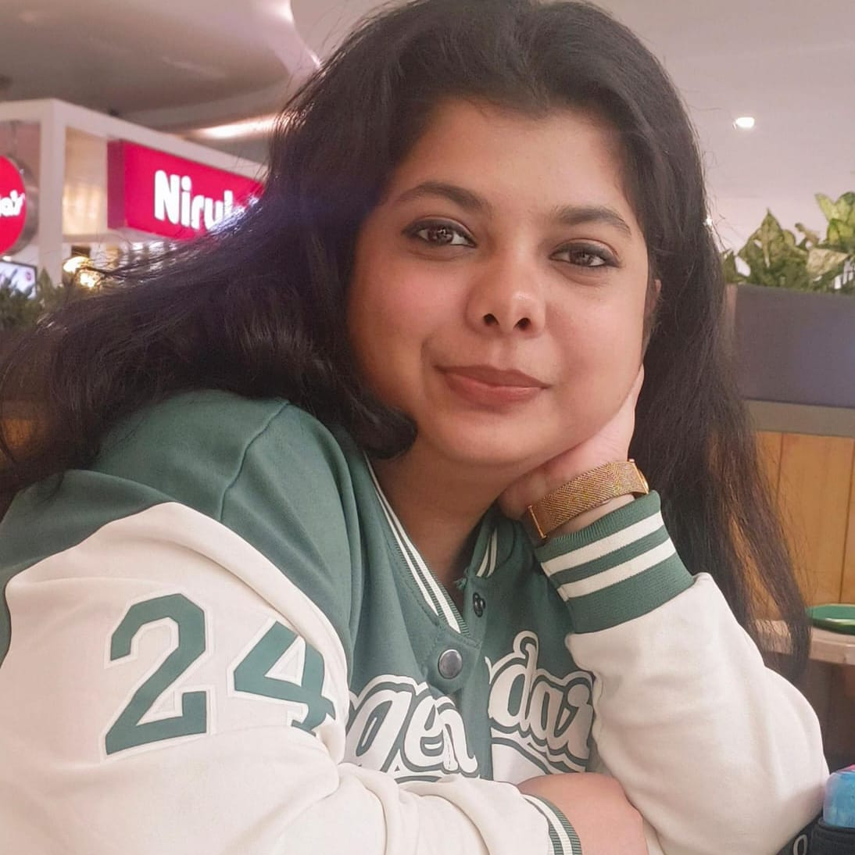
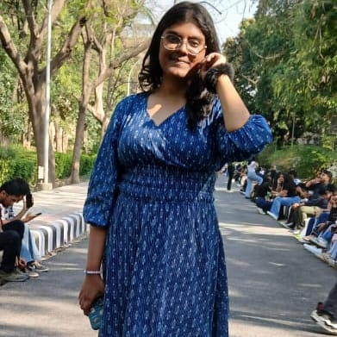
VOLUNTEER MANAGEMENT SYSTEM
SCHOOL Of ENGINEERING AND TECHNOLOGY
ANUSHKA SINGH
2401730229
(Frontend)
KAASHVI GUPTA
2401730180
(Storage)
PARI BANSAL
2401730282
(Backend)
ARPITA ROY
2401730295
(Backend)
INTERNAL SUPERVISOR: Ms. Mansi Kajal

Slide 2
ABSTRACT
Earlier when there was no such high technology, people used to collect data of volunteers by pen and paper method. This makes difficult for organizations to manage the volunteers and give the task according to the skills and time management. Manual record keeping is very time consuming and are more prone to errors. Scheduling volunteers, tracking the attendance and sending updates become troublesome. So to manage them easily we have created the volunteer management system (VMT).
To ensure proper task assignment based on skills and time available organizers can distribute the work to volunteers and manage them easily.

Slide 3
OBJECTIVE
Facilitate easy registration and onboarding of volunteers.
Efficiently assign tasks based on skills and availability.
Maintain a database for tracking volunteer contributions.
Improve communication between volunteers and event organizers.
Generate reports for performance evaluation and improvement.
Volunteers can take part in events according to their interest and prior knowledge.

Slide 4
PROBLEM STATEMENT (To build Volunteer Management System)
Key Challenges & Gaps in Current Systems Inefficient Volunteer
Registration – Manual processes make it difficult to track and update volunteer availability.
Scheduling Conflicts – Lack of an automated system leads to double bookings or unassigned volunteers.
Poor Communication – No centralized messaging system results in missed updates and low engagement.
Security & Access Issues – No proper role-based access control, leading to unauthorized data access.
Due to online registration, we can manage Auto task assignment & scheduling, Instant notifications, Real time tracking & analytics, Efficient volunteer engagement.

Slide 5
METHODOLOGY
The Volunteer Management System (VMS) will be developed using a structured approach, ensuring efficient design, implementation, and testing.
The front page will include sign page for users to enter their details followed by a lost of events in which they have to volunteer.
After the selection of event, the page will be directed to the organizer for task allotment further sharing the details for that event.
Volunteer Registration
Profile building (Name, age, phone no. field of interest, skills)
Task Allocation
Communication and coordination
Event monitoring and execution
Selection of task
Recognition and rewards

Slide 6
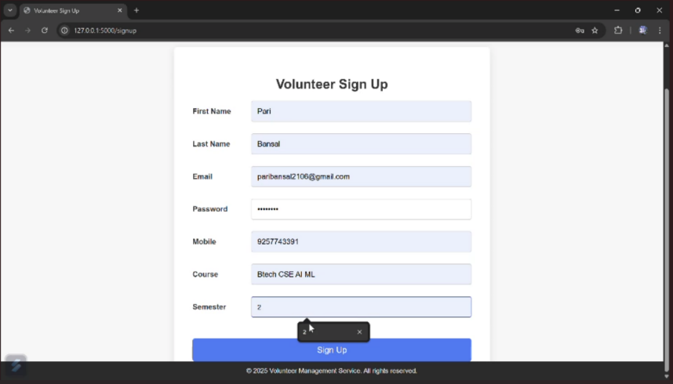
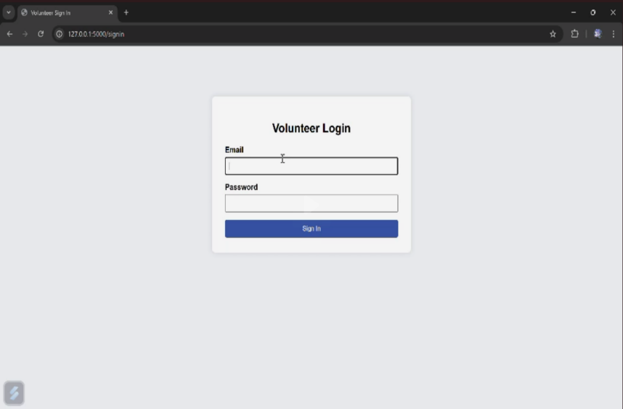
This is a Volunteer Sign Up page from a web app, likely built using Flask). It collects user info like name, email, password, mobile number, course, and semester. The form is styled simply and has a "Sign Up" button to submit the data.
Volunteers can sign up to join the platform. In the centre, existing volunteers can sign in to view or manage their participation. On the right, admins can log in to oversee all events and volunteer activities. The design is clean and user-friendly, making navigation easy for all users."

Slide 7
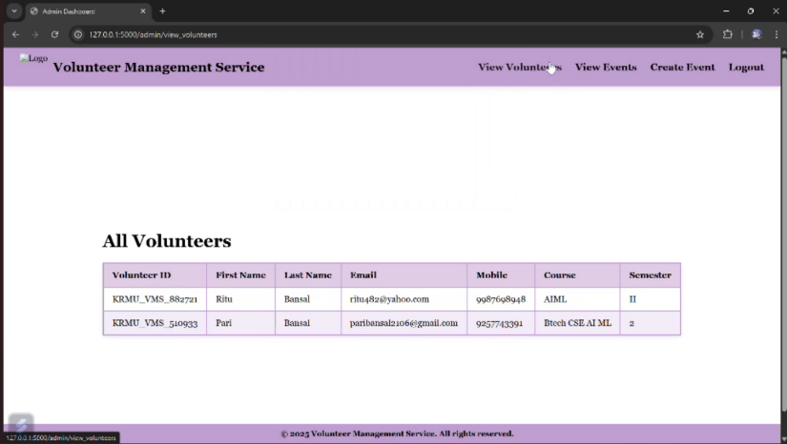
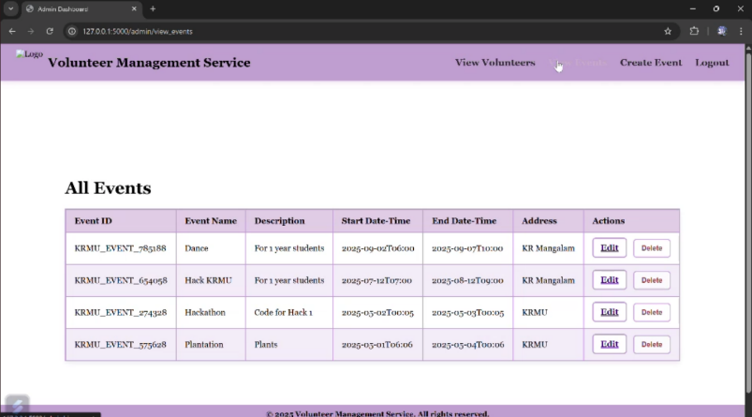
This page is created using HTML for layout, CSS for design, and JavaScript for form validation and redirection. It helps ensure that only verified admins can manage volunteer data, events, and system settings.
This page shows a complete list of registered volunteers in the system. Admins can view the names, emails, contact details , course and semester of each volunteer. It helps manage and communicate with volunteers more efficiently. The page is built using HTML, CSS, JavaScript, and connected to a backend for dynamic data display.

Slide 8
TOOLS TO BE USED
Front-End: Design a responsive UI using HTML, CSS, JavaScript for easy navigation.
Back-End: Develop a secure and scalable system using Python (Django/Flask) and C++.
Database: Implement MySQL/PostgreSQL to store volunteer data, schedules, and event details.
Security & Access Control: Define user roles (Admin, Volunteer, Event Manager, etc.) with appropriate permissions.

Slide 9
EXPECTED OUTCOMES
Automated registration and scheduling reduce manual workload for admins.
Streamlined task assignments ensure better utilization of volunteers.
Volunteers stay informed about upcoming events, shifts, and updates.
Organizations can efficiently track volunteer hours and participation.
The system is scalable to accommodate growing volunteer bases and multiple organizations

Slide 10
CHALLENGES
Building a website for efficiency comes with a lot of challenges
Strong encryption and access control is required to store personal information of users.
Cloud based solutions may be required to handle large amount of data.
Last minute cancelling by volunteers can disrupt event planning.
Organizations may require technical support for troubleshooting and improvements.

Slide 11
THANK YOU!!

