Slide 1
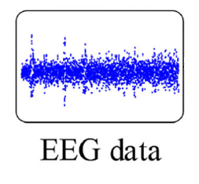
Input signal
Preprocessing
(segmentation and relabeling)
Optimized CNN
Emotional state classification
DEAP dataset
SEED dataset
Binary classification
Binary classification
Binary classification
Binary classification
Multi-class classification
Positive
High dominance
Neutral
High valence
High arousal
Low dominance
Low valence
Low arousal
Liking
Disliking
Negative

