Slide 1

MACHINE LEARNING COURSE PROJECT · PROPOSAL
Predict the Future of Vechicle Trajectory
diffusion vs. flow matching — and when to use which
Team memers: Parick He, Silas He, Mila Liu, Nacy Lin
CS 1675 INTRODUCTION TO MACHINE LEARNING
01

Slide 2

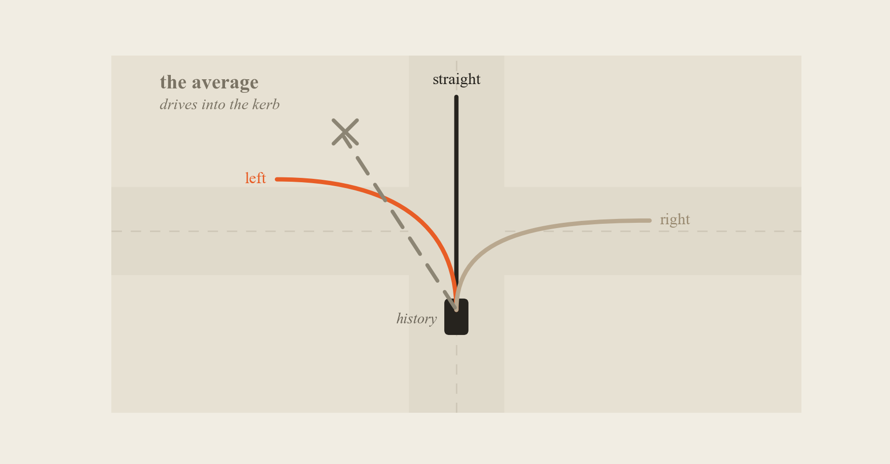
01 / THE PROBLEM
One past, three futures
Predict the average — and the car drives into the kerb.
A regressor trained with mean squared error returns the conditional mean, not a drivable path.
02

Slide 3
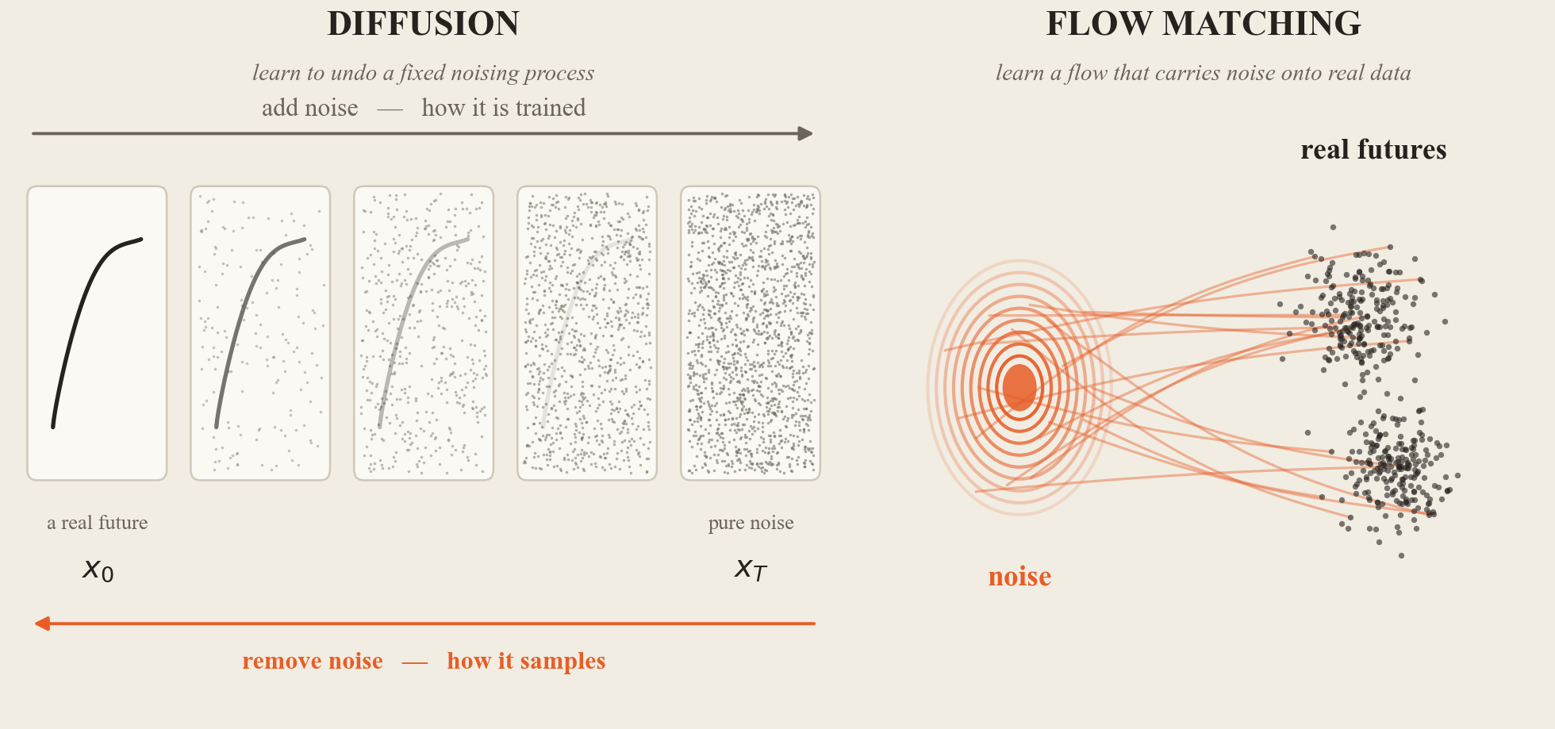
02 / THE TWO METHODS
Two ways to learn a future
One learns to undo noise; the other learns a flow. The number of steps follows from that.
Both are trained on the same data and share the same encoder in our experiments.
03

Slide 4
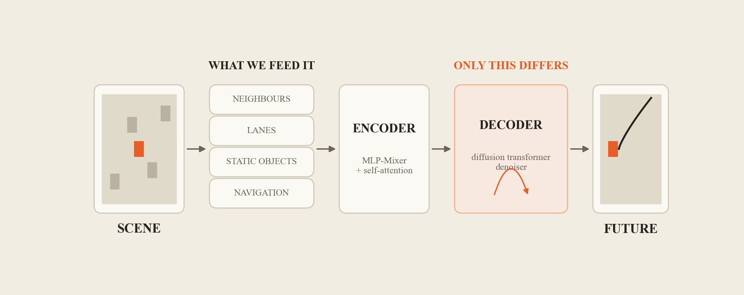
03 / HOW IT RUNS ON nuPLAN
From a scene to a future
One encoder reads the scene. Only the decoder that imagines is swapped between models.
04
Pipeline after Diffusion-Planner (ICLR 2025), redrawn. It plans the ego car on nuPlan; we reuse the recipe for prediction.

Slide 5
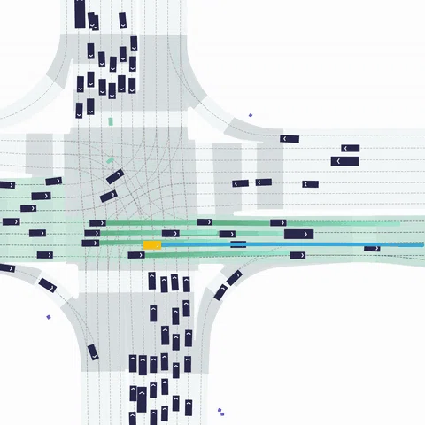
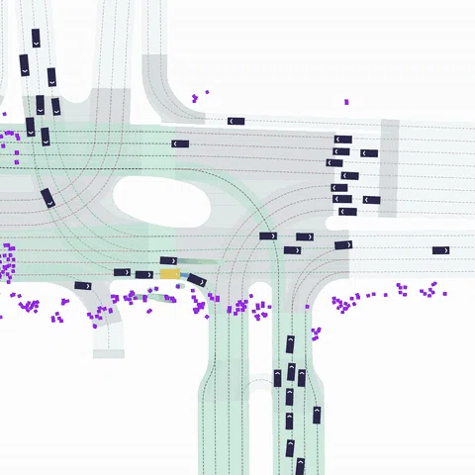
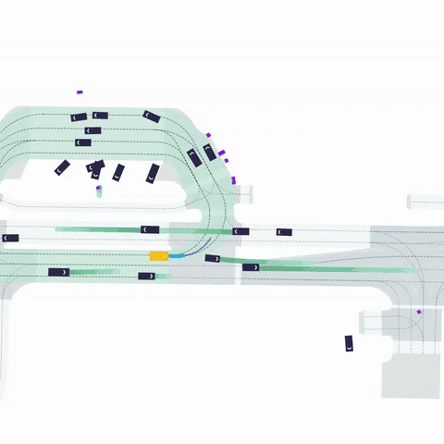
04 / THE DATA
Real driving, seen from above (Database: nuPlan)
INTERSECTION
PEDESTRIAN CROSSING
UNPROTECTED TURN
2 s of history → 8 s of future
nuPlan already labels every intersection, crossing and turn — so we do not have to guess.
05
nuPlan mini · 10 Hz · four cities. Scene renders: nuPlan bird's-eye view, shown as an illustration of the data.

Slide 6
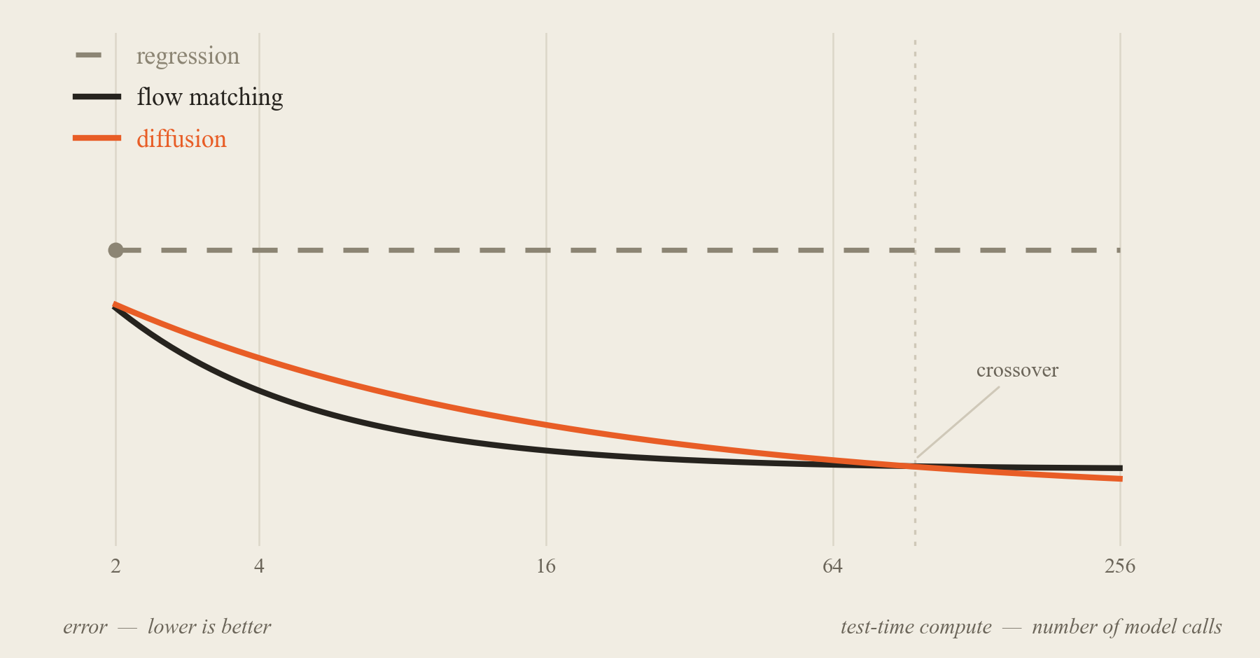
05 / THE QUESTION WE ASK
No model
wins
everywhere
It depends on how much compute you are allowed to spend at test time.
That is the question our whole project is built to answer.
06
Chart shows the expected shape of the comparison, not measured results.

Slide 7
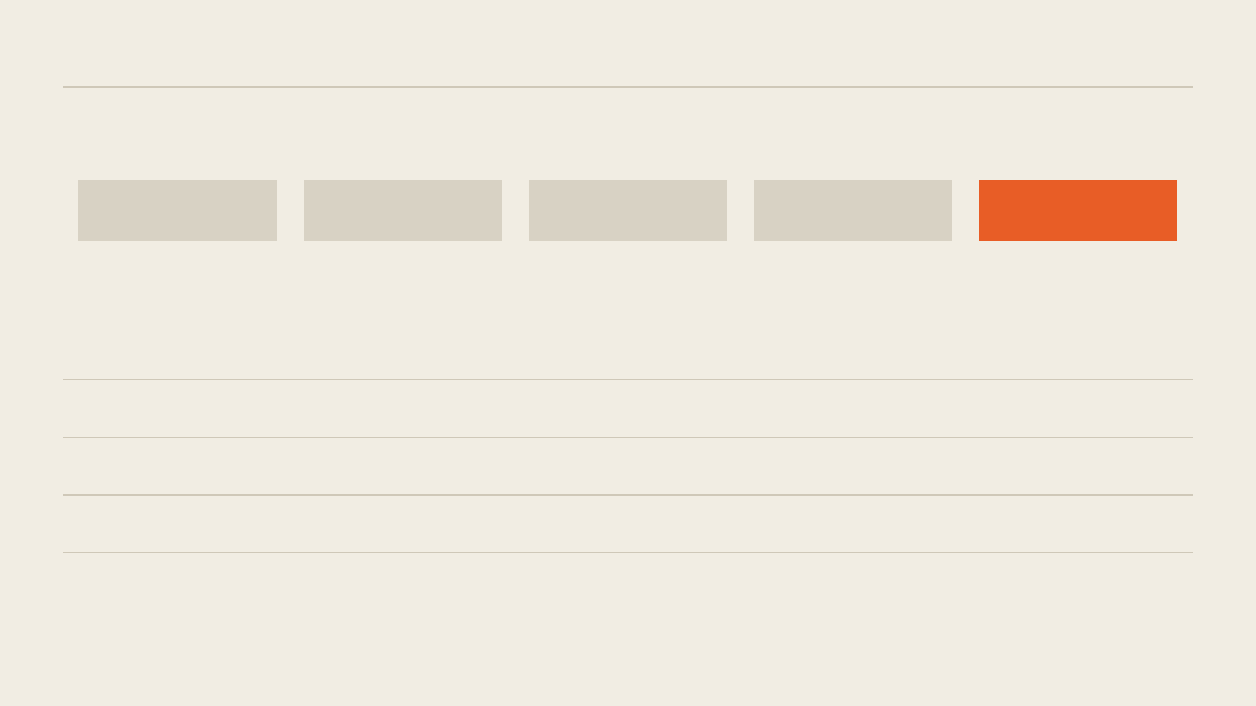
06 / THE PLAN
Several models, one brain
1
2
3
4
5
extract
data
train
models
sample
futures
score
& search
pick the
model
ACCURACY
how close the best guess gets to the real future
COVERAGE
does it cover the futures that really happen?
SAFETY
how often nothing lands near the truth
COST
model calls and wall-clock time per prediction
One shared encoder. Only the way each model imagines is allowed to differ.
07
Headline comparison: both generative models use the same first-order solver, so a difference cannot come from the solver.

Slide 8
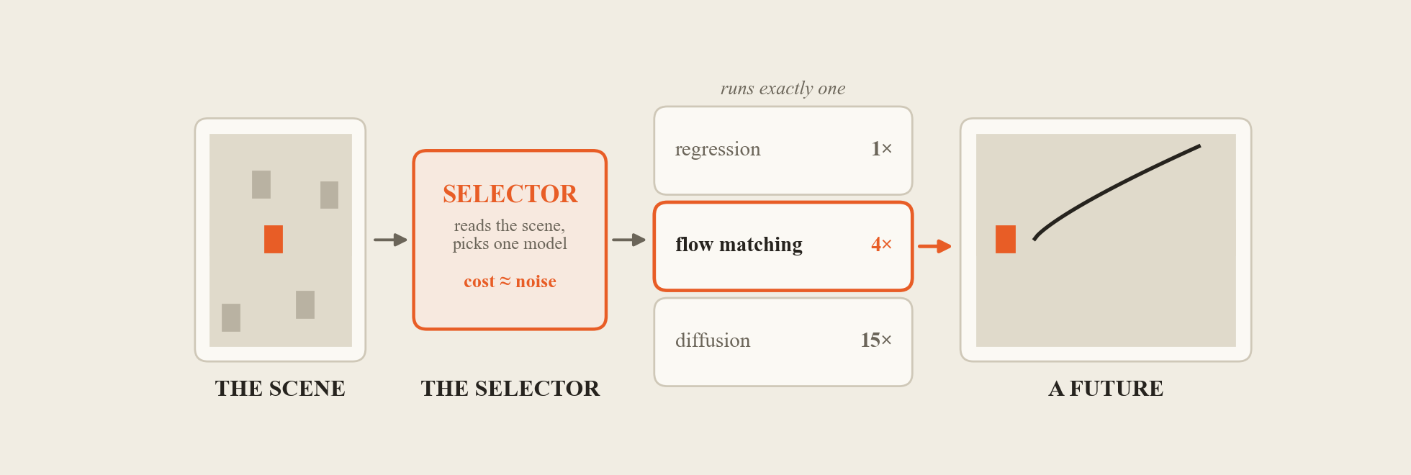
07 / WHAT WE DELIVER
One cheap selector to decide which model to use
Total decision time = the selector plus exactly one model. The selector itself is almost free.
Easy scenes go to the cheap model; only the hard ones pay for the expensive one.
08
We provide four trained models of different cost; the selector runs at prediction time and never retrains them.

Slide 9
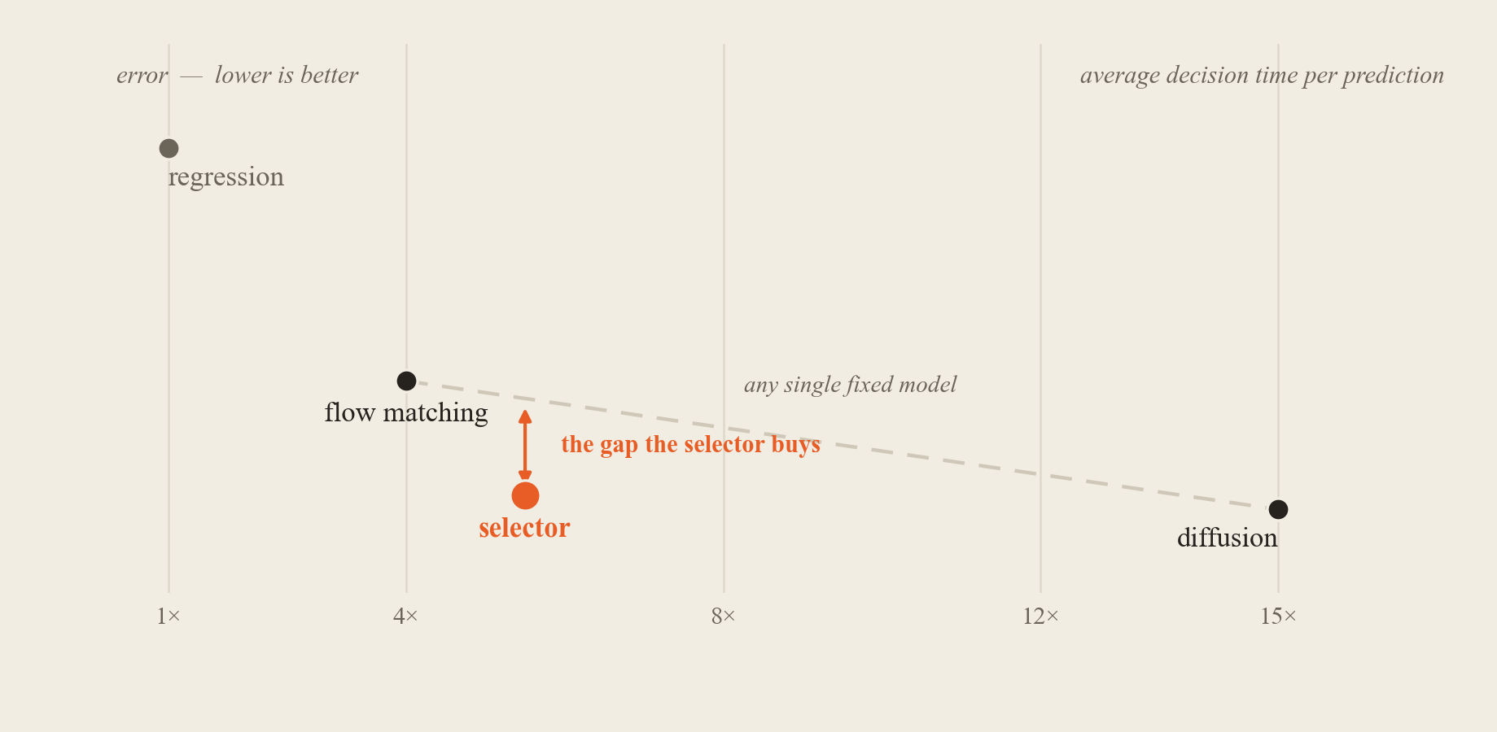
08 / WHAT WE EXPECT TO SHOW
Near-best quality, far less time
The selector should sit below the line that any single fixed model can reach.
We check it on our own four models first, then some sota models on nuPlan's official scorer.
09
Illustrative shape, not measured results. The blunt question: does a routed policy beat every single model?

Slide 10

09 / WHO DOES WHAT
Task assignment
W1
W2
W3
W4
W5
A · DATA
extraction, splits, timing, encoder
B · DIFFUSION+ANALYSIS
diffusion model, analysis
C · FLOW+ANALYSIS
flow-matching model, analysis
D · SELECTOR+TEST
selector, test on both modles, report
Gate / end of Week 1 — a complete baseline exists, so the project stays intact.
Everyone owns a deliverable. Nobody is blocked waiting on anyone.
10
The shared model code and the harness each have one owner, so the workstreams never edit the same file.

Slide 11
Thanks for your
                Listening!
We will deliver the table that says which one wins where — and what that table is worth.
CS 1675 INTRODUCTION TO MACHINE LEARNING · TEAM - 四人帮
11

