Slide 1
Group -3
Climate Knowledge Hunt
Hackathon
NIPGR

Slide 2
Summary
1 Data Annotation
2 Data Summarization
3 Key word Extraction

Slide 3
Steps for Data Annotation
Semantic Climate
It is a semantic climate github repository from where we get tools to analyze the the data
Data Extraction
We run pyami to extract text from PDF files from respective sections and sub sections stored them in html
We then use pyami again to parse the html based on the links and hyperlinks present to generate the connected sections. So this connected sections are then used to create the Knowledge graph
Paragraph Linking
The generated Knowledge graphs lacks the attribute linking the two nodes so we used the paragraph linking collab page to annotate each link with the desired attributes.

Slide 4
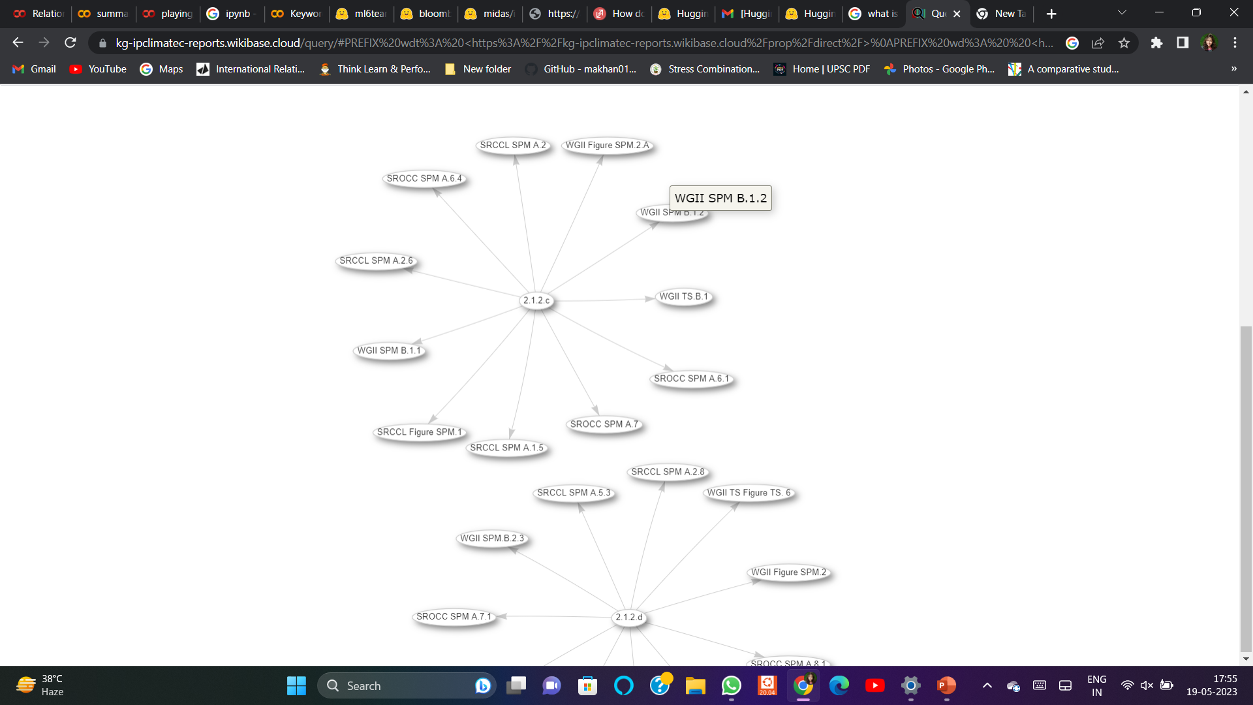
Knowledge Graph
Attribute id ?????

Slide 5
DATA ANNOTATION
Data annotation is the process of labeling individual elements of training data (whether text, images, audio, or video) to help machines understand what exactly is in it and what is important.
Given the KG we Read the Anchor text and Target text tried to Annotate attribute ID for the connection between Anchor and Text Node.
We then Analyzed how the generated summary and the keywords for the blob of the text were helpful.
Tools Used in Data Annotation
1. Google Collab Paragraph Linking notebook. Identified the key attributes of the edges.
2. pandas

Slide 6
SUMMARIZATION
The term Data Summarization can be defined as the presentation of a summary/report of generated data in a comprehensible and informative manner. To relay information about the dataset, summarization is obtained from the entire dataset.
Libraries Required in Summarization
1 Pandas
2 Transformers
3 Torch

Slide 7
Steps For Summarization
We imported all the libraries required for the Summarization.
We copied the text and pasted the text that’s need to be summarized in quotes with some parameters like
min length
max length
ngram size
Repetition penalty
Numbeans etc.
Append the summaries to the CSV file.

Slide 8
Key word Extraction
Keyword extraction (also known as keyword detection or keyword analysis) is a text analysis technique that automatically extracts the most used and most important words and expressions from a text. It helps summarize the content of texts and recognize the main topics discussed.
Libraries used in Key word Extraction
Transformers
Numpy
Pandas
The model used in the method
HuggingFace

Slide 9
Requirments
Import the requirements
Os
Json
Torch
Pandas as pd
Numpy as np
Define the extraction function

Slide 10
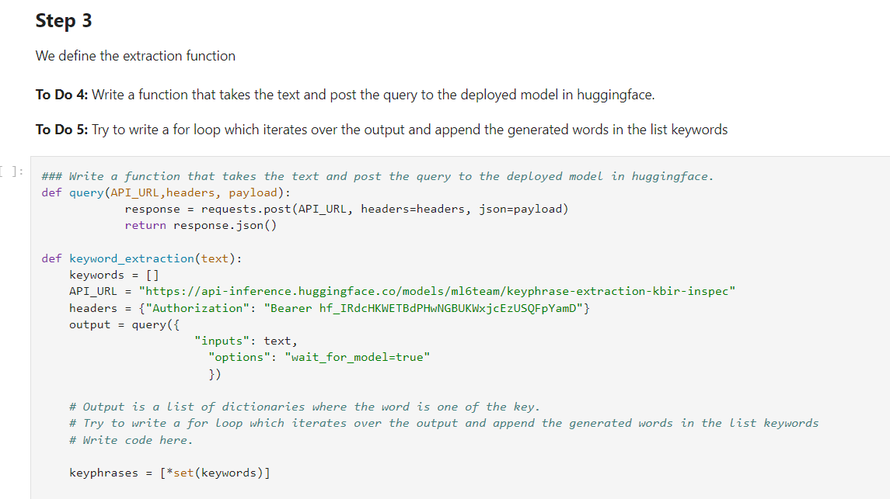
Doing keyword extraction

Slide 11
Next steps
Using transformers to identify the linkage between the target and the anchor node on top of manual annotation.
Then we can verify the annotation and then compute inter-annotator agreement.
These annotation will be then uploaded to wikibase.
Attribute id 1
Attribute id 1
Attribute id 2

Slide 12
Thank You

