Slide 1



2023 International Training Workshop on Open Science and SDGs
(SemanticClimate Presentation by the team and Peter Murray-Rust) 2023-09-01
IPCC SYR Synthesis Report 2023-03
António Guterres March 2023 statement and video
“In short, our world needs climate action on all fronts -- everything, everywhere, all at once”.
SemanticClimate can’t do everything, but can do * something unique (create semantic climate knowledge)
* everywhere
* from everyone (secondary school onwards)
* all at once , working in parallel with Open NotebookScience

Slide 2
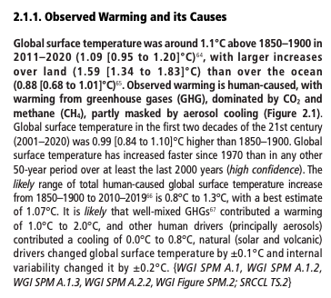
2023-03 IPCC SYR-LongerReport – “survival guide for humanity”:
Written for specialists
and policy makers in English
SemanticClimate makes this accessible for:
School students
Local government
Open Educational Resources
Everywhere … !

Slide 3
2023-03 IPCC SYR-LongerReport – “survival guide for humanity”:
PDF sub-subsection to be semantified and added to Wikibase Global Knowledge Graph
Unique label
statements
Confidence metadata
Crosslinks within 7 Reports

Slide 4
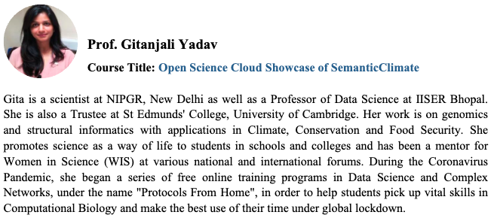

Slide 5
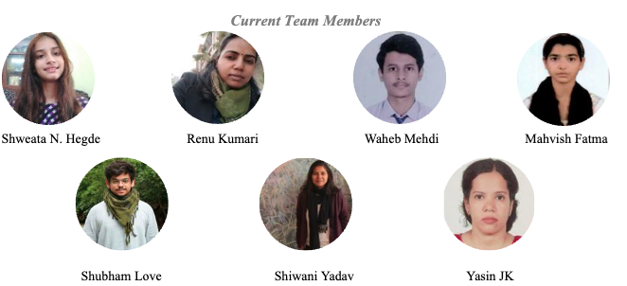
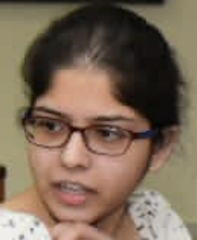
Ananya Singha
Presentations from Team members

Slide 6
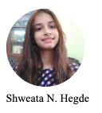
SemanticClimate, its people , events, mission and technology
Shweata has been with SemanticClimate as manager and author of docanalysis for 3 years. Normally she would present in person but has just started as Science Communicator TIGS (Tata Institute for Genetics and Society). We have extracted her earlier presentation at Wikimania 2023-08
Part 1 – overview
Part 2 – future events

Slide 7
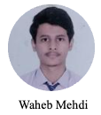
Anatomy of an AR6 Report

Slide 8

SemanticClimate organization, events and internships

Slide 9
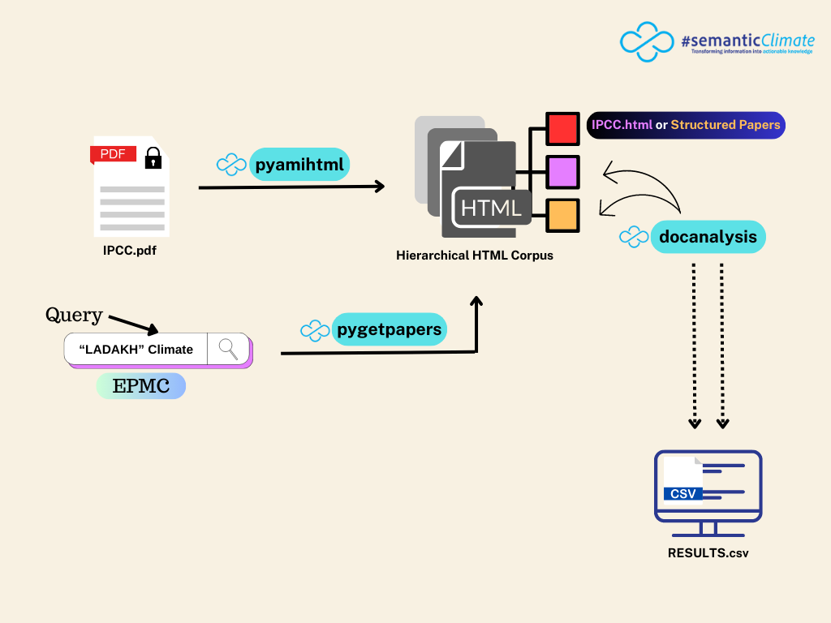
Two sources of climate knowledge: IPCC and EPMC (Open Access)
(This tech is very general)

Slide 10
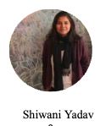
IPCC and Climate Crisis in Ladakh

Slide 11
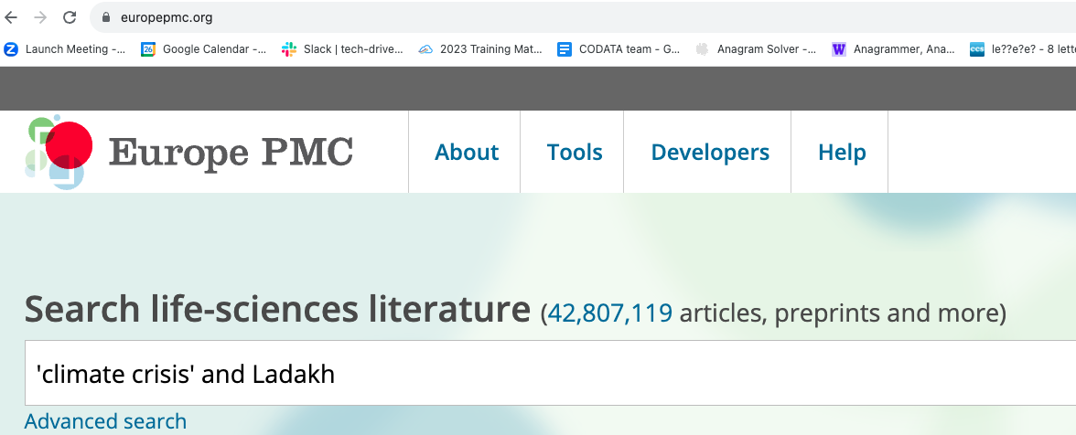
Search Climate Crisis and Ladakh in EuropePMC
Peter Murray-Rust
https://europepmc.org

Slide 12
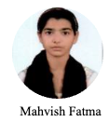

Loading and running pygetpapers
Written by Ayush Garg (15 yrs old)

Slide 13
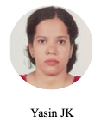
Food Security

Slide 14
IPCC WG3/Ch08 and City/CarbonCapture

Slide 15
docanalysis to extract places from pygetpapers results
Peter Murray-Rust
Standing in for Shweata Hegde, author of docanalysis
Run pygetpapers to get a corpus
Run docanalysis to extract entities (here we use GPE == places)

Slide 16
Create Wikibase graph from IPCC statements
Peter Murray-Rust
Statements annotated and turned into graph by Egon and Lars Willighagen 2023--05
Pyamihtml extracts numbered statements from IPCC/SYR/LongerReport
Statements manually annotated with Wikibase property/values
Statements entered into Wikibase
Demo shows several SPARQL searches and display

Slide 17
SemanticClimate immediate future

Slide 18
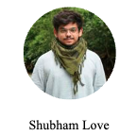
Behind the scenes
Google Colab , Jupyter Notebooks
Ananya pioneered the use of Containers and Notebooks which played a large part in Hackathon Piaget 2023
video
Ananya Singha
Shubham has been a 1-month intern and played the major part in putting all the videos and stories together
Also Simon Worthington and Axel Duerkop

Slide 19
Discussion

Slide 20
Ideas for the future
How can we find partners?
To help scale (e.g. by doing extra chapters in parallel)
To complement SemanticClimate
Potential users
Education (SemanticClimate as a learning resource)
Owners of non-semantic reports (i.e. National Institutions)
Knowledge graph developers
Policy makers (e.g. in cities)
Infrastructure
Integration with existing technologies or resource providers
To expand the world view (we are only a small number of countries and disciplines)
What are the generic problems that SemanticClimate can help to answer?
A plugin to enhance other tools?
Natural Language Processing (not AI)
Generic Open Resources (cloud) that SemanticClimate can use or work with?
Websites and landing pages.
Knowledge bases
Collections of terminology
Trustable-AI-in-the-Cloud
Reference data (upload and download), especially machine-converted text-to-data

