Slide 1
Google Colab and Schematics
Ananya Singha
Volunteer #SemanticClimate

Slide 2



Introduction to Google Colab Notebook
An open Jupyter notebook environment
No pain with setups
Human Machine friendly
Supports interactive programming
Easy learn and explore new tools
Step 1: Install
Step 2:
Abbreviation extraction
Step 3:
Keywords Extraction
Step 4: WordCloud
Open Collaboration
And exchange of knowledge
Step 5: Markup
Notes:
Hello everyone…I am part of open virus team…Let me take you through the Google Colab Environment which we are going to use today to showcase our tools…
90% of time people hassle through in downloading software pakages …and it is a painstaking process which we can completely avoid by using colab as it runs in browser
You don’t have to think how much cpu you have and whether it is enough for your tsk as you get cloud compatibility
You get access to gpu which enhance the computation capability and helps you in using gpu based ML tool
Once you run the code you don’t have to switch to another window to see the output….everything happens in the same niche

Slide 3

Our CodeFlow:
Step 0: Open the notebook
You can access the notebook from here
Notes:
While attending your session in breakout room…you get a notification on the chat for the shared notebook

Slide 4
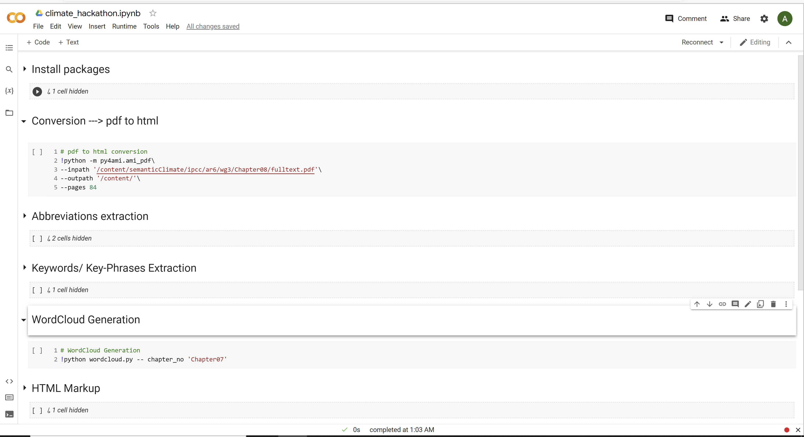
Outlook: Hackathon Notebook
Click to run
Install 1
STEP 1
Abbreviation 2
STEP 2
Keyword 3
STEP 3
WordCloud 4
STEP 4
Markup 5
STEP 5
Notes:
Now lets dive deep on how today’s notebook will look like….

Slide 5
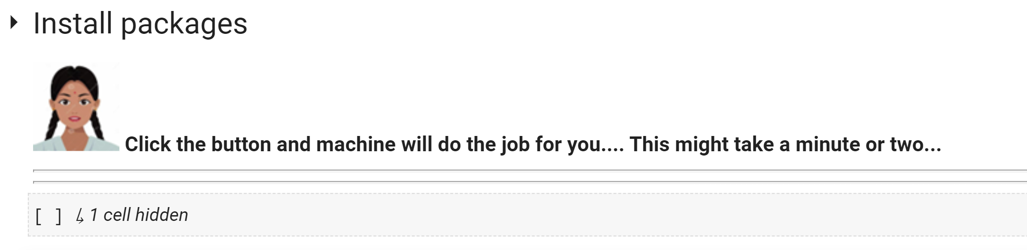
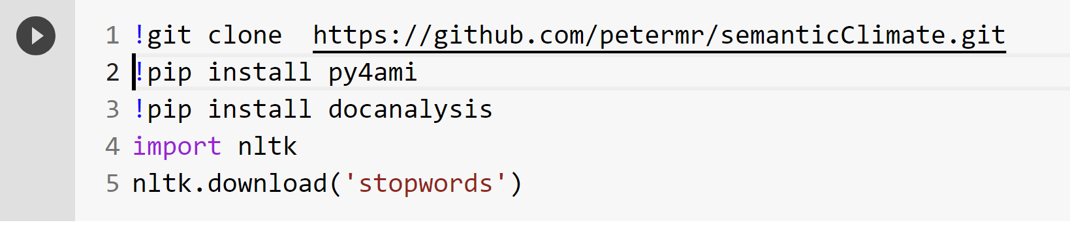
Step 1: Installing packages
Run Install 1
Install 1
CHUN 1

Slide 6
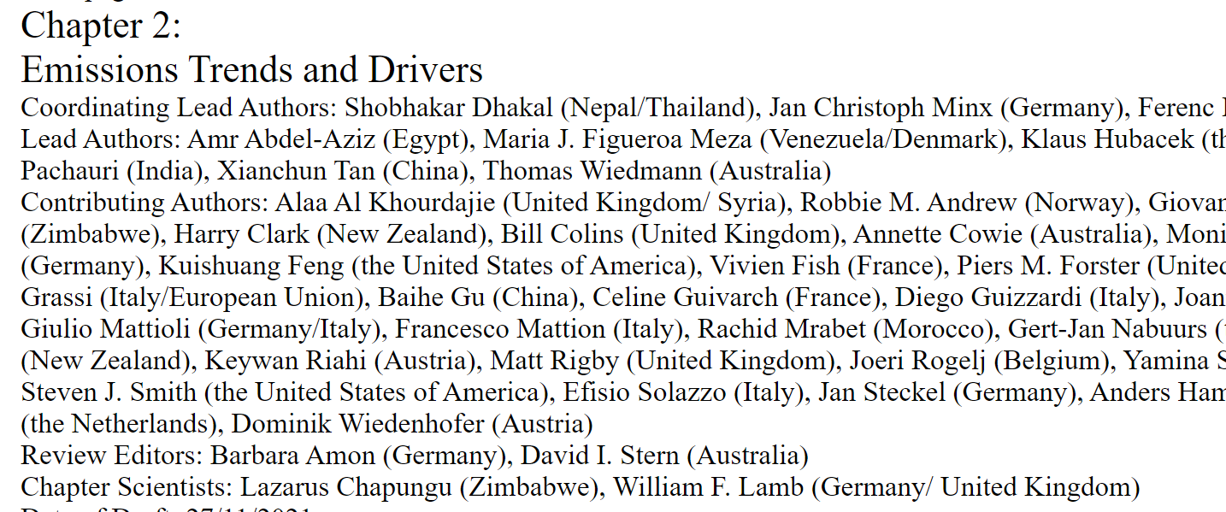
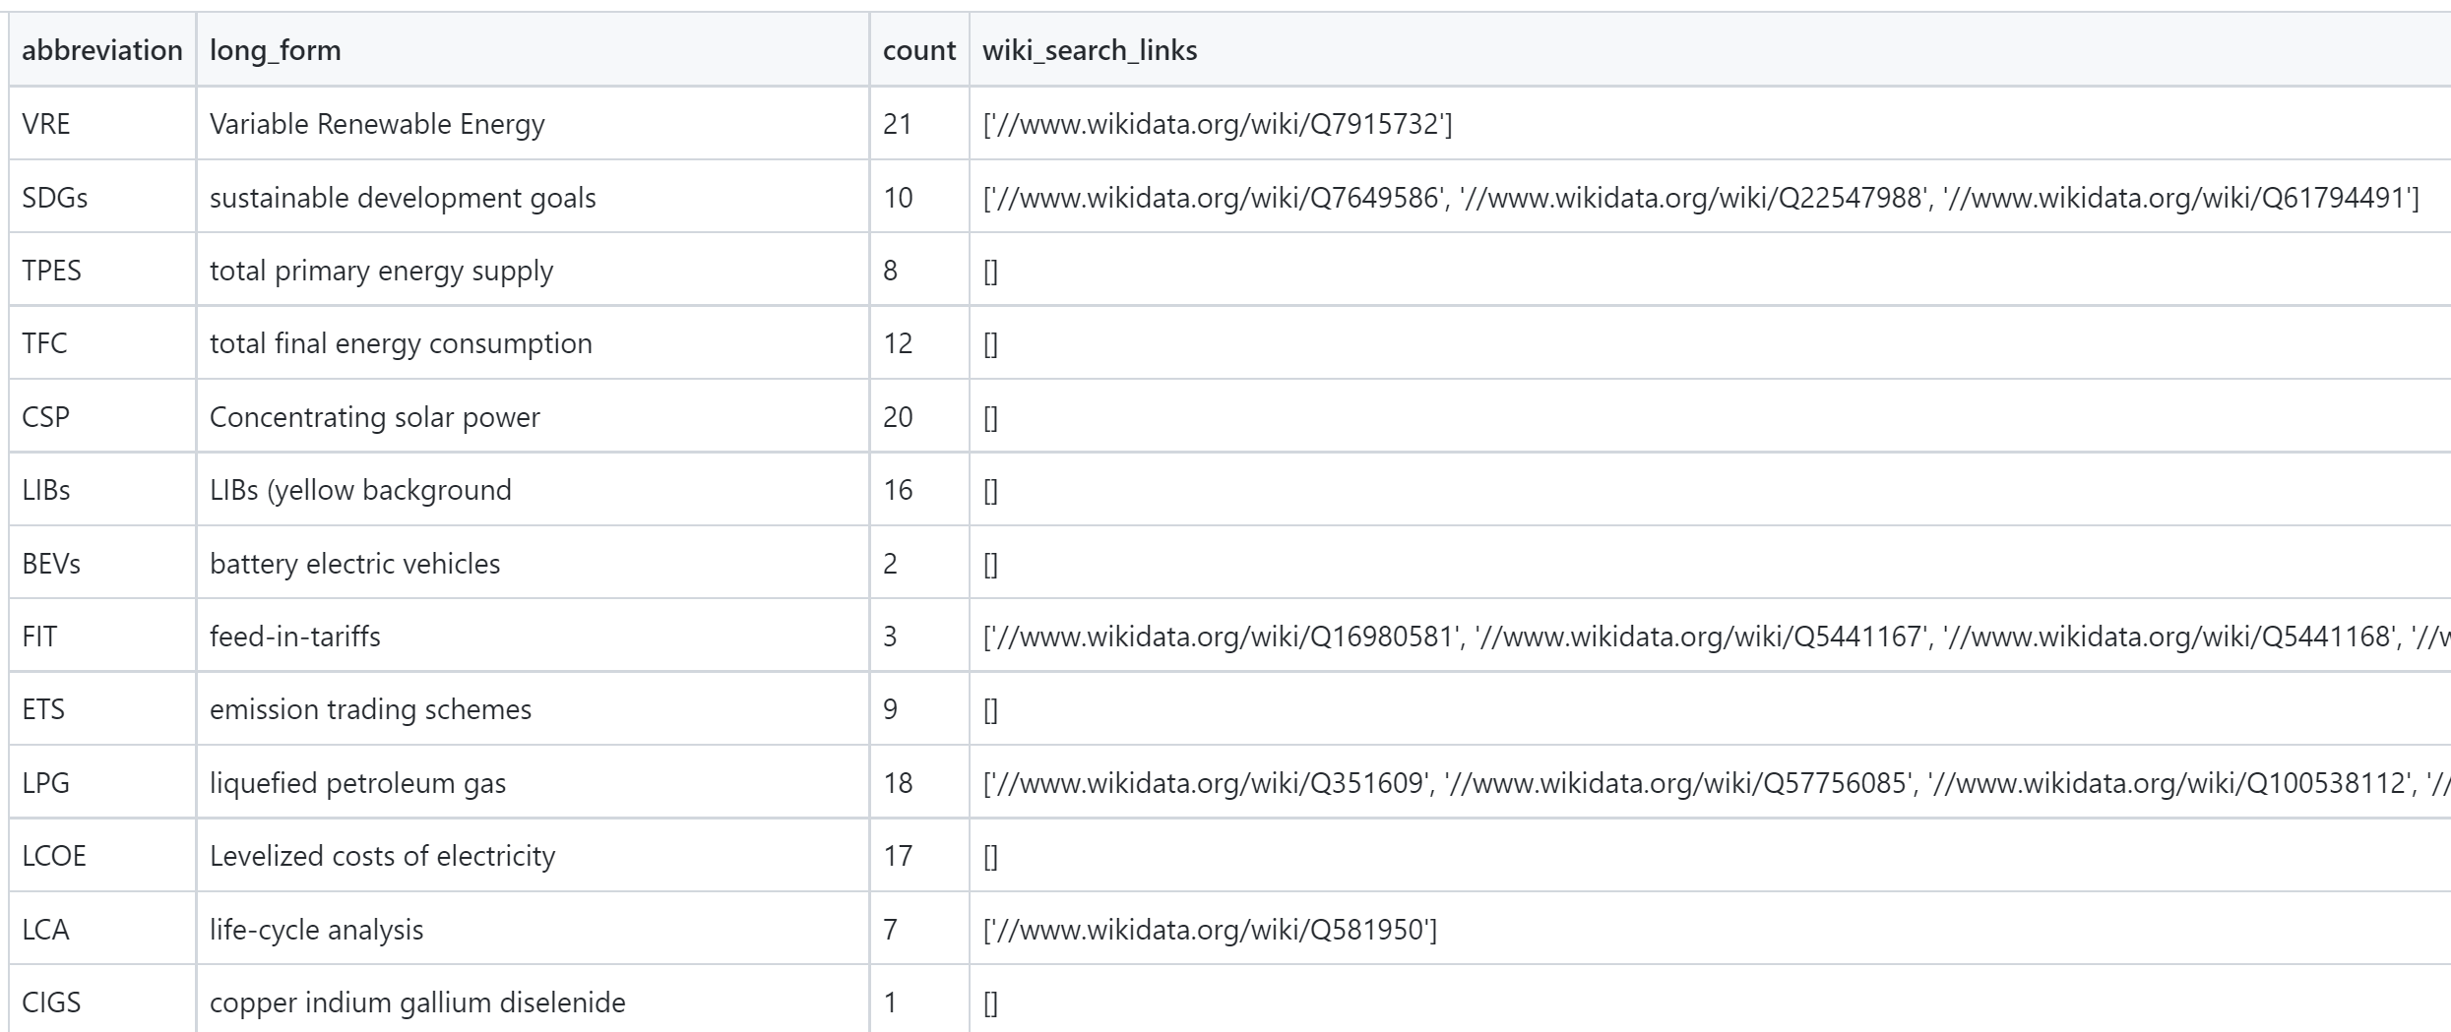
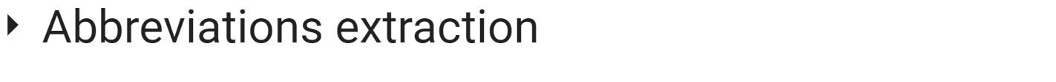
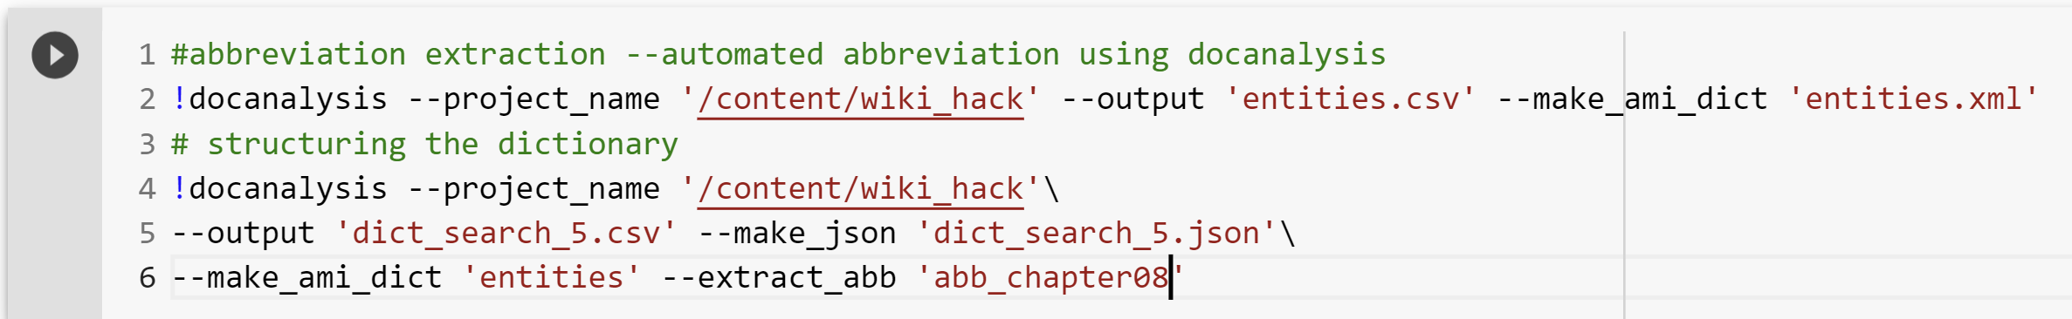
Step 2: Abbreviations Extraction
HTML
Abbreviations
Abbreviation 2
docanalysis
Wow!!!
So easy..
Abbreviation 2

Slide 7
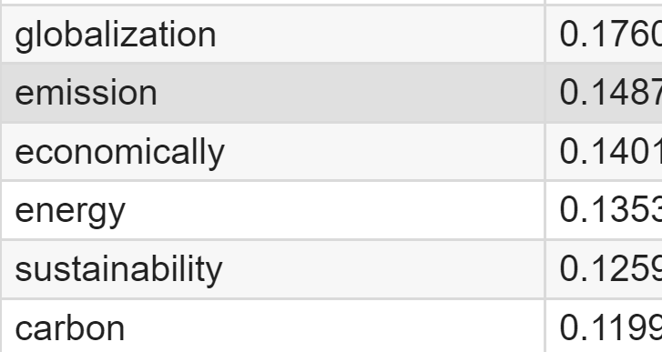
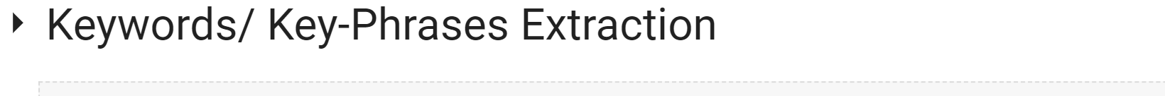
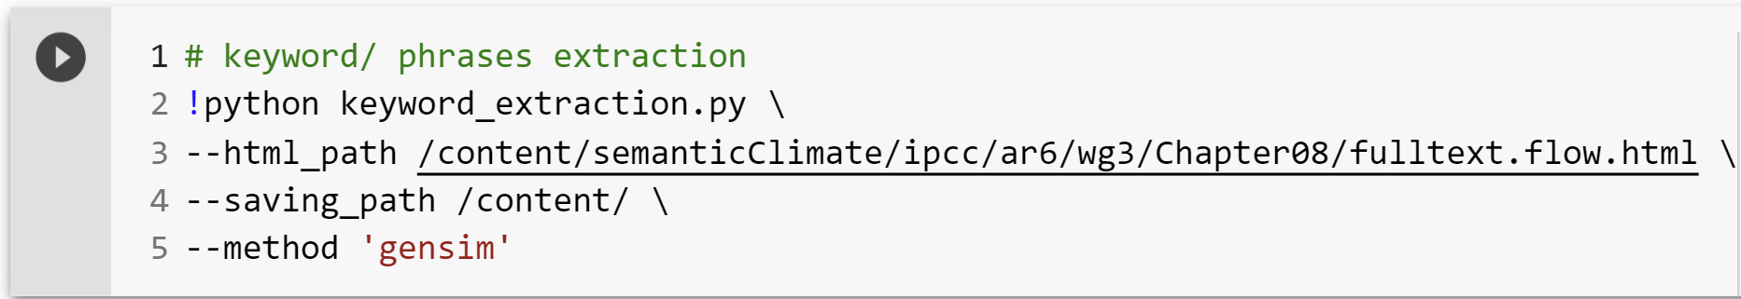
Step 3: Keyword Extraction
Keywords Table
HTML
Keyword 3
Keyword | score
OpenVirus
Keyword tool
Keyword 3
Cell 4

Slide 8
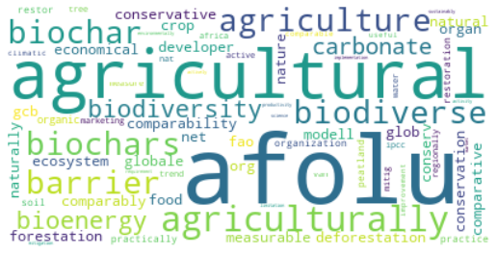
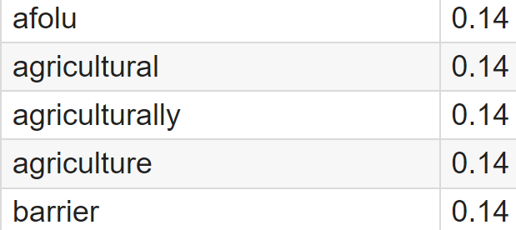
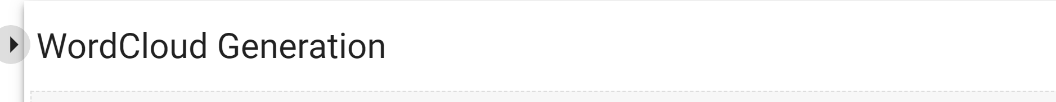
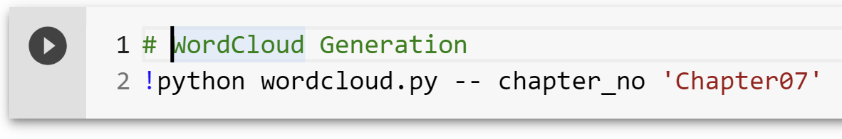
Step 4: Word Cloud Generation
Keywords Table
WordCloud
Keyword | score
WordCloud 4
Cell 5
WordCloud 4

Slide 9

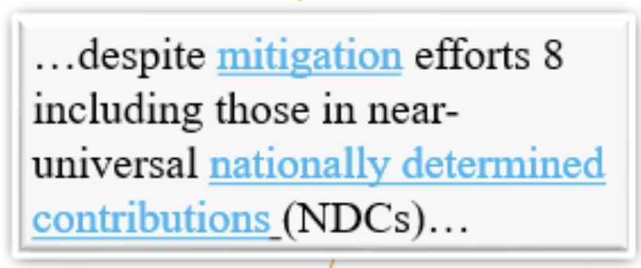
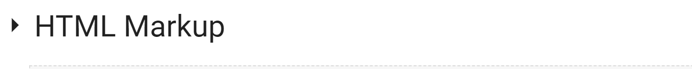
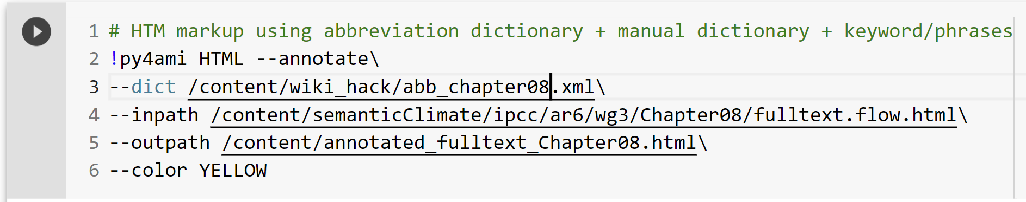
Step 5: HTML Markup
Clickable Wiki link
MarkedUp HTML
Abbreviations
Keywords Table
+
+
Keyword | score
Manual
Dictionary
Cell 2
Markup 5
Markup 5

