Slide 1
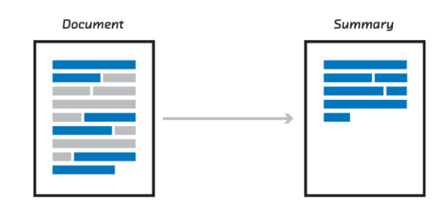
EXTRACTIVE SUMMARIZATION

Slide 2

PyTorch
Powerful, yet easy-to-use deep learning library for Python commonly used for natural language processing
Has algorithms that uses matrices, vector algebra, etc.
In this case, will be used to run transformers

Slide 3
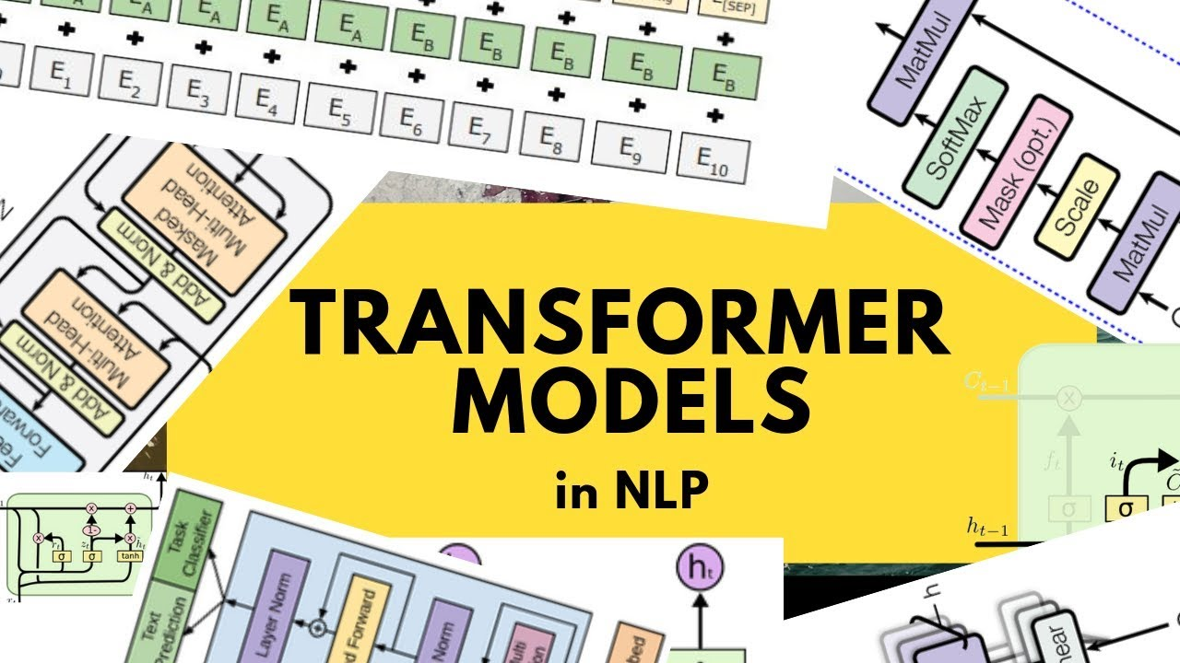

Slide 4

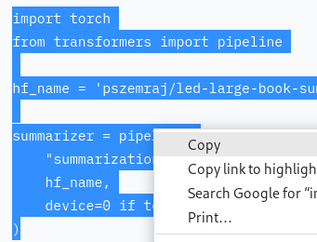
Huggingface.co
Search for your desired transformer in the hugging face library
Paste the required code into your jupyter notebook
Source: https://huggingface.co/pszemraj/led-large-book-summary

Slide 5

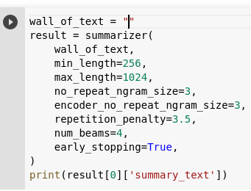
How to summarize text
Paste the text required to be summarized in the “wall_of_text” variable and run the notebook to obtain the summarized version of your text.
The summarization jupyter notebook can be found in github (link below)
Source: https://github.com/petermr/semanticClimate/blob/main/Summarization/summarization.ipynb

