Slide 1
SEMANTIFYING IPCC REPORTS
By
Gayathri jonnalagadda
Volunteer intern #semantic climate
NIPGR, New Delhi

Slide 2




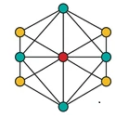
CHAPTER ANALYSIS
Conversion of to <HTML>
Keyword extraction
Dictionary creation
- manually created dictionary
- automated abbreviation dictionary
knowledge graphs
pdf

Slide 3
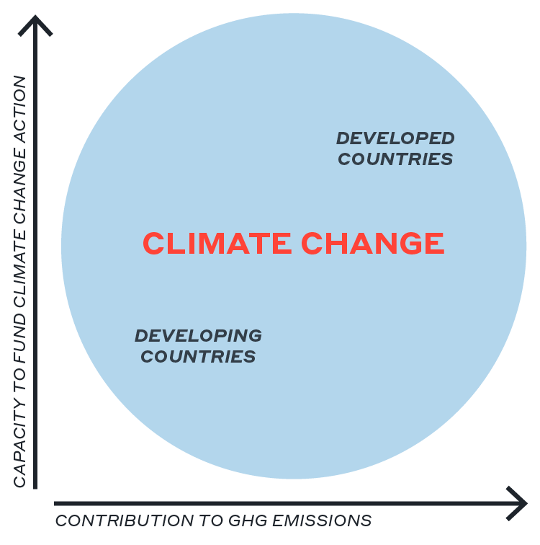
KEYNOTE FROM THE IPCC CHAPTER
Chapter 15: “Finance and Investment”
Why finance climate action? A LIVABLE CLIMATE IS BEST INVESTMENT
Information on this slide is from ipcc chapter_15_finance_and_investment

Slide 4


CONVERSION OF IPCC CHAPTERS (PDF’S) TO HTML FILES - PYAMI
< >
HTML
pyami
ipcc chapter 15

Slide 5



CREATION OF ABBREVATED DICTIONARIES - DOCANALYSIS
<dictionary title="abb_chapter15">
<entry name="SCF" term="Standing Committee on Finance">
<raw wikidataID="Q115097350, Q3421536"/> </entry>
pyami
Docanalysis
Ipcc reports
<Html >
Generation of abbreviated dictionaries

Slide 6
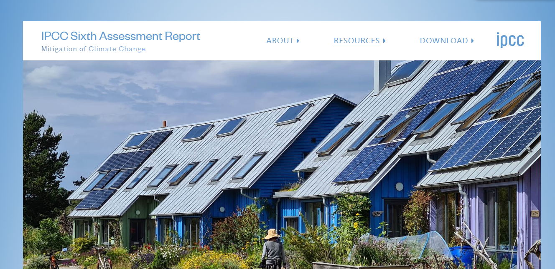

DICTIONARY
Set of terms with unique Wikidata Identifiers
<dictionary title="finance and investment" version="0.0.5">
<desc> manually created by Gayathri Jonnalagadda 2023-01-24 </desc>
<entry
term=“ capital“
wikidataID="Q1897397"
desc="money used by entrepreneurs and businesses to buy what they need to make their products or provide their services"/>
Manually created by reading the chapter

Slide 7
We extract keywords from the converted html files
1
keyword/phrase | score
financ | 0.25
doi | 0.25
climatic | 0.24
pdf | 0.19
Converted HTML
Extract keywords using different tools
< >
HTML
2
keyword/phrase | score
fuel | 2.76
facility | 2.69
springer | 2.66
bond | 2.66
1.Gensim
2.RAKE
3.YAKE
keyword/phrase | score
climate | 4.05
finance | 0.0001
financial | 0.0002
energy | 0.0002
3

Slide 8
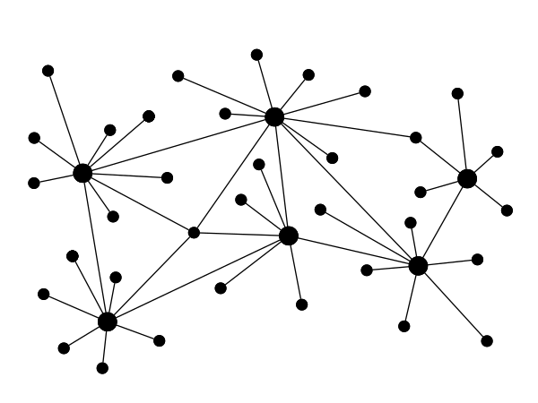
FUTURE PROSPECTS
We are going to create knowledge graphs that connects the contents of chapters in a structured manner and tells us the relations
knowledge graphs is a digital structure that represents knowledge as concepts and the relationships between them.
KG creates a semantic structure of data that can be understood by both machine and human.

