Slide 1
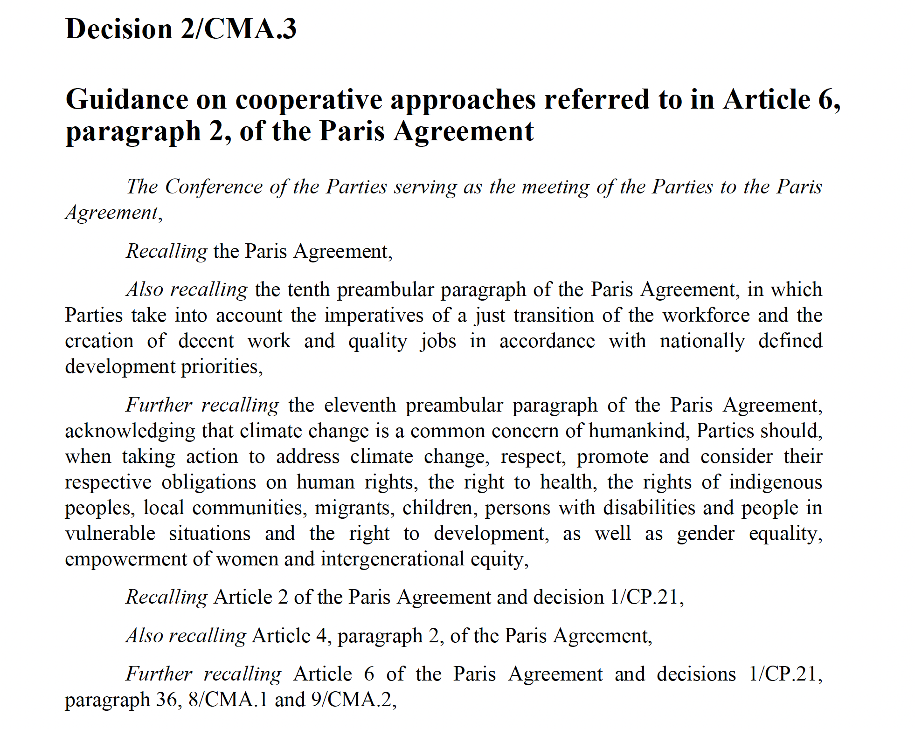
~2000 UNFCCC documents over 30 years, 50 statements/doc => over 1 statements
Cross-references between documents
HOW TO MAKE THIS MACHINE-READABLE?

Slide 2
~2000 UNFCCC documents
SOURCE
RELATION
TARGET DOCUMENTS

Slide 3
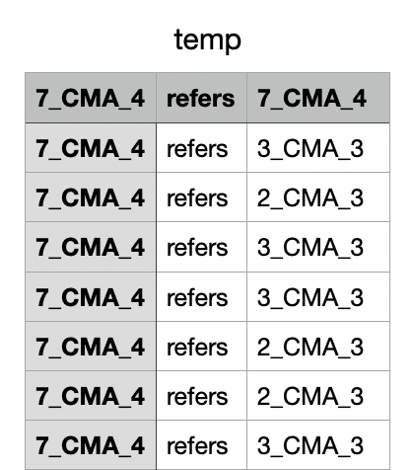
Pyamihtml converts PDF to HTML automatically search for SOURCE, RELATION, TARGETS
SOURCE
TARGET
Automatic, 1 sec/document
Gives network graph

Slide 4
Network graph goes here

