Slide 1
SEMANTIFYING IPCC REPORTS
By
Gayathri jonnalagadda
Volunteer intern #semantic climate
NIPGR

Slide 2
CHAPTER ANALYSIS FLOW
Conversion of pdf’s to html
Creating dictionaries (man, abb)
Extracting keywords
Obtaining knowledge graphs

Slide 3
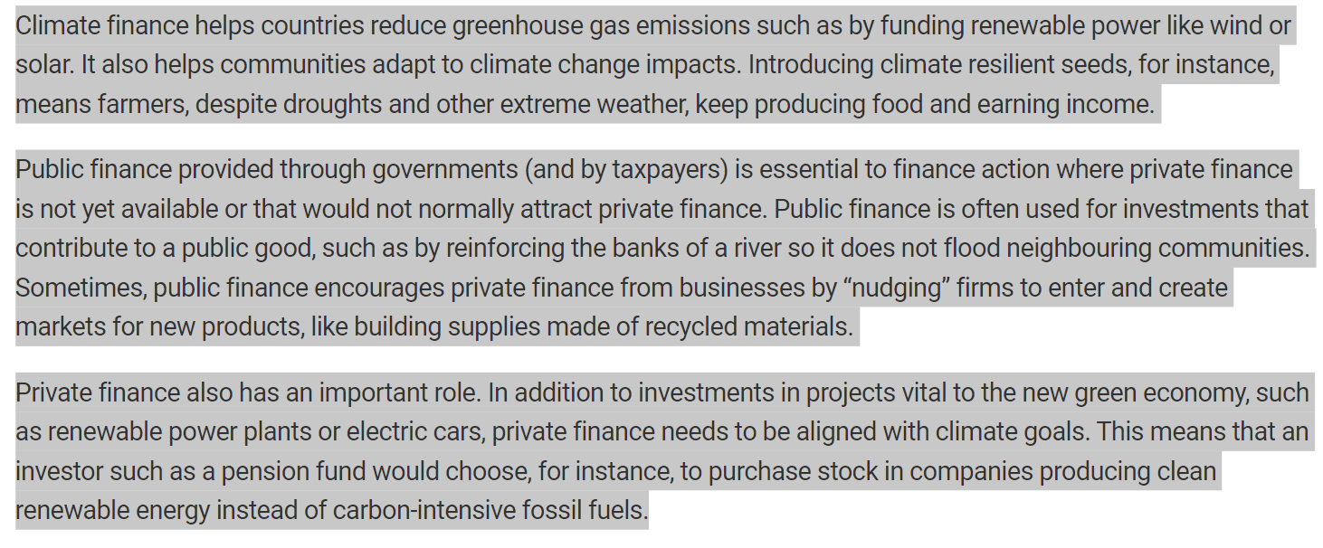
CHAPTER INTRODUCTION
WHAT IS CLIMATE FINANCE?

Slide 4
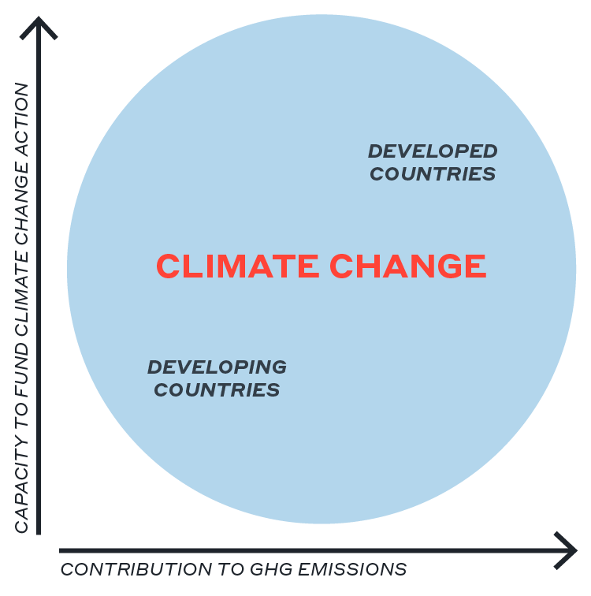
Why finance climate action? A LIVABLE CLIMATE IS BEST INVESTMENT

Slide 5
CONVERSION OF IPCC REPORTS (PDF’S) TO HTML FILES - PYAMI
Executive summary
Finance to reduce net greenhouse gas (GHG) emissions and enhance resilience to climate impacts
represents a critical enabling factor for the low carbon transition. Fundamental inequities in
access to finance as well as its terms and conditions, and countries exposure to physical impacts
Executive summary
Finance to reduce net greenhouse gas (GHG) emissions and enhance resilience to climate impacts represents a critical enabling factor for the low carbon transition. Fundamental inequities in access to finance as well as its terms and conditions, and countries exposure to physical impacts of climate change
pyami
Pdf format of ipcc report (chapter15)
Html file of the report

Slide 6



CREATION OF ABBREVATED DICTIONARIES - DOCANALYSIS
<dictionary title="abb_chapter15"> <entry name="SCF" term="Standing Committee on Finance"> <raw wikidataID="Q115097350, Q107564351, Q60753288, Q3421536"/> </entry> <entry name="LDCs" term="Least Developed Countries"> <raw wikidataID="Q752401, Q177323"/> </entry> <entry name="GHG" term="greenhouse gas"> <raw wikidataID="Q167336, Q3588927, Q112192791, Q925312, Q57584895, Q110612403, Q111461869"/>
pyami
Docanalysis
Ipcc reports
<Html >
Generation of abbreviated dictionaries

Slide 7
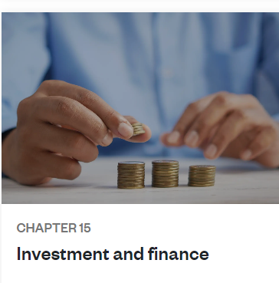
MANUAL DICTIONARY CREATION
Read the chapter and create dictionary
<dictionary title="finance and investment" version="0.0.5"> <desc> manually created by Gayathri Jonnalagadda 2023-01-24 </desc><entry term="capital" wikidataID="Q1897397" wikipediapage="https://en.wikipedia.org/wiki/Financial_capital" desc="money used by entrepreneurs and businesses to buy what they need to make their products or provide their services"/> <entry term="Low carbon transition" wikidataID="" wikipediapage="" desc=""/>

Slide 8
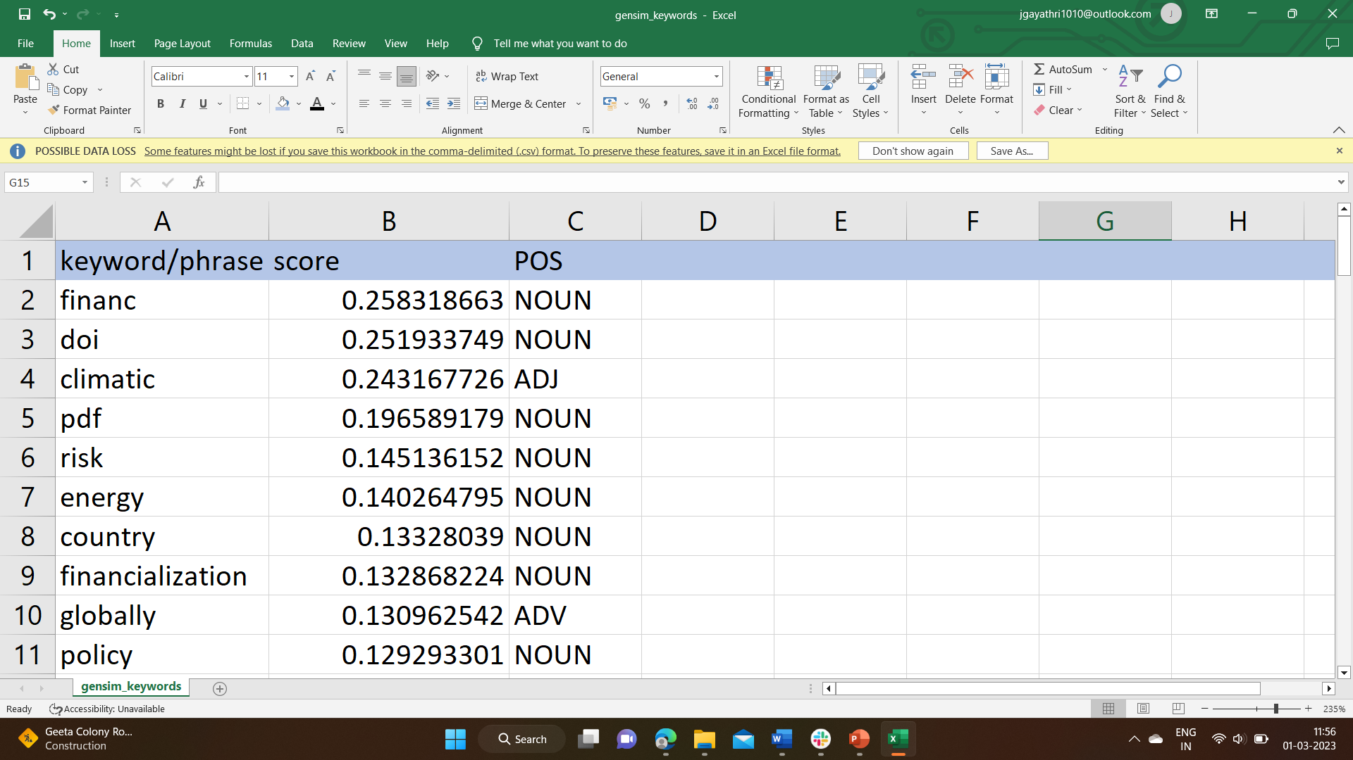
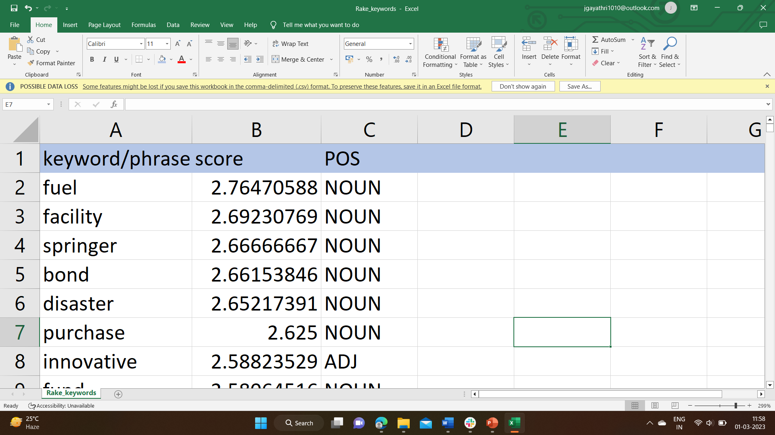
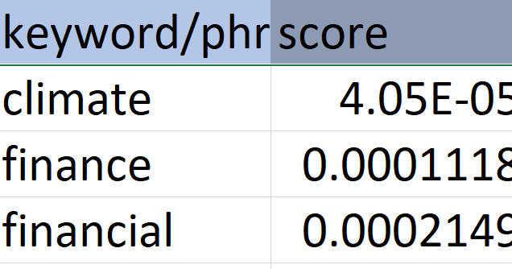
KEYWORD EXTRACTION
Converted HTML
Extract keywords using different tools
< >
HTML
Gensim
RAKE
YAKE

Slide 9
FUTURE PROSPECTS
Word cloud generation
Obtaining knowledge graphs (obsidian)

