Slide 1
CLIMATE KNOWLEDGE HACK
#semanticClimate
Group 2

Slide 2
AIM
Summarize large PDFs AND TEXTS
METHODOLOGY
Google Colab, Jupyter and GitHub repository
Tools (Summarisation) : Hugging face models: Transformers and specific packages from it
LXML – For storing and transforming data
DATA
sample text paragraphs
IPCC Chapters PDFs

Slide 3
ISSUES
Cannot read multiple lines
Abrupt Endings and defining Min and Max Length manually
Words without meaning/ Not Relevant

Slide 4
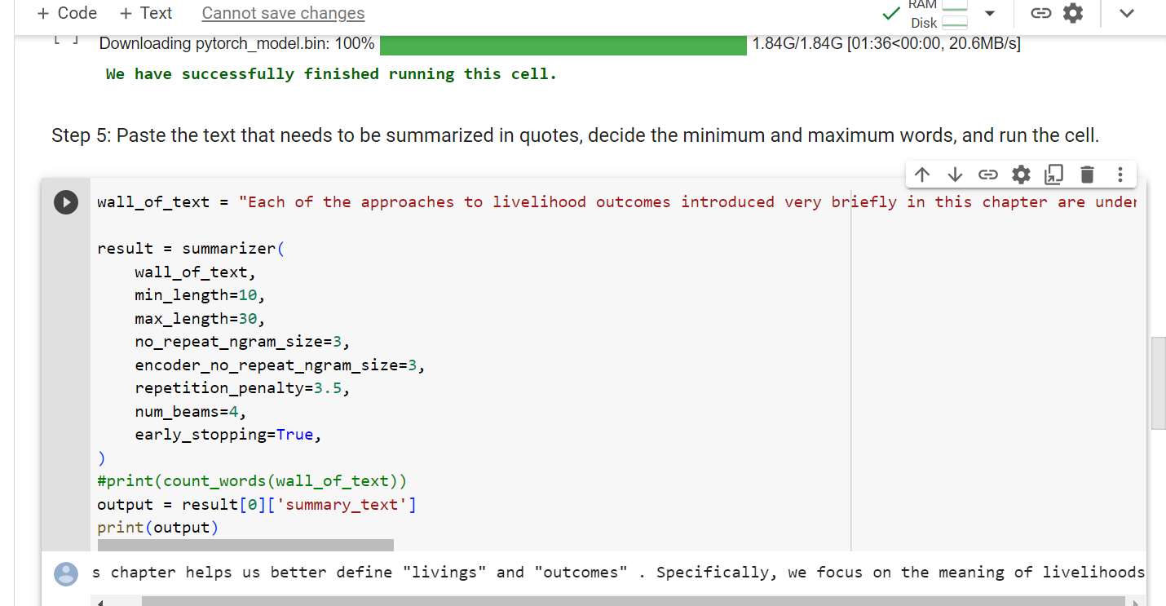

Slide 5
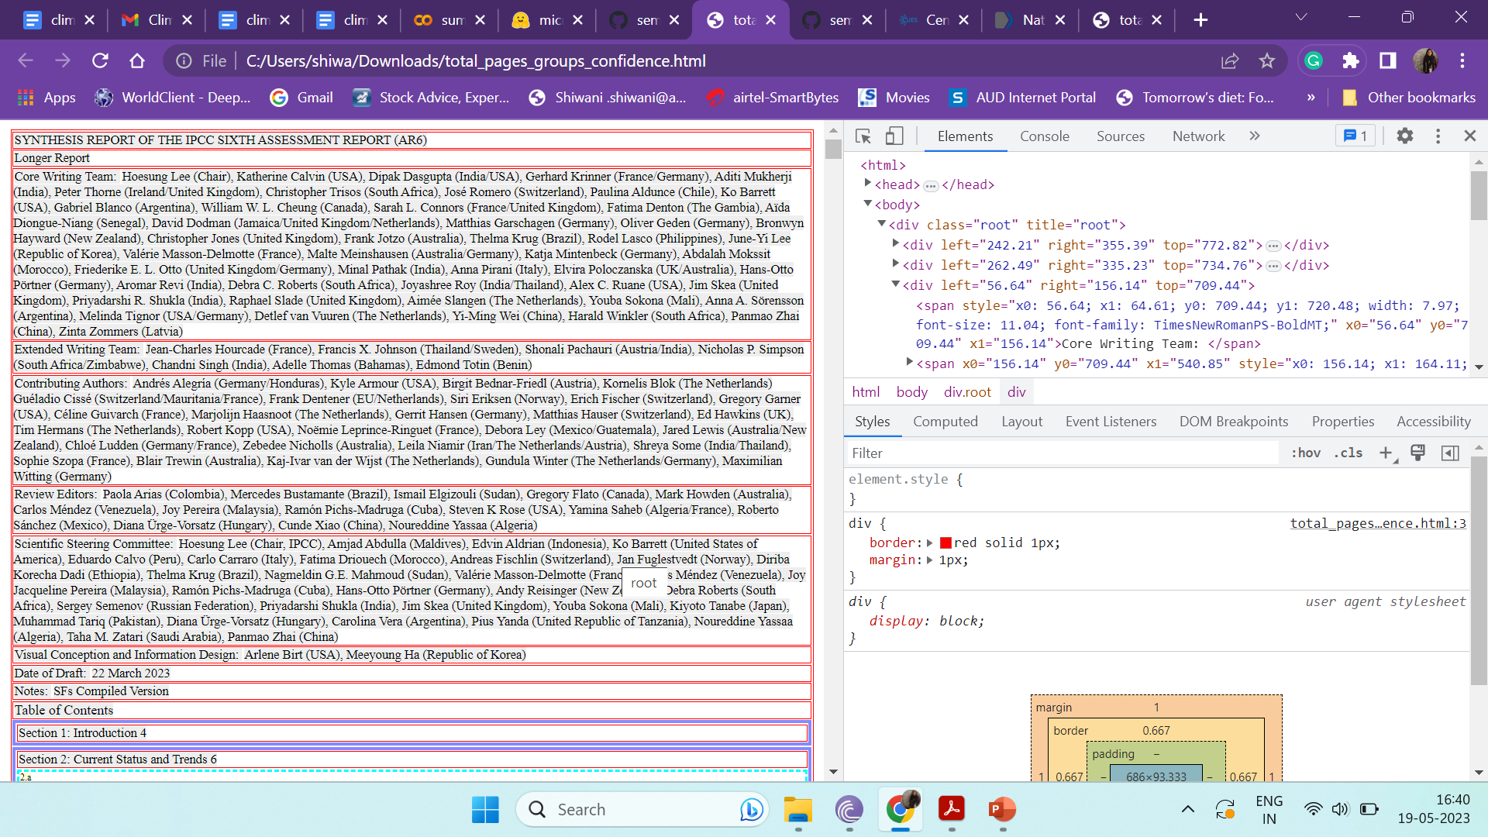

Slide 6
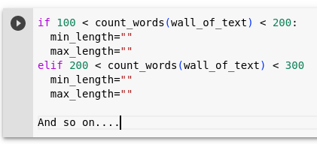
SOLUTIONS
CREATE AND USE LOOPS
CONDITIONALS (IF-ELSE)
CREATE TRANSFORMERS SPECIFIC TO CLIMATE DATA

Slide 7
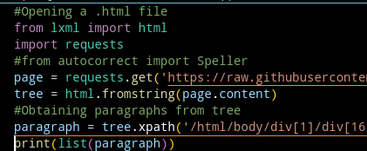
CODE
RESULT

Slide 8

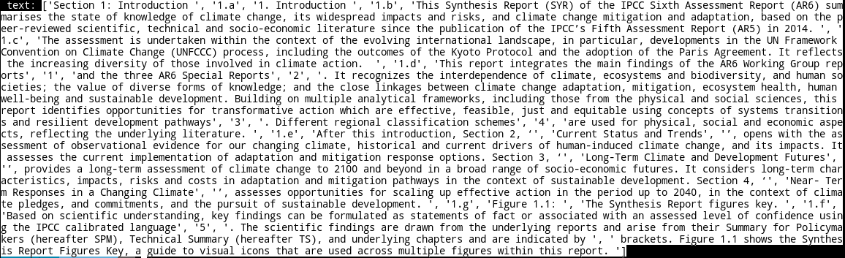
CODE FOR IMPORTING MULTIPLE PARAGRAPHS FROM HTML

Slide 9
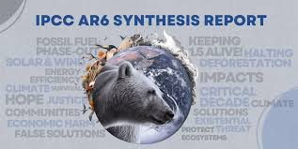
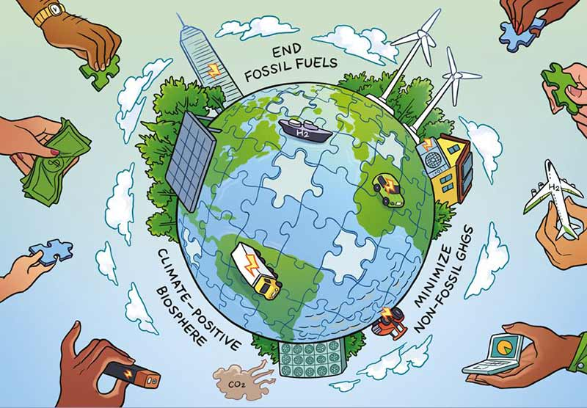
Future Development
Develop a transformer which can read more than 18000 words
Develop a transformer specific to Climate Data

