Slide 1

CONTAINERS ON THETA-GPU AND THETA INTRODUCTION
ALCF COMPUTATIONAL PERFORMANCE WORKSHOP MAY 24-26, 2022
Taylor Childers, Aditya Tanikanti Datascience team
Argonne Leadership Computing Facility

Slide 2
Outline
Build docker container which runs a mpi based c program and a mpi based python program locally and publish to dockerhub
Use dockerhub to build singularity containers for the applications and run singularity on ThetaGPU and Theta.
Using pre-existing singularity images on ThetaGPU for deep learning workloads.
Show how to bootstrap existing containers for re-use and reproducability
When in doubt – message us on the CPW slack channel.
Prerequisite
Due to time constraints – we cannot show you how to install docker on your local machine (but this is not very difficult). visit https://docs.docker.com/get-docker/ and choose your OS and install Docker locally.

Slide 3
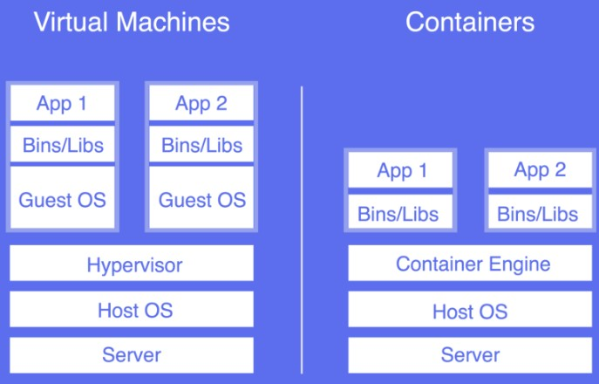
Containers
•
Lightweight alternatives to virtual machines and increasingly popular for cloud applications. Examples: Docker, Singularity, Rocket etc.
Singularity is our container of choice for security reasons.
However, Docker is the most widely used container platform.

Slide 4
Dockerfiles and dockerhub
Option 1: Build a docker image on their local machine and upload to dockerhub (needs local installation of docker).
Option 2: Link Github and dockerhub and auto-build using Dockerfile. (does not need local installation however needs a dockerhub pro account which will not be covered in this tutorial).
We’ll show you how docker and dockerhub can be used to port your docker containers to thetagpu and build singularity images.

Slide 5
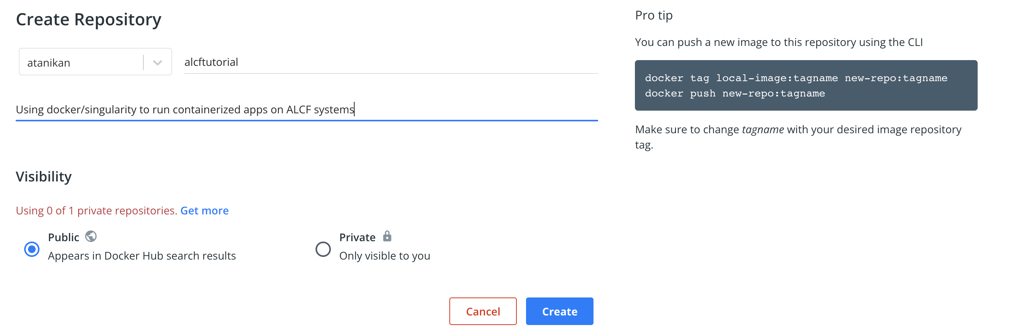
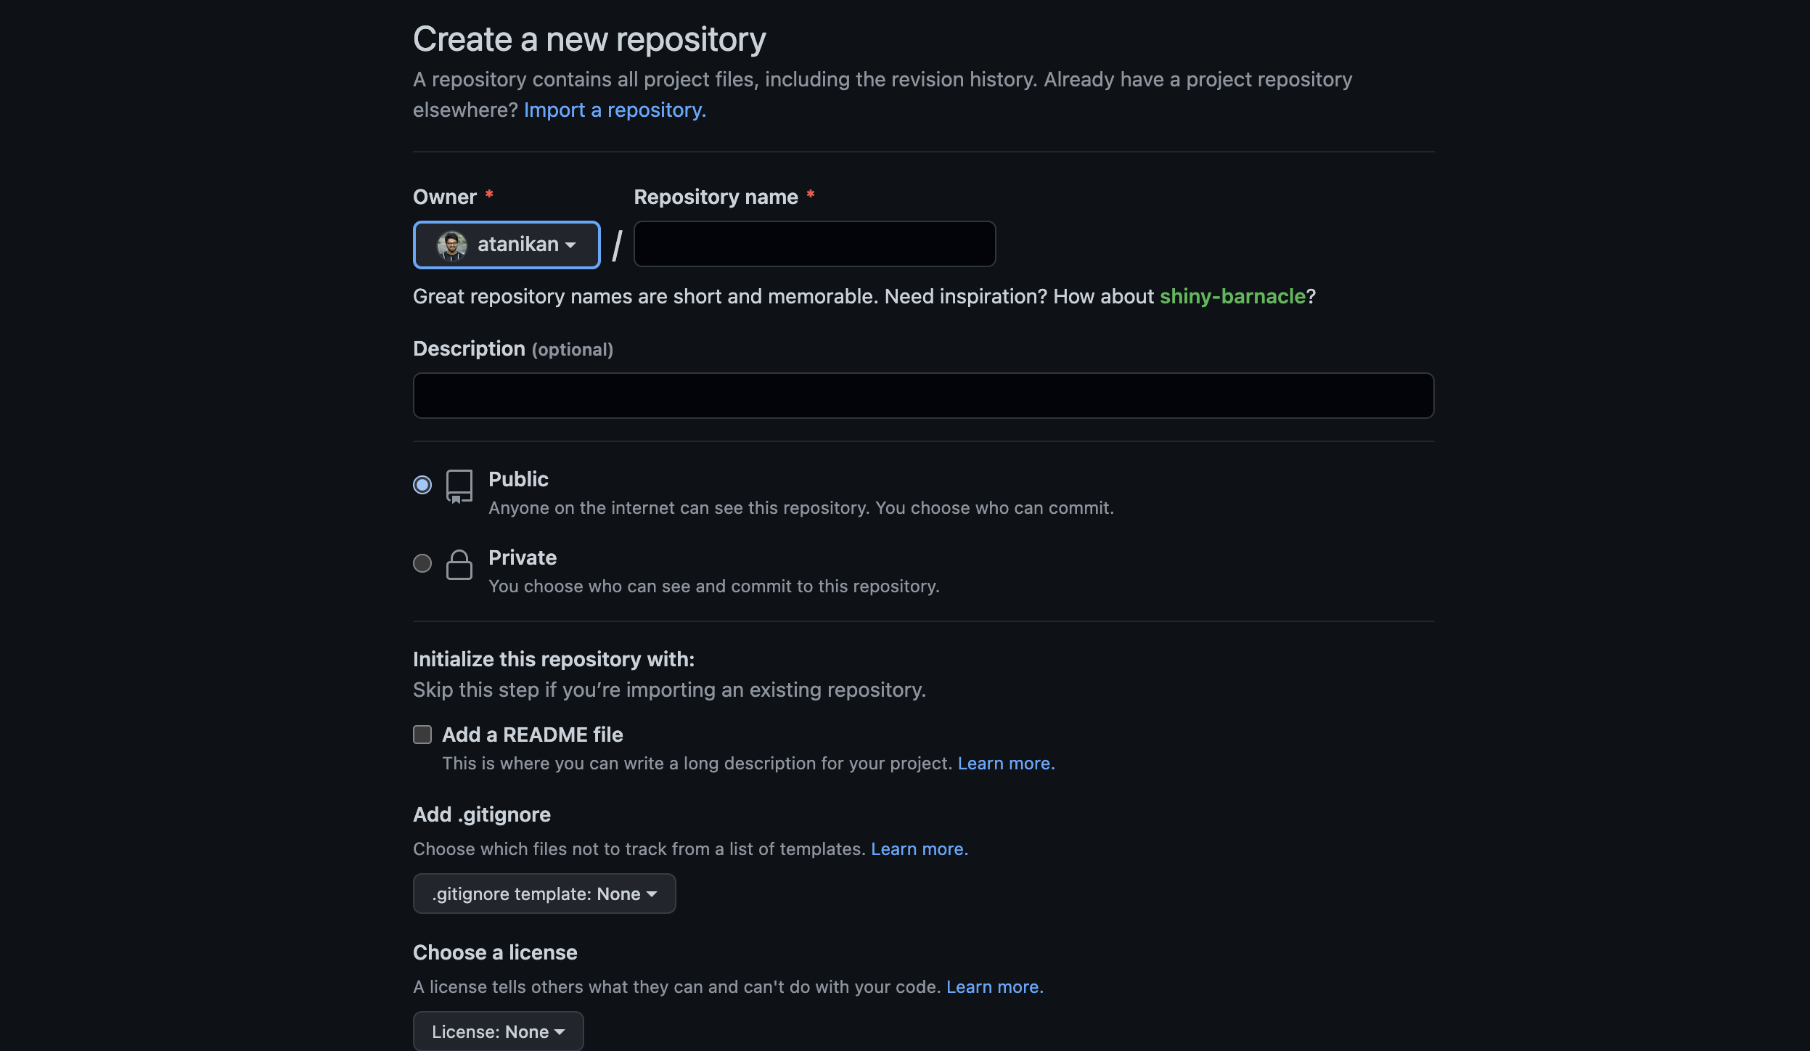
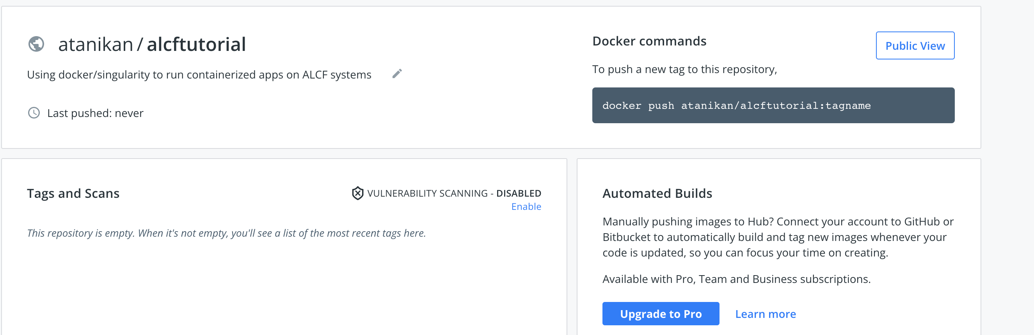
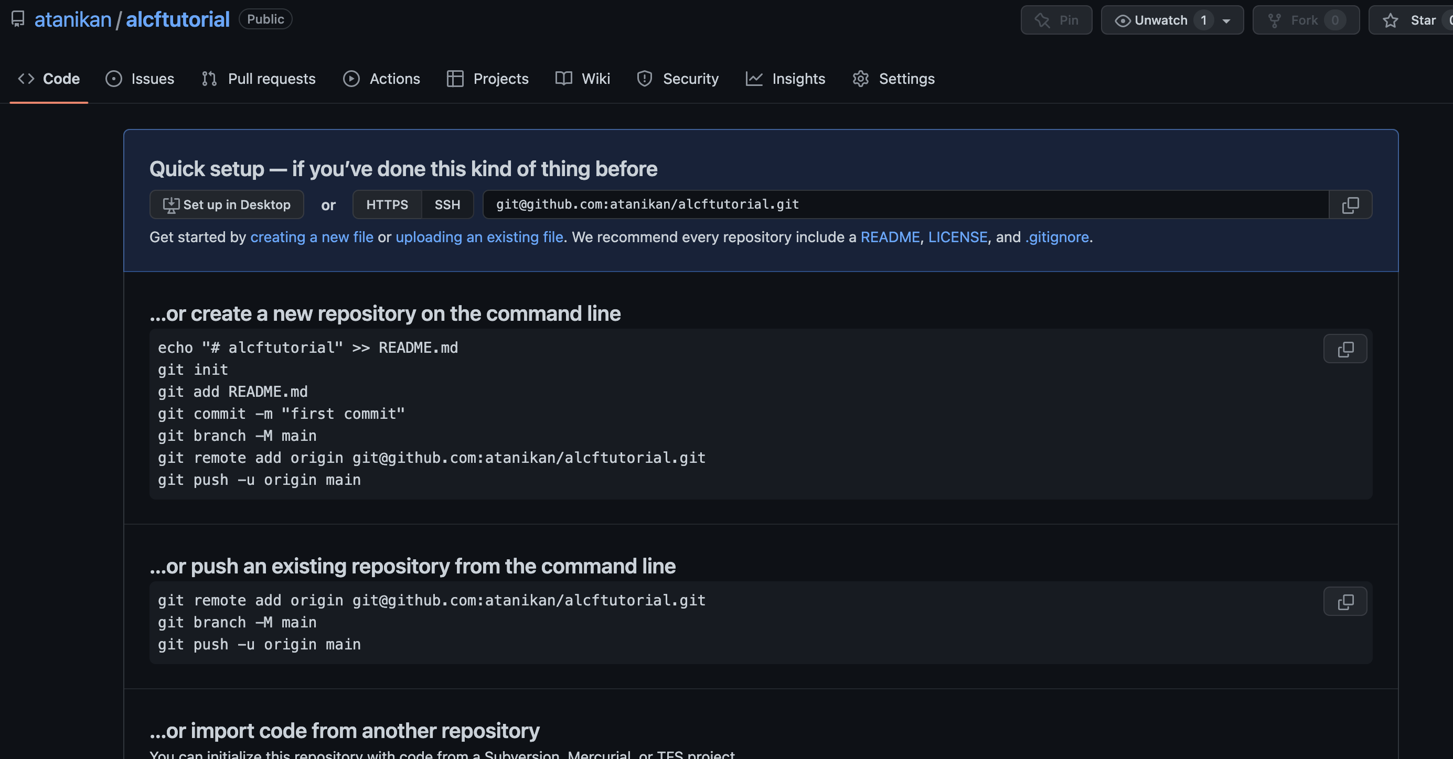
Sign up to GitHub and dockerhub
Sign up to dockerhub at https://hub.docker.com/ and GitHub (Optional) at https://github.com/ and create repositories

Slide 6
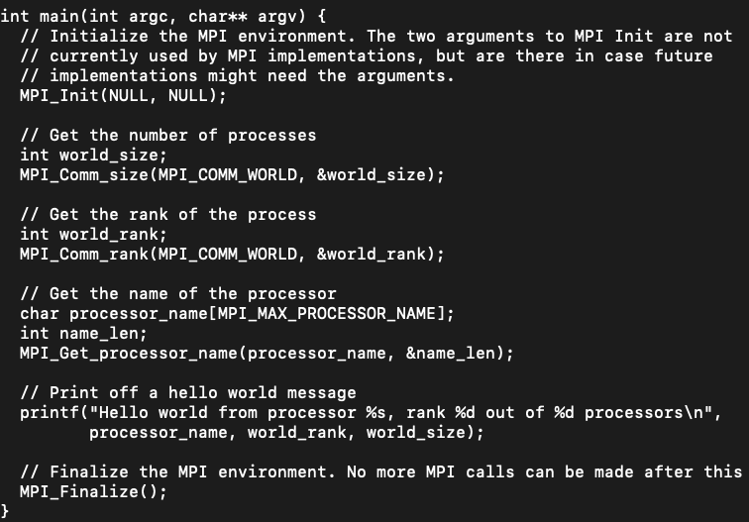
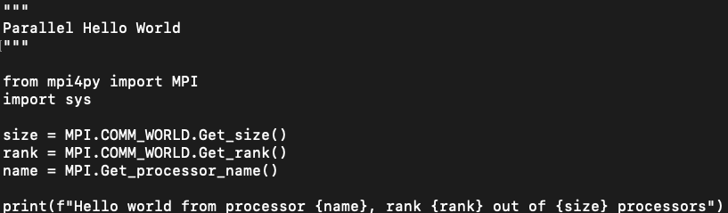
Local Installation: Example MPI codes
fork/clone the repository from https://github.com/argonne-lcf/CompPerfWorkshop.git to refer to the mpi codes in 03_containers/local/source folder
mpi_hello_world.c
mpi_hello_world.py

Slide 7

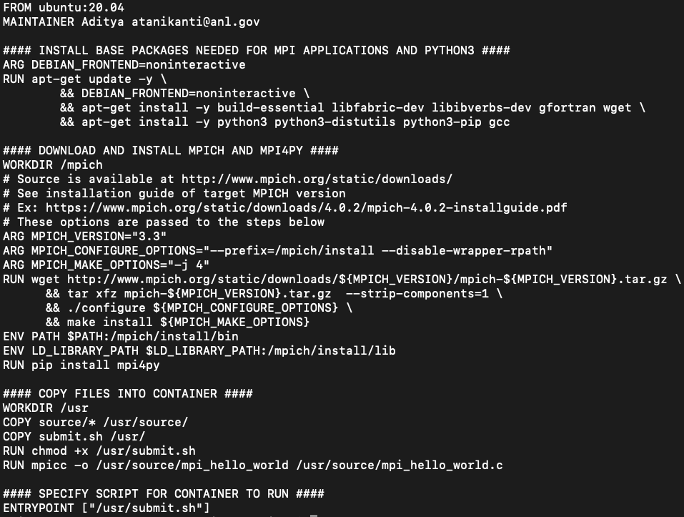
Local Installation: Example Docker file
Refer to the Dockerfile in 03_containers/local folder
Base OS (Ubuntu) of container pulled from docker hub repository
Install pre-requisite libraries for mpich and python
Download and install mpich and mpi4py
Move source files into container from local

Slide 8
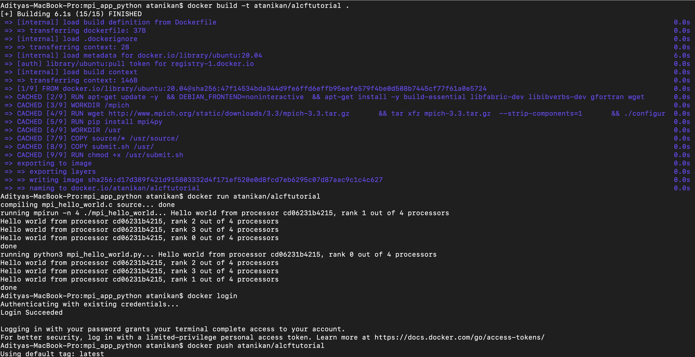
Local Installation: Publish Docker image
To build the image: “docker build –t <username>/<respository_name>”
To test the image: “docker run <username>/<respository_name>” runs the docker image
To publish the docker image: “docker push <username>/<respository_name>” to dockerhub repository
Note: Don’t forget to chmod +x all your scripts

Slide 9
ThetaGPU: Build and run singularity (Interactive mode)
Login to theta and ssh to thetagpu service node
ssh username@theta.alcf.anl.gov
ssh thetagpusn1
Submit interactive job to single-gpu queue of ThetaGPU
qsub -n 1 -q single-gpu -A <projectname> -I -t 1:00:00 --attrs pubnet=true:filesystems=home,theta-fs0
Once you get a compute node e.g. thetagpu16, run the following for access to internet:
export http_proxy=http://proxy.tmi.alcf.anl.gov:3128
export https_proxy=http://proxy.tmi.alcf.anl.gov:3128
Build a singularity image from the docker image published to dockerhub in previous step
singularity build mpi_app.img docker://atanikan/alcftutorial:latest (replace with your repo name)
Finally run your code using singularity exec
mpirun -n 1 singularity exec mpi_app.img /usr/source/mpi_hello_world
mpirun -n 1 singularity exec mpi_app.img python3 /usr/source/mpi_hello_world.py
Output

Slide 10
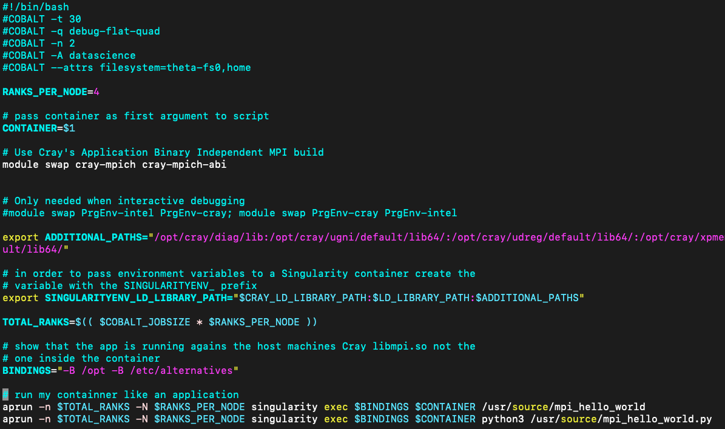
Theta: Build and run singularity
Documentation: https://www.alcf.anl.gov/support-center/theta/singularity-theta
Login to theta
ssh username@theta.alcf.anl.gov
Build singularity image from the docker image
singularity build mpi_app.img docker://atanikan/alcftutorial:latest (replace with your repo name)
Run job submission script (see below) with singularity image qsub job_submission_theta.sh mpi_app.img or copy from /03_containers/theta/job_submission.sh
Parameters passed to cobalt
Use cray-mpich-abi for compatibility with your build
Pass paths to CRAY objects to your container using SINGULARITYENV_LD_LIB RARY_PATH
Run container on theta compute nodes using aprun

Slide 11
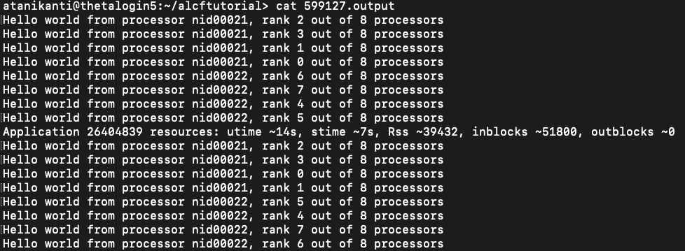
Theta: Output

Slide 12
ThetaGPU: Preexisting Images for Deep Learning
•
There are several containers on ThetaGPU that will help you get started with deep learning experiments that can efficiently use the A100 GPUs.
•
Documentation: https://argonne-lcf.github.io/ThetaGPU-Docs/
https://argonne-lcf.github.io/ThetaGPU-Docs/Singularity%20Containers/
•
The different optimized containers for DL are available at:
ls /lus/theta-fs0/software/thetagpu/nvidia-containers/
•
To leverage these containers – you must either perform the following in a shell script that acquires a compute node or do this interactively.
Further details may be found in:
https://github.com/argonne-lcf/sdl_ai_workshop/tree/master/05_Simulation_ML/ThetaGPU

Slide 13
ThetaGPU: Building on top of a container
Submit interactive job to single-gpu queue of ThetaGPU
qsub -n 1 -q single-gpu -A <datascience> -I -t 1:00:00 --attrs pubnet=true:filesystems=home,theta-fs0
Once you get a compute node e.g. thetagpu16, run the following for access to internet:
export http_proxy=http://proxy.tmi.alcf.anl.gov:3128
export https_proxy=http://proxy.tmi.alcf.anl.gov:3128
Activate singularity container
singularity exec -B /lus:/lus --nv /lus/theta-fs0/software/thetagpu/nvidia-containers/tensorflow2/tf2_21.08-py3.simg bash
Create a virtual environment and install your packages for example:
python -m pip install --user virtualenv
export VENV_LOCATION=/home/$USER/THETAGPU_TF_ENV # Add your path here
python -m virtualenv --system-site-packages $VENV_LOCATION
source $VENV_LOCATION/bin/activate
pip install sklearn

Slide 14
ThetaGPU: Run the prebuilt DL image
Now that packages are installed – run your DL script directly on the compute node or construct a script for submission to the queue: or copy from /03_containers/thetagpu/job_submission.sh
#!/bin/bash -l
#COBALT -n 1
#COBALT -t 00:10:00
#COBALT -q training
#COBALT -A project_name
#COBALT –attrs filesystems=home,theta-fs0:pubnet=true
export http_proxy=http://proxy.tmi.alcf.anl.gov:3128
export https_proxy=http://proxy.tmi.alcf.anl.gov:3128
CONTAINER/lus/theta-fs0/software/thetagpu/nvidia-containers/tensorflow2/tf2_21.08-py3.simg
singularity exec --nv $CONTAINER python /usr/local/lib/python3.8/dist-packages/tensorflow/python/debug/examples/debug_mnist.py

Slide 15
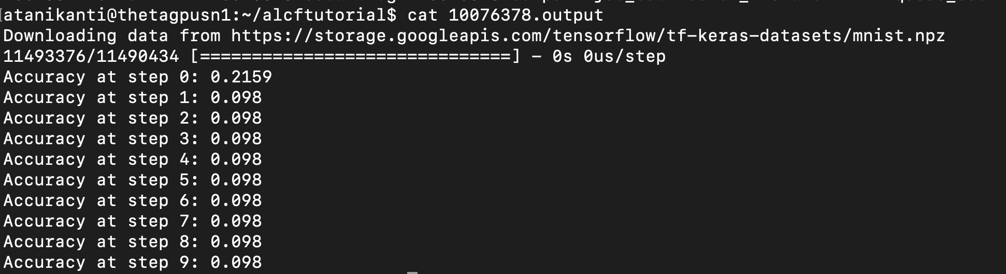
ThetaGPU: Output of running the prebuilt DL image

Slide 16
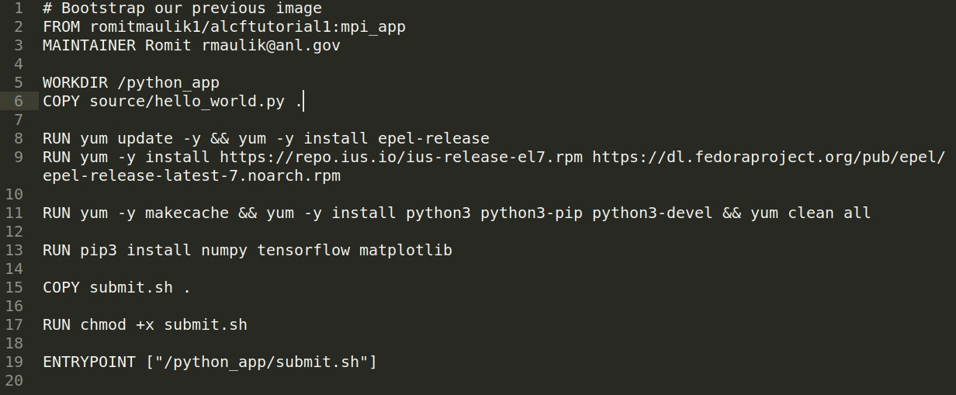
Bootstrapping
16
•
When possible reuse previous builds in opensource repositories. For e.g. see 03_containers/bootstrap
We add a python application into this pre-existing image and build a new one
Install some common datascience packages

Slide 17
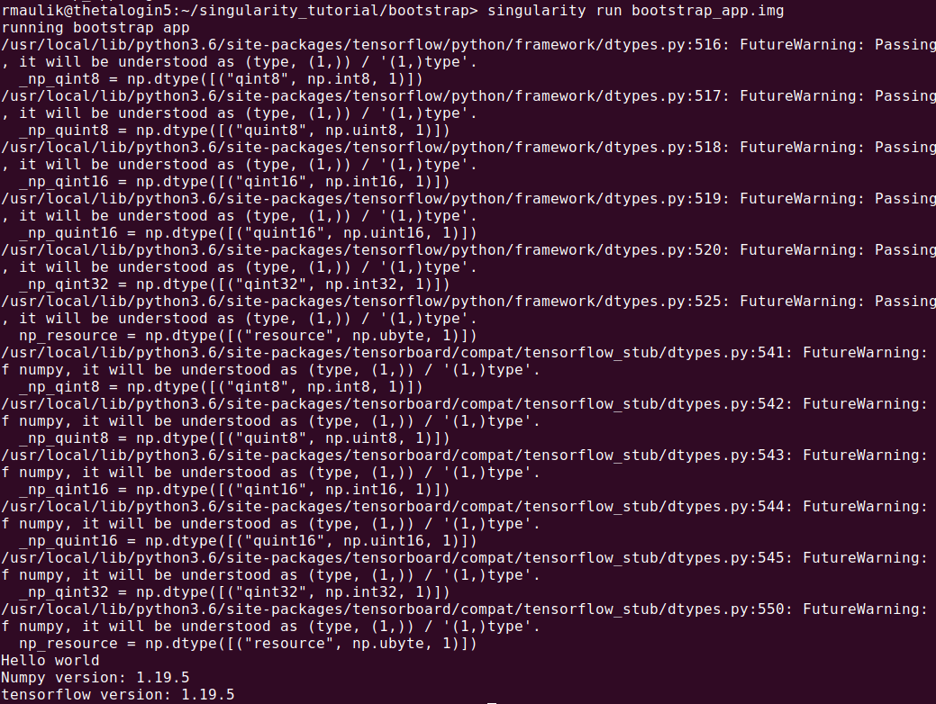
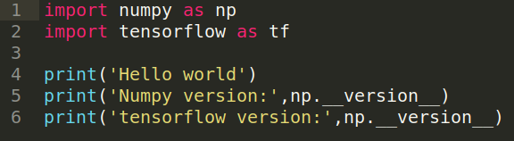
Bootstrapping

Slide 18
Fin!
22
•
I encourage you to try these tutorials and get back to us with any questions.

Slide 19
ADDITIONAL INFORMATION

Slide 20
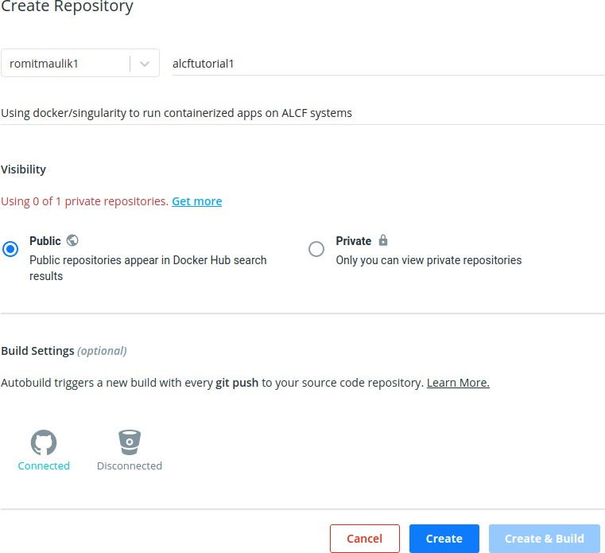
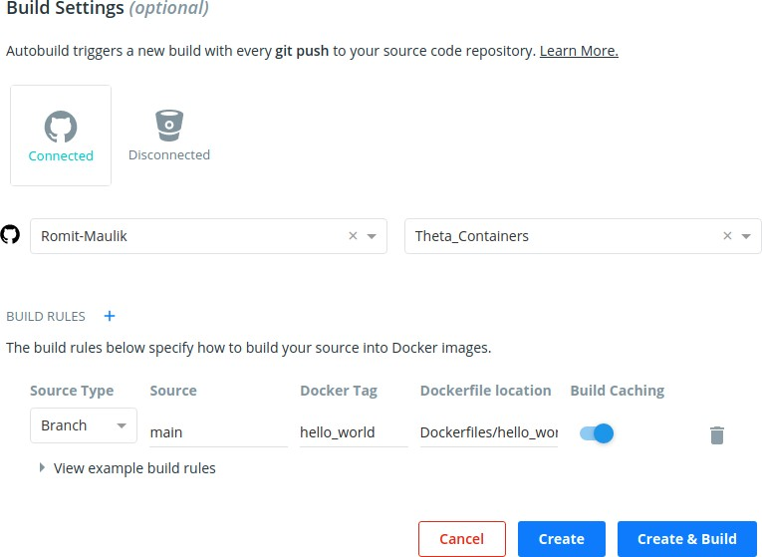
Non Local Installation: Link GitHub and dockerhub
8
•
Needs a pro account on dockerhub.
Master branch is now “main”
This will be disconnected the first time
Specify branch, image name (tag), path to docker file in repo
For example: “Dockerfiles/hello_world/Dockerfile”

Slide 21
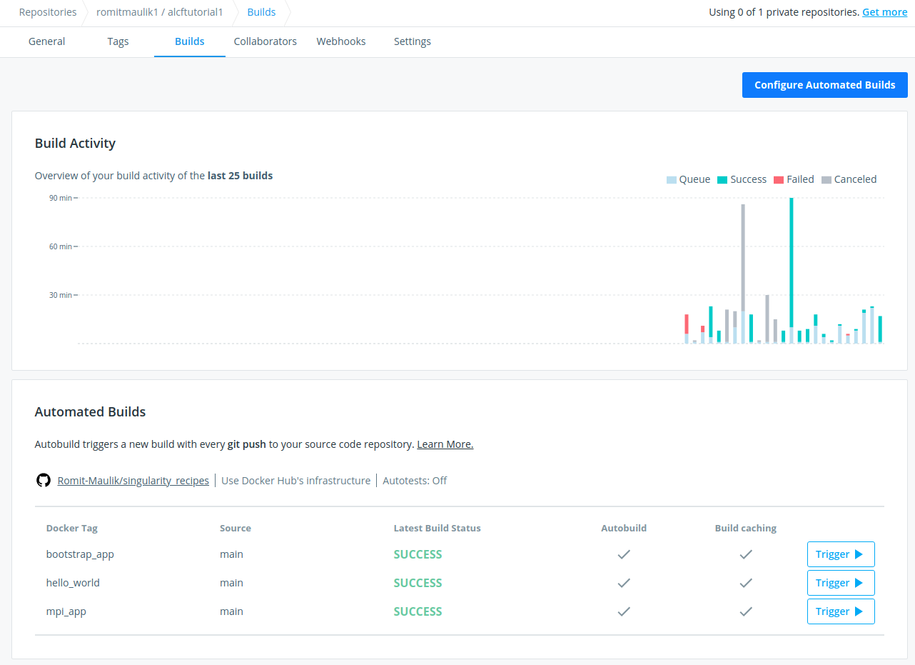
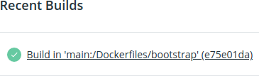
Non Local Installation: Link GitHub and dockerhub
9
•
Building on docker-hub is slow (when compared to your local machine) but once complete you should see something like this
Using “Configure Automated Builds” to edit build names (tags), paths etc.
Clicking on a recent build with give you logs (useful for debugging fails) and the docker file itself.

Slide 22
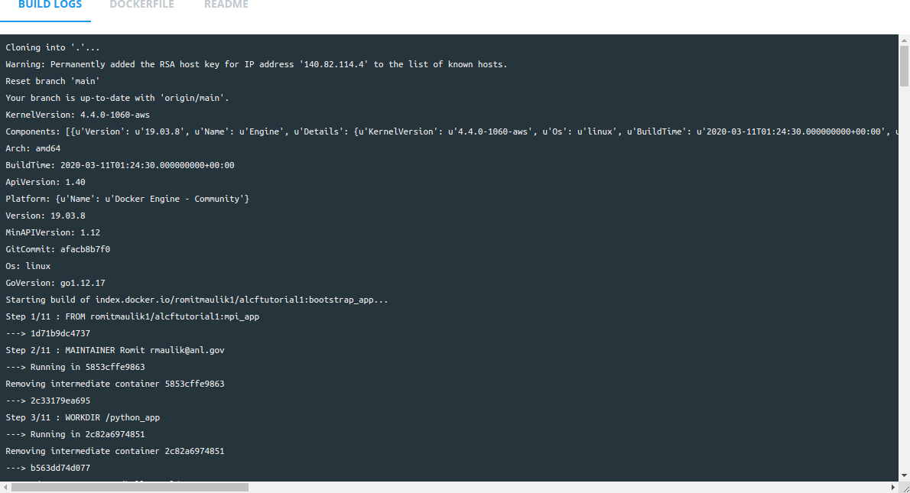
Non Local Installation: Link GitHub and dockerhub
10
•
Building on docker-hub is slow (when compared to your local machine) but once complete you should see something like this
Using “Configure Automated Builds” to edit build names (tags), paths etc.
Clicking on a recent build with give you logs (useful for debugging fails) and the docker file itself.

Slide 23
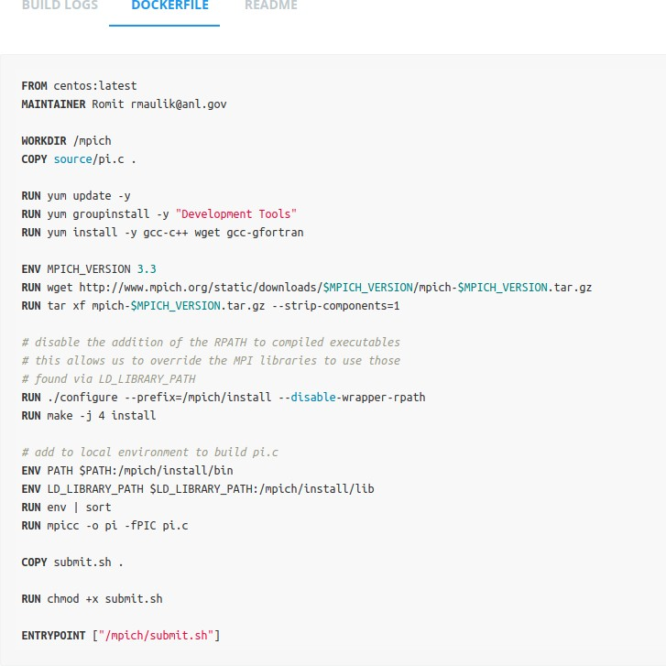
Non Local Installation: Link GitHub and dockerhub
11
•
Building on docker-hub is slow (when compared to your local machine) but once complete you should see something like this
Using “Configure Automated Builds” to edit build names (tags), paths etc.
Clicking on a recent build with give you logs (useful for debugging fails) and the docker file itself.

Slide 24
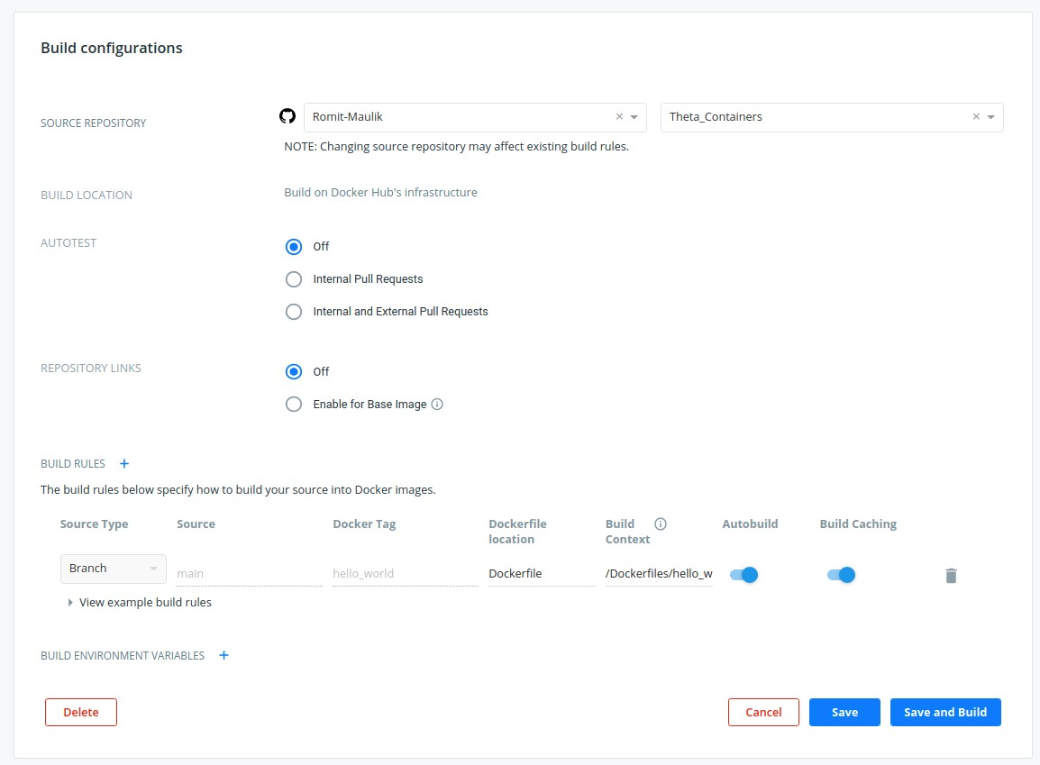
Copying source files from github to dockerhub may cause build fails. In this case manually configure the context/locations/filenames etc. (I have made a video that demonstrates this)
Non Local Installation: Link GitHub and dockerhub
12
•
Using “Configure Automated Builds” to edit build names (tags), paths etc.
Clicking on a recent build with give you logs (useful for debugging fails) and the docker file itself.
The location of the file “/Dockerfiles/hello_world/”
Name of our dockerfile

