Slide 1
Microcontroller
By Parikshit Saha

Slide 2
What is Microcontroller?
A microcontroller is basically a computer which is placed on a single integrated circuit chip. It consists of memory, a processor, as well as input-output interfaces. Microcontrollers are programmed to run a certain task, which means, if there is a need to change or enhance its functionality, one must install a new program on the chip.
Microcontrollers can be found in a variety of everyday items: household appliances (e.g. microwave ovens, TV-sets), toys (Lego NXT, talking dolls), vehicles (cars, hoists), etc. Microcontrollers’ wide usage has been possible because they are easy to program and have a wide range of functionalities

Slide 3
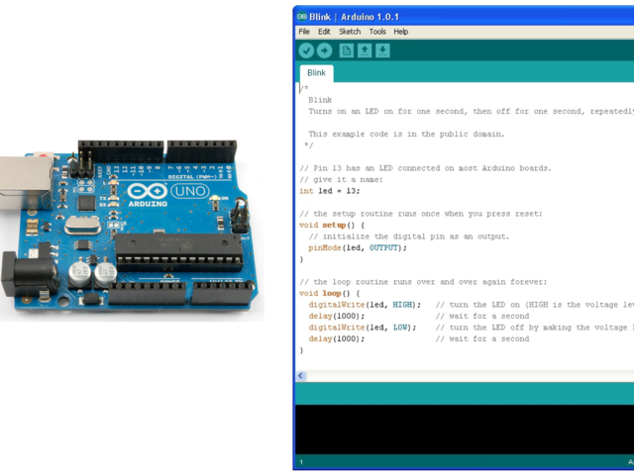
What is Arduino?
Arduino is open-source hardware which consists of ATMEL microcontroller based programmable circuit board and a easy to use Software IDE (Integrated Development Environment) that runs on your computer.

Slide 4
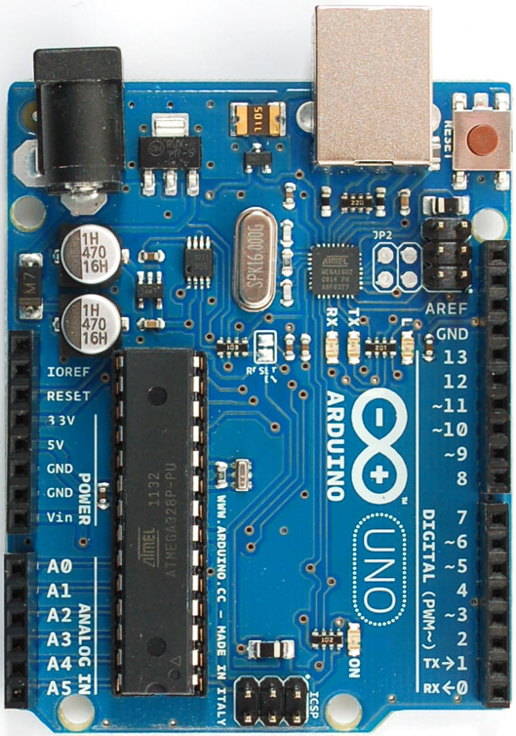
Basic features of Arduino UNO
Microcontroller | ATmega168/328
Operating Voltage | 5V
Input Voltage (recommended) | 7-12V
Input Voltage (limits) | 6-20V
Digital I/O Pins | 14 (of which 6 provide PWM output)
Analog Input Pins | 6
DC Current per I/O Pin | 40 mA
DC Current for 3.3V Pin | 50 mA
Flash Memory | 16 KB (ATmega168) or 32 KB (ATmega328) of which 2 KB used by bootloader
SRAM | 1 KB (ATmega168) or 2 KB (ATmega328)
EEPROM | 512 bytes (ATmega168) or 1 KB (ATmega328)
Clock Speed | 16 MHz

Slide 5
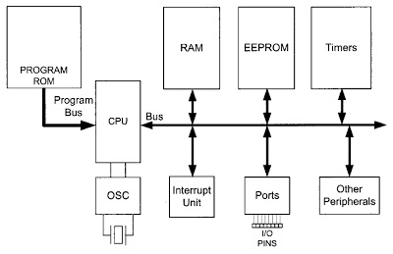
Simplified AVR Architecture

Slide 6
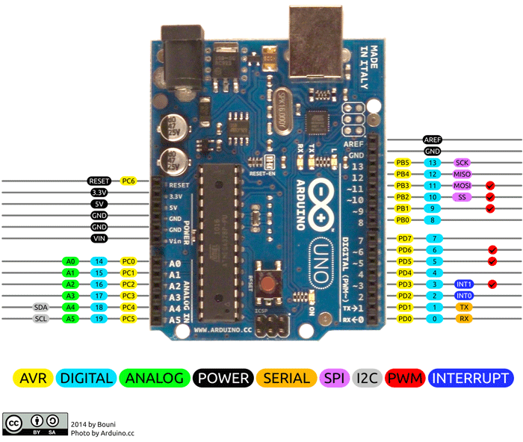
Arduino Pin Diagram

Slide 7
Port Pin Directionality
Input/output from Arduino’s Perspective
pinMode(Pin, Mode)
For Sensor Pins Mode will be input i.e. data incoming (except vcc-gnd pins)
For Motor Pins Mode will be output i.e. data outgoing (except vcc-gnd pins)

Slide 8
I/O Operations
digitalRead(Pin)
digitalWrite(Pin,State), State is 0(LOW) or 1(HIGH)
analogRead(Pin)
analogWrite(Pin, Value), Value is between 0 to 255

Slide 9
Arduino Basic Coding Structure
<define global variables and include header files here>
void setup() {
< executed only once>
< define input/output mode for digital pins > } void loop() {
<infinite loop>
<things like input from sensors, sending output etc. > }

Slide 10
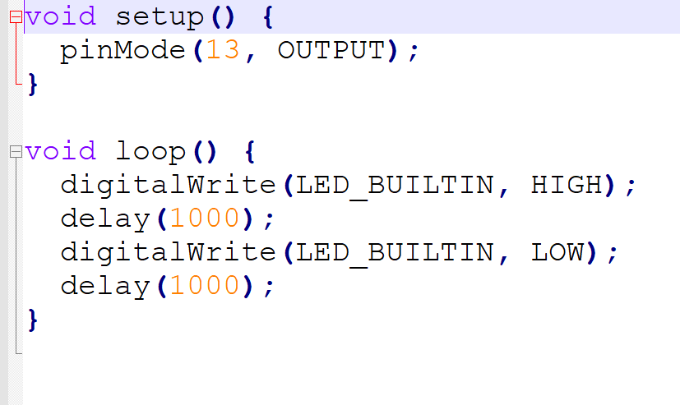
Led blink Arduino Demo

Slide 11
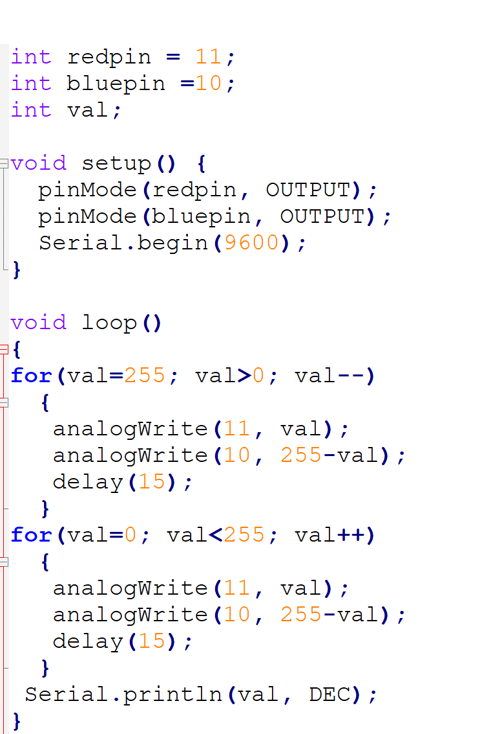
dual color Led glow Arduino Demo

Slide 12
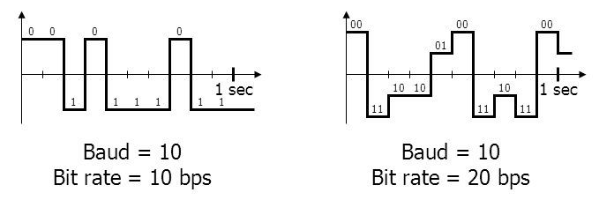
Baud Rate & Bit Rate
Baud- Changes of Signal per second
Bit Rate- Nos of bits sent per second

Slide 13
Serial Port Monitor
Serial.begin(speed)
Serial.read()
Serial.available()

Slide 14
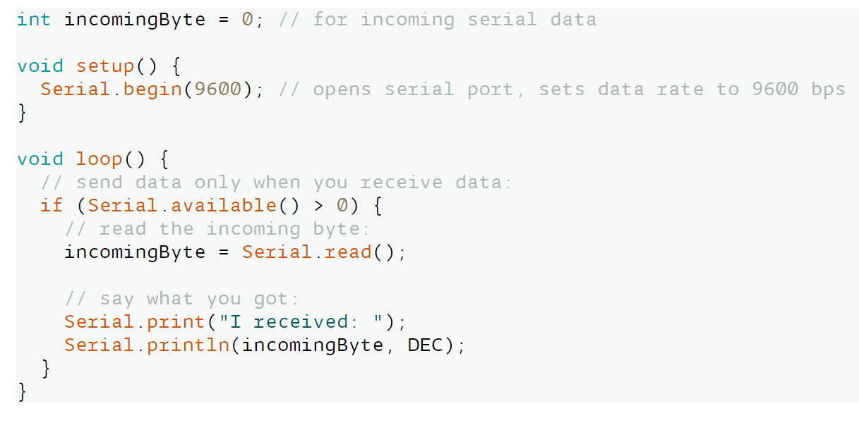
Serial Port Demos

Slide 15
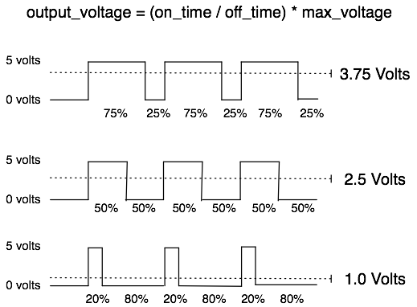
What is PWM & PWM Pin in Arduino?

Slide 16
Sensor Interfacing with Arduino
By Parikshit Saha

Slide 17
Sensor Interfacing
Sensors usually used to have 3 terminals Vcc, Gnd & Signal (either digital or analog)
Some of the sensors used to have 4 terminals with facility of both digital as well as analog signal read.

Slide 18
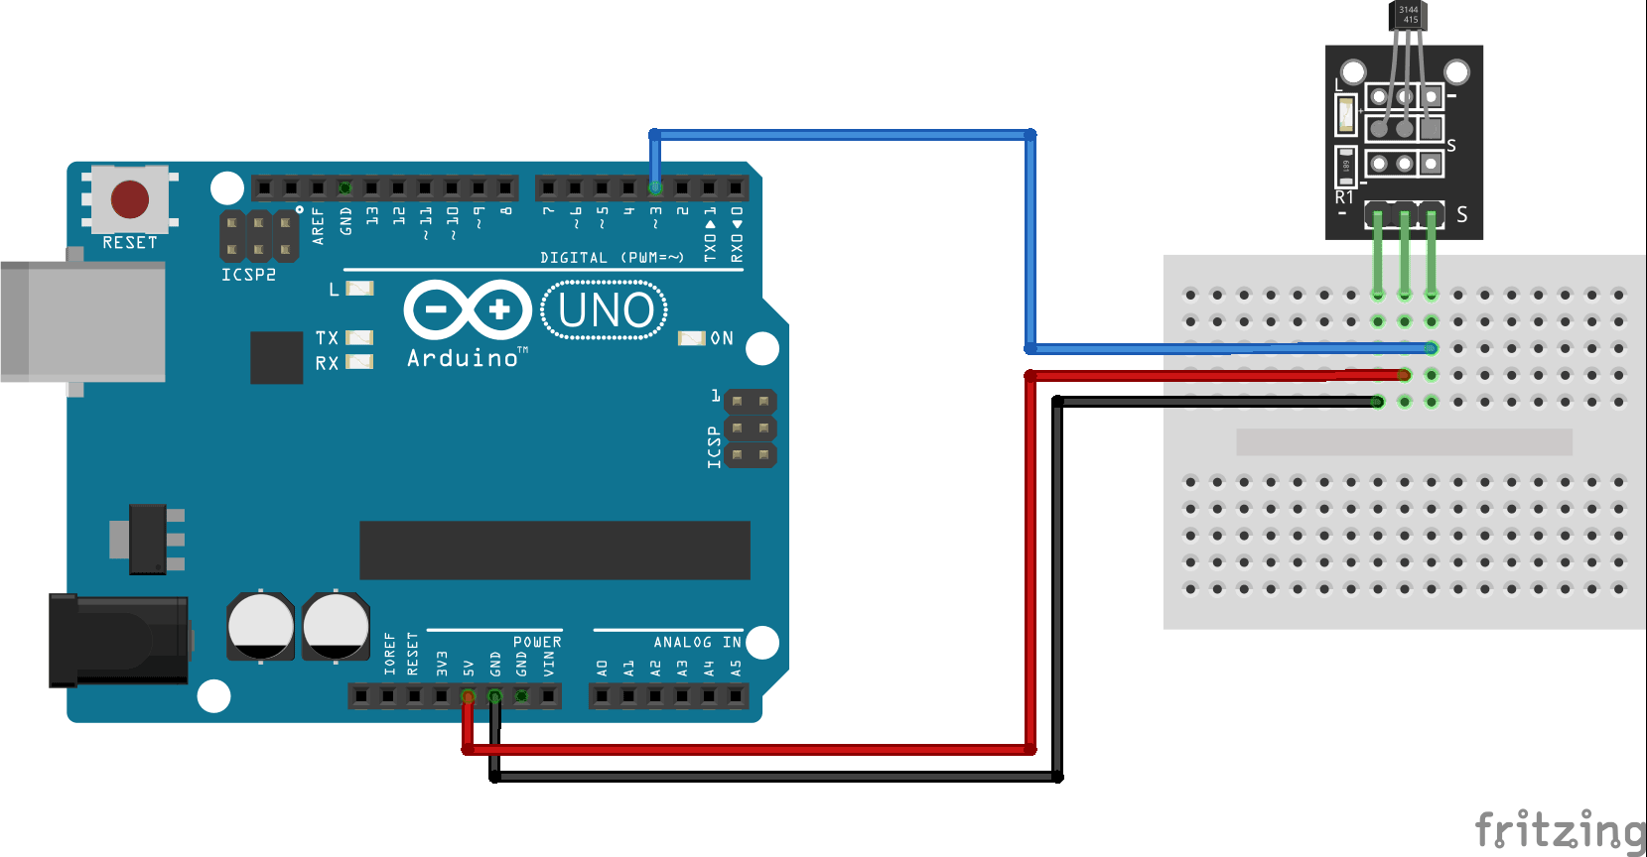
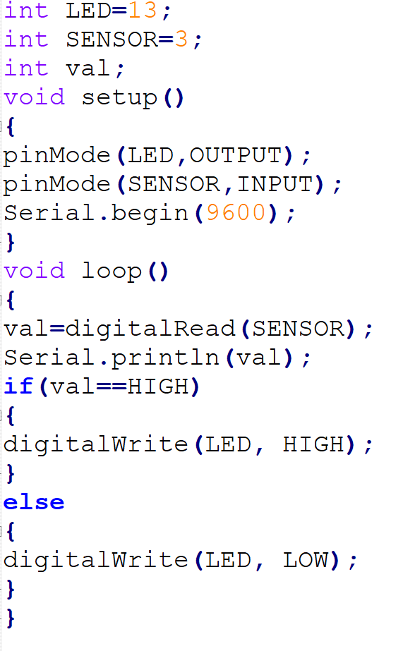
Hall Sensor Interfacing

Slide 19
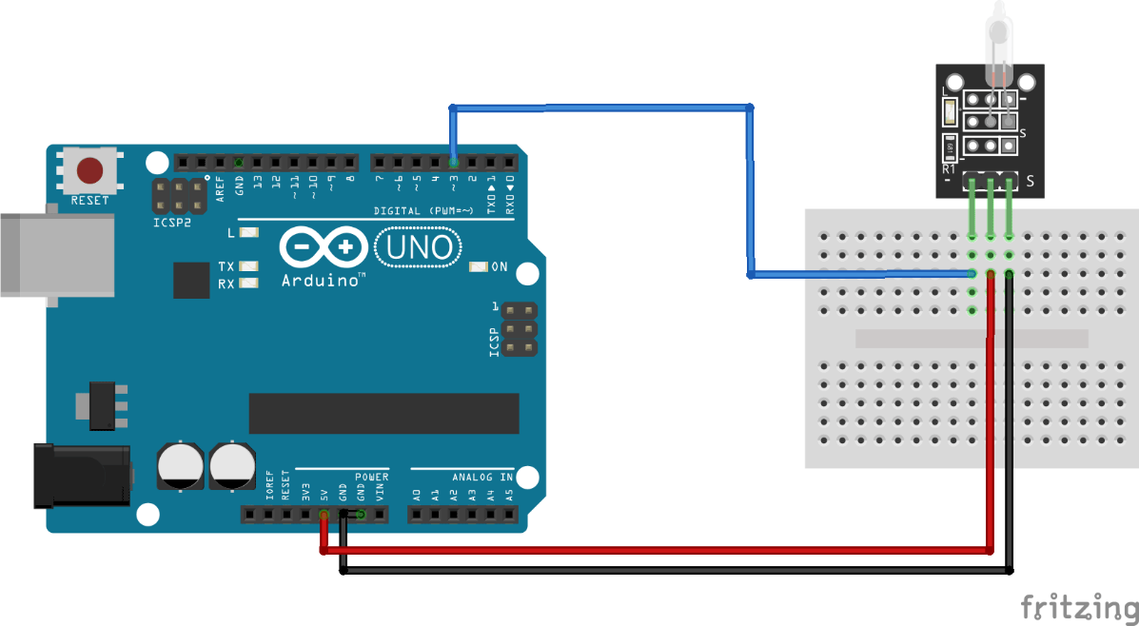
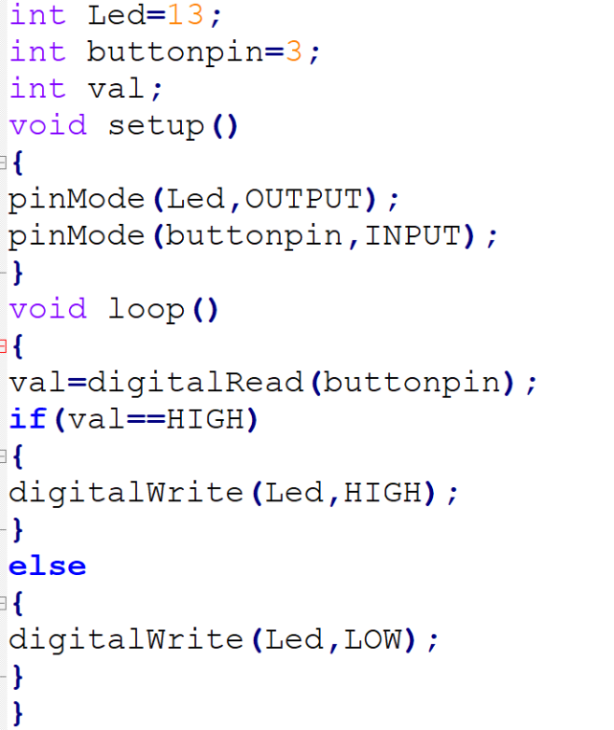
Tilt Switch Interfacing

Slide 20
Motor Interfacing with Arduino
By Parikshit Saha

Slide 21
Types of Motors
DC Motor
Servo Motor
Stepper Motor

Slide 22
DC Motor Interfacing
Dc Motor have two terminals vcc & gnd
Arduino directly can provide only 40mA of current within an max of 5V output which is insufficient to rotate the motor. So we need a specific type of circuit known as Motor Driver to drive the motor.
Some Dc Motor also has a higher V-I requirement based on torque of operation. (600mA, 4.5V to 36V)
H-bridge circuit is used.
Different types of H-bridge circuits are L293, L293D, L298
Some Advanced level H-bridge circuits are VNH2SP30, VNH5019 have the higher voltage- current motor driving capabilities.

Slide 23
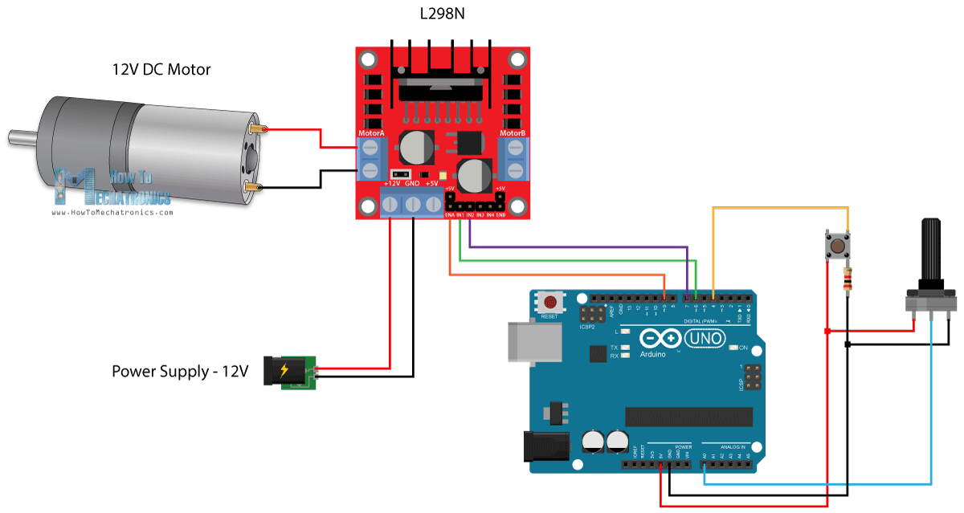
DC Motor Interfacing (contd.)
fhgfation

Slide 24
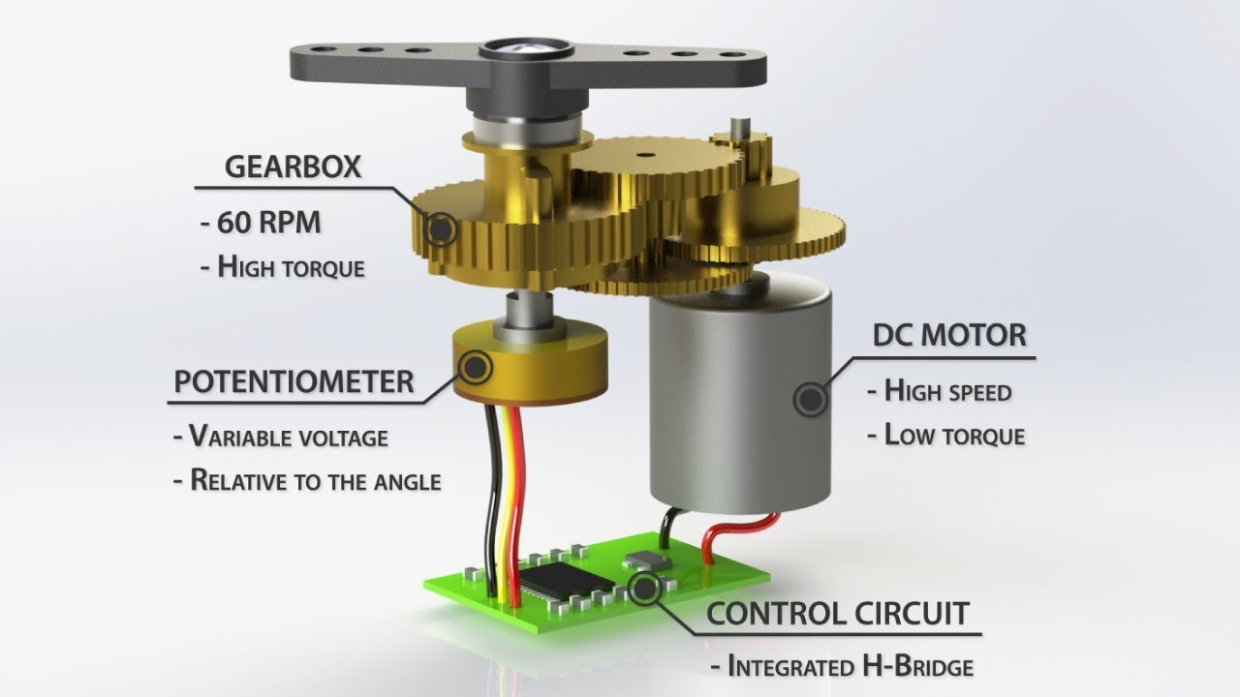
What is Servo Motor?
3 Wire terminals vcc, gnd & signal
In signal terminal we feed angle of rotation in degree while using directly ‘servo.h’ Arduino library
Internally Dc Motor + Potentiometer

Slide 25
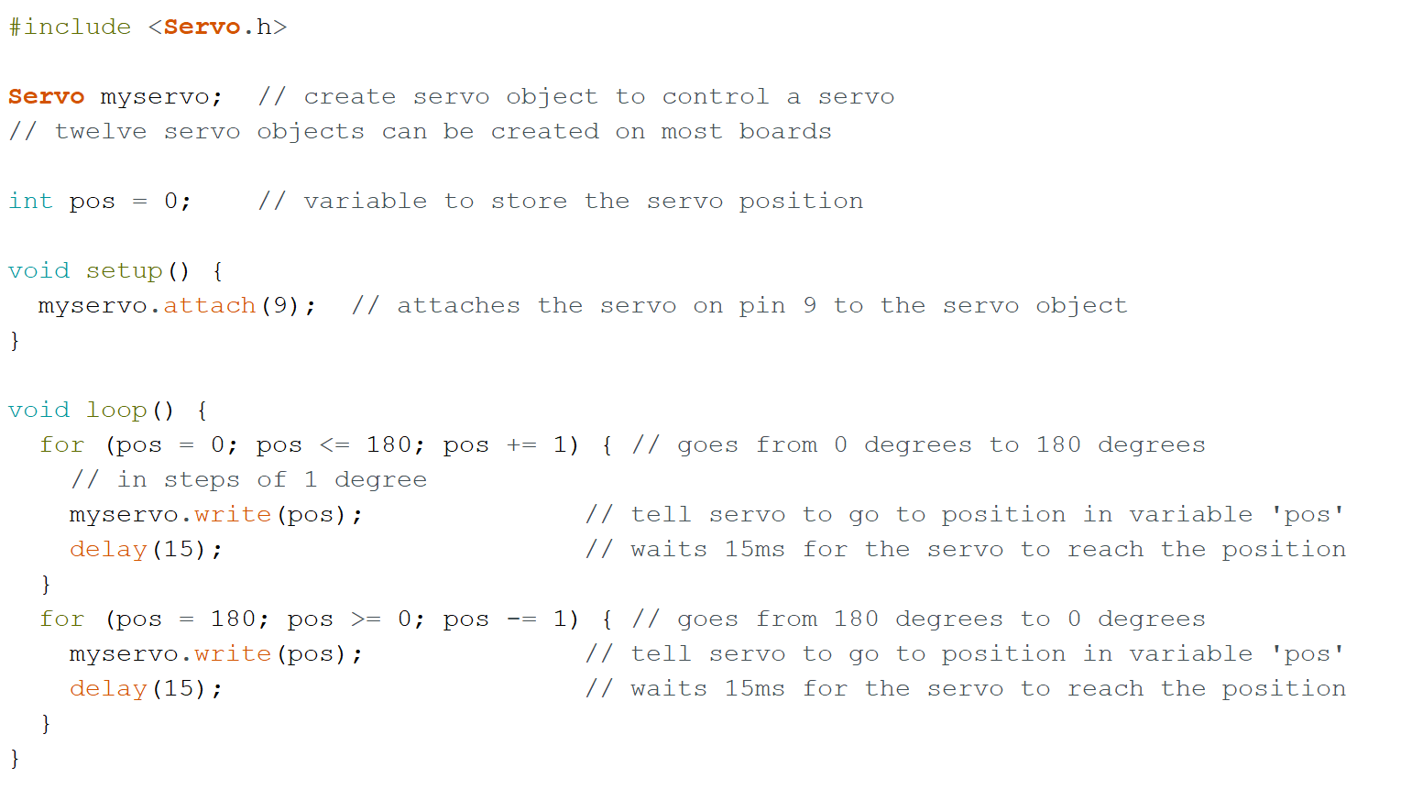
Servo Motor Interfacing (from library function)

Slide 26
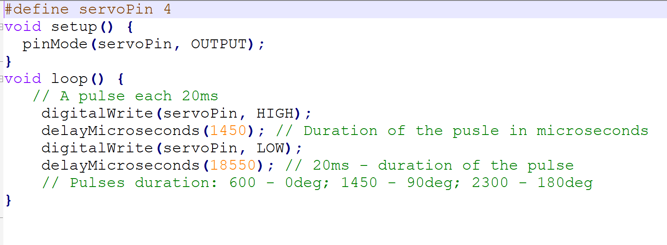
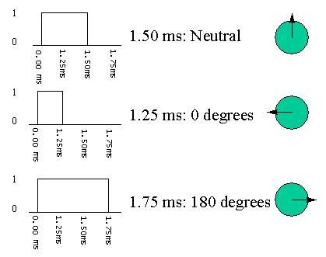
Servo Motor Interfacing (building from scratch)

Slide 27
Limitation & Solution to Overcome
High Torque Servo Motor Interfacing-
Direct Arduino I-O Pins can feed only 40mA of Current which is insufficient to rotate high torque servo motors (like mostly used MG995 Servo needs 170mA of current).
Generally High Voltage Input used to give high amount of current but as our servo motors are used to have a specific limited voltage of operation (like 5V for MG995 Servo), we use Step Down transformer circuit in between & connect +Vcc & GND terminal of the output with the servo directly while only the signal pin is feed from the Arduino. (N.B.- Common Ground between Arduino & Step Down Output is required)

Slide 28
DC Motor with Encoder
By Parikshit Saha

Slide 29
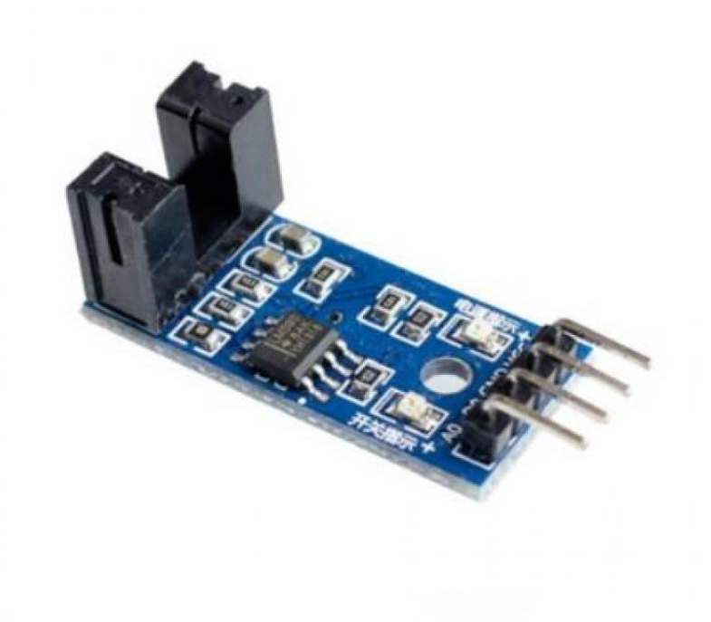
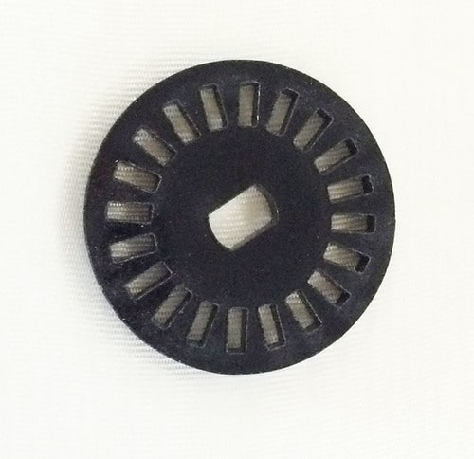
What is Encoder?
DC Motor has only two terminal Vcc & Gnd. So it’s impossible to control it’s movement or track it’s movement. Encoder helps us to resolve this issue.
Encoder is basically consists of an circular disk with specifically encoded pattern & an ir transmitter-receiver block.
Slots within the encoded pattern disk indicated the resolution of the encoder.
When the ir is blocked by encoder disk no signal is received by rx terminal & viceversa.

Slide 30
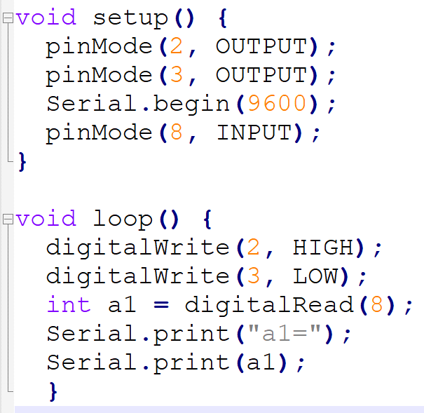
Encoder ON-OFF Demo
fhgfation

Slide 31
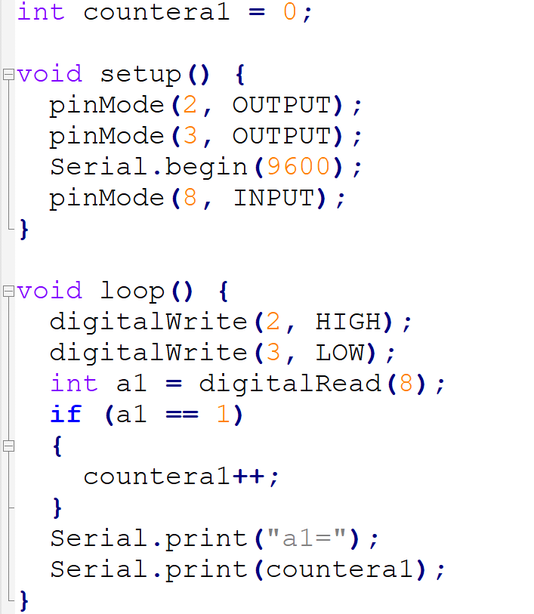
Encoder Counter Demo
fhgfation

Slide 32
Limitation & Solution to overcome it
Availability of limited no of Analog & Digital Pins with Arduino Uno
Lower Specific Speed of Operation
Go for advanced version of Arduino like Arduino Mega which has more nos of I-O Pins
Use of Higher Processing Speed Arduino Variants Microcontroller Boards
Most of the Variant optional Boards (ex. NODE32 MCU) can also be program using Arduino IDE.

