Slide 1
Video Analytics - SBI
Powered By - Microsoft Corporation Pvt Ltd.

Slide 2

Problem Being Solved
Surveillance is being constantly carried out via Video Cameras at Branches, ATMs & Offices of the Bank. As a proactive measure and to protect against unscrupulous elements, the video feed is constantly monitored by personnel at Command Centres / Control rooms

Slide 3
Approach taken to create the model
->Live Video from multiple cctv cameras will go to some high-end computer will GPU.
-> On the GPU our own deeplearning AI based model will run which will detect face of different unique people and save it as a database along with the time slot when a particular person is detected.
-> It will also detect suspicious activities and create alarm and lock the ATM activities
-> It will create specific alert based on fire- theft activities
-> Reduced requirement of manual monitoring of live camera feedback

Slide 4
Prerequisites
Fixed resolution + FPS of Video footage

Slide 5
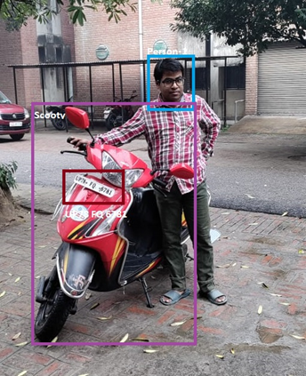
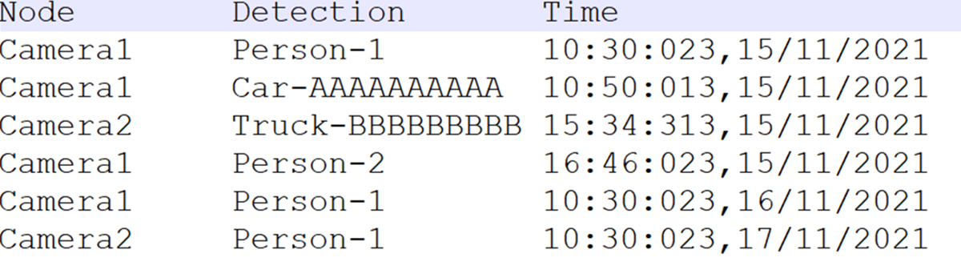
A Sample solution having integrated face detection and Vehicle no plate detection is shown below
Any supporting assumptions, functional requirements(FR) and non-functional requirements(NFR)

Slide 6
reason why your solution should be considered
-> Good accuracy on our system
-> less no for false alert
-> Easy to use interface

Slide 7
Source code (Github Repository Link)
Will be available in Final Prototype Submission

Slide 8
Demonstration Video showing the
functionalities/working of the solution.
Will be available in Final Prototype Submission

Slide 9

Submitted By : Parikshit Saha
Email : psaha053@gmail.com
Mobile No: 9163616002

