Slide 1

<: PROJECT :>
JetHorizon
Airlines
Reservation
System
project
in C++

Slide 2
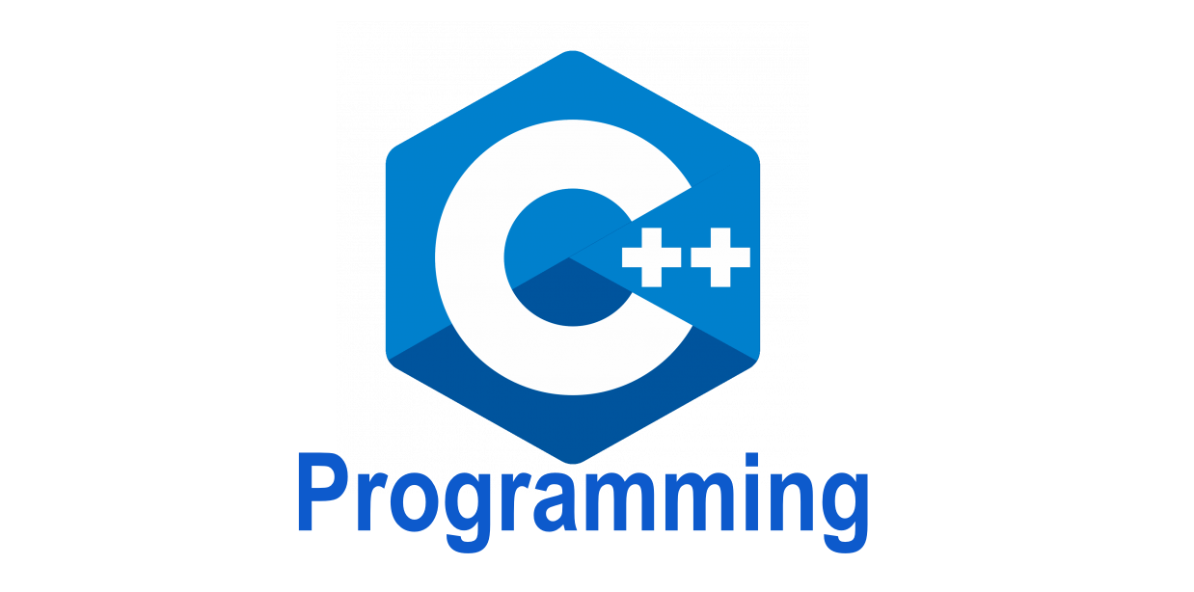
CONTENTS
Introducing To C&C++ Language
Features Of C&C++
Advantage And Disadvantage Of C&C++
Coding And Result
Conclusion

Slide 3
Introducing To C&C++
Language.......
C is a high-level and general-purpose programming language that is ideal for developing firmware or portable applications. Originally intended for writing system software, C was developed at Bell Labs by Dennis Ritchie for the Unix Operating System in the early 1970s.Ranked among the most widely used languages, C has a compiler for most computer systems and has influenced many popular languages
C++ is a cross-platform language that can be used to create high-performance applications . C++ was developed by Bjarne Stroustrup , as an extension to the C language . C++ gives programmers a high level of control over system resources and memory. C++ is one of the world's most popular programming languages . C++ can be found in today's operating systems, Graphical User Interfaces, and embedded systems . C++ is fun and easy to learn!

Slide 4
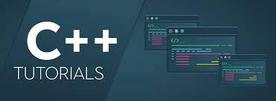
There are some information for variables in c:-
C variable is a named location in a memory where a program can manipulate the data. This location is used to hold the value of the variable. The value of the C variable may get change in the program.
C variable might be belonging to any of the data type like int, float, char etc.
int - stores integers (whole numbers), without decimals, such as 123 or -123
double - stores floating point numbers, with decimals, such as 19.99 or -19.99
char - stores single characters, such as 'a' or 'B'. Char values are surrounded by single quotes
string - stores text, such as "Hello World". String values are surrounded by double quotes

Slide 5
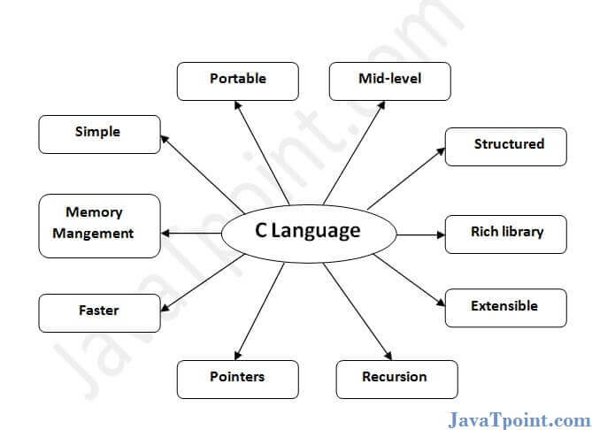
FEATURES OF C&C++…..
Simple
Machine Independent or Portable
Mid-level programming language
structured programming language
Rich Library
Memory Management
Fast Speed
Pointers
Recursion
Extensible

Slide 6
Simple:-
C is a simple language in the sense that it provides a structured approach, the rich set of library functions, data types, etc.
Machine Independent or Portable:-
Unlike assembly language, c programs can be executed on different machines with some machine specific changes. Therefore, C is a machine independent language.
Mid-level programming language:-
C is intended to do low-level programming. It is used to develop system applications such as kernel, driver, etc. It also supports the features of a high-level language. That is why it is known as mid-level language.

Slide 7
Structured programming language:-
C is a structured programming language in the sense that we can break the program into parts using functions. So, it is easy to understand and modify. Functions also provide code reusability.
Rich Library:-
C provides a lot of inbuilt functions that make the development fast
Memory Management:-
It supports the feature of dynamic memory allocation. In C language, we can free the allocated memory at any time by calling the free() function.
Speed:-
The compilation and execution time of C language is fast since there are lesser inbuilt functions and hence the lesser overhead.

Slide 8
Pointer:-
C provides the feature of pointers. We can directly interact with the memory by using the pointers. We can use pointers for memory, structures, functions, array, etc.
Recursion:-
In C, we can call the function within the function. It provides code reusability for every function. Recursion enables us to use the approach of backtracking.
Extensible:-
C language is extensible because it can easily adopt new features.

Slide 9
ADVANTAGES
DISADVANTAGES
Portability
Mid-level programming language
Object-Oriented
Memory Management
Fast and Powerful
Standard Library
Huge Community
Pointers
No garbage collection
Unsafe
Complex
Less flexible
Functions are not first-class type
No custom operators

Slide 10
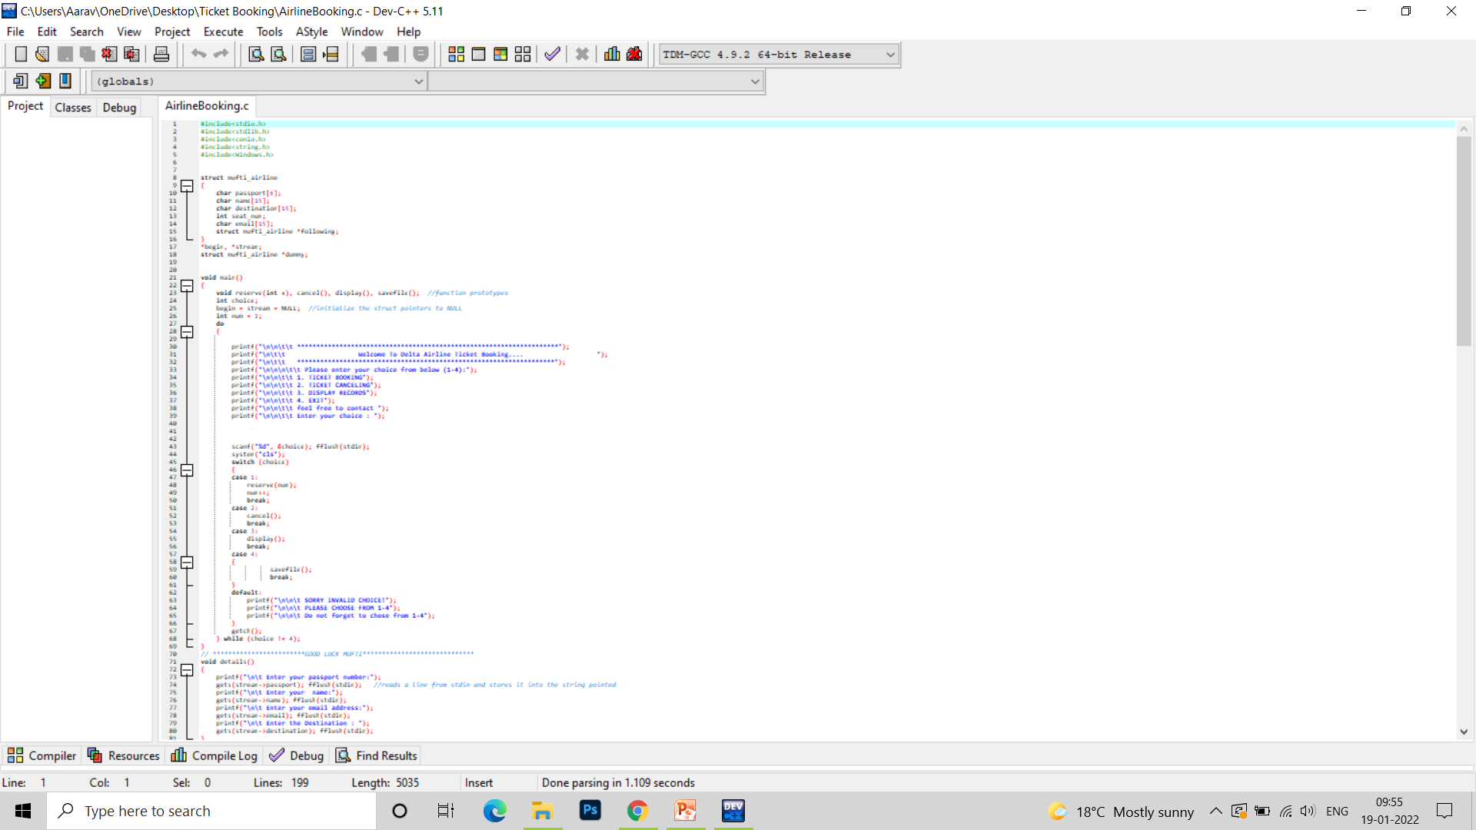
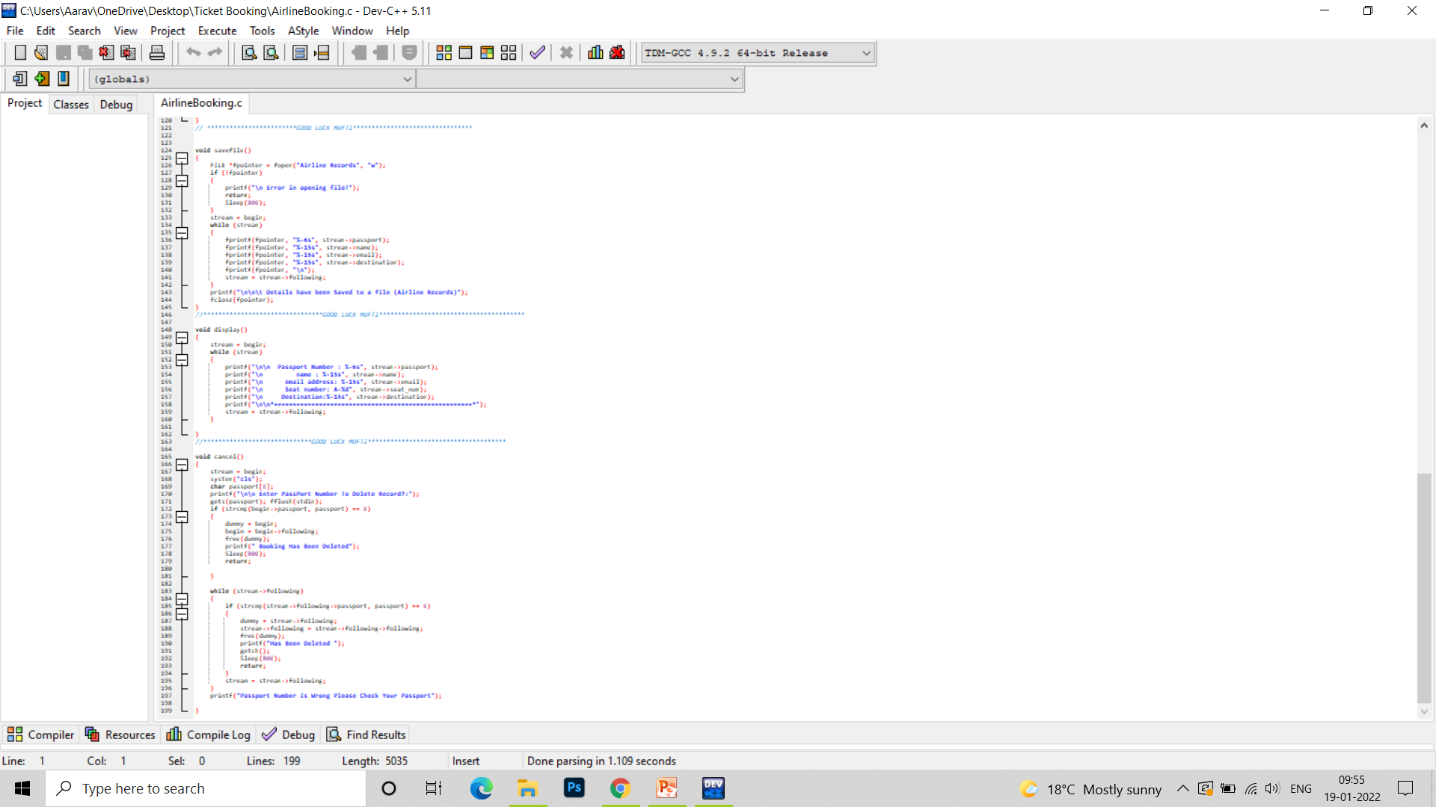
CODING:-

Slide 11
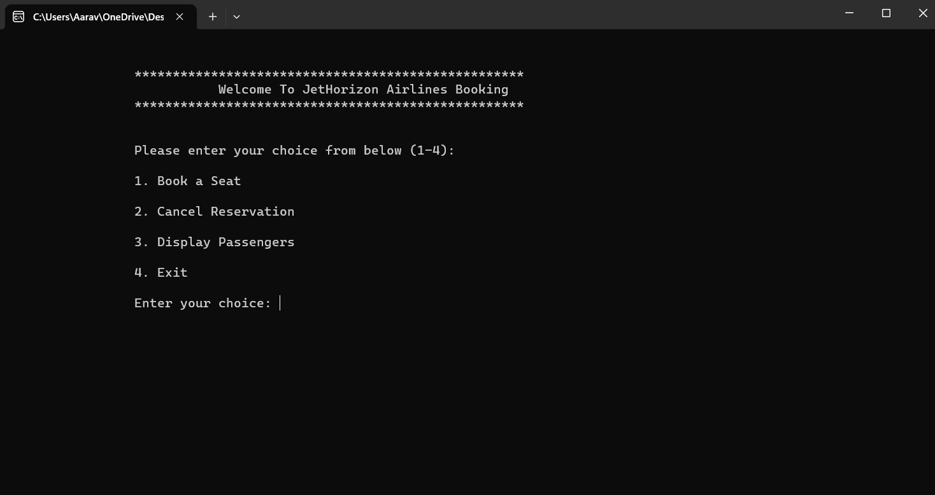
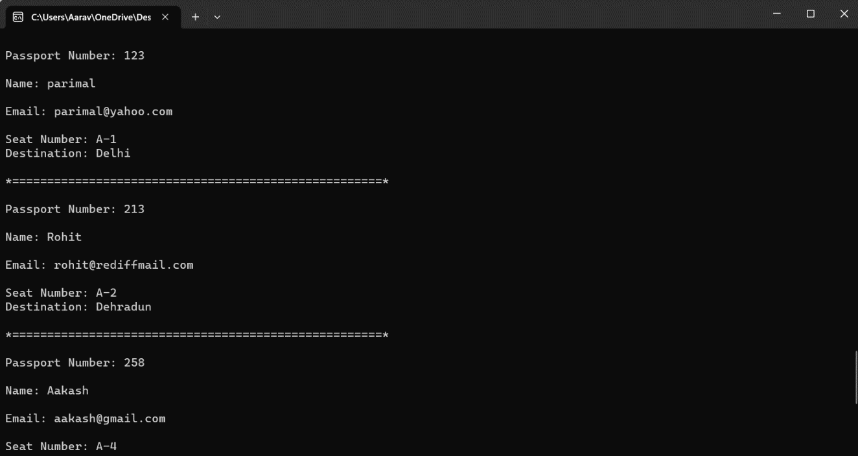
OUTPUT:-

Slide 12
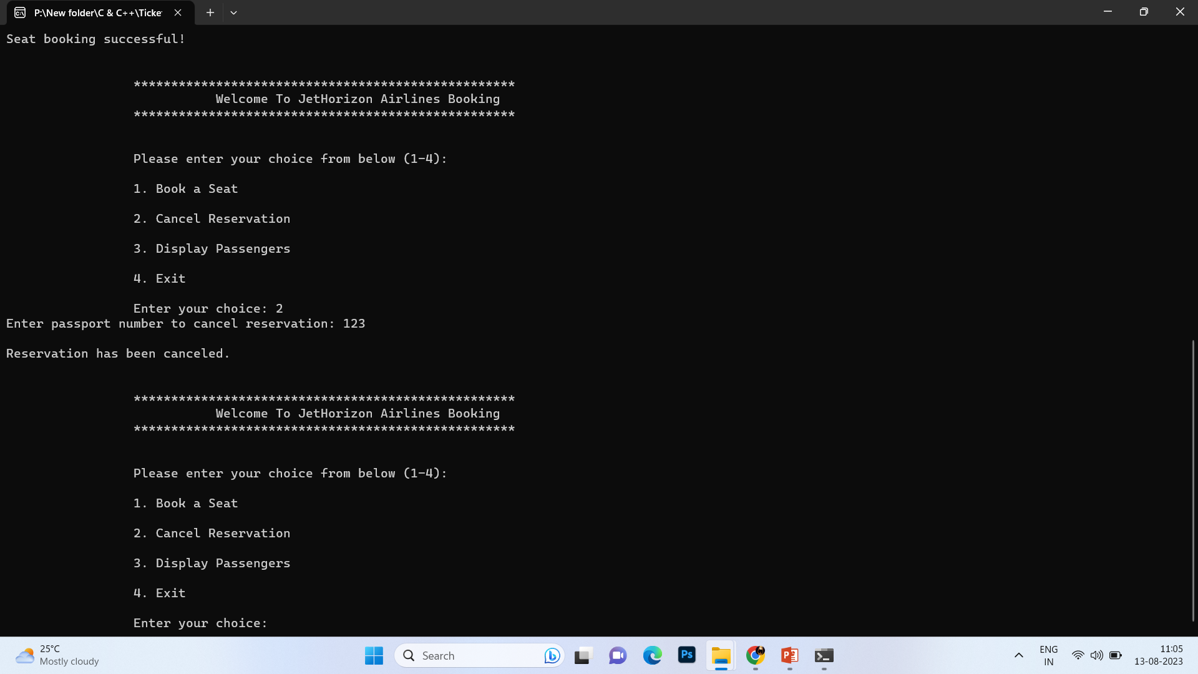
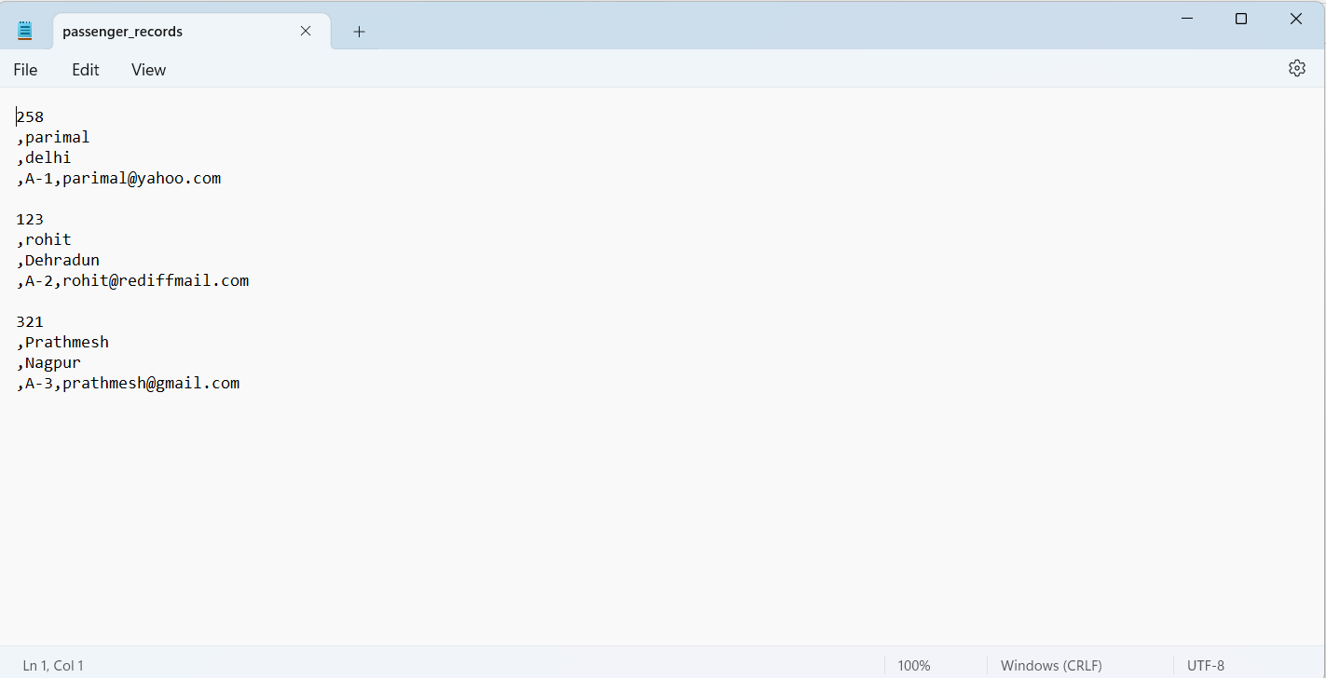

Slide 13
CONCLUSION:-
C is most useful for embedded systems, or applications that require the ability to be light-weight and have precise control over system resources. C is lacking a lot of the functionality that more contemporary languages feature, but remains a core tool for Unix developers

Slide 14
THANK YOU!
Presented By:- Parimal Rajesh Chaudhari
Roll No.:- 13
PRN No.:-2010121245025

