Slide 1
SQL:MYSQLBASIC PRACTICE -1

Slide 2
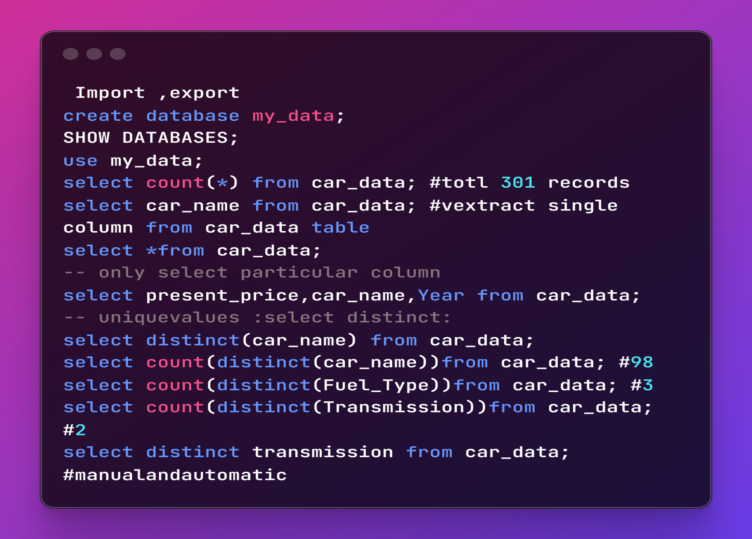

Slide 3
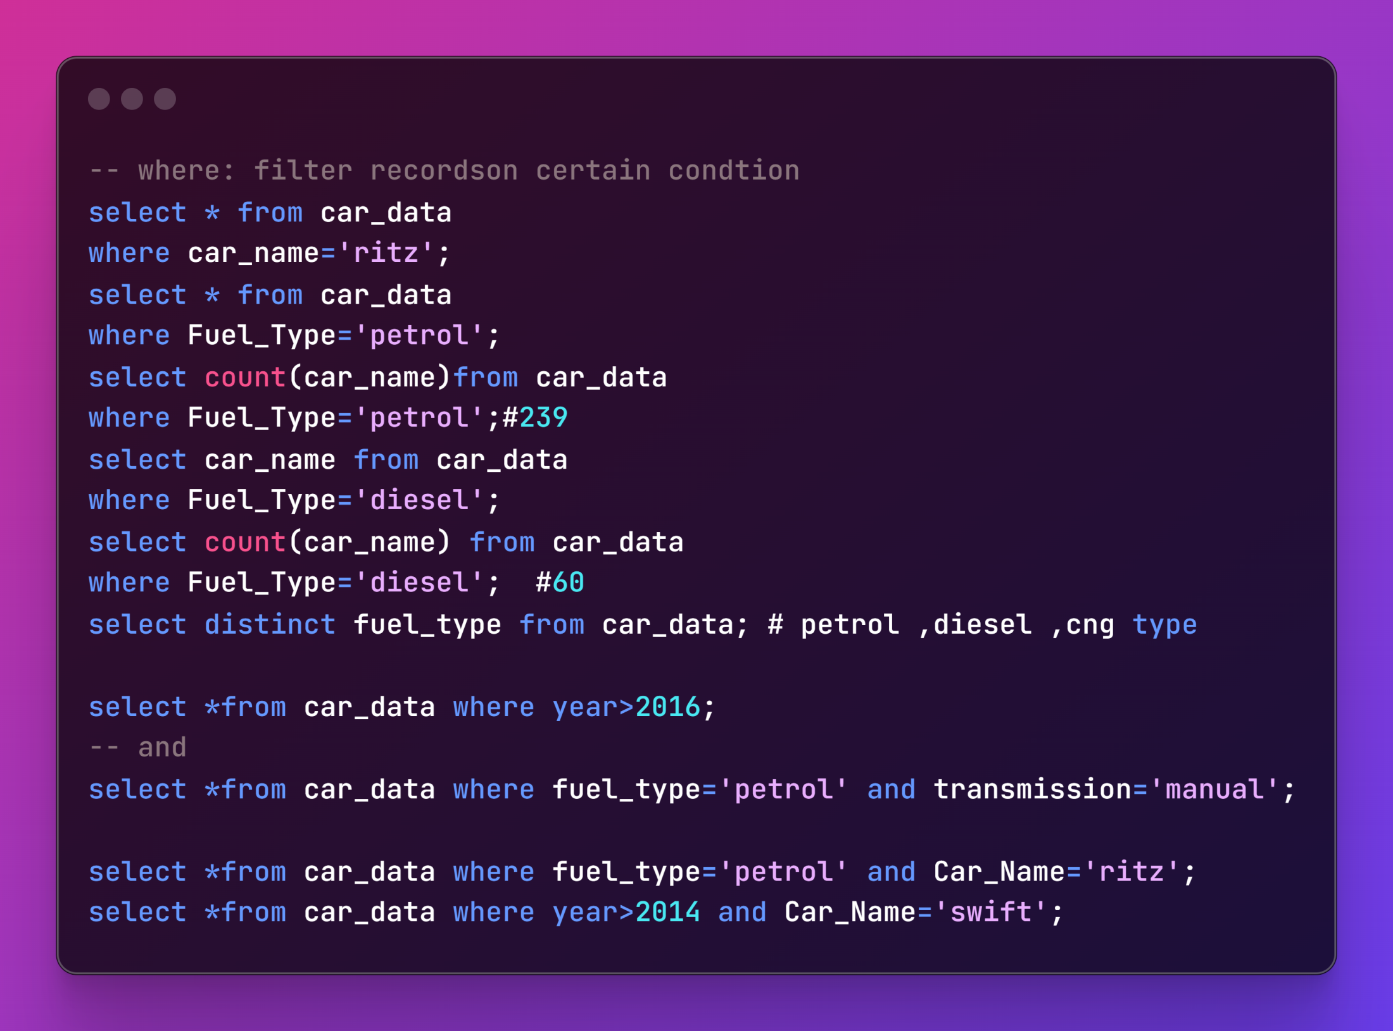

Slide 4
