Slide 1
Travel agent
CAPSTONE PROJECT
Presented By:
Parimal Ahire
MIT Academy Of Engineering
Computer Engineering

Slide 2
OUTLINE
Problem Statement
Technology used
Wow factor
End users
Result
Conclusion
Git-hub Link
Future scope
IBM Certifications

Slide 3
Problem Statement
Students and early-career professionals often face difficulty navigating the vast and unstructured landscape of online learning resources. With no personalized guidance or real-time support, they struggle to identify the right learning paths aligned with their goals, current skills, and interests, leading to confusion and inefficiency in skill development.
Proposed Solution: An agentic AI learning assistant named AIDA, built using IBM watsonx.ai and powered by a Granite foundation model, interacts with users to understand their interests, goals, and current skill levels. It dynamically constructs and refines personalized learning paths by recommending relevant courses, resources, and skill-building strategies. Through ongoing dialogue, AIDA adapts its guidance in real time, offering tailored support and motivation to help learners progress effectively.

Slide 4
Technology used
IBM cloud lite services - Free-tier access for building and deploying AI agents
IBM Granite Foundation Model - Large language model for generating intelligent responses
Natural Language Processing (NLP) - Allows the agent to understand and respond in natural language

Slide 5
IBM cloud services used
IBM Cloud Watsonx AI Studio – Build and Configure AI agent
IBM Cloud Watsonx AI runtime – Deploy and test agents in real time
IBM Cloud Agent Lab – Interface to manage agent behavior and tools
IBM Granite foundation model – Powers natural and intelligent conversations

Slide 6
Wow factors
This agent helps learners cut through overwhelming course options, stay motivated, and follow a structured, goal-aligned path. It empowers students with personalized guidance, adapting continuously based on interaction.
Unique Features:
Dynamic course recommendations based on interests and current skills
Personalized learning paths generated through conversation
Real-time adaptation and progress-aware suggestions
Skill-based tool recommendations and portfolio-building tips
Instruction-driven behavior with no coding required
Motivational tone designed to guide and support learning

Slide 7
End users
High School & College Students
Looking for guidance on which courses and skills to pursue based on their interests.
Early-Career Professionals
Exploring ways to upskill or transition into new tech domains through structured learning.
Self-Learners & Career Changers
In need of personalized roadmaps instead of generic course lists.
Academic Institutions & EdTech Platforms
Can integrate the agent to provide smart, adaptive learning support.

Slide 8
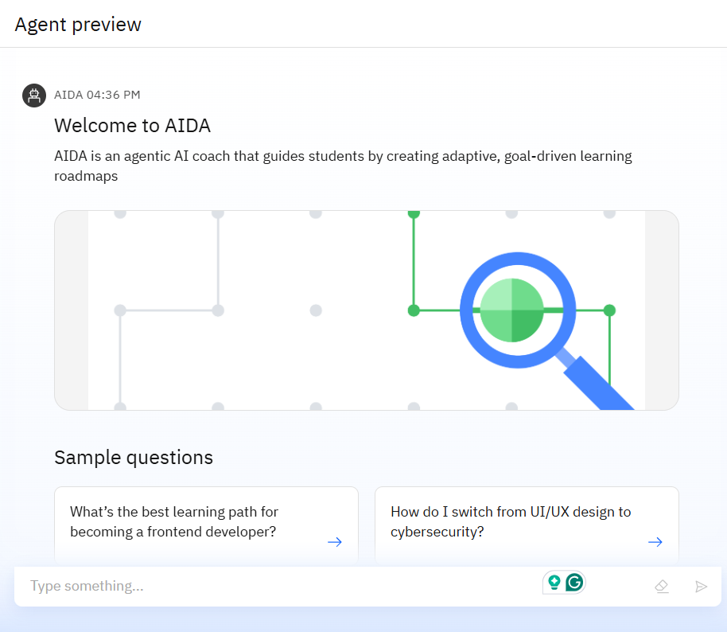
Results

Slide 9
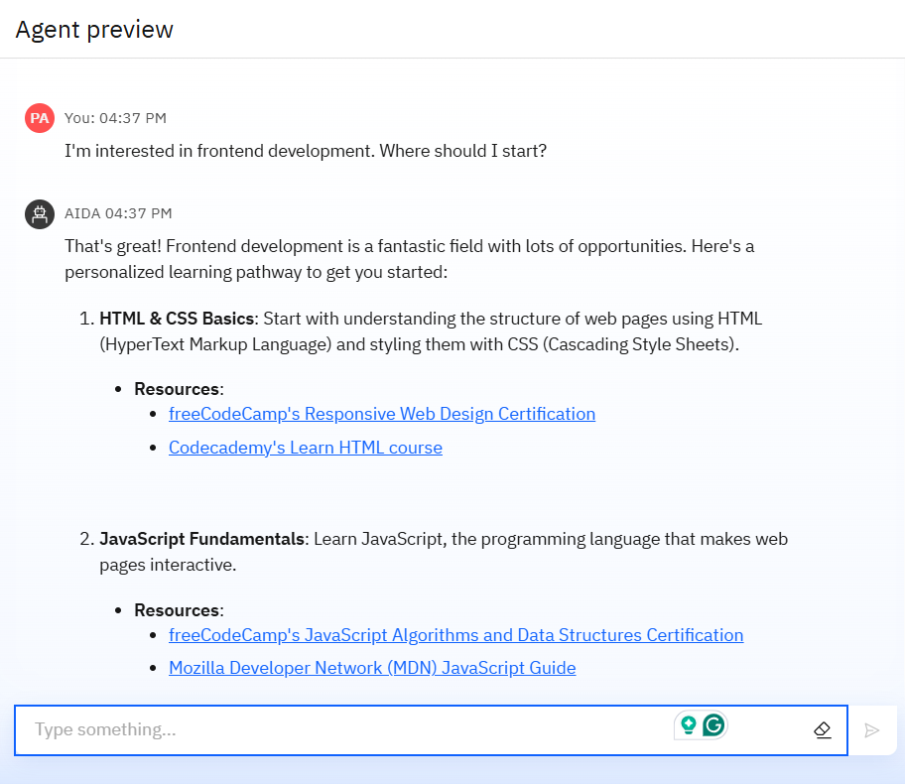
Results

Slide 10
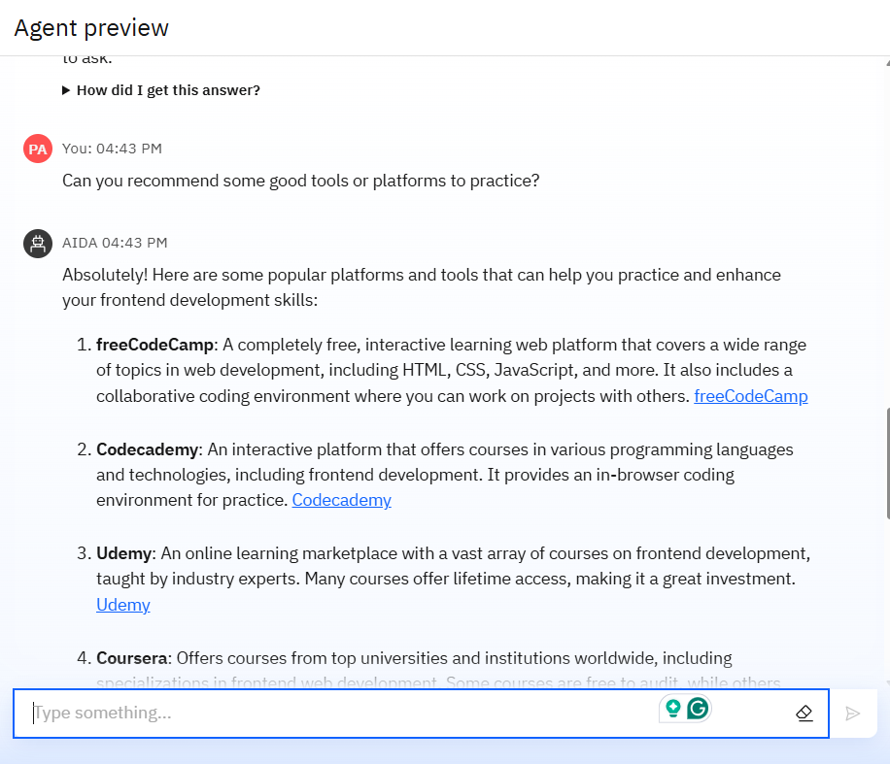
Results

Slide 11
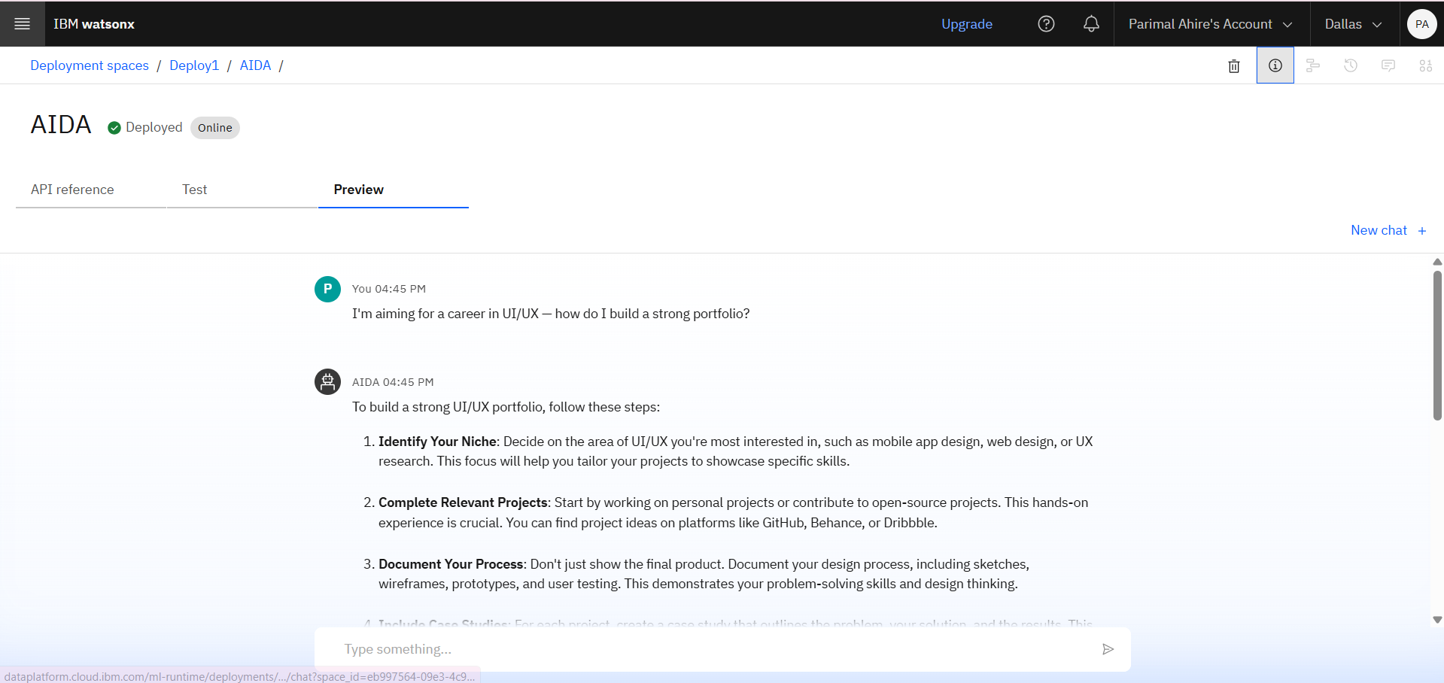
Results
Deployed AI Agent

Slide 12
Conclusion
The solution highlights how agentic AI can transform the way learners receive guidance by delivering personalized, adaptive, and conversational support.
Through natural interactions, the assistant understands user goals, recommends relevant learning paths, and continuously adapts to individual progress.
Built on IBM Cloud Lite services with Granite foundation models, it offers a low-code, scalable approach to empower users with clear, goal-driven learning experiences.

Slide 13
Future scope
Persistent User Profiles: Implement login and user account functionality to retain learning history, preferences, and past conversations, enabling long-term personalized support.
Academic Data Integration: Include additional inputs like academic performance, certifications, and resume details to further enhance the relevance and accuracy of learning path recommendations.
Dynamic Learning Path Updates: Integrate external APIs (e.g., Coursera, edX, job market data) to allow AIDA to adapt roadmaps based on trending skills, course availability, and market demand.
Scalable Deployment: Move beyond web preview and integrate AIDA into learning platforms, institutional portals, or mobile apps for broader adoption.

Slide 14
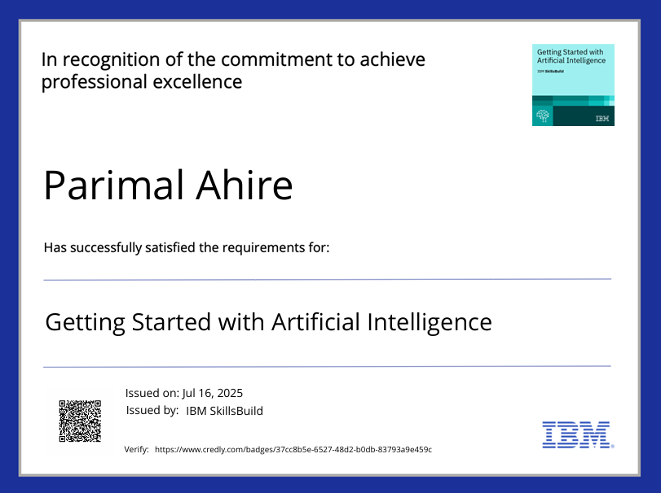
IBM Certifications

Slide 15
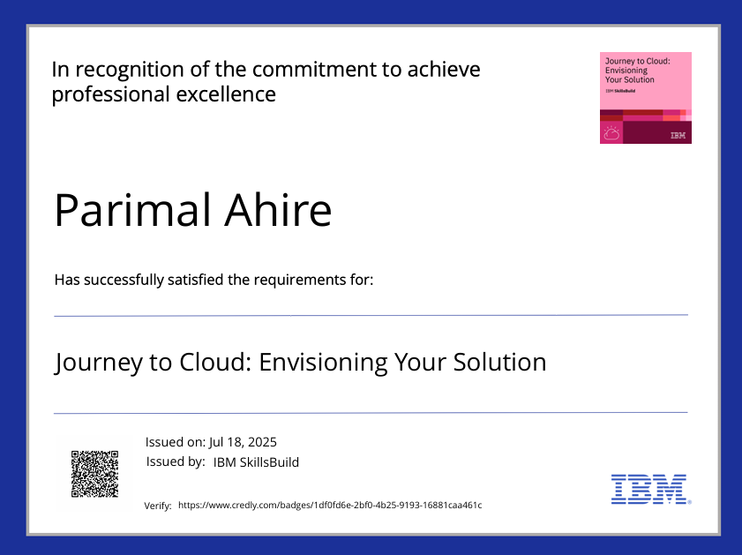
IBM Certifications

Slide 16
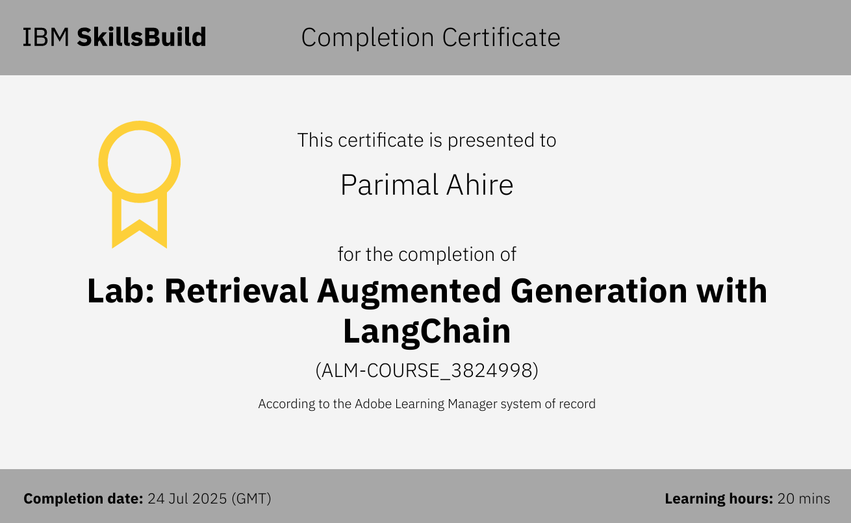
IBM Certifications

Slide 17
GitHub Link
GitHub link : https://github.com/ParimalAhire/PathCraft-AIDA

Slide 18
THANK YOU

