Slide 1
PROJECT TITLE
CAPSTONE PROJECT
Presented By:
Parimal Ahire
MIT Academy Of Engineering
Computer Engineering

Slide 2
OUTLINE
Problem Statement
Proposed System/Solution
System Development Approach
Algorithm & Deployment
Result
Conclusion
Future Scope
References

Slide 3
Problem Statement
Students today face an overwhelming number of online courses, platforms, and specializations, making it difficult to choose the right learning path. Many struggle to align their educational journey with personal interests, skill levels, and long-term career goals. This often leads to wasted time, confusion, and low motivation. Generic recommendation systems fail to offer the depth of personalization learners need. Without tailored guidance, students may follow the wrong path or abandon learning altogether. There is a pressing need for an intelligent, adaptable system that understands each learner’s context and provides dynamic, evolving support. Such a solution should actively guide users, respond to their progress, and help them make informed decisions throughout their journey.

Slide 4
Proposed Solution
The proposed system aims to address the challenge of helping students identify the most suitable learning path that aligns with their interests, current skill level, and long-term career goals. This is achieved through the use of an agentic AI coach that personalizes and continuously adapts the learner’s educational roadmap. The solution consists of the following components:
Data Collection:
AIDA collects user inputs during chat conversations, including interests (e.g., Cybersecurity, UI/UX), current skill level, learning preferences, and long-term goals.
Future enhancements may include integration of academic performance data and learning history for deeper personalization.
Agentic Behavior:
AIDA follows explicit behavioral instructions — it proactively asks questions, clarifies vague responses, offers motivational feedback, and tailors its interaction style based on the user’s age, confidence, and clarity.
It doesn't wait for commands but drives the conversation toward a clear, actionable learning plan.
Learning Path Generation:
Based on collected inputs, AIDA builds a dynamic and personalized roadmap that includes curated online courses, project ideas, certifications, and estimated durations.
The path evolves over time as the user provides progress updates, changes preferences, or completes milestones.
Adaptive Planning:
AIDA continuously monitors the learner’s status through ongoing conversations and autonomously updates the course recommendations.
It reorders steps, adds/removes suggestions, and reminds users to stay on track based on their pace and feedback.
Deployment:
The system is deployed using IBM watsonx.ai and IBM Granite models on IBM Cloud Lite.
It is currently accessible through a web-based preview interface, with plans for full integration into a scalable learning platform.

Slide 5
System Approach
System Requirements: IBM Cloud Lite with access to watsonx.ai Studio, watsonx.ai Runtime, and IBM Cloud Object Storage.
Libraries/Tools Used:
IBM watsonx.ai Studio for building AIDA’s conversation logic and agentic behavior.
IBM Granite model for natural language processing and interaction generation.
watsonx.ai Runtime for executing and testing real-time chatbot interactions.
IBM Cloud Object Storage to manage user session data, logs, and static learning content for path recommendations.
Instruction Design:
AIDA follows a detailed instruction set that governs how it greets users, asks questions, personalizes recommendations, follows up on vague input, and adapts its tone and responses. This enables it to function autonomously with human-like mentorship qualities.
Logic Design:
Core logic revolves around extracting and using user inputs like interest area, current skill level, and long-term goals. AIDA uses this data to suggest relevant learning paths and continuously adapt those paths based on feedback and updates.
Conversation Flow:
Designed with agentic structure — AIDA initiates discussions, guides users step-by-step, and evolves its dialogue using contextual awareness. It combines flexible logic with predefined goals to deliver personalized and proactive support.

Slide 6
Algorithm & Deployment
Algorithm Selection: The system uses the Granite-3-3B-8 large language model from IBM watsonx.ai. This model was selected for its ability to handle natural language conversations, follow instruction-based behavior, and provide contextual, real-time responses suited for educational support. It is well-suited for use cases where learners seek conversational guidance instead of static suggestions.
Data Input: Users provide inputs during the chat session, such as:
Areas of interest (e.g., UI/UX, Frontend, Cybersecurity)
Questions like “What should I learn next?” or “I’m confused between two domains”
Clarifications like “This course is too hard” or “Suggest beginner-level content” These conversational cues are parsed and used to provide helpful responses.
Training Process: The Granite model is already pretrained by IBM. No custom training is done. Instead, AIDA’s behavior is crafted using instruction-based prompt design, defining how the assistant should speak, guide, motivate, and personalize recommendations.
Response Generation: AIDA does not predict outcomes. It listens to the user’s questions or problems and provides personalized learning suggestions based on the conversation. The AI adapts its guidance in real time depending on how the user responds — but only when the user communicates progress, confusion, or interest shifts.

Slide 7
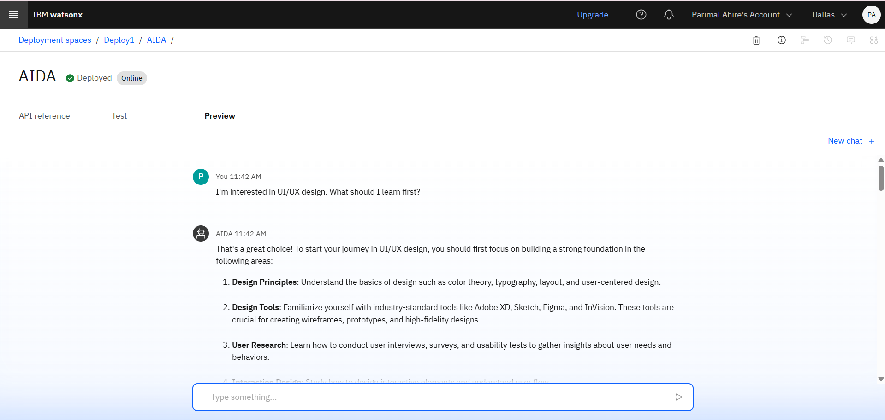
Result

Slide 8
Conclusion
Summary
PathCraft successfully delivers personalized learning guidance through a conversational AI system powered by IBM's Granite model. The agentic AI, AIDA, provides real-time, context-aware course suggestions based on user inputs like interest area, skill level, and career goals. The solution was effective in offering adaptive, supportive, and structured learning roadmaps through natural dialogue, simulating the behavior of a helpful mentor.
Challenges
Designing prompt-based agentic behavior required thoughtful instruction engineering to ensure AIDA responded with clarity, empathy, and goal-aligned suggestions. Since the system depends on user-driven input, progress tracking is limited to what the user shares. Also, the current web preview interface limits persistent memory or long-term learning history integration.

Slide 9
Future scope
Persistent User Profiles: Implement login and user account functionality to retain learning history, preferences, and past conversations, enabling long-term personalized support.
Academic Data Integration: Include additional inputs like academic performance, certifications, and resume details to further enhance the relevance and accuracy of learning path recommendations.
Dynamic Learning Path Updates: Integrate external APIs (e.g., Coursera, edX, job market data) to allow AIDA to adapt roadmaps based on trending skills, course availability, and market demand.
Project & Portfolio Recommendations: Add functionality to suggest capstone project ideas and portfolio-building strategies based on the learner’s chosen path.
Scalable Deployment: Move beyond web preview and integrate AIDA into learning platforms, institutional portals, or mobile apps for broader adoption.

Slide 10
References
IBM Watson Assistant Documentation
https://cloud.ibm.com/docs/watson-assistant
IBM Cloud Object Storage Guide
https://cloud.ibm.com/docs/cloud-object-storage
IBM Watsonx.ai Studio Overview
https://cloud.ibm.com/docs/watsonx-ai
IBM watsonx.ai Agentic AI Lab (Foundation Model Lab) https://dataplatform.cloud.ibm.com/docs/content/wsj/analyze-data/fm-agent-lab.html?context=wx&audience=wdp#model
International Journal of Computing and Engineering
ISSN 2958-7425 (online)
Vol. 7, Issue No. 12, pp. 1 - 10, 2025

Slide 11
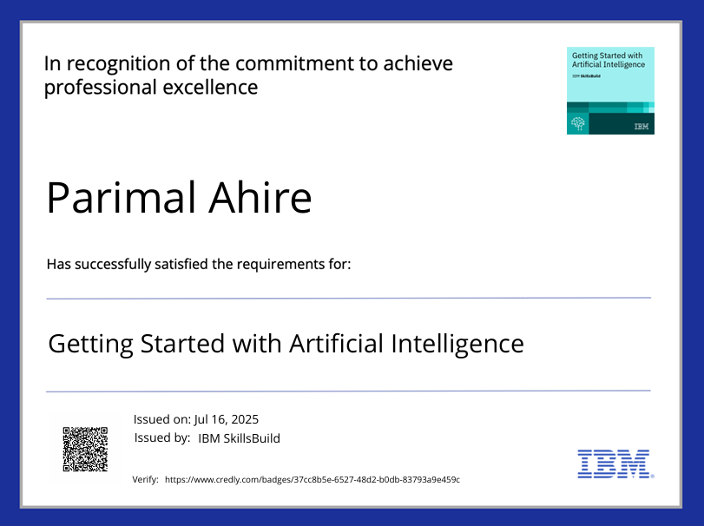
IBM Certifications

Slide 12
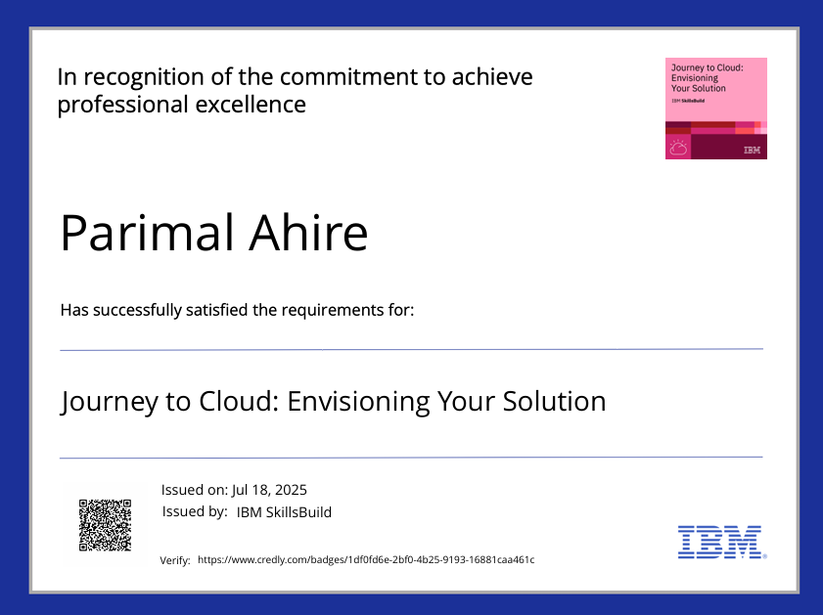
IBM Certifications

Slide 13
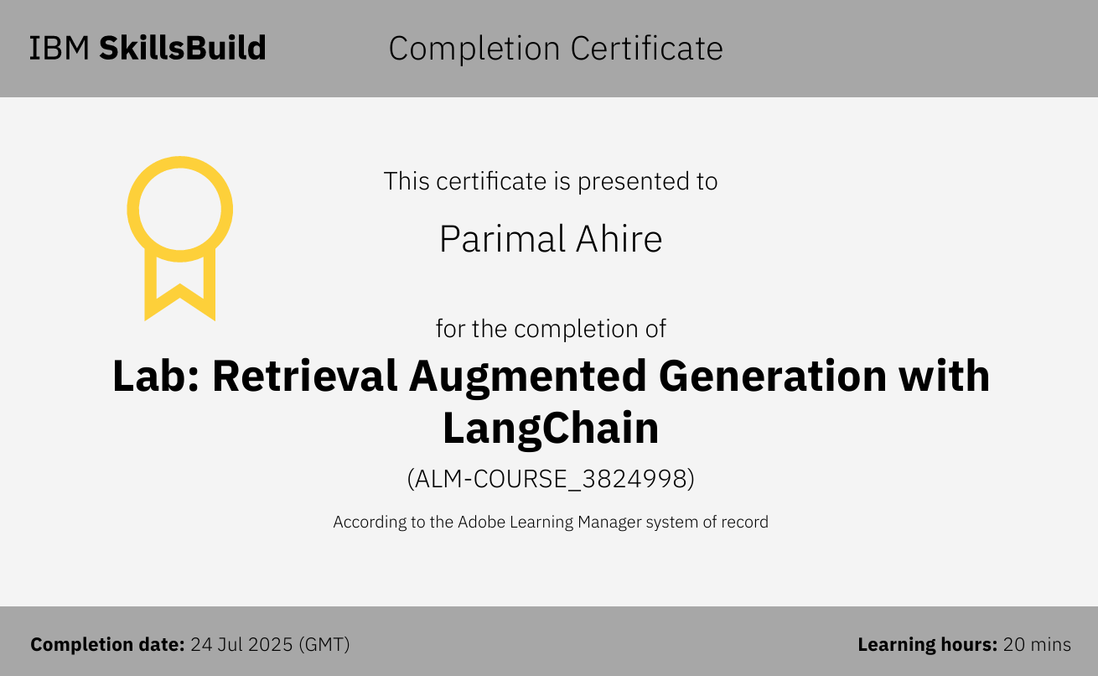
IBM Certifications

Slide 14
THANK YOU

