Slide 1
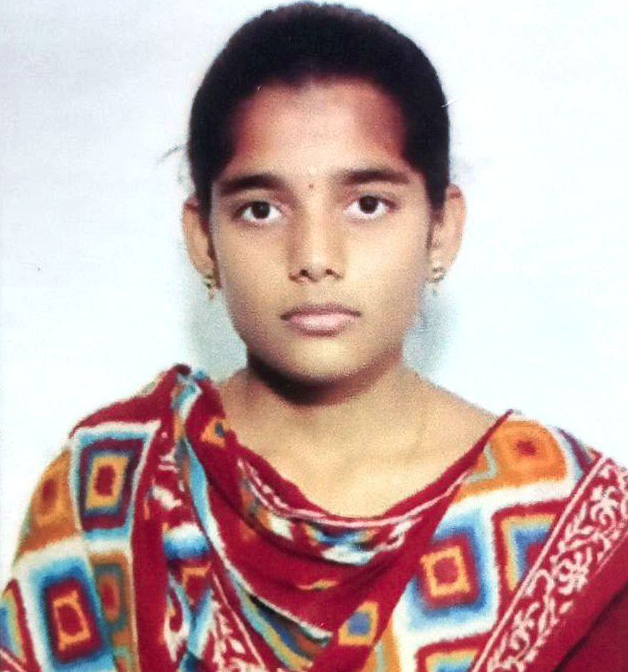

DEGALA PARIMALA
Analyst/Software Engineer
BACHELORS IN COMPUTER
SCIENCE: 2019 - 2022
Skills
C# | C# Basics, OOPS, Generics, Collections, Array, Loops
.NET | ADO.NET, ASP.NET with MVC and WEB API, Entity framework
Angular | Components, Services, Modules, Routing, Forms & Validation
Database | Microsoft SQL Server
UI Tech | HTML5 & CSS3, TypeScript
Tools | Git, Swagger, SSMS, Visual studio, Visual Studio Code.
Add On skills | Communications , Team management , Peer Learning
Banglore
d-parimala.d-parimala@capgemini.com
+91 9391170435
A3
Full Stack Developer
Hands on experience on C#,ADO.NET,SQL Server, ASP.NET MVC5 with WEBAPI
Knowledge on creating Single page web applications using Angular
Hands on experience in developing web pages using HTML5, CSS3, TypeScript
Having knowledge on Git and GitHub.
Attended training on iTransform - Microsoft.Net
Shopping Cart System[Video profile]
Developed Case Study of Shopping cart System using ASP.NET Core, Web API, and SQL Server Management Studio, User Interface created with HTML5, CSS, TypeScript and Angular. It is a website for customers so that they can order the products through online.
DEGREED
Successfully completed the degreed training in Git, HTML, CSS, SQL, C#, .NET Core, and Angular.
Check out my work on GitHub

