Slide 1




Rx In Action
Jim Wooley
www.ThinqLinq.com
Twitter: @JimWooley

Slide 2
Reactive Extensions
“Rx is a library for
composing asynchronous and
event-based programs using
observable collections.”

Slide 3



Pull vs Push – Audience Participation

Slide 4
Pull vs Push
From candy in bagOfCandies
Where Not candy.HasNuts
Group candy By Key = candy.Name into GroupedCandies
Select new {Key, CandyCount = GroupedCandies.Count}

Slide 5

IEnumerator vs. IObserver
public interface IEnumerator
{
object Current { get; }
bool MoveNext();
void Reset();
}
Blocking
public interface IObserver<T>
{
void OnCompleted();
void OnError(Exception exception);
void OnNext(T value);
}

Slide 6
Demo
Moving from Enumerable to Observable

Slide 7
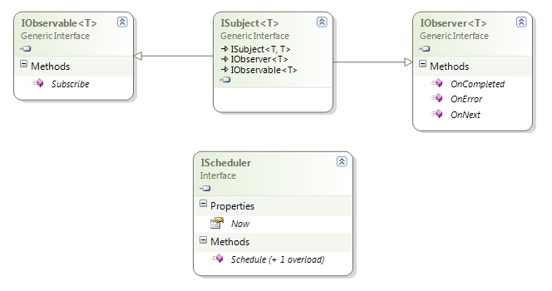
Rx Interfaces

Slide 8
Subscription Pipeline
var query = observable.Select(f); //build
var sub = query.Subscribe(handler); // subscribe
… handler.OnNext // receive
… handler.OnNext // data
… handler.OnNext
sub.Dispose(); // unsubscribe

Slide 9

Cross the Streams?

Slide 10
Merge

Slide 11
Zip

Slide 12
Repeat

Slide 13
IO<T> TakeUntil(IO<T> source, IO<U> until)
IO<T>
IO<U>
IO<T>

Slide 14
Observable Events
First Class Objects
Disposable
Supports DI/IOC
Mockable

Slide 15
Composing with Events
demo

Slide 16
Additional LINQ operators
Amb
Asynchronous
BufferWithCount
Catch
Concat
Defer
Delay
Do
Generate
Merge
OnErrorResumeNext
Repeat
Retry
Run
StartWith
Timeout

Slide 17





Flavors of Rx
Rx-C++
F#
Rx.RB
Rx.Py
Haskell - FRP
Rx-Perl
Reactive Scala/MongoDB
RxJava
RxPhp
RxJs

Slide 18






Common Uses

Slide 19
Resources
Twitter: @ReactiveX #RxNet #RxJs #RxJava
Rx Data Developer Center: http://msdn.microsoft.com/data/gg577609
Source: https://github.com/Reactive-Extensions https://rx.codeplex.com/
Reactive Extensions Team Blog: http://blogs.msdn.com/rxteam
Rx Forum http://social.msdn.microsoft.com/Forums/en-US/rx/threads
Channel9: http://channel9.msdn.com/Tags/Rx
Paper.li: http://paper.li/jimwooley/1365169132
Free Ebook: http://www.introtorx.com/

Slide 20
Rx In Action Reactions?
Jim Wooley
www.ThinqLinq.com
Twitter: @JimWooley

