Slide 1



Practical
Jim Wooley
www.ThinqLinq.com
Twitter: @JimWooley

Slide 2
Reactive Framework
“Rx is a library for
composing asynchronous and
event-based programs using
observable collections.”

Slide 3






Flavors of Rx
JavaScript

Slide 4


Pull vs Push – Audience Participation

Slide 5
Pull vs Push
From candy in bagOfCandies
Where candy.HasNuts
Group candy By Key = candy.Name into GroupedCandies
Select new {Key, CandyCount = GroupedCandies.Count}

Slide 6

IEnumerator vs. IObserver
public interface IEnumerator
{
object Current { get; }
bool MoveNext();
void Reset();
}
Blocking
public interface IObserver<T>
{
void OnCompleted();
void OnError(Exception exception);
void OnNext(T value);
}

Slide 7
Demo
Moving from Enumerable to Observable

Slide 8
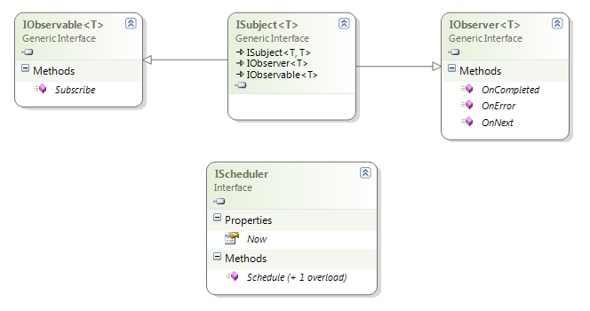
Rx Interfaces

Slide 9
Composing with Events
demo

Slide 10
Observable Events
First Class Objects
Disposable
Supports DI/IOC
Mockable

Slide 11
Subscription Pipeline
var query = observable.Select(f); //build
var sub = query.Subscribe(handler); // subscribe
… handler.OnNext // receive
… handler.OnNext // data
… handler.OnNext
sub.Dispose(); // unsubscribe

Slide 12
Merge

Slide 13
Zip

Slide 14
Repeat

Slide 15
IO<T> TakeUntil(IO<T> source, IO<U> until)
IO<T>
IO<U>
IO<T>

Slide 16
Additional LINQ operators
Amb
Asynchronous
BufferWithCount
Catch
Concat
Defer
Delay
Do
Generate
Merge
OnErrorResumeNext
Repeat
Retry
Run
StartWith
Timeout

Slide 17






Common Uses

Slide 18
Resources
Rx Data Developer Center: http://msdn.microsoft.com/data/gg577609
Reactive Extensions Team Blog: http://blogs.msdn.com/rxteam
Rx Forum http://social.msdn.microsoft.com/Forums/en-US/rx/threads
RxWiki (Samples and more) http://rxwiki.wikidot.com
Channel9: http://channel9.msdn.com/Tags/Rx

Slide 19
Questions
Jim Wooley
www.ThinqLinq.com
@LinqKinq

