Slide 1
Ajax
Basic objects necessary
Setting up the XMLHttpRequest object
Making the call
How the server responds
Using the reply
XML basics

Slide 2
The usual way we operate in the Web
Typical browsing behavior consists of loading a web page, then selecting some action that we want to do, filling out a form, submitting the information, etc.
We work in this sequential manner, requesting one page at a time, and have to wait for the server to respond, loading a whole new web page before we continue.
This is also one of the limitations of web pages, where transmitting information between a client and server generally requires a new page to be loaded.
JavaScript is one way to cut down on (some of) the client-server response time, by using it to verify form (or other) information before it’s submitted to a server.
One of the limitations of JavaScript is (or used to be) that there was no way to communicate directly with a web server.
Another drawback to this usual sequential access method is that there are many situations where you load a new page that shares lots of the same parts as the old (consider the case where you have a “menu bar” on the top or side of the page that doesn’t change from page to page).

Slide 3
Things change…
We used to not have any alternative to this load/wait/respond method of web browsing.
Ajax (sometimes written AJAX) is a means of using JavaScript to communicate with a web server without submitting a form or loading a new page.
Ajax makes use of a built-in object, XMLHttpRequest, to perform this function.
This object is not yet part of the DOM (Document Object Model) standard, but is supported (in different fashions) by Firefox, Internet Explorer, Safari, Opera, and other popular browsers.
The term “Ajax” was coined in 2005, but the XMLHttpRequest object was first supported by Internet Explorer several years before this.

Slide 4
Ajax
Ajax stands for “Asynchronous JavaScript and XML”.
The word “asynchronous” means that the user isn’t left waiting for the server the respond to a request, but can continue using the web page.
The typical method for using Ajax is the following:
1) A JavaScript creates an XMLHttpRequest object, initializes it with
relevant information as necessary, and sends it to the server. The script
(or web page) can continue after sending it to the server.
2) The server responds by sending the contents of a file or the output of a
server side program (written, for example, in PHP).
3) When the response arrives from the server, a JavaScript function is
triggered to act on the data supplied by the server.
4) This JavaScript response function typically refreshes the display using the
DOM, avoiding the requirement to reload or refresh the entire page.

Slide 5
What is AJAX?
Not a language itself
A group of related existing technologies compiled together or technique to make web pages feel more responsive
Makes interactive web pages by providing a way for the web page to interact with the server
AJAX is a framework

Slide 6
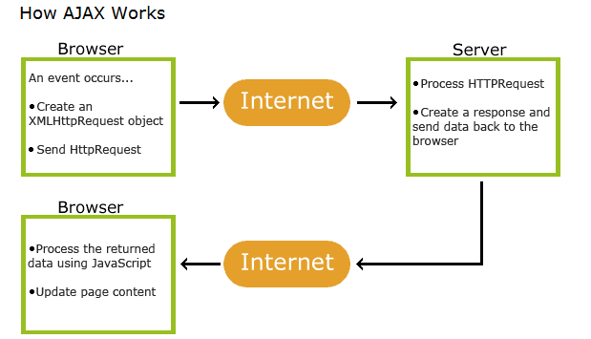
How it works

Slide 7
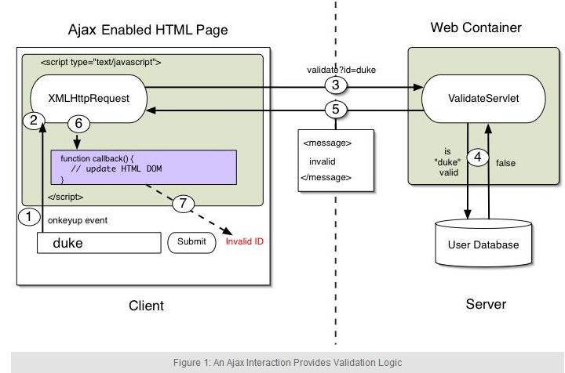

Slide 8
Where to use Ajax
Ajax should be used anywhere in a web application where small amounts of information could be saved or retrieved from the server without posting back the entire pages.
Ex:
  change the values in a drop down list-box based on other inputs, such as state and college list boxes
  when the client needs to save or retrieve session values from the server, based on a user preference

Slide 9
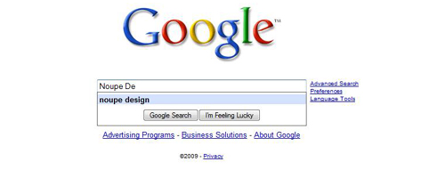
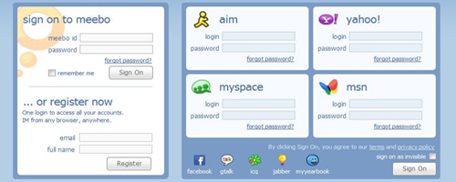
Who uses Ajax

Slide 10
Based on Internet Standards
XHTML/HTML and CSS
  To display the data
JavaScript (XMLHttpRequest calls)
  To exchange data asynchronously with the server
XML
  To tranfer the data
DOM (document object model)
  To navigate the hierarchy of X/HTML elements

Slide 11
The XMLHttpRequest object
The XMLHttpRequest object is the backbone of every Ajax method. Each application requires the creation of one of these objects. So how do we do it?
As with most things in web programming, this depends upon the web browser that the client is using because of the different ways in which the object has been implemented in the browsers.
Firefox, Safari, Opera, and some other browsers can create one of these objects simply using the “new” keyword.
<script type="text/javascript">
ajaxRequest = new XMLHttpRequest();
</script>

Slide 12
The XMLHttpRequest object (cont.)
function getXMLHttpRequest()
/* This function attempts to get an Ajax request object by trying
a few different methods for different browsers. */
{
var request, err;
try {
request = new XMLHttpRequest(); // Firefox, Safari, Opera, etc.
}
catch(err) {
}
return request;
}
If this function doesn’t return “false” then we were successful in creating an XMLHttpRequest object.

Slide 13
The XMLHttpRequest object (cont.)
As with any object in JavaScript (and other programming languages), the XMLHttpRequest object contains various properties and methods.
We list the most important of these properties and methods on the next pages.
The main idea is that the properties are set after the object is created to specify information to be sent to the server, as well as how to handle the response received from the server. Some properties will be updated to hold status information about whether the request finished successfully.
The methods are used to send the request to the server, and to monitor the progress of the request as it is executed (and to determine if it was completed successfully).

Slide 14
XMLHttpRequest object properties
Property Description
readyState An integer from 0. . .4. (0 means the call
is uninitialized, 4 means that the call is
complete.)
onreadystatechange Determines the function called when the
objects readyState changes.
responseText Data returned from the server as a text
string (read-only).
responseXML Data returned from the server as an XML
document object (read-only).
status HTTP status code returned by the server
statusText HTTP status phrase returned by the server
We use the readyState to determine when the request has been completed, and then check the status to see if it executed without an error. (We’ll see how to do this shortly.)

Slide 15
XMLHttpRequest object methods
Method Description
open('method', 'URL', asyn) Specifies the HTTP method to be used (GET
or POST as a string, the target URL, and
whether or not the request should be
handled asynchronously (asyn should be
true or false, if omitted, true is
assumed).
send(content) Sends the data for a POST request and
starts the request, if GET is used you
should call send(null).
setRequestHeader('x','y') Sets a parameter and value pair x=y and
assigns it to the header to be sent with
the request.
getAllResponseHeaders() Returns all headers as a string.
getResponseHeader(x) Returns header x as a string.
abort() Stops the current operation.
The open object method is used to set up the request, and the send method starts the request by sending it to the server (with data for the server if the POST method is used).

Slide 16
A general skeleton for an Ajax application
<script type="text/javascript">
// ***** include the getXMLHttpRequest function defined before
var ajaxRequest = getXMLHttpRequest();
if (ajaxRequest) { // if the object was created successfully
ajaxRequest.onreadystatechange = ajaxResponse;
ajaxRequest.open("GET", "search.php?query=Bob");
ajaxRequest.send(null);
}
function ajaxResponse() //This gets called when the readyState changes.
{
if (ajaxRequest.readyState != 4) // check to see if we’re done
{ return; }
else {
if (ajaxRequest.status == 200) // check to see if successful
{ // process server data here. . . }
else {
alert("Request failed: " + ajaxRequest.statusText);
}
}
}
</script>

Slide 17
Sending text back the server
The response stored in XMLHttpRequest.responseText from the server can be any text that JavaScript is capable of processing as a string.
Thus, you can send back a simple text string as the first example did, or you could send a string with HTML tags embedded in it. You can process the string using JavaScript functions (to split it into substrings, add/delete parts of it, etc.).
You could even send back a string that has JavaScript code it in and execute it using the JavaScript eval() method.
Recall, however, that the responseText property is a read-only variable, so if you’re going to alter it you must first copy it to another variable.
(Change the PHP script to insert HTML tags.)
(As above, change the PHP script.)
Example with HTML tag
Example using a table

Slide 18
XML: a (very) brief intro(Just for your understanding)
XML, the eXtensible Markup Language, is used in many ways, the most relevant to us being the transfer of structured information.
XML and HTML look similar in many ways and this is because both are based on SGML, the Standard Generalized Markup Language established by the International Organization for Standards (ISO).
Like HTML, XML uses tags to denote information but is not limited to the types of tags that occur in HTML. Tags can be essentially anything a user likes and are used to define the type of data present in the document.

Slide 19
XML: a (very) brief intro (cont.)
Here’s an example: (This is how an XML file looks like)
<library>
<book>
<title>Programming PHP</title>
<author>Rasmus Lerdorf</author>
<author>Kevin Tatroe</author>
<author>Peter MacIntyre</author>
<chapter number="1">Introduction to PHP</chapter>
<chapter number="2">Language Basics</chapter>
. . .
<pages>521</pages>
</book>
. . .
</library>
See the other notes for some more details/examples.
view other notes

