Slide 1
END-SEMESTER PROJECT · NOVEMBER 2026
ApexHunter
Finding driver mistakes and pit-stop windows in Formula 1 telemetry, and an honest test of how well it works
Parin Shah
23001091
92
57.9 M
2
sessions
readings
seasons
Notes:
ApexHunter asks two questions of Formula 1 car data: where did a driver make a mistake, and when should he change tyres. Each gets a simple baseline, a machine-learning model and a deep-learning model.

Slide 2
THE PROBLEM
Two questions asked of the car's data
1
Where did the driver make a mistake?
2
When should he change tyres?
Moments where he did something different from the fastest drivers at the same spot, in a way that cost time: a lock-up, an early lift, a missed downshift.
From the laps driven so far, a five-lap pit window, and a "pit now" call when a safety car makes the stop cheaper. Checked against the stops drivers really made.
Why it is hard:
No one labels mistakes, and a pit lap is a team decision, not a correct answer. The tyre signal is tiny: about 0.05 s per lap, against 0.9 s of normal lap-to-lap variation. So every model is tested on data it has not seen and compared with a simple baseline.
02 · ApexHunter
Notes:
Two questions, and why they are hard: nobody labels mistakes, a pit lap is a team decision, and the tyre effect is tiny compared with normal lap-to-lap variation. So we test on unseen data against a baseline.

Slide 3
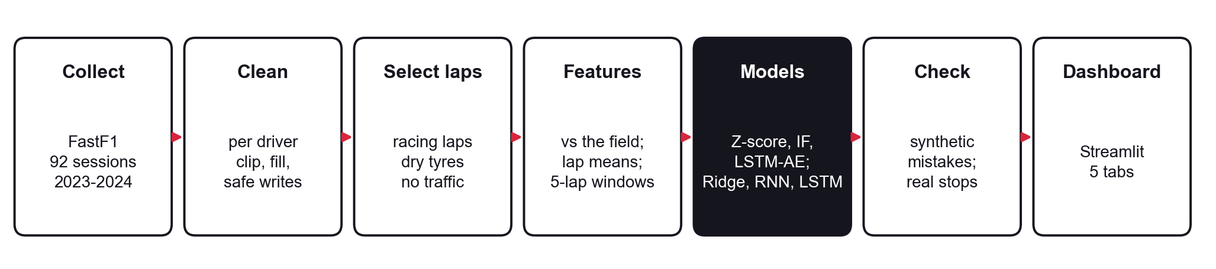
WHAT WE BUILT
From raw telemetry to a dashboard
Simple baseline
Machine learning
Deep learning
Z-score rule · "no change" (next lap = last lap)
Isolation Forest · Ridge regression
LSTM autoencoder · Vanilla RNN · LSTM
Data: every race and qualifying of 2023–2024 from FastF1: 92 sessions, 57.9 M readings, ~50,000 laps. 55 data and code problems were fixed first, each with a test.
03 · ApexHunter
Notes:
Data flows left to right: download, clean, keep racing laps, build features, train, check, and show it on the dashboard. The bottom row is the baseline, ML and DL model used for each question.

Slide 4
QUESTION 1 · MISTAKES
Compare with the field, using three detectors
Key idea: braking before a corner is normal, braking on a straight is not. So each moment is compared with the 5 fastest other drivers at the same spot.
Five features: how much slower, and how different the throttle, brake, gear and acceleration are, compared with the field there.
Result: "mistakes" that were just braking fell from 95 % to about 45 %.
Z-score (baseline)
Flags a reading when any one feature is extreme.
Isolation Forest
Random trees isolate unusual readings in few splits.
LSTM autoencoder
Learns to rebuild ~2 s of normal driving; what it cannot rebuild is unusual.
Two checks: a controlled test on synthetic mistakes (limit: shows the patterns are found, not that every real flag is a mistake) and a real-lap check (did a flag really cost time?)
04 · ApexHunter
Notes:
For mistakes, each moment is compared with the five fastest drivers at the same spot, so normal braking is not flagged. Three detectors, and two checks: synthetic mistakes, and whether real flags cost time.

Slide 5
QUESTION 1 · RESULTS
Both learned detectors beat the baseline
0.34
Isolation Forest mean F1 (Z-score 0.28)
0.40
LSTM autoencoder mean F1: finds the most synthetic mistakes
18 %
of Isolation Forest flags cost time on real laps (random places 12 %, autoencoder 14 %)
05 · ApexHunter
Notes:
Both learned detectors beat the baseline on synthetic mistakes; the autoencoder finds the most. On real laps the Isolation Forest's flags lose time most often: 18 % against 12 % for random places.

Slide 6
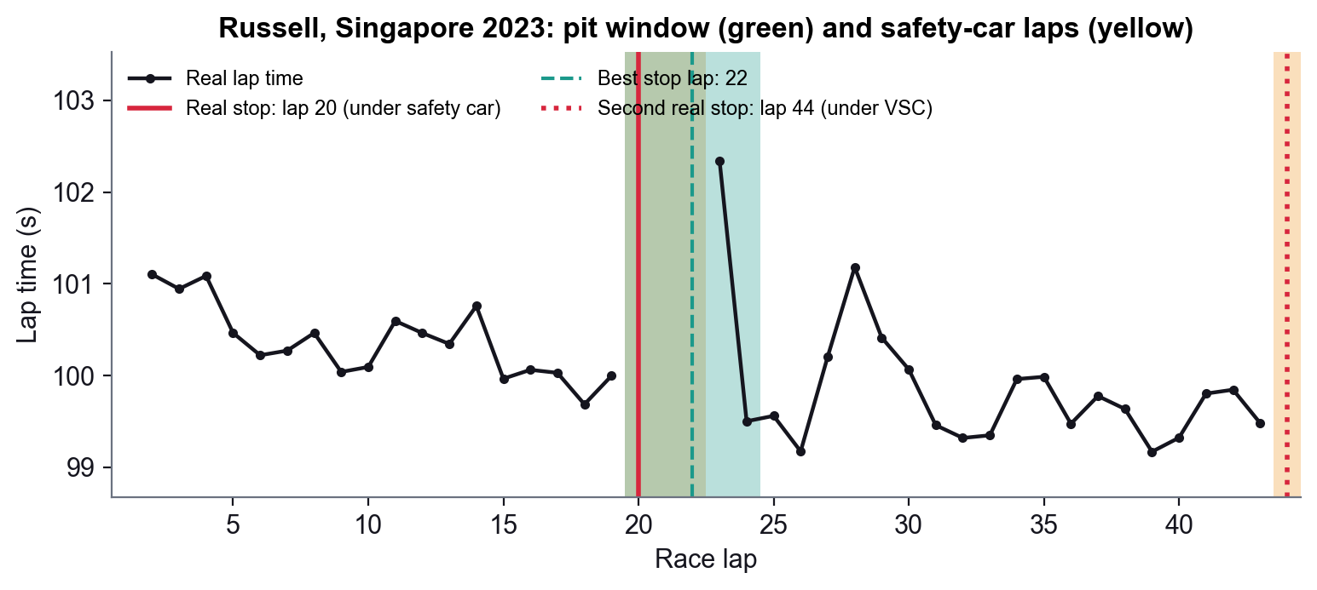
QUESTION 2 · TYRES
Predict the next lap, then find the pit window
The model sees the driver's last 5 laps: pace, throttle, brake, tyre age and compound.
It predicts how many seconds slower the next lap will be (the change, because a lap time mostly tells you the track).
A pit stop costs 22.8 s (median), 30 % less under a safety car.
The window in 3 steps:
1. estimate tyre wear per lap
2. for each possible stop lap, add tyre time lost + stop cost
3. cheapest lap ± 2 laps = the window
Example: Russell, Singapore 2023. Window laps 20–24. A safety car on lap 20 made the stop 30 % cheaper, so "pit now". He really pitted on lap 20, inside the window.
06 · ApexHunter
Notes:
For tyres, the model reads the last five laps and predicts how much slower the next will be. The pit window: estimate wear, add up the time lost for every possible stop lap, take the cheapest plus or minus two.

Slide 7
DEEP LEARNING · MISTAKES
An LSTM autoencoder learns normal driving
1
Input
2
Encoder → decoder
3
Score
16 readings (~2 s) of the five deviation features
an LSTM squeezes the window into 16 numbers, a second LSTM rebuilds it
rebuild error; the 2 % worst readings are flagged, as for the Isolation Forest
0.40
0.34
14 %
mean F1 on synthetic mistakes, the best of the three (Isolation Forest 0.34)
recall: it finds most mistakes that unfold over time, such as early lifts
of its real flags cost time: about as often as random places (12 %)
07 · ApexHunter
Notes:
The autoencoder learns normal driving over about two seconds and flags what it cannot rebuild. It wins the synthetic test, but its real flags cost time only about as often as random places.

Slide 8
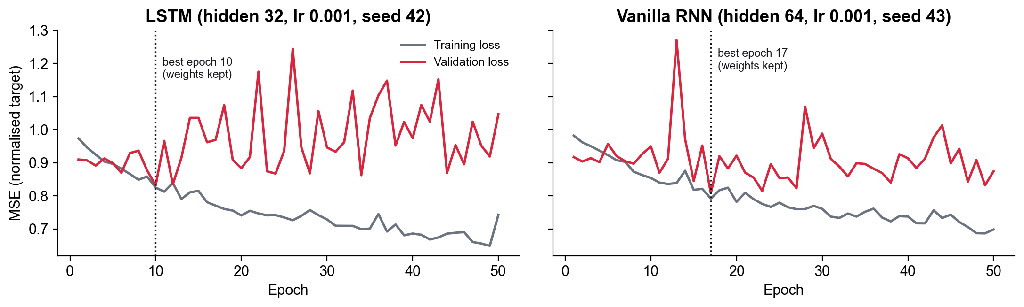
DEEP LEARNING · TYRES
Two recurrent networks read the five laps in order
1
Vanilla RNN
2
LSTM
3
Fair comparison
Reads one lap at a time and keeps a running memory; over long sequences that memory fades (vanishing gradients).
Adds gates that decide what to remember, forget and pass on, so the memory does not fade.
Same laps, same test races, same baseline; trained 3 times each and averaged.
Overfitting, and the fix:
after 10–17 epochs validation error stops improving while training error keeps falling: the networks memorise noise. We keep the best validation epoch.
08 · ApexHunter
Notes:
Both networks read the five laps in order; the LSTM adds gates so its memory does not fade. After 10 to 17 epochs they start memorising noise, so we keep the best validation epoch.

Slide 9
RESULTS · NEXT-LAP PREDICTION
All models beat the baseline; the networks do best
5 test races never seen in training. The RNN ties the LSTM: with only 5 laps, the LSTM's longer memory does not help.
09 · ApexHunter
Notes:
On five unseen races, every model beats the 'no change' baseline and both networks beat Ridge. The RNN ties the LSTM because five laps is too short for longer memory to matter.

Slide 10
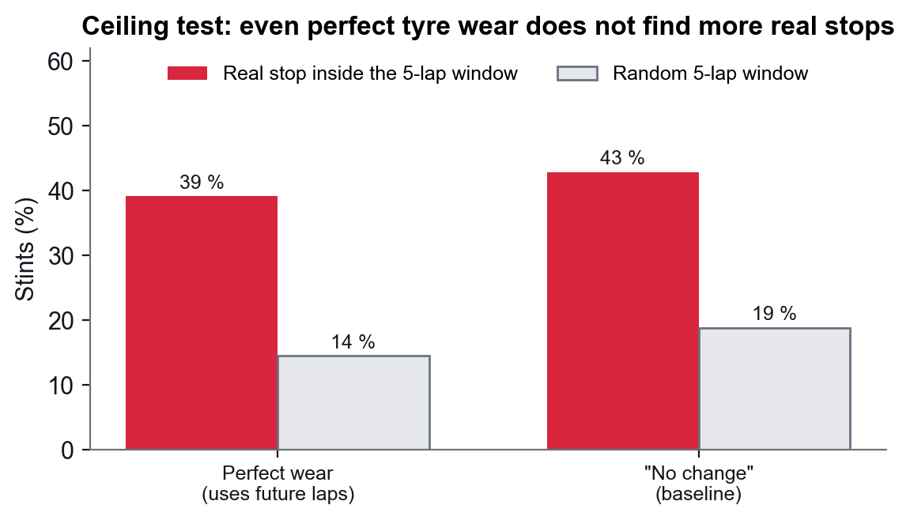
RESULTS · PIT WINDOWS
Better lap times do not mean better pit windows
Every model beats a random window, but none beats the simple baseline.
Ceiling test: even perfect tyre wear (using future laps) finds no more real stops. Stops are decided by strategy, traffic and safety cars.
10 · ApexHunter
Notes:
Every model's window beats a random window, but none beats the simple baseline. The ceiling test explains why: even perfect tyre wear does not find more real stops, because strategy and safety cars decide them.

Slide 11
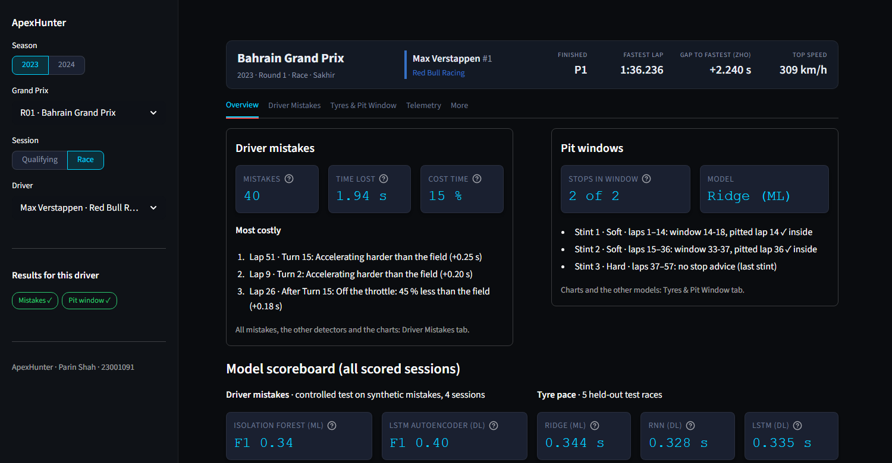
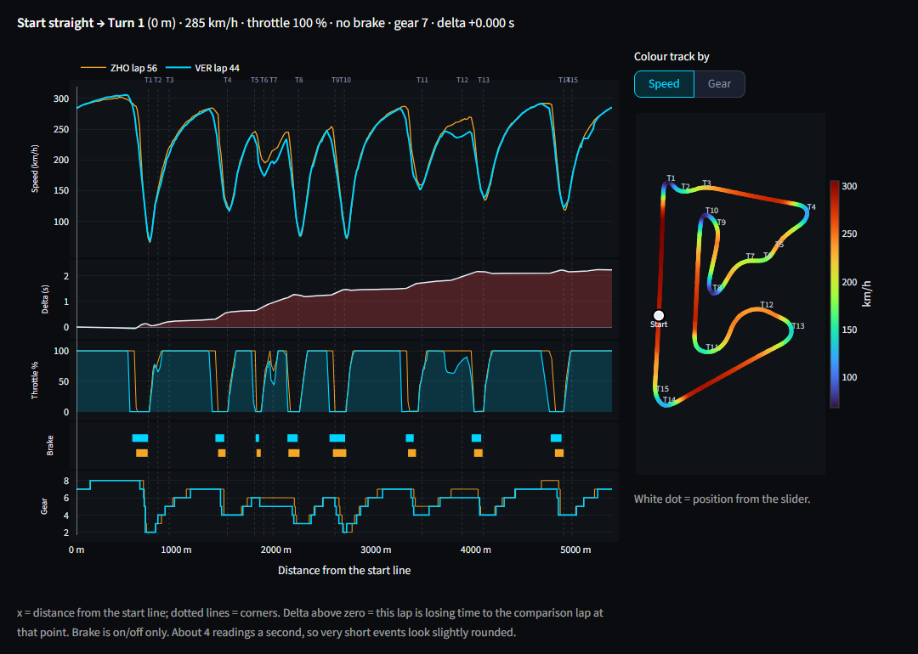
THE DASHBOARD
Five tabs, one chart per question
Overview
Driver Mistakes
Tyres & Pit Window
Telemetry
More
both answers + scoreboard
3 detectors, map, list
Ridge / RNN / LSTM
any lap, against distance
last semester's parts
11 · ApexHunter
Notes:
The dashboard has five tabs, each answering one question. Telemetry is plotted against distance so laps compare corner by corner; any driver in any of the 92 sessions.

Slide 12
WRAPPING UP
What we learned, and what we can't claim
✓
What we learned
!
Limits and next steps
Clean the data first: 55 problems would have changed the results.
Compare with the right reference: the field at the same spot.
Test with an answer key, and check it on real laps.
Deep learning is not automatic: the plain RNN ties the LSTM.
Report what does not work: the ceiling test.
Synthetic mistakes show the patterns are found, not that every flag is a real mistake.
Only four sessions scored for mistakes; five test races for tyres.
The strategy ignores traffic and rivals on purpose.
Next: predict the laps until a driver pits; add traffic.
12 · ApexHunter
Notes:
Lessons: clean the data first, compare with the right reference, test with an answer key, and report what does not work. Limits: synthetic mistakes, four scored sessions, no traffic in the strategy.

Slide 13
APEXHUNTER
Thank you
Questions are welcome
Mistakes: Isolation Forest F1 0.34, LSTM autoencoder 0.40 vs Z-score 0.28 · Tyres: RNN and LSTM best on lap times; pit window above chance
Notes:
Thank you; happy to take questions.

