Slide 1

Sentinels Vault : An Enterprise Grade Cryptographic Password Manager with Security Auditing
Parineeta Deb
Roll Number : 2470472
Supervisor : Prof. Lucy Dash
MCA. [2024-26]

Slide 2
Abstract
SentinelsVault is a local-first, zero-knowledge password manager designed to eliminate cloud-based vulnerabilities and ensure 100% user data ownership.
Implements AES-256 encryption and PBKDF2 key derivation to secure sensitive credentials within an ACID-compliant SQLite database.
Features a built-in Security Auditor for heuristic password strength analysis and Multi-Factor Authentication (MFA) for enhanced access control.
Utilizes a modular Python architecture to achieve a reduced remote attack surface while maintaining high performance and system integrity.

Slide 3
Related Works
Existing Works and Software:
Cloud-based Managers: Google Password Manager, LastPass, and Dashlane.
Offline / Open-source Tools: KeePassXC and Bitwarden (Self-hosted).
Drawbacks of Existing Solutions:
Cloud Vulnerability: Popular cloud-based managers have a "Single Point of Failure." A server-side breach can expose user metadata or encrypted vaults to remote attackers.
Remote Attack Surface: Constant synchronization requires an active internet connection, which increases exposure to network-based threats.
Passive Storage: Most existing tools are "passive" vaults; they store passwords but do not proactively run heuristic audits to detect weak entropy or reuse across different sites.
Trust & Ownership: Proprietary cloud systems require users to trust the provider's infrastructure. There is often no Zero-Knowledge guarantee that the provider cannot access metadata.
Lack of Custom Entropy: Many tools do not allow "Power Users" to define specific security parameters like custom salt iterations (PBKDF2) for their local encryption.

Slide 4
Methodology
Core Development Methodology:
SDLC (Iterative Model): Followed a structured Software Development Life Cycle, moving from detailed SRS/SDD documentation to modular coding and unit testing.
Modular Architecture: The system is decoupled into five independent modules:
Auth Manager: Handles PBKDF2 key derivation.
Crypto Engine: Implements AES-256 encryption.
Storage Engine: Manages ACID-compliant SQLite operations.
Security Auditor: Performs heuristic strength analysis.
App UI: Provides the interactive desktop interface.
Security & Implementation Logic:
Zero-Knowledge Framework: Designed so that the master key exists only in volatile memory (RAM) and is never stored on disk or transmitted.
Cryptographic Standard: Utilizes AES-256 in GCM mode to ensure both data confidentiality and integrity (authenticated encryption).
Database Design: Implemented a 3rd Normal Form (3NF) relational schema in SQLite to ensure data atomicity and prevent redundancy.
Local-First Resilience: Eliminated the "Remote Attack Surface" by restricting all data persistence to the host machine.

Slide 5
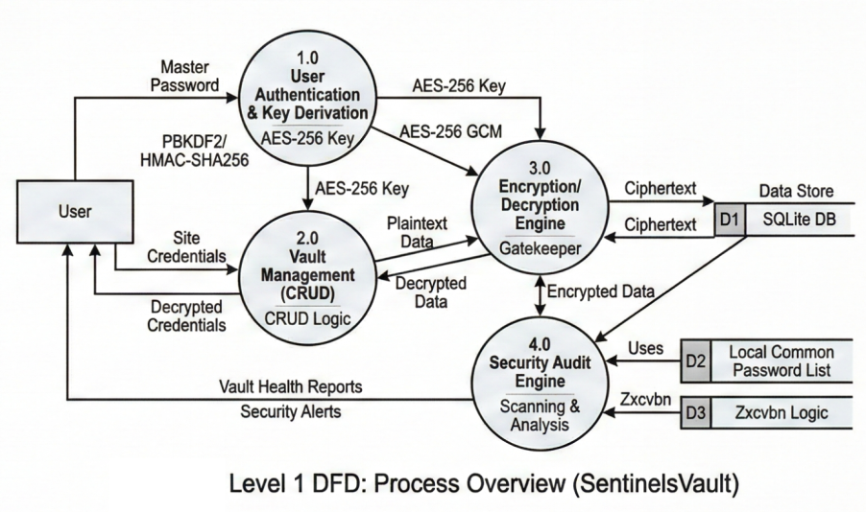
Data Flow Diagram (Level 1)
Notes:
Logical Data Flow: Illustrates the transformation of a plaintext Master Password into a high-entropy AES-256 key via PBKDF2.
Modular Decoupling: Each process (1.0 to 4.0) represents an independent Python module, ensuring a maintainable and secure codebase.
Cryptographic Gatekeeping: Process 3.0 acts as the sole "Gatekeeper" for the SQLite DB, ensuring no unencrypted data ever reaches the disk.
Heuristic Intelligence: Process 4.0 (Security Auditor) operates on decrypted data in volatile memory to generate real-time security alerts.
Data Persistence: Highlights the interaction with the SQLite Database as the primary data store.

Slide 6
Slide 6: Process Analysis
Encryption Lifecycle: Describes the transformation of a plaintext Master Password into a 256-bit AES key using PBKDF2 with a unique salt.
Modular Isolation: Each process (Auth, CRUD, Crypto) is isolated into separate Python modules to prevent memory leaks and unauthorized data access.
Storage Integrity: Process 3.0 (Storage Engine) ensures all data saved to the SQLite BLOB field is already encrypted at the "Gatekeeper" level.
Real-time Auditing: Process 4.0 performs heuristic scans on the active vault to identify weak entropy or credential reuse across different sites.

Slide 7
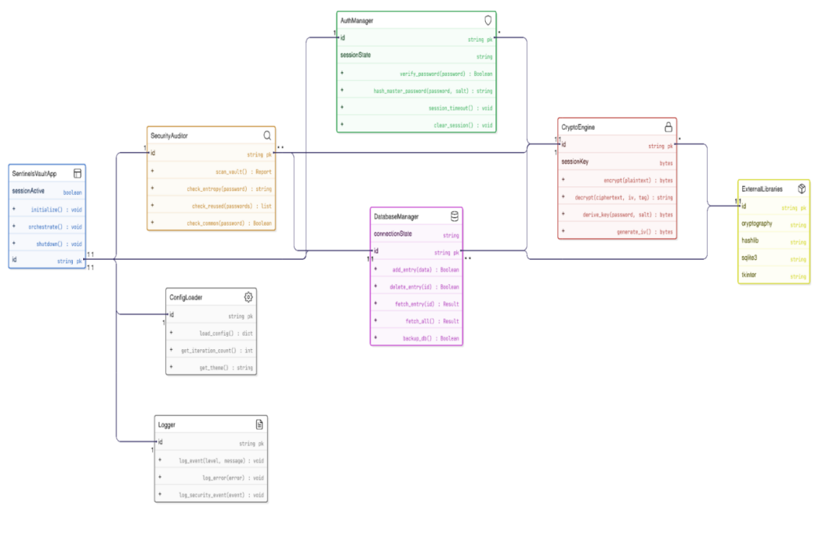
Class Diagram

Slide 8
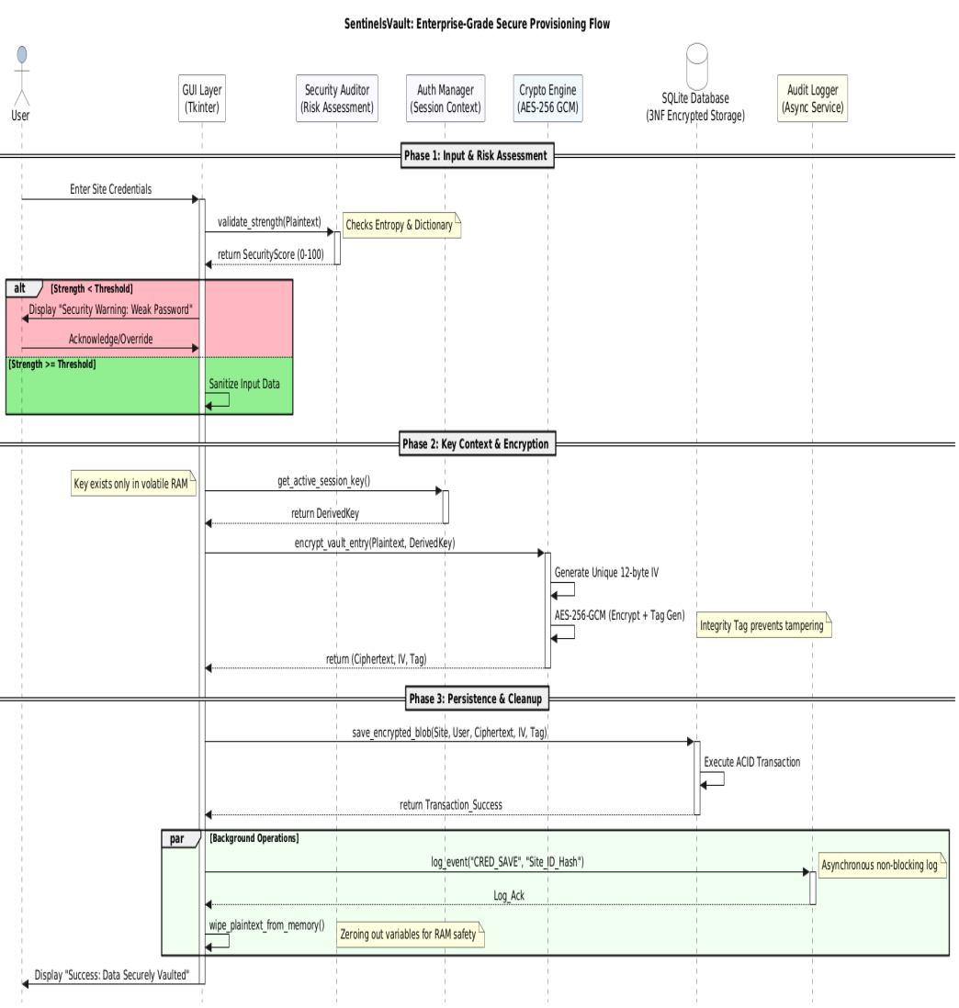
Sequence Diagram

Slide 9
Key Security Modules
1. Cryptographic Engine (AES-256 GCM)
Authenticated Encryption: Implements AES-256 in Galois/Counter Mode (GCM), which provides both data confidentiality and authenticity (integrity checking).
Key Derivation (PBKDF2): Converts the user's Master Password into a high-entropy 256-bit key using PBKDF2-HMAC-SHA256 with 600,000+ iterations.
Salt & Nonce Management: * Uses a unique 16-byte Cryptographic Salt for every user to prevent Rainbow Table attacks.
Utilizes a unique Initialization Vector (IV/Nonce) for every password entry to ensure the same password never produces the same ciphertext twice.
2. Security Auditor (Heuristic Logic)
Entropy Calculation: Analyzes password strength based on character variety, length, and unpredictability (calculating bits of entropy).
Vulnerability Scanning:
Duplicate Detection: Identifies reused passwords across different accounts to mitigate "Credential Stuffing" risks.
Dictionary Attack Prevention: Cross-references entries against a local list of "10,000 Most Common Passwords."
Local Reporting: Generates an on-demand "Vault Health Report" without sending any unencrypted data to external servers.

Slide 10
Tools & Technology
Programming & Logic
Python 3.x: Selected for its robust standard library and extensive support for high-level cryptographic implementations.
Object-Oriented Programming (OOP): Used to build a modular architecture, ensuring clean separation between the UI, Logic, and Database layers.
Security & Cryptography
cryptography Library: Utilized for industry-standard AES-256 GCM implementation. It provides the "Hazmat" (Hazardous Materials) layer for low-level primitive control and high-level symmetric encryption.
hashlib: Implements PBKDF2-HMAC-SHA256 for secure password "stretching" and hashing.
secrets: Python's dedicated module for generating cryptographically strong random numbers for Salts and Initialization Vectors (IVs).
Data Persistence & UI
SQLite3: An ACID-compliant, serverless relational database used for Local-First storage. Chosen for its zero-configuration requirement and file-based portability.
Tkinter / CustomTkinter: Employed to develop a professional, cross-platform Desktop GUI that provides a seamless user experience while maintaining a low system resource footprint.

Slide 11
Conclusion & Future Scope
Conclusion
Secured Data Ownership: SentinelsVault successfully implements a Zero-Knowledge architecture, ensuring that only the user has access to their sensitive credentials.
Modular Engineering: By strictly following a modular design, the project achieves high maintainability and clearly separates core cryptographic logic from the user interface.
Proactive Defense: Unlike traditional managers, the Security Auditor shifts the application from a passive storage tool to an active security intelligence system.
Performance: Optimized for local-first use, achieving decryption and search results in under 100ms while maintaining a minimal system footprint.
Future Scope
Cross-Platform Cloud Sync: Implementing End-to-End Encrypted (E2EE) synchronization via a personal Dropbox or Google Drive API for multi-device access.
Biometric Integration: Adding support for Windows Hello or Fingerprint scanning as an additional layer for Multi-Factor Authentication.
Browser Extensions: Developing a companion extension to allow Auto-fill capabilities for web-based logins without compromising the local vault's security.
Dark Web Monitoring: Integrating an API (like Have I Been Pwned) to alert users if their email/credentials appear in global data breaches.

Slide 12
References
International Security Standards
NIST Special Publication 800-63B: Digital Identity Guidelines – Authentication and Lifecycle Management. (Focus on PBKDF2 and salt entropy standards).
FIPS PUB 197: Advanced Encryption Standard (AES) – Official Federal Information Processing Standards Publication.
OWASP Top 10: Current security guidelines for credential management and broken access control prevention.
Technical Documentation & Frameworks
Python Cryptography Authority (PyCa): Official documentation for the cryptography library (AES-GCM implementation).
SQLite Documentation: "Atomic Commit in SQLite" – Reference for ACID compliance and data integrity.
Python Software Foundation: hashlib and secrets module specifications for cryptographically strong random number generation.
Literature & Research
A. J. Menezes, P. C. van Oorschot, and S. A. Vanstone: Handbook of Applied Cryptography, CRC Press (Reference for symmetric key management).
S. Burnett and S. Paine: RSA Security's Official Guide to Cryptography, McGraw-Hill.

