Slide 1
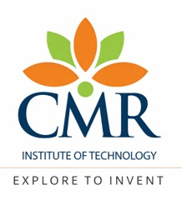
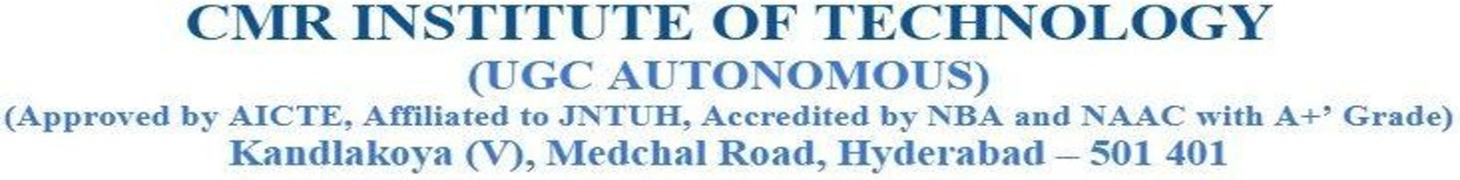
Canon: An AI-Assisted Reconciliation Engine for CRM-Data Warehouse Hierarchy Synchronization
Department of CSE(AI and ML)
Team 17: 1. Vallabh Dasari (23R01A66R0)
2. Parinita Malisetty (23R01A66X2)
3. S Keerti Madhavi (23R01A66Y2)
Under the Guidance of:
Mrs. Saritha
(Asst. Professor)
CSE (AI&ML)
CMRIT, Hyderabad.

Slide 2
OUTLINES:
Abstract
Problem statement
Introduction
Literature Review

Slide 3
ABSTRACT
Canon is an AI-assisted reconciliation engine that detects and resolves inconsistencies between CRM platforms such as Salesforce/HubSpot and data warehouses like Databricks/Snowflake. It converts records into a common schema, intelligently matches them, identifies and classifies field-level conflicts, and applies deterministic rules before using an LLM for unresolved cases. Resolutions are validated against source data, while ambiguous conflicts are escalated for human review. An append-only audit trail records every decision, making data reconciliation automated, reliable, explainable, and measurable.

Slide 4
Problem Statement
Organizations often maintain the same business data across multiple systems, such as CRM platforms and data warehouses, which are updated independently and can gradually drift apart. This results in inconsistent records, incorrect account ownership, misattributed commissions, and unreliable business analytics. Existing manual reconciliation processes are time-consuming, error-prone, and difficult to scale, while traditional rule-based approaches may struggle with complex or ambiguous conflicts. Therefore, there is a need for an automated and intelligent reconciliation system that can accurately identify matching records, detect and resolve inconsistencies, validate proposed decisions, and provide explanations and audit trails while escalating uncertain cases for human review. There is a need for an automated system that detects these cross-system conflicts, proposes a defensible, policy-grounded resolution, and records every decision for audit.

Slide 5
INTRODUCTION
Organizations increasingly rely on multiple data systems to manage critical business information. However, differences in how these systems are updated and maintained often cause records to become inconsistent over time. Changes in employees, account ownership, territories, and organizational structures can further increase this data drift. Such inconsistencies can impact reporting, forecasting, commissions, and operational decisions. As data volumes grow, traditional manual reconciliation becomes inefficient, highlighting the need for a scalable and reliable approach to maintaining consistency across enterprise systems.

Slide 6
INTRODUCTION
Four-Stage Reconciliation Pipeline:
Data Ingestion & Normalization:
Extracts CRM and warehouse records and converts them into a common canonical schema.
Entity Matching:
Uses exact matching, embeddings, and FAISS-based blocking to efficiently identify corresponding records.
Conflict Detection:
Compares matched records field-by-field and classifies conflicts by type and severity.
Intelligent Resolution and Evaluation:
Applies deterministic survivorship rules first, then uses a LangGraph-orchestrated LLM agent for unresolved conflicts.

Slide 7
LITERATURE REVIEW
S.No | Title of the Paper | Limitation of Existing Work | Research Gap | Methodology or Algorithm | Inference
1 | Deep Entity Matching with Pre-trained Language Models (Ditto) | Evaluated on flat e-commerce/product catalogs with no structural relationships. | No evaluation on hierarchical, relationally-linked enterprise data. | Fine-tuned Transformer (BERT/RoBERTa) as sequence-pair classification, with data augmentation | Pre-trained LMs beat prior entity-matching SOTA by up to 29% F1; needs domain-knowledge injection to focus attention.
2 | LinkTransformer: A Unified Package for Record Linkage with Transformer LMs | Treats linkage as a standalone task with no downstream conflict-resolution step. | Matching solved in isolation from what happens after a match is found. | Sentence-transformer embeddings fine-tuned for record linkage, packaged as a unified toolkit | Lowers the barrier to transformer-based linkage, but string-matching baselines still dominate real deployments.
3 | Trustworthy Self-Composable BDaaS: LLM-Orchestrated Multi-Agent Data Engineering | Demonstrates agent specialization and audit trails only on generic tabular ML pipelines. | No evidence these governance patterns transfer to real CRM/org-data reconciliation. | Specialized agents per data-lifecycle stage under a central LLM orchestrator with human checkpoints | Demonstrates reusable governance/audit patterns, but evaluated only on tabular ML pipelines, not CRM data.
4 | Structured Multi-Step Reasoning for Entity Matching Using LLMs | Improves interpretability but adds latency; no check that reasoning is grounded in real data. | Reasoning transparency without a factual-grounding guarantee. | Decomposes matching into intermediate evidence-generation steps rather than one-shot classification | Multi-step reasoning improves accuracy and interpretability over monolithic LLM matching, at added latency cost.
5 | A Comprehensive Survey of Hallucination Mitigation Techniques in LLMs | Mitigation techniques surveyed generically, mostly on QA/summarization tasks. | No evaluation of hallucination risk for structured database field values. | Taxonomy of RAG, prompt refinement, chain-of-verification and constrained decoding | Combining retrieval grounding with verification loops is the strongest lever against fabricated outputs.

Slide 8
Thank You

