Slide 1
DISTRIBUTED SYSTEMS REVIEW
RideX
Case Study: Uber | Prototype: a full-stack, real-time ride-hailing system
Rithikkaa S J - CH.EN.U4CCE23035
Parinitha M - CH.EN.U4CCE23028
Srikant M Y - CH.EN.U4CCE23017
MERN
Socket.IO
2
1
STACK
REAL-TIME EVENTS
ROLES: RIDER + CAPTAIN
LIVE DEMO

Slide 2




PROBLEM RECAP · PROBLEM IDENTIFIED
The Problem We Identified
Ride-hailing must match riders with nearby drivers instantly, accurately and reliably, and a centralized design cannot do this at scale.
Real-Time Matching
Unpredictable Demand
Millions of ride requests per minute must find the closest driver within seconds, not minutes.
Surge events — rain, holidays, concerts, flight delays — spike traffic 10-20x within minutes.
Global Scale
Zero Tolerance for Downtime
Thousands of cities across 70+ countries, each with distinct local rules, maps, and traffic patterns.
A single outage means lost trips, lost revenue, and eroded trust from riders and drivers alike.

Slide 3

PROBLEM RECAP · WHY DISTRIBUTED?
Why a Distributed System Is Required
A single shared database turns a local demand spike into a global outage. Here's how it happens step by step:
1
2
3
4
5
A demand spike hits
The shared DB saturates
Unrelated queries slow down
API timeouts cascade
The whole platform stalls
›
›
›
›
A concert lets out thousands of ride requests land in one city within minutes.
Billing and notification queries now compete with ride-matching for the same locked rows.
Rider and driver apps start timing out; retries pile on and add even more load to the DB.
One city's spike degrades ride matching everywhere the monolith serves a global outage from a local cause.
Dispatch, pricing, and billing all query the same PostgreSQL instance; connection pools exhaust.
The CAP Theorem, in practice. A distributed system can only fully guarantee two of three: Consistency, Availability, and Partition tolerance. Uber's redesign deliberately favours Availability + Partition tolerance for ride matching, accepting brief, eventual consistency on things like driver location, so the platform never goes fully dark.

Slide 4
PROBLEM RECAP · PROPOSED SOLUTION (REVIEW 1)
Review 1 Solution: Uber's Distributed Reference Architecture
Dispatch
Pricing
Trip
Payments
Service
Service
Service
Service
Rider / Driver
API Gateway
Mobile Apps
Routing & Auth
Kafka Event Stream
Billions of real-time events per day
Review 1 reference design;
RideX is a scaled-down version
Trip DB
Location DB
Cache
Analytics
(Schemaless)
(Cassandra)
(Redis)
Store
WHY DISTRIBUTE IT?
Each service scales independently based on demand
No single point of failure across the platform
Teams deploy and update services independently
Data is partitioned close to where users need it

Slide 5
FINAL PROPOSED ARCHITECTURE
Tiered, Event-Driven RideX Platform
Ride
Captain
Maps
Mail
Service + fare
Service
Google API
Nodemailer (OTP)
Rider / Captain
Express API
React 18 + Vite
JWT auth · REST
Socket.IO Real-Time Layer
ride-request · OTP start · payment-made · ride-ended · GPS every 10 s
Client, API and database run
as separate network nodes
Users
Captains
Rides
Hosting
(MongoDB Atlas)
(MongoDB Atlas)
(MongoDB Atlas)
(Vercel)
ARCHITECTURE HIGHLIGHTS
Clients, API and database are independent, separately deployable tiers
Stateless JWT auth lets any API instance serve any request
Socket.IO pushes live updates, with polling as a fallback
Managed MongoDB Atlas replica set keeps data durable and available

Slide 6
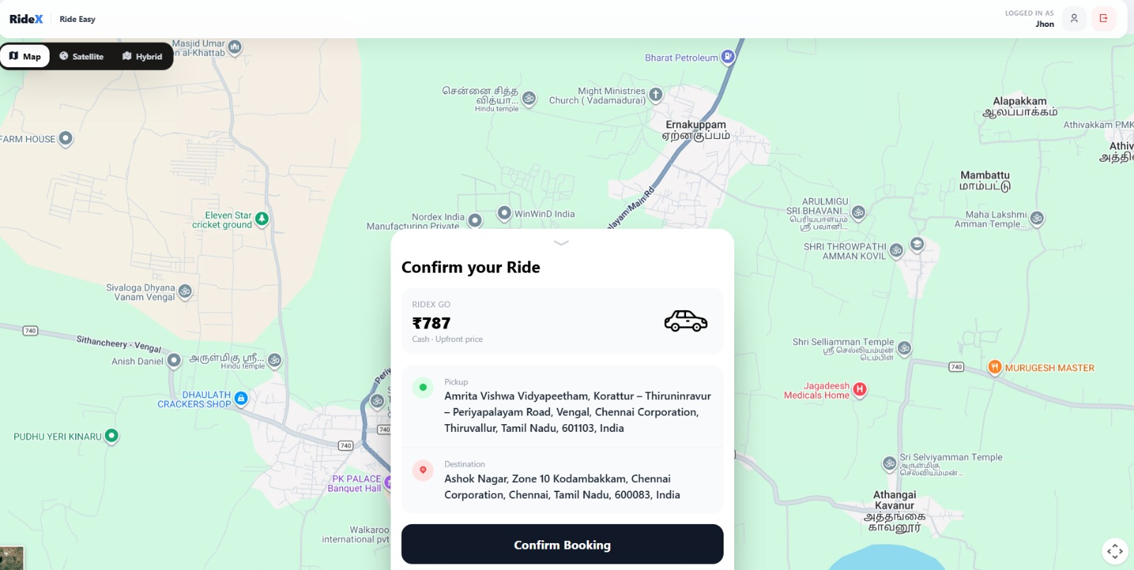



IMPLEMENTATION / PROTOTYPE
RideX Prototype
A working MERN application we built and demoed, covering rider and captain journeys end to end.
Rider booking
Live map, location autocomplete, vehicle choice and upfront fare before confirming.
Captain dashboard
Online status, live GPS, ride-request popup, accept/ignore and earnings stats.
RideX confirm-ride screen: pickup, destination and upfront fare.
Real-time ride flow
Socket.IO pushes requests, OTP start, payment and ride-end events to both apps.
3 vehicles • ₹787 Go fare • 2 min ETA
Secure access
Screenshot captured from the running RideX demo.
Role-based JWT auth for riders and captains, plus email OTP password reset.

Slide 7



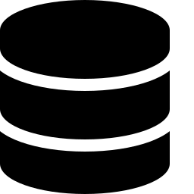


TECHNOLOGIES USED
The RideX Technology Stack
React 18 + Vite
Node.js + Express
Socket.IO
SPA for riders and captains with Tailwind CSS, GSAP and React Router.
REST API with controllers, services and auth middleware.
Real-time ride requests, OTP, payment and GPS events.
MongoDB Atlas
JWT + bcrypt
Google Maps + Nodemailer
Cloud document store (via Mongoose) for users, captains and rides.
Stateless tokens with role-based guards and hashed passwords.
Distance, autocomplete and fares; SMTP OTP emails for password reset.

Slide 8


DISTRIBUTED SYSTEMS IMPLEMENTATION
Distributed Concepts Applied in RideX
Even at prototype scale, RideX applies core distributed-systems techniques.
Client–Server Separation
Event-Driven Messaging
React clients and the Express API run as separate nodes over HTTP and WebSocket.
Socket.IO events (ride request, OTP start, payment, ride end) sync both apps in real time, with polling as fallback.
Distributed Data Layer
Stateless Auth + Remote Services
MongoDB Atlas is a managed, replicated cloud database, separate from the application server.
JWT lets any API instance verify requests; Google Maps and SMTP are consumed as remote services.

Slide 9
SYSTEM WORKFLOW
End-to-End Ride Lifecycle
Every step is coordinated across the rider app, API server, database and captain app.
1
2
3
4
5
Rider books ride
Captain is matched
OTP starts the ride
Live tracking
Pay and finish
›
›
›
›
Picks pickup, destination and vehicle; upfront fare is confirmed.
OTP goes to the rider; captain enters it to verify and start.
Captain GPS is broadcast every 10 s so the rider sees progress.
Rider confirms cash payment; captain finishes and stats update.
Request pops up on the captain app in real time; captain accepts.
Consistency vs availability. Ride state is stored in MongoDB while Socket.IO events fan out updates, so both apps converge on the same ride status within moments (eventual consistency).

Slide 10





FAULT TOLERANCE IMPLEMENTATION
How RideX Keeps Working When Parts Fail
FAULT-TOLERANCE MECHANISMS
Resilience by Design
Prototype level
Socket Auto-Reconnect
Polling Fallback
Clients retry indefinitely (1 s delay); captains re-register their socket on reconnect.
If sockets fail (e.g. serverless hosting), apps poll every 3 s for rides and active-ride status.
Failures stay contained to one tier.
Ride state lives in MongoDB, so a refresh, window switch or server restart does not lose an active ride.
Ride State Recovery
Location Heartbeat
Active ride, status and OTP reload from the database after a refresh.
GPS is saved every 10 s, so a missed update is corrected by the next.

Slide 11

PERFORMANCE TESTING
Load Test: Concurrent Fare Requests
GET /rides/get-fare (auth + Google Maps lookup) fired with 1, 10, 25 and 50 simultaneous requests.
LOAD
SUCCESS
LATENCY (AVG / P95)
1 request
1 / 1
2,740 ms / 2,740 ms
10 concurrent
10 / 10
3,685 ms / 4,475 ms
25 concurrent
25 / 25
3,877 ms / 4,644 ms
50 concurrent
50 / 50
4,052 ms / 4,595 ms
Setup. Local backend (Node 20). 50x more load raised average latency only ~1.5x with zero failures; each request includes an external Google Maps call.

Slide 12
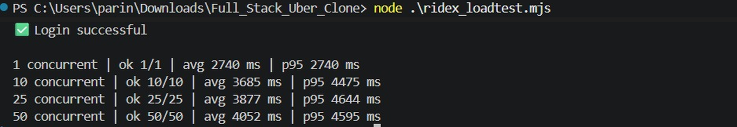
PERFORMANCE TESTING · TEST OUTPUT
Load Test Output: GET /rides/get-fare
Output of ridex_loadtest.mjs run against the local backend: 1, 10, 25 and 50 concurrent requests, all successful (ok = successful responses). Latencies are in milliseconds.

Slide 13
RESULT & ANALYSIS
What the Distributed Design Gives Us
DESIGN COMPARISON · BASELINE → RIDEX
Live updates
FROM THE LOAD TEST
Constant polling
Socket.IO push, polling fallback
50
concurrent requests, 0 failures
Ride state
2.7 s
Held in one server
Stored in MongoDB Atlas
avg latency, single request
4.1 s
Refresh or restart
Active ride lost
Ride recovered from database
avg latency at 50 concurrent
~1.5x
latency rise for 50x the load
Captain location
Manual refresh
Auto GPS every 10 s
Analysis: latency stays nearly flat as load grows, so the API tier scales well. Time is likely dominated by the external Maps call, so caching fares is the next step.

Slide 14
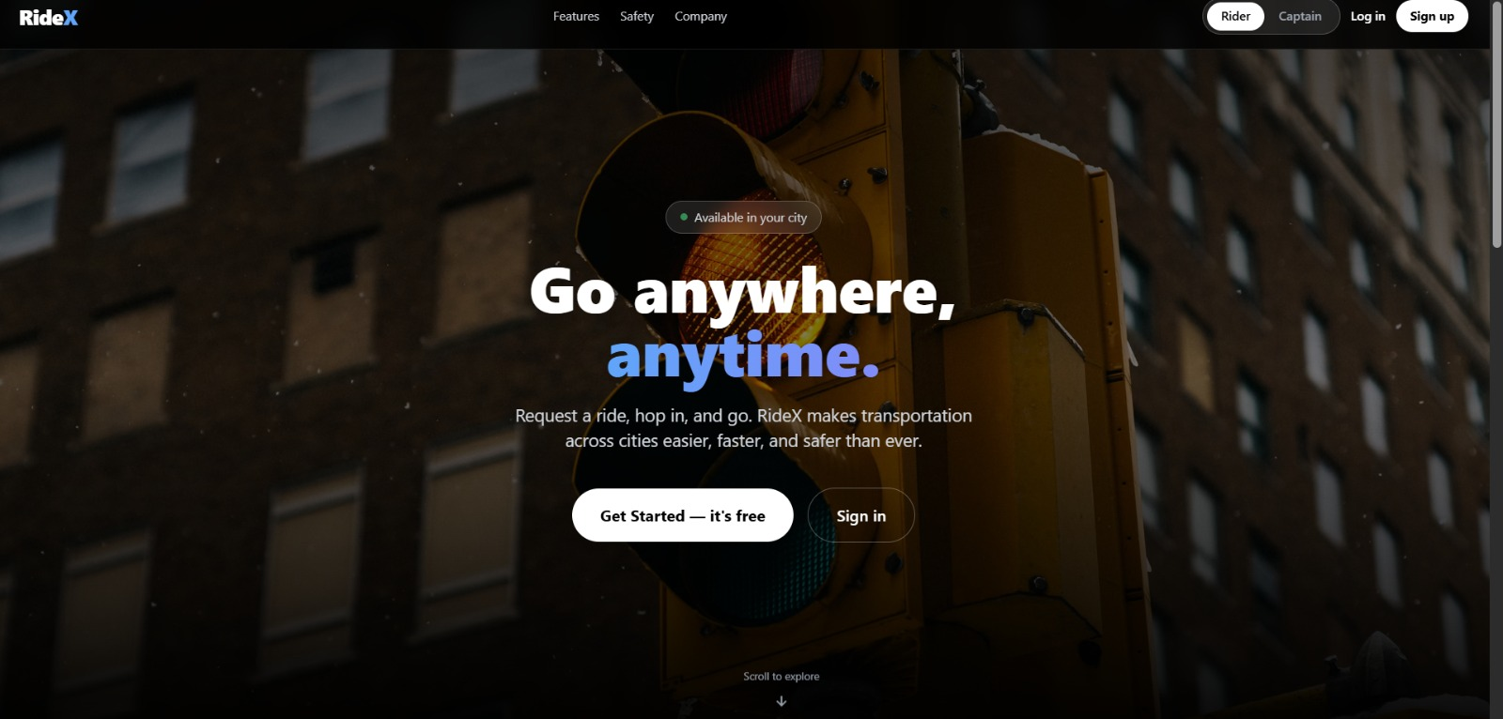
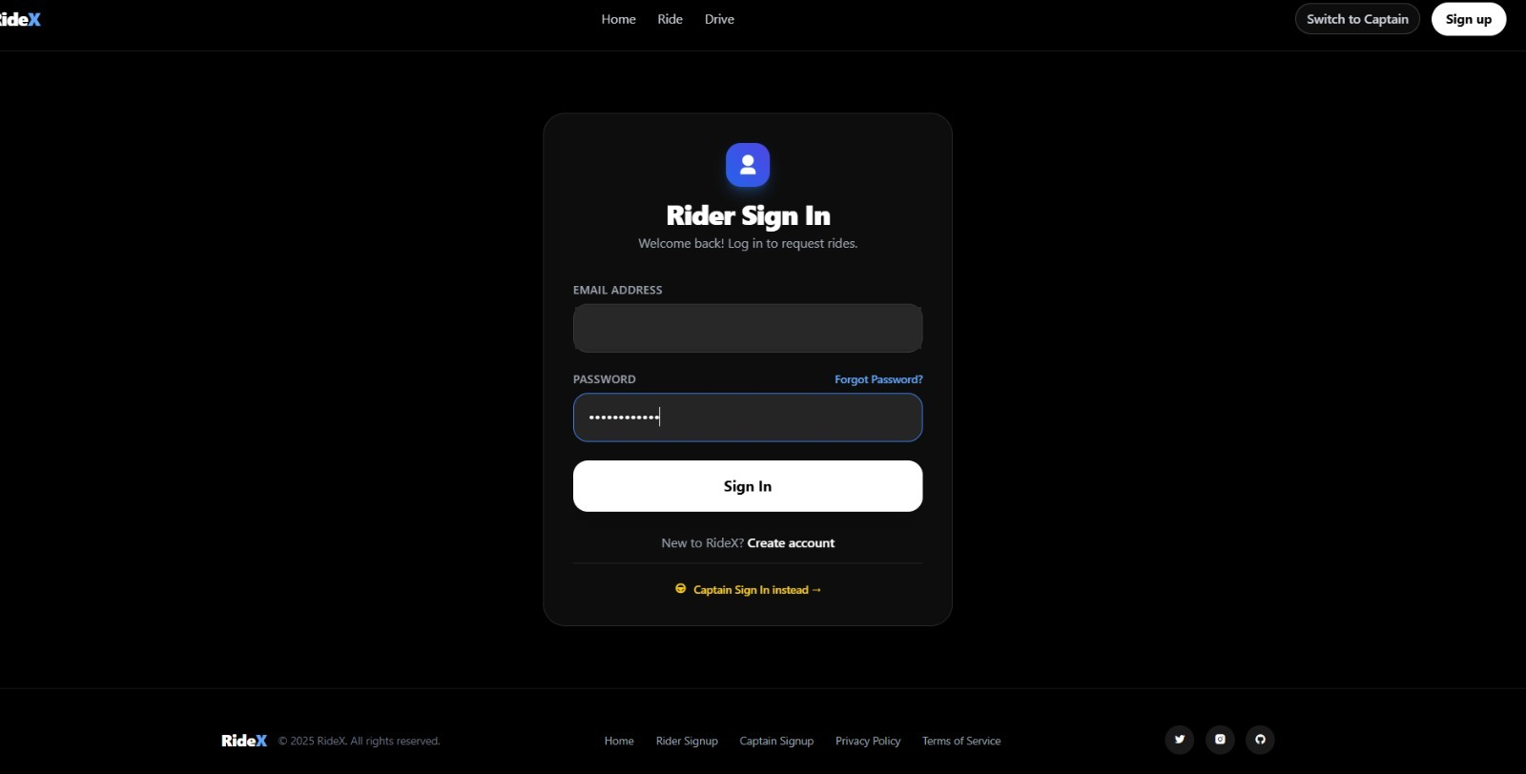
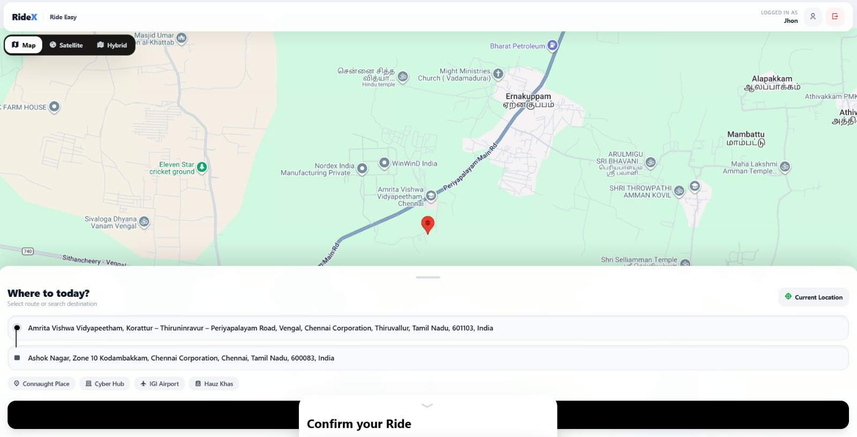
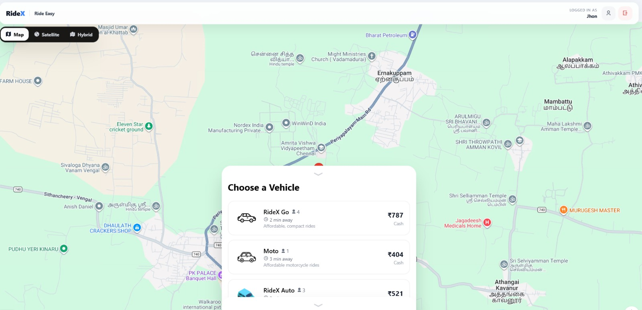
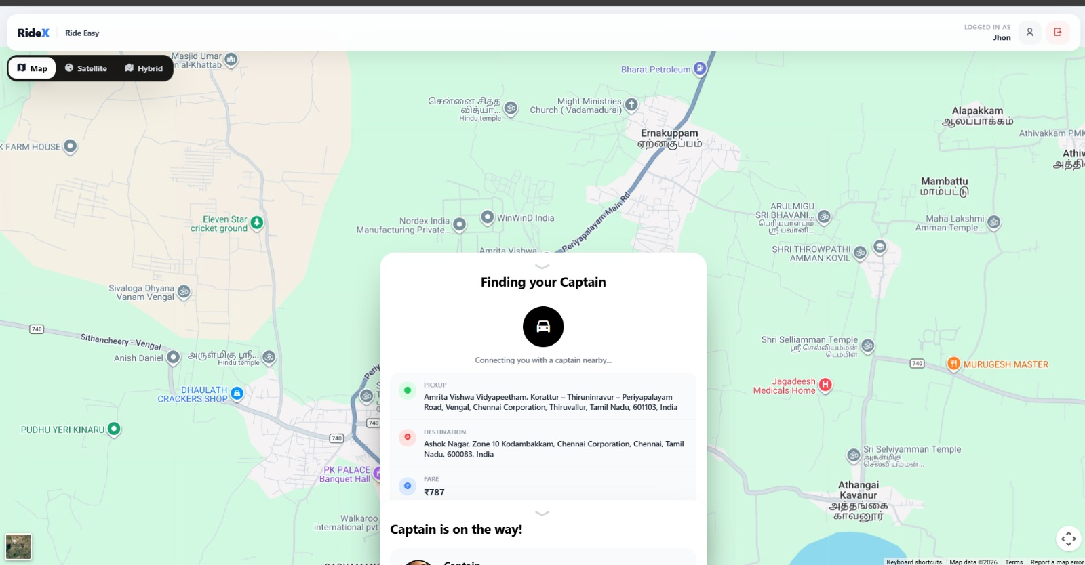
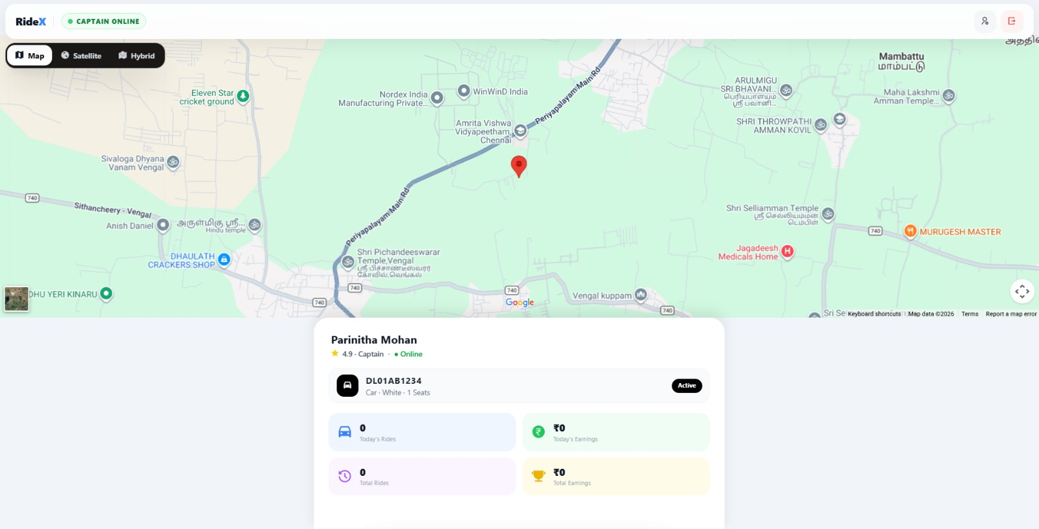
DEMO & SCREENSHOTS
RideX Live Demo
Landing page
Rider sign-in
Pickup and destination on map
Vehicle and fare choice
Finding a captain
Captain dashboard

Slide 15


CHALLENGES & SOLUTIONS
Challenges We Faced and How We Solved Them
Sockets on serverless hosting
Vercel functions cannot hold persistent connections, so we added 3 s polling fallbacks for rider and captain.
Database connections on cold starts
Added a connection-reuse guard so each serverless call reuses the open MongoDB connection.
Deployment-only model error
A case-sensitive file name (blackListToken) broke on Vercel's Linux build; renamed it.
Ride state lost on refresh
Active ride, status and OTP are recovered from the database after refresh or window switch.
Too many map API calls
Debounced location suggestions to cut Google Maps requests while typing.
Takeaway: Deploying the prototype showed that real-time systems must tolerate unreliable connections and restarts.

Slide 16
CONCLUSION
Conclusion
We moved from the Uber case study to a working RideX prototype that applies distributed-systems principles.
Problem addressed
Principles applied
Real-time matching of riders and captains through independent tiers.
Client-server separation, event-driven sockets and a replicated cloud database.
Trade-offs understood
Future work
Availability and eventual consistency were favoured for live ride updates.
Fare and route caching, geospatial indexing, horizontal scaling and tests with real devices.

