Slide 1

Flora Leaf & Canopy
ESM FLORA PLATFORM
User Guide · OR billing, itemize templates, dictation and chart data quality
leaf-1.2.8 · canopy-1.2.9 · October 2026
Notes:
New Leaf and Canopy features for the operating room. Screens are from demo data (synthetic patient D-HL7-001).

Slide 2





What's new
OR billing checklist
Itemize templates
Billing on Canopy
Leaf → Billing: tick items, quantities, Fill from chart, Submit, Print
Workflow Studio: standing-order item lists shared by workflows
Orders from every Leaf, item totals, item master with prices
Dictation
Invalid device data
Undo
Offline speech-to-text; AI fills form fields for review
Mask artifacts; excluded from graph and reports
Revert your last chart change with ↶ or Ctrl/⌘+Z
Notes:
Master data (billing items, templates) lives in Canopy and syncs to Leaf, so the checklist works offline. Orders sync back to Canopy with the case.

Slide 3
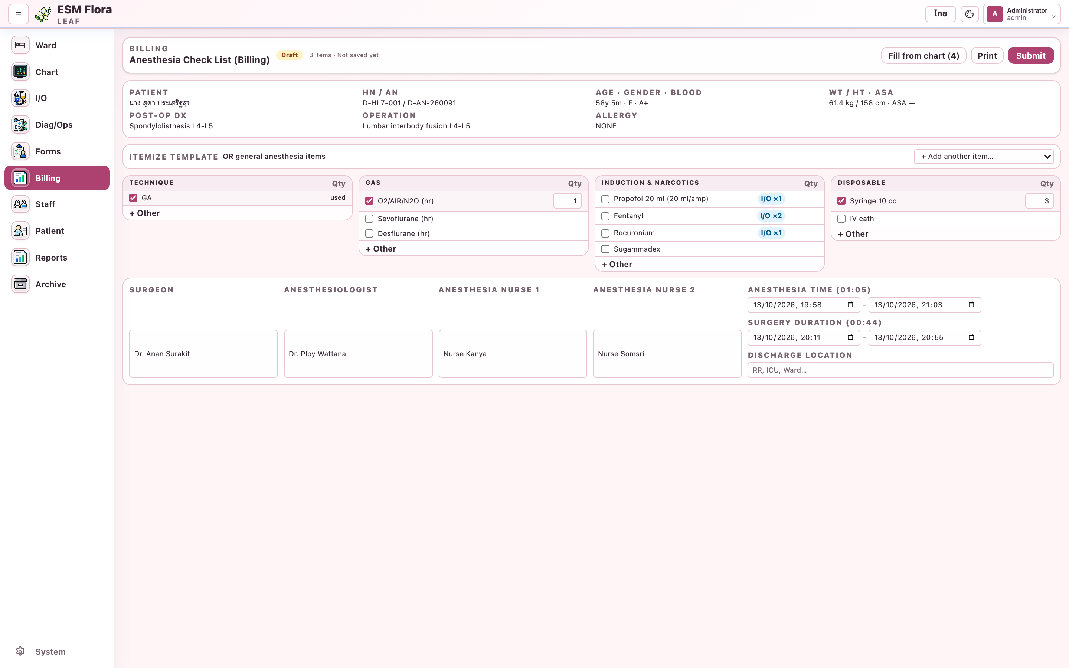
Billing checklist
1
Open the case, then Billing in the left menu
2
Tap a name to tick it; tap again for +1
3
Tap the box to untick; type in Qty to set
4
Blue I/O ×n: charted in I/O; tap to add
5
+ Other adds a free-text line
Notes:
Preselected items from the itemize template are already ticked. Changes save automatically about a second after the last edit.

Slide 4
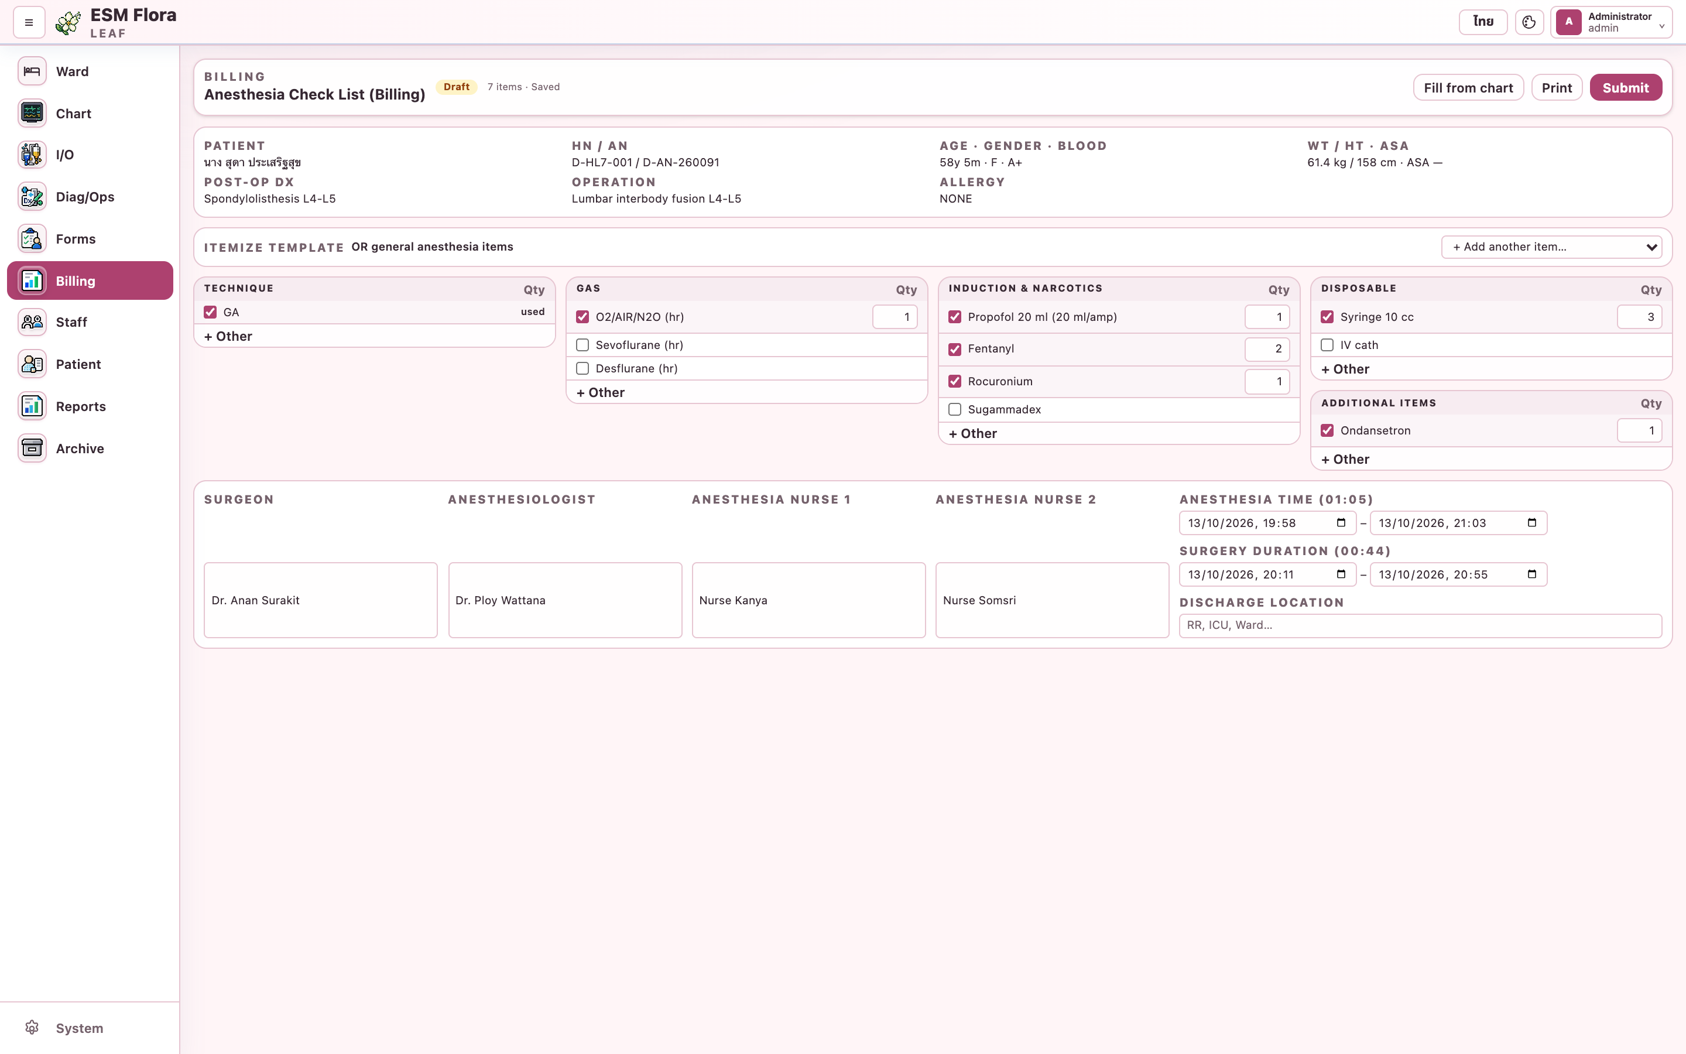
Fill from chart
1
Anesthesia and surgery times from events
2
Surgeon, anesthesiologist, nurses from Staff
3
Technique from Forms → Case & Plan
4
Drugs charted in I/O (items outside the template go to Additional items)
Notes:
Fill from chart never removes what was entered; it only adds what the chart knows.

Slide 5
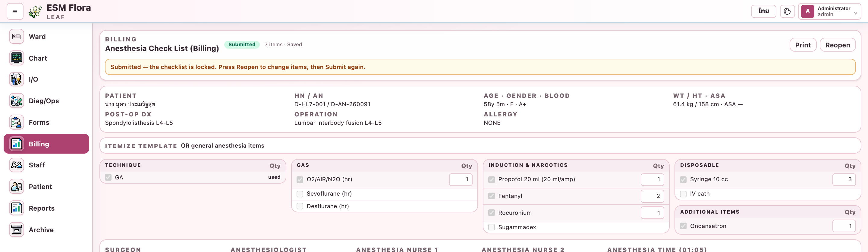
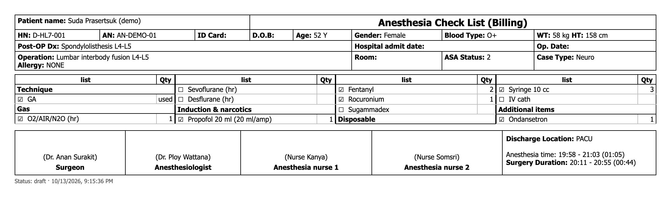
Submit, reopen and print
Workflow
Submit locks the checklist for billing
Reopen to change, then Submit again
Print gives the A4 paper layout
Notes:
Submitted checklists show as submitted on Canopy. Tapping an item on a locked checklist highlights the banner.

Slide 6
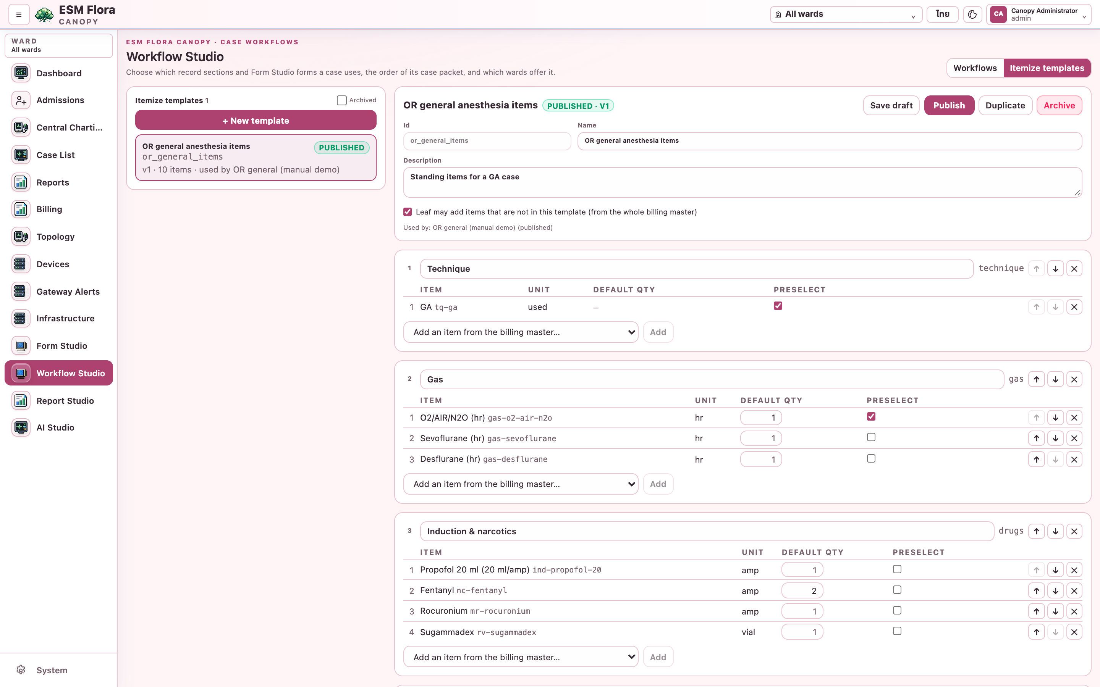
Itemize templates
1
Workflow Studio → Itemize templates
2
Add groups, or copy a master group
3
Add items; order with ↑ ↓
4
Default qty and Preselect per item
5
Save draft → Publish (validated)
Notes:
One template can be shared by many workflows. Editing a published template makes it a draft; Leafs keep the published copy until it is published again.

Slide 7
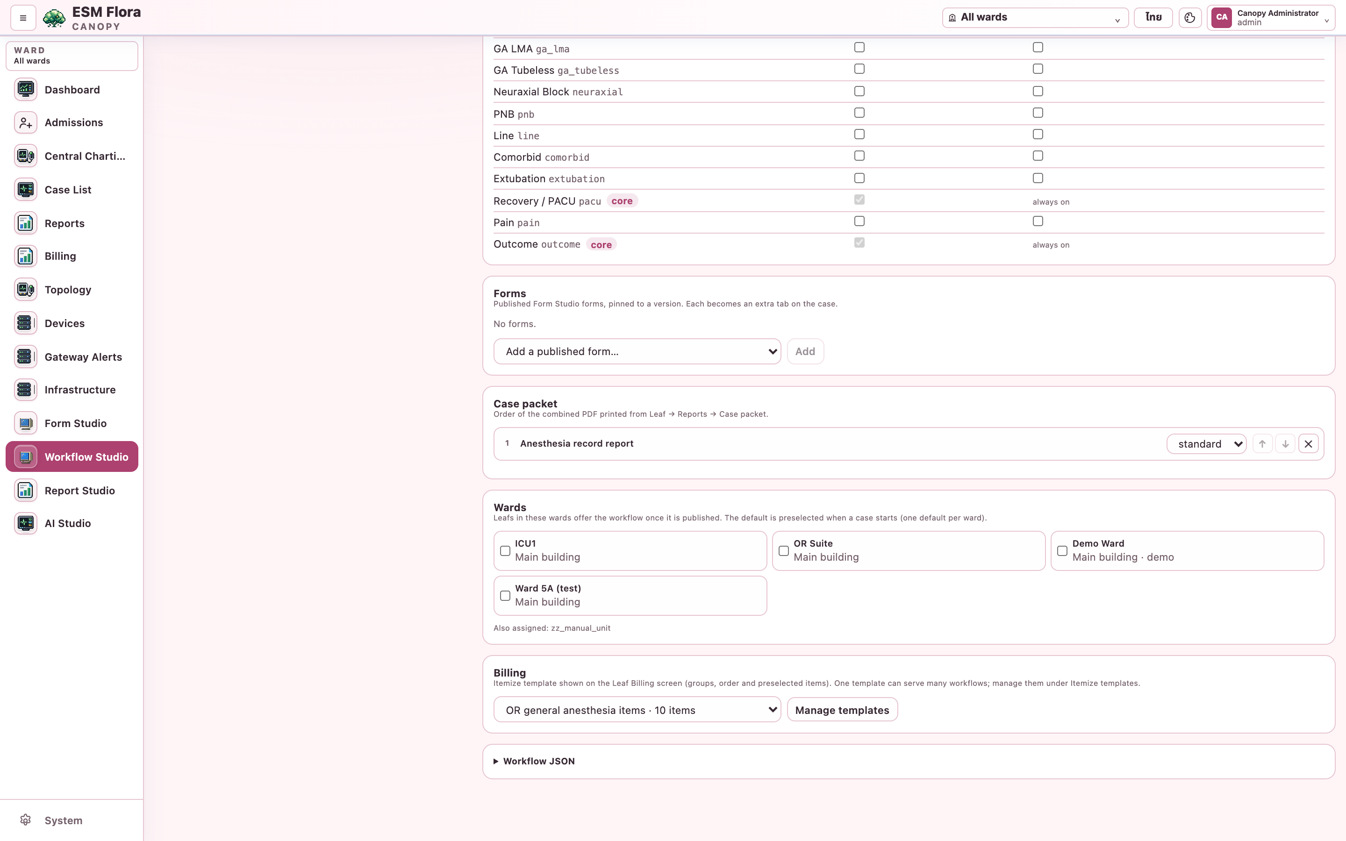
Link a template to workflows
1
Open a workflow → Billing
2
Pick the itemize template
3
Publish the workflow (its template must be published)
4
Leafs in its wards get it at the next sync
Notes:
A case uses the template of its workflow; a case without a workflow uses the ward's default workflow; with no template the whole master is shown.

Slide 8
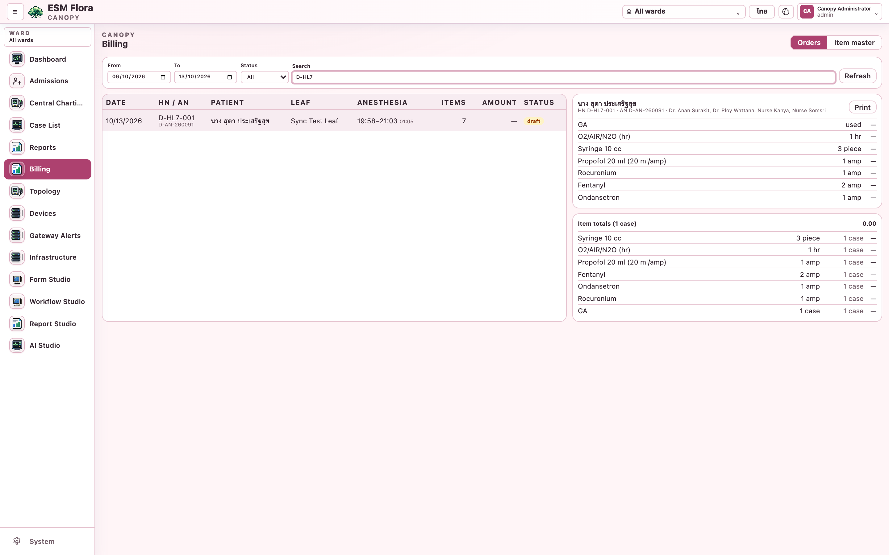
Billing orders on Canopy
1
Canopy → Billing → Orders
2
Filter by date, status, HN / AN / name
3
Select a row for its lines; Print
4
Item totals over the filtered cases
Notes:
Orders arrive with each case's sync from the Leaf.

Slide 9
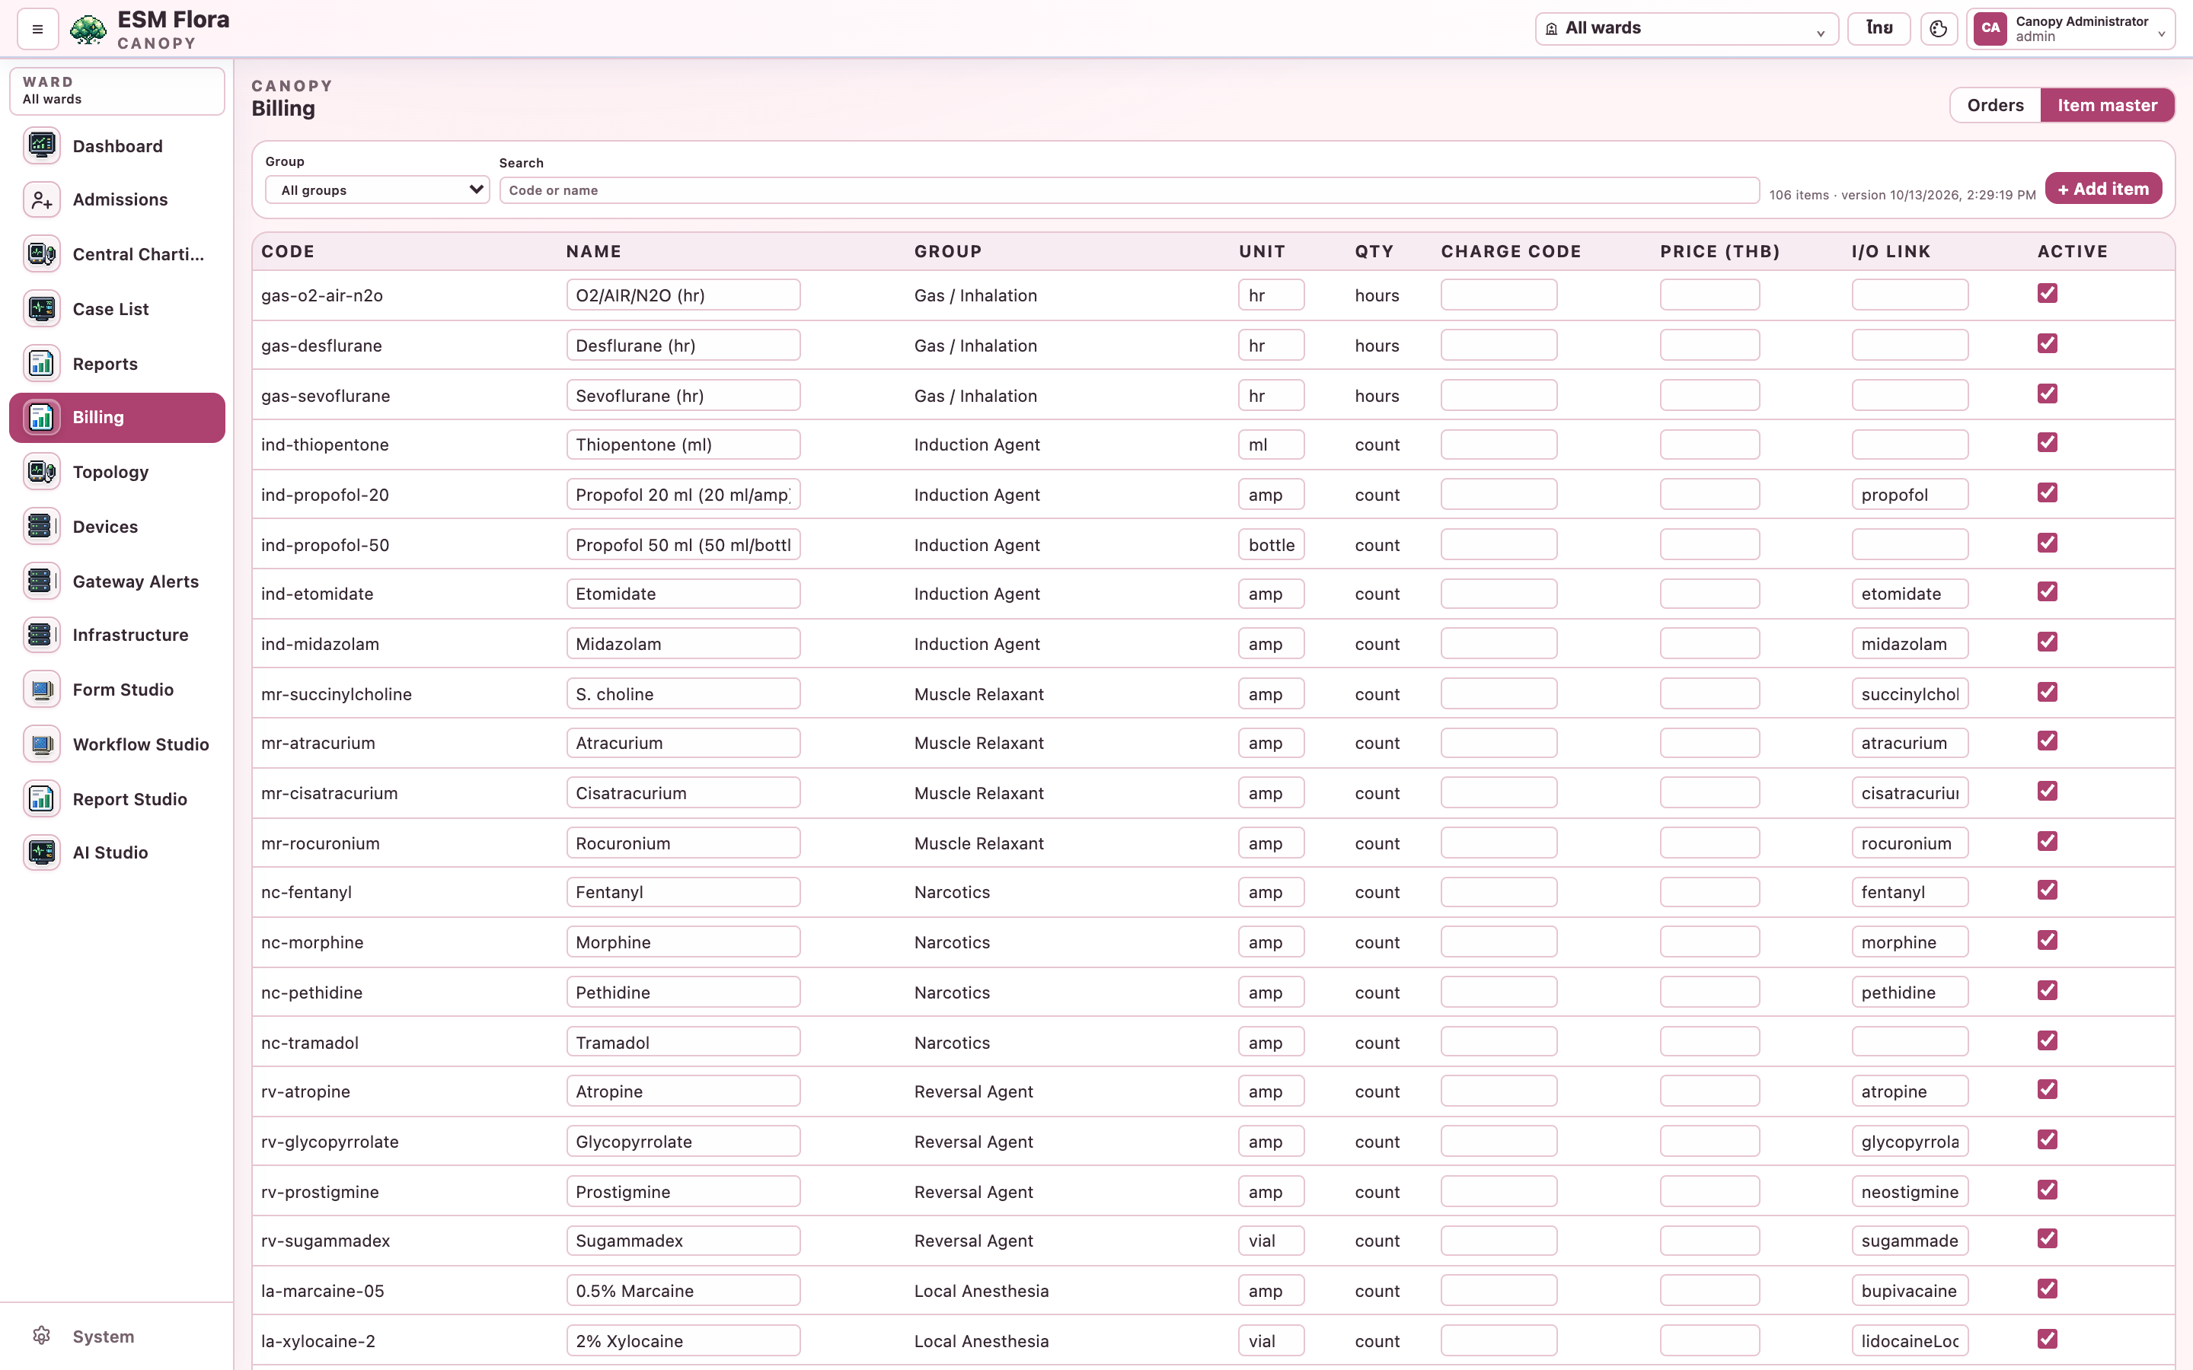
Item master
1
Canopy → Billing → Item master
2
Set charge code and price per item
3
I/O link enables I/O hints on the Leaf
4
Untick Active to hide an item
Notes:
Needs billing.manage. Leafs receive changes at their next sync.

Slide 10
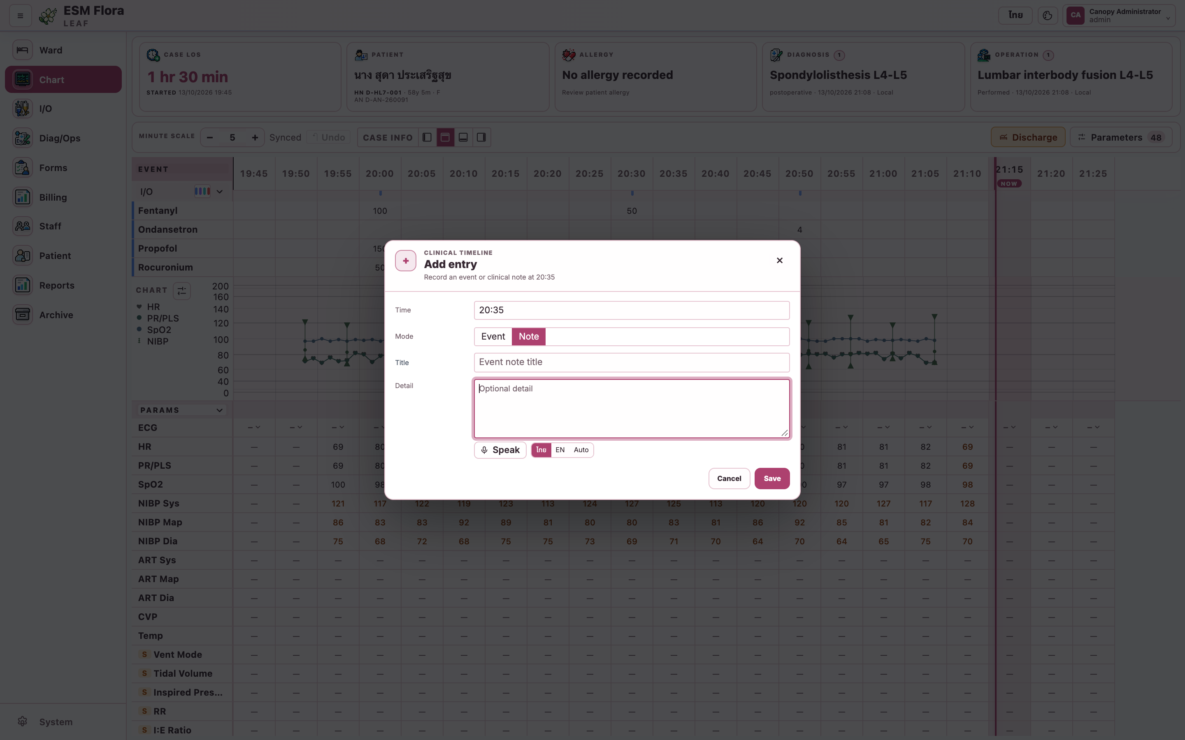
Dictation: event notes
1
Chart → Add entry → Note
2
Choose ไทย / EN / Auto, press Speak
3
Text appears live; final text after each pause
4
Stop, check, Save
Notes:
Speech-to-text runs on the Leaf; no audio leaves the workstation and no internet is needed.

Slide 11
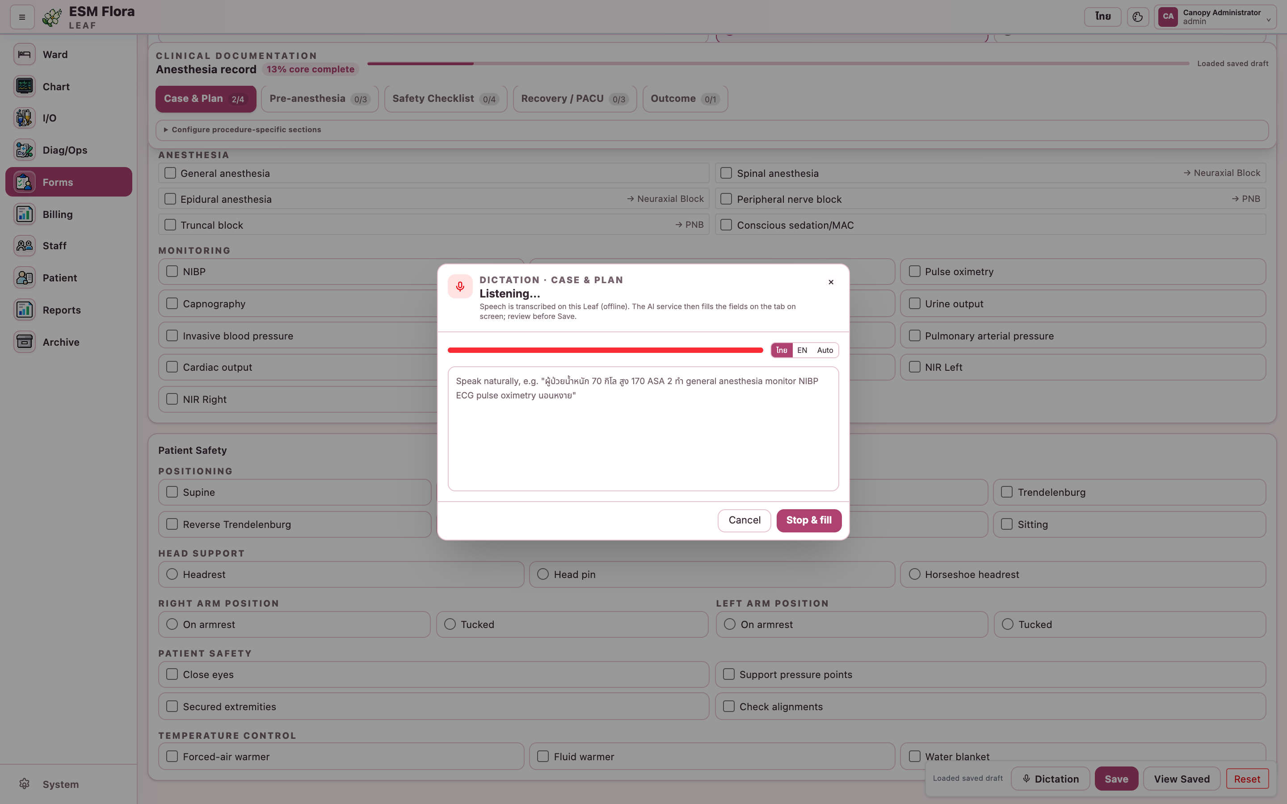
Dictation: fill a form
1
Forms → Dictation (next to Save)
2
Speak the findings
3
Stop & fill: AI proposes field values
4
Review, Fill, then Save as usual
Notes:
Needs the AI service configured in Canopy. Facts that fit no field are listed separately.

Slide 12
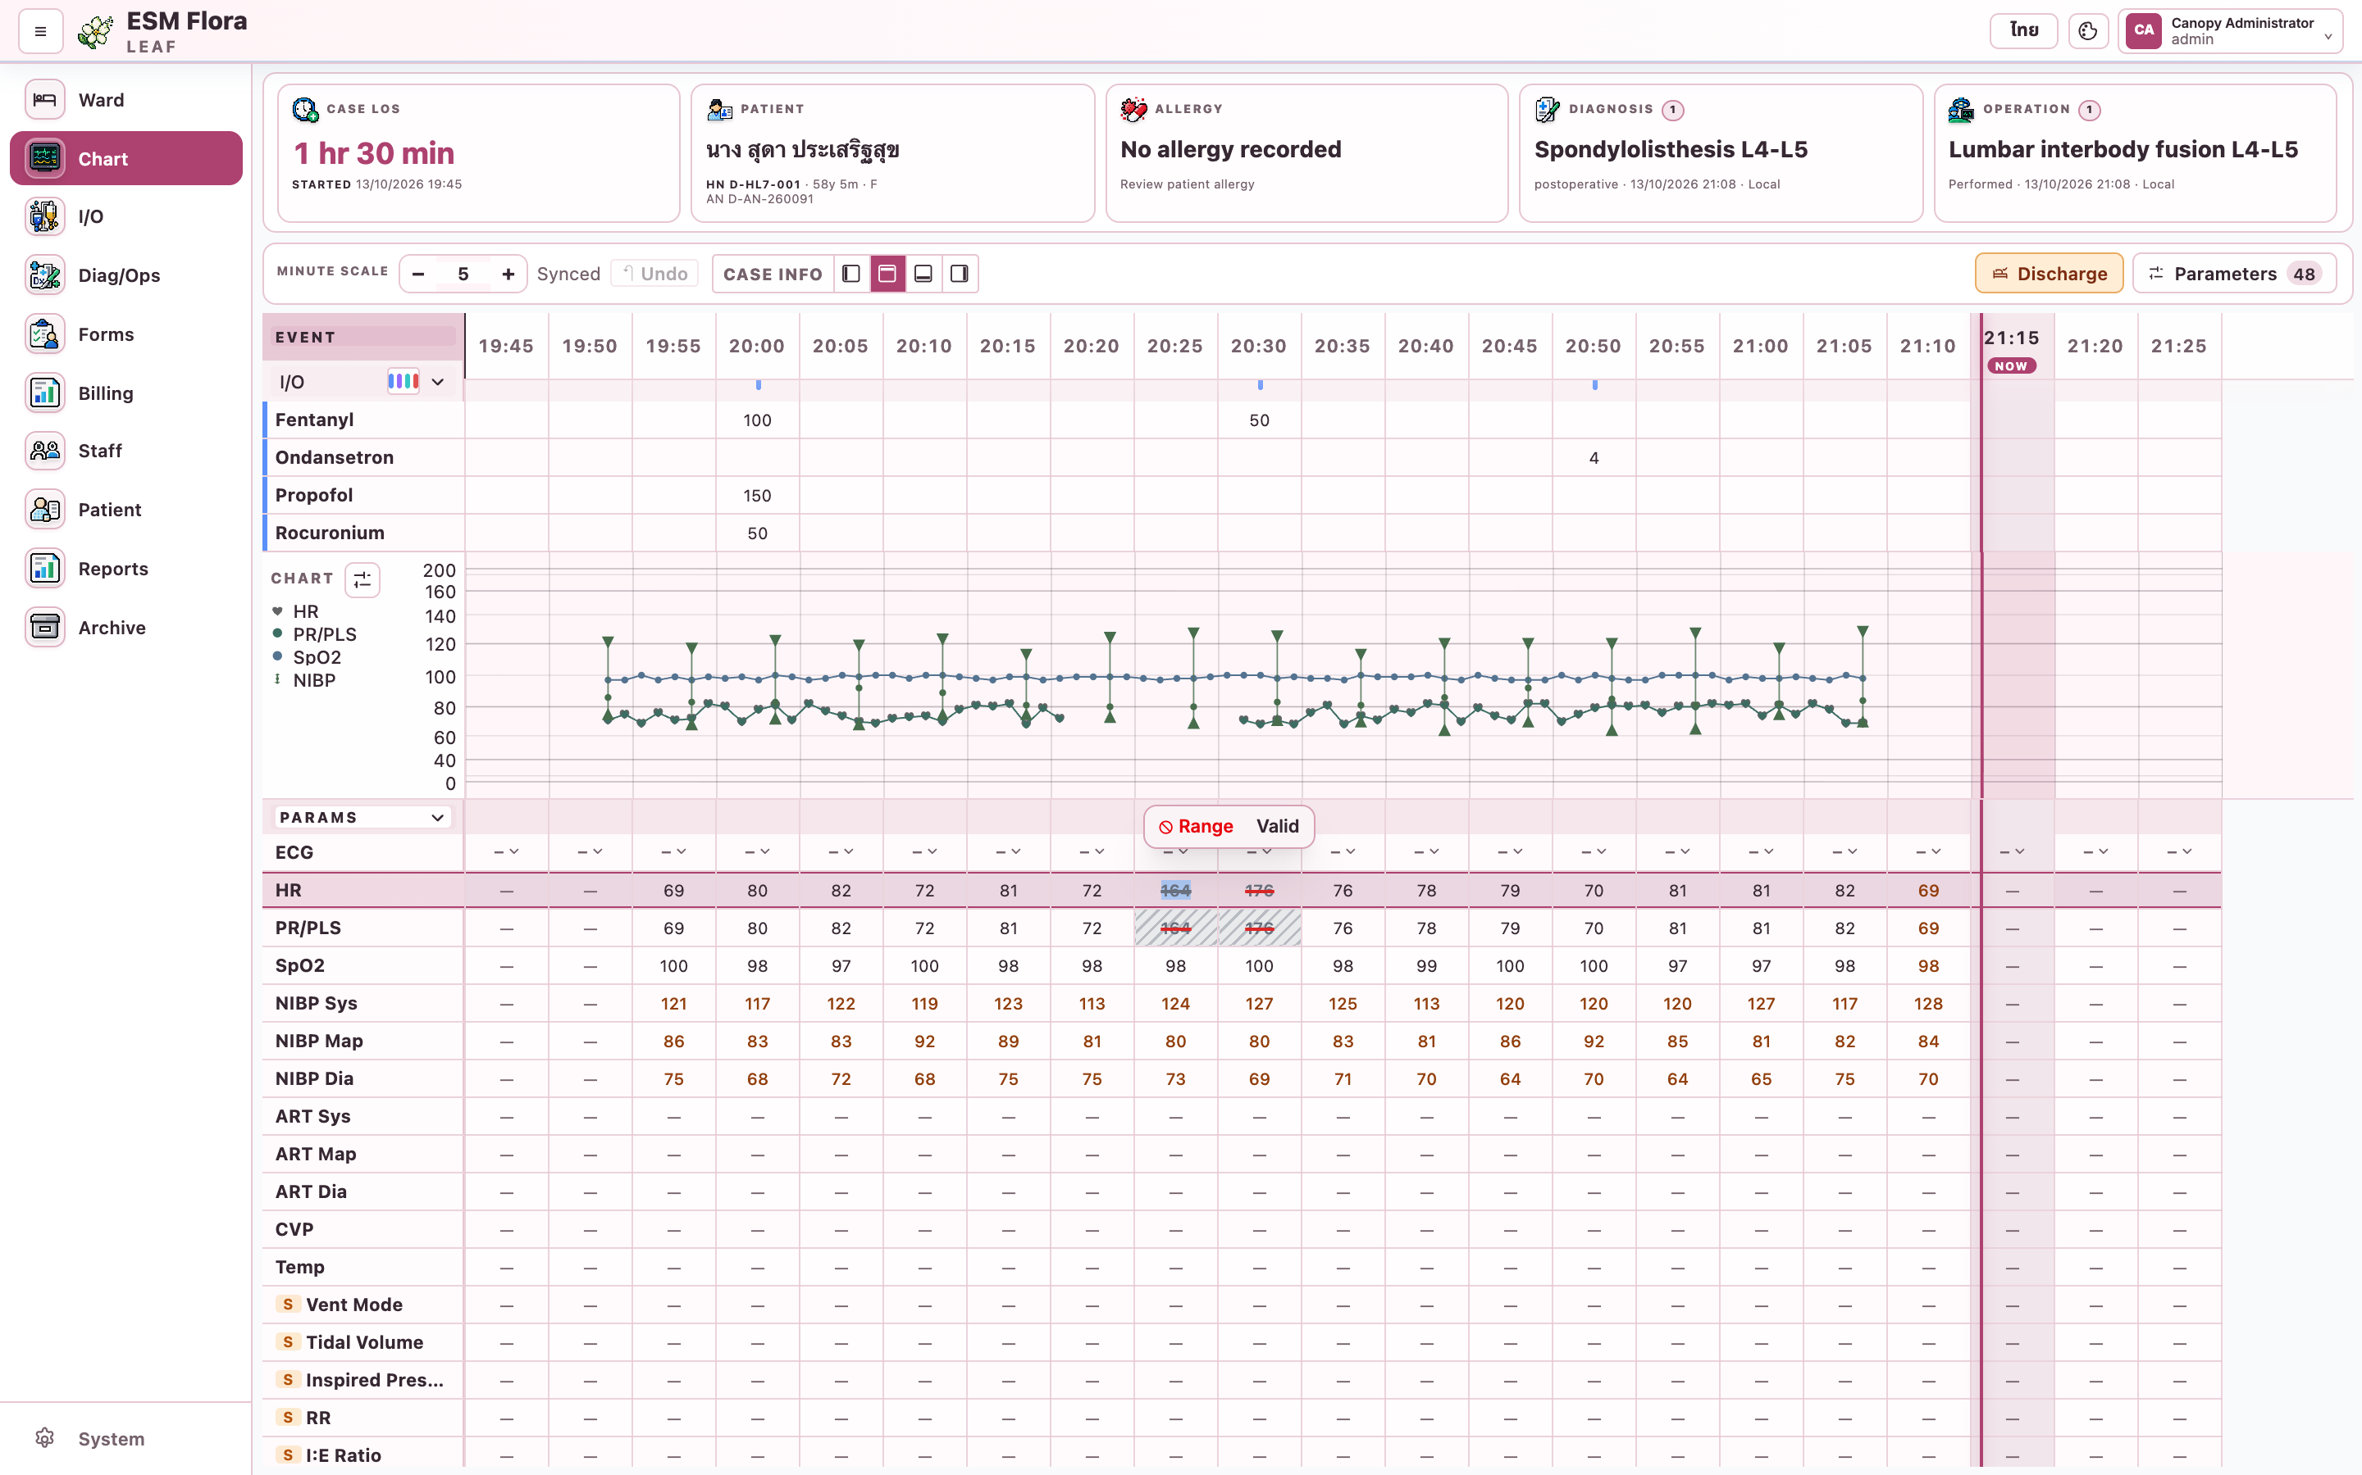
Invalid device data and undo
1
Select a value → ⊘ Invalid
2
⊘ Range, then another cell: mask a range
3
Valid restores; graph and reports skip masked values
4
↶ Undo or Ctrl/⌘+Z reverts your last chart change
Notes:
Clinician-entered values are never masked. Undo refuses when the same entry was changed again afterwards.

Slide 13
Troubleshooting
Symptom | What to do
Billing shows “not found” | Leaf on an older release; it updates after the case closes
Items cannot be ticked | Checklist submitted: Reopen, change, Submit
Whole master instead of template | Pick and publish the template in the workflow
No I/O badges | Set the I/O link in Canopy item master
Amount shows — | Enter prices in the item master
Speech service not running | Restart the Leaf services (leaf-stt)
Microphone denied | Allow the microphone for Flora
Spike still in graph after masking | Mask the other channel (e.g. PR) too
Notes:
The Word guide has the full table.

Slide 14

Further reading
Flora-Leaf-Canopy-User-Guide.docx · docs/BILLING.md · docs/STUDY-CPOE-SNOMED.md · Flora Gateway User Manual
Notes:
The Word guide includes the data reference and the full troubleshooting table.

