Slide 1
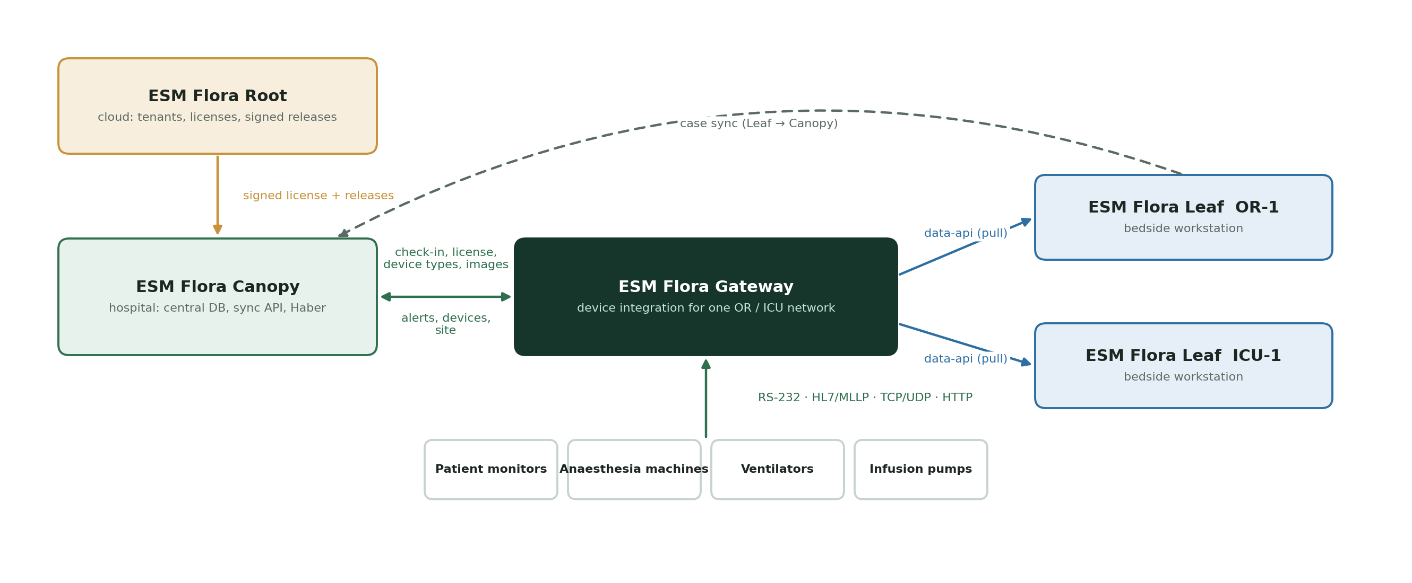
ESM Flora Gateway
User and Operations Guide
Version 1.0 · October 2026 · release gateway-0.2.4
Connects bedside medical devices to ESM Flora Leaf workstations, with licensing and updates controlled by Canopy and Root.
Notes:
This deck summarises the ESM Flora Gateway user and operations manual. The Word manual contains every field, table and procedure in full.

Slide 2






What this guide covers
01
Overview
What the gateway does and where it fits
02
Architecture
Layers, data flow and technology stack
03
Using the station admin
Overview, Devices, Streams, Alerts, System
04
Procedures
Register devices, check data, troubleshoot
05
Data structures
18 tables, relational diagrams, Kafka, data-api
06
Updates and licensing
Haber check-in, releases, license rules

Slide 3




What ESM Flora Gateway does
Connects any device
RS-232, HL7 v2 / MLLP, TCP / UDP, HTTP polling and HTTP push
One parser per device
Isolated container decodes each protocol into ESM Flora observations
Stores everything
Observations, original measurements and logs in PostgreSQL
Serves each Leaf
data-api returns only the devices assigned to that workstation
Watches itself
7-day status history and alerts forwarded to Canopy
Centrally governed
Device types, parser images, license and updates from Canopy and Root

Slide 4
Where the gateway fits in ESM Flora
Root (cloud)
Signs releases and the hospital license, including device types and device count.
Canopy / Haber (hospital)
Gateway checks in every 20–30 s: devices, site and alerts out; types, images and license in.
Leaf (bedside)
Pulls its own devices' observations from the gateway data-api.

Slide 5
Architecture and technology
Layers, data flow, stack, ports and security

Slide 6
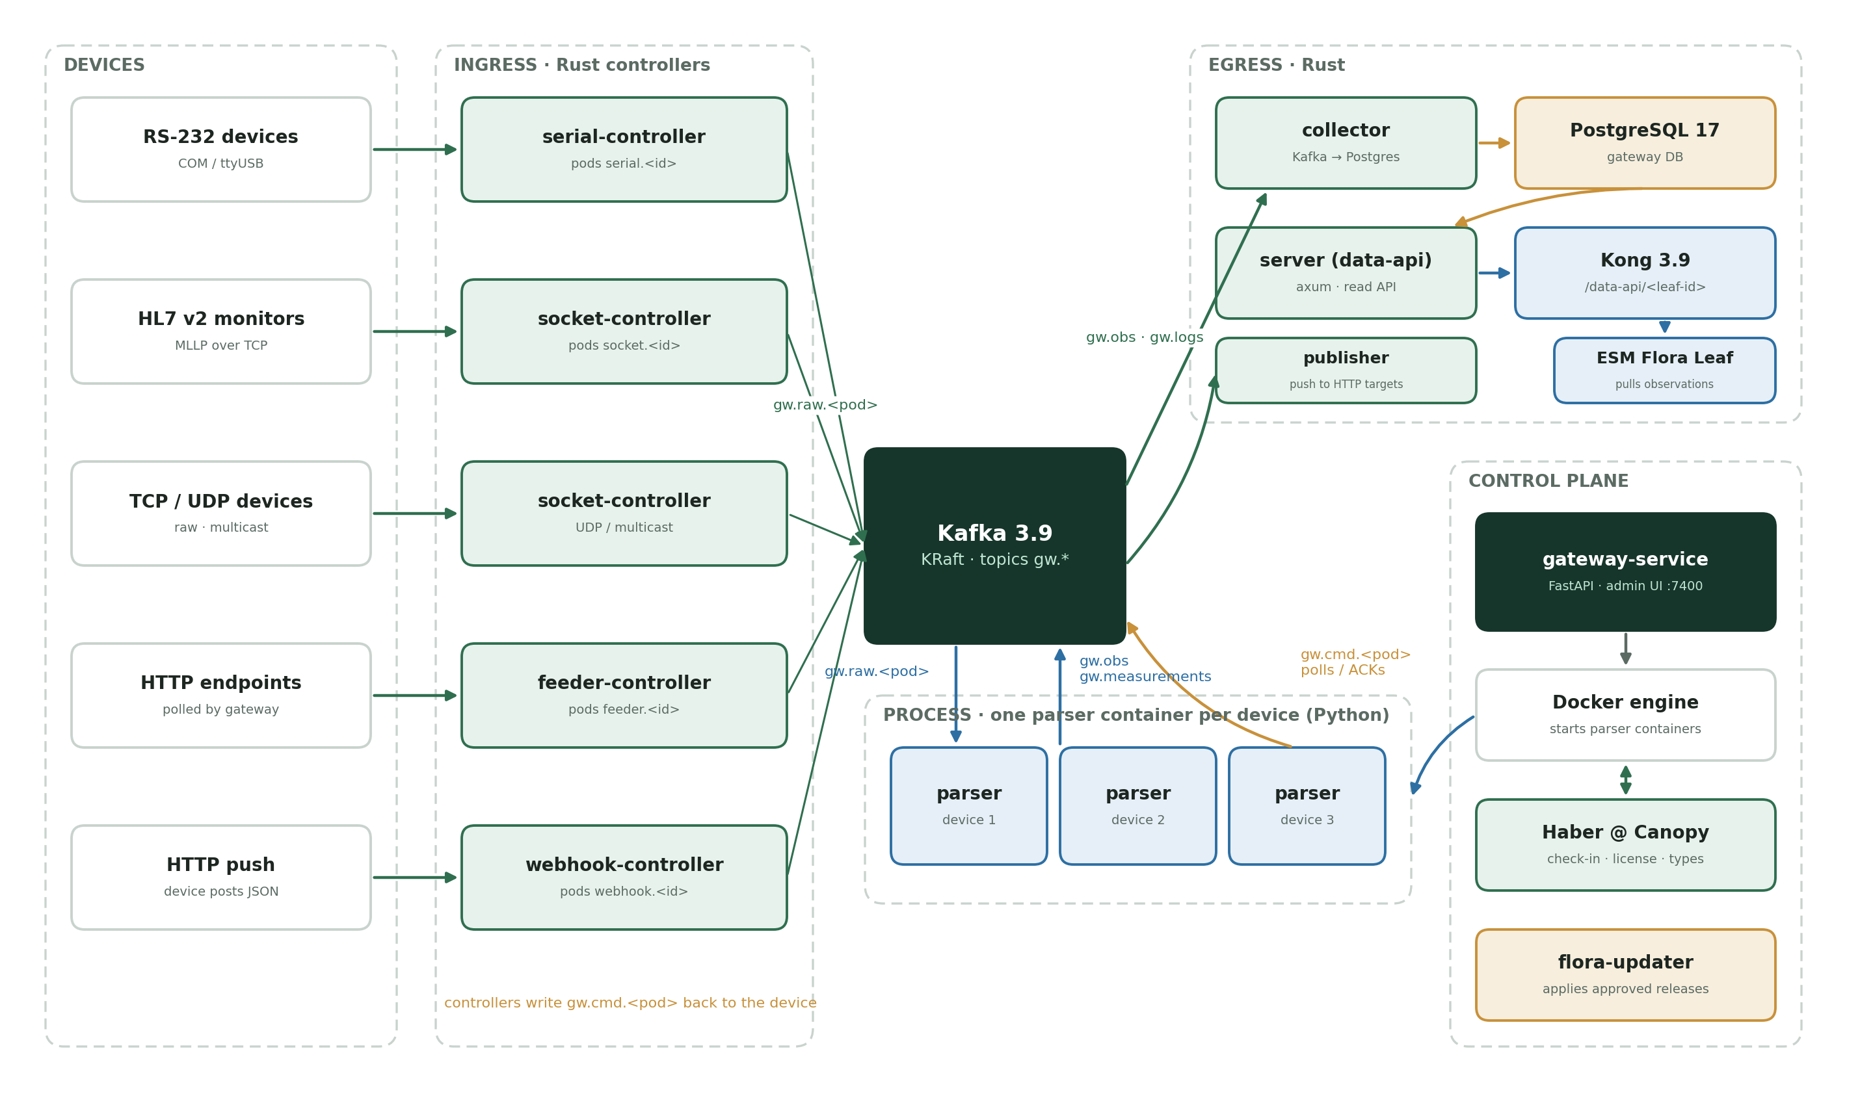
Five layers, one Docker Compose project
Ingress — Rust controllers own every port and connection (pods)
Broker — Kafka 3.9 decouples devices from parsers
Process — one Python parser container per enabled device
Egress — collector, server (data-api), Kong, publisher
Control — gateway-service, Docker, flora-updater, TLS edge

Slide 7
How a measurement travels
1
2
3
4
5
6
7
Device
sends a frame to its port
Controller
RawFrame → gw.raw.<pod>
Parser
decodes; polls on gw.cmd.<pod>
Kafka
gw.obs · gw.measurements
Collector
batch insert to PostgreSQL
data-api
Kong /data-api/<leaf-id>
Leaf
charts the vitals
Pods name every connection
serial.COM1, socket.or-monitor, feeder.icu-ventilator, webhook.or-anesthesia. Each device points at one pod; its parser reads gw.raw.<pod> and writes gw.cmd.<pod>.
Nothing is lost
The collector commits Kafka offsets only after the database write; telemetry is stored even for devices not yet registered.

Slide 8





Technology stack
Rust (edition 2021)
Apache Kafka 3.9.1
PostgreSQL 17.6
Controllers, collector, server, publisher · tokio 1.53, rdkafka 0.37, axum 0.8, tokio-serial 5.5
Single-node KRaft broker · topics gw.raw, gw.cmd, gw.obs, gw.measurements, gw.logs
Registry, telemetry, logs, status history and alerts · 18 tables
Kong 3.9 (DB-less)
Python 3.13 · FastAPI 0.118
Docker · nginx 1.27
data-api with one route per Leaf; adds leaf_id
Station admin, parser runtime (aiokafka 0.12), Canopy check-in
Every service and parser in containers; TLS edge on 443; flora-updater

Slide 9
Ports and security
Port | Service | Bound to
443 (dev 7443) | HTTPS edge: station admin + /data-api/ | all interfaces
7400 | Station admin (HTTP) | 127.0.0.1
7410 | Kong data-api | 127.0.0.1
7412 · 7414 | PostgreSQL · Kafka | 127.0.0.1
7421 / 7422 | HL7 MLLP monitors (OR / ICU) | all interfaces
7423 | Webhook (HTTP push) | all interfaces
9500 | Dräger Vista CMS link | all interfaces
Sign-in — local accounts, scrypt hashes, HttpOnly session cookie (12 h)
Roles — operator (devices, controllers) and admin (types, users, Canopy)
Transport — TLS 1.2 / 1.3 at the edge; hospital CA trusted via certs/trust.env
Canopy — bearer tokens for check-in and updater; Root Ed25519 signatures on releases
Host — Docker socket is root-equivalent: restrict OS access

Slide 10
Using the station admin
https://<gateway-host>/ · local: http://localhost:7400

Slide 11
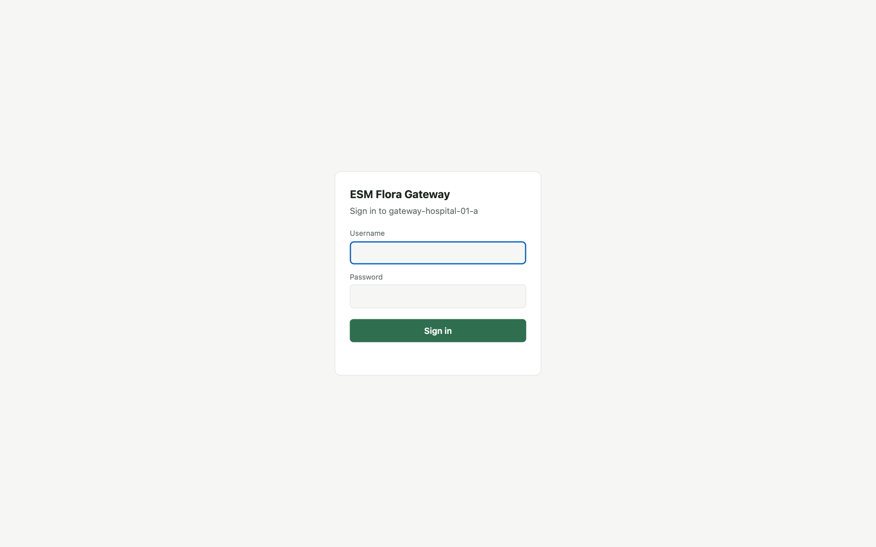
Sign in and roles
Capability | Operator | Admin
Overview, Devices, Streams, Alerts | Yes | Yes
Add / edit / enable / remove devices | Yes | Yes
Start / stop / restart controllers | Yes | Yes
Acknowledge alerts, Sync now | Yes | Yes
Device types, manufacturers | View | Edit
Users | Own password | Manage
Canopy connection, location | — | Yes
Change the default password
A new gateway creates admin / admin only when no user exists. Change it at once under System → Users → My password.

Slide 12
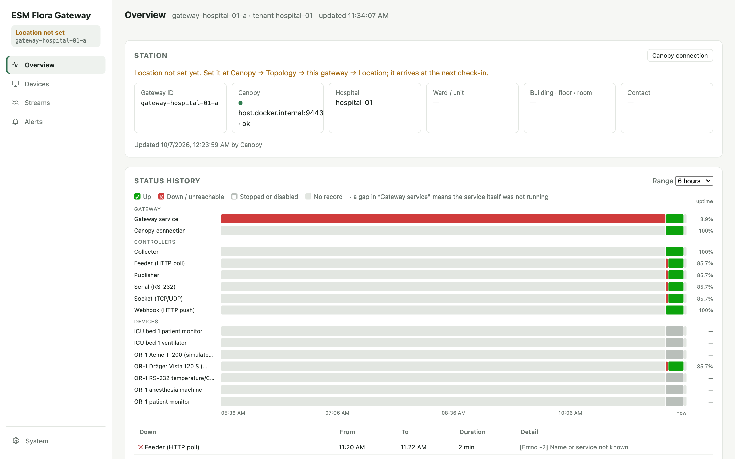
Overview: is everything working?
Station — gateway ID, Canopy link, hospital, ward, room
Status history — one lane per service, controller and device; 1, 6 or 24 h
Green up · red down · grey stopped · hatched no record
Down — a device after 120 s without data

Slide 13
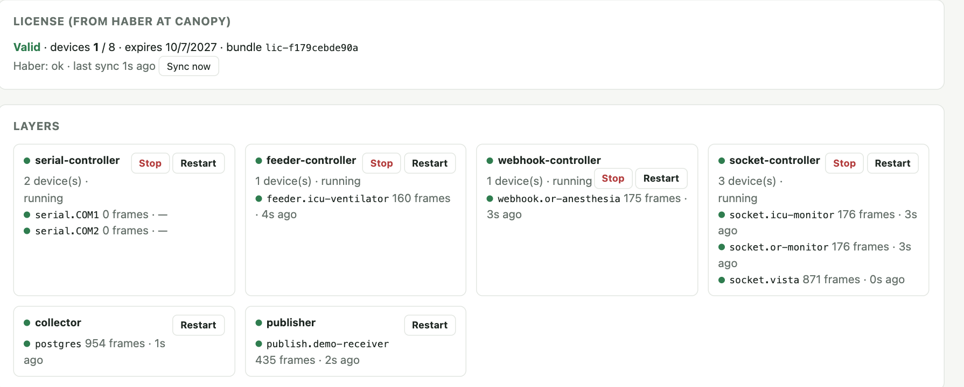
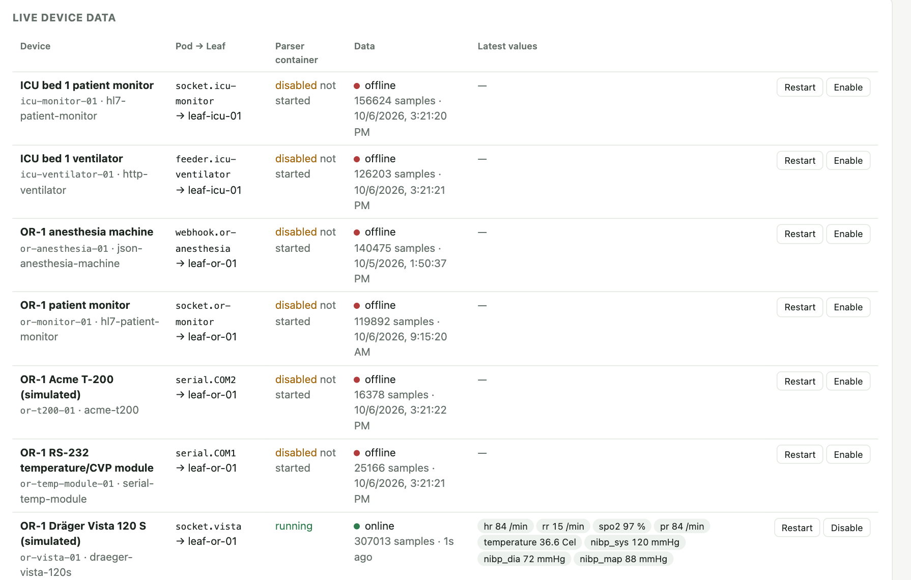
License, layers and live device data
License — Valid / Not valid, devices used / allowed; invalid stops every parser
Layers — one card per controller; pod dot, frames, last error; Stop / Start / Restart
Live device data — data status, latest values, Restart, Enable / Disable
Logs — latest 40 entries from every component

Slide 14
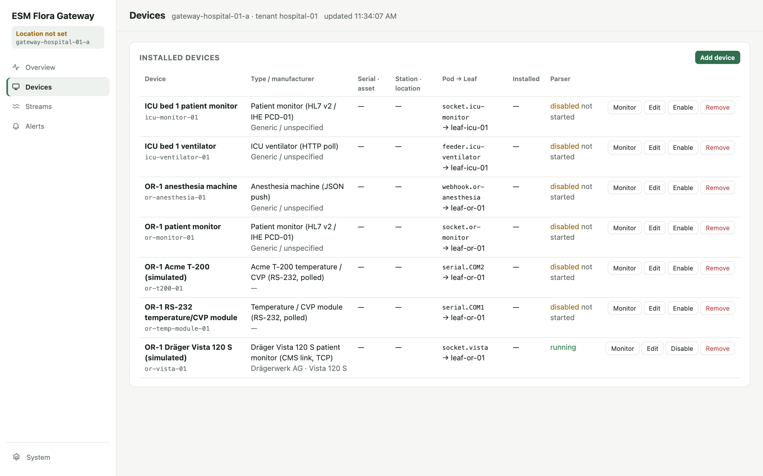
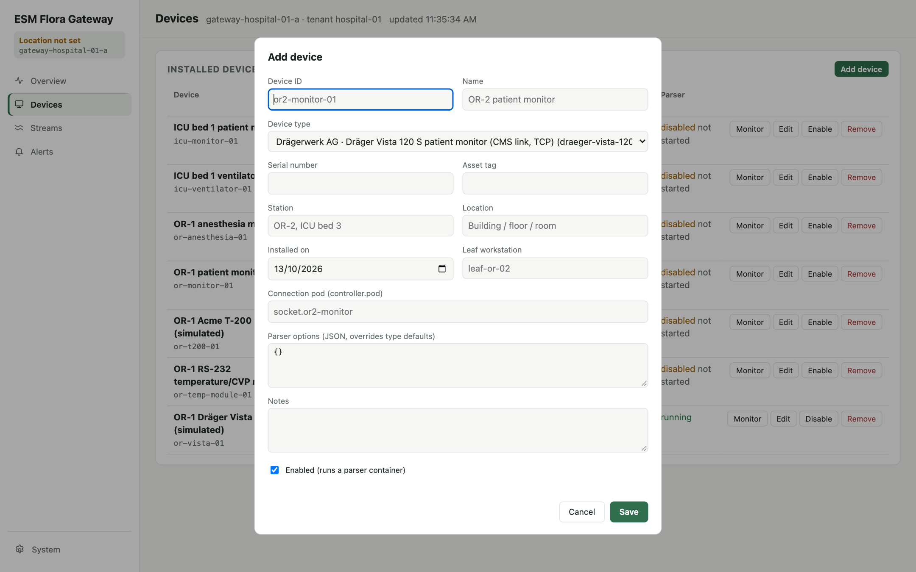
Devices: register and manage
Installed devices
Monitor · Edit · Enable / Disable · Remove. Parser column shows disabled, not started or the container status.
Add device
Device ID (permanent), type, Leaf workstation, connection pod e.g. serial.COM1. Saving an enabled device starts its parser.

Slide 15
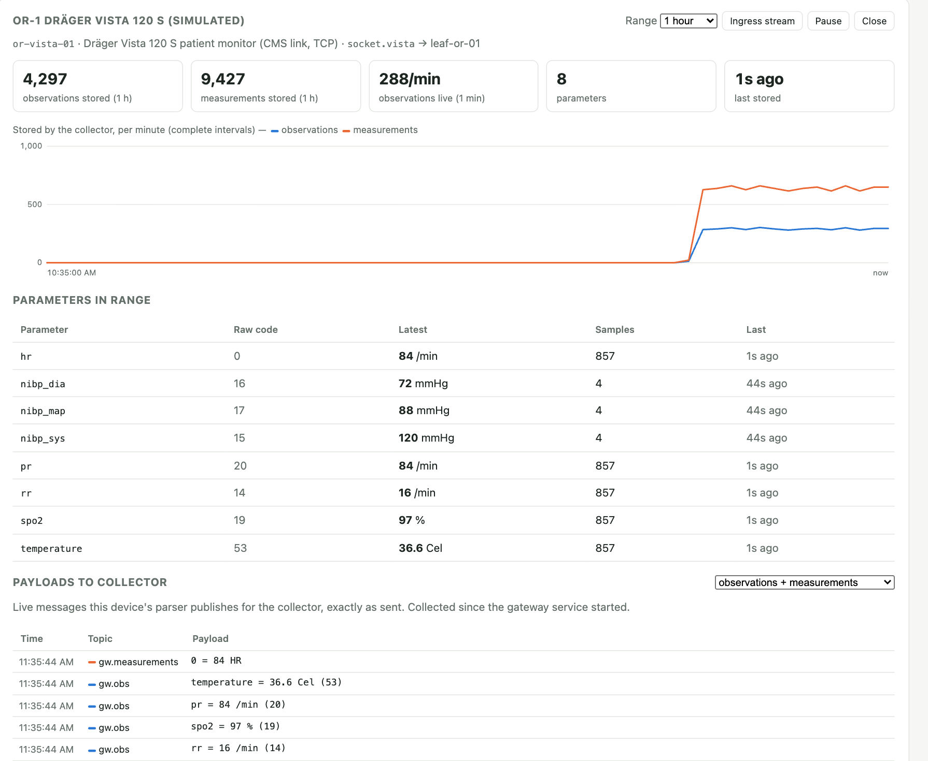
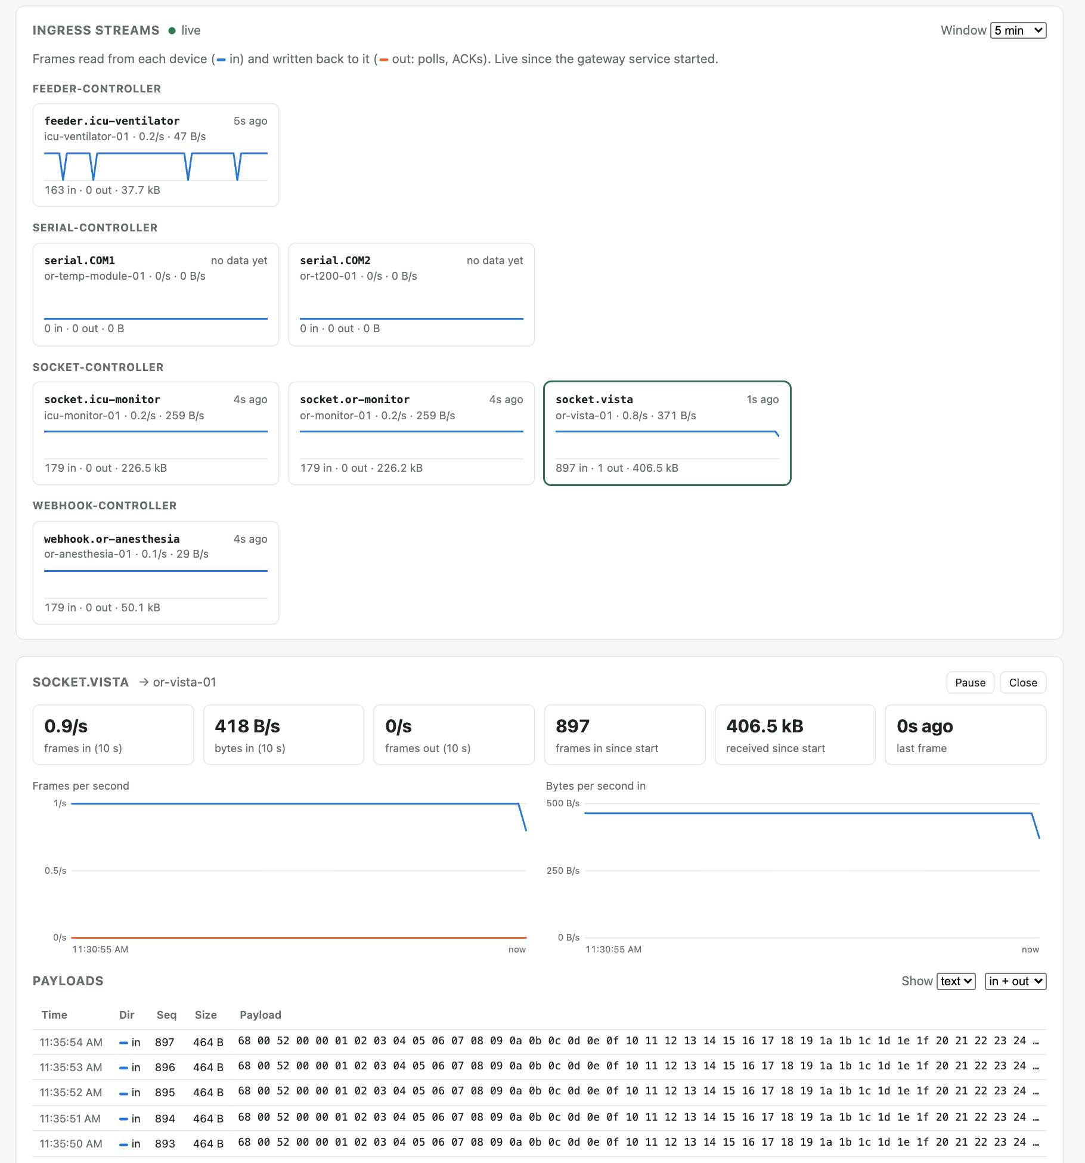
Device monitor and raw streams
Monitor
Stored rows per minute, parameters in range, payloads sent to the collector.
Streams
Raw frames per pod before parsing; text or hex; in = blue, out = orange.

Slide 16
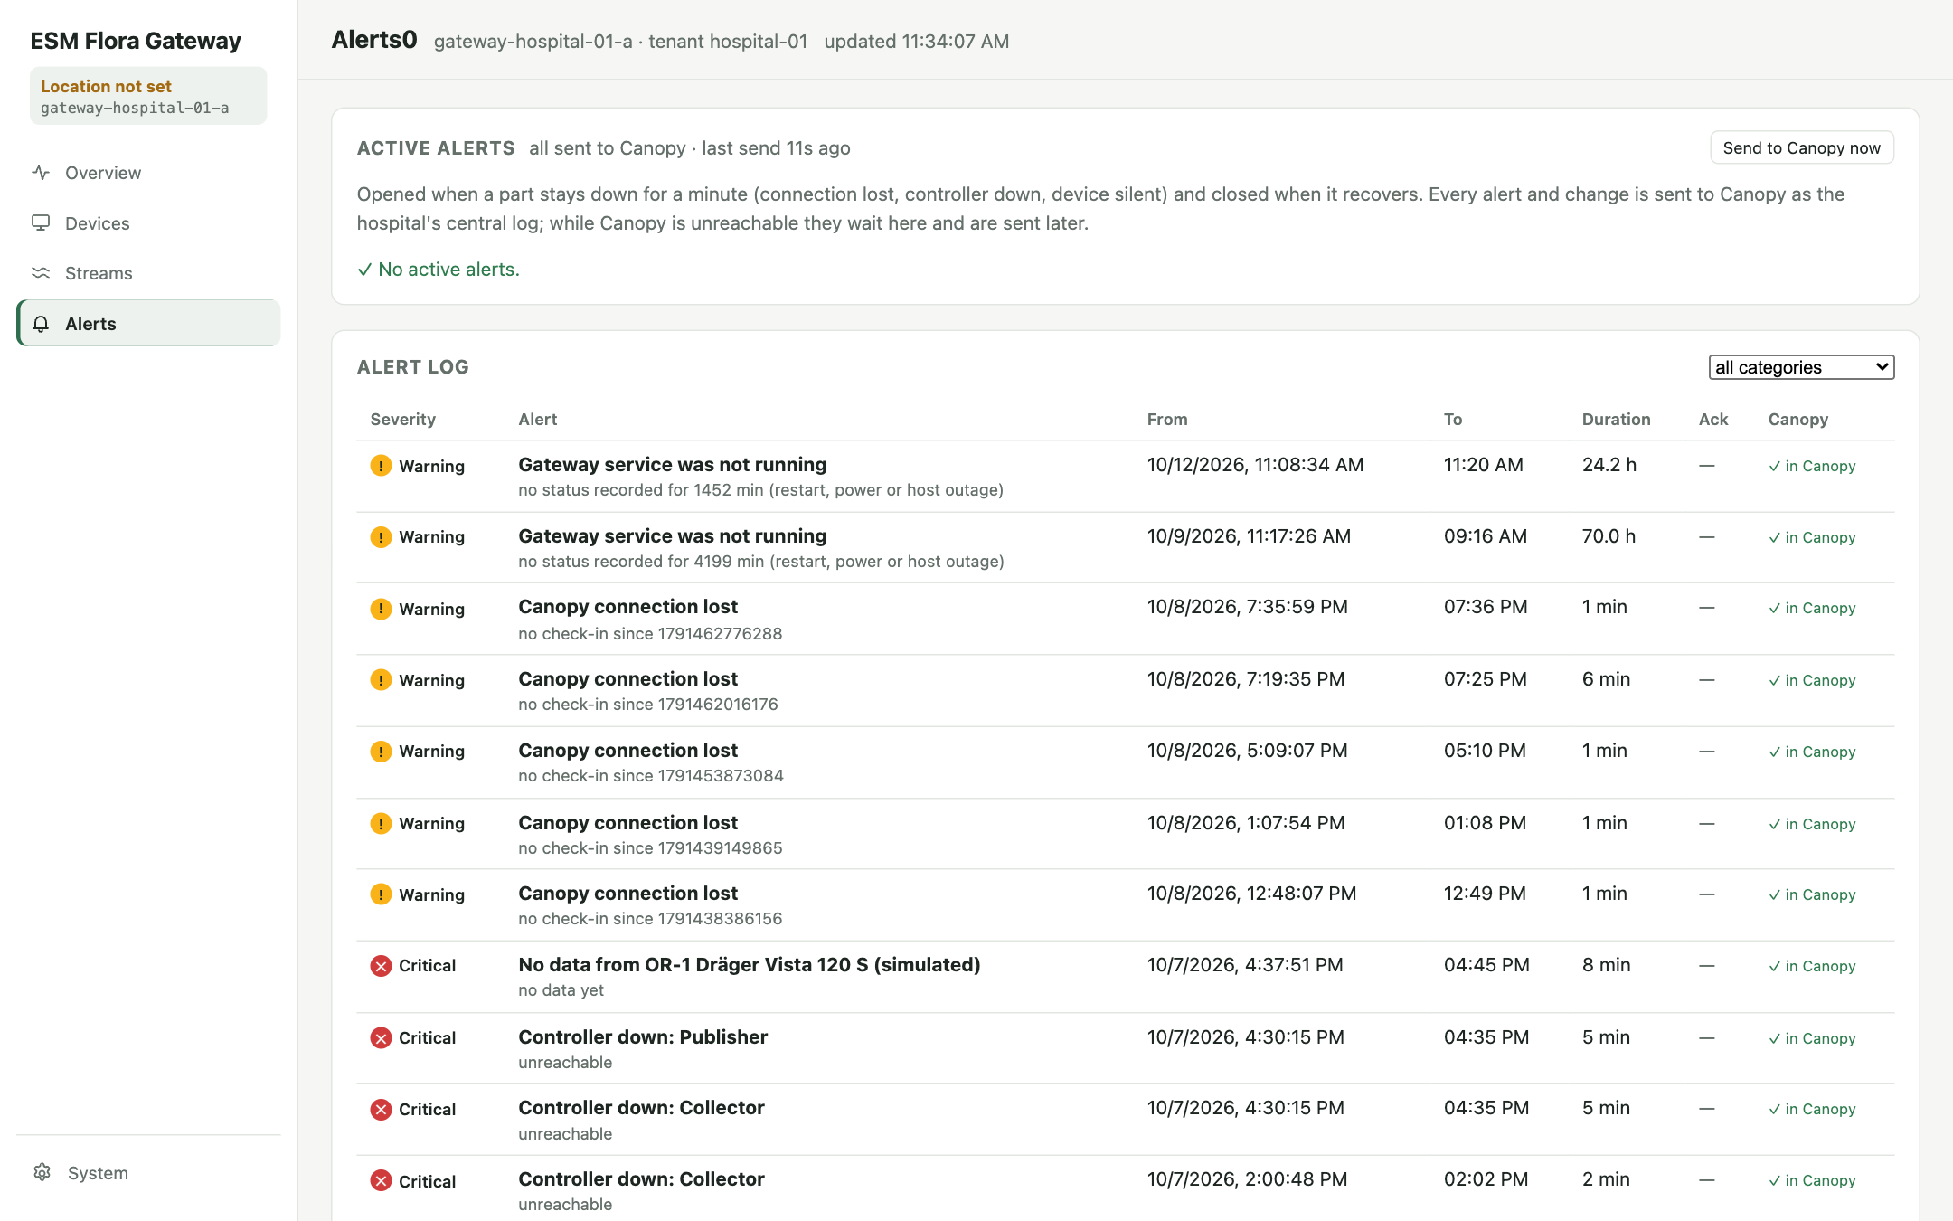
Alerts
Alert | Severity | Opens when
Canopy connection lost | Warning | No check-in for ~1 min
Controller down: <name> | Critical | Controller stopped or unreachable
No data from <device> | Critical | Enabled device silent 120 s
Gateway service was not running | Warning | Gap in the service lane
Acknowledge — records who handled it
Delivery — ✓ in Canopy or ◷ queued for Canopy
Alert log — resolved alerts with filters

Slide 17
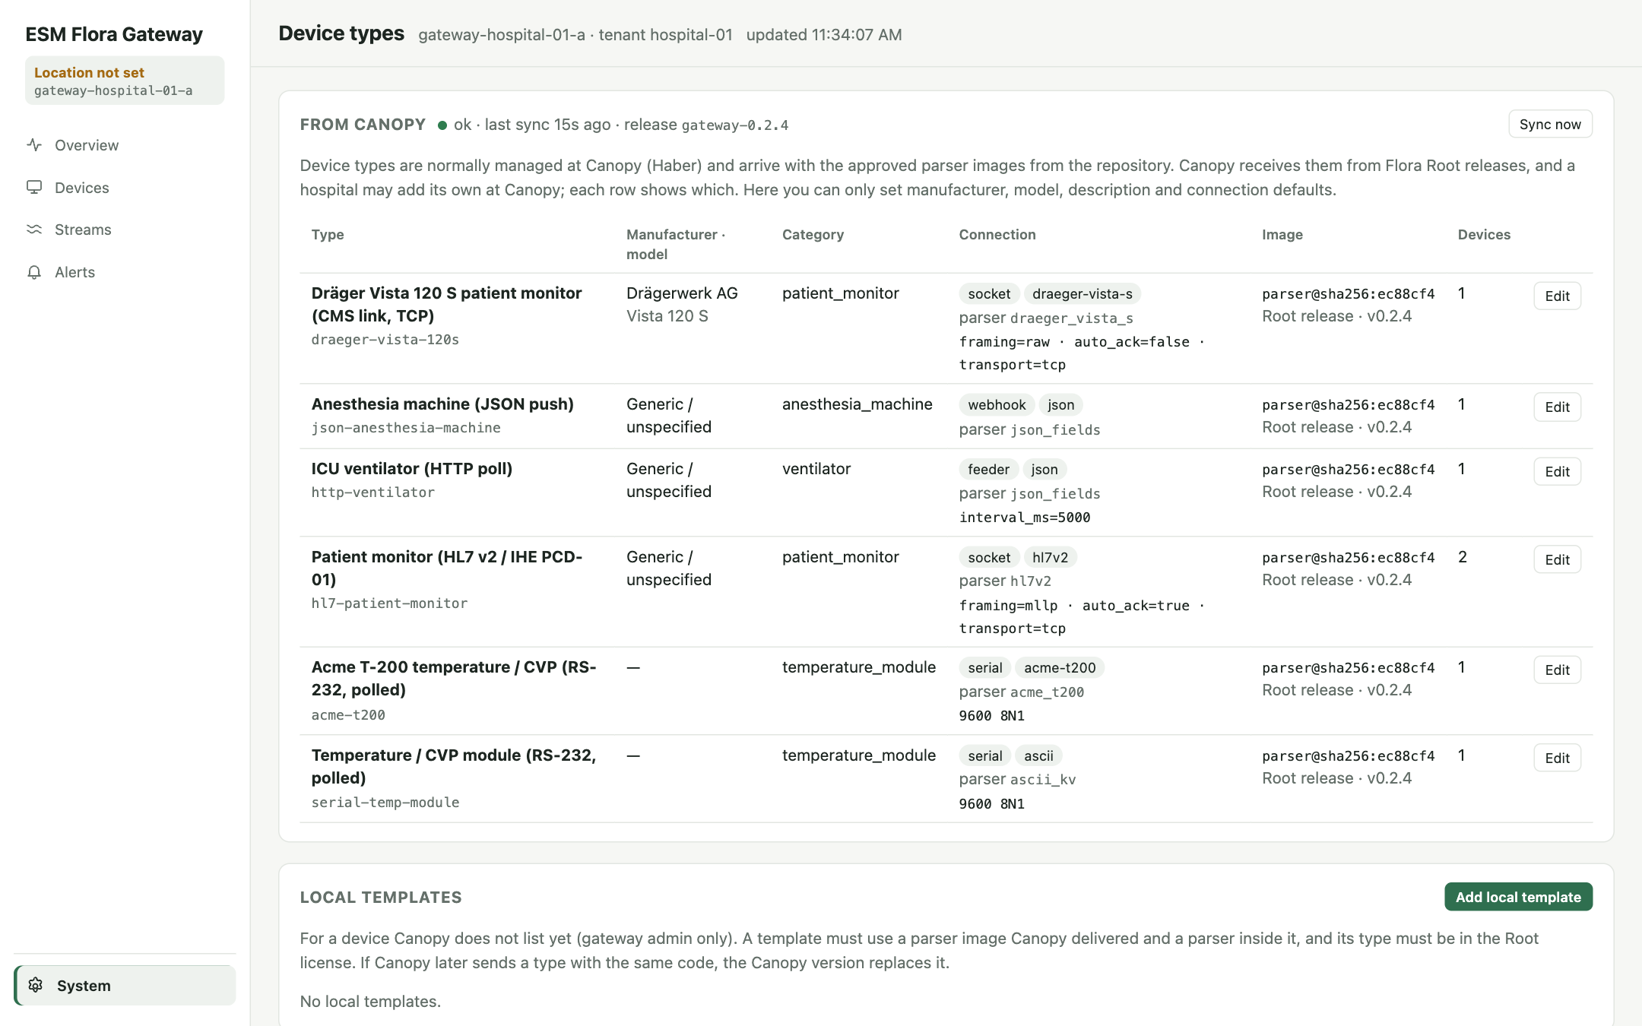
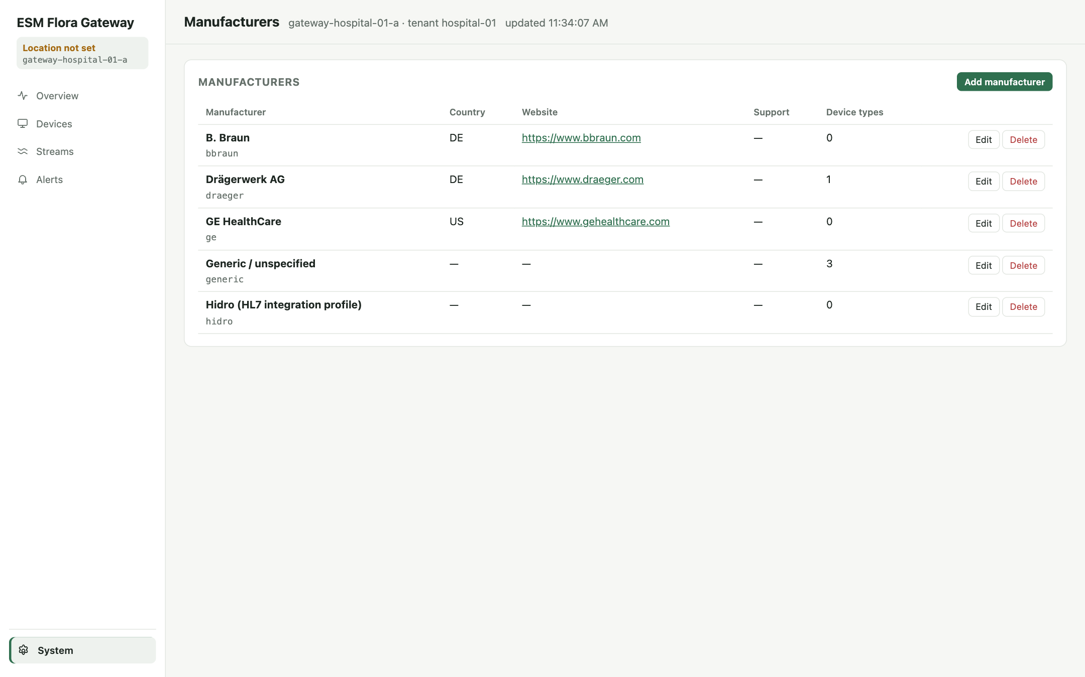
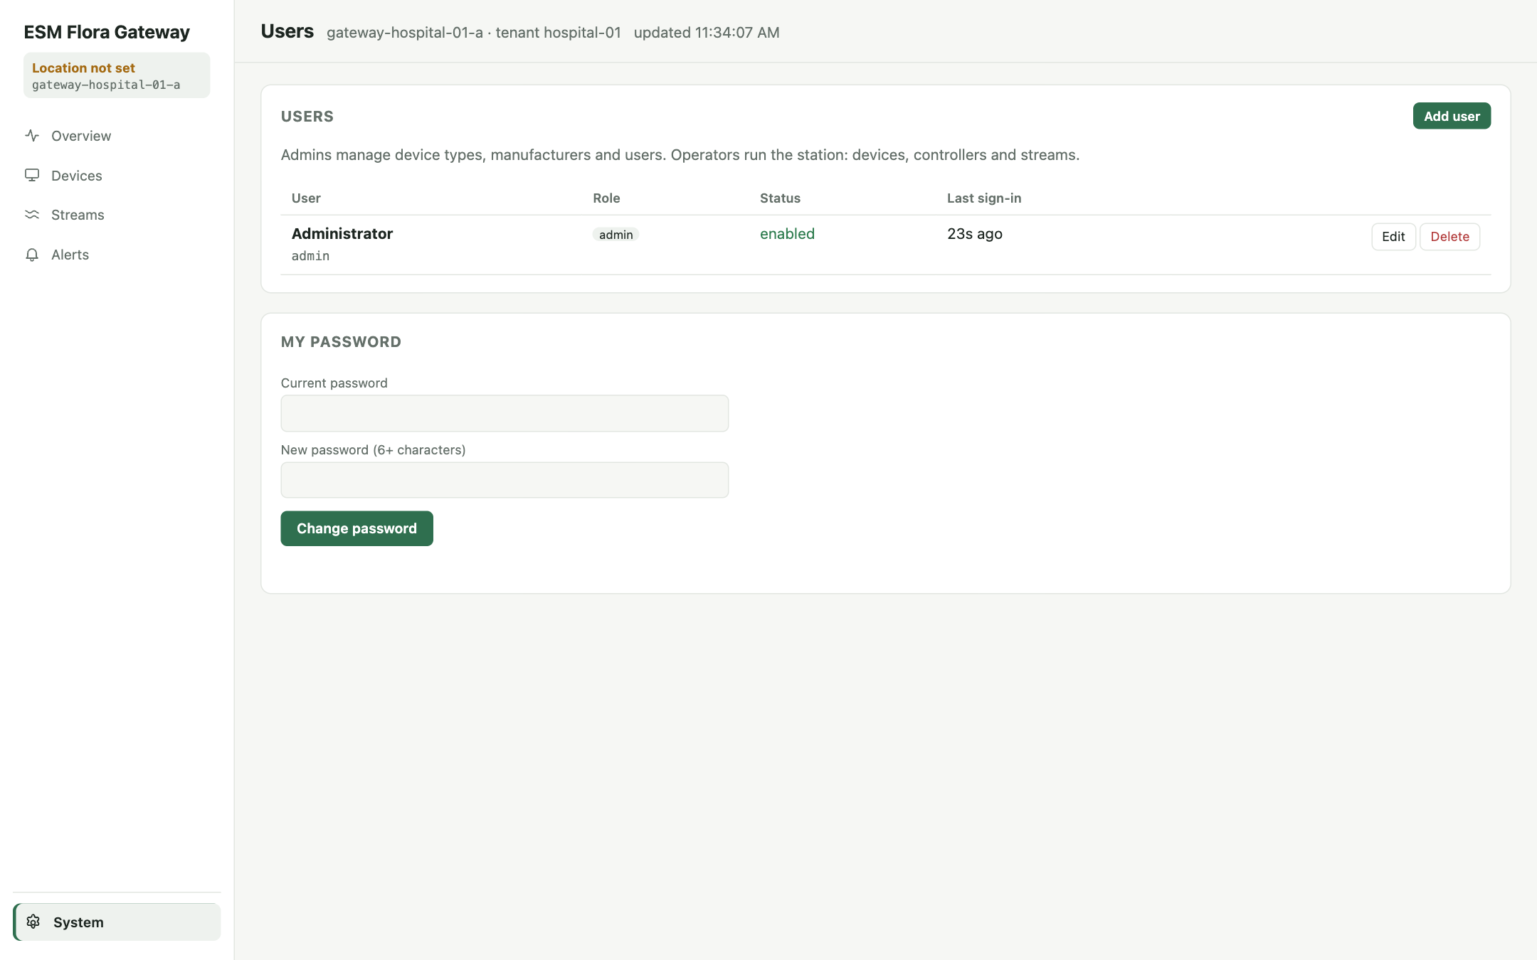
System menu: device types, manufacturers, users
Device types
From Canopy (release-managed) plus local templates that reuse a delivered parser image.
Manufacturers
Vendor directory; cannot delete one still used by a type.
Users
Admins manage accounts; one enabled admin must remain. Everyone can change their own password.

Slide 18
Register a new device
1
Check the type System → Device types. Missing? Sync now, or ask Canopy for a release and license.
Pods are configuration, not UI
COM port, baud rate and network listeners live in config/gateway.toml (or PUT /api/config/<section> with the full pod list), followed by a controller restart.
2
Define the pod gateway.toml: [[serial.pods]] path + line settings, or [[socket.pods]] port + framing.
3
Restart the controller Overview → Layers → Restart (serial- or socket-controller).
Licensing applies
Only licensed device types can be added or enabled, and enabled devices cannot exceed max devices. Moving a device to another Leaf: Edit → Leaf workstation.
4
Add the device Devices → Add device: type, pod (serial.COM6), Leaf workstation → Save.
5
Verify Parser running, frames on Streams, values in Live device data, vitals on the Leaf.

Slide 19
Troubleshoot a device with no data
# | Check | Where | If not OK
1 | Device enabled | Devices | Enable
2 | Parser running | Devices · Parser | Restart; read Logs parser.<device_id>
3 | Controller running | Overview · Layers | Start / Restart
4 | Pod connected | Layers · pod dot, last error | Cable, COM port, IP, firewall, source_ips
5 | Frames arrive | Streams | No frames: physical / network. Frames but no values: type, options, device settings
6 | License valid | Overview · License | Canopy connection, Sync now, contact Canopy admin
Rule of thumb
Streams tells you whether the problem is before the parser (no frames: cable, port, network) or in the parser (frames but no values: device type, options, protocol settings).

Slide 20
Data structures
18 PostgreSQL tables · Kafka messages · data-api

Slide 21
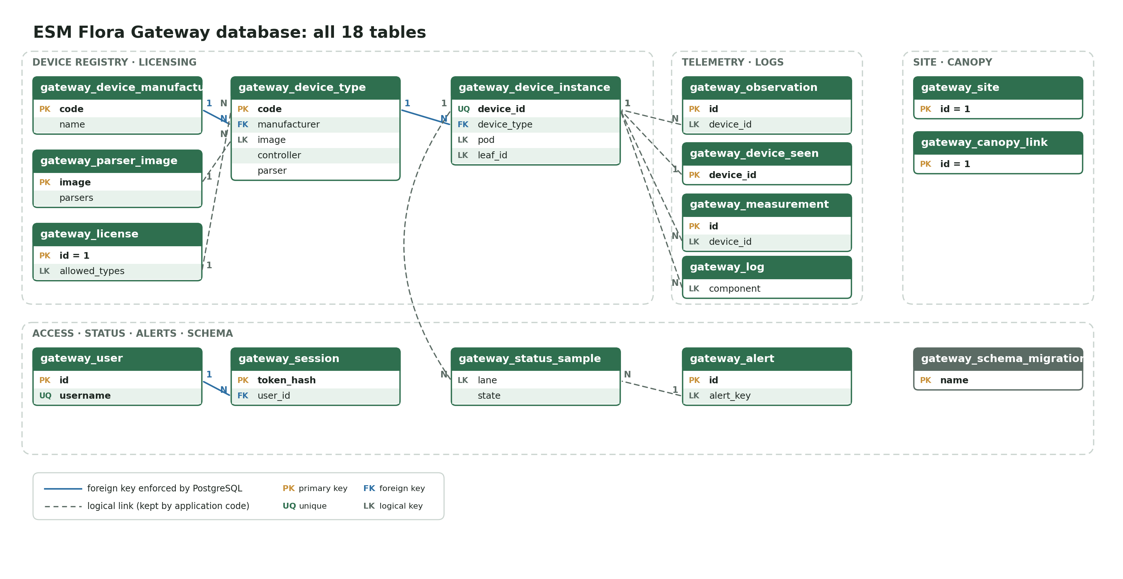
Database overview: 18 tables in four domains
Only three foreign keys are enforced (solid). The rest are logical links kept by the application (dashed), so telemetry is never rejected.

Slide 22
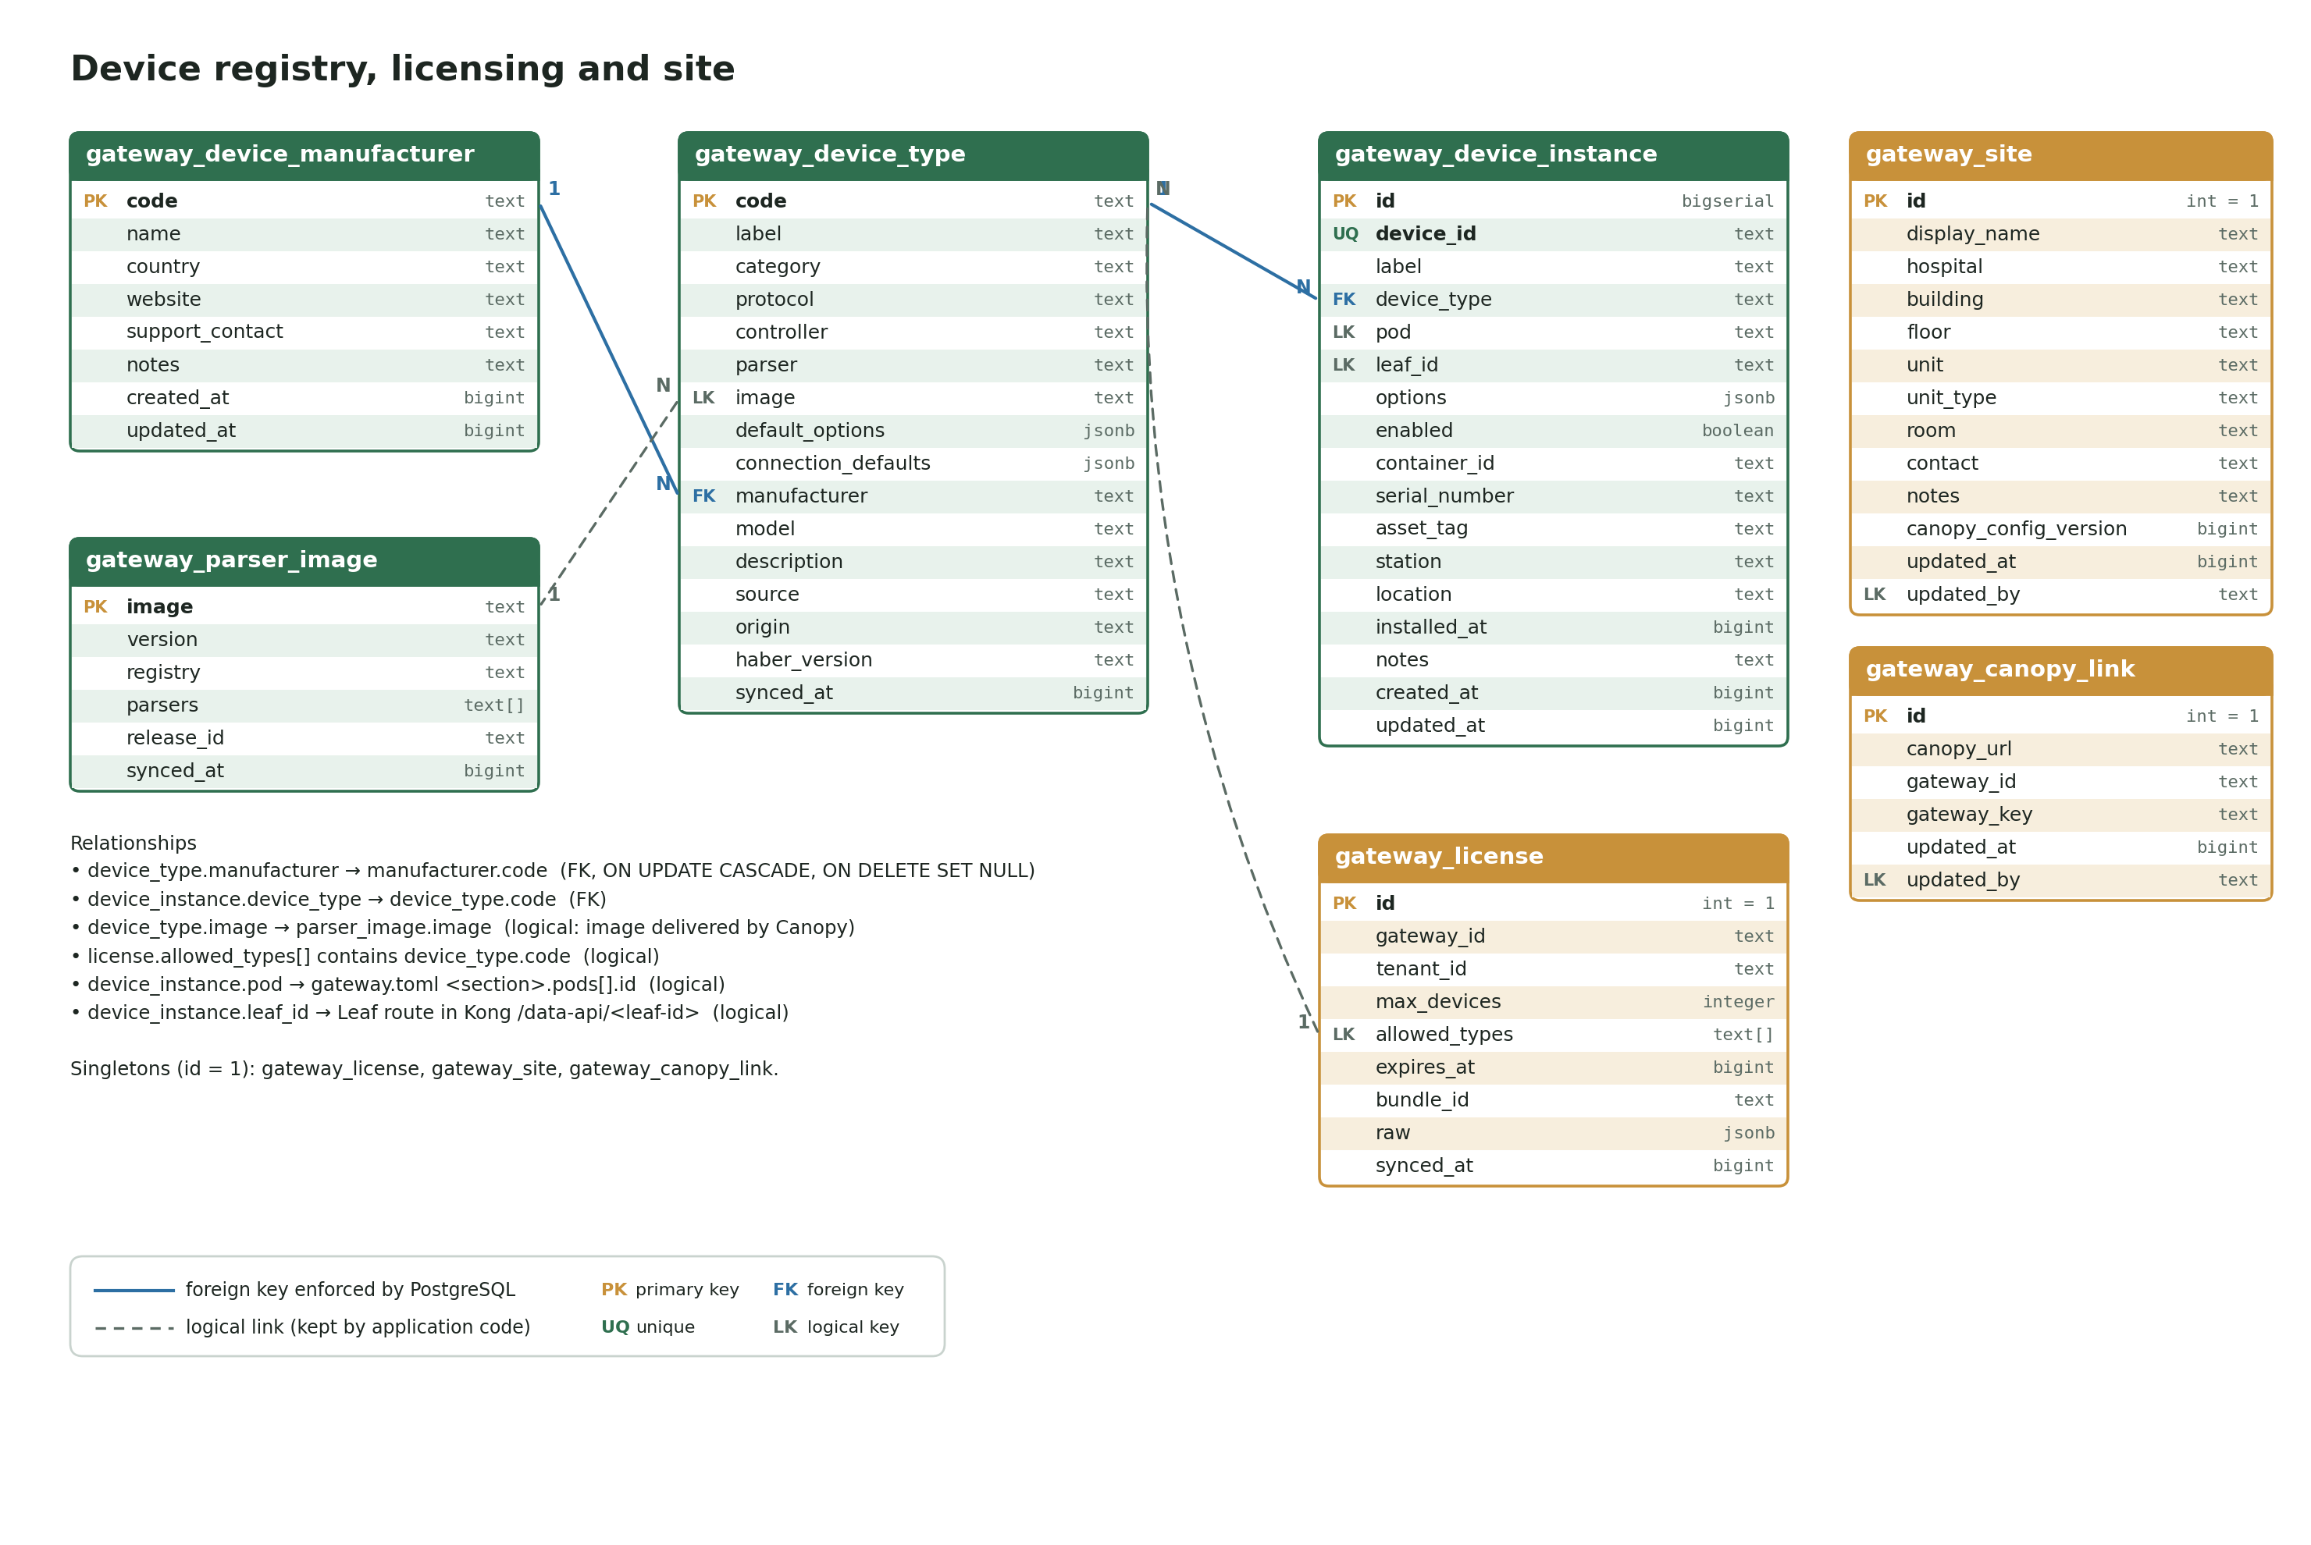
Device registry, licensing and site
device_instance → device_type → manufacturer are enforced. Types point to delivered parser images; the license lists allowed types.

Slide 23
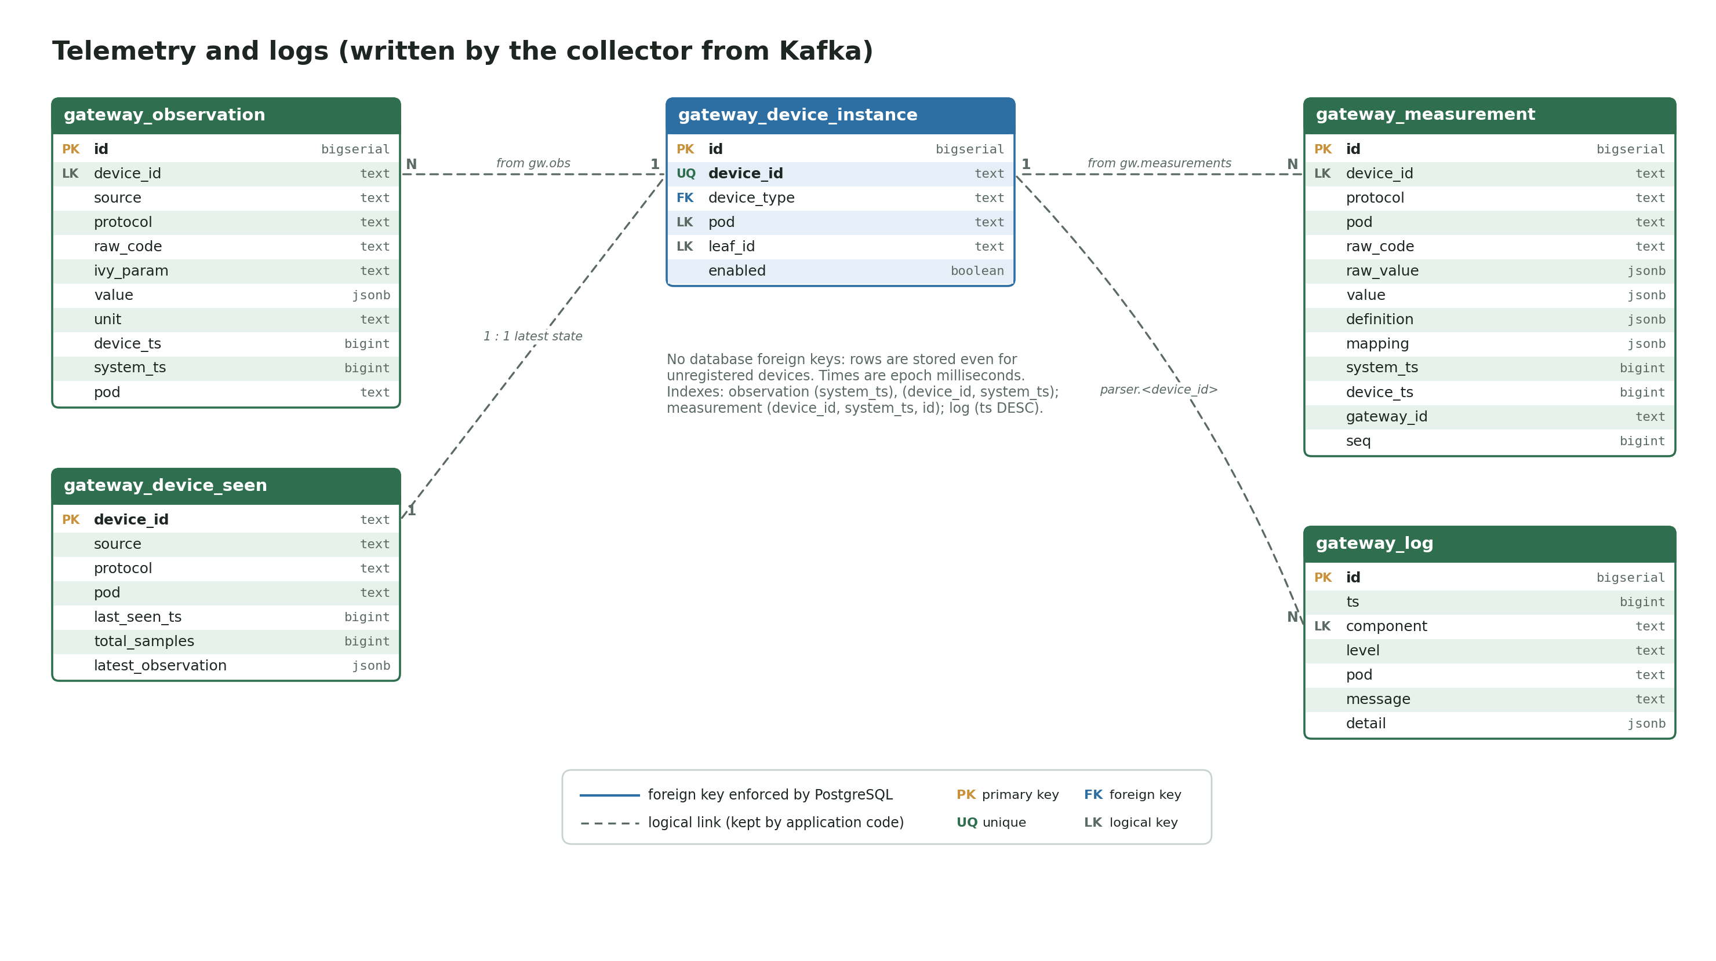
Telemetry and logs
Written by the collector from Kafka. device_id links each row to the instance logically; device_seen keeps the latest state per device.

Slide 24
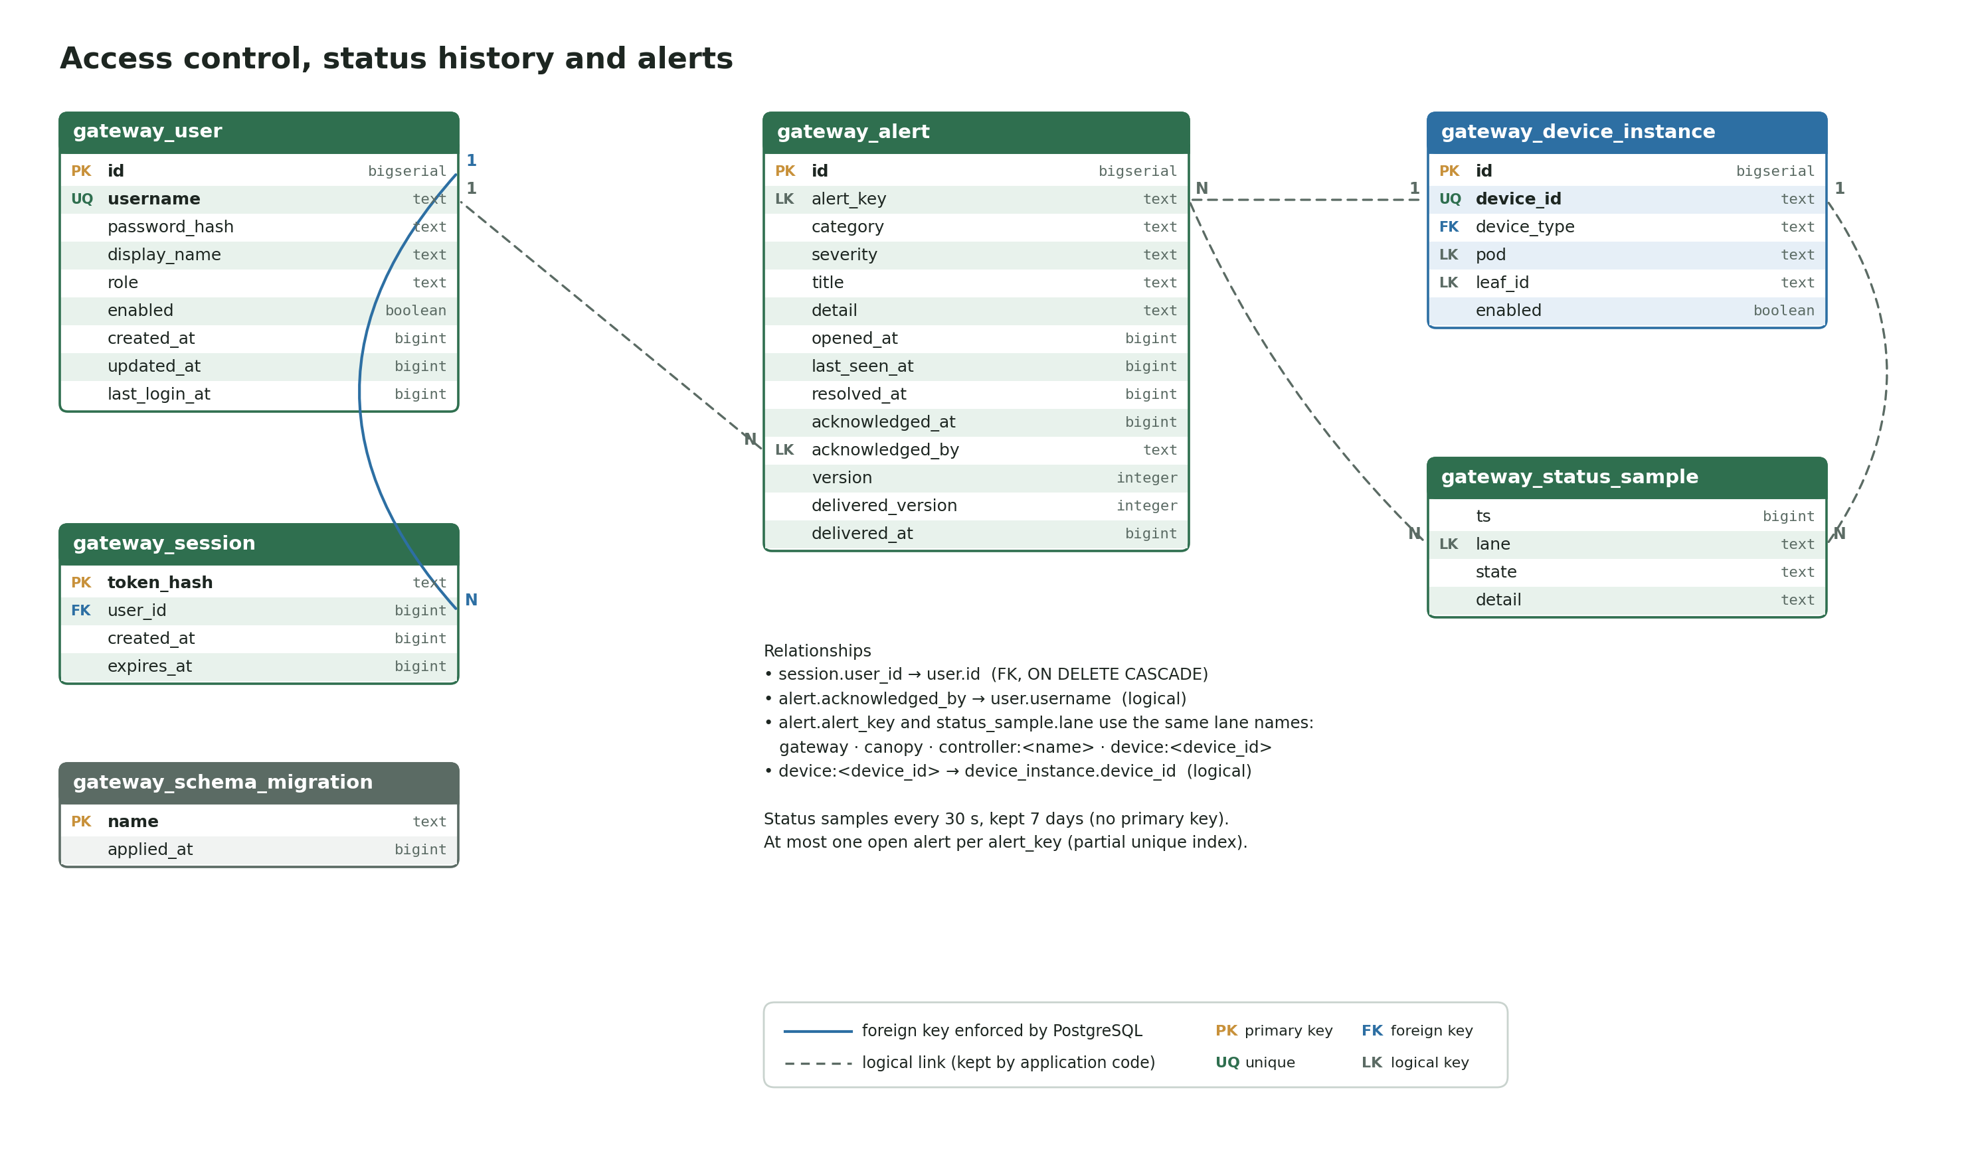
Access control, status history and alerts
Sessions cascade with users. Status samples and alerts share lane names: gateway, canopy, controller:<name>, device:<id>.

Slide 25
Kafka topics and the data-api
Topic | Producer → consumer | Message
gw.raw.<pod> | controller → parser | RawFrame
gw.cmd.<pod> | parser / service → controller | Command
gw.obs | parser → collector, publisher | Observation
gw.measurements | parser → collector | DeviceMeasurement
gw.logs | any → collector | LogEvent
Endpoint | Returns
GET /api/observations?from&to | Observations of the Leaf's devices (window ≤ 4 h)
GET /api/measurements | Original fields, paged with after_id
GET /api/devices/status | online / waiting / offline per device and by category
GET /health | Service status
Observation (stored 1:1 in gateway_observation)
device_id · source · protocol · raw_code · ivy_param (hr, spo2, nibp_sys, etco2 …) · value · unit · device_ts · system_ts · pod. Leaf reads it from https://<gateway-host>/data-api/<leaf-id>/api/observations; Kong adds leaf_id so each Leaf sees only its own devices.

Slide 26


Updates and licensing
Root
Builds and signs every release and license
Haber @ Canopy
Mirrors images; hospital approves the rollout
flora-updater
Verifies signature, recreates changed services, rolls back on failure
Parsers
Replaced one per cycle; new image pulled before the old one stops
License not valid — no license, revoked by Root, or expired: every parser stops until a valid license arrives
Canopy unreachable — the last license is kept and data collection continues
Limits — only licensed device types; enabled devices ≤ max devices
Maintenance window — FLORA_UPDATER_WINDOW, e.g. 02:00-05:00

Slide 27
Supported devices (release gateway-0.2.4)
Device type | Device | Connection | Parser
hl7-patient-monitor | Patient monitor, HL7 v2 / IHE PCD-01 | socket · MLLP | hl7v2
hidro-hl7-monitor | Hidro HL7 monitor profile | socket · MLLP | hidro_hl7
draeger-iacs-m540 | Dräger M540, IACS | socket · UDP | iacs_m540
draeger-medibus | Dräger MEDIBUS.X | serial | medibus
draeger-vista-120s | Dräger Vista 120 S, CMS link | socket · TCP | draeger_vista_s
ge-carestation-750 · ge-aisys-cs2 | GE Carestation 750 · Aisys CS2 (COM 1.2) | serial | ge_carestation
ge-bx50-dri · ge-s5-dri · ge-aisys-dri | GE Bx50 / B650 · S/5 · Aisys (DRI) | serial | ge_dri
bbraun-space-bcc | B. Braun SpaceCom, BCC | socket · TCP client | bbraun_bcc
json-anesthesia-machine · http-ventilator | JSON push · HTTP poll devices | webhook · feeder | json_fields
serial-temp-module · acme-t200 | Temperature / CVP modules | serial | ascii_kv · acme_t200

Slide 28
Administrator checklist
Change the default admin password and create named accounts
Connect to Canopy (Overview → Canopy connection) and confirm the license is Valid
Define pods in gateway.toml, then add devices with their Leaf workstation
Verify data on Streams, Live device data and the Leaf chart
Back up the gateway database volume, config/ and certs/; plan telemetry housekeeping
Notes:
Full procedures, configuration keys and the complete data dictionary are in the Word manual ESM-Flora-Gateway-User-Manual.docx.

