Slide 1
ESM Flora Gateway
User manual · medical device integration for Flora Leaf, managed from Canopy · release 0.2.4
Notes:
This manual covers the gateway admin page, connecting devices and Canopy, the data model and the technology stack.

Slide 2
What the gateway does
Connect
Monitors, ventilators, anaesthesia machines, pumps over RS-232, HL7/TCP, HTTP, UDP and TCP links.
Decode
One parser per device turns device data into Flora observations (hr, spo2, nibp…), keeping the originals.
Serve
The collector stores everything; Leaf workstations pull their devices' data through the data API.
Govern
Canopy supplies device types, licence and location, and keeps the central alert log.
A pod is one connection (controller.id, e.g. socket.vista). A device type is a template; a device is one installed unit on a pod, assigned to a Leaf.

Slide 3
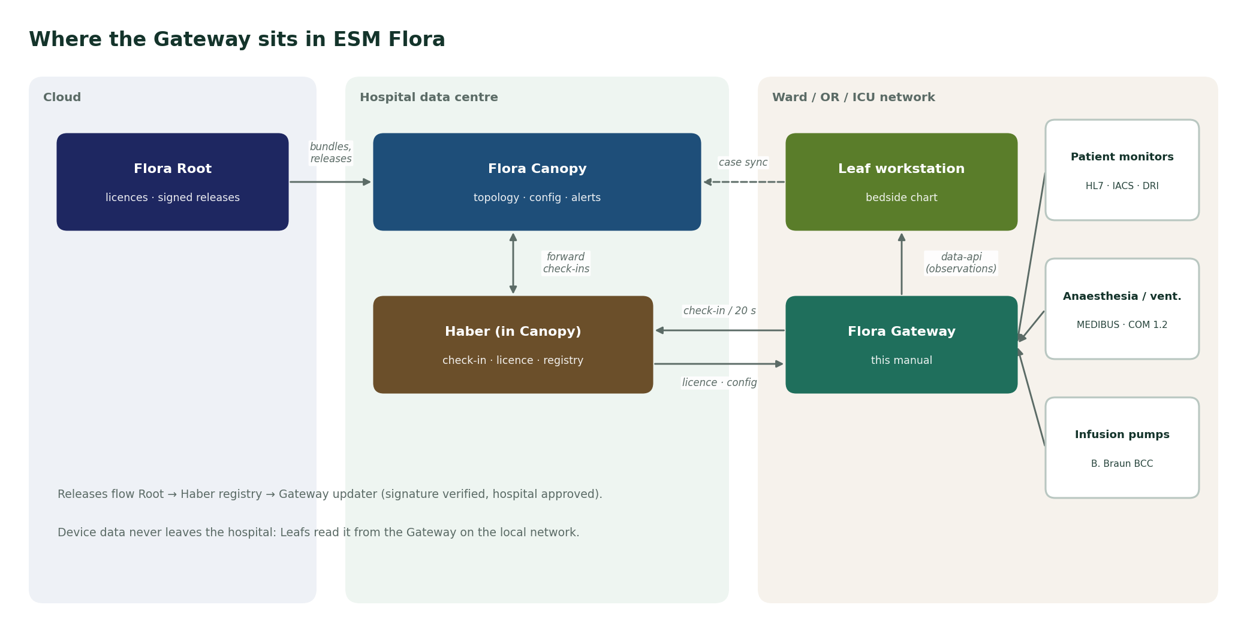
Where the gateway sits in ESM Flora

Slide 4
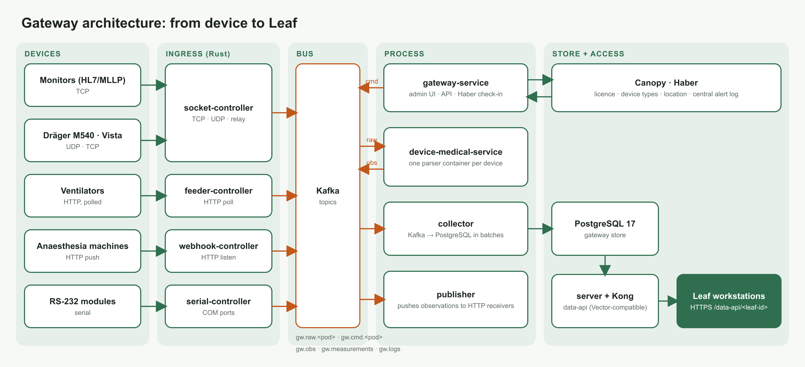
Architecture: from device to Leaf
Notes:
Ingress controllers (Rust) read devices and publish raw frames to Kafka. Parsers (Python) decode them. The collector stores observations in PostgreSQL; Kong serves them to Leaf.

Slide 5
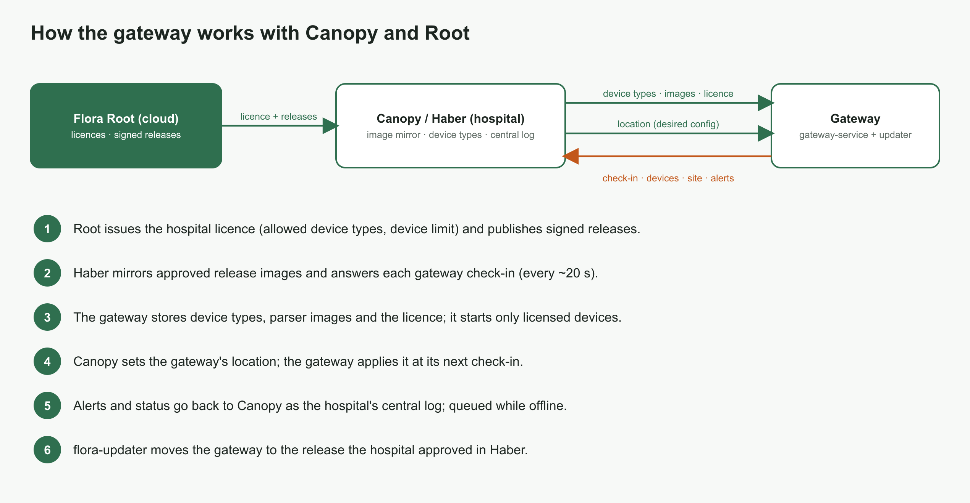
Working with Canopy and Root

Slide 6
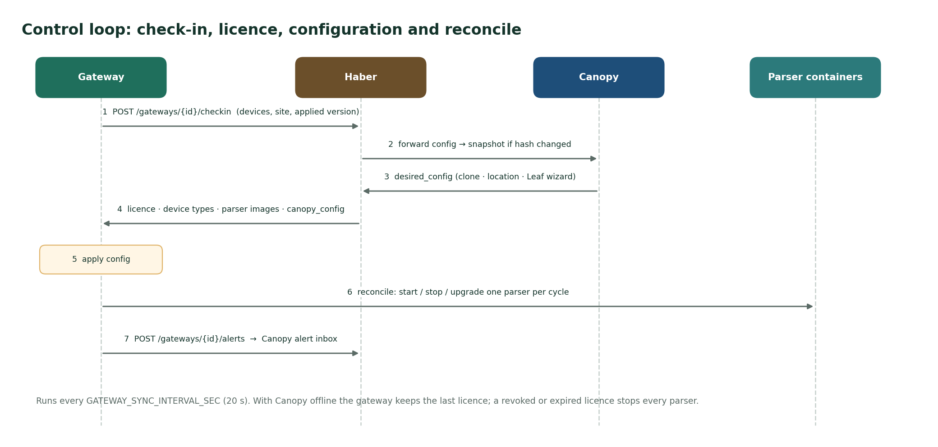
The control loop with Canopy

Slide 7
Using the gateway
Sign-in, roles and the five screens

Slide 8
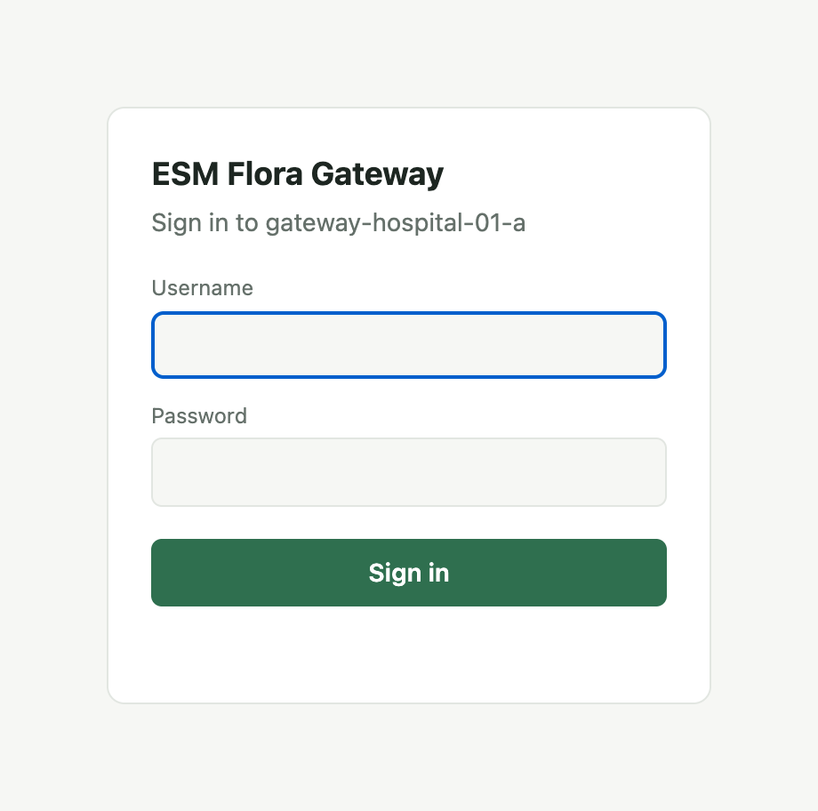
Sign in and roles
Open
https://<gateway-host> (7443 in the demo) or http://localhost:7400 on the gateway itself.
First sign-in
admin / admin — change it at once under System → Users → My password.
admin
Operator rights plus device types, manufacturers, users and the Canopy connection.
operator
Devices, controllers, streams and alerts.

Slide 9
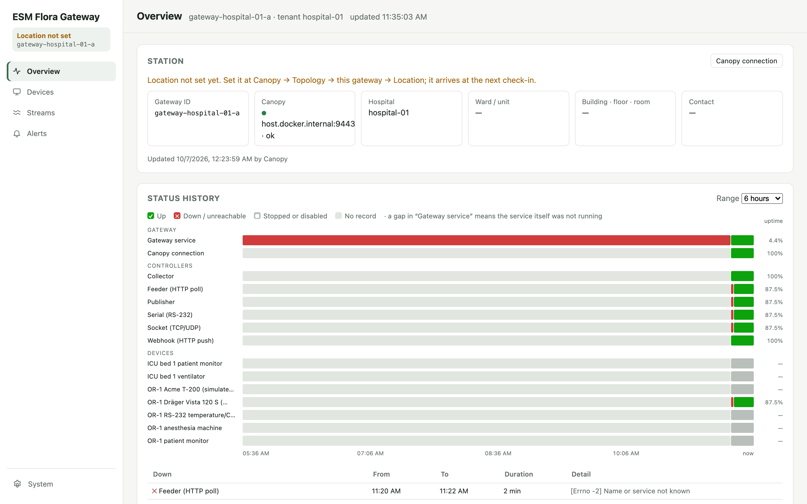
Overview
Station: ID, Canopy status, ward and room
Status history: up, down, stopped, per part
Outage list with duration and cause
Layers: start, stop, restart controllers

Slide 10
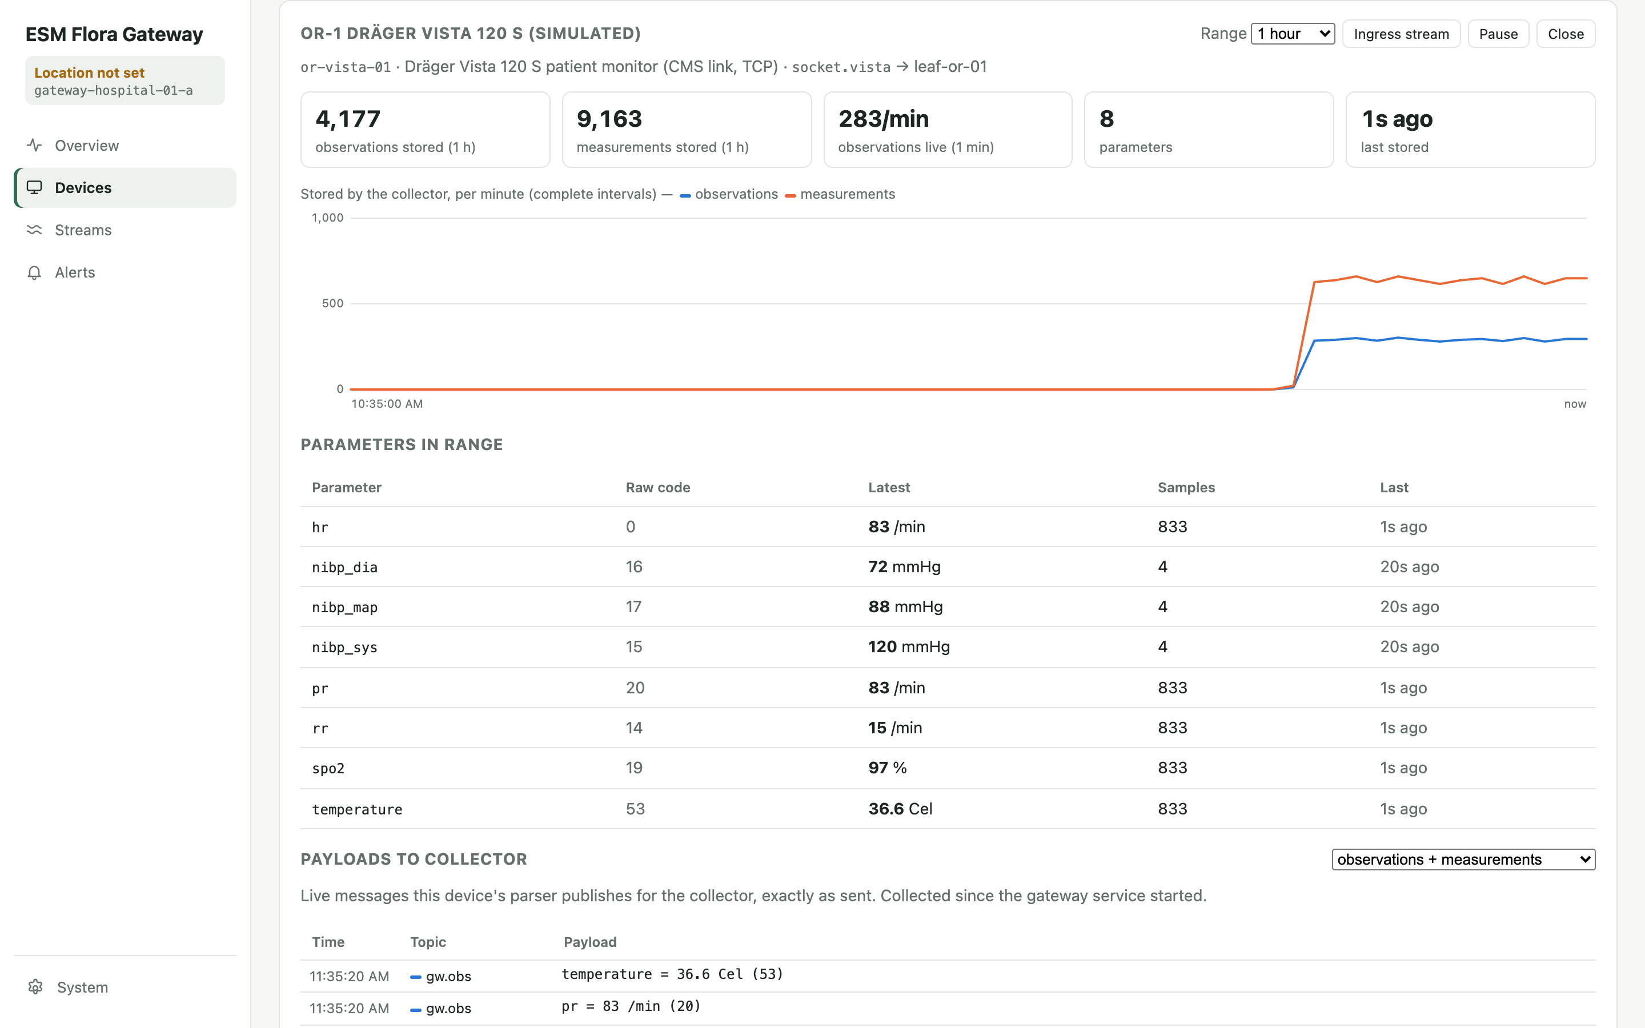
Devices and device monitor
Add, edit, enable, remove devices
Monitor: stored data per minute, 6 h or 24 h
Latest value of every parameter
Live payloads sent to the collector

Slide 11
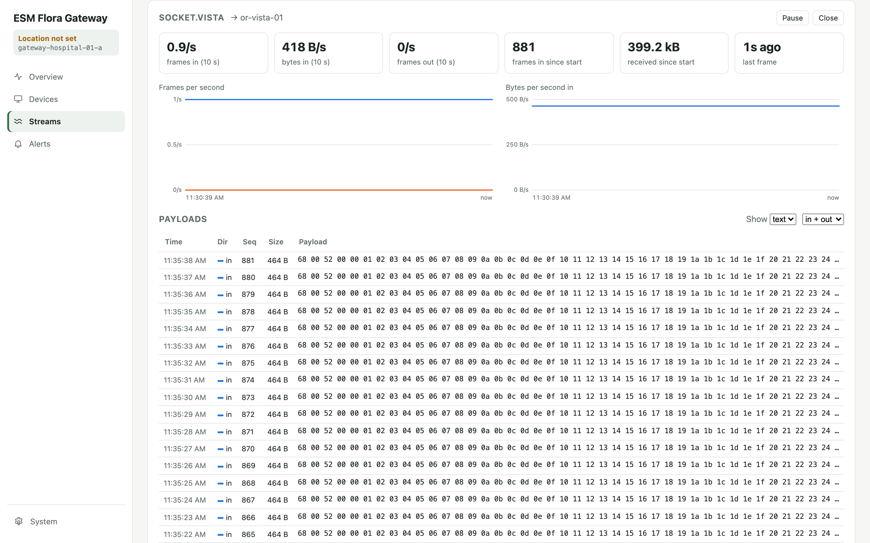
Streams: raw device traffic
One card per ingress pod
Frames and bytes per second, in and out
Every payload as text or hex
Use it to prove a device is talking

Slide 12
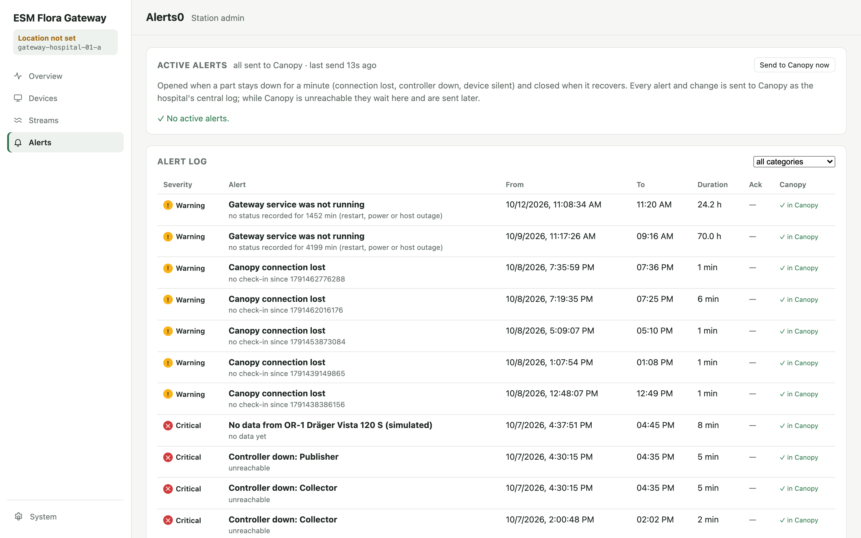
Alerts
Opens after about a minute down
Canopy lost, controller down, device silent
Acknowledge, then fix; closes by itself
Every change goes to Canopy's central log

Slide 13
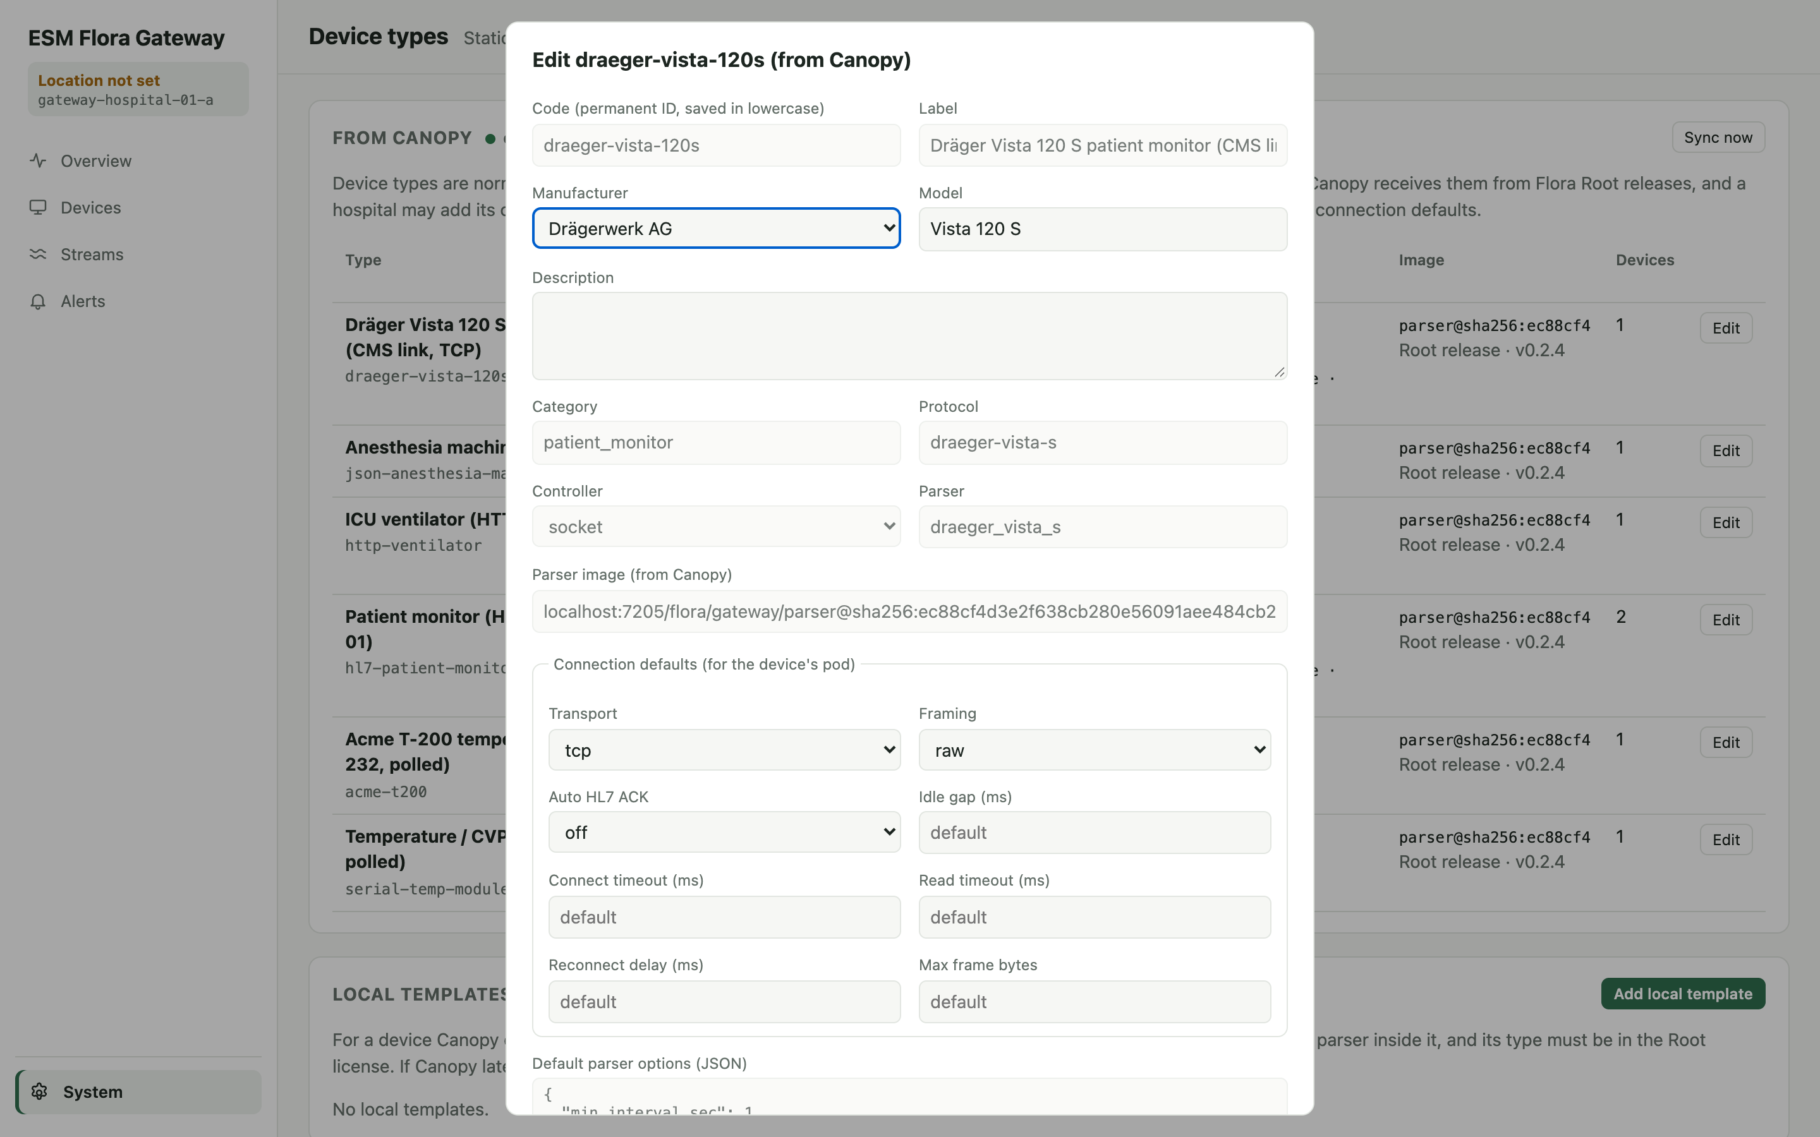
Device types and connection defaults
Types arrive from Canopy
Locally: manufacturer, model, description
Serial defaults: baud, data bits, parity, stop bits
Admins may add local templates

Slide 14
Common tasks
Connect to Canopy, add devices, Dräger monitors, check data

Slide 15
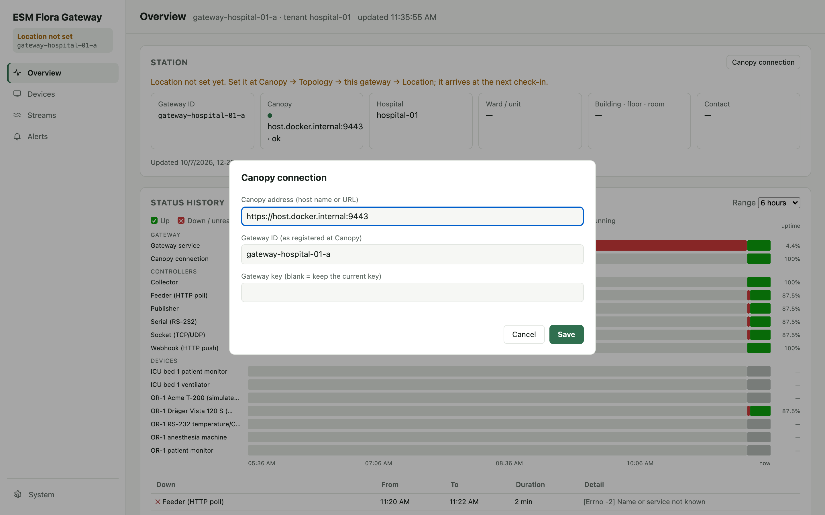
Connect the gateway to Canopy
1
Overview → Canopy connection
Admin only.
2
Enter Canopy address, gateway ID and key
A host name means https on port 443.
3
Save
The gateway checks in at once; 401 = wrong key.
4
Set the location at Canopy
Topology → gateway → Set location…

Slide 16
Add a device
1
Type exists and is licensed
System → Device types; Overview → Licence
2
Pod is configured
e.g. socket.or2-monitor, serial.COM3
3
Devices → Add device
ID, name, type, serial, station, location
4
Choose pod and Leaf workstation
5
Save with Enabled ticked
A parser starts for the device
6
Check Monitor
Values appear within seconds

Slide 17
Dräger monitors
Vista 120 S · TCP 9500
Connects to the gateway as to its central station; the gateway greets it and decodes HR, RR, NIBP, SpO2, PR and temperature.
1. Enable pod socket.vista (framing raw).
2. Optional beacon: broadcast on UDP 9610 so monitors find the gateway.
3. Device type draeger-vista-120s; source_ip per monitor when shared.
M540 (IACS) · UDP 2050
Multicast. Discovery on 224.127.1.254:2000 joins each monitor's group 224.0.1.<last octet> automatically.
Direct: enable pod m540, set multicast_interface.
Other subnet or Docker: run tools/iacs-relay/relay.py and use pod m540-relay (TCP 2051, udp_relay).
One device draeger-iacs-m540 per monitor (source_ip).

Slide 18
Check that data reaches Leaf
Streams
Frames arriving on the pod?
Monitor
Observations stored, latest recent?
Status history
Device green?
Leaf chart
Values on the running case
→
→
→
If a device is enabled but silent for 2 minutes, an alert opens and Canopy is told.

Slide 19
Data structures
Gateway database (16 tables, four diagrams) · Kafka messages · related data at Canopy

Slide 20
The data model at a glance
ER 1 · Registry
manufacturer, device_type, device_instance, parser_image, license
ER 2 · Telemetry
observation, measurement, device_seen, log
ER 3 · Users
user, session
ER 4 · Operations
status_sample, alert, site, canopy_link, schema_migration
Solid line: foreign key in PostgreSQL. Dashed: logical link by value. Times are epoch milliseconds.

Slide 21
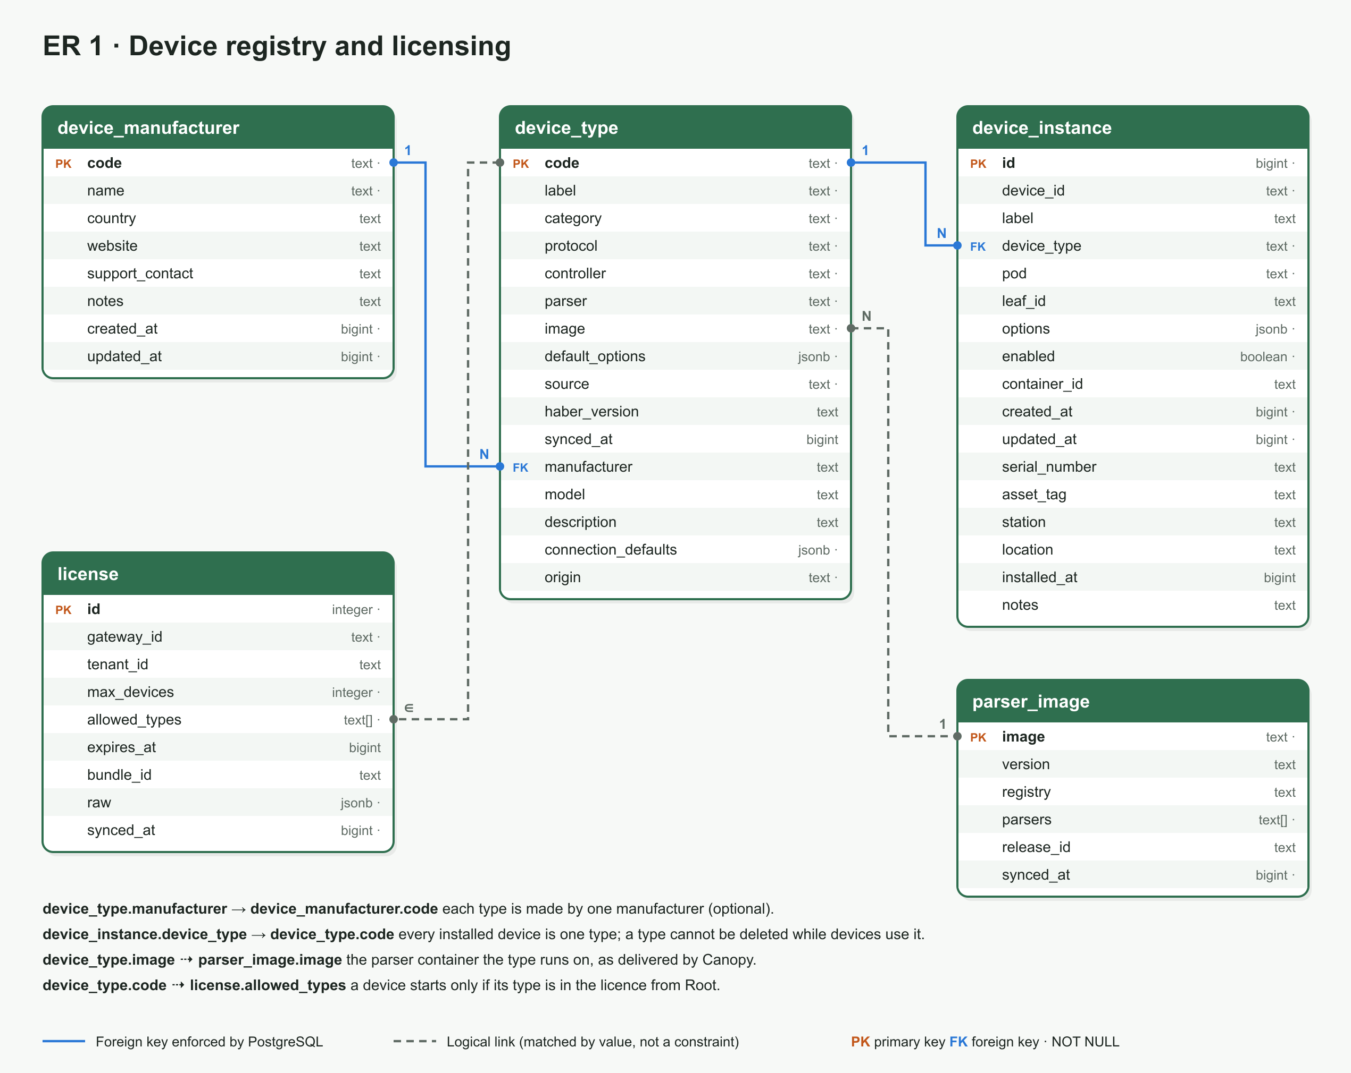
ER 1 · Device registry and licensing

Slide 22
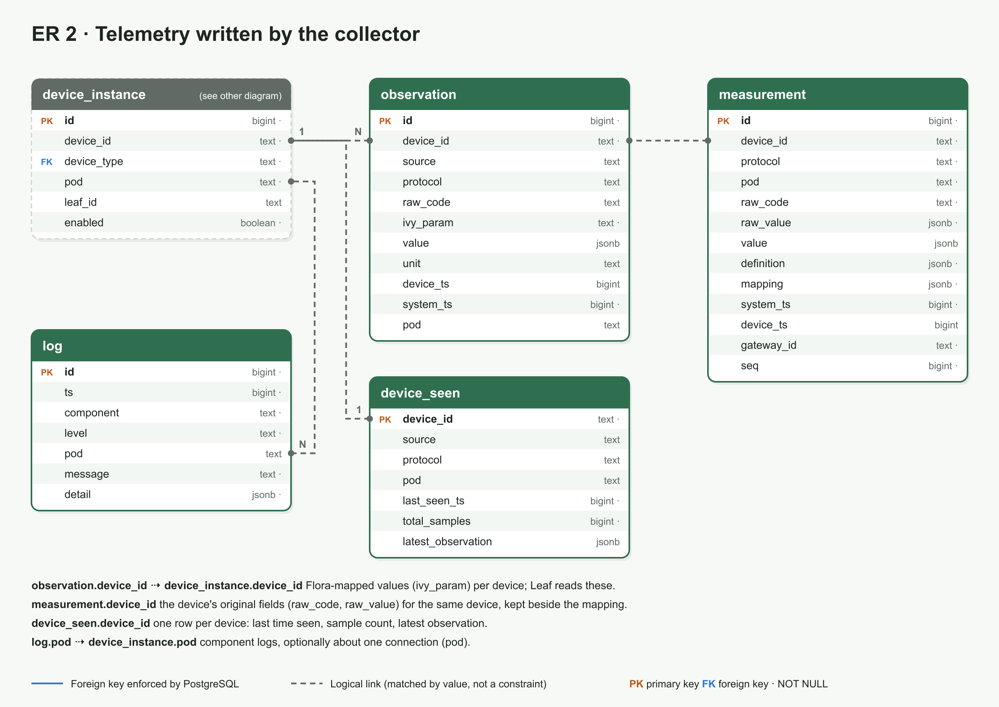
ER 2 · Telemetry

Slide 23
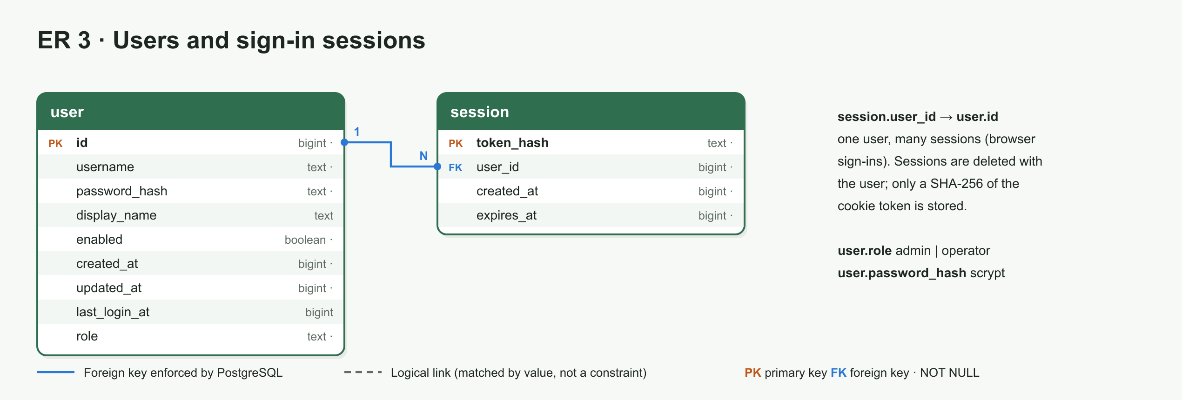
ER 3 · Users and sessions

Slide 24
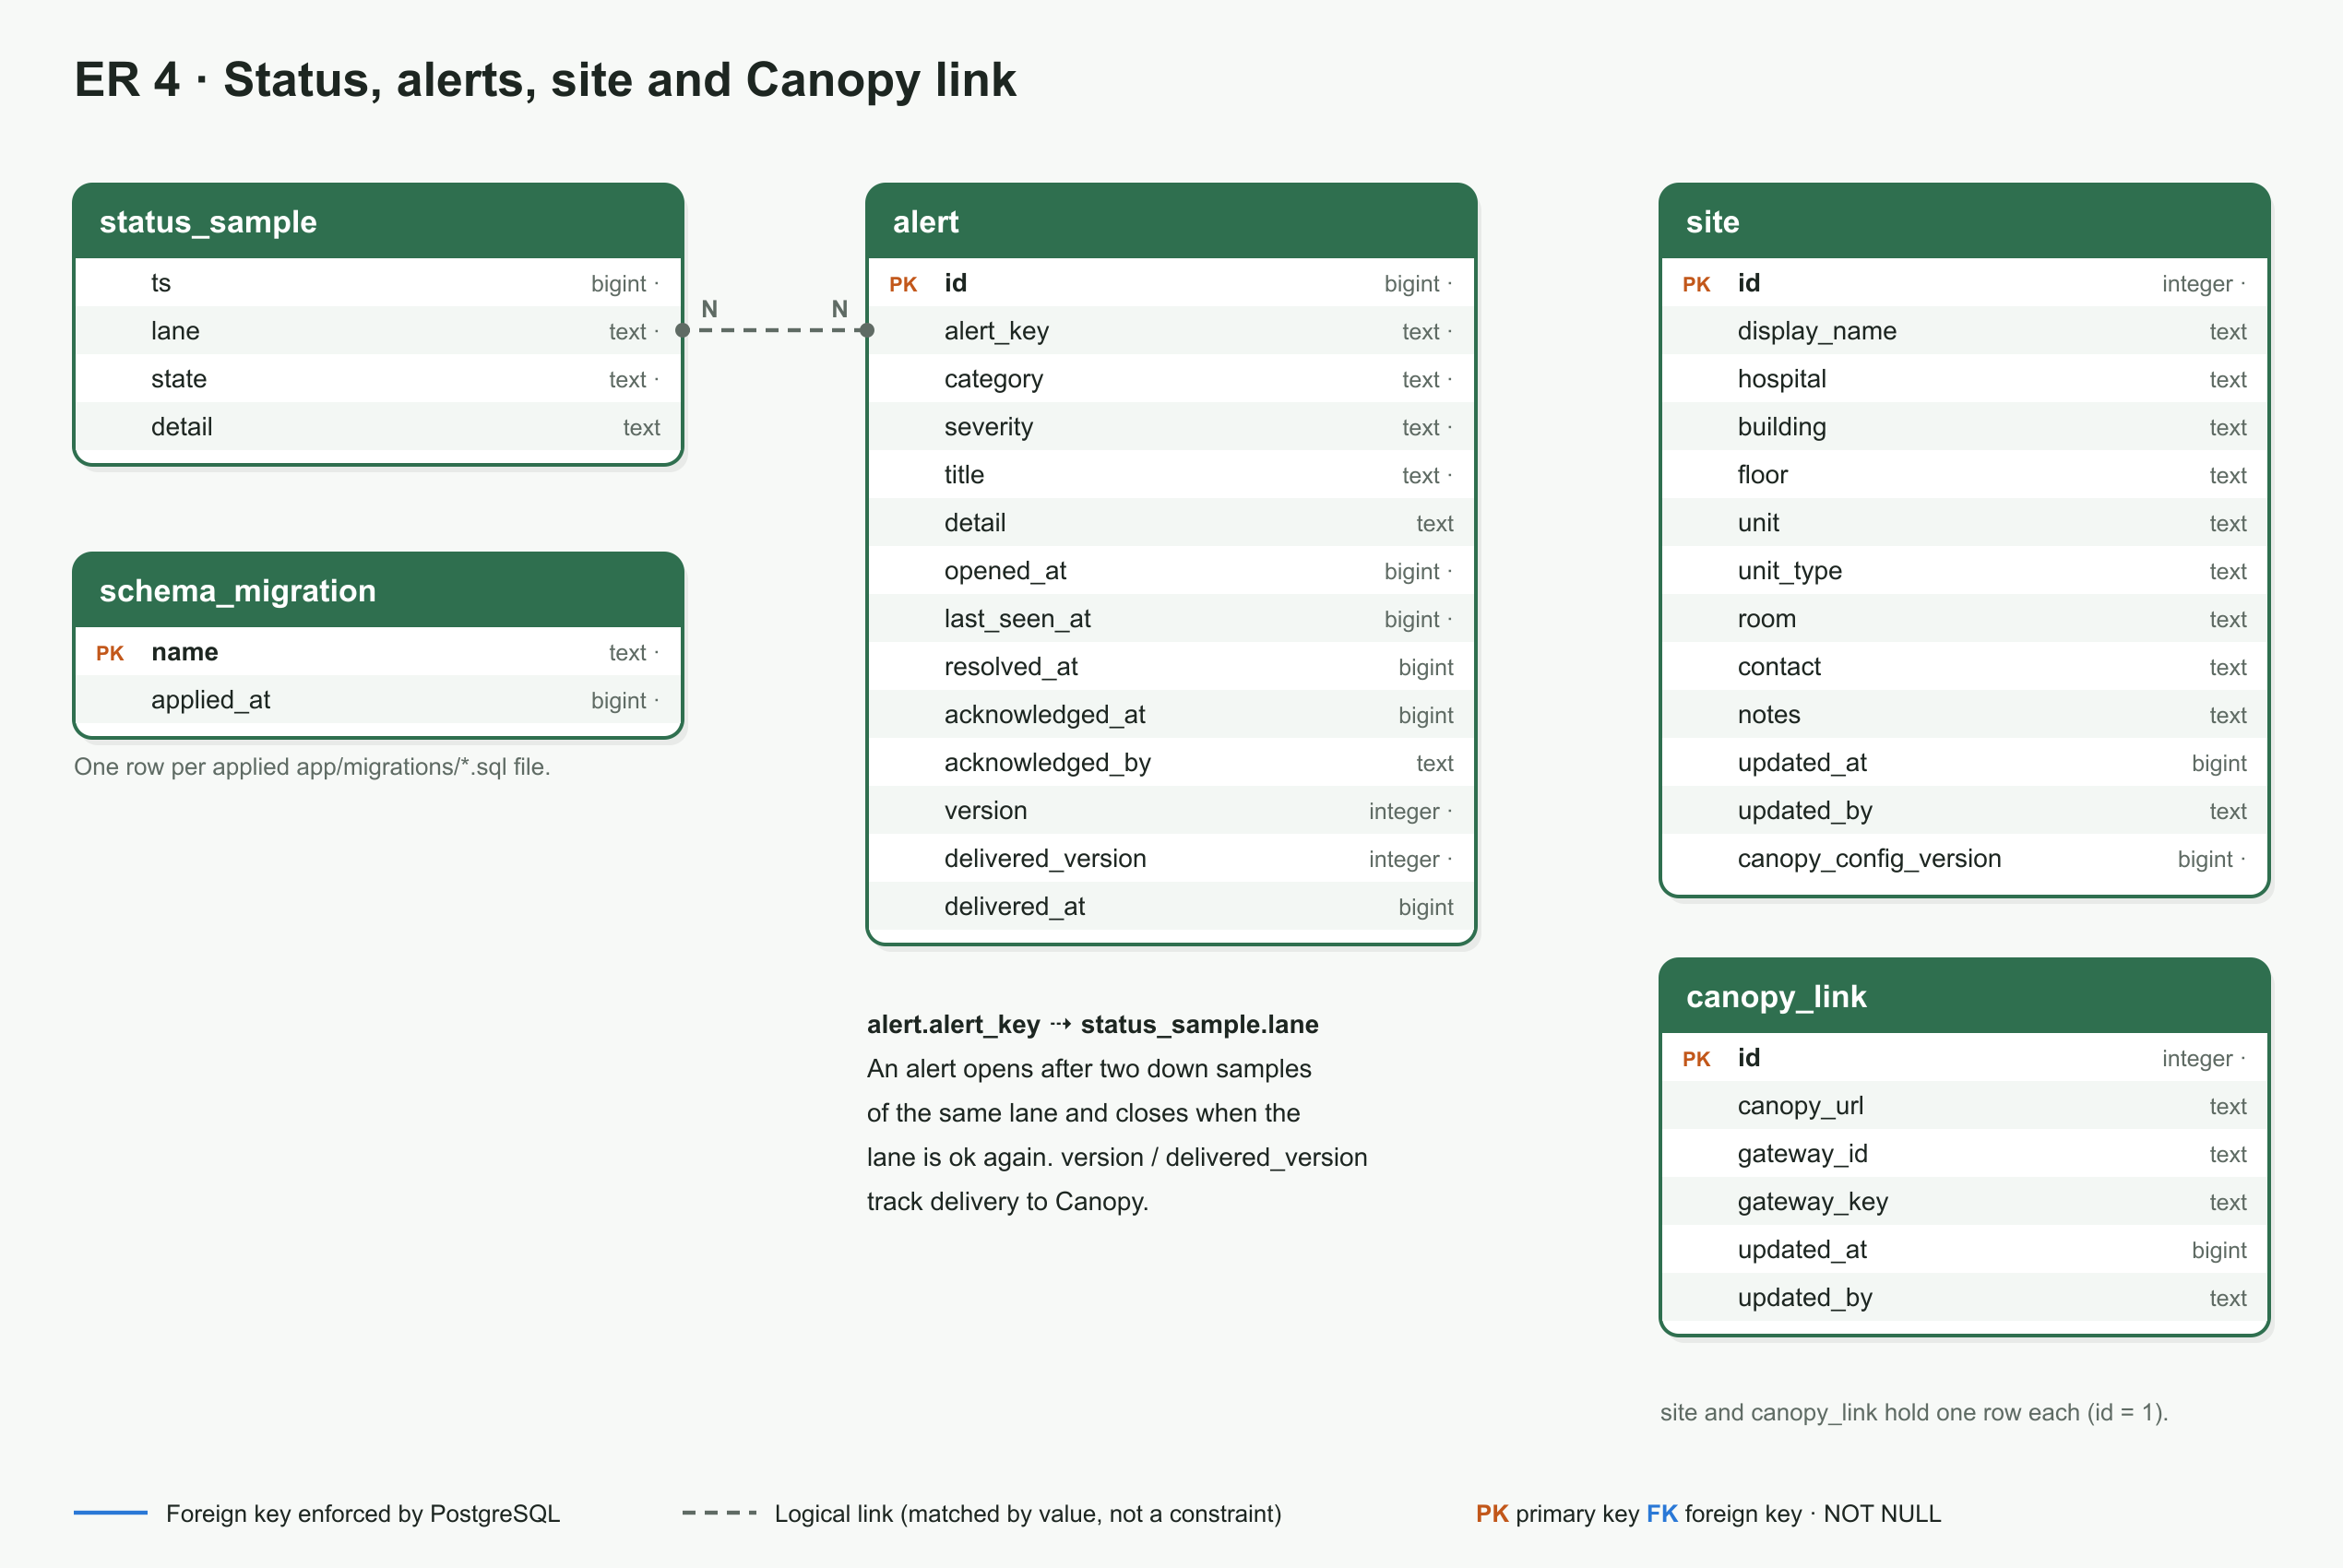
ER 4 · Status, alerts, site, Canopy link

Slide 25
Messages on Kafka
Topic | From → to | Content
gw.raw.<pod> | controller → parser | RawFrame: bytes read from a device, with source IP, connection and framing
gw.cmd.<pod> | parser / gateway-service → controller | Command: bytes to write to a device (polls, ACKs, greetings)
gw.obs | parser → collector, publisher | Observation: Flora parameter (ivy_param), value, unit, timestamps
gw.measurements | parser → collector | Original device field (raw_code, raw_value, definition)
gw.logs | any component → collector | LogEvent

Slide 26
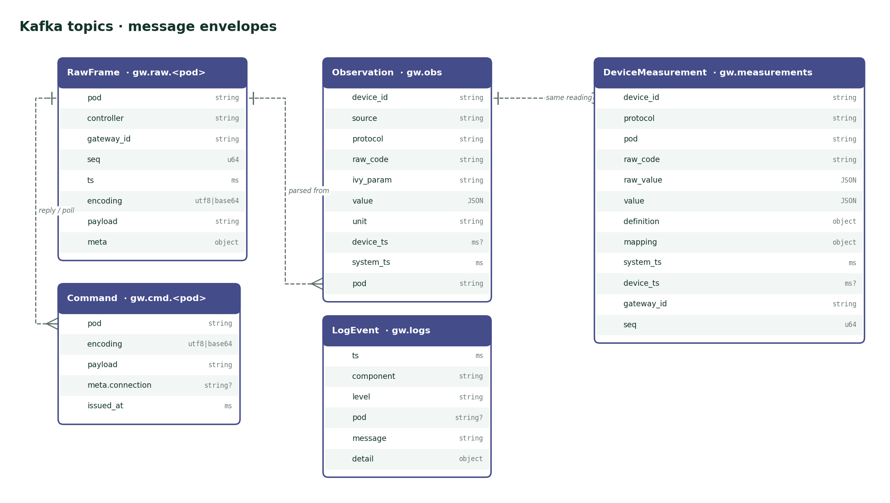
Kafka message envelopes

Slide 27
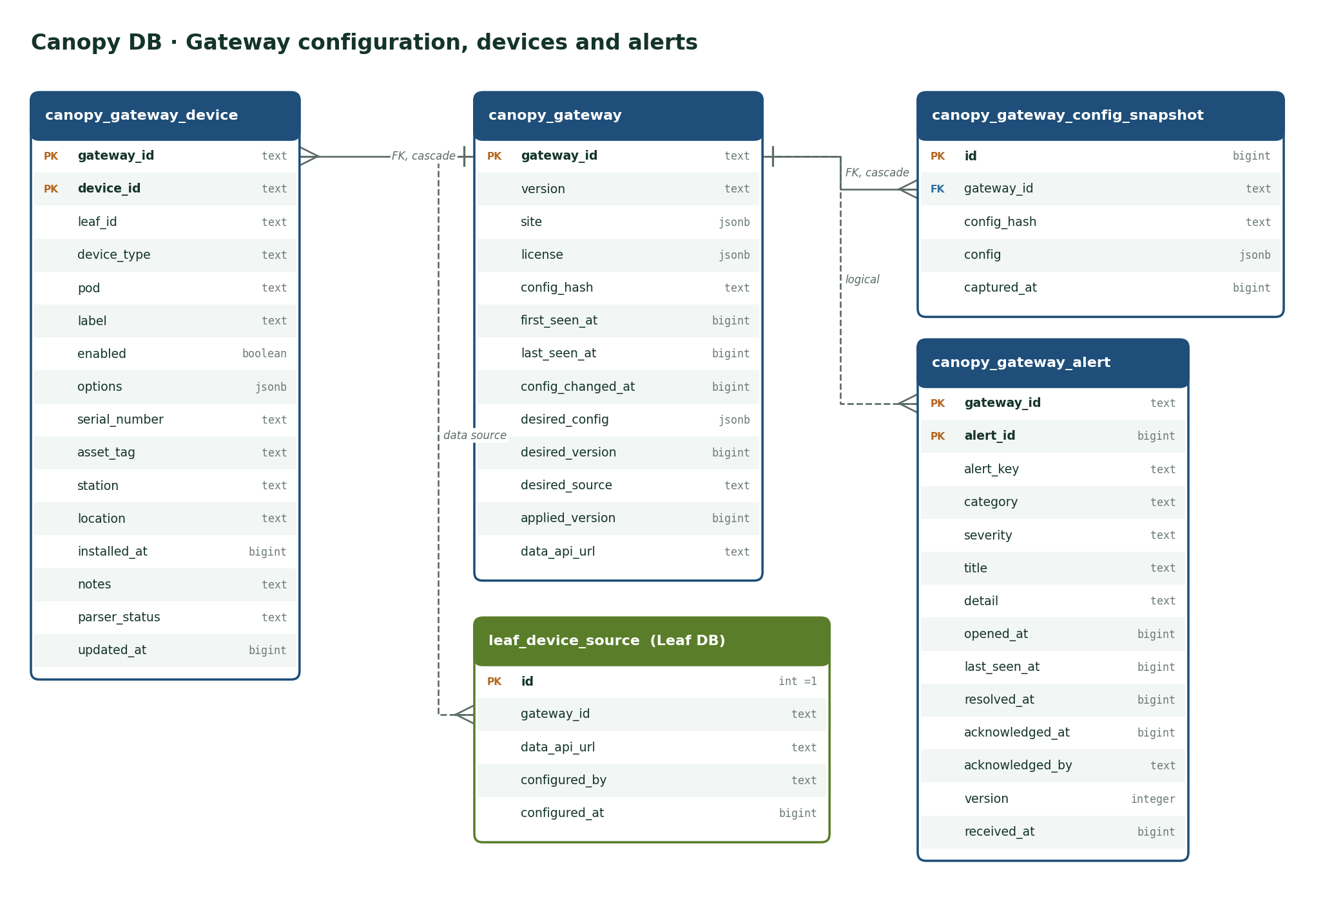
Related data at Canopy
Notes:
Not in the gateway database: Canopy's record of each gateway, filled from check-ins, plus the desired configuration and the central alert log.

Slide 28
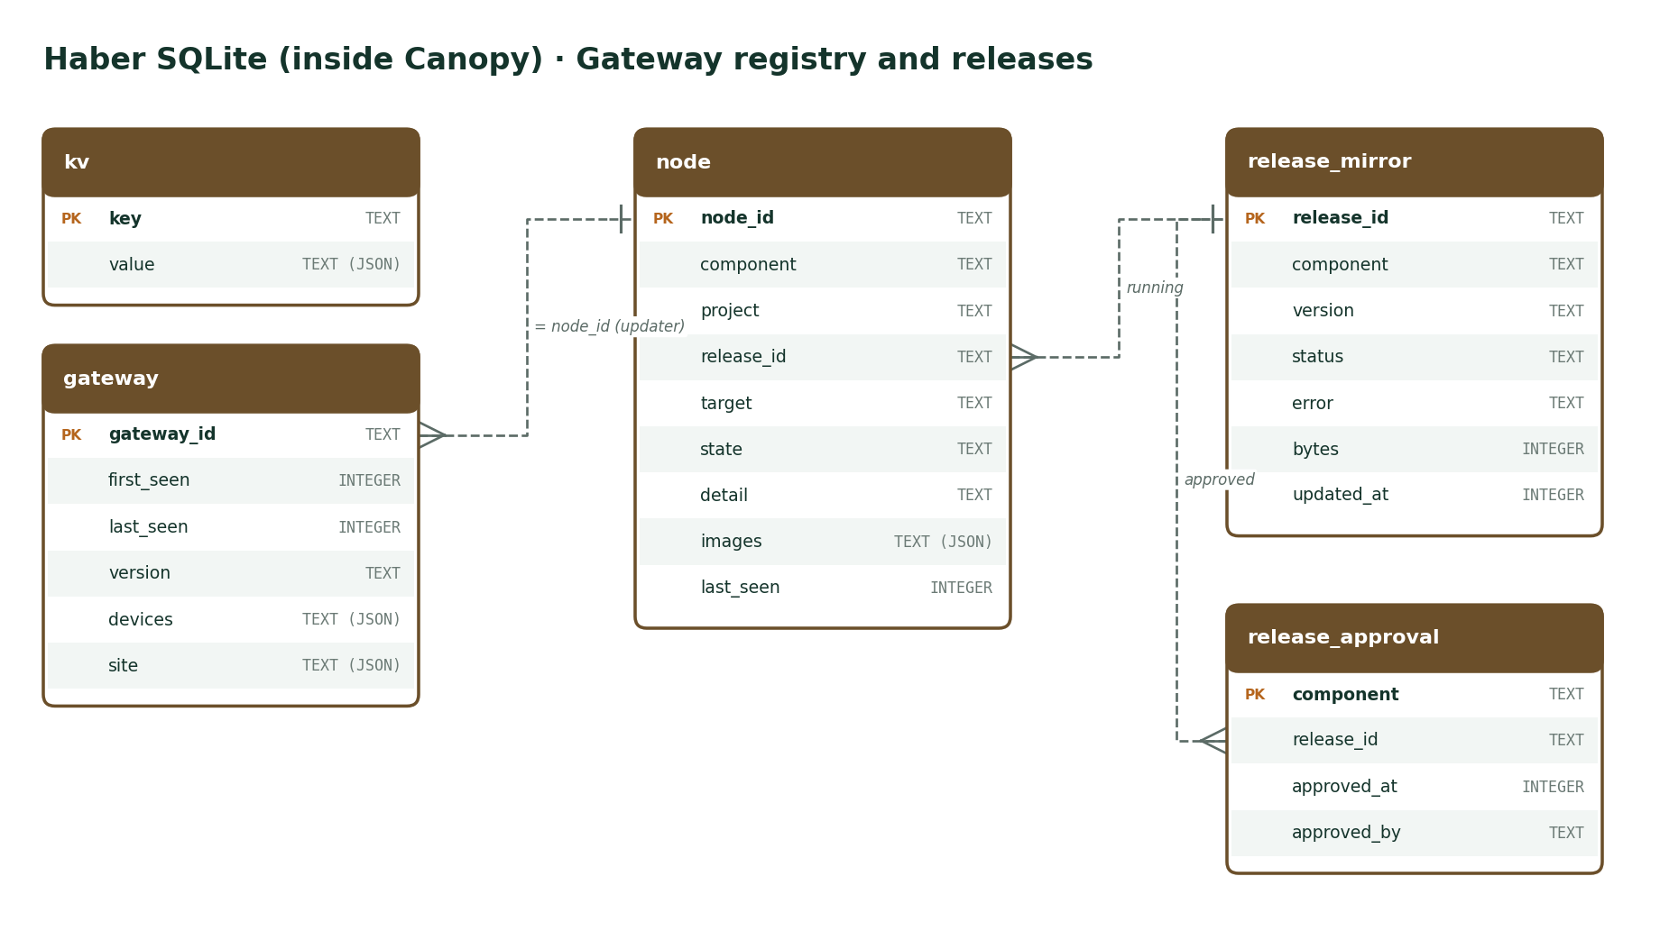
Haber: gateway registry and releases

Slide 29
Technology and operations
Stack, ports, releases, troubleshooting

Slide 30
Technology stack
Layer | Technology | Main libraries / versions
Ingress, egress | Rust (edition 2021) | tokio 1, rdkafka 0.37, tokio-postgres 0.7, tokio-serial 5.4, axum 0.8
Device parsers | Python 3.13 | aiokafka 0.12
Admin service | Python 3.13 | FastAPI 0.118, uvicorn 0.37, psycopg 3.2, Docker SDK 7.1, httpx 0.28
Admin UI | HTML, CSS, JavaScript | No framework; inline SVG charts
Message bus | Apache Kafka 3.9.1 | KRaft mode, single node
Database | PostgreSQL 17.6 | Alpine image
Data API | Kong 3.9 | DB-less, one route per Leaf
Edge | nginx 1.27 | TLS
Packaging | Docker Compose | flora-updater, Haber registry

Slide 31
Network ports
Port | Service | Reachable from
443 (demo 7443) | HTTPS edge: admin page and /data-api/ | Network
7400 | Admin page and API (gateway-service) | Local only
7410 | Data API (Kong) | Local only; use the edge from other machines
7401–7406 | Controller status endpoints | Local only
7412 / 7414 | PostgreSQL / Kafka | Local only
9001, 9002 (7421, 7422) | HL7 monitors (demo pods) | Device network
9500 | Dräger Vista 120 S CMS link | Device network
2050, 2000 (UDP) | Dräger M540 data and discovery | Device network (multicast)
2051 | M540 TCP relay (udp_relay) | Device network

Slide 32
Releases and updates
1
Build and publish
./demo/release.sh <version> gateway — Root signs it
Do not use compose --build
On a release-managed gateway it competes with the updater and can leave services stopped. Ship a new release (versions are immutable).
2
Approve at Canopy
Haber mirrors the images; the hospital approves
3
flora-updater applies it
Pinned in .release/flora-gateway.env

Slide 33
Troubleshooting
Symptom | What to check
A device shows “disabled” or “not started” | Enable it on Devices. Check the licence on Overview: the type must be licensed and the device limit not reached.
No data on Leaf | Devices → Monitor: are observations stored? Streams: are frames arriving on the pod? Then check that Kong (data API) is running.
Pod connected but 0 frames | Polled devices send only when asked: check that the device is enabled so its parser polls.
Canopy shows “offline” | Overview → Canopy connection: check the address, gateway ID and key. A 401 means the key is wrong.
Alerts “queued for Canopy” | Canopy is unreachable. Alerts are resent automatically when it comes back; use Send to Canopy now to retry.

Slide 34
Where to find more
Full manual: docs/gateway-manual/ESM-Flora-Gateway-User-Manual.docx
Developers: flora-gateway/README.md, DEVELOPMENT.md, CONFIGURATION.md, DRAEGER.md

