Slide 1
Flora Gateway User Manual
ESM FLORA
Medical device integration for OR, ICU and bedside workstations
Manual 1.0 · gateway release 0.2.4 · October 2026

Slide 2






What this manual covers
Overview
Technology stack
Where the Gateway sits, its components and data flow
Rust, Python, Kafka, PostgreSQL, Kong, nginx
Using the console
Canopy integration
Sign-in, roles, devices, streams, alerts
Licence, configuration sync, clone, Leaf wizard
Data structures
Reference
Relational diagrams for every data store
Ports, settings, security, updates, troubleshooting

Slide 3




From device signal to charted observation
Connect
RS-232, HL7 v2 / MLLP, UDP multicast, TCP and HTTP poll / push
Parse
One isolated parser container per device produces Flora observations
Store & serve
Local PostgreSQL store; each Leaf reads its own devices via the data-api
Licence
Device licence, catalogue and parser images come from Haber in Canopy
Watch
Status history for every lane, alerts pushed to Canopy

Slide 4
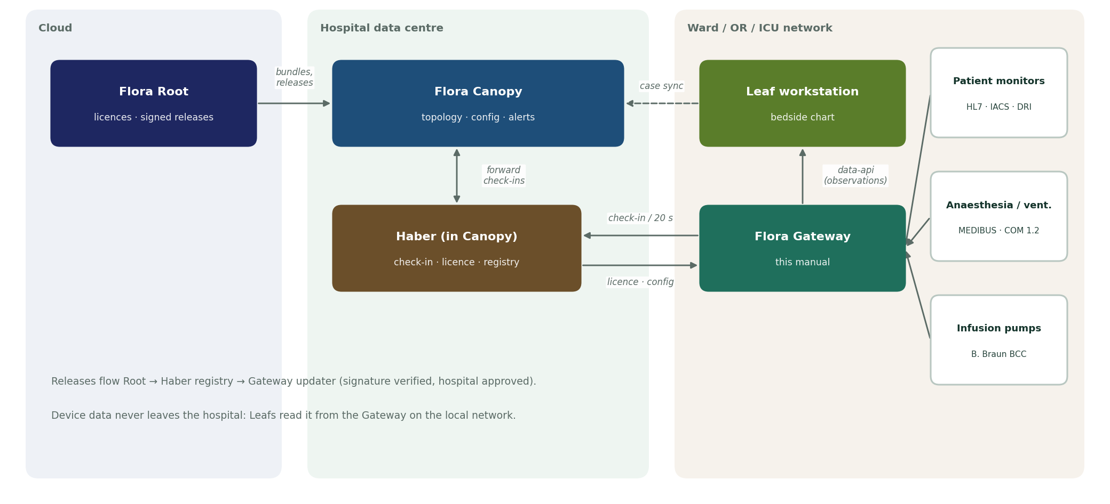
Where the Gateway sits in ESM Flora
Notes:
Root issues licences and releases; Canopy (with Haber) manages gateways; Leafs read device data from the Gateway on the local network.

Slide 5
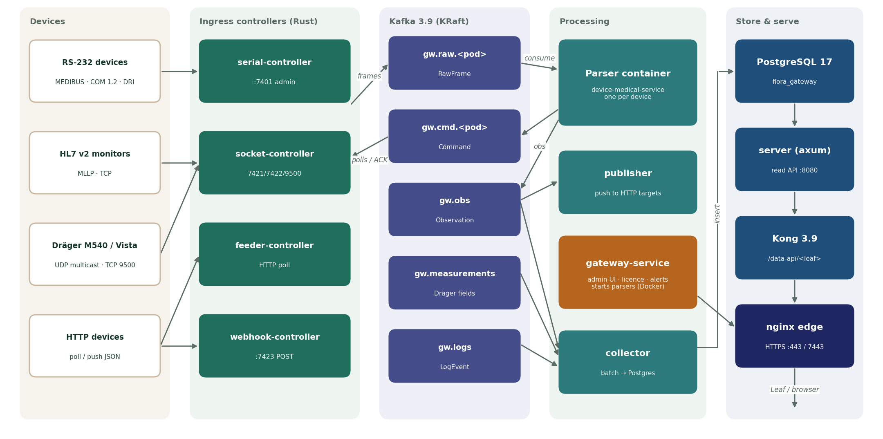
Inside the Gateway: device bytes to Leaf observations
Notes:
Controller -> gw.raw.<pod> -> parser -> gw.obs -> collector -> PostgreSQL -> server -> Kong /data-api/<leaf> -> nginx edge -> Leaf.

Slide 6
Fifteen containers, one Compose project
Container | Role | Port
kafka | Message bus between controllers, parsers and the collector (Kafka 3.9, KRaft) | 127.0.0.1:7414
gateway-db | PostgreSQL 17 store: registry, licence, alerts and observations | 127.0.0.1:7412
serial-controller | RS-232 ingress and egress (frames split by idle time) | 127.0.0.1:7401 admin
socket-controller | TCP/UDP ingress: HL7 MLLP, line, raw, UDP multicast and relay | 7421, 7422, 9500
feeder-controller | Polls device HTTP endpoints | 127.0.0.1:7402 admin
webhook-controller | Receives HTTP POSTs from devices | 7423
parser (one per device) | device-medical-service container, turns frames into observations | internal
collector | Writes observations, measurements and logs to PostgreSQL in batches | 127.0.0.1:7405 admin
publisher | Optionally pushes observations to external HTTP receivers | 127.0.0.1:7406 admin
server | Read API for observations, measurements and device status (Rust/axum) | internal :8080
kong | data-api routes for each Leaf (DB-less Kong 3.9) | 127.0.0.1:7410
gateway-service | Admin console and API, Haber check-in, licence, parser lifecycle, alerts | 127.0.0.1:7400
edge | nginx HTTPS entry point for the console and /data-api/ | 443 (dev 7443)
updater | Applies the release approved in Haber, with health check and rollback | outbound only
simulator (demo) | Synthetic devices for demonstrations and training | 127.0.0.1:7420

Slide 7





Technology stack
Rust 2021
Python 3.13
Kafka 3.9.1
Controllers, collector, server, publisher: tokio, axum, rdkafka, tokio-serial
gateway-service (FastAPI 0.118, psycopg 3) and device parsers (aiokafka)
KRaft single node, topics per pod, 72 h retention
PostgreSQL 17.6
Kong 3.9 + nginx 1.27
Docker Compose
Registry, licence, alerts and observation time series
Per-Leaf data-api routes; HTTPS edge with Flora CA certificates
One parser container per device; signed, digest-pinned releases

Slide 8
Protocols and security
Device protocols
Security
HL7 v2 (ORU, IHE PCD-01) over MLLP
Dräger MEDIBUS.X, IACS (M540), Vista CMS link
GE Datex COM 1.2 and DRI
B. Braun BCC (SpaceCom)
JSON push / poll, ASCII key=value
HTTPS edge, certificate from the shared Flora CA
scrypt passwords, HttpOnly 12 h sessions
Admin and operator roles
Bearer gateway key to Haber
Ed25519-signed releases, digest-pinned images

Slide 9
Using the console
https://<gateway-host> · dev https://localhost:7443

Slide 10


Sign in and roles
First sign-in
Open https://<gateway-host> and sign in.
New gateway: admin / admin (from GATEWAY_ADMIN_USERNAME / _PASSWORD).
Change it at once: gear → Users → My password.
Sessions last 12 hours; a password change signs out other sessions.
Admin
Everything an operator can do, plus device types, manufacturers, users, the Canopy connection and the site/location.
Operator
Devices (add, edit, enable, disable, remove, restart), controllers (start, stop, restart), streams, acknowledging alerts, Haber sync.

Slide 11



Four tabs run the gateway
Overview
Devices
Streams
Alerts
Station and Canopy status, uptime history, licence, controller layers, live device data, logs
Installed devices with inventory data; add, edit, enable, remove; per-device Monitor
Every ingress pod: frames/s, bytes/s, last 200 frames in and out as text or hex
Active alerts to acknowledge, alert log, delivery status to Canopy
Gear menu: Device types · Manufacturers · Users · Sign out

Slide 12
Add a device in four steps
1
Devices → Add device
Before you start
The device type exists (from Canopy or a local template)
The licence allows the type and has a free slot
The pod (e.g. socket.icu-monitor) exists in gateway.toml
Device ID is unique: letters, digits, . _ - (max 80)
Changing type, pod or options restarts the parser
2
Fill Device ID, type, pod, Leaf and inventory fields
3
Tick Enabled → Save: type, ID and licence are checked, parser starts
4
Monitor: values within a minute; else open Ingress stream

Slide 13






Everyday operations
Restart a parser
Enable / disable
Overview → Live device data → Restart
Devices → Enable/Disable; enabled devices use licence slots
Stop a controller
Look at data
Overview → Layers → Stop / Start / Restart; stays stopped until started
Streams for raw frames · Monitor for parsed values · Overview → Logs
Sync with Canopy
Remove a device
Overview → License → Sync now (check-in immediately)
Devices → Remove; parser stops, stored observations are kept

Slide 14
Monitoring and alerts
Alert | Category | Severity | Raised when
Canopy connection lost | canopy | warning | No good check-in within 3 × the sync interval
Controller down: <name> | controller | critical | Controller /status unreachable or container stopped
No data from <device> | device | critical | Enabled device sent nothing for 120 s
Gateway service was not running | gateway | warning | Recorded on start when the last sample is more than 2 min old
One status sample per lane every 30 s, kept 7 days
Opens after 2 consecutive down samples; resolves on the first OK
Disabled devices and stopped controllers report stopped, not down
Every change is pushed to the Canopy gateway alert inbox

Slide 15
Working with Canopy
Licence · configuration sync · clone · Leaf assignment

Slide 16
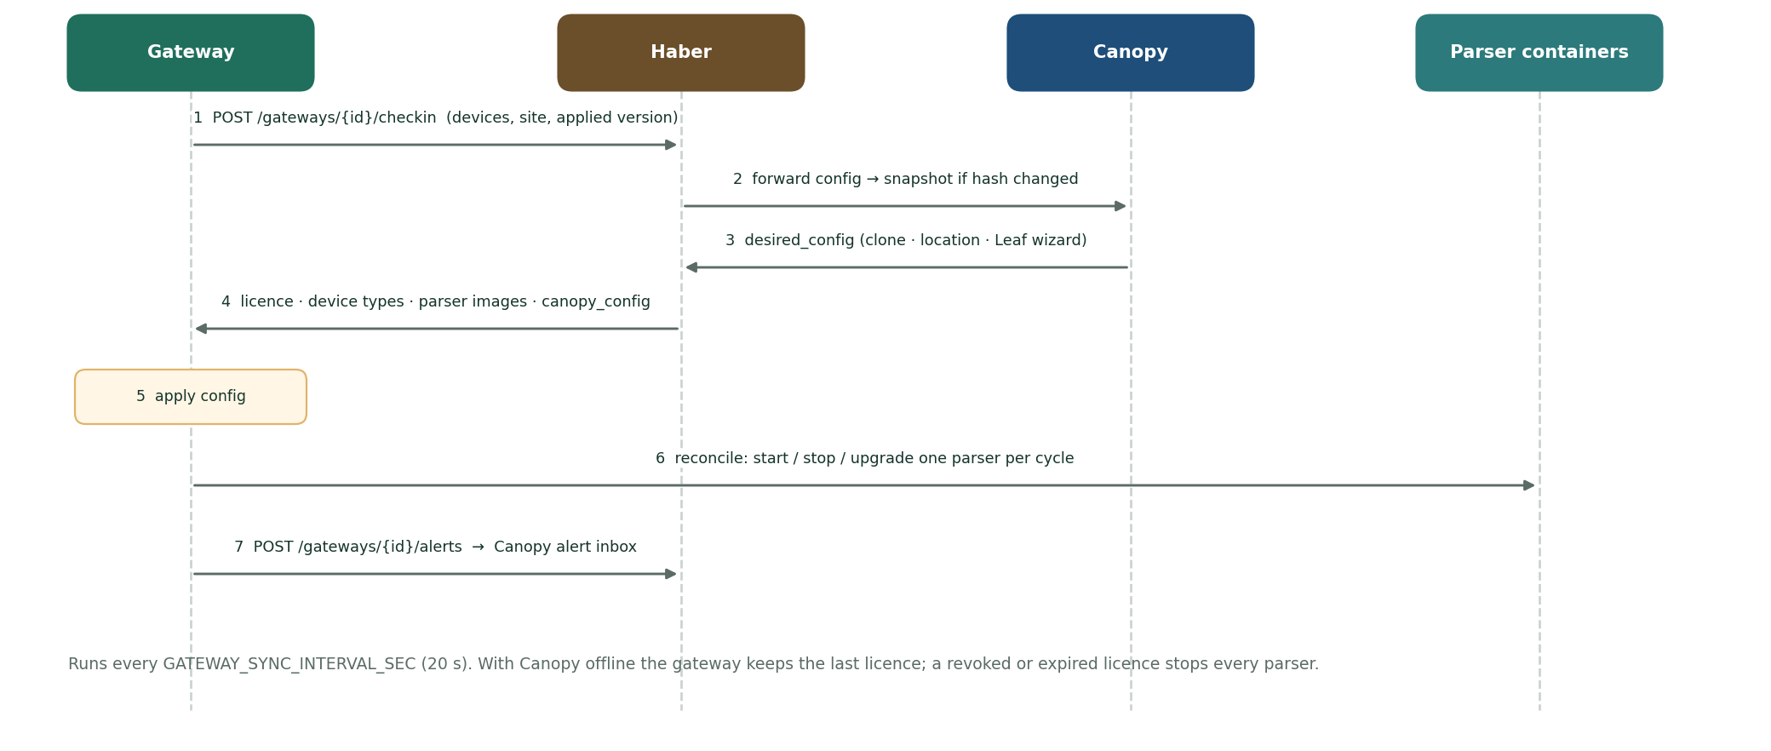
Every 20 seconds the gateway checks in

Slide 17



Connect, license, locate and clone
Connect
Licence
Overview → Station → Canopy connection: address, Gateway ID, Gateway key. Saving checks in at once.
Max devices, allowed types, expiry. Kept while Canopy is offline; revoked or expired stops all parsers.
Location
Clone
Set at Canopy → Topology → gateway → Set location…; applied at the next check-in.
Canopy snapshots each configuration; clone it to a new gateway, which receives it on first check-in.

Slide 18
Assign devices to a Leaf with the gateway wizard
1
2
3
4
Test the data-api URL the gateway reported
Choose devices for this Leaf
Assignment travels via Canopy, applies at next check-in
Verify values from the last 60 s, save the source
On the Leaf: Ward settings → Gateway wizard (permission config.manage). The Leaf then reads https://<gateway>/data-api/… filtered by its leaf_id.

Slide 19
Supported device types
Code | Device | Controller | Parser
hl7-patient-monitor | Patient monitor (HL7 v2 / IHE PCD-01) | socket | hl7v2
hidro-hl7-monitor | Hidro shared HL7 monitor | socket | hidro_hl7
draeger-iacs-m540 | Dräger M540 (IACS UDP) | socket | iacs_m540
draeger-vista-120s | Dräger Vista 120 S (CMS link, TCP) | socket | draeger_vista_s
draeger-medibus | Dräger MEDIBUS.X (RS-232) | serial | medibus
ge-carestation-750 | GE Carestation 750 (COM 1.2) | serial | ge_carestation
ge-aisys-cs2 | GE Aisys CS2 (COM 1.2) | serial | ge_carestation
ge-bx50-dri | GE Bx50 / B650 (DRI) | serial | ge_dri
ge-s5-dri | GE S/5 (DRI) | serial | ge_dri
ge-aisys-dri | GE Aisys (legacy DRI) | serial | ge_dri
bbraun-space-bcc | B. Braun SpaceCom (BCC over TCP) | socket | bbraun_bcc
json-anesthesia-machine | Anaesthesia machine (JSON push) | webhook | json_fields
http-ventilator | ICU ventilator (HTTP poll) | feeder | json_fields
serial-temp-module | Temperature / CVP module (RS-232, polled) | serial | ascii_kv
acme-t200 | Acme T-200 temperature / CVP (RS-232) | serial | acme_t200

Slide 20
Data structures
Relational diagrams · solid = foreign key · dashed = logical link

Slide 21
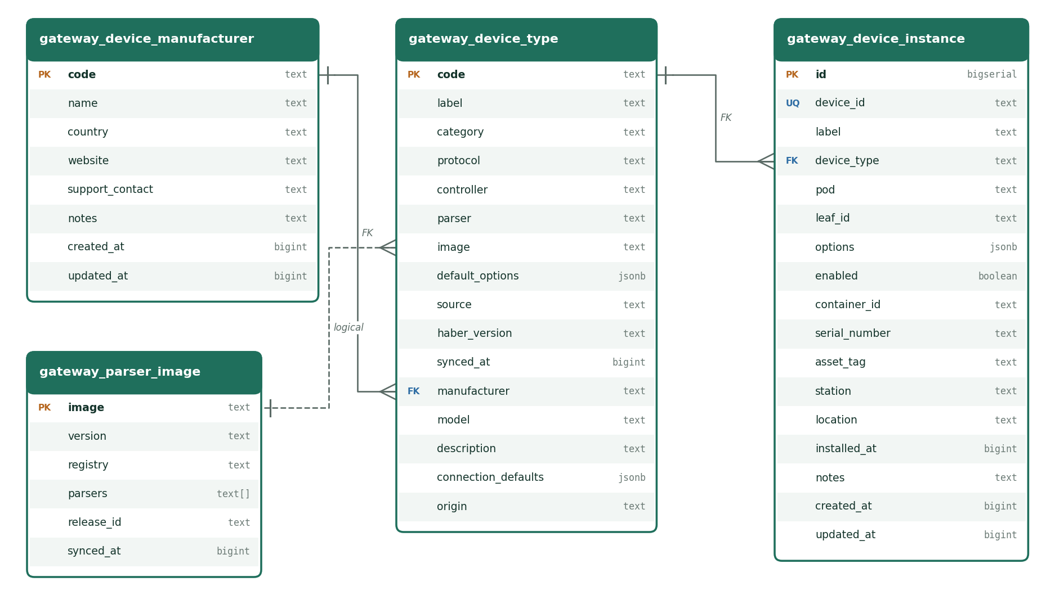
Gateway DB · device registry

Slide 22
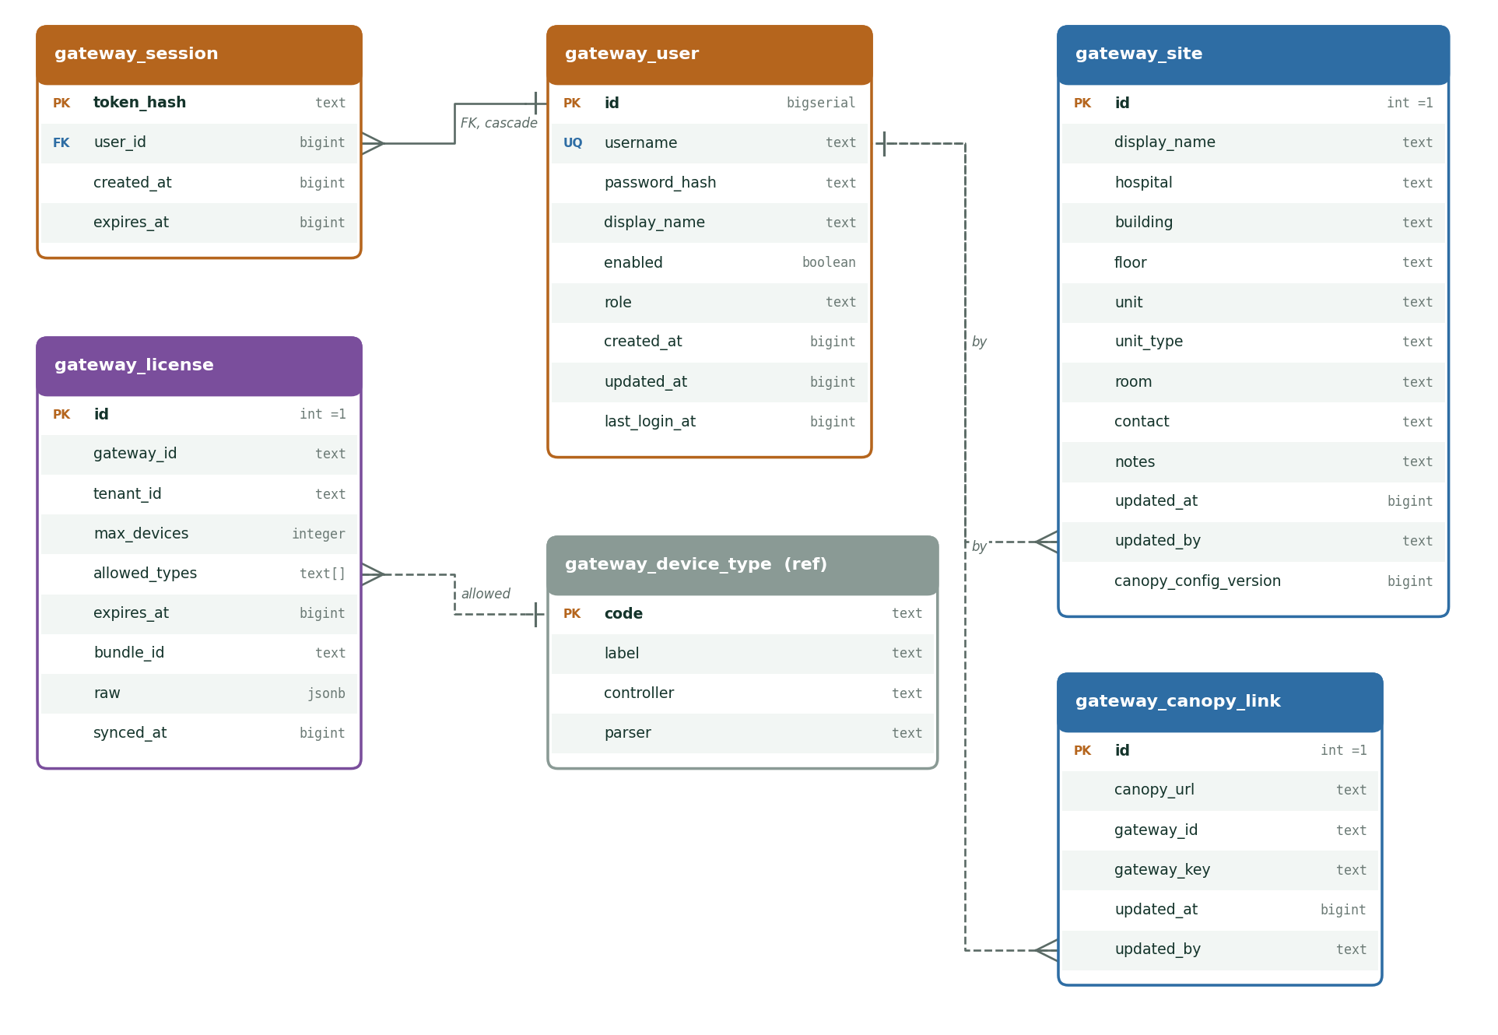
Gateway DB · licence, site, Canopy link, users

Slide 23
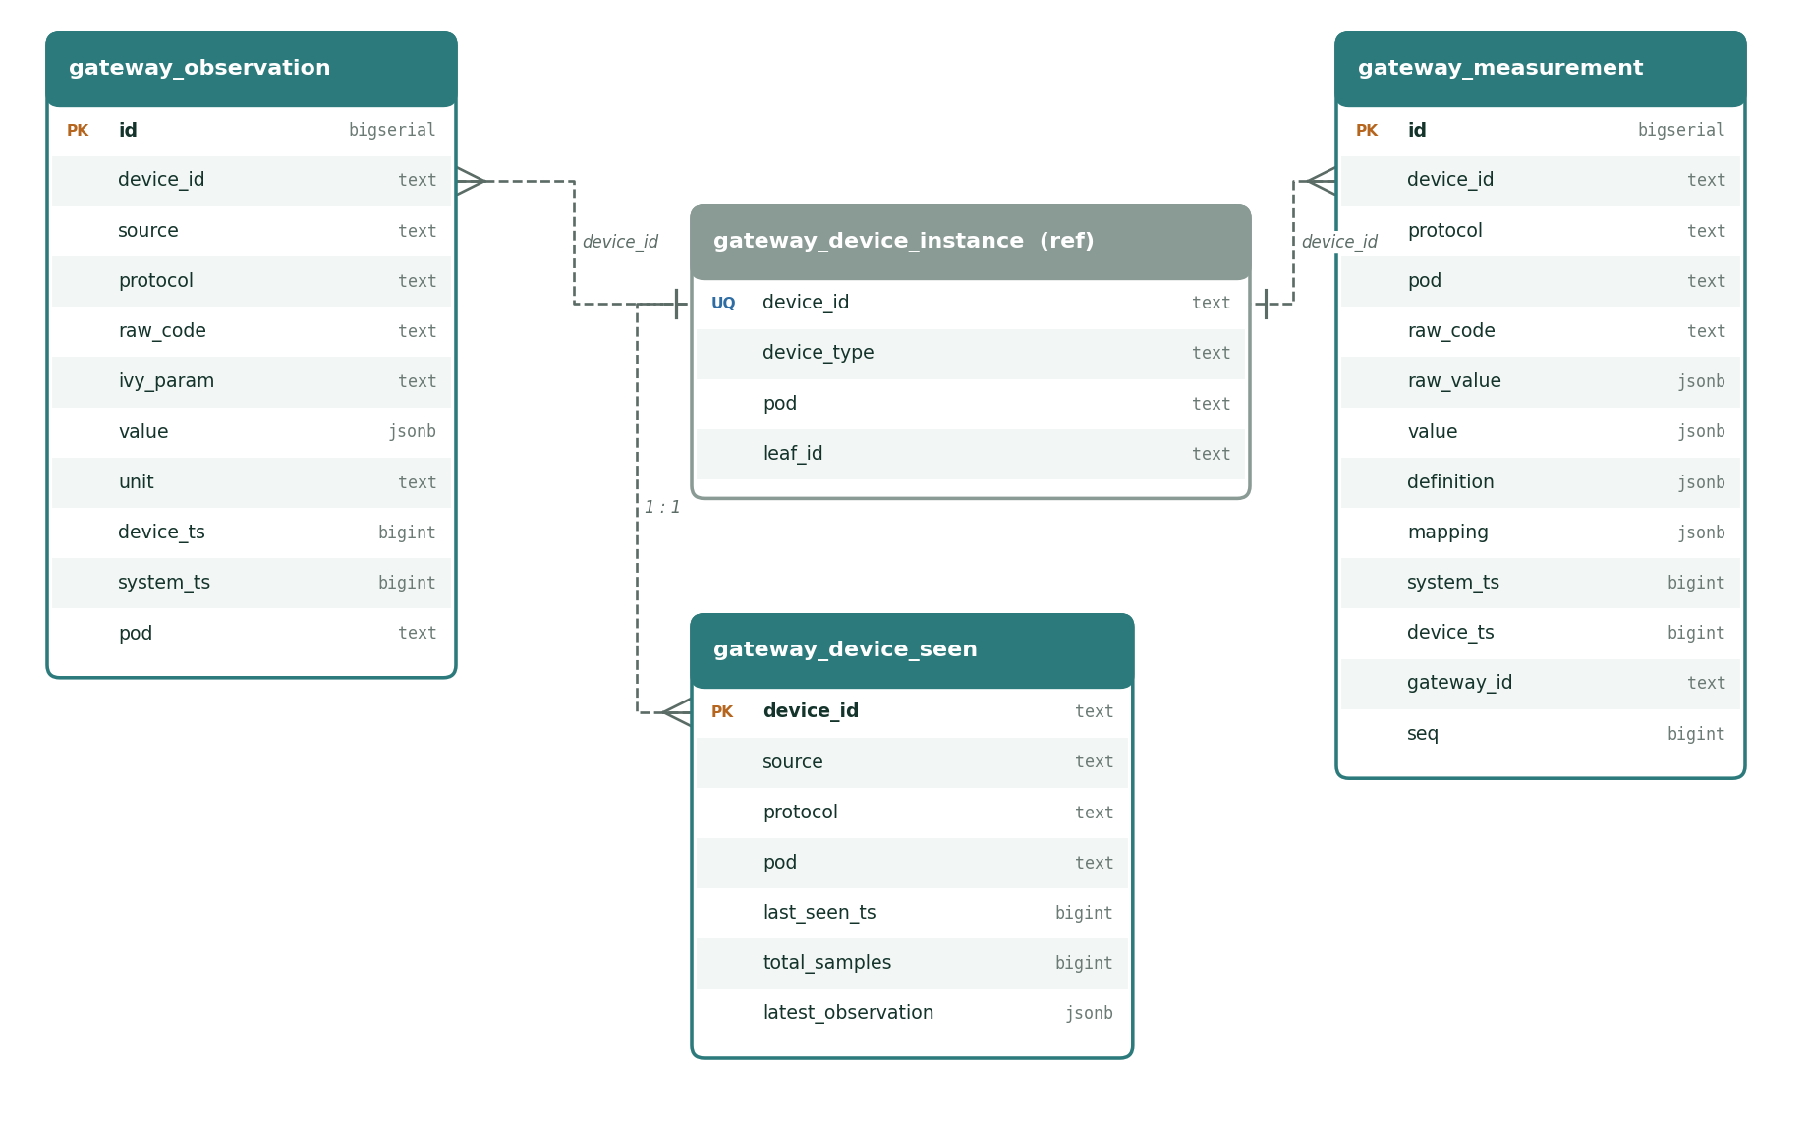
Gateway DB · observations (time series)

Slide 24
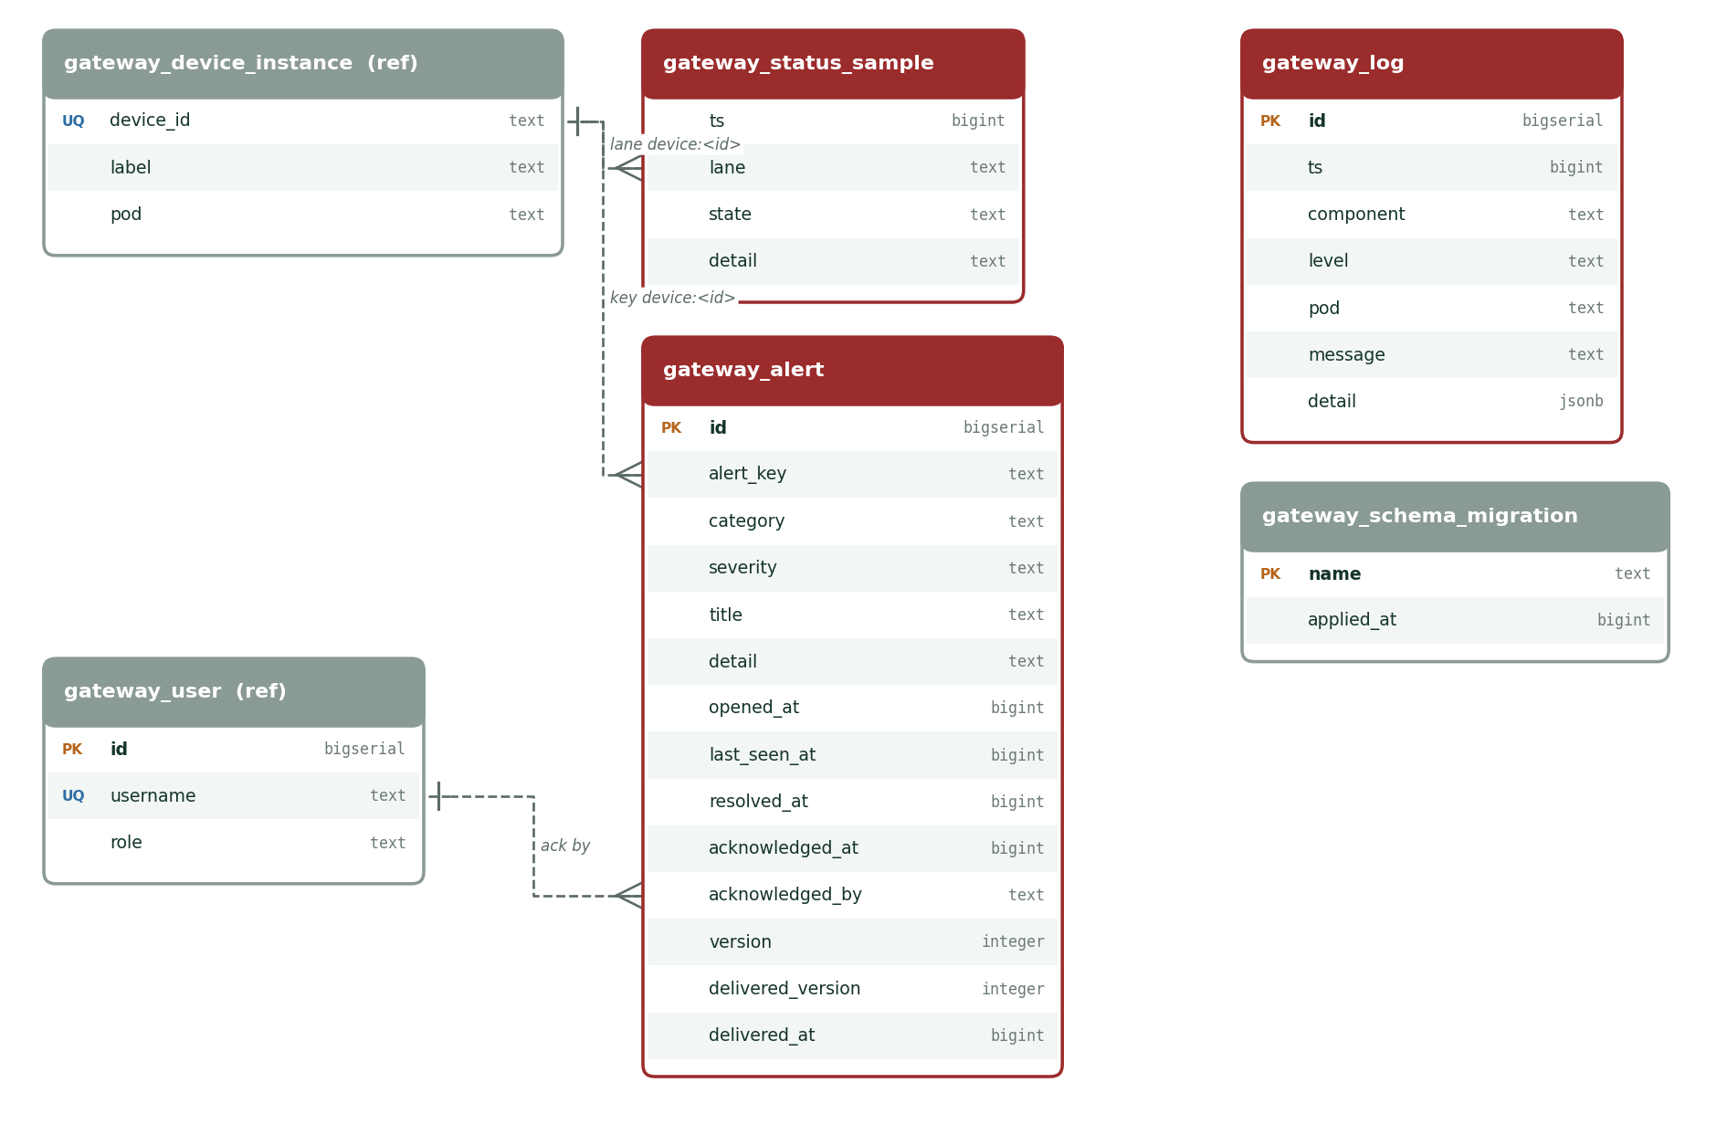
Gateway DB · monitoring, alerts, operations

Slide 25
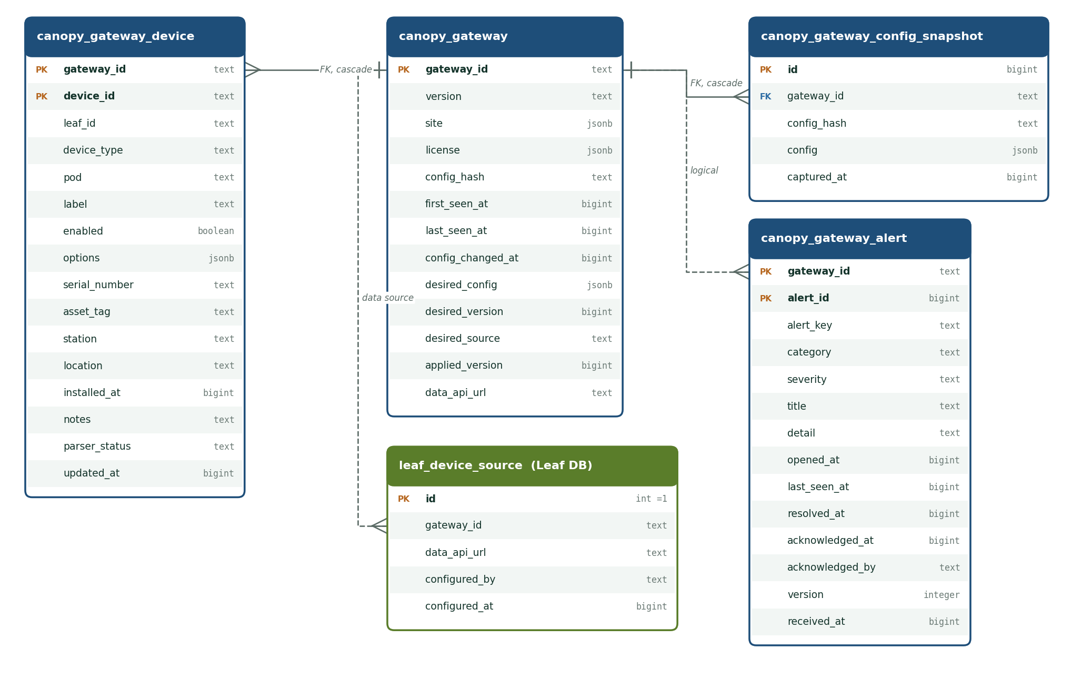
Canopy DB · gateway configuration and alerts

Slide 26
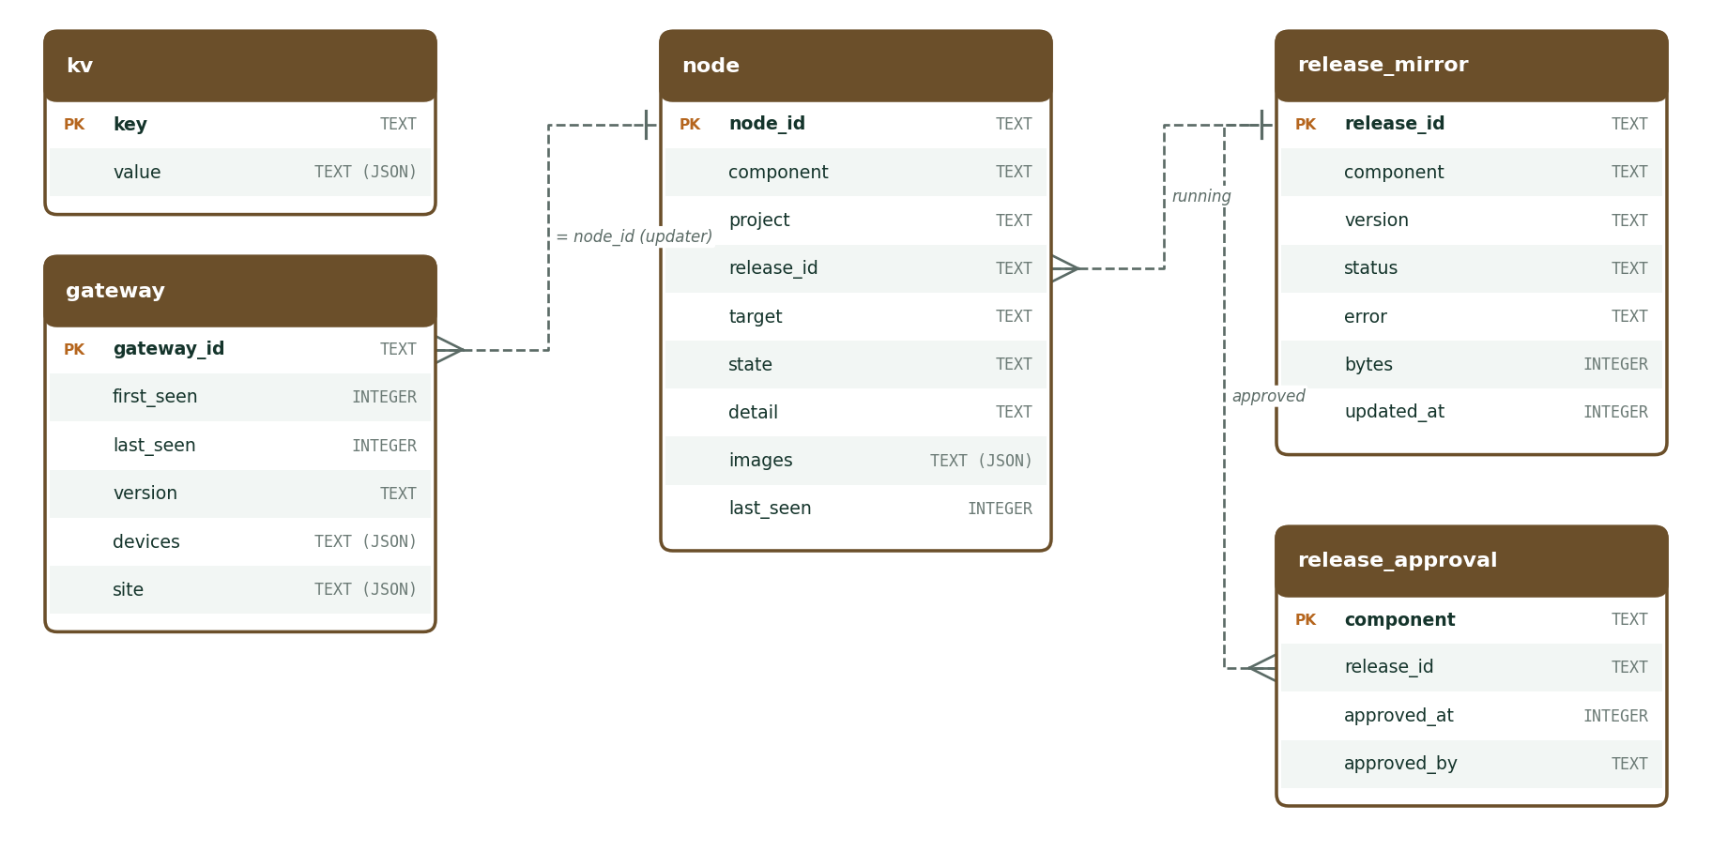
Haber SQLite · gateway registry and releases

Slide 27
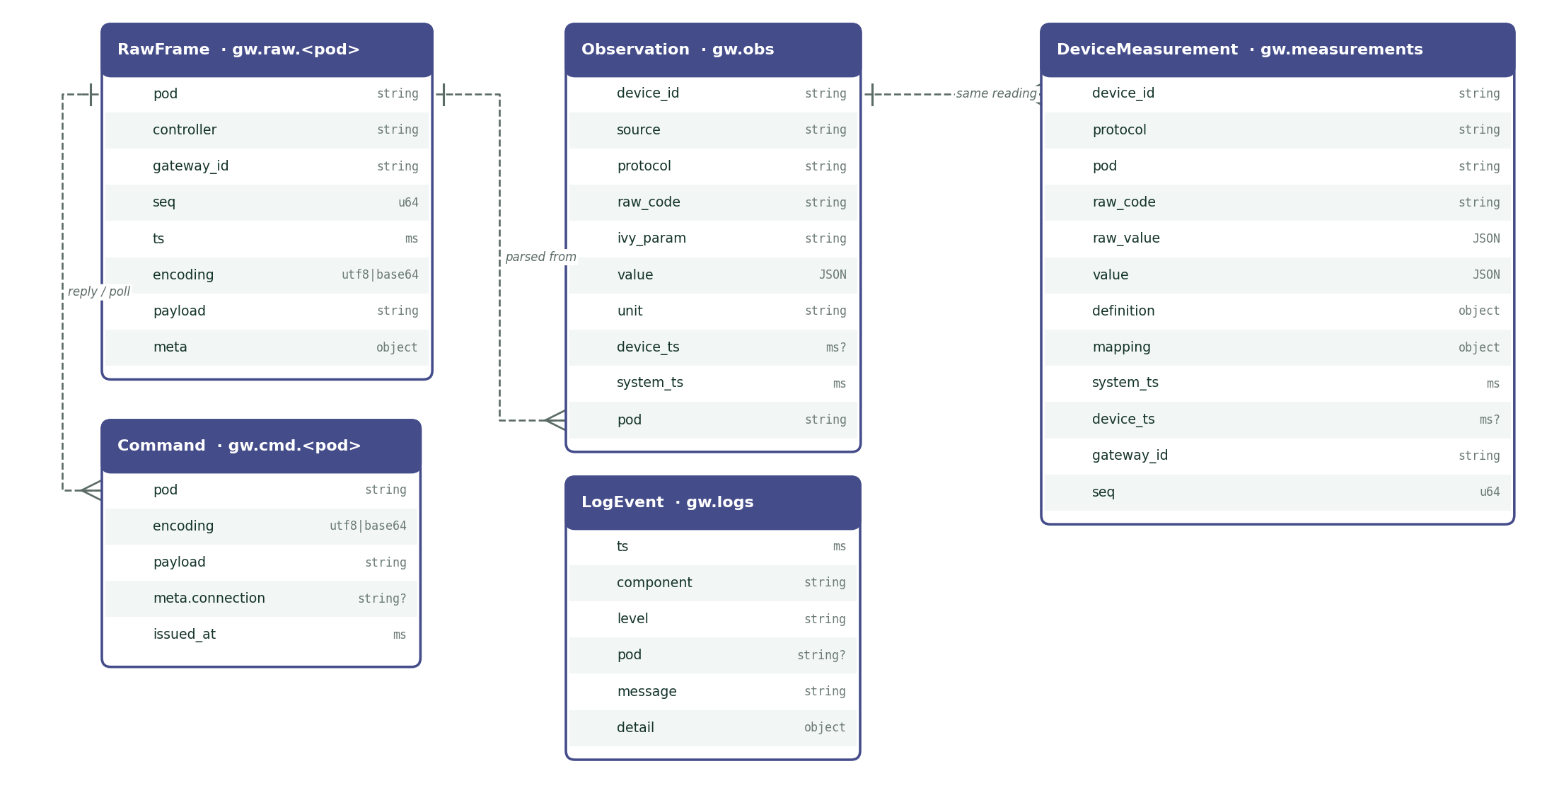
Kafka topics · message envelopes

Slide 28
Network and ports
Port | Service | From
443 (dev 7443) | HTTPS edge: admin console and /data-api/ | LAN
7400 | gateway-service admin (HTTP) | localhost
7401–7406 | Controller, collector and publisher /status | localhost
7410 | Kong data-api (HTTP) | localhost
7412 / 7414 | PostgreSQL / Kafka | localhost
7421 / 7422 | HL7 MLLP OR / ICU monitors | device LAN
7423 | Device webhook (HTTP POST) | device LAN
9500 (UDP 9610) | Dräger Vista 120 S CMS link (beacon) | device LAN
2050 UDP · 2000 | Dräger M540 data · discovery multicast 224.127.1.254 | device LAN
2051 | M540 relay (udp_relay framing) | device LAN
4001 (outbound) | B. Braun BCC SpaceCom | device LAN
7420 | Simulator (demo profile only) | localhost
Canopy 443 (dev 9443) | Haber check-in at /api/haber/ (outbound) | hospital

Slide 29
Key settings in flora-gateway/.env
Variable | Default | Meaning
FLORA_GATEWAY_ID | gateway-hospital-01-a | Gateway identity, stamped on every frame
HABER_URL | https://host.docker.internal:9443 | Canopy / Haber address
HABER_GATEWAY_TOKEN | (demo token) | Gateway key sent as Bearer token
GATEWAY_SYNC_INTERVAL_SEC | 20 | Check-in interval in seconds
GATEWAY_LICENSE_REQUIRED | true | Without a valid licence, parsers do not run
GATEWAY_DATA_API_URL | http://host.docker.internal:7410/data-api | data-api URL reported to Canopy for the Leaf wizard
GATEWAY_ADMIN_USERNAME / _PASSWORD | admin / admin | First admin account (only when no users exist)
GATEWAY_SESSION_HOURS | 12 | Console session lifetime
GATEWAY_ADMIN_KEY | (empty) | Optional x-gateway-key header for scripted write calls
FLORA_GATEWAY_CONFIG_FILE | gateway.toml | Controller and pod configuration
FLORA_GATEWAY_SEED_FILE | instances.json | First-start device seed (ignored once Canopy config applied)
FLORA_GATEWAY_DB_PASSWORD | flora-gateway-local-only | PostgreSQL password — change in production

Slide 30




Releases arrive signed and approved
Root signs
Haber mirrors
Hospital approves
Updater applies
Health check / rollback
Images are pinned by sha256 digest and verified against the Root key
Health checks within 180 s; automatic rollback if unhealthy
Parser images upgrade one device per check-in cycle
Optional maintenance window: FLORA_UPDATER_WINDOW=HH:MM-HH:MM

Slide 31
Troubleshooting
Symptom | What to do
"unknown device type …; sync from Haber first" | The type is not in the catalogue yet. Check the Canopy connection and the licence, then Overview → License → Sync now.
403 "device license invalid / not licensed / device limit reached" | Licence problem: expired, revoked, type not allowed or max_devices reached. Ask the Canopy administrator; Root issues licences per hospital.
Canopy shows 503 "no verified license bundle" | Canopy has no verified bundle from Flora Root yet: a Canopy-side issue.
Alert "No data from <device>" | Open Streams: are frames arriving on the pod, are polls going out? Check cable, baud/parity, port, source IP and that the controller is running.
Controller shows Stopped | It stays stopped across restarts until you press Start (or run docker compose up).
COM port not visible (Windows) | Docker Desktop cannot pass COM ports. Run serial/socket controllers natively and point SERIAL_ADMIN_URL / SOCKET_ADMIN_URL to them.
Dräger M540 silent | Multicast does not cross subnets or Docker bridges: use tools/iacs-relay/relay.py with udp_relay framing.
Edits to instances.json have no effect | It is only a first-start seed. Edit devices in the console.

Slide 32
Quick reference
Console https://<gateway> · data-api /data-api/<leaf-id>/api/observations · full manual and diagrams in docs/gateway-manual/

