Slide 1

Flora Gateway
ESM FLORA PLATFORM
User Manual · medical device integration for OR and ICU
Release line gateway-0.2.x · October 2026
Notes:
Flora Gateway user manual. This deck summarises installation, device setup, Leaf assignment, central management, data structures and the technology stack. The full detail is in the Word manual delivered alongside.

Slide 2






What this manual covers
Architecture
Technology stack
Install & operate
Services, data path and connectivity
Rust, Python, Kafka, PostgreSQL, Kong
Ports, settings, station admin UI
Devices & Leaf
Canopy & fleet
Data structures
Add devices, assign them to a bed
Check-in, license, alerts, updates
Relational diagrams and message schemas
Notes:
Six parts. The data-structures part has separate relational diagrams, also delivered as PNG and SVG files.

Slide 3


Where the gateway fits in ESM Flora
Flora Root
Flora Canopy
Flora Leaf
Flora Gateway
Cloud
Tenants, signed licenses, signed releases
Hospital data centre
Central data, fleet management, Haber registry
Each OR / ICU workstation
Bedside charting; works without Canopy
One per device network
Talks to devices, serves data to Leaf
Every tier connects outward only, so each one works behind NAT. The Leaf reads the gateway directly, so device data keeps flowing when Canopy is unreachable.
Notes:
Four tiers, each its own Docker Compose application. The gateway is the hardware-facing tier; one is installed per OR or ICU device network.

Slide 4
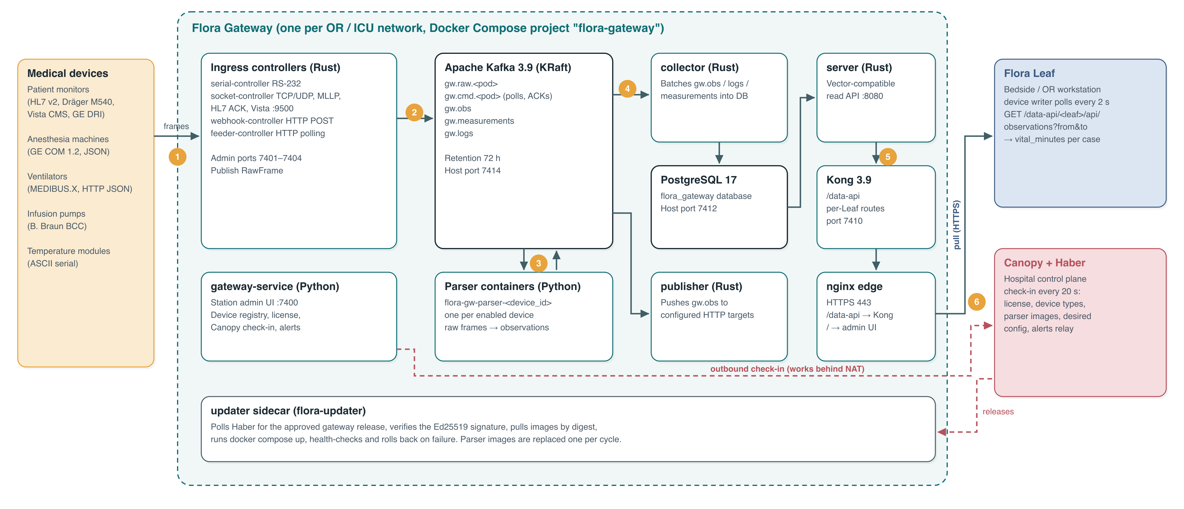
Architecture and data flow
Notes:
Devices send frames to the ingress controllers, which publish them on Kafka. A parser container per device turns them into observations; the collector stores them in PostgreSQL; the server and Kong expose them as /data-api, which the Leaf pulls. gateway-service is the control plane and checks in with Canopy.

Slide 5
How a reading travels
1
2
3
4
5
Controller
Parser
Collector
Read API
Leaf
Receives the frame and publishes it unchanged on gw.raw.<pod>
Decodes the protocol; emits observations on gw.obs
Stores observations in PostgreSQL in batches
server + Kong publish /data-api, filtered per Leaf
Pulls one minute per case into vital_minutes
Kafka keeps 72 hours of messages; the collector commits only after storing, so a database restart loses nothing.
Notes:
A pod is <controller>.<id>, for example socket.or-monitor or serial.COM1. Parsers also emit original fields on gw.measurements and logs on gw.logs, and send polls or ACKs back on gw.cmd.<pod>.

Slide 6
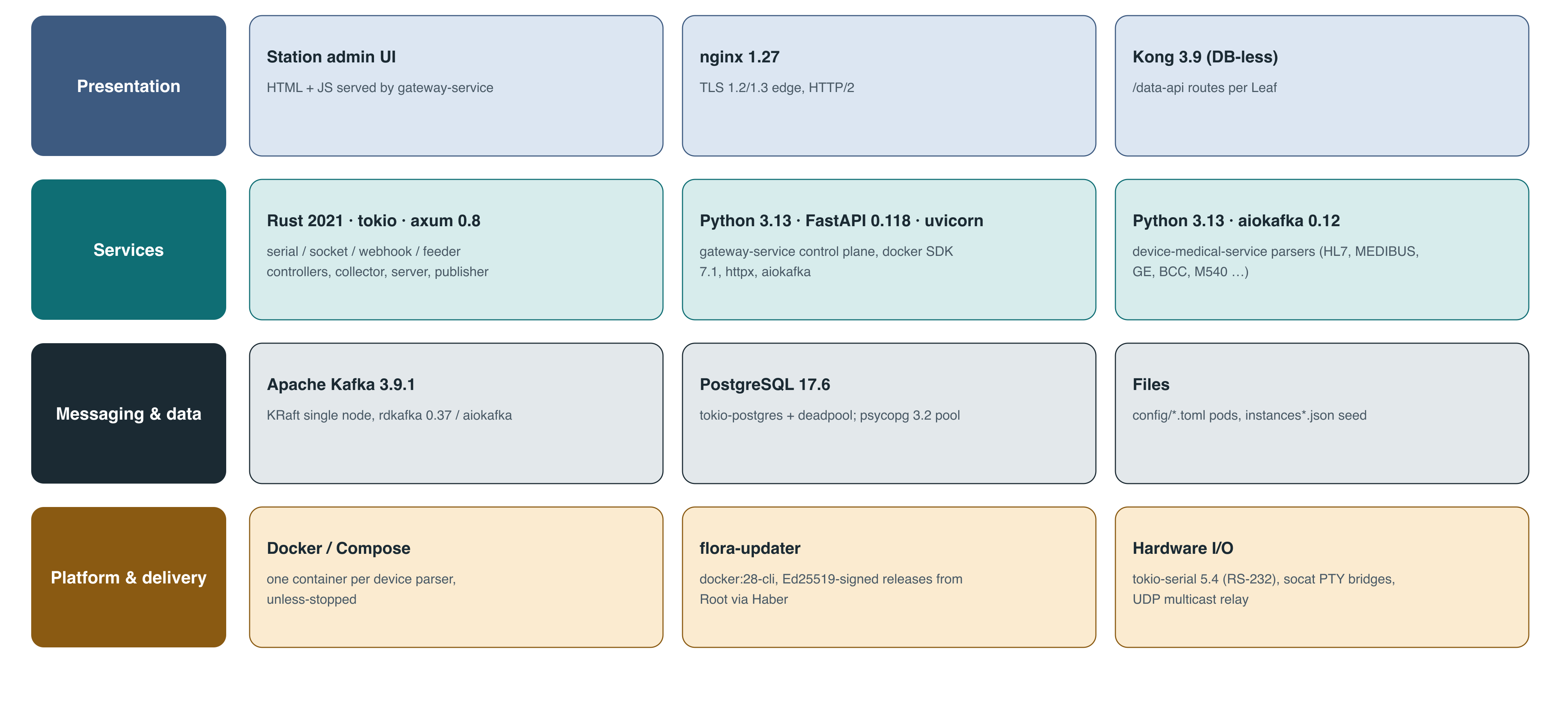
Technology stack
Notes:
Presentation: station admin UI, nginx edge, Kong. Services: Rust for the data path, Python for the control plane and parsers. Messaging and data: Kafka and PostgreSQL. Platform: Docker, flora-updater, serial I/O helpers.

Slide 7
Pinned versions
Rust 2021
Kafka 3.9.1
PostgreSQL 17.6
Python 3.13
7 services: 4 controllers, collector, server, publisher
KRaft single node, 72 h retention
Local flora_gateway database
FastAPI 0.118 control plane, aiokafka parsers
Component | Version
Kong (DB-less) | 3.9
nginx edge | 1.27, TLS 1.2/1.3
axum / rdkafka / tokio-serial | 0.8 / 0.37 / 5.4
psycopg / docker SDK / aiokafka | 3.2.10 / 7.1.0 / 0.12.0
Notes:
Versions are those pinned in compose.yaml, rust/Cargo.toml and the Python requirements files.

Slide 8
Install in four steps
1
Prepare the host
Docker + Compose v2 on the device network; outbound HTTPS to Canopy; serial ports if needed
2
Configure
cp flora-gateway/.env.example .env; set HABER_URL, GATEWAY_HTTPS_PORT, TLS_HOSTNAMES
3
Certificate and start
scripts/tls/make-cert.sh flora-gateway, then docker compose up -d (add --profile demo for the simulator)
4
Verify
curl :7400/health, :7410/data-api/health; sign in at https://<host>/ and change admin / admin
Notes:
Docker Desktop on Windows cannot pass COM ports; run the serial controller natively there. After a release is approved, keep --env-file .release/flora-gateway.env on manual compose commands.

Slide 9
Ports
Port | Service | Purpose
443 (dev 7443) | edge (nginx) | HTTPS for admin UI and /data-api (Leaf entry)
7400 | gateway-service | Station admin UI and control API
7401–7406 | Rust admin ports | /health and /status per service
7410 | Kong | /data-api read API (local by default)
7412 / 7414 | PostgreSQL / Kafka | Maintenance / native controllers
7421 / 7422 | socket-controller | HL7 MLLP listeners (OR / ICU)
7423 | webhook-controller | HTTP POST ingress
9500 | socket-controller | Dräger Vista CMS link
Notes:
74xx is the gateway block (72xx Canopy, 73xx Leaf). Keep Kong, PostgreSQL and Kafka on 127.0.0.1 and let Leaves read through the HTTPS edge.

Slide 10
Station admin UI
Overview
Devices
Types
Roles
Station, Canopy link, license, layers, status history
Add, enable, restart; Monitor live output
Catalog from Canopy, local templates
admin: everything, incl. types, users, Canopy link
operator: devices, controllers, streams; no types or users
Manufacturers
Streams
Alerts
Dräger, GE, B. Braun, Hidro …
Live raw and command frames per pod
Open alerts; acknowledge
Sessions last 12 hours. Change admin / admin under Users → My password on first sign-in.
Notes:
The Users tab manages accounts. API clients can use HTTP Basic with a gateway user. When GATEWAY_ADMIN_KEY is set, write calls need the x-gateway-key header.

Slide 11
Connect to Canopy and license
1
Register the gateway ID in Canopy and get its token
License rules
No, revoked or expired license: all parsers stop
Type not allowed or device limit reached: 403
Canopy unreachable: last license kept, alert opens
The key is stored but never shown again
2
Overview → Canopy connection: URL, gateway ID, key
3
Save: the gateway checks in at once, then every 20 s
Manual check-in: curl -u admin:admin -X POST http://127.0.0.1:7400/api/haber/sync
Notes:
Each check-in sends devices (secrets masked), site, applied configuration version and the data API URL. It receives the license, device types, parser images pinned by digest and any newer desired configuration.

Slide 12
Supported devices
Category | Devices and protocols | Controller
Patient monitors | HL7 v2 ORU^R01 (IHE PCD-01), Hidro HL7, Dräger M540 IACS, Dräger Vista 120 S (CMS), GE Bx50 / S5 (DRI) | socket, serial
Anesthesia machines | GE Carestation 750 / Aisys CS² (COM 1.2), GE Aisys (DRI), JSON over HTTP | serial, webhook
Ventilators | Dräger MEDIBUS.X (RS-232), HTTP JSON | serial, feeder
Infusion pumps | B. Braun Space, SpaceCom BCC (TCP 4001) | socket
Temperature modules | ASCII key=value serial records | serial
Philips and Mindray native protocols are not implemented; they connect when they or a middleware emit HL7 v2 ORU.
Notes:
The catalog is device-types.json, delivered to the gateway through Canopy with each release.

Slide 13
Add a device
1
Devices → Add device
4
Pod and connection options (port, framing …)
2
Choose the device type (defaults fill in)
5
Save and enable: parser container starts
3
Unique device ID, label, inventory fields
6
Monitor: online within 30 s of data
Socket framing
mllp (HL7 + ACK) · line · idle · raw · udp_relay — TCP listen, outbound client (remote_host) or UDP
Notes:
The parser container is named flora-gw-parser-<device_id>. Changing type, pod or options restarts it. Use Streams to see raw frames and Monitor to see decoded values.

Slide 14
Assign devices to a Leaf: Set up gateway wizard
1
2
3
4
5
Choose gateway
Test connection
Assign devices
Check live data
Save
From Canopy, or a manual URL
/health and /api/devices/status
Queued in Canopy; applied in ~20 s
Last 60 s for this Leaf
Stored in leaf_device_source
Ward → Bedside devices → Set up gateway (needs config.manage). Step 3 times out after 2 minutes if the gateway is offline in Canopy.
Notes:
A device belongs to at most one Leaf. Assignment can also be done centrally in Canopy, and a case handover with 'move devices' moves them to the new Leaf.

Slide 15
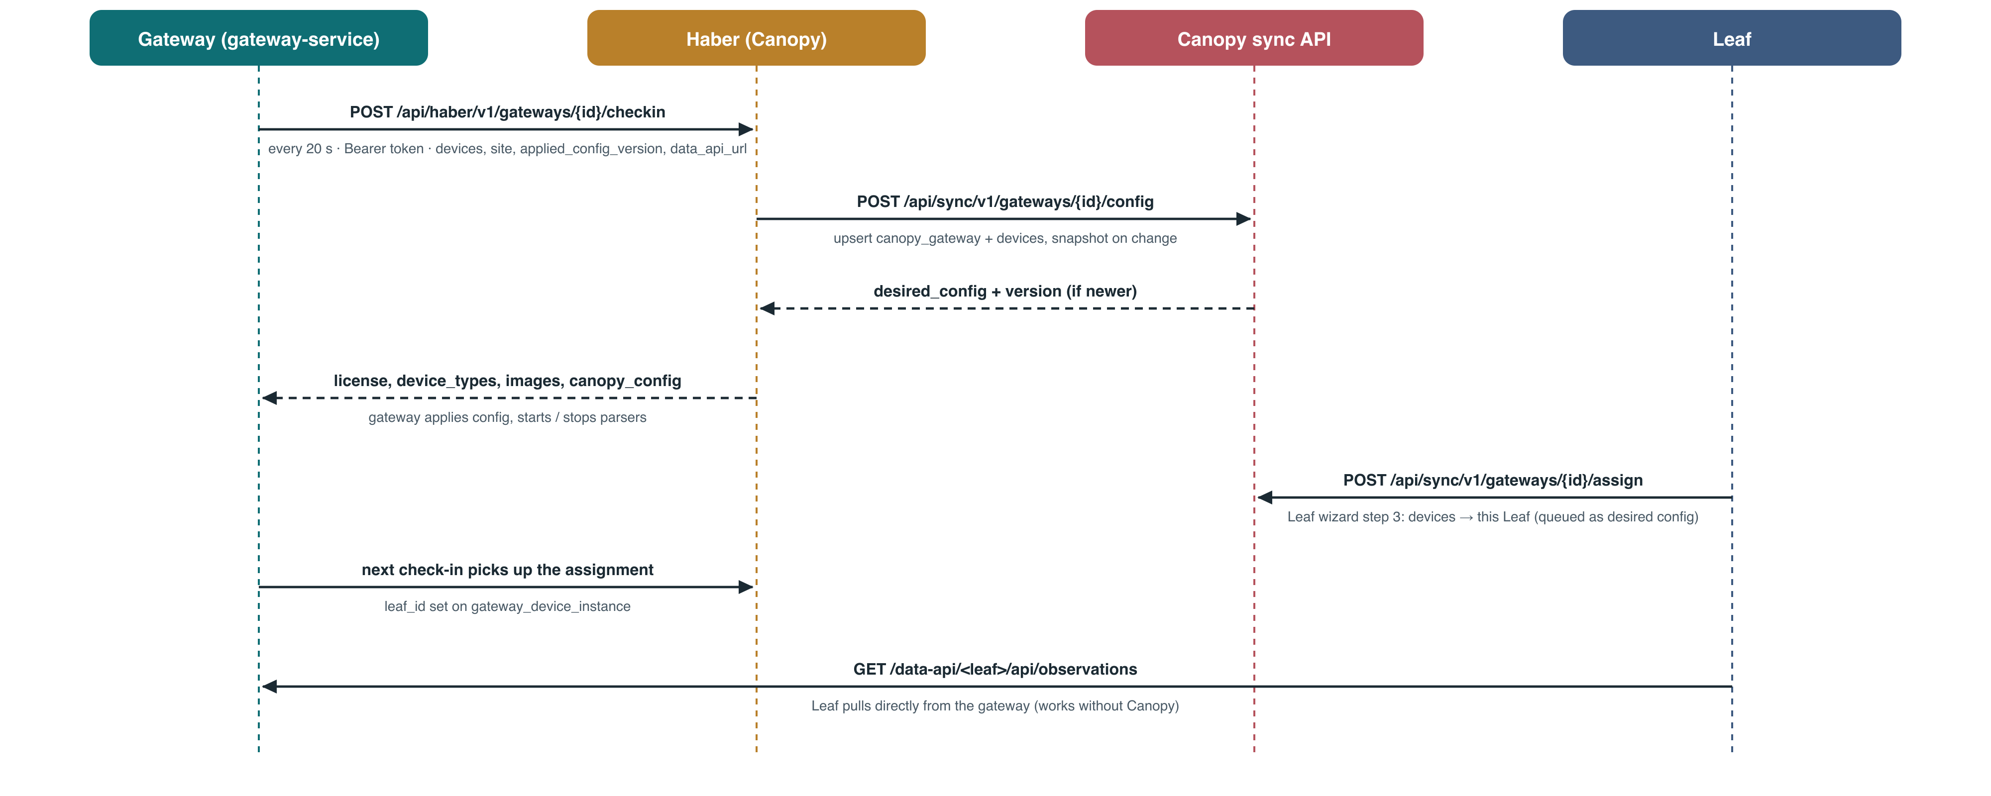
Check-in, configuration and assignment
Notes:
All connections are outbound from the gateway and the Leaf. Canopy queues changes and returns them in the reply to the next check-in. The Leaf reads the gateway directly.

Slide 16
Data API for Leaf and integrators
Endpoint | Returns
GET /api/observations?from&to | Observations, window ≤ 4 h, max 50 000
GET /api/measurements | Original device fields, paged by after_id
GET /api/devices/status | online / waiting / offline per device
GET /health | Database check
{ "device_id": "or1-monitor",
"ivy_param": "heart_rate",
"value": 72, "unit": "/min",
"system_ts": 1760000012345,
"pod": "socket.or-monitor" }
URL: https://<gateway-host>/data-api/<leaf-id>/api/observations — the Leaf route adds leaf_id, so each Leaf sees only its devices. /data-api has no authentication of its own: keep it on the device network.
Notes:
The Leaf device writer polls every 2 seconds, one minute per case, and maps parameters to chart rows (heart_rate → hr, nibp_mean → nibp_map, MDC 147842 → hr).

Slide 17
Central management from Canopy
Site only
Devices list
Masked secret ••••
Station location is replaced; devices are untouched
The full set: devices not listed are stopped and deleted
Gateway keeps its own; missing ones are reported for entry
Fleet operations: clone a gateway's configuration to new hardware, set the site from Canopy's location tree, review the last 50 configuration snapshots and the device → Leaf topology.
Notes:
Desired configuration is versioned. Once Canopy has sent one, the gateway site is read-only locally and seed files are ignored.

Slide 18
Monitoring and alerts
canopy
controller
device
gateway
Warning
Canopy connection lost
Critical
Controller not running or unhealthy
Critical
No data from a device for 120 s
Critical
Service was down for 2 min or more
Lanes are sampled every 30 s; an alert opens after two consecutive down samples and resolves on recovery. Alerts are pushed to Canopy's fleet view; acknowledge them in the Alerts tab. Samples are kept 7 days.
Notes:
Up to 100 alerts are delivered per check-in cycle; Canopy only replaces an alert with a newer version.

Slide 19
Updates and releases
1
2
3
4
5
Root
Haber
Approve
Updater
Health
Builds and signs the release (Ed25519)
Mirrors images by digest
Hospital admin approves or holds
Verifies, waits for the window, applies
Rolls back if not healthy in 180 s
Parser containers are then upgraded one per cycle. Set FLORA_UPDATER_WINDOW (HH:MM-HH:MM) to update outside clinical hours.
Notes:
Sites never build images. The updater polls Haber every 30 s and reports its state (current, applying, failed, waiting) back to Haber.

Slide 20
Data structures
Gateway database · Kafka message schemas · Canopy, Haber and Leaf tables
Notes:
Three diagrams follow. Each is also delivered as a separate PNG and SVG file for printing at full size.

Slide 21
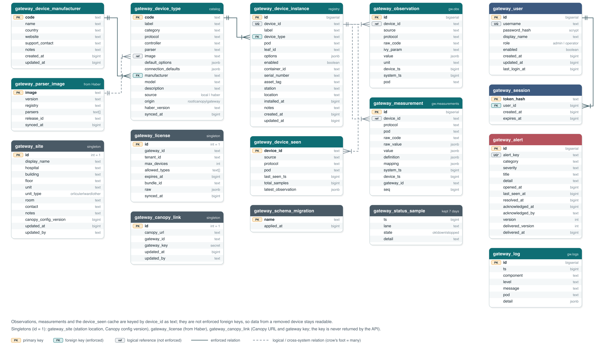
Gateway database (flora_gateway)
Notes:
Registry: device types, instances, manufacturers, parser images. Data: observations, measurements, device_seen, logs. Operations: users, sessions, alerts, status samples. Singletons: site, license, Canopy link. Observations reference devices by device_id without an enforced key.

Slide 22
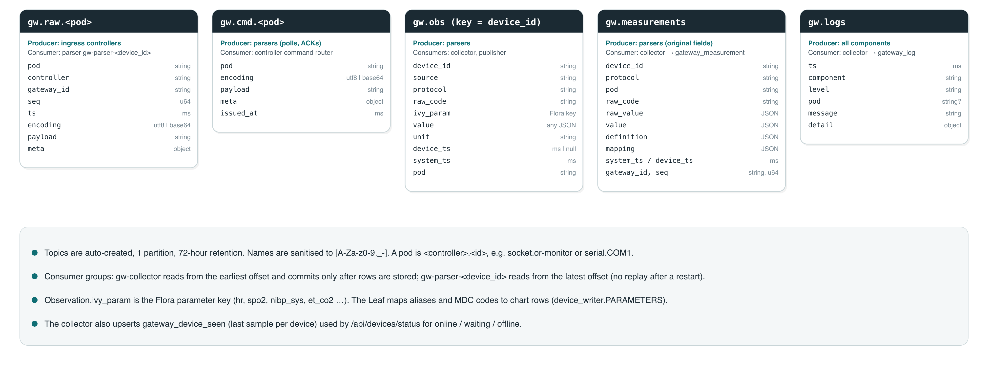
Kafka topics and message schemas
Notes:
Five topic families. gw.raw and gw.cmd are per pod; gw.obs, gw.measurements and gw.logs are shared. The collector reads from the earliest offset and commits after storing; parsers read from the latest offset.

Slide 23
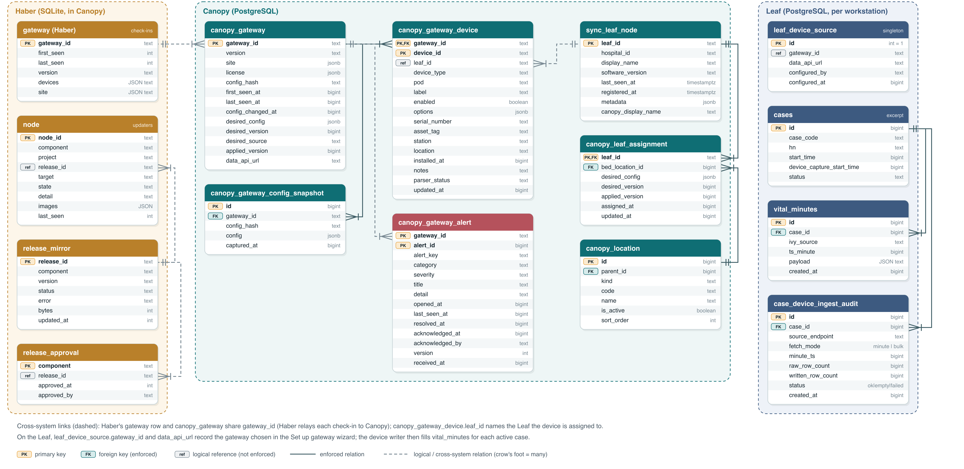
Gateway data in Canopy, Haber and Leaf
Notes:
Haber records check-ins and release state in SQLite. Canopy stores each gateway, its devices (with the assigned Leaf), configuration snapshots and alerts. The Leaf stores its chosen gateway and the per-minute device data for each case.

Slide 24
Troubleshooting
Symptom | What to do
All devices stopped, license invalid | Renew in Canopy; run a manual sync
Canopy connection lost | Check HABER_URL, token and the Canopy CA
Device waiting / offline | Open Streams for the pod; check cabling, IP, serial settings
Frames but no values | Check type and parser options in Monitor
Leaf wizard step 3 times out | Check the gateway is online in Canopy; retry
Leaf chart empty | Re-run the wizard; check /data-api/<leaf>/api/devices/status
Serial device on Windows | Run the serial controller natively
Dräger M540 missing | Use the IACS relay to a udp_relay pod
Notes:
The Word manual has the full table, including 400 invalid window, 502 after an update, missing secrets, disk growth and 409 on controller stop.

Slide 25

Security checklist
Change admin / admin; create named accounts
Keep Kong, PostgreSQL and Kafka on 127.0.0.1
Replace every *-demo-* token and the DB password
Limit device ports to the gateway host
Set GATEWAY_ADMIN_KEY for automation
Treat the host as privileged (Docker socket)
Use a hospital or Flora CA certificate
Approve releases with a maintenance window
Notes:
/data-api has no authentication of its own and the leaf filter is a query parameter, so network placement is the main control.

Slide 26

Further reading
Flora-Gateway-User-Manual.docx · diagrams/ (PNG + SVG) · flora-gateway/README.md · CONFIGURATION.md · DEVELOPMENT.md · DRAEGER.md · HIDRO.md · flora-updater/README.md
Notes:
The Word manual contains the full data dictionary, environment variables and troubleshooting table.

