Slide 1
Clustering
Paris Tian

Slide 2
What I did
Pre-process data
Change golden target label to ID: 0 ~ k-1
Cluster data with different algorithms into clusters labelled 0 ~ k-1
Hierarchy clustering: Single-Linkage/Complete-Linkage/Average-Linkage
Point assignment clustering: Lloyd’s Algorithm/K-mean++
Match the golden target labels with my clustered labels
Try all possible combinations, pick the best accuracy.
Calculate Hamming Distance and accuracy
Plot the clustering outcome, comparing with the golden label
Compare my result with the outcome of the same algorithm in the library (scipy.cluster.hierarchy.linkage)

Slide 3
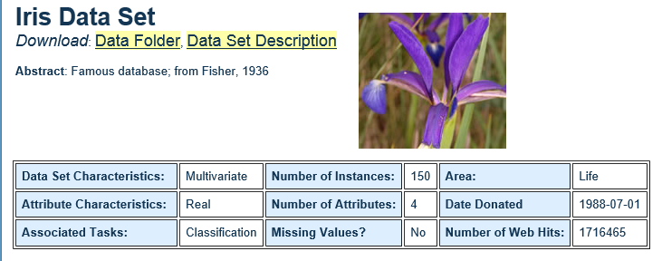
Data Set used: #1 – Iris
4 attributes:
1. sepal length 2. sepal width 3. petal length 4. petal width
Clustered samples into 3 categories
-- Iris Setosa -- Iris Versicolour -- Iris Virginica

Slide 4
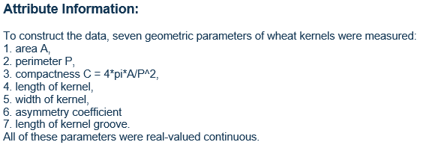
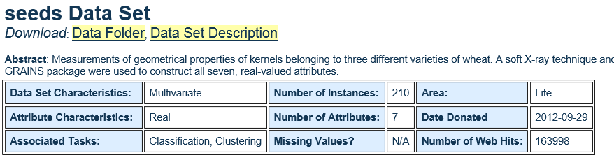
Data Set used: #2 – Seed
7 attributes
3 clusters

Slide 5
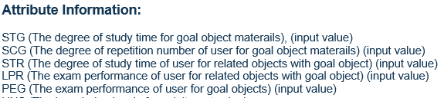

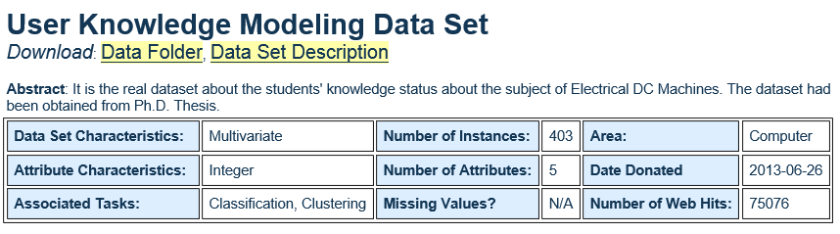
Data Set used: #3 – Knowledge Modeling
5 Attributes
4 Clusters

Slide 6
Report:
Data Sets | Measure | Single-Linkage | Average-Linkage | Complete-Linkage | Lloyd’s | Kmean++
Iris | Accuracy | 68.00 % | 90.67% | 84.00 % | 88.67 % | 89.33%
 | Hamm Dist | 0.22 | 0.11 | 0.16 | 0.13 | 0.12
Seed | Accuracy | 36.97 % | 91% | 80.57 % | 89.10 % | 8.57%
 | Hamm Dist | 0.64 | 0.11 | 0.20 | 0.13 | 0.12
Knowledg Model | Accuracy | 35.66 % | 62.02% | 60.47 % | 47.29 % | 49.61%
 | Hamm Dist | 0.69 | 0.34 | 0.34 | 0.34 | 0.33

Slide 7
Normalization doesn’t help for these dataset
Data Sets | Measure | Single-Linkage | Average-Linkage | Complete-Linkage | Lloyd’s | Kmean++
Iris | Norm HD | 0.23 | 0.13 | 0.13 | 0.13 | 0.13
 | Hamm Dist | 0.22 | 0.11 | 0.16 | 0.13 | 0.12
Seed | Norm HD | 0.66 | 0.12 | 0.20 | 0.13 | 0.13
 | Hamm Dist | 0.64 | 0.11 | 0.20 | 0.13 | 0.12
Knowledg Model | Norm HD | 0.69 | 0.34 | 0.34 | 0.34 | 0.33
 | Hamm Dist | 0.69 | 0.34 | 0.34 | 0.34 | 0.33

Slide 8
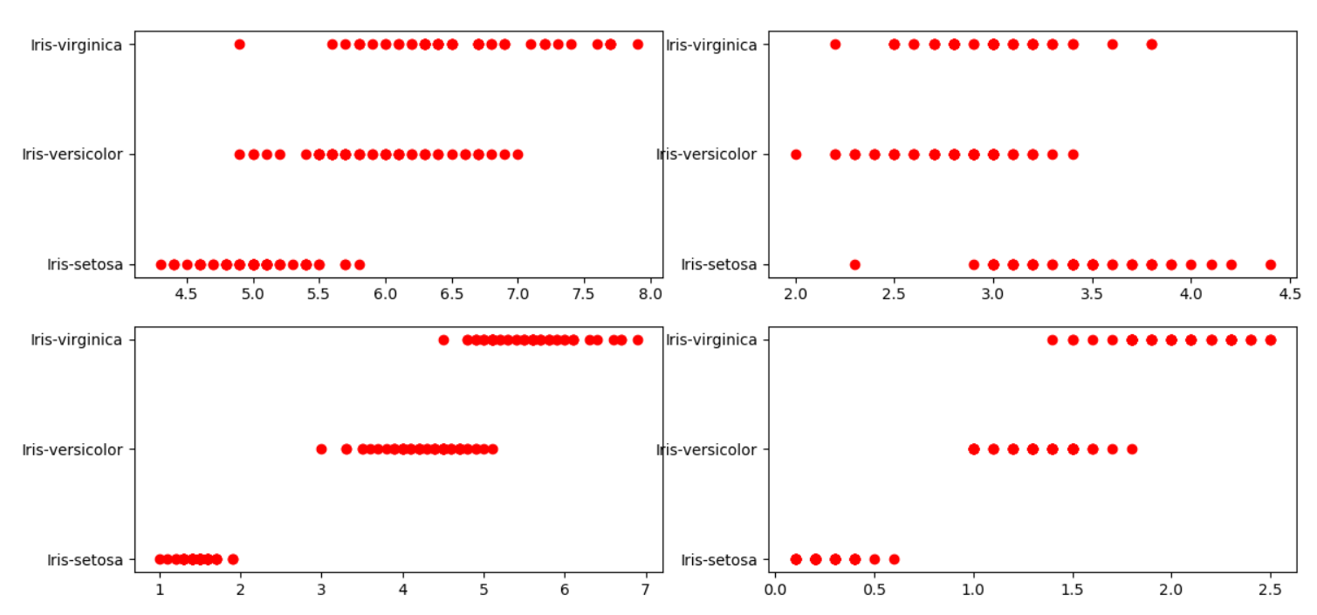
Iris – data scattering (attribute, label)

Slide 9
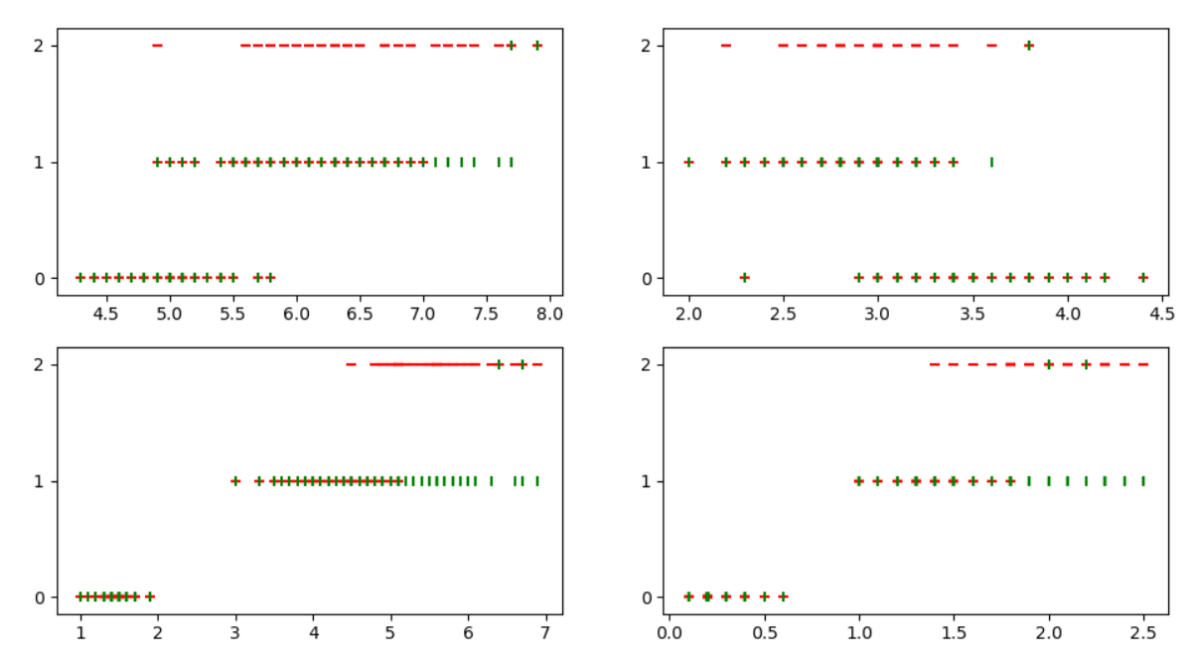
IRIS – SL (‘-’ is golden ‘|’is my cluster)

Slide 10
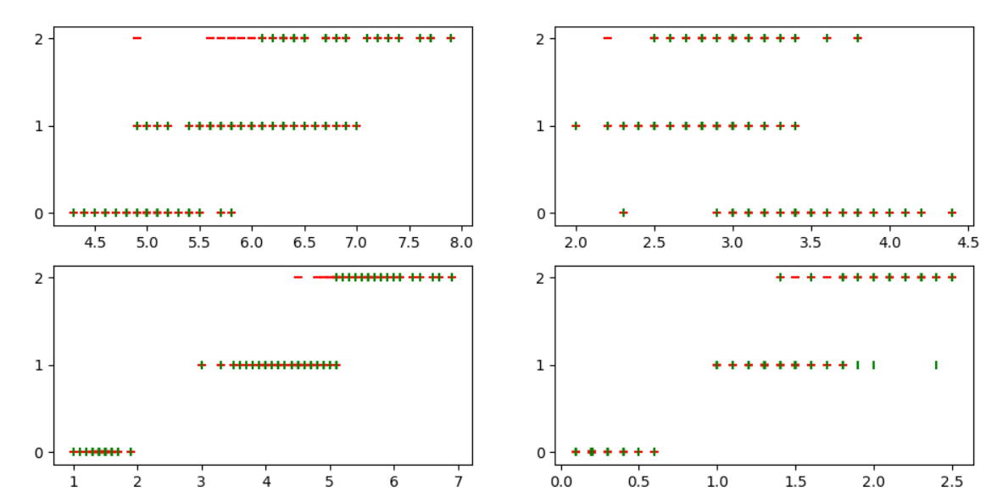
IRIS – AL (‘-’ is golden ‘|’is my cluster)

Slide 11
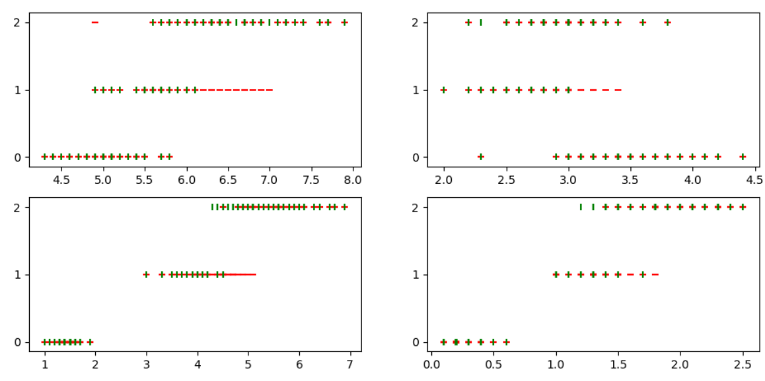
IRIS – CL (‘-’ is golden ‘|’is my cluster)

Slide 12
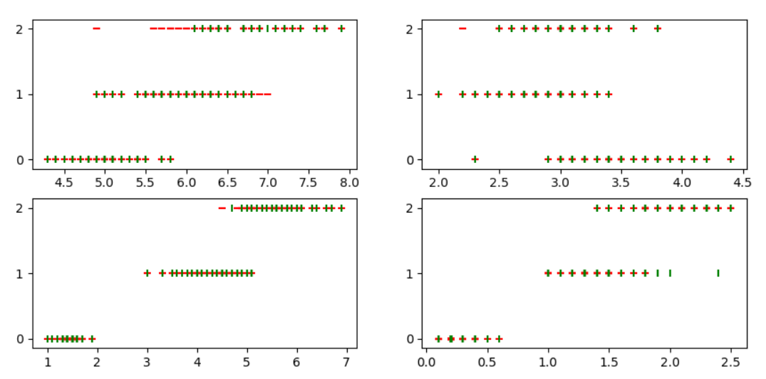
IRIS – Lloyd (‘-’ is golden ‘|’is my cluster)

Slide 13
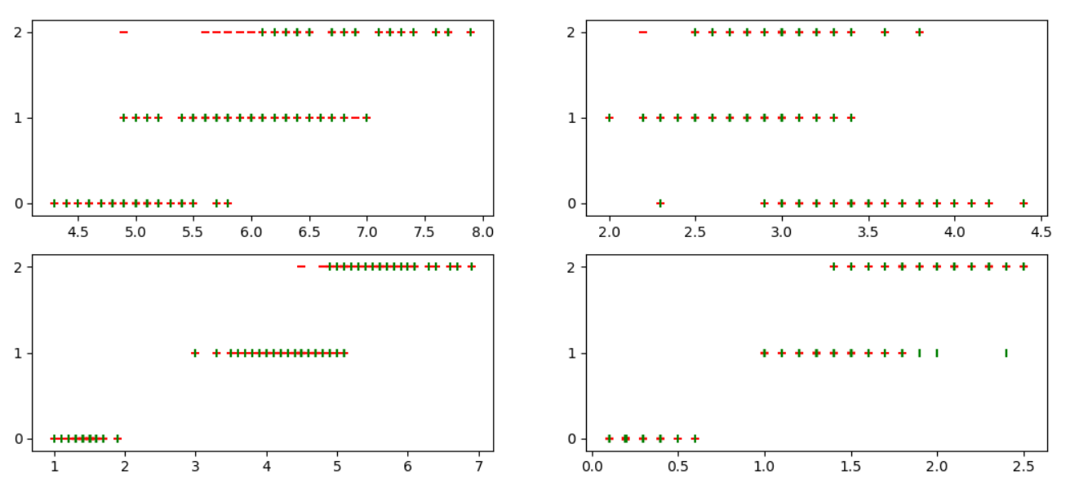
IRIS – K-mean++ (‘-’ is golden ‘|’is my cluster)

Slide 14
Compare with lib
from scipy.cluster.hierarchy import linkage
from scipy.spatial.distance import pdist
data_attr with only attribution, eliminate the label column.
dist_array = pdist(data_attr, ‘Euclidean’)
out = linkage(dist_array, ‘complete’)
print (out)
Keyword for different linkage algorithm: ‘single’, ‘average’, ‘complete’

Slide 15
The outcome from lib:
New cluster name | cluster A | Merge with cluster B | the dist for closest clusters | my distance
150 | 9 | 34 | 0.0000 | 0.0000
151 | 37 | 150 | 0.0000 | 0.0000
152 | 101 | 142 | 0.0000 | 0.0000
153 | 7 | 39 | 0.0278 | 0.0278
154 | 10 | 48 | 0.0278 | 0.0278
… | … | … | … | …
295 | 290 | 293 | 0.7923 | 0.7923
296 | 284 | 292 | 0.9379 | 0.9379
297 | 295 | 296 | 1.2871 | …
298 | 294 | 297 | 1.6512 | …

Slide 16
Some Thought:
Linkage Algorithm outcome variants only when more pairs have the same distance. If no such case, the outcome always the same.
Average-linkage has the best outcome comparing to S/C-linkage
Lloyd’s Algorithm could NOT guarantee the outcome, could be good, could be bad:
My Lloyd accuracy: 78 out of 150 :: 52.00 % Hamming Distance: 0.29
K-means++ has a relatively stable/good clustering outcome, very small fluctuation.
K-means++ and average-linkage has the similar good outcome, but k-means++ runs faster then average-linkage.

Slide 17
END

